Slide 1

CIVE 717 – Homework #4
Personal Research Interest
Stilling Basin Scour Analysis
Dana Moses
22Apr21

Slide 2
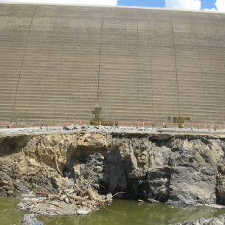
Introduction/Problem Statement
How do we evaluate the Scour and Undermining Potential for Hydraulic Jump Stilling Basins founded on Rock?
Paradise Dam, Australia

Slide 3
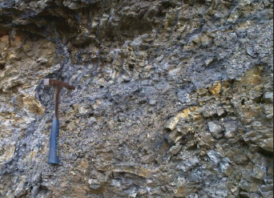
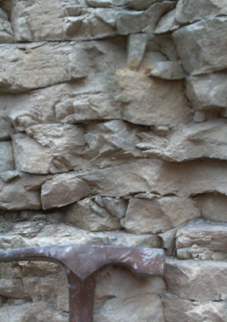
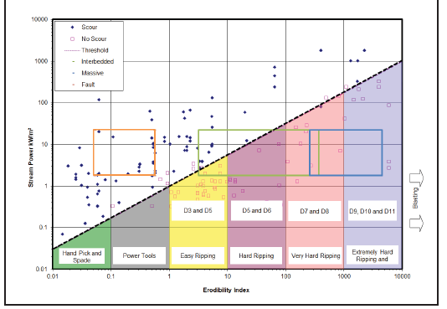
Methods Utilized
Bluestone Dam Foundation
(Fault Material)
Bluestone Dam Foundation
(Interbedded Orthoquartzite)
Physical Modeling
  Proxy Materials
  Measurement of Dynamic Pressure Fluctuations
Hydraulic Index
  Unit Stream Power Dissipated
Geo-mechanical Index
  Erodibility Index (Kirsten Index)
Source: Annandale 2015

Slide 4

Proxy Material Scaling Process
Determine Prototype Erodibility Index
Determine Prototype Threshold Stream Power
Determine Power Scale Ratio from Froude Similitude
Determine Model Scale Threshold Stream Power
Determine Appropriate Proxy Material to Represent Incipient Detachment of Individual Blocks from the Rock Mass
  Directly through Erodibility Index for Non-Cohesive Material
  Through Converting Stream Power to Shear Stress and Developing Stability Threshold from Shields Parameter (See next slide)

Slide 5
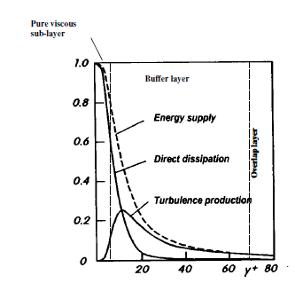
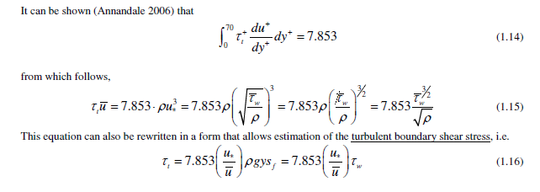
Boundary Layer Theory
Assumes A Universal Energy Balance Exists in Turbulent Flows (From Schlichting 2000)
This Turbulence Production can be integrated over the buffer layer
This can be used to relate wall shear stress to unit stream power applied to the boundary
Source: Annandale 2006

Slide 6
Proxy Material Scaling Results
(Pipestem Dam Example)

Slide 7
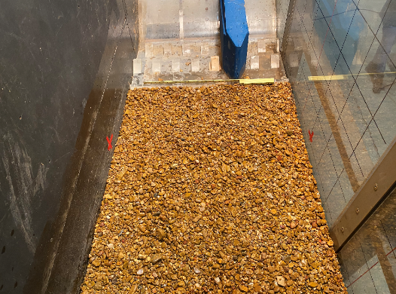
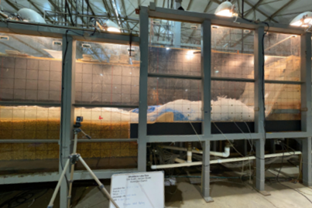
Bluestone Dam Spillway (Week of 05Apr)

Slide 8
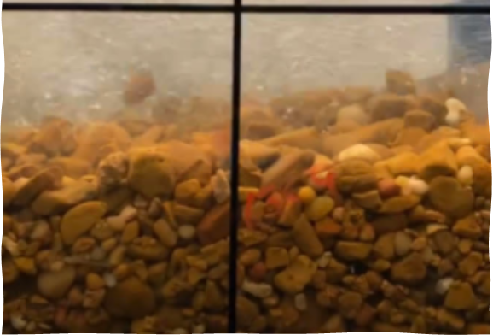
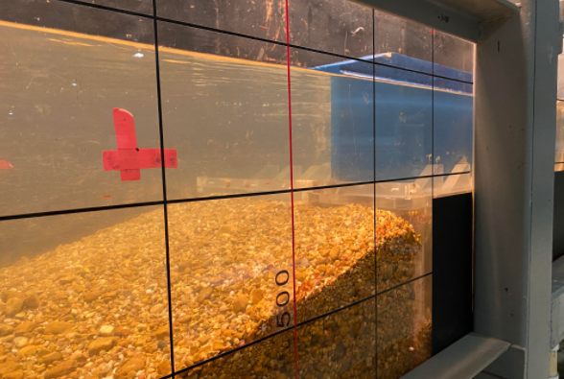
Bluestone Dam Spillway (Week of 05Apr)

Slide 9
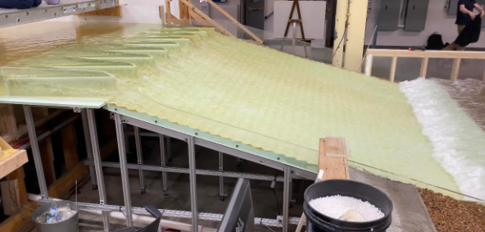
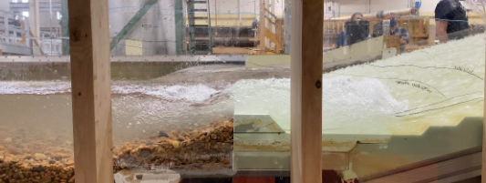
Pipestem Dam Spillway (15Apr)

Slide 10

Identified Limitations
Hydraulic
Estimates of Hydraulic Index Parameters include in Erodibility Index Thresholds are approximate (Rough Order of Magnitude)
Some uncertainty in turbulence scaling (Scale Effects)
Thresholds for Incipient motion are uncertain
Geomechanical
Index values are approximate (rough-order-of-magnitude)
Geology is highly variable and feedback loops with boundary and flow field are not captured (model assumes homogenous)
Non-cohesive material cannot hold face steeper than submerged angel of repose (additional errors with boundary-flow feedbacks)
Other
Limited database for developing thresholds
Scour rates not estimated

Slide 11
Personal Take-Aways
Scour evolution and final geometry is highly uncertain
The geology and rock mass behavior is generally much more uncertain than the hydraulic stresses/pressures
Estimates of rock scour depth and geometry are semi-quantitative, at best and I would consider more qualitative in most cases
Many of the engineering decisions can be made with appreciation of the uncertainty (i.e. we don’t need precise answers and focus is on the three R’s of Hydraulic Structures (Redundancy, Robustness, and Resiliency).

Slide 12
Discussion
Does anyone see any fatal flaws with the approach?
Is anyone aware of alternate approaches for evaluation of discontinuous rock masses?
Any additional thoughts or suggestions?

