Slide 1
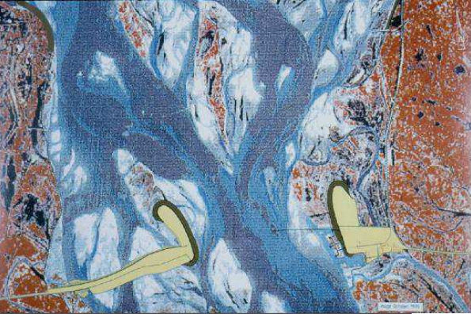
Guide Banks
Ben Tyner

Slide 2
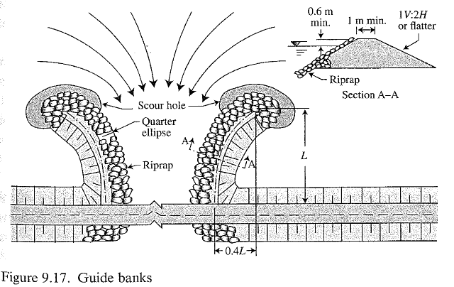
What are Guide Banks?
Riprap and earthen control structures
Confine flow under bridges to reduce scour

Slide 3
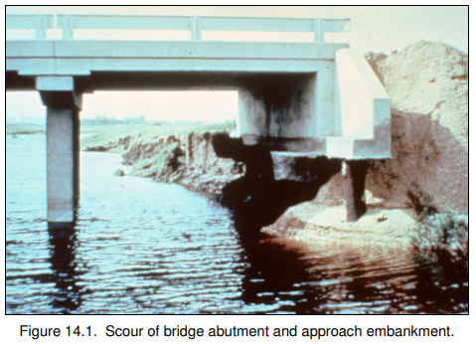
Why are Guide Banks important?
Increased control of scour locations
Protection from lateral approach flows
Reduction of flow separation
Reduction of large scale turbulence

Slide 4
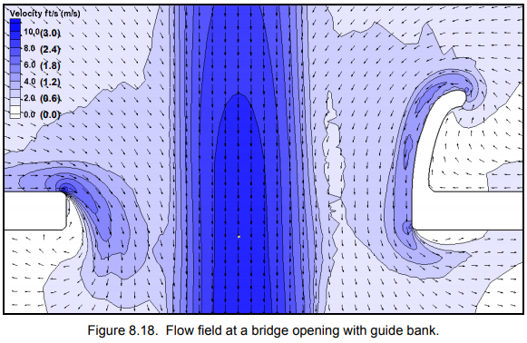
How do Guide Banks work?
Lateral flows are accelerated inward and around the ellipse of the revetment
Flows are streamlined and centered
Scour occurs along the guide bank as opposed of bridge abutments
Reduction of flow separation and reverse currents/eddies

Slide 5
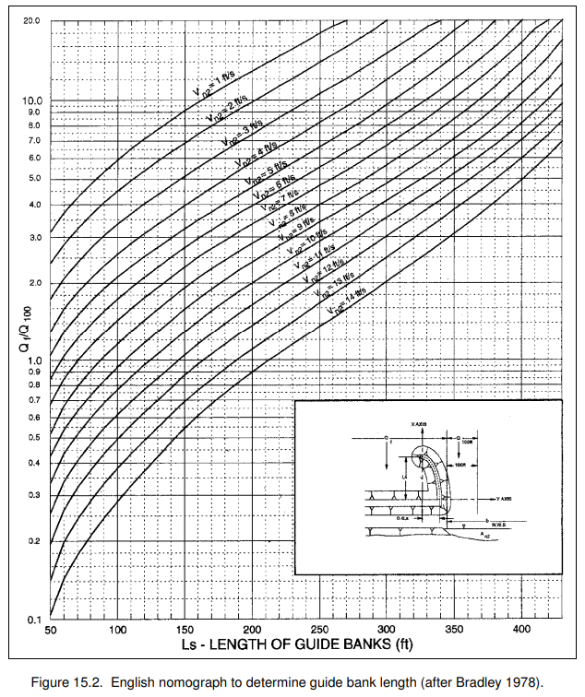

Design Guidelines
General Equation of Quarter Ellipse:
Minimum 1ft freeboard, (2ft per HEC-23)
1V:2H Side Slopes or less
Minimum 3ft width
Trees kept towards toe for increased resistance
Drain pipes to remove ponding left behind Guide Banks

Slide 6
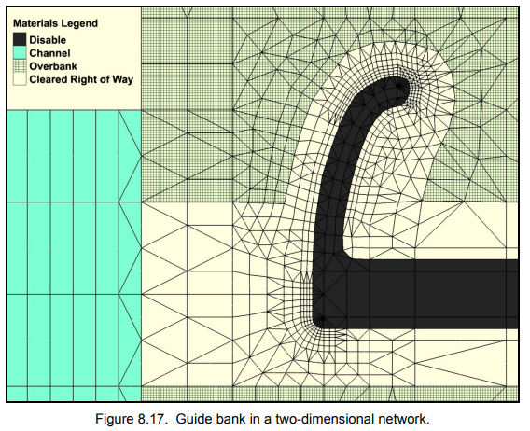
Complexities of Guide Banks
Complex regions of rapidly varying velocities and directions
Design flows should not overtop the revetment
Proper riprap gradation and design

Slide 7
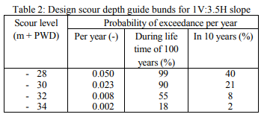
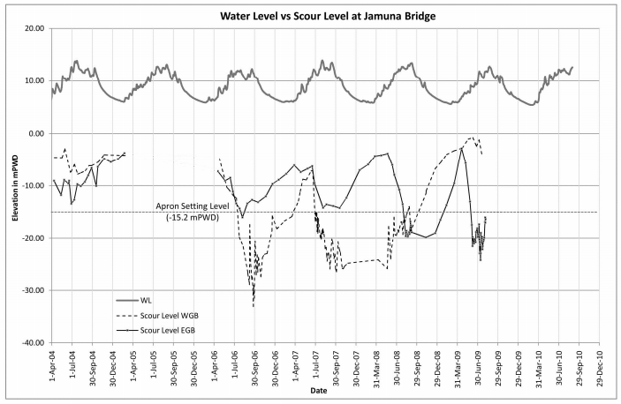
Do Guide Banks work?
13 year review of Jamuna River in Bangladesh
Guide Banks work fairly well, with few instances of extreme scour or localized failure
Design Scour Depths

Slide 8
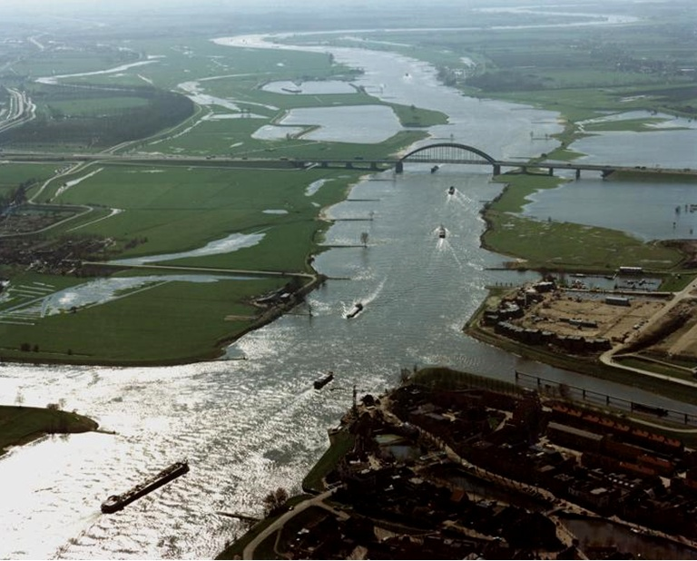
Final Thoughts on Guide Banks
Guide banks protect bridge abutments from critical scour in rivers
Streamline of flow reduces highly turbulent flow structures
Scour is strategically controlled
Guide banks are very successful in the management of scour with room left for further research and modeling

