Slide 1
Riprap Gradation and Filters
Luke Flores and Mason Garfield
CIVE 717
Spring 2018

Slide 2
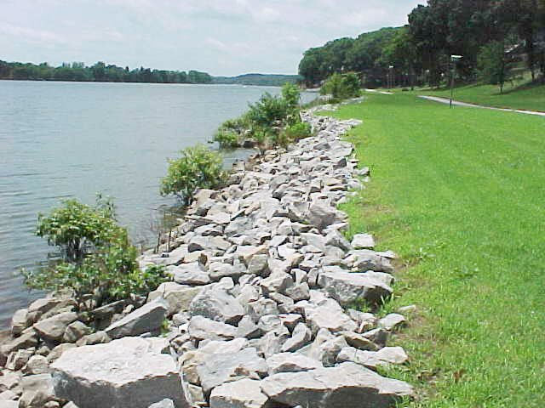
Outline
Gradation
Riprap Definition
Motivation
Determination of representative rock size $d_{50}$
USACE Gradation Limits
Other guidelines
Filters
Motivation
Governing Equations
Design
Filter Cloths
Example
References

Slide 3
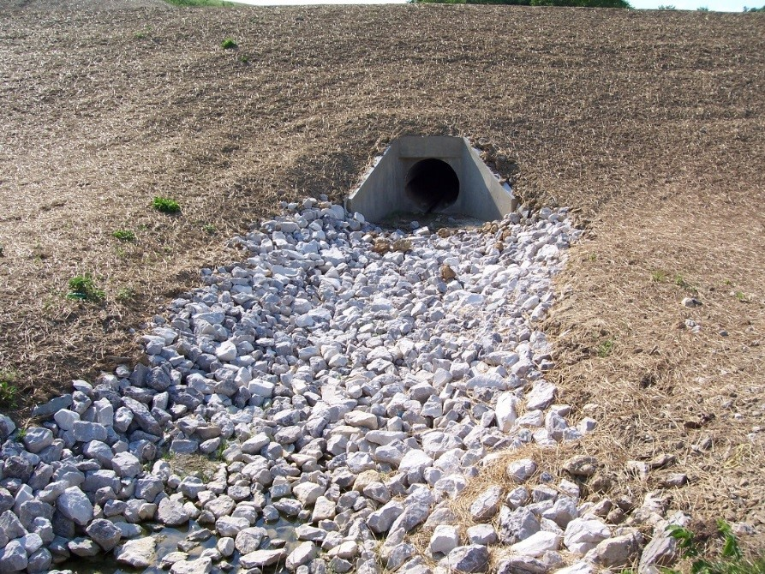
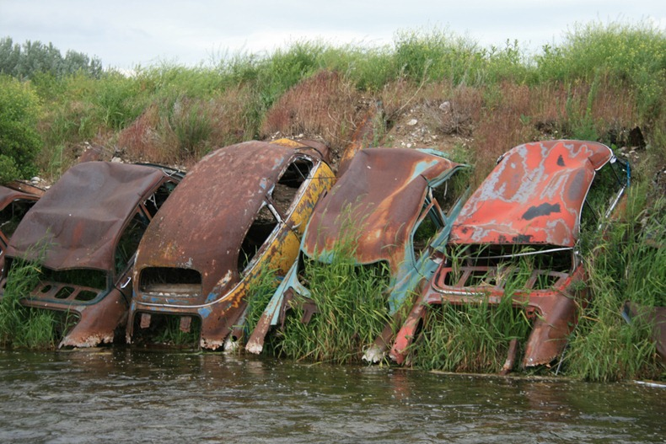
Riprap Definition
Riprap refers to rock (usually) that armors stream banks and beds, shorelines, and man-made structures such as piers.
Due to its size and weight, riprap can resist the applied shear stresses and does not erode as easily as smaller particles.
In effect, an armoring layer is created where finer particles are entrained beneath the coarse, heavy riprap.
Pros:
Usually cheap and widely accessible.
Durable and easily constructed
Natural aesthetic
Cons:
Difficult (or impossible) to construct in deep channels or coast lines
Example of rock riprap beneath drainage culvert
Example of Detroit riprap when rock is not easily available

Slide 4
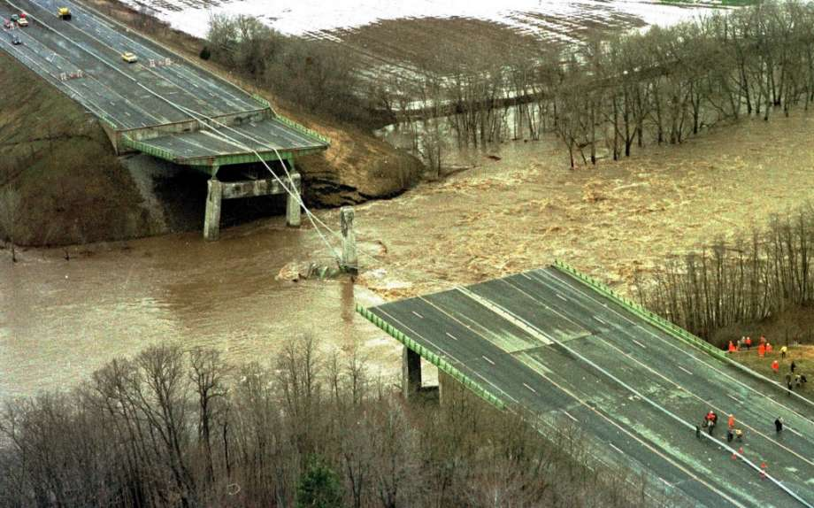
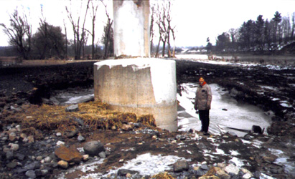
Motivation
On April 5, 1987 high temperatures resulting in snowmelt combined with 6 inches of rain fell upon the town of Florida, New York.
The 50-year flood drained into the Schoharie Creek which led to the collapse of the Schoharie Creek Bridge.
Ten people were killed
Investigation concluded that collapse was due ~10 feet of scour which one pier fell into.
Engineering designs called for riprap that was sufficiently gradated with a filter around the pier but later determined no filter was applied and representative riprap size was too small.
Collapse of Schoharie Creek Bridge
Scour around Pier 3

Slide 5
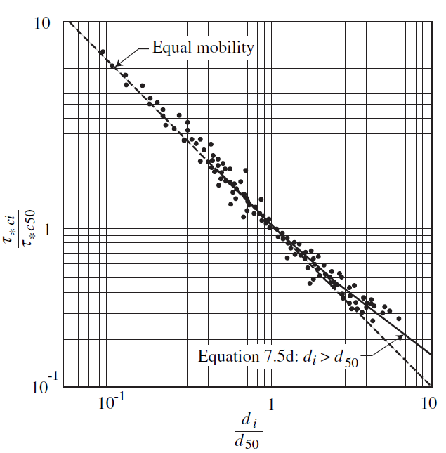
Riprap Gradation Theory
Installation of riprap is an engineered armoring layer.
A natural armor layer occurs in cycles with fines being mobilized, leaving a coarse layer but installation of riprap simply places a coarse layer over fines with no need for cycles.
The idea of Equal Mobility is that finer sized fractions will not move until coarse fractions moved. The idea of riprap is that the coarse riprap will not realistically ever transport at high rates, forever protecting the fines.

Slide 6
Determination of Representative Rock Size $d_{m}$
Julien (2002) outlines two methods for determining median diameter based on physical arguments (Shear Stress Method and Velocity Method).
A plethora of other methods (some physical, some empirical) that are well suited for various situations. Two methods below:
USACE Method, 1994
$$d_{30}=S_{f}C_{s}C_{V}C_{t}h{\left[{\left(\frac{γ_{w}}{γ_{S}−γ_{W}}\right)}^{0.5}\frac{V}{\sqrt{K_{1}gh}}\right]}^{2.5}$$
$$S_{f}=safety factor$$
$$C_{s}=stability coefficient \left(0.3 for angular rock\right)$$
$$C_{v}=vertical velocity distribution coefficient$$
$$C_{v}= 1.0 for straight channels$$
$$C_{v}=1.283−0.2\log\left(\frac{R}{w}\right)for bends$$
$$h=local depth of flow$$
$$γ_{w},γ_{s}=unit weight of water and stone respectively$$
$$v=flow velocity$$
$$K_{1}=side slope correction factor$$
*USACE method ideal for low turbulence zones, slopes less than 2%, and discharge between 15-100 cfs.
Isbash Method, 1936
$$d_{50}=\frac{V^{2}}{2gC^{2}(G−1)}$$
$$v=flow velocity$$
$$g=gravitational constant$$
$$G=specific gravity of stone$$
$$C=0.86 for high turbulence, 1.20 for low turbulence$$
*Isbash method has been shown to be valid in reaches with high flow velocities.

Slide 7
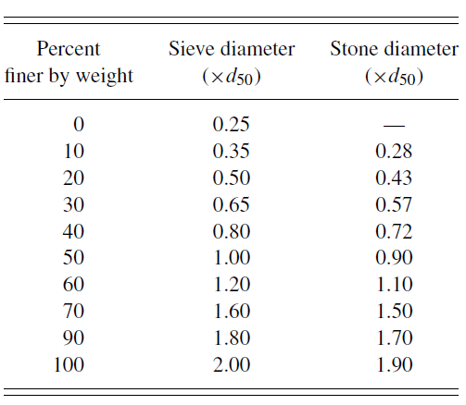
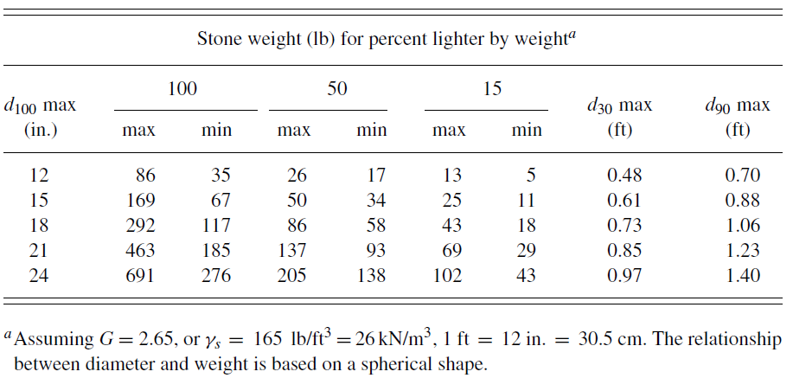
Riprap Gradation
Once median riprap size is determined, gradation must be determined.
Riprap gradation is necessary because a uniformly graded riprap with a median size $d_{50}$ will scour to a greater depth than a well-graded mixture with the same median size (Julien, 2002).
When uniform, scouring occurs at a velocity up to the required velocity for all particles finer than the $d_{50}.$ A well graded mixture will develop an armor plate to protect the fines.
The USACE provides suggested riprap size gradation tables.
Table 1 relates stone (and sieve) diameter to percent finer by weight
Table 2 relates stone size to suggested stone weight
Table 1
Table 2 – Other tables available for $G≠2.65$

Slide 8
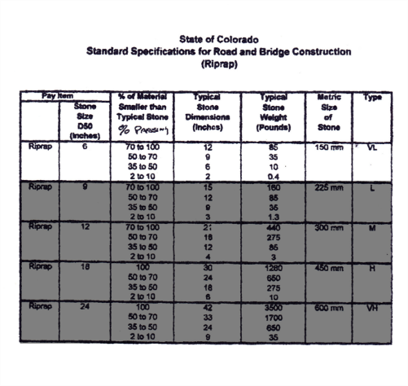
Riprap Gradation
Below is the standard for the State of Colorado for riprap size. It does not provide a range of weights as the USACE standard does and is based on $d_{50}$ (not $d_{100}$). However, it follows the USACE standards fairly closely.

Slide 9
Riprap Gradation
Others USACE gradation recommendations are below (from Julien (2002):
$d_{50}$ should not be less than the computed size required for the expected shear stresses.
The upper limit of the $d_{50}$ stone should not be greater than five times the lower limit of the $d_{50}$ stone.
The lower limit of the $d_{100}$ stone should not be less than two times the lower limit of the $d_{50}$ stone.
The lower limit of the$d_{15}$stone should not be less than 1/16 the upper limit of the $d_{100}$ stone.
The bulk volume of stone lighter than $d_{15}$ stone should not exceed the volume of voids in the structure without the lighter stone
Riprap thickness should be at least 1ft but less than the maximum between the upper limit of the $d_{100}$stone and 1.5 times the upper limit of the $d_{100}$ stone.
If the riprap will be primarily underwater the thickness should be increased by 50%.
Oversized rock, while maybe tempting, should be used to because it does not lock well with other rocks, inducing particle movement.
To induce locking, angular rocks are recommended.
However, y/x should not exceed 3.5
Also, no more than 30% of stones should satisfy y/x < 2.5
No more than 15% of stones should satisfy y/x > 3.0
x
y

Slide 10
Riprap Filters
Required when:
d₁₅ of the riprap gradation exceeds five times the d₈₅ of the bank material
Must be fine enough to prevent the base material from escaping but it must be more permeable than the base layer.
Two types of filters:
Gravel
Synthetic filter cloth

Slide 11
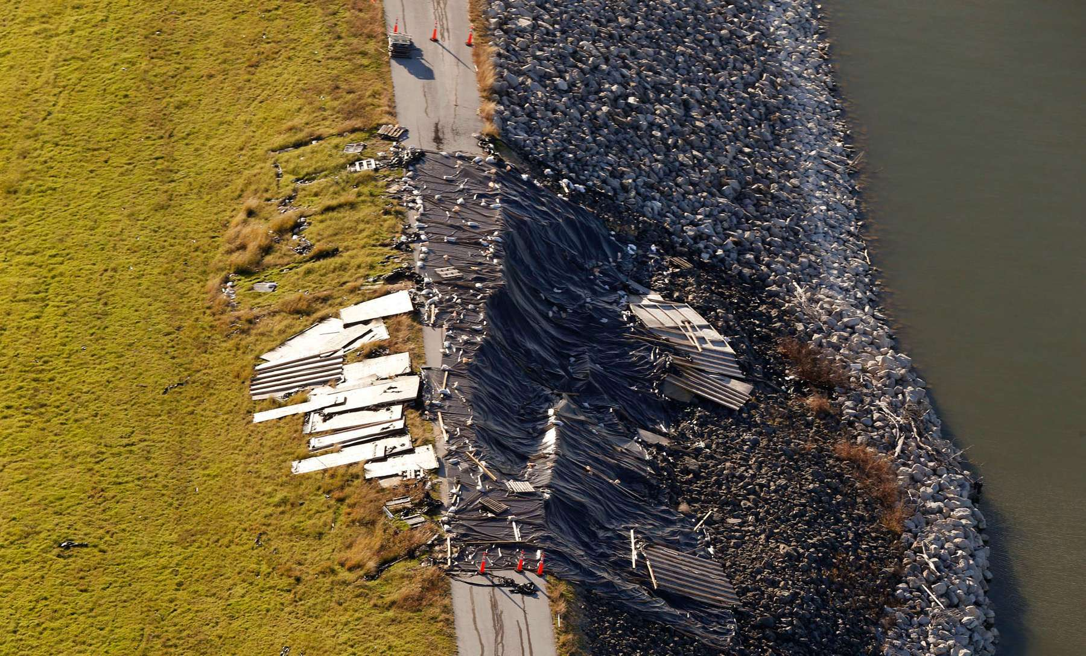
Importance of Filters
Prevents migration of fines through voids in the riprap, distributes the weight of the rip rap (more uniform settling) and permits relief of hydrostatic pressures through soils.
For areas above the waterline it also prevents runoff from eroding the soil beneath the rip rap.
Failure of the riprap can occur without filters such as at the Lewisville Lakes Dam as depicted below caused by erosion of the clay base material under the riprap during a large storm.

Slide 12
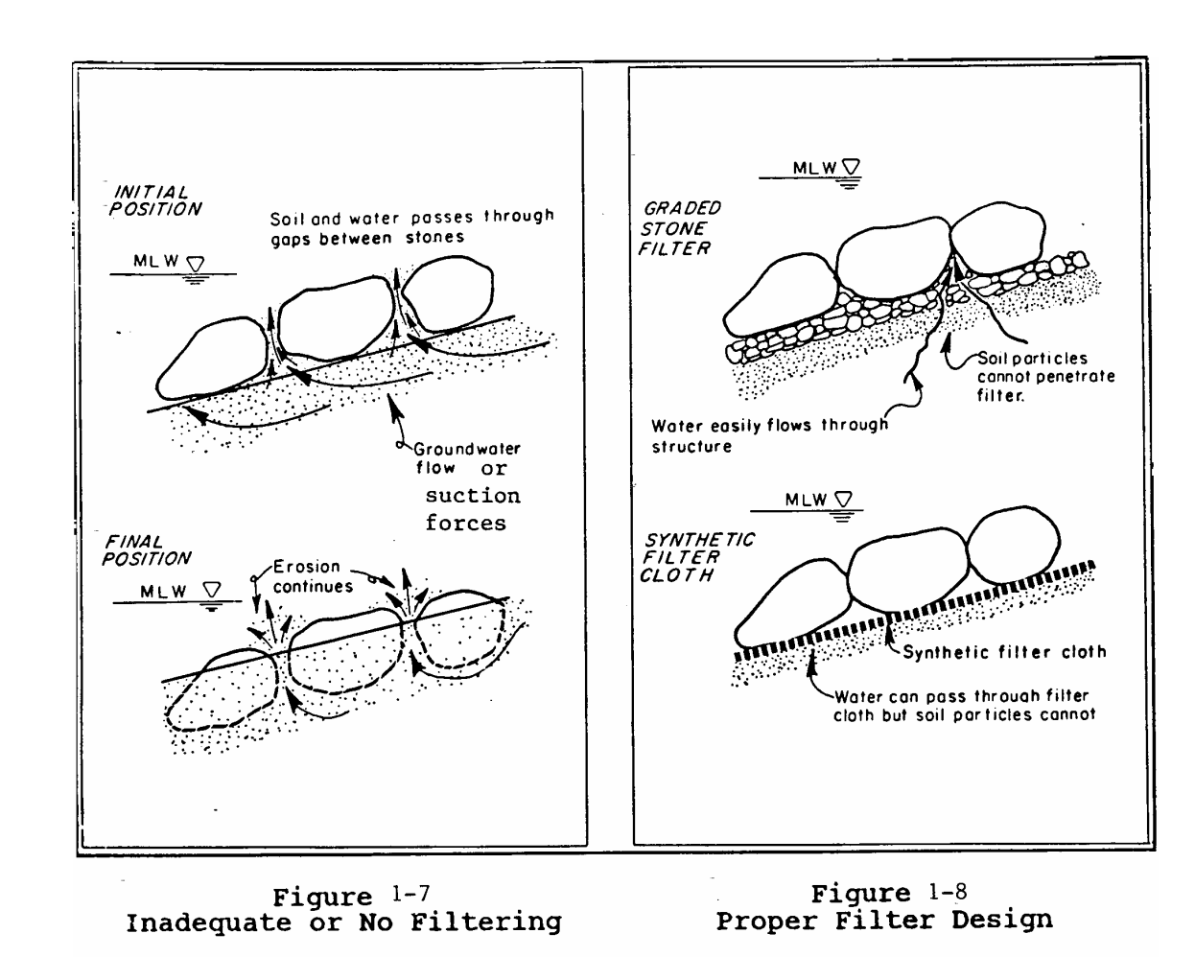
Importance of Filters
As displayed in the figure from NRCS, filters prevent erosion of the base material, but still allows flow through them to avoid hydrostatic forces on the river bank, preventing a failure of the bank when the riprap is much larger than the bank soil size.

Slide 13
Governing Equations (gravel filters)
Equations a, b, and c allows for the filter size between layers to be large enough to prevent hydrostatic pressure on the bank, but small enough to hold the river bank’s material.
*The equations are only applicable for non cohesive soil. For cohesive soil the d15 of the filter cannot exceed 0.4 mm.

Slide 14
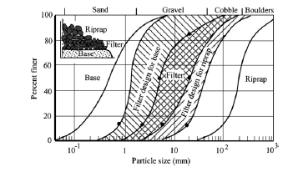
Design of Gravel Filters
As seen in the example below the filter’s gradation falls between the base and the riprap. This design accommodates the gradation of the base as well as the riprap and finds a proper sized filter in the double cross-hatched region of the graph between the riprap and the base based off of the equations on the previous slide.

Slide 15
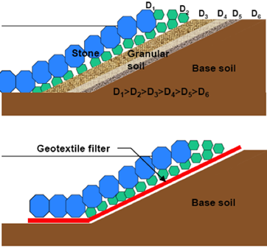
Synthetic Filter Cloths
Synthetic filter cloths can replace numerous layers of gravel filters with one layer as seen in the figure to the right.
Synthetic filter cloths have a variety of number of openings, strength, and durability.
https://www.geosinindo.co.id/application/filtration/

Slide 16
Design of Filter Cloth
For many river banks with riprap, non-woven geotextiles are preferred over woven geotextiles especially with slopes greater than 3:1.
Openings of 25% to 30% are desirable to minimize the potential for clogging and to reduce head loss.
A blanket of sand or gravel on the filter can be used to protect the filter from punctures by the filter fabric.
The sides and the toe of the filter fabric should be sealed or trenched to avoid the bank material from leaching around the filter cloth.

Slide 17
Design of Geotextile Filter
Example of Specification requirements for a nonwoven geotextile filter (filter fabric, geotextile liner, or filter cloth) which depends on the size of the aggregate for the rip rap from the Michigan Department of Environmental Quality.

Slide 18
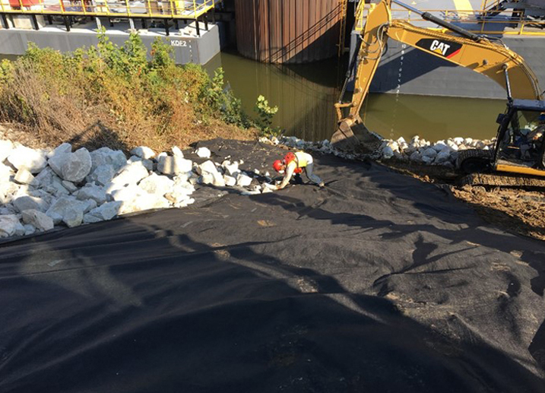
Installation Example
Installation of 8 ounce nonwoven geotextile fabric beneath 3’ of riprap at marathon barge terminal in Kenova, WV. The workers below are ensuring that adjacent sections of the fabric are holding together.

Slide 19
References
Federal Highway Administration. HEC 11. Design of Riprap Revetment.
Julien, P. (2002), River Mechanics, Cambridge University Press
Michigan Department of Environmental Quality. Riprap-Stabibilized Outlet.
Soil Conservation Service, (1989). Loose Riprap Protection. Minnesota Technical Note 3.
United States Army Corps of Engineers Engineering Manual EM 1110-21601 (1994), Hydraulic Design of Flood and Control Structures. (Obtained and abbreviated by Dr. Christopher Thornton's notes for CSU CIVE 510).
State of Colorado’s Riprap Standards table obtained from Front Range Material Inc.

