Slide 1
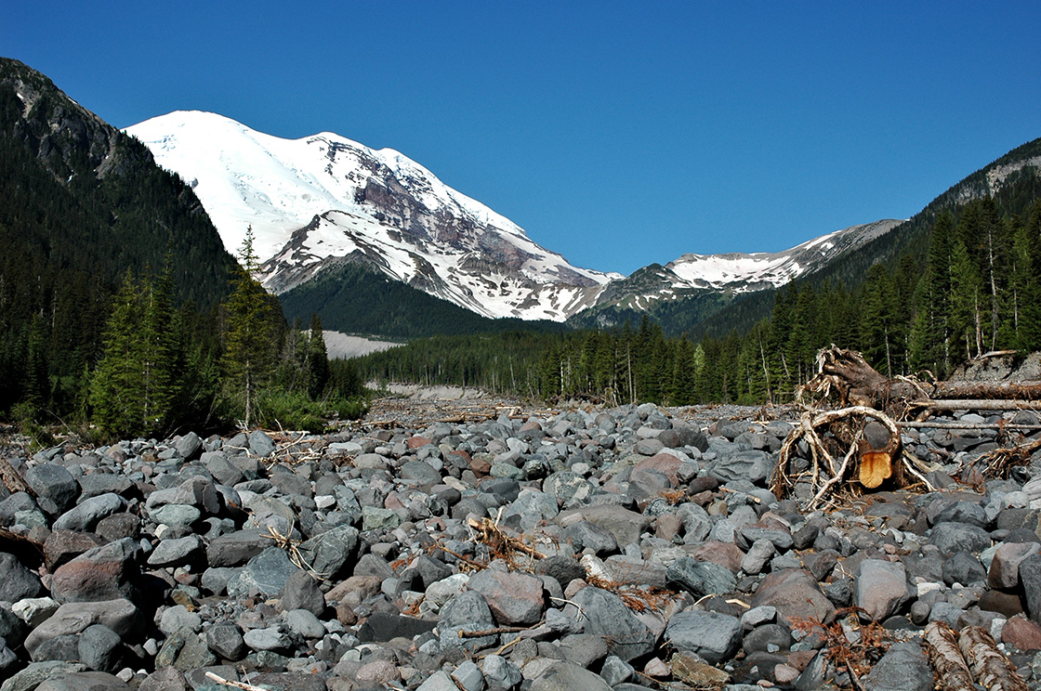
Armoring in Gravel Bed Streams
Tess Hanson, Nick Koutsunis
Department of Civil & Engineering
Colorado State University

Slide 2
Outline
Definition /Importance
Process & Patterns
Measurement Techniques
Governing Equations
Influences
Case Studies
Notes:
Picture
http://nancywagnerphotography.blogspot.com/2011_08_01_archive.html

Slide 3
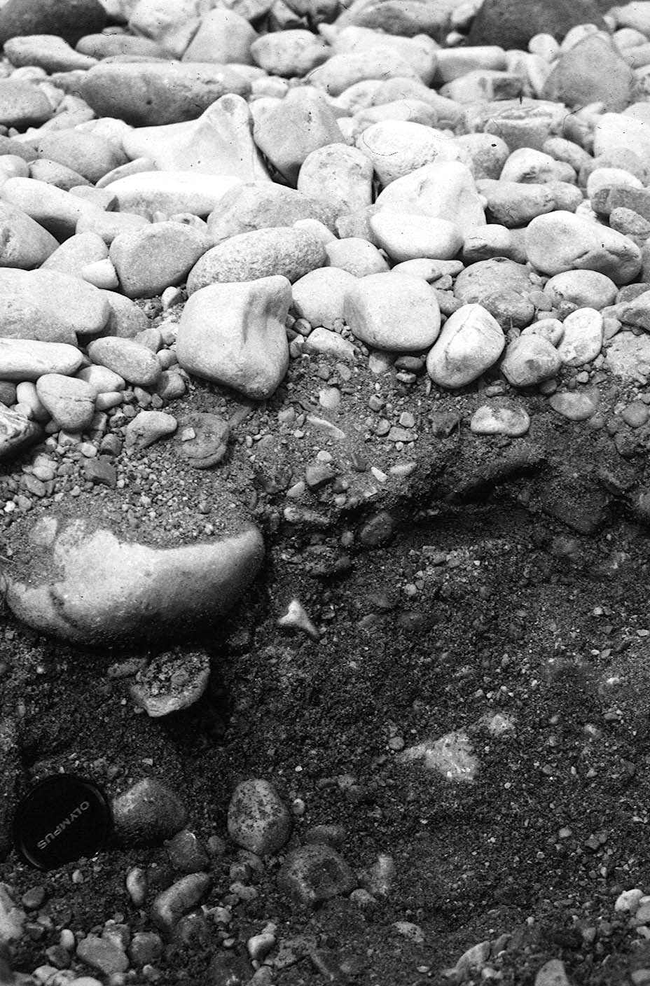
Definition
Armoring occurs when the bed surface of gravel-bed rivers is coarsened relative to the sub-surface.
Degree of armoring can be described by the armor ratio.
Armor ratio= $\frac{D_{50,surface}}{D_{50, subsurface}}$
Where $D_{50,surface}>D_{50,subsurface}$
when armoring present.
(Wilcock, 2005)

Slide 4
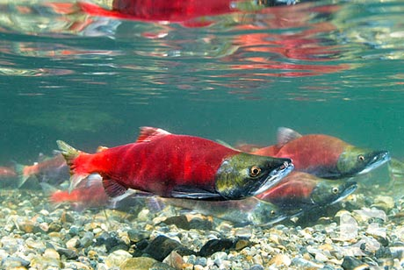
Importance
Armoring is important because it influences:
Channel Hydraulics
Grains Available for Transport
Hydraulic Roughness
Bed Permeability
Living Conditions for Aquatic Species
(Wilcock, 2005)

Slide 5
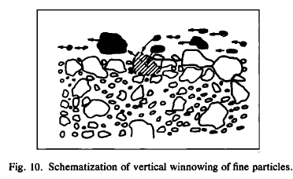
Armoring Process
Flow develops shear stresses less than required to move large particles, but large enough to move fines
Flow entrains fine particles, winnowing them from bed surface
Coarse layer forms, sheltering fine grains
Coarse layer increases resistance to entrainment
(Curran & Tan, 2010)

Slide 6
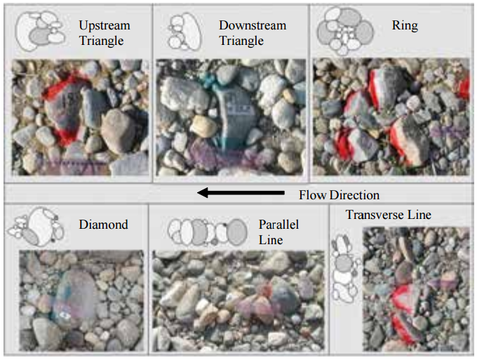
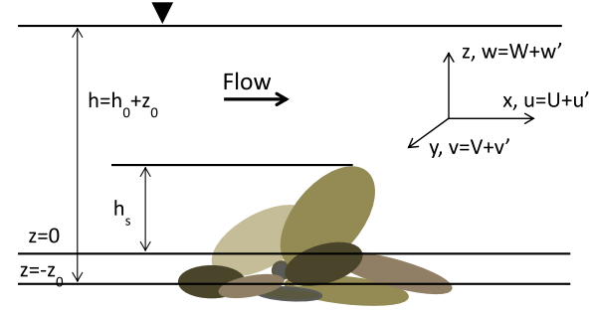
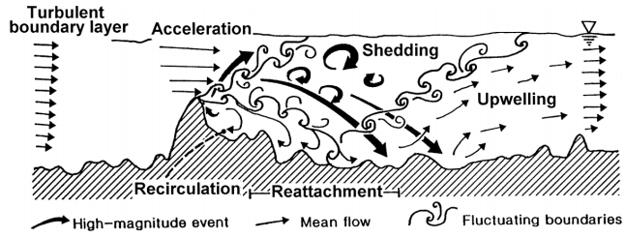
Rock Clusters
Form as part of the armoring process
Self Organizing
Enhanced by presence of stationary objects on bed
Attenuates the sediment transport of the surrounding bed
Cause flow separation
Increases turbulent flow properties
Forms a recirculation zone
Flow reattaches downstream of cluster
Increase hydraulic roughness of bed
Notes:
http://www.iihr.uiowa.edu/wp-content/uploads/2013/06/TR452-H-G-Controls-Evolution-of-Cluster-1.pdf
http://ascelibrary.org/doi/pdf/10.1061/%28ASCE%29HY.1943-7900.0000810
https://researchspace.auckland.ac.nz/handle/2292/13048

Slide 7
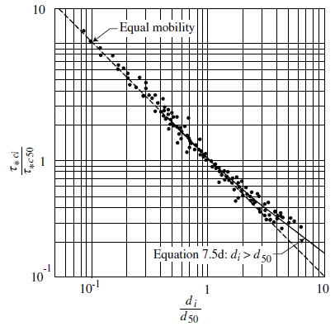
Near-Equal Mobility
Coarser fractions of bedload mixture are not moving, shielding the finer particles.
Mobilization of all sediment size fractions as shear stress exceeds motion threshold of coarsest particles.
$$τ_{ci}=τ_{c50}{\left(\frac{d_{i}}{d_{50}}\right)}^{1−x}$$
$$τ_{∗ci}=Shield^{′}s parameter of fraction d_{i}$$
$$τ_{∗c50}=Shield^{′}s parameter of d_{50}$$
$$d_{i}=median grain diameter$$
$$d_{50}=median grain diameter$$
(Julien, 2002)

Slide 8
Armoring Conditions
Degrading stream
Sediment transport capacity must exceed sediment supply
Coarse bed material
$d_{sc}≅10hS$
$d_{sc}$ is grain size at incipient motion ($τ_{∗c}≅0.047)$
Sufficient quantity of coarse bed material
A$s \frac{Δp_{c}}{d_{sc}}$ decreases, the amount of scour necessary for the armor layer to form increases
$Δp_{c}$ is the fraction of bed material coarser than $d_{sc}$
(Julien, 2002)

Slide 9
Patterns of Armoring
Most streams display a mobile armor layer, as sediment supply tends towards zero → static armor (Parker, 2004).
The degree of armoring varies inversely with the rate of sediment transport (Wilcock &DeTemple, 2004).
Armor Layer usually coarser than mean annual load of transported gravel (Lisle, 1995).
Substrate has a broader distribution of grain sizes, but tend to be closer in size to the average.
Surface grain sizes are strongly and positively correlated to shear stress.
Channels tend to become less armored in downstream direction (Pitlick et al., 2008)

Slide 10
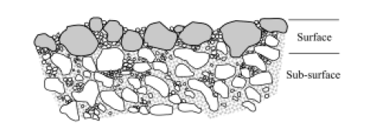
Measurement Techniques
Why Difficulties Arise:
Most transport data provides composition of bed subsurface and not surface.
Bed surface can be measured at low flow but not at flows moving sediment (Wilcock 2010).

Slide 11
Governing Equations
Powell, Reid, Laronne (2001)
$$q_{bi}=11.2F_{i}\frac{u_{∗}^{3}}{Rg}{\left(1−\frac{1}{∅_{i}}\right)}^{4.5}$$
Where $q_{bi}$ is the unit bedload transport rate for the ith grain size and the term indicated in red drives armoring.
$$∅_{i}=∅_{s50}{\left(\frac{D_{i}}{D_{s50}}\right)}^{−0.26}$$
$$τ_{s50}^{∗}=\frac{u_{∗}^{2}}{RgD_{s50}}$$
$$∅_{s50}=\frac{τ_{s50}^{∗}}{τ_{sc50}^{∗}}$$
$$τ_{sc50}^{∗}=0.03$$

Slide 12
Physical Modeling
Feed Flume
Sediment is continually fed into flume
Armoring in feed flumes diminish with increasing transport rate
Recirculating Flume
Sediment entrained in flume and recirculated through the system
Armoring in recirculating flumes is caused by kinetic sieving processes
Neither flume configuration can simulate natural conditions
(Wilcock, 2004)

Slide 13
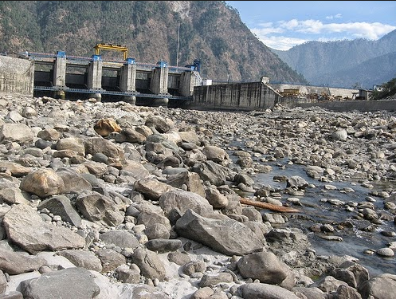
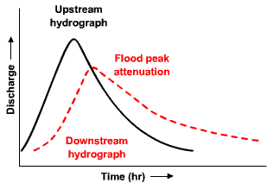
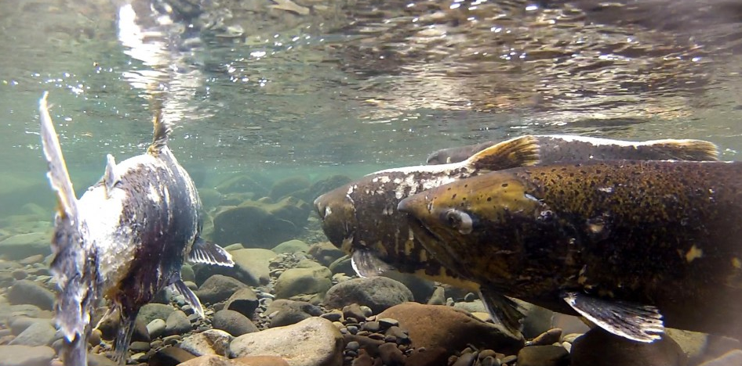
Dam Influence
Dams disrupt longitudinal continuity of the river system
Sediment is stored in reservoir
Clear water released downstream
Absence of sediment downstream of a dam exemplifies armor layer formation
Reduction of flood peak decreases bed mobility in downstream reaches.
Impacts salmonids that use freshwater gravels to incubate their eggs
Notes:
http://ac.els-cdn.com/S0169555X05003399/1-s2.0-S0169555X05003399-main.pdf?_tid=f2edf93e-da26-11e4-945c-00000aab0f26&acdnat=1428082334_e85fcd02d94ef4cbdf2a1b3015f2a831
http://download-v2.springer.com/static/pdf/402/art%253A10.1007%252Fs002679900048.pdf?token2=exp=1428084650~acl=%2Fstatic%2Fpdf%2F402%2Fart%25253A10.1007%25252Fs002679900048.pdf*~hmac=7967b56f422474423ece78b8477f9ce465efef09fe62825a0cd137c78fa5a837 page 535

Slide 14
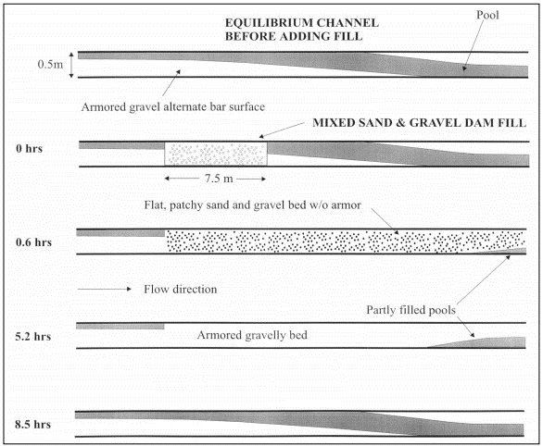
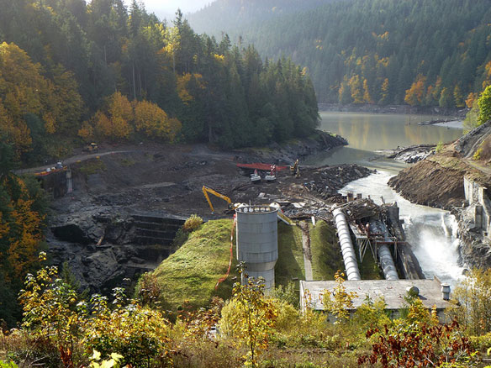
Dam Removal
Physical Process:
Incision
Floodplain Formation
Equilibrium Channel Development
Increased Sediment Supply
Covers Armor Layer
Evolution of a Sediment Wave
(Pizzuto, 2002)
Notes:
http://ac.els-cdn.com/S0169555X05003399/1-s2.0-S0169555X05003399-main.pdf?_tid=f2edf93e-da26-11e4-945c-00000aab0f26&acdnat=1428082334_e85fcd02d94ef4cbdf2a1b3015f2a831
http://download-v2.springer.com/static/pdf/402/art%253A10.1007%252Fs002679900048.pdf?token2=exp=1428084650~acl=%2Fstatic%2Fpdf%2F402%2Fart%25253A10.1007%25252Fs002679900048.pdf*~hmac=7967b56f422474423ece78b8477f9ce465efef09fe62825a0cd137c78fa5a837 page 535

Slide 15
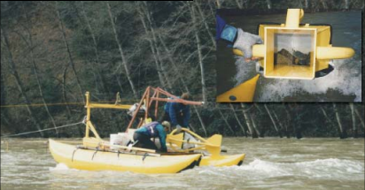
Case Study 1
Lewiston Dam – Trinity River, California, USA
Impacts
Cuts off sediment
Maintains constant flow, well below bank-full flow.
Impacts from Dam to first major tributary downstream.
Restoration
Replenish gravel storage downstream of dam.
Increase discharges to be capable of transporting gravels/cobbles downstream to promote formation of bars, riffles, and floodplains.
Introduce long-term periodic gravel and cobble supply.
Sediment sampling during high flows measure the effectiveness of dam releases in routing gravel and sand through river

Slide 16
Case Study 2
Parker & Klingeman, 1982
Bedload measurements from Oak Creek, Oregon used to test hypothesis about armoring.
“Vertical winnowing” process leads to equal mobility.
Pavement present in gravel bed stream at low flow remains through high flow events.
“Low-stress” range required for pavement layer to form.

Slide 17
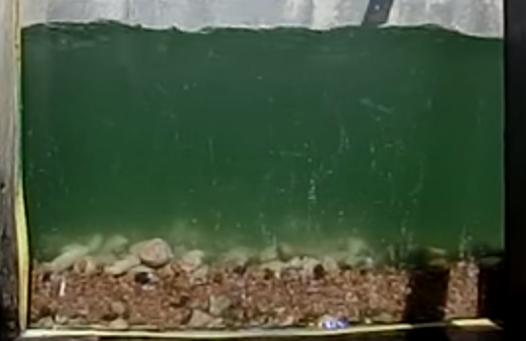
Case Study 3
Dietrich et al., 1989
Flume experiments tested hypothesis that armoring occurs when supply is less than capacity of flow.
Results supported hypothesis and showed that decrease in supply also confined transport to a narrow band.
Propose to connect degree of armoring to sediment supply from land use changes.
Flow Direction
Armor Layer
Subsurface Layer

Slide 18
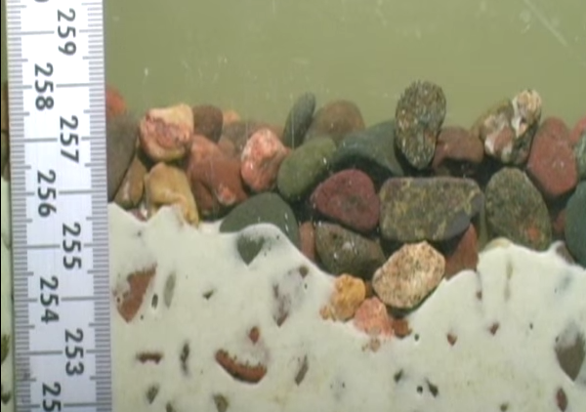
Case Study 4
Wilcock & DeTemple, 2005
Used a surface-based transport model to explore persistence of armor layers during high flow events.
Model results displayed the persistence of these layers even at large flows.
This suggests that grain size measured at low flows can be used to make predictions about conditions during large flows.

Slide 19
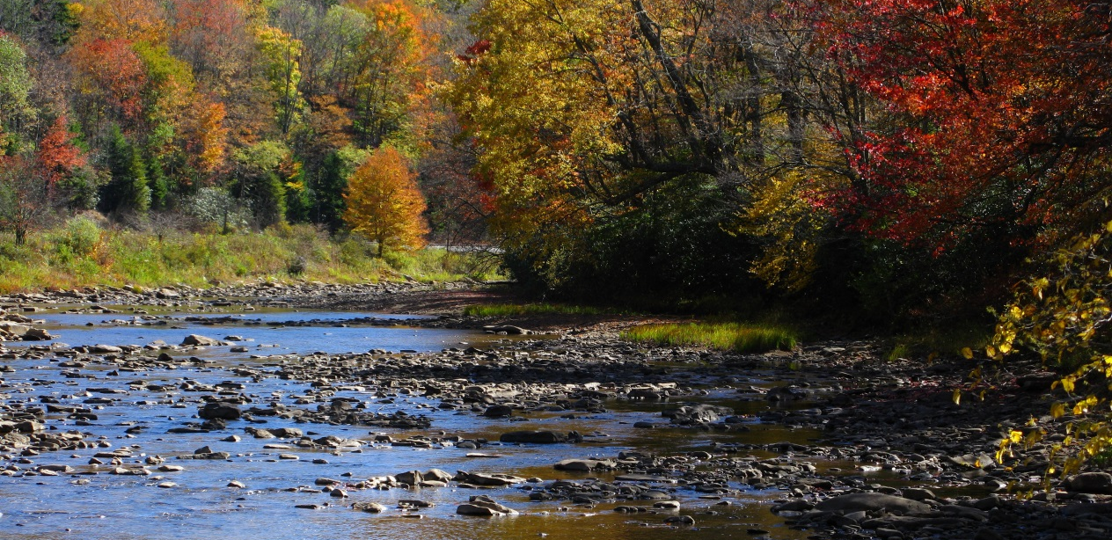
Conclusions
Gravel bed armoring influences instream hydraulics and habitat.
Dams exacerbate gravel bed stream armoring.
Patterns of armoring are very distinct, both spatially and temporally.

Slide 20
Citations
Curran, Joanna Crowe, and Lu Tan. “An Investigation of Bed Armoring Process and Formation of Microclusters.” 2nd Joint Federal Interagency Conference (2010).
Dietrich, William E., James W. Kirchner, Hiroshi Ikeda, and Fujiko Iseya. "Sediment Supply and the Development of the Coarse Surface Layer in Gravel-bedded Rivers." Nature 340.6230 (1989): 215-17.
Julien, Pierre Y. Erosion and Sedimentation. Second ed. Cambridge: Cambridge UP, 2010. Print.
Parker, Gary, and Peter C. Klingeman. "On Why Gravel Bed Streams Are Paved." Water Resources Research 18.5 (1982): 1409.
Pizzuto, Jim. "Effects of Dam Removal on River Form and Process." BioScience 52.8 (2002): 683. Web.
Wilcock, Peter R. "Persistence of Armor Layers in Gravel-bed Streams." Geophysical Research Letters 32.8 (2005).

