Slide 1
River Measurement Techniques
Haider Addab Neil A. Hadimoeljono Ramsey Pickard
Cive 717 – River Mechanics
Spring 2015

Slide 2
Outline
Objectives
Basic Principles
Accuracy
River Measurement Techniques
Stage Measurements
Velocity Measurements
Discharge Measurement Structures
Sediment Sampling Techniques

Slide 3
Objectives
Understand some basic principles of river measurement techniques
Present several river measurement techniques for:
Discharge / flow measurements
Sediment measurements
Provide some information about the accuracy of river measurement devices

Slide 4
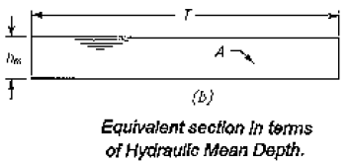

Basic Principles Critical Flow
Downstream wave or pressure disturbance cannot travel to upstream
Froude number = 1
$$Fr=\frac{v}{\sqrt{gD}}=1$$
$$\frac{Q^{2}}{g}=\frac{A_{c}^{3}}{T_{c}}$$
For a given discharge, it produces a minimum specific energy
$$E_{min}=h_{c}+\frac{v_{c}^{2}}{2g}$$
D
D
Equivalent section in terms of hydraulic mean depth (D))

Slide 5
Accuracy
Errors and uncertainties classification:
Spurious errors, caused by accident and resulting in false data like misreading and intermittent mechanical malfunction. Can be minimize by maintenance, inspection and training.
Systematic errors, caused by deviations from standard devices dimensions. Can be corrected by maintenance, adjusting to accurate dimensional measurements or replacement of the device.
Random errors, for example, when estimating required between the smallest division of head measurement device and water surface waves. Can be decreases with repeating readings
Total errors, result of systematic and random errors.

Slide 6
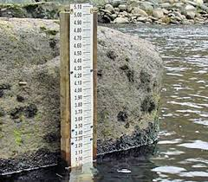
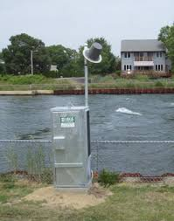
Stage Measurements
Stage gages are vertical boards or rods precisely graduated with reference to a datum
Point gages consist of mechanical or electromagnetic devices to locate and measure the water surface elevation. Lidars can be used for field measurements.

Slide 7
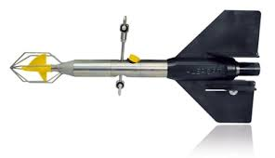
Velocity Measurement Rotating Current Meters
Rotating current meters are based on the proportionality between the angular velocity of the rotating device and the flow velocity. By counting the number of revolution of the rotor in a measured tie interval, point velocity is determined.
Horizontal-axis meters act as a propellers in a moving fluid. Common meters included the Ott and the Neyrpic current meters.
Rotating current meters are useful to determine time-averaged flow velocity.

Slide 8
The depth-averaged velocity is normally obtained from a time-averaged velocity profile. The following approximate methods for turbulent flows can be used to determine the depth-averaged flow velocity from point velocity measurements:
The one point method (at 60% of the total depth measured down from the water surface) uses the observed time-averaged velocity at 0.6 h as the mean velocity in the vertical. This method gives reliable results in uniform cross-sections.
The two point method (at 20% and 80% of the total depth measured down from the water surface) averages the two velocity measurements.
The three point method (at 20%, 60%, and 80% of the total depth measured down from the water surface) averages the one point and two point methods.

Slide 9
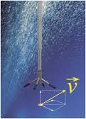
Velocity Measurement Acoustic (ultrasound)
Acoustic velocity meters measure velocity by determining the travel time of sound pulses transmitted and back scattered from small articles moving with the fluid.
Acoustic Doppler Current Profilers (ADCP) provide instantaneous velocity profiles in a cone from the point of measurement.
The measurement is not as good very near or vary far from the instrument.

Slide 10
Velocity Measurements
Electromagnetic flow meters are based on Faraday’s induction law stating that voltage is induced by the motion of a conductor perpendicular to a magnetic field.
Hot film and hot wire anemometers are electrically heated sensors being cooled by advection. The heat loss being a function for the flow velocity, this laboratory instrument is calibrated to measure fluctuating velocities with high spatial resolution and high frequency response.

Slide 11
Cross Section Geometry
Cross-section geometry can be measured using a steel tape and rod and level.
The steel tape is used to measure the width of the channel.
The rod and level measured relative elevation.
Measurements are taken at a tenth of the stream length.

Slide 12
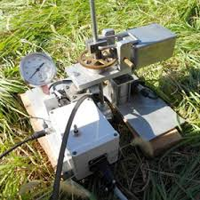
Bank Stability
Immediate results save the owner and engineer time and money, particularly with failed slopes
Measures the drained shear strength of soils in place
A new development allows for residual effective shear strength measurements
Used for designing earth slopes, retaining walls and determining the bearing capacity of foundations

Slide 13
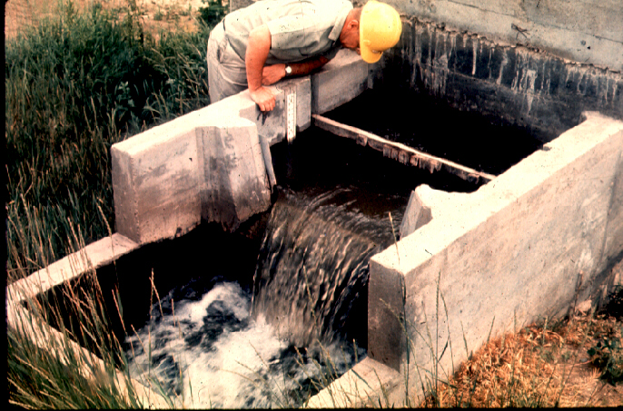
River Measurement Strucuture Discharge Measurement
Type of discharge measurement structure:
Weirs
Sharp-crested weir
Broad-crested weir
Flume
Long-throated flume
Short-throated flume
Special flume
Source: http://www.usbr.gov/pmts/hydraulics_lab/pubs/wmm/chap07_13.html

Slide 14
River Measurement Strucuture Discharge Measurement
Main consideration to select a measuring structure:
Accuracy requirements
Cost (construction, operation and maintenance)
Range of flow rates
Head loss
Ability to pass sediment

Slide 15
River Measurement Strucuture Discharge Measurement
Site selection consideration:
To prevent excessive curvature of streamlines, channel reach upstream should be relatively straight and uniform for a distance about 10 times average channel width
To ensure relatively smooth surface, Froude number upstream should be less than 0.5 for a distance of 30 yards
To prevent water surface fluctuation, the minimum distance from any upstream structure should be 20 times water surface width at maximum flow
Avoid placing structure in location where the soil characteristics are unsuitable.

Slide 16
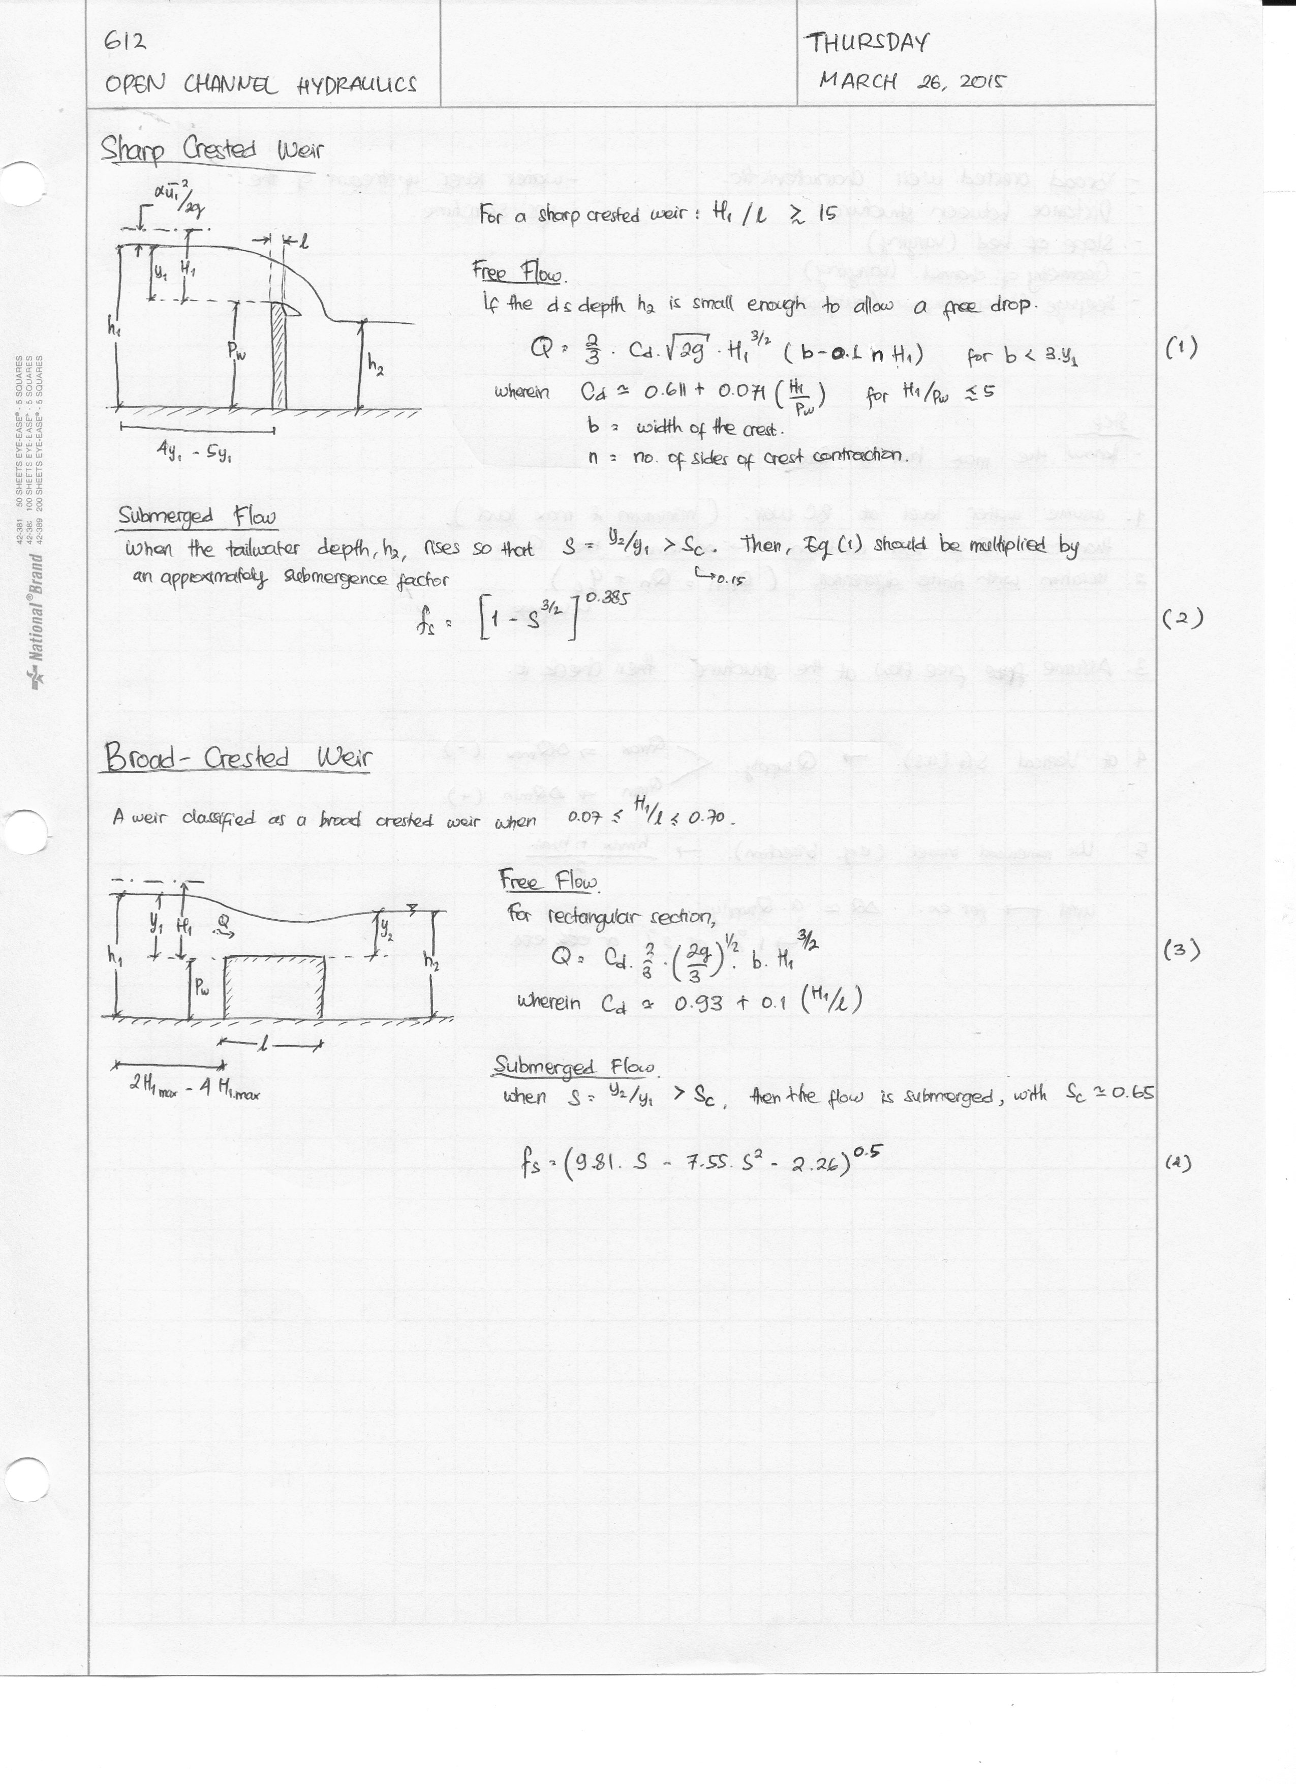

Weir Discharge measurement
Sharp crested weir (when H₁/l ≥ 15).
There are 2 condition:
Free flow
$$Q_{sw}=C_{d}\frac{2}{3}\sqrt{2g} L H_{1}^{1.5}$$
Submerge flow, when the submergence (S) is bigger than critical factor (S_{c}). Thus Q_{sw} should be multiplied by submergence factor (f_{s})
$$S=\frac{y_{2}}{y_{1}}>S_{c}=0.15$$
$$f_{s}={\left[1−S^{1.5}\right]}^{0.385}$$

Slide 17

Weir Discharge measurement
Broad crested weir (when 0.70 ≥ H₁/l ≥ 0.07).
There are 2 condition:
Free flow
$$Q_{bw}=C_{d}\frac{2}{3}\sqrt{\frac{2g}{3}} L H_{1}^{1.5}$$
Submerge flow, when the submergence (S) is bigger than critical factor (S_{c}). Thus Q_{bw} should be multiplied by submergence factor (f_{s})
$$S=\frac{y_{2}}{y_{1}}>S_{c}=0.65$$
$$f_{s}={\left(9.81S−7.55S^{2}−2.26\right)}^{0.5}$$

Slide 18
Weir Discharge measurement
Free flow is preferred than submerge flow,
Submerge flow tends to be more inaccurate than free flow, because submergence factor (f_{s}) only predict the value of submerge flow.
Submerge flow needs 2 field data (y₂ and y₁)
Broad crested is preferred than sharp crested,
Because broad crested weir has a bigger critical submergence (S_{c}), so the probability of submerge flow in broad crested weir is less than in sharp crested weir

Slide 19
Flume Discharge Measurement
Structure that cause a critical flow in a channel by either a width contraction or a combination of width and relatively small bottom contraction
Classes:
Long-Throated Flumes
Short-Throated Flumes
Special Flumes

Slide 20
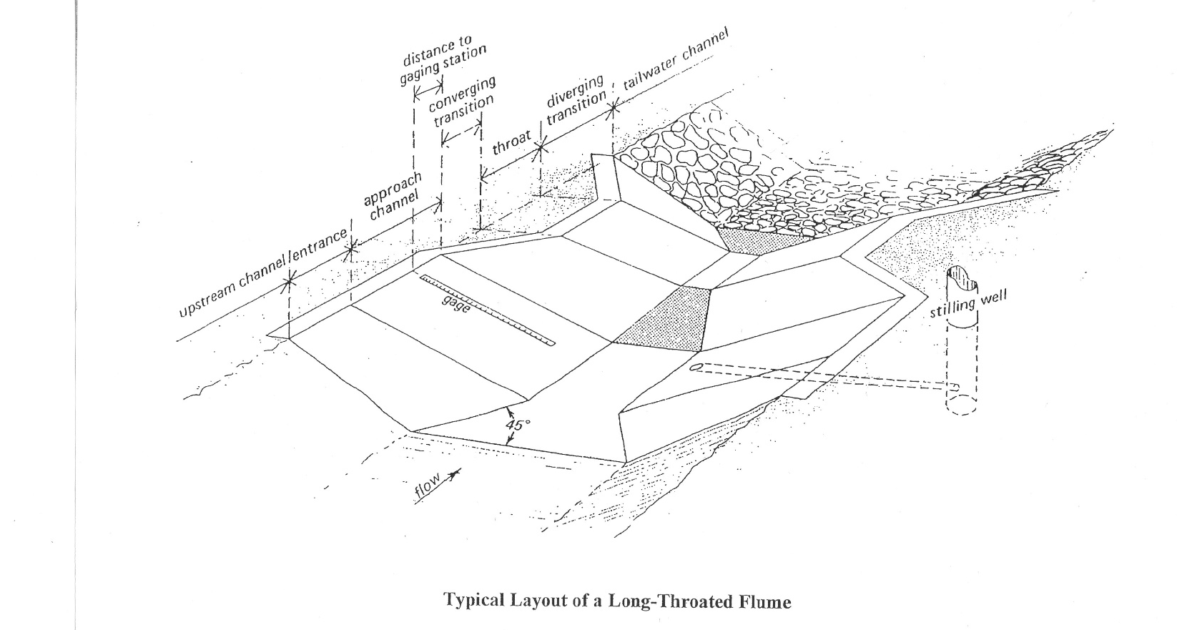
Flume Discharge Measurement
Long-Throated Flumes, have a throat that long enough to cause nearly parallel flow line

Slide 21
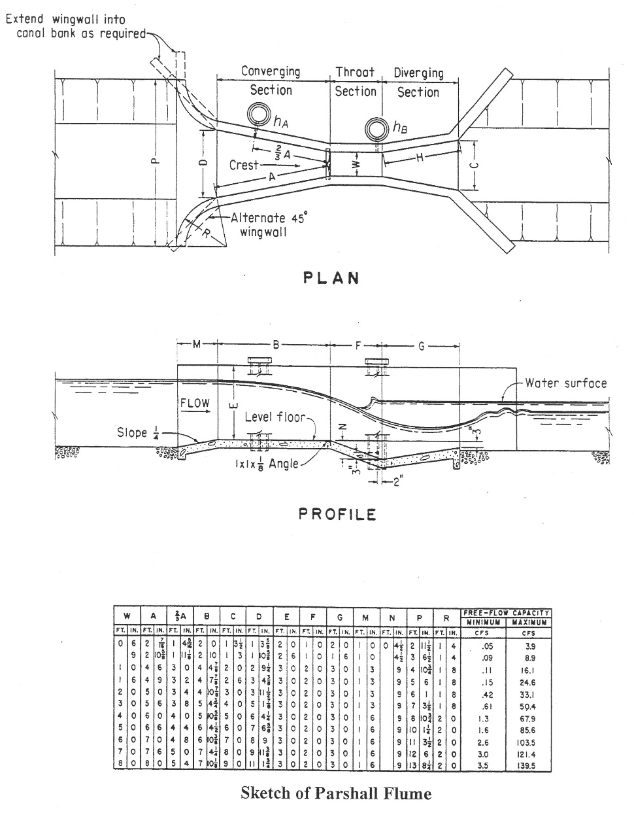
Flume Discharge Measurement
Short-Throated Flume (Parshall Flume), which control flow in a region that produces curvilinear flow.

Slide 22
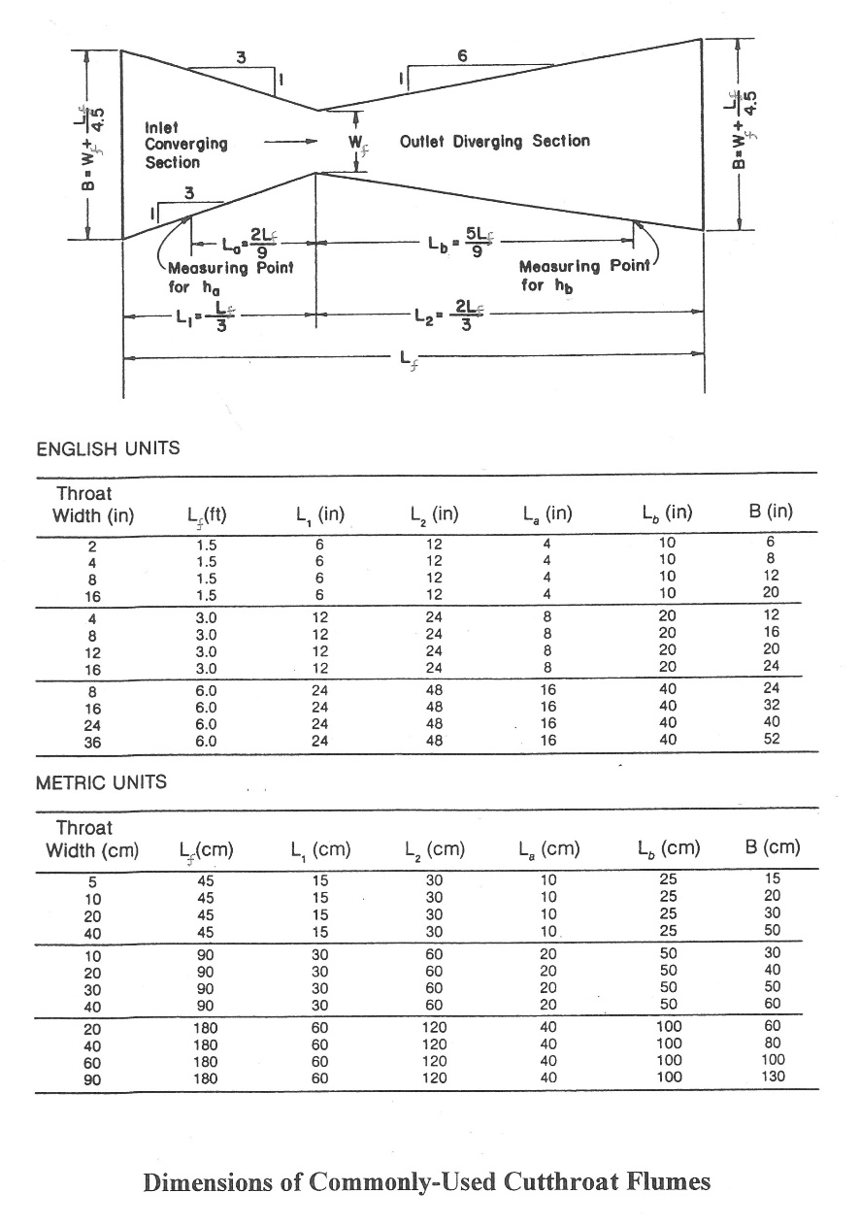
Flume Discharge Measurement
Special Flumes
Cutthroat Flume, resembles Parshall Flume with the throat “cut out”.

Slide 23
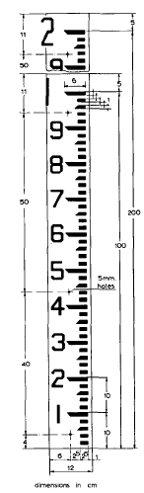
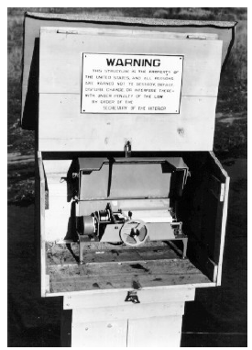
Auxiliary Equipment Discharge measurement structures
Head measurement station
Staff gage
Recording gage
Stilling well
Continuous water gage recorder
Staff gage

Slide 24
Sampling Techniques for Sediment
Sampling the water-sediment mixture for
Determine the mean suspended sediment concentration,
Particle size distribution,
Specific gravity,
Temperature of the water sediment mixture,
Other physical and chemical properties of the transported solids.
Sampling frequency
Generally dictated by the study approach and level of funding
Types of sediment samplers:
Bed Sediment Samplers.
Suspended Sediment Samplers.
Bed load samplers.

Slide 25
Bed sediment sampling
Shallow Samplers:
Drag bucket samplers.
Scoop samplers.
Grab bucket or clamshell samplers.
Vertical pipe or core samplers.
Piston core samplers
Rotating bucket samplers.

Slide 26
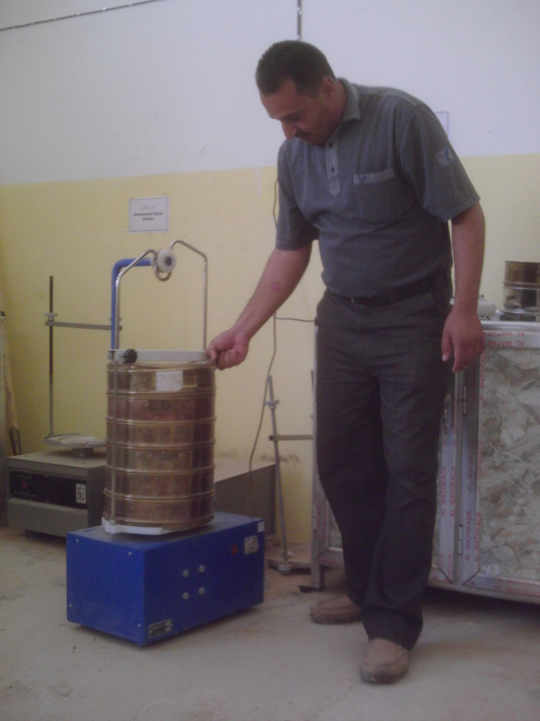
Bed sediment sampling
Benefits:
Particle size distribution
Density of sediment particles
Discharge of bed material by analytical method

Slide 27
Bed sediment sampling
Drag bucket Sampler :
Consist of weighted bucket with a cutting edge.
Lowered to the bed & dragged in the upstream direction by a tow line operated from boat.
They are not taking a sample from a single spot.
Mix the material scooped from the different depths penetrated.

Slide 28
Bed sediment sampling
Scoop Samplers:
One end is closed.
Other end beveled to provide cutting edge.
Used up to 6 m depth.
Could collect samples from top 60 mm of the bed.
A hinged cover plate may be placed over the cutting edge of the sampler.

Slide 29
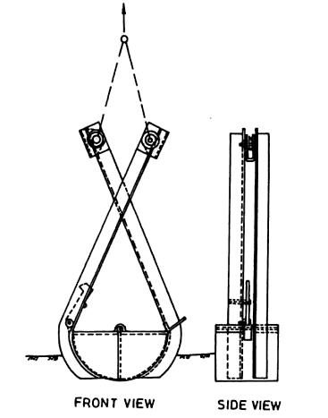
Bed sediment sampling
Grab bucket sampler:
Work very good in sandy stream.
Do not close properly if the sample contains gravels or clay.
Consist of cupped jaws which are closed at the bed to trap the sample.
Could collect samples from top 125 mm of the bed.
Special control is required to ensure the representative of the bed material.

Slide 30
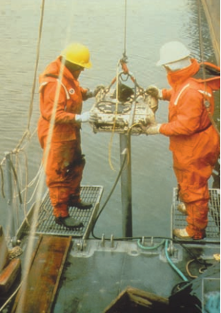
Bed sediment sampling
Vertical pipe or core:
Consist of tube forced into the stream bed.
Good quality sample.
less disruptive than dredge or grab samplers.
Easy to use in fine grained bed but its hard to use in sand bed.
Inexpensive samples &simple to maintain.

Slide 31
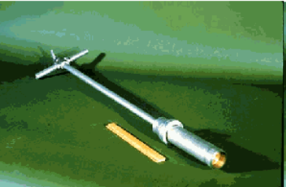
Bed sediment sampling
Piston core sampler: (US BMH-53)
Consist of (9x2)in pipe with cutting edge and suction piston .
The piston is retracted as the cutting cylinder is forced into the streambed.
Used in shallow streams.

Slide 32
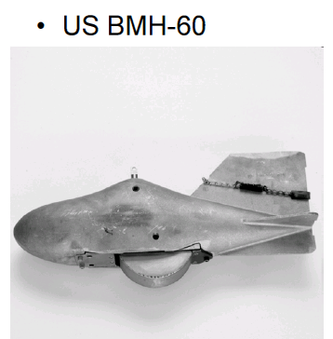
Bed sediment sampling
Deep sampler:
Rotating bucket sampler: (US BM 60)
Designed for sand-bed streams.
The sampler can be suspended from a handline or sounding reel.
The bucket, in closing, penetrates the streambed and completely encloses a sample of material.
30 IB weight.

Slide 33
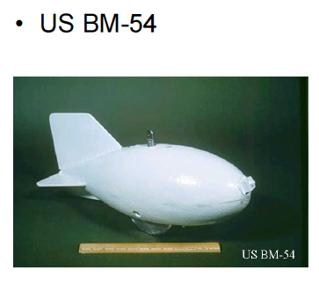
Bed sediment sampling
Deep sampler:
Rotating bucket sampler: (US BM 54)
Designed to be suspended from a cable and to scoop up a sample of the bed sediment that is 3 in width and 2 in max depth.
When the sampler contacts the stream bed with the bucket completely retracted , the tension in the suspension cable is released & heavy coil spring quickly rotates the bucket through 180 degree to scoop up the sample.

Slide 34
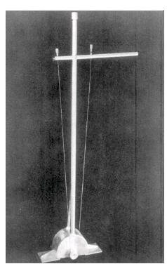
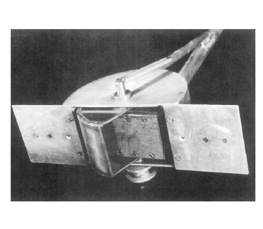
Bed sediment sampling
Rotary-bucket bed material sampler: (US RBMH-80)
hand-operated sampler that has a semi-cylindrical bucket for collecting the bed material samples.
It is constructed from lightweight aluminum and uses a BM-54 sample bucket.
Operation is simple: the lever on the handle opens and closes the bucket.

Slide 35
2. Suspended Sediment Sampler
Instantaneous suspended sediment samplers
Trap a volume of suspension flowing through a cylindrical tube by simultaneously closing off both ends.
Bucket sampling from the free surface also considered as instantaneous sampler.

Slide 36
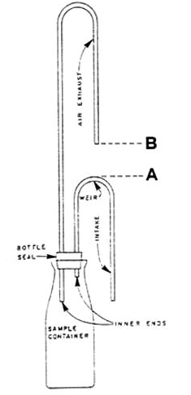
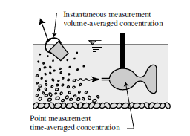
2. Suspended Sediment Sampler
Point Integrating Samplers:
The point-integrating sampler remains at a fixed point in the stream and samples continuously during the time it takes for the bottle to fill.
The dried sample measures the time average d sediment concentration
During the sampling period , the valve is opened and the air escapes the sampler at a nozzle intake velocity nearly equal to the local stream velocity.
The body of the sampler contains air which is compressed by the inflowing liquid .

Slide 37
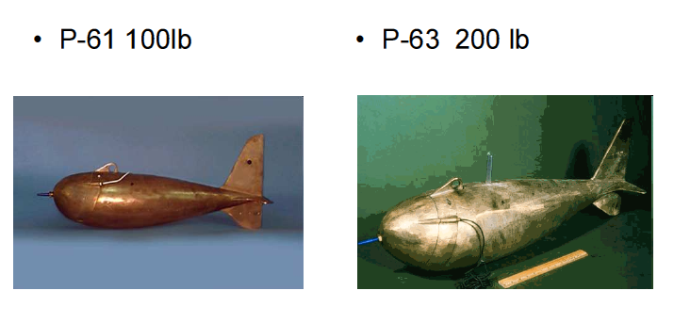
2. Suspended Sediment Samplers

Slide 38
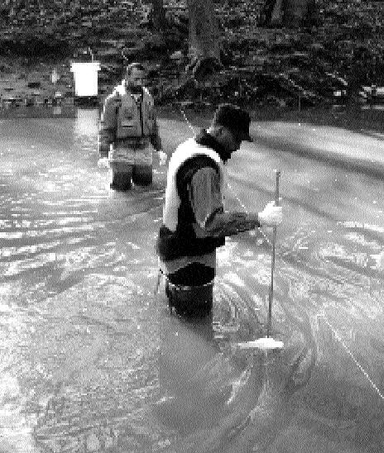
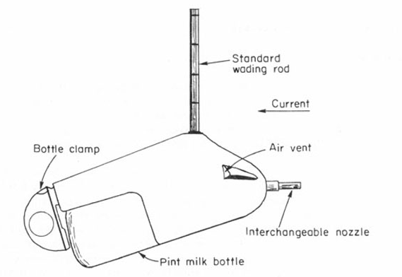
2. Suspended Sediment Samplers
Depth Integrating Samplers:
Gives a single sample combined from small sub-samples taken from different points.
Lowered from the water surface to the streambed and returned at a constant rate of travel.
Ascending and descending speeds need not be the same, but the rate of travel must be constant in each direction.
Air in the container is compressed so that the pressure balances the hydrostatic pressure at the air exhaust
The inflow velocity is approximately equal to the stream velocity.

Slide 39
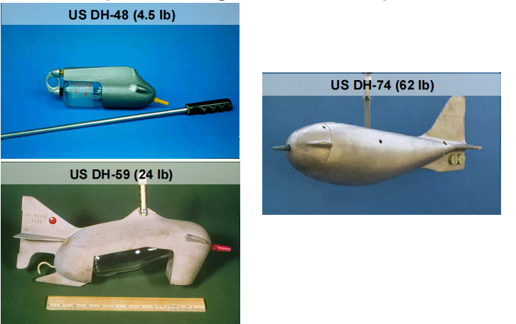
2. Suspended Sediment Samplers
Depth Integrating Samplers

Slide 40
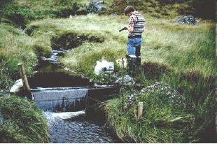
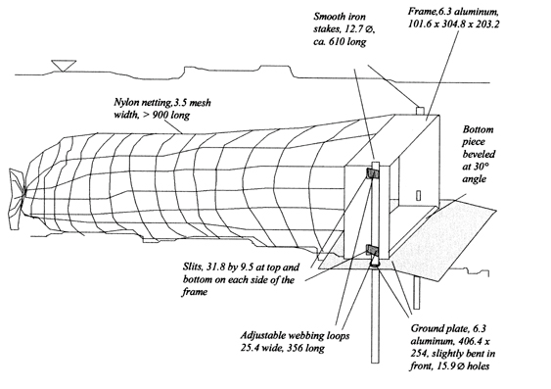
3. Bed load Measurements
Bed load traps
Sampling initiation of gravel motion and coarse bed load transport rates in wadable gravel and cobble bed mountain streams.
The trap is temporarily fastened onto ground plates anchored into the stream bottom.
This capability for representative sampling provides valuable bedload data-sets suitable for performing initial motion computations.

Slide 41
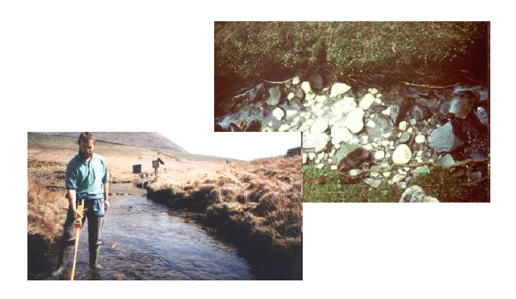
3. Bed load Measurements
Tracer Techniques:
Coarse bed material.
Painting, staining or radio tracking coarse particles from the bed.
Positions of particles indicates the distance traveled during the flood and reflect sediment transport .

Slide 42
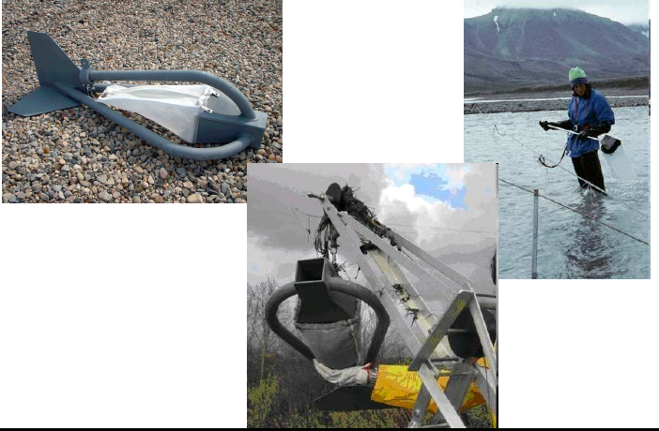
3. Bed load Measurements
Haley-Smith sampler:
Suited to coarse sand to fine gravel bed streams.
Long period of sampling could clog the sample bag.
Very coarse material(ds>80 mm) will not enter the sampler & very fine material(ds<0.5 mm) will be washed.

Slide 43
References
Geol 642. Fluvial Geomorphology – Field Trip Manual.
Julien P. Y., (2010). Erosion and Sedimentation. Cambridge University Press, Cambridge, UK.
http://www.rickly.com/index.htm
U.S. Bureau of Reclamation, (2001). Water Measurement Manual. U.S. Government Printing Office, Washington, DC.
Voltman W. F., (1989). Discharge Measurement Structures 3rd ed. International Institute for Land Reclamation and Improvement, Wageningen, The Netherlands.

