Slide 1
River Engineering
CIVE 717 River Mechanics Team Presentation
Prepared by
Aaron Orechwa
Miles Yaw
Jacob Morgan

Slide 2
Emergency River Engineering Case Study- Big Thompson River
In some situations a rare flood event can cause severe damage to critical resources.
Such was the flood event that occurred in September 2013 in the Big Thompson River.
In this particular case, the river changed paths due to excessive debris flow; this caused major erosion on the new path and the backwater effects eroded away two major pipelines for the drinking water delivery to the City of Loveland.
Slide Prepared by A. Orechwa

Slide 3
Timeline of Big Thompson Flood 2013
September 9th – Started to Rain
September 12th – Heavy Rain fell in Boulder, Aurora and Estes Park
September 13th – Big Thompson River peaks at 4 am, stream gages wiped out.
September 14th –We helped Loveland GPS survey the flood inundation limits
September 15th – Emergency call from the Water Dept to come up to the WTP as they have lost 2 of their 3 water supply lines to the City. Emergency mtgs with Water Dept, Public Works, and Ayres to come up with a plan to reroute river back to its original course.
Slide Prepared by A. Orechwa

Slide 4
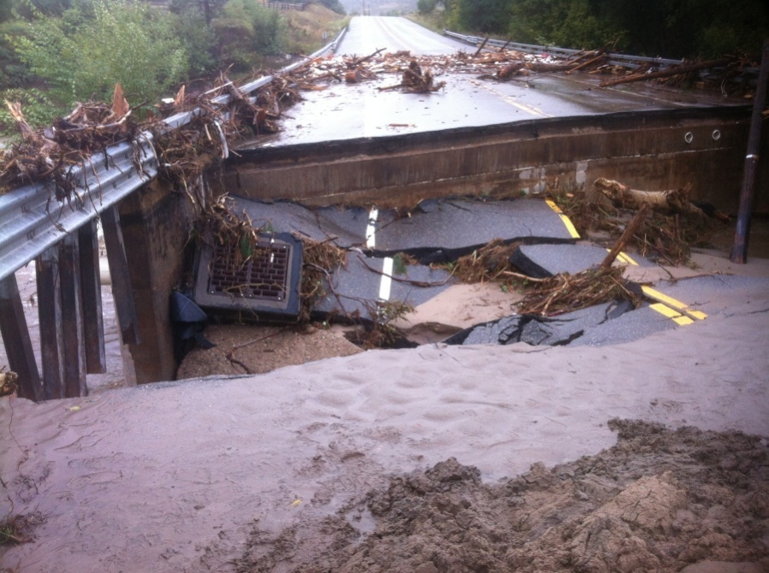
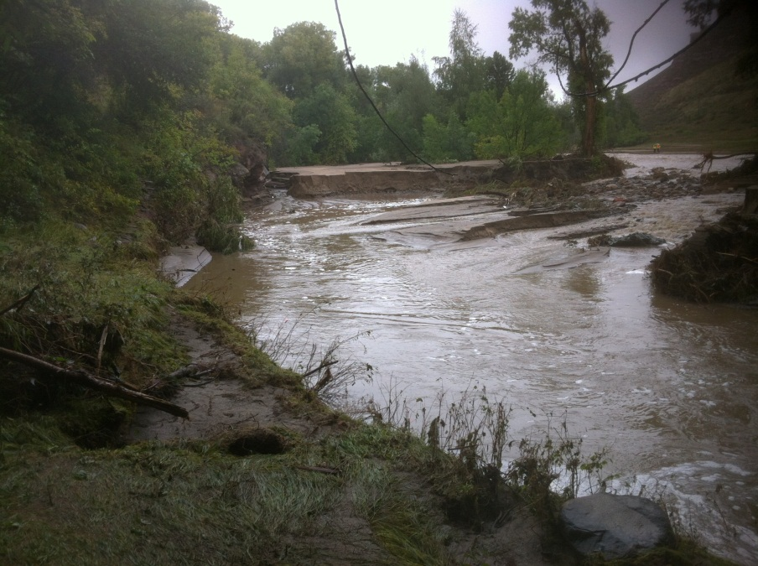
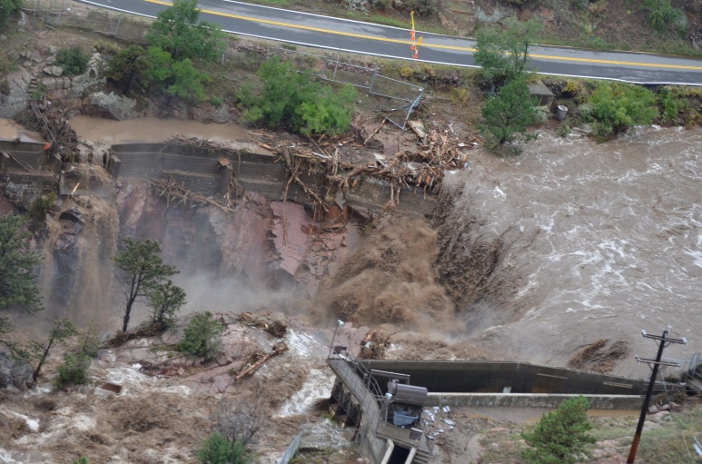
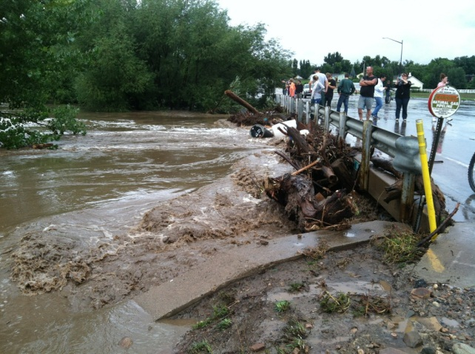
Flooding Damage Example Photos Around Northern Colorado
Slide Prepared by A. Orechwa

Slide 5
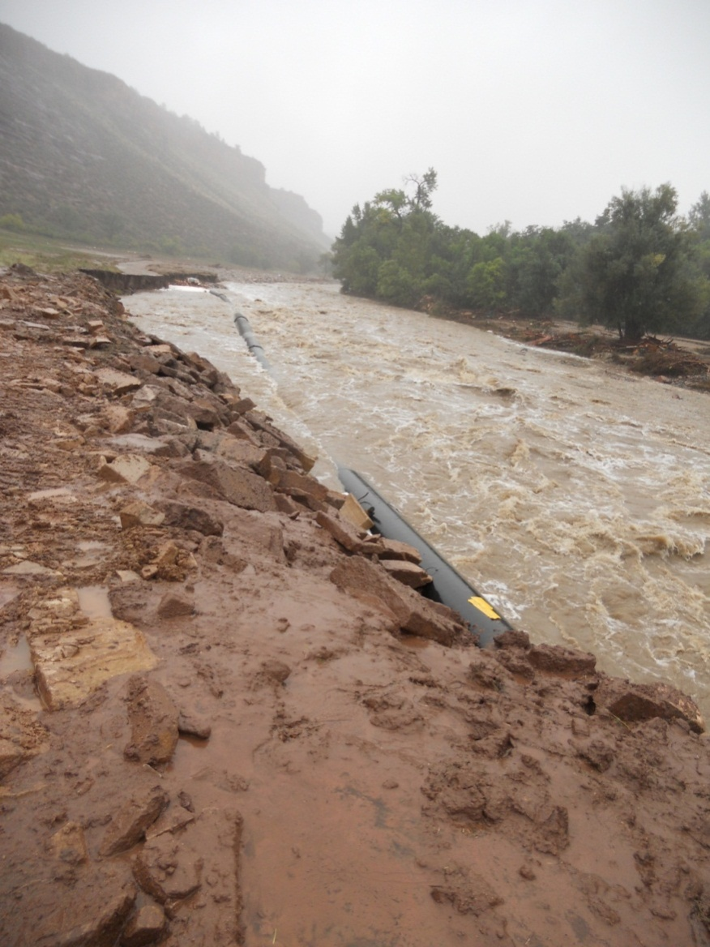
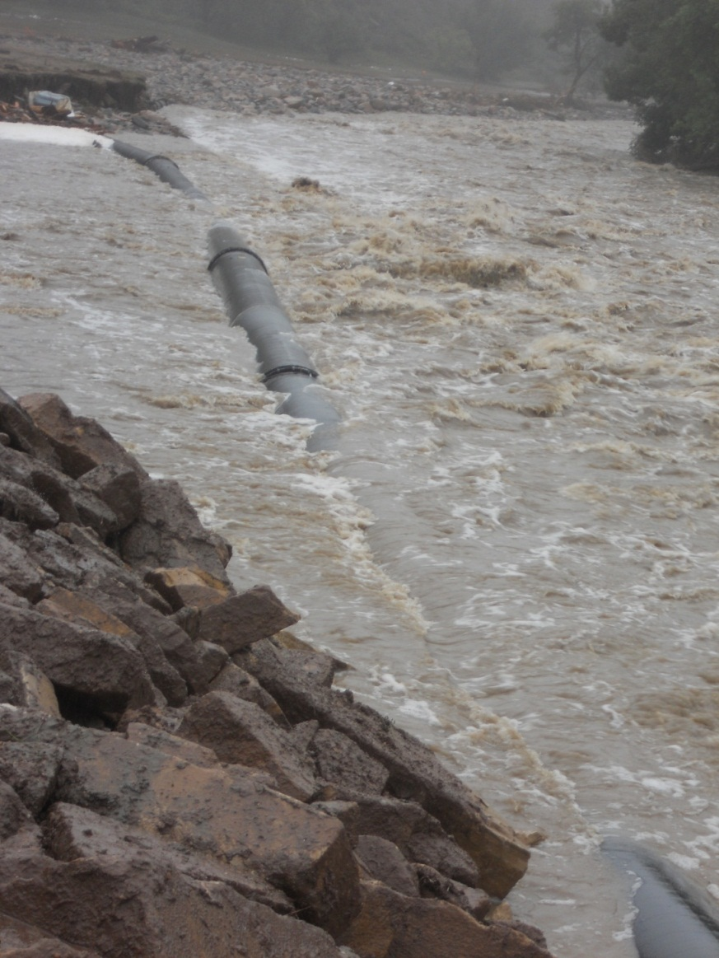
Exposed Water Mains – From Debris Flow and Backwater Effect
Slide Prepared by A. Orechwa

Slide 6
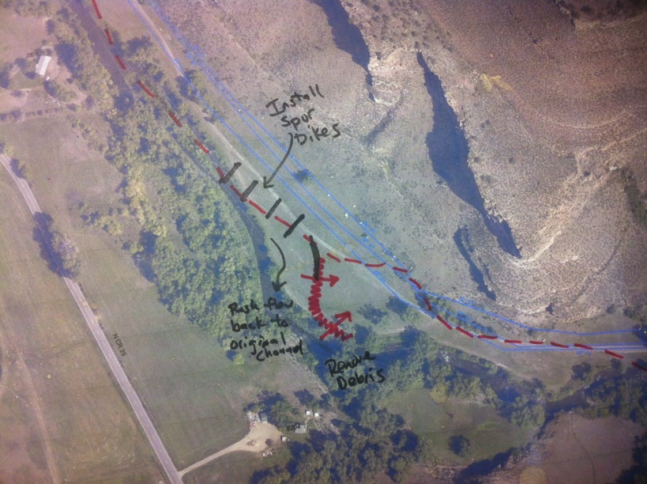
Bank Protection Using Spur Dikes
The effect of the spur dikes is to reduce the current along the streambank, thereby reducing the erosive capability of the stream and in some cases inducing sedimentation.
The purpose of these spur dikes is to redirect the flow back into the original flow path and protect the pipelines from further damage.
Slide Prepared by A. Orechwa

Slide 7
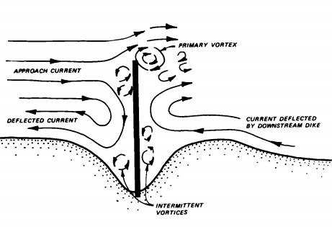
Slide Prepared by A. Orechwa

Slide 8
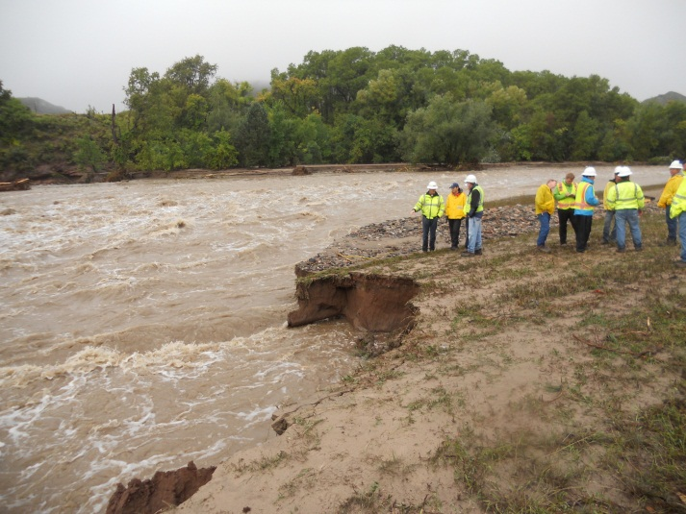
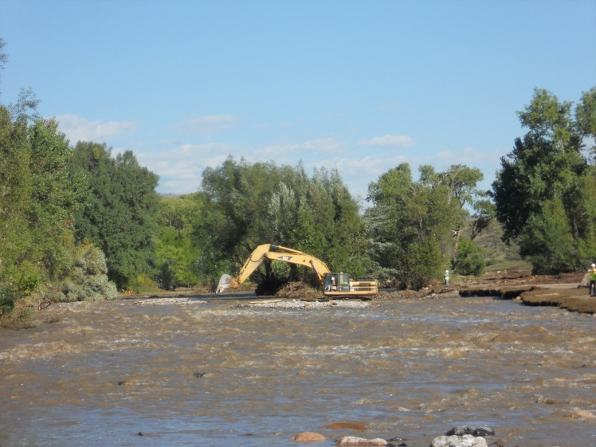
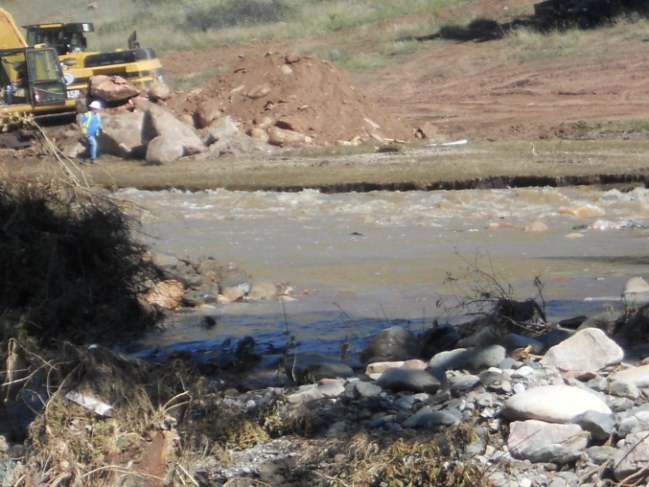
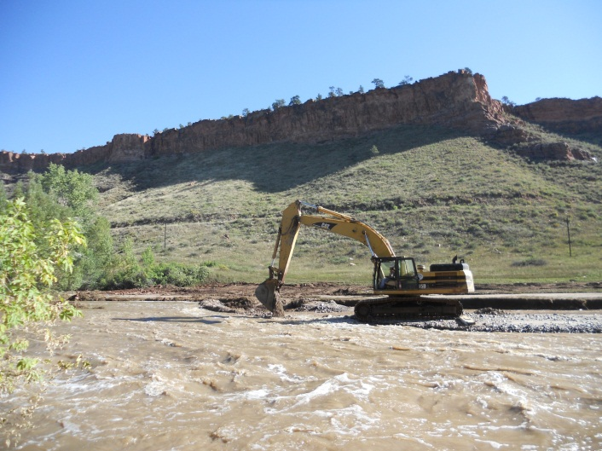
Install Spur Dikes and Re-Direct River
Slide Prepared by A. Orechwa

Slide 9
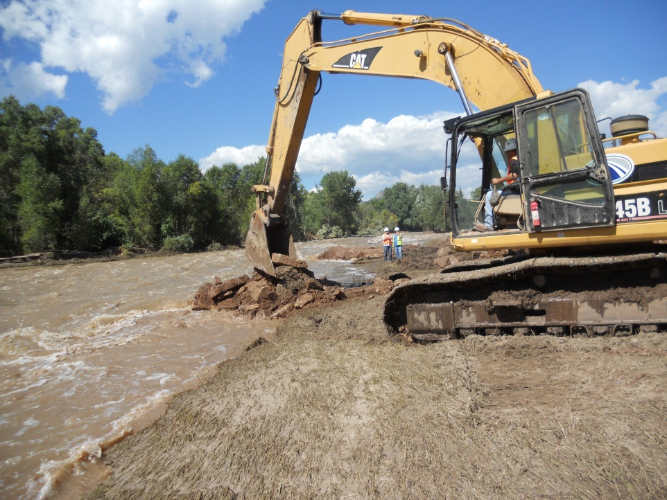
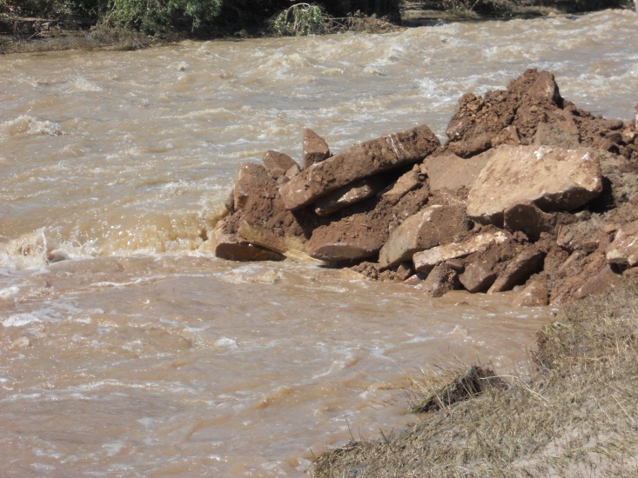
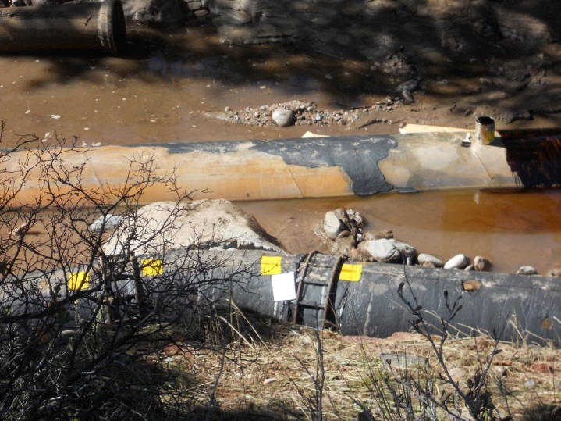
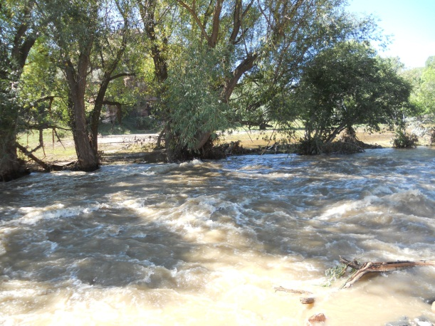
Slide Prepared by A. Orechwa

Slide 10
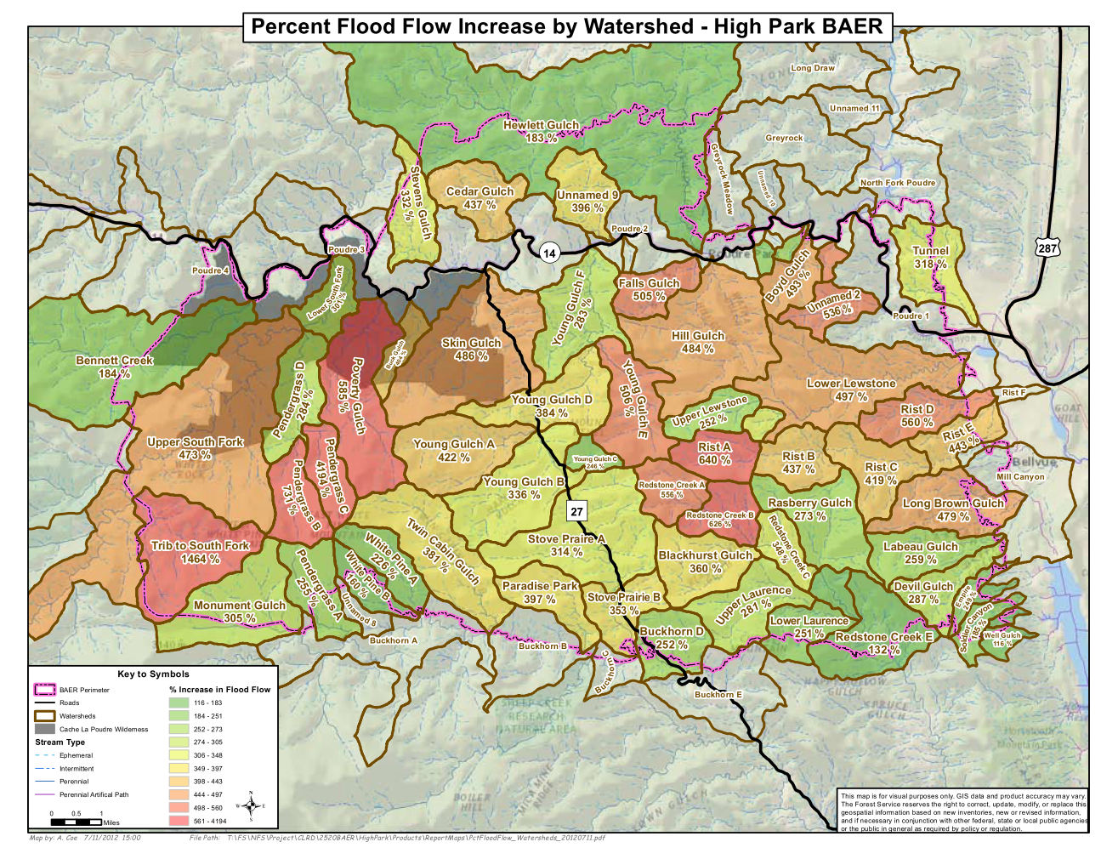

Buckhorn Creek – High Park Fire
National Resource Conservation Service (NRCS)
  Flood Hazard Assessment Report (NRCS 2013a)
  Response to High Park Fire in June 2012
    87,000 acres of forest land burned
    Increased flow volume x2 from northern watershed
Larimer County (2012)
Slide Prepared by J. Morgan

Slide 11
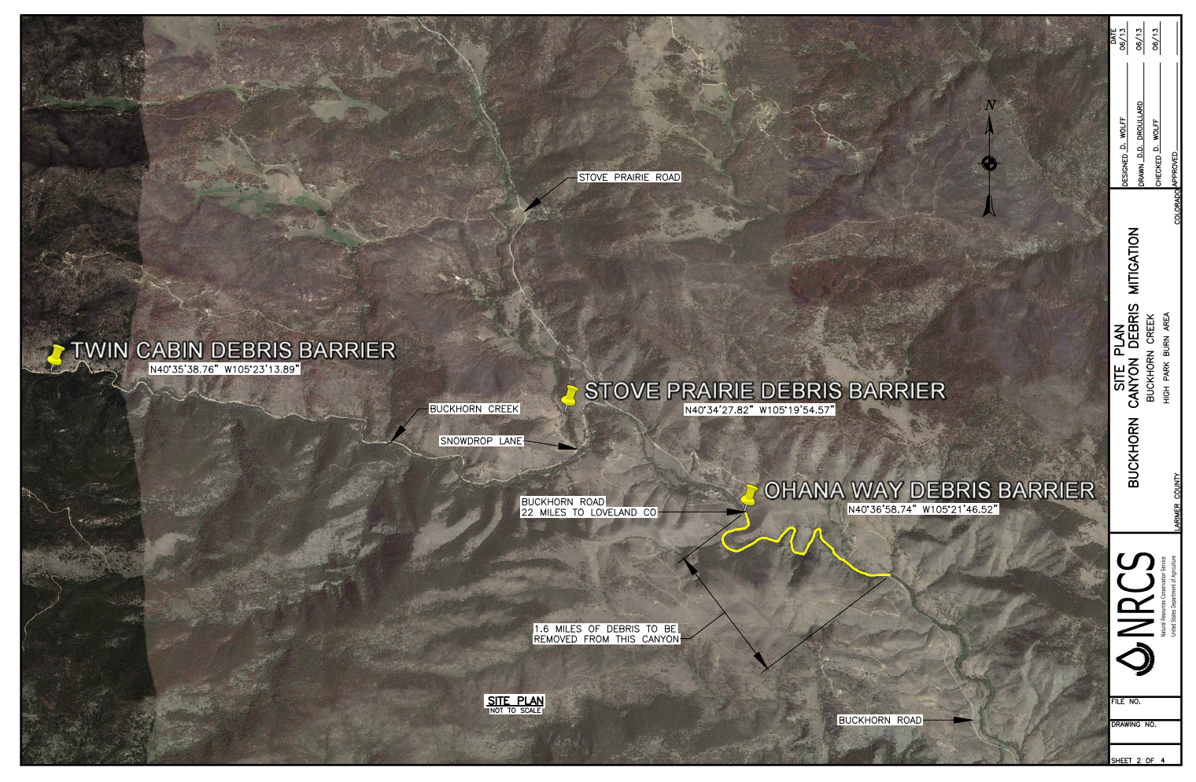
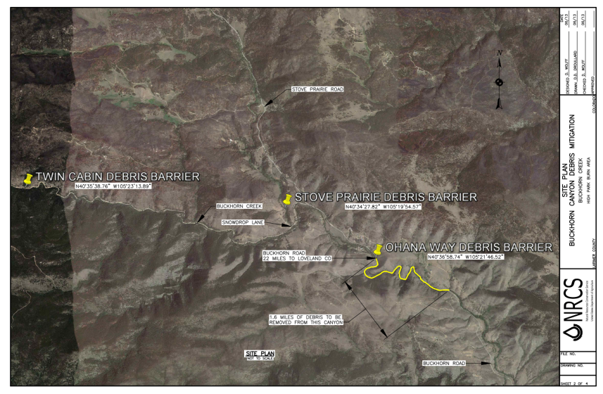
Buckhorn Creek – Flood Hazard Assessment Report
“Rainfall in excess of a 25yr-1hr event of 1.8 in/hour”
  Hazardous travel “with up to 4 ft of flow over and down… the roadway”
  “Culverts… have the potential to be washed out and/or plugged with debris”
Recommendations
  Debris control structures
  Debris removal
NRCS (2013a)
Slide Prepared by J. Morgan

Slide 12
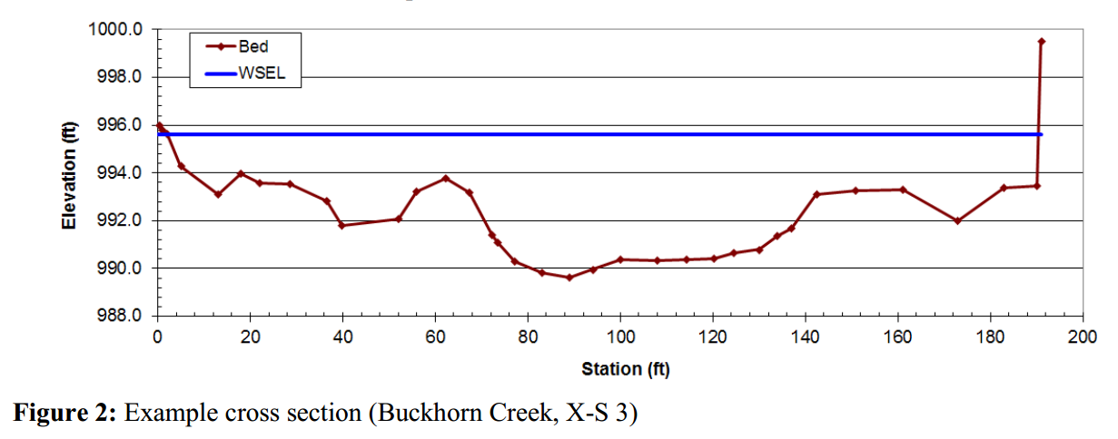
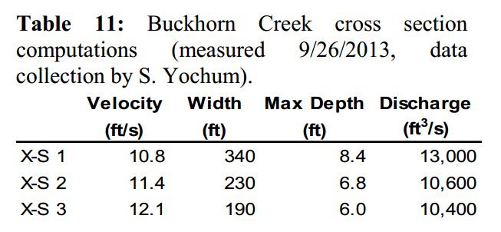
Buckhorn Creek – September Flood
3 months following Flood Hazard Assessment Report
NRCS Peak Flow Estimates (NRCS 2013b)
  Average peaks
    Flow: ~11,000 cfs (b/t 50 & 100-yr flood)
    Velocity: ~11.4 fps
  Channel width increased from ~25 ft to >200 ft downstream of canyon
NRCS (2013b)
Slide Prepared by J. Morgan

Slide 13
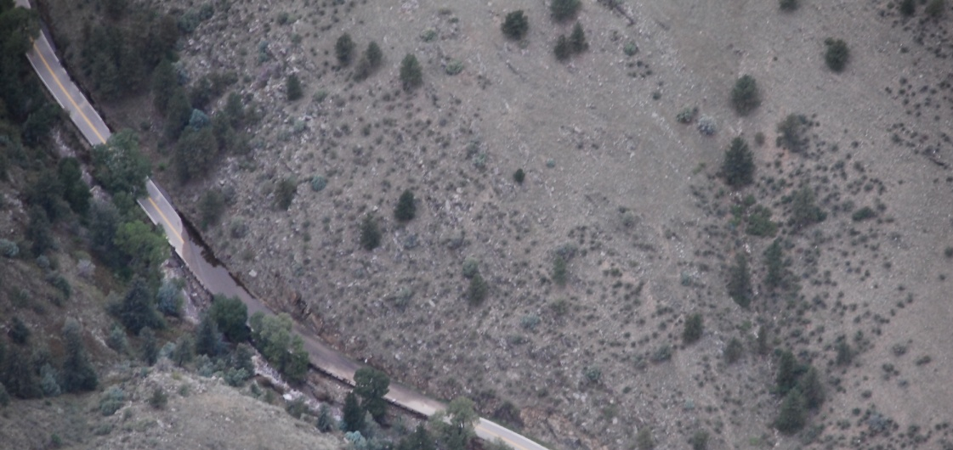
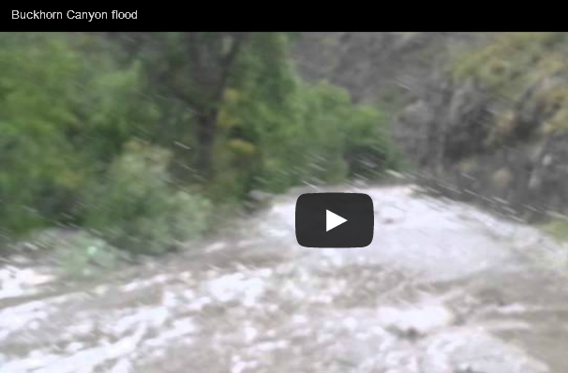
Buckhorn Creek – September Flood
Narrow canyon for 1.6 miles downstream of Ohana way
4 culverts/stream crossings in canyon
  All culverts overtopped
  All culverts washed out
Slide Prepared by J. Morgan

Slide 14
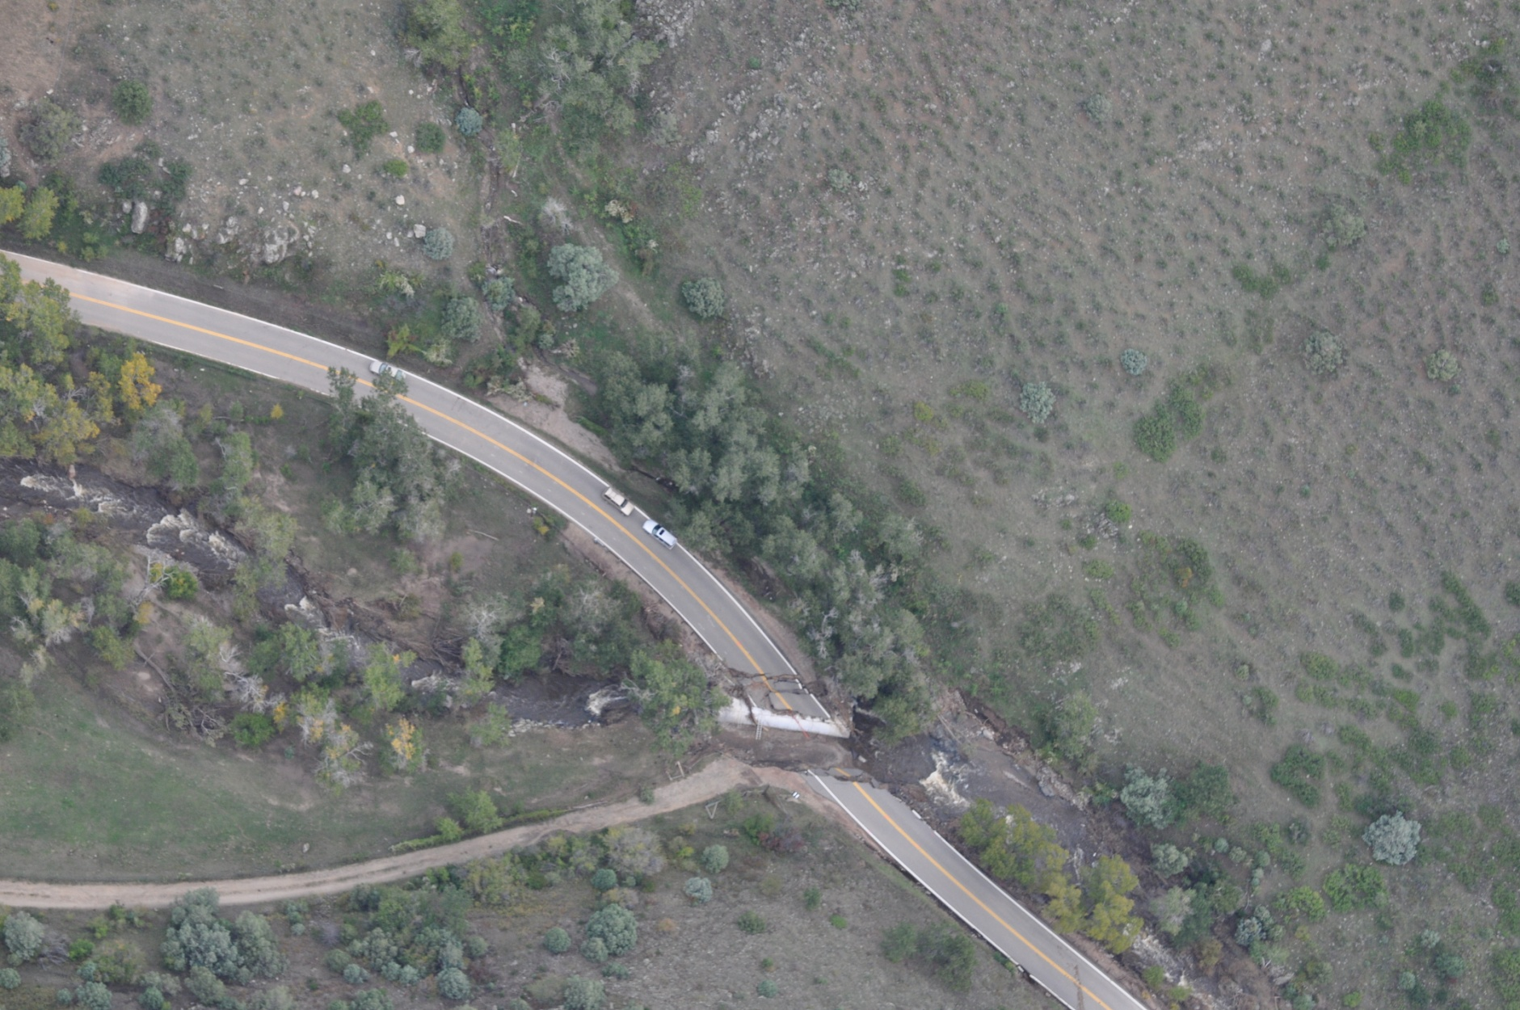
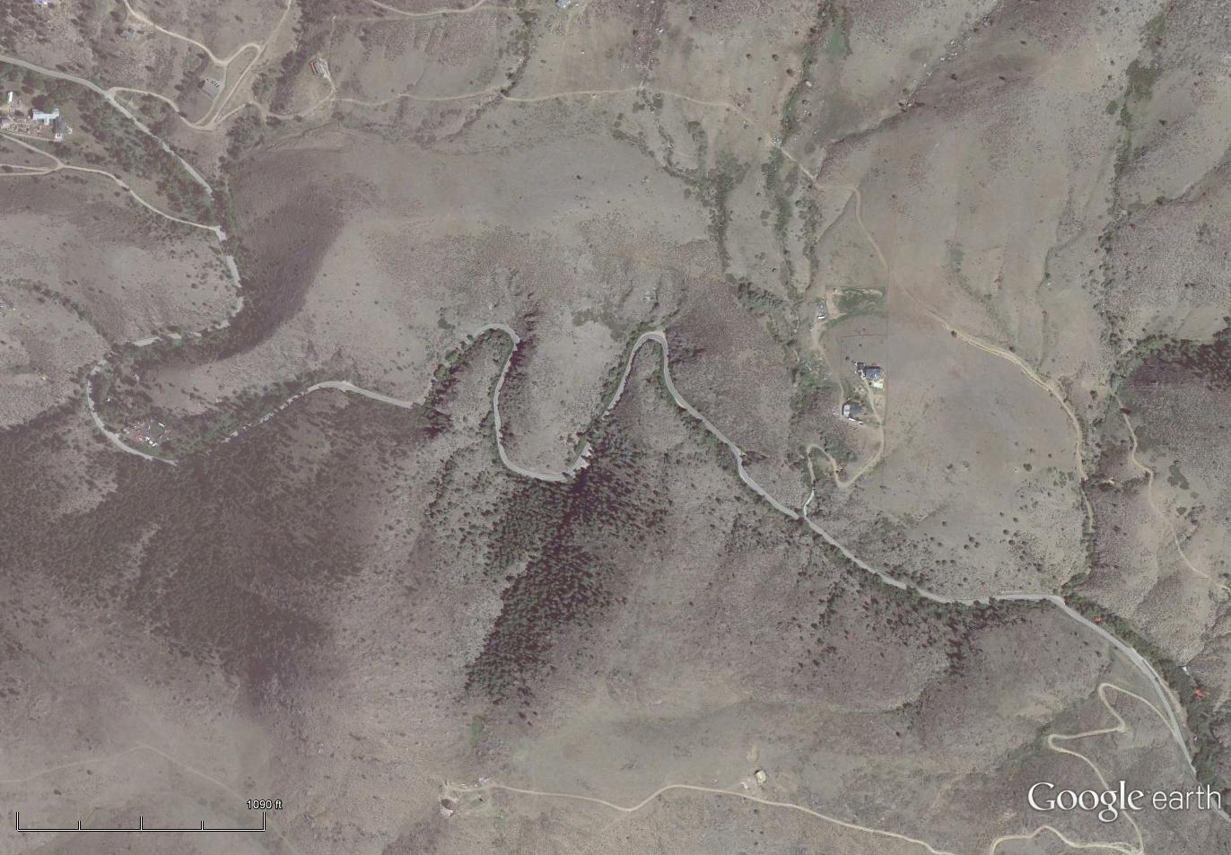
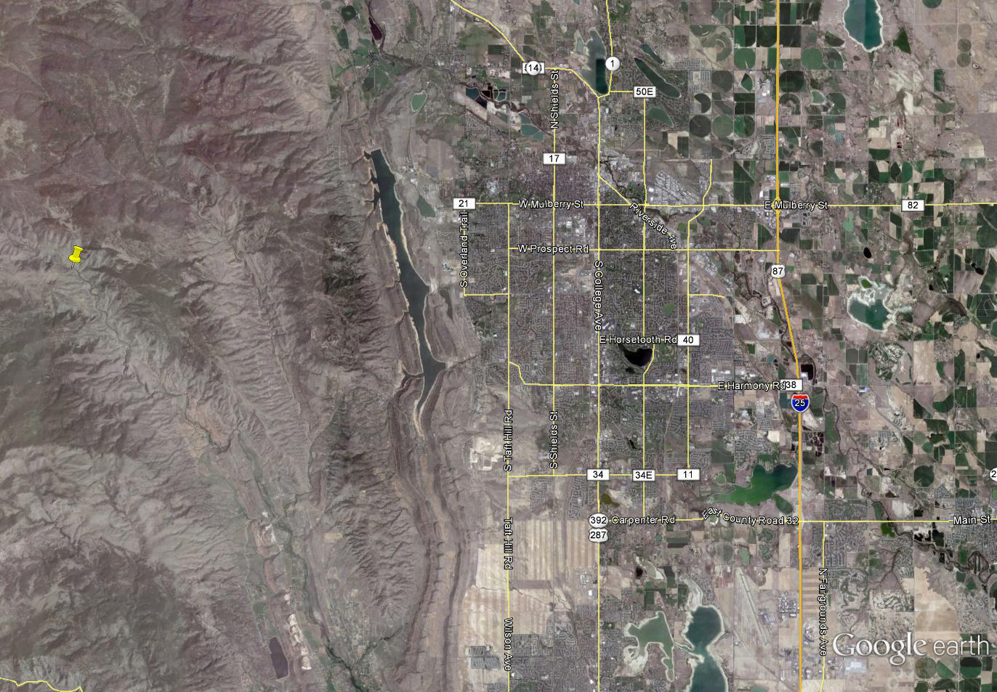
Buckhorn Creek – Too Late
Buckhorn Creek
Buckhorn Road
ESRI (2013)
Slide Prepared by J. Morgan

Slide 15
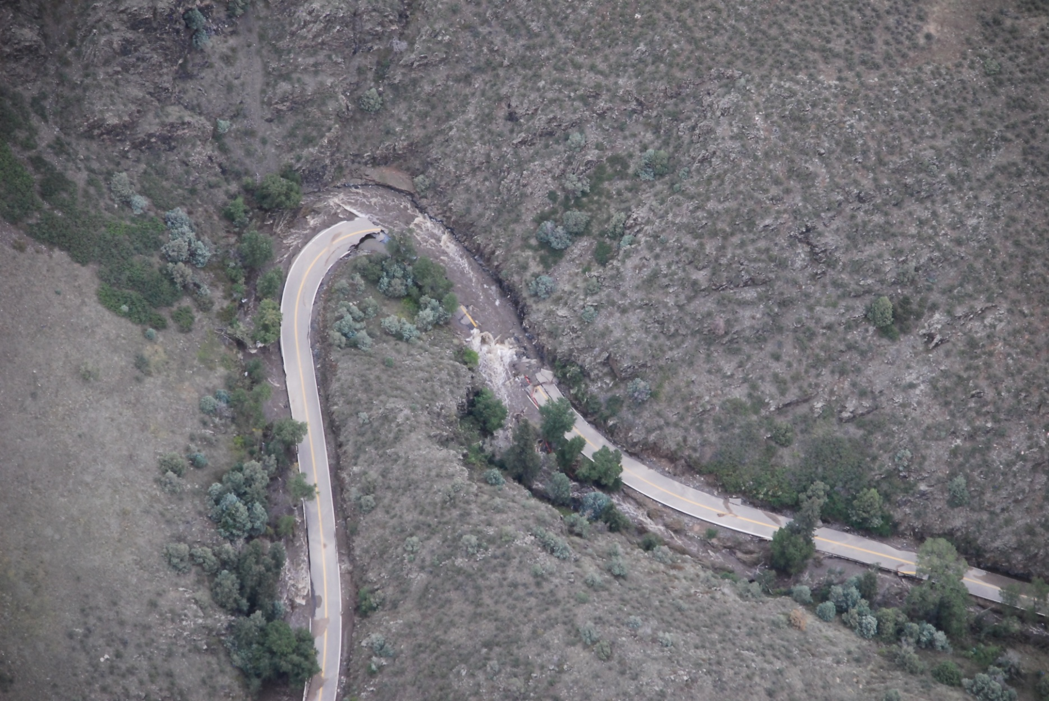
Buckhorn Creek – Too Late
Buckhorn Creek
Buckhorn Road
ESRI (2013)
Slide Prepared by J. Morgan

Slide 16
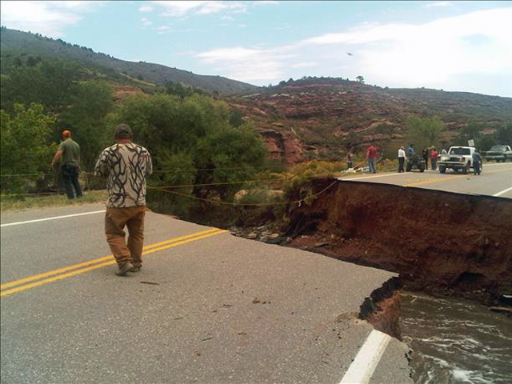
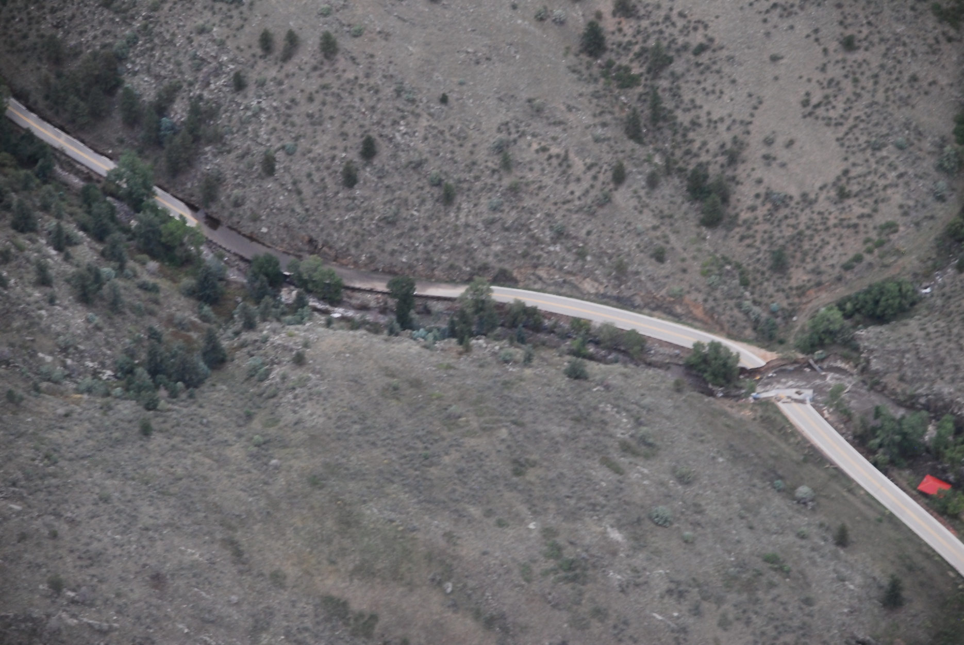
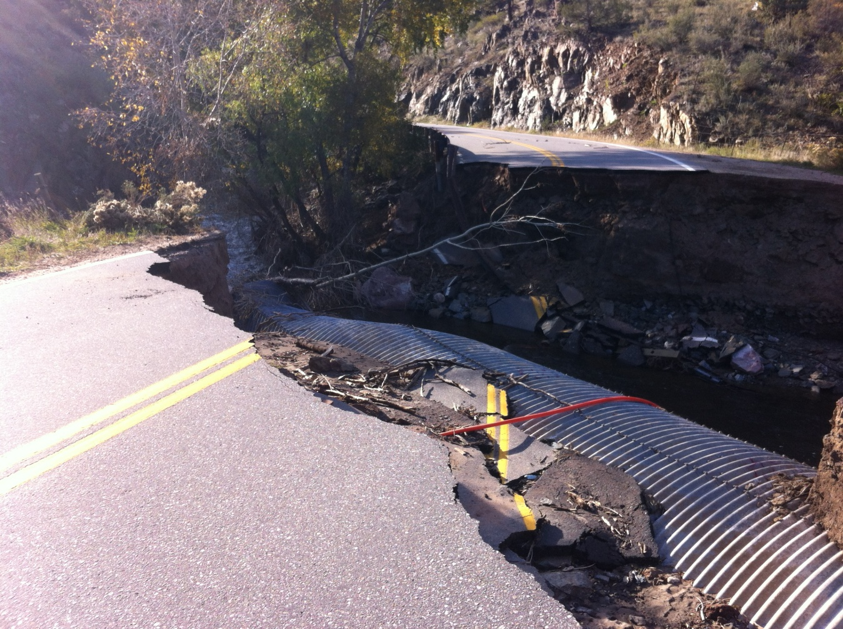
Buckhorn Creek – Too Late
Buckhorn Creek
Buckhorn Road
TheDenverChannel.com (2013)
ESRI (2013)
Slide Prepared by J. Morgan

Slide 17
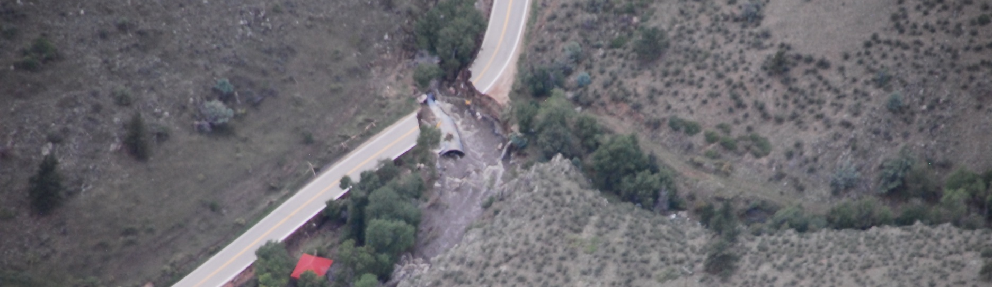
Buckhorn Creek
Flow/sediment regime changing events (e.g. forest fires in a watershed) can make once sufficiently designed riverine structures inadequate
It is best, if possible, to update structures or take other protective measures before a significant event proves the structures inadequate
ESRI (2013)
Slide Prepared by J. Morgan

Slide 18
Santa Ana River Bank Protection
Santa Ana River (SAR) downstream of Prado dam
River threatens Hwy 91
USACE existing bank protection analysis
  Top of protection elevation
  Bottom-line toe depth
Slide Prepared by M. Yaw

Slide 19
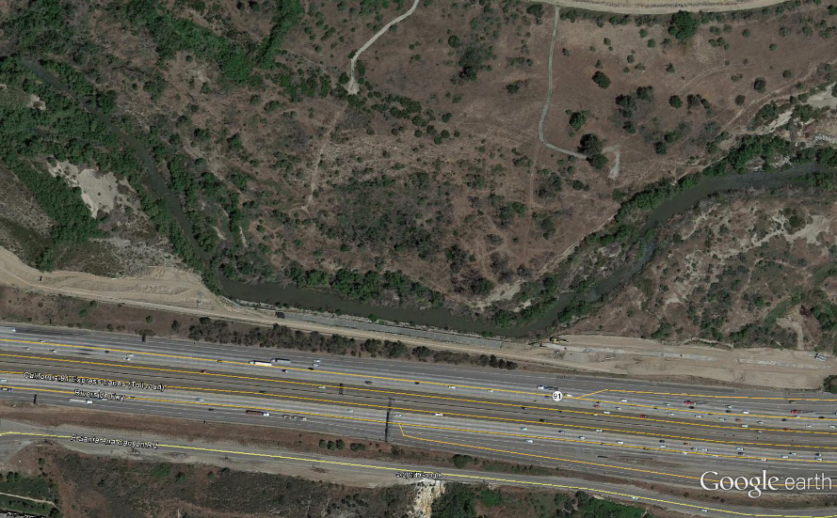
Erosion Risk at SAR Sheet Pile Wall
Hwy 91 built through historical channel path
  1929 – red
  1968 – orange
  2007 – dark blue
Wall built on the outside of a river bend
Slide Prepared by M. Yaw

Slide 20
Determination of Maximum Possible Scour
2 sources of erosion applied at sheet pile wall:
  General bed degradation
  Bend Scour
Contraction, drop, and bedform scour were also considered, but did not apply to the sheet pile wall
Slide Prepared by M. Yaw

Slide 21
Determination of Maximum Possible Scour
General Bed Degradation
  Computed by HEC-6T using long-series flood hydrograph
Long-series flood hydrograph
HEC-6T model calibration results
Slide Prepared by M. Yaw

Slide 22

Determination of Maximum Possible Scour
Radius of curvature
u/s Bankfull Depth
u/s Bankfull Topwidth
Cross Section ID | Max. General Degradation (ft) | Max. Bend Scour (ft)
19,180 | 3.5 | 4.6
19,700 | 3.5 | 3.7
20,240 | 1.6 | 3.5
Slide Prepared by M. Yaw

Slide 23
Bottom Line Depth Design
Slide Prepared by M. Yaw

Slide 24
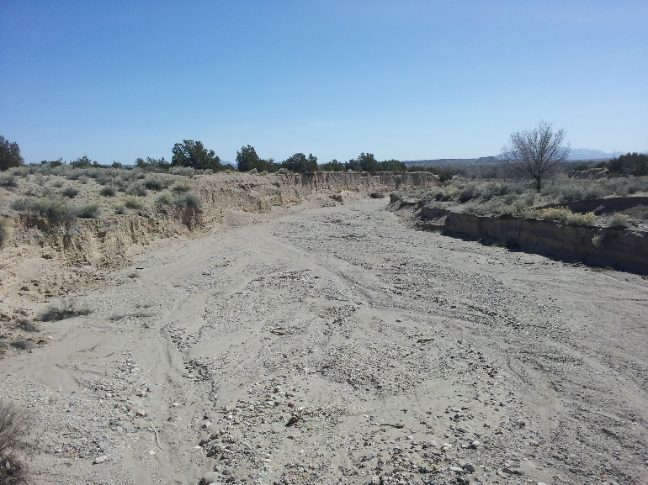
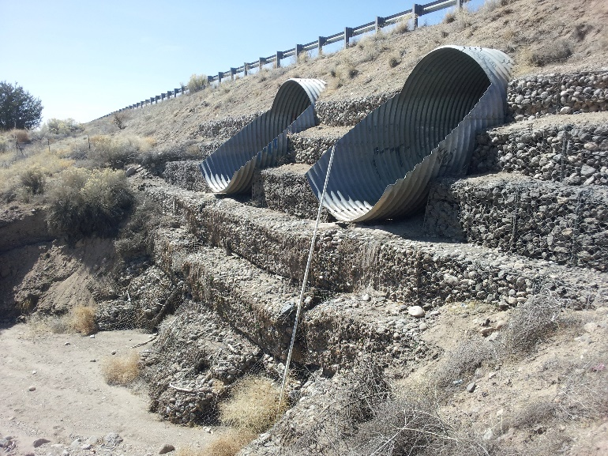
Peralta Canyon, NM Road Protection
Headcut advancing upstream
2x 6’ CMP Culverts pass flow under road
Gabion wall to protect embankment
  March 2012 - photos show sloughing at wall base
Downstream of crossing
14’
Downstream side of embankment, note sloughing at toe
Slide Prepared by M. Yaw

Slide 25
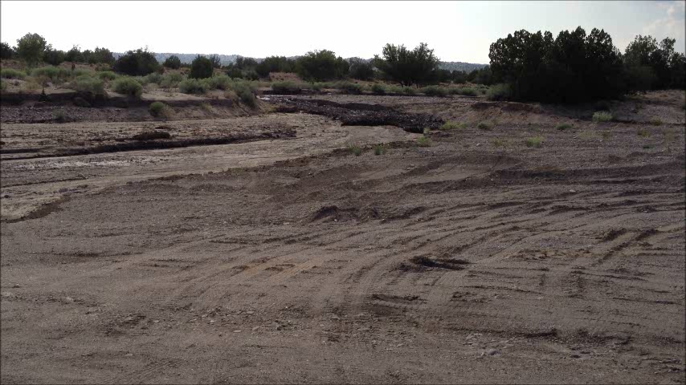
Peralta Canyon Debris Flow
Summer 2012 – flood in canyon, culverts destroyed
August 2012 – Debris flow from Las Conchas fire
Slide Prepared by M. Yaw

Slide 26
References
Copeland, R. R., “Bank Protection Techniques Using Spur Dikes,” Miscellaneous Paper HL-83-1, US Army Corps of Engineers Hydraulics Laboratory, 1983.
ESRI, “Colorado Flooding: Assess Your Community Map & Satellite Images,” http://www.esri.com/services/disaster-response/floods/colorado-flooding-assess-your-community-map, 2013.
Julien, P. Y., Erosion and Sedimentation, Cambridge University Press, 2010.
Julien, P. Y., River Mechanics, Cambridge University Press, 2002.
Larimer County, “High Park Fire Burned Area Emergency Response Report”, High Park Fire Emergency Stabilization Plan, Larimer County, CO, 2012.
NRCS, “Flood Hazard Assessment Report, Buckhorn Creek, Larimer County, Colorado,” US Dept of Agriculture, 2013a.
NRCS, “Peak Flow Estimates at Selected Mountain Stream Locations,” Colorado Front Range Flood of 2013, US Dept of Agriculture, 2013b.
TheDenverChannel.com, “Latest Colorado road closures caused by historic September flood,” http://www.thedenverchannel.com/traffic/traffic-news/road-closures-due-to-flooding-mud-rock-slides-includes-us-36-us-34-co-14-co-72, 7News Denver, 2013.

