Slide 1
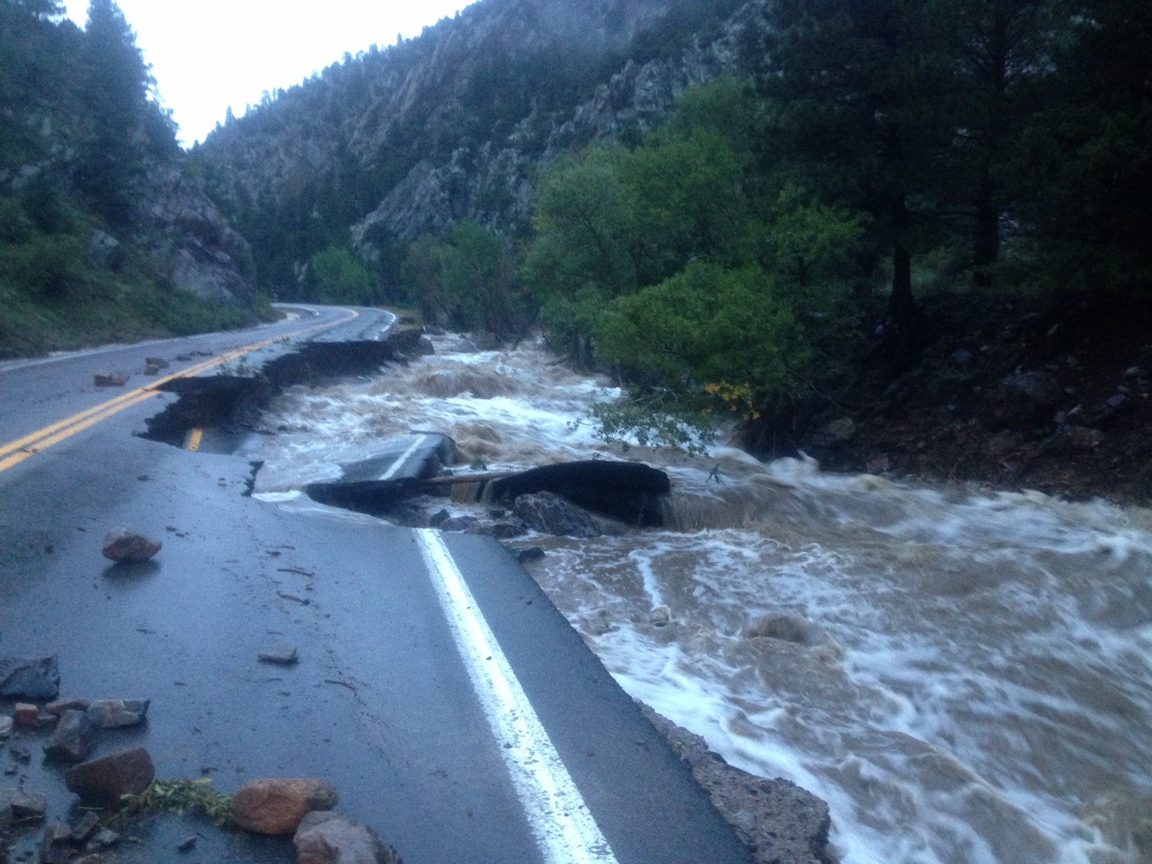
Colorado 2013
Flood hydrology
Oladapo Aseperi
Justin Kattnig
Olga Martyusheva
April 10, 2014

Slide 2
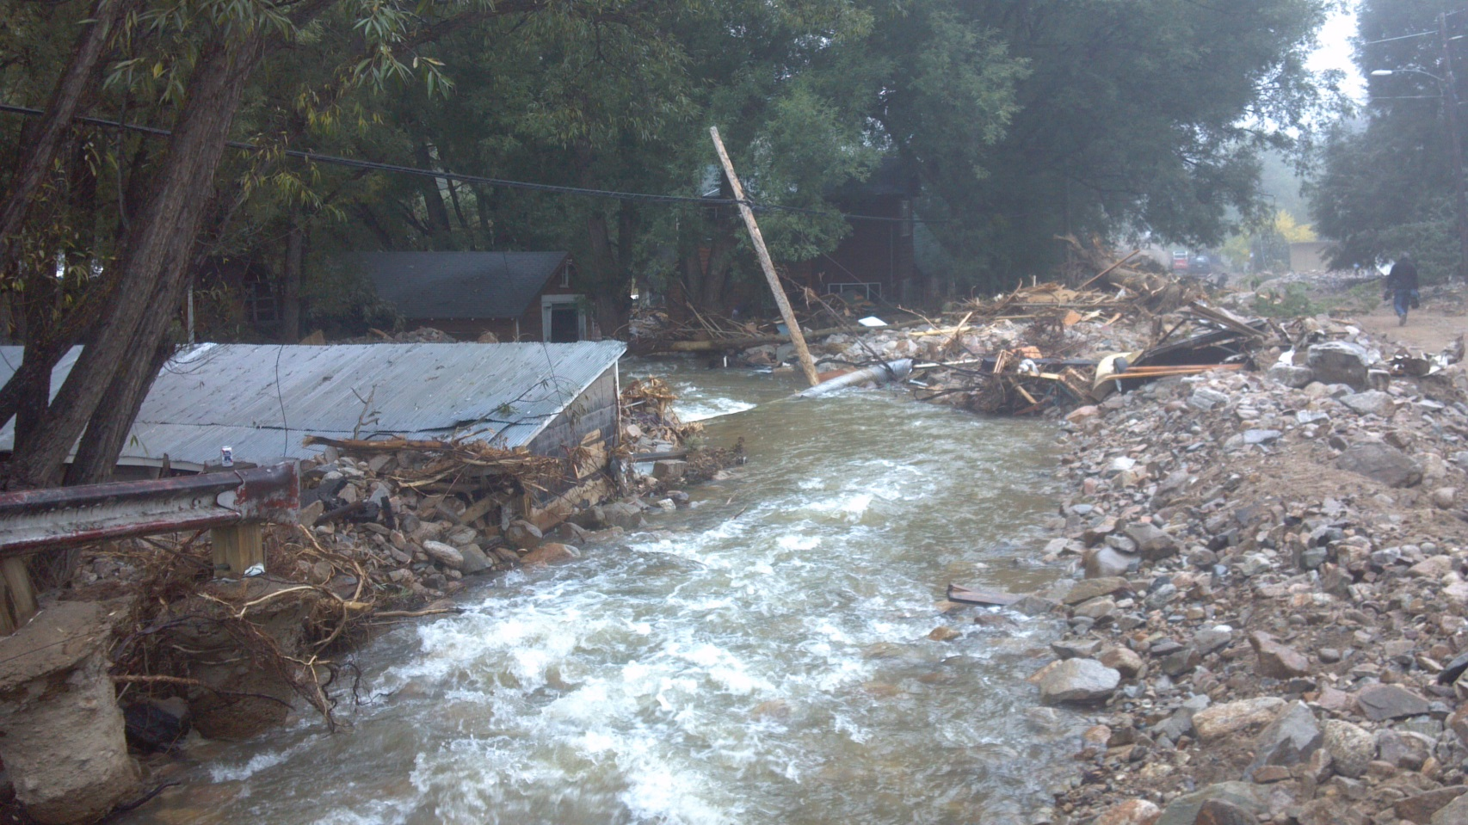
Purpose and Objectives
Define and Describe Major Hydrologic Processes
Highlight Governing Equations and Design Procedures
Summarize Hydrological Characteristics of the September 2013 Colorado Flood

Slide 3
Outline
Overview: Hydrologic Cycle
    Which parameters are important and why?
Introduction to Colorado Flood of 2013
Rainfall (Precipitation)
      Length Scales, Properties, and Stochastic Modeling
      Rainfall distribution for the 2013 Colorado Flood
Infiltration
      Governing Parameters and Processes
      Estimates for the 2013 Colorado Flood
Runoff
      Parameters affecting overland flow and stream flow
      Flow rates for the 2013 Flood

Slide 4
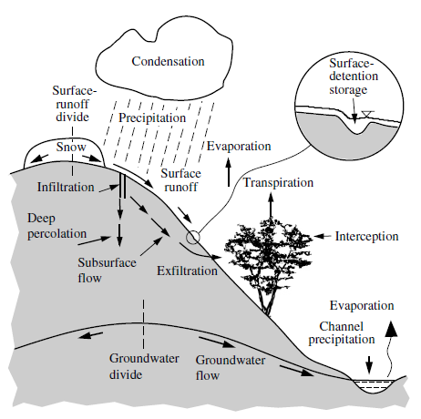
Overview: Hydrologic Cycle
Photo from Julien, 2002
Notes:
Describe major hydrologic processes. Which events occur first when a “Large” storm event is considered? -> Rainfall, Infiltration/Interception, Runoff -> Overland flow and streamflow. Introduction of manmade structures changes governing principles (more runoff, varied conveyance structures).

Slide 5
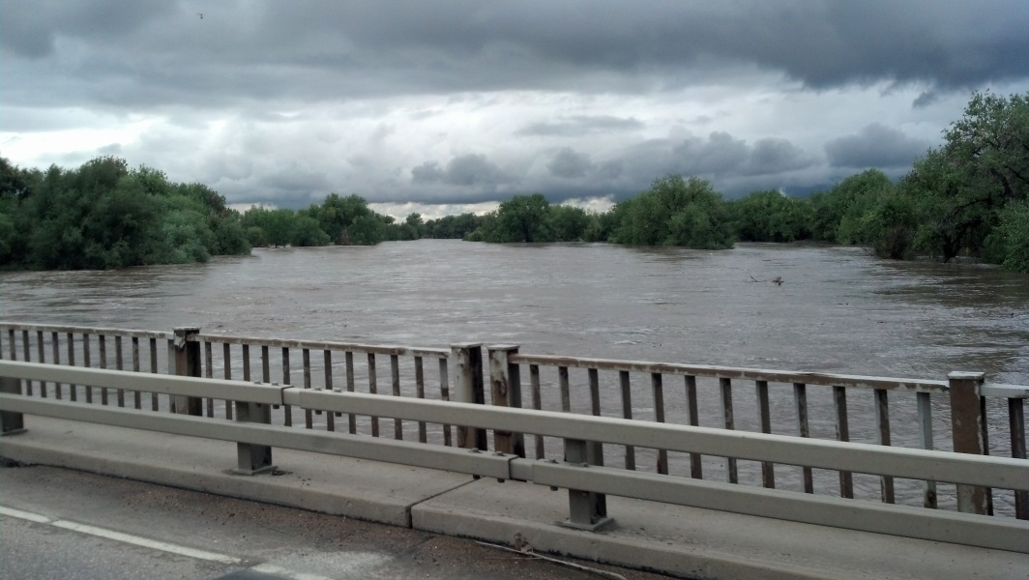
Which Physical Processes are Important?
The following processes are important when considering upland erosion and river mechanics (for large storm events):
Precipitation (Rainfall)
Infiltration
Overland Flow and Stream Flow (Runoff)
Notes:
Use previous slide to lead into this slide. Briefly discuss why we will not cover additional processes (storage, surfacewater ground-water interactions, etc.). Note that if a given watershed is significantly vegetated interception may become significant.

Slide 6
Introduction to the Colorado Flood
The Colorado Flood occurred from September 9 – September 16, 2013
Most extreme rainfall and flood event recorded in Colorado history
Areas within the storm epicenter received 600% of the average precipitation for September (CCC)
Runoff provided flows up to 25,000% of average (CCC, USGS)
Very high return period (still being determined)

Slide 7
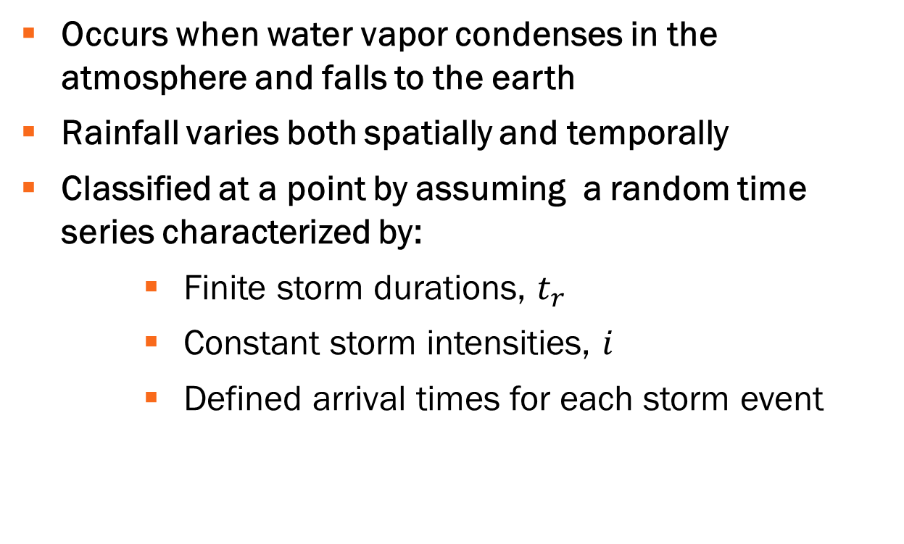
Rainfall (Precipitation)
Occurs when water vapor condenses in the atmosphere and falls to the earth
Rainfall varies both spatially and temporally
Classified at a point by assuming a random time series characterized by:
Finite storm durations, $t_{r}$
Constant storm intensities, $i$
Defined arrival times for each storm event

Slide 8
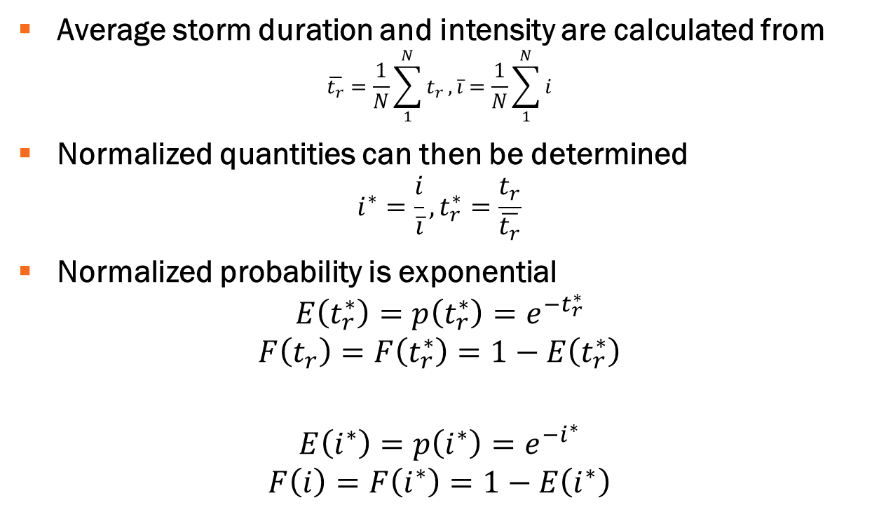
Probability of Rainfall
Average storm duration and intensity are calculated from
$$\overline{t_{r}}=\frac{1}{N}\sum_{1}^{N}{t_{r}},\overline{i}=\frac{1}{N}\sum_{1}^{N}{i}$$
Normalized quantities can then be determined
$$i^{∗}=\frac{i}{\overline{i}}, t_{r}^{∗}=\frac{t_{r}}{\overline{t_{r}}}$$
Normalized probability is exponential
$$E\left(t_{r}^{∗}\right)=p\left(t_{r}^{∗}\right)=e^{−t_{r}^{∗}}$$
$$F\left(t_{r}\right)=F\left(t_{r}^{∗}\right)=1−E\left(t_{r}^{∗}\right)$$
$$E\left(i^{∗}\right)=p\left(i^{∗}\right)=e^{−i^{∗}}$$
$$F\left(i\right)=F\left(i^{∗}\right)=1−E\left(i^{∗}\right)$$

Slide 9
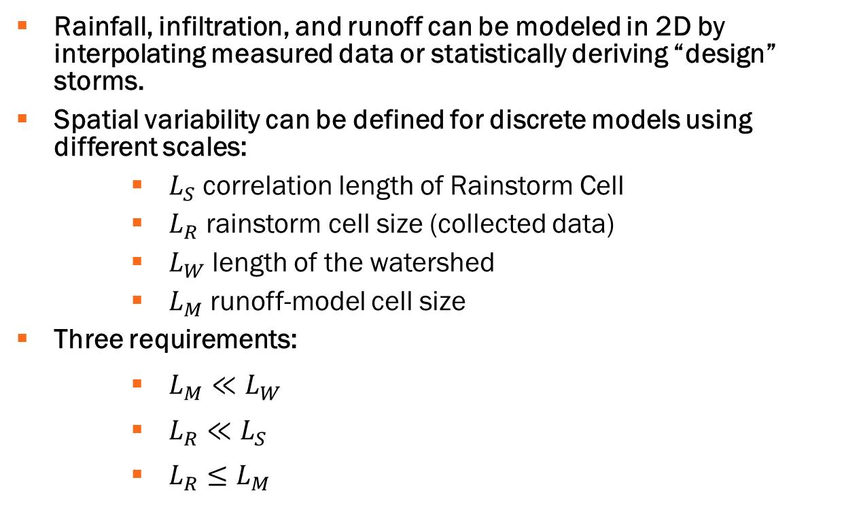
2d spatial rainfall models
Rainfall, infiltration, and runoff can be modeled in 2D by interpolating measured data or statistically deriving “design” storms.
Spatial variability can be defined for discrete models using different scales:
$L_{S}$ correlation length of Rainstorm Cell
$L_{R}$ rainstorm cell size (collected data)
$L_{W}$ length of the watershed
$L_{M}$ runoff-model cell size
Three requirements:
$L_{M}≪L_{W}$
$L_{R}≪L_{S}$
$L_{R}≤L_{M}$

Slide 10
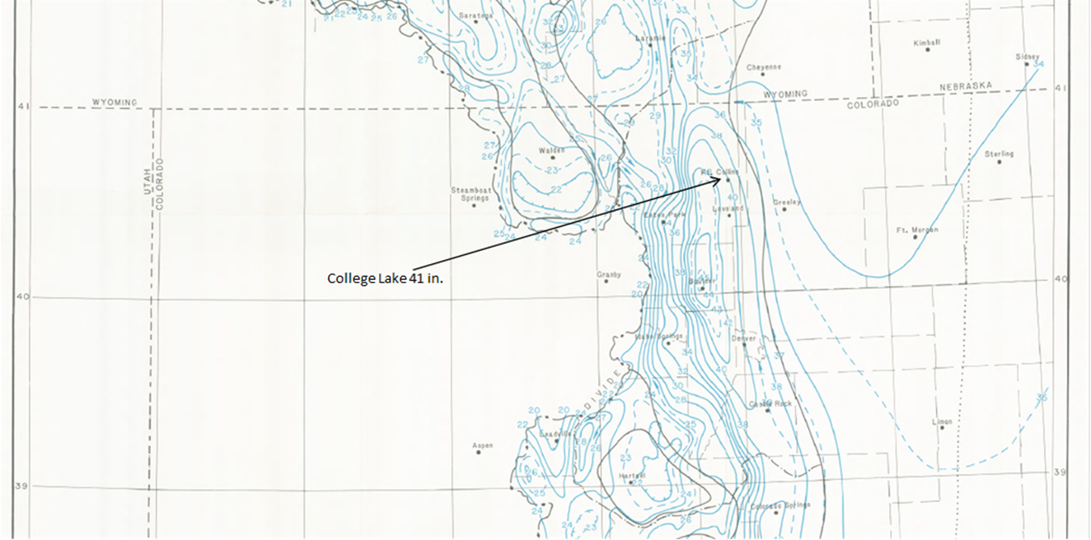
Simpler Storm Creation
PMP storms required for design of dams and other structures
Use of historical data from HMR55a or Extreme Precipitation Analysis Tool (EPAT)
Spatial averaging of high risk isohyetal maps
Methods will be affected by 2013 flood

Slide 11
Colorado Rainfall Data
NOAA Radar Data, Satellite Imagery, and other data
    NWS Cooperative Observers, Spotters, UDFCD/FCD Alert, SnoTel and Raws Data
Colorado Climate Center
Community Collaborative Rain, Hail, and Snow Network (CoCoRaHS) Rain Gauges
Local Radar Data

Slide 12
CoCoRaHS Rain Gauges

Slide 13
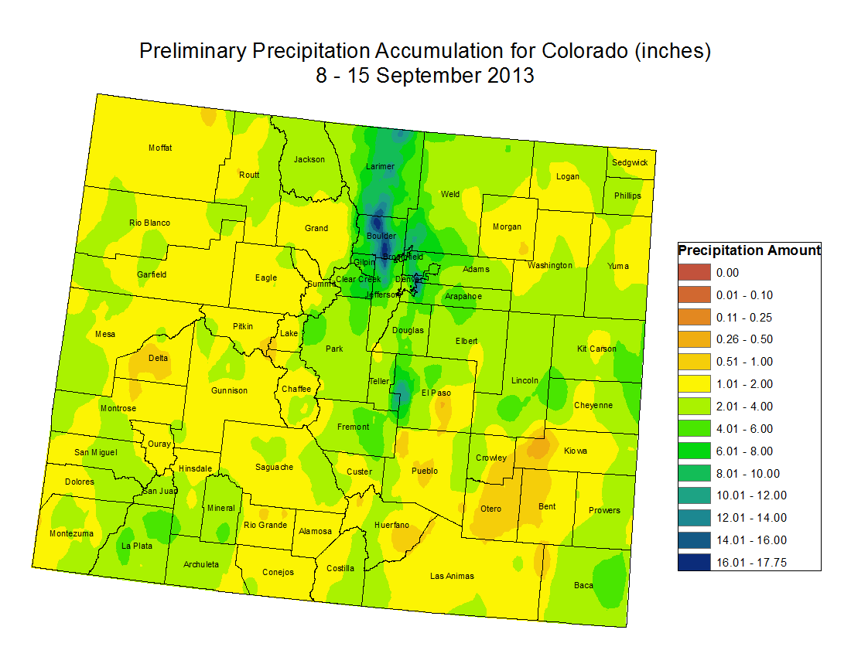
Notes:
Estimated precipitation totals from the Colorado Climate Center using rain gauge and radar data. Note that the bulk of the storm occurred in Boulder and Larimer Counties. This explains the disastrous effects on Boulder creek, the Saint Vrain river, and the Big Thompson River.

Slide 14
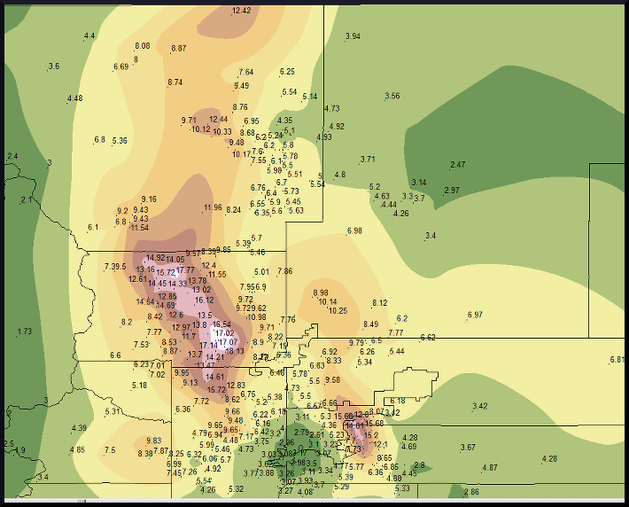
Notes:
Local Precipitation map around Denver and Boulder County (Prepared by NOAA using CoCoRaHS rain guage data, radar, and other independent sources. Significant amounts of rain at lower elevations.

Slide 15
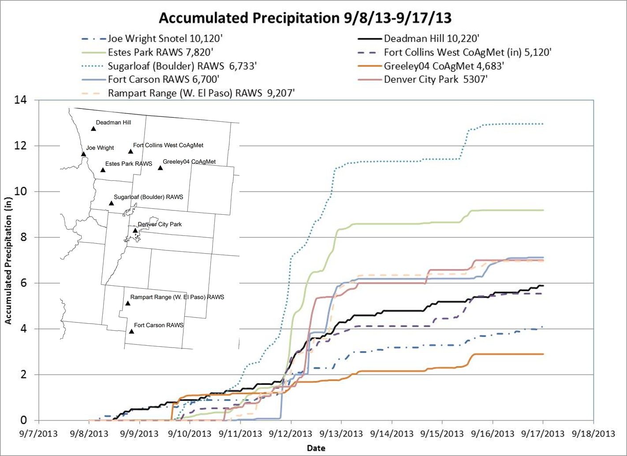
Notes:
Figure was taken from http://coflood2013.colostate.edu/accum.html . Results enforce previous observations that the majority of rainfall occurred around Boulder and into the foothills. Elevations below 2,300 feet did not get as much rain fall as the foothills and areas further east did not get as much rainfall. Damages out east were mainly due to runoff (flooding).

Slide 16
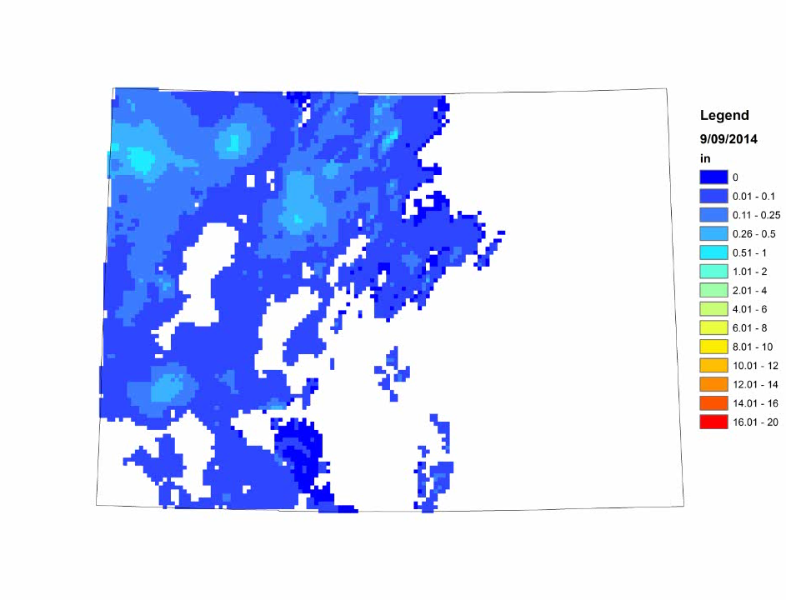
Cumulative Precipitation (NOAA Data)
Notes:
THIS IS A VIDEO! Data was downloaded, processed, and organized by Justin Kattnig. Data is from NOAA.

Slide 17
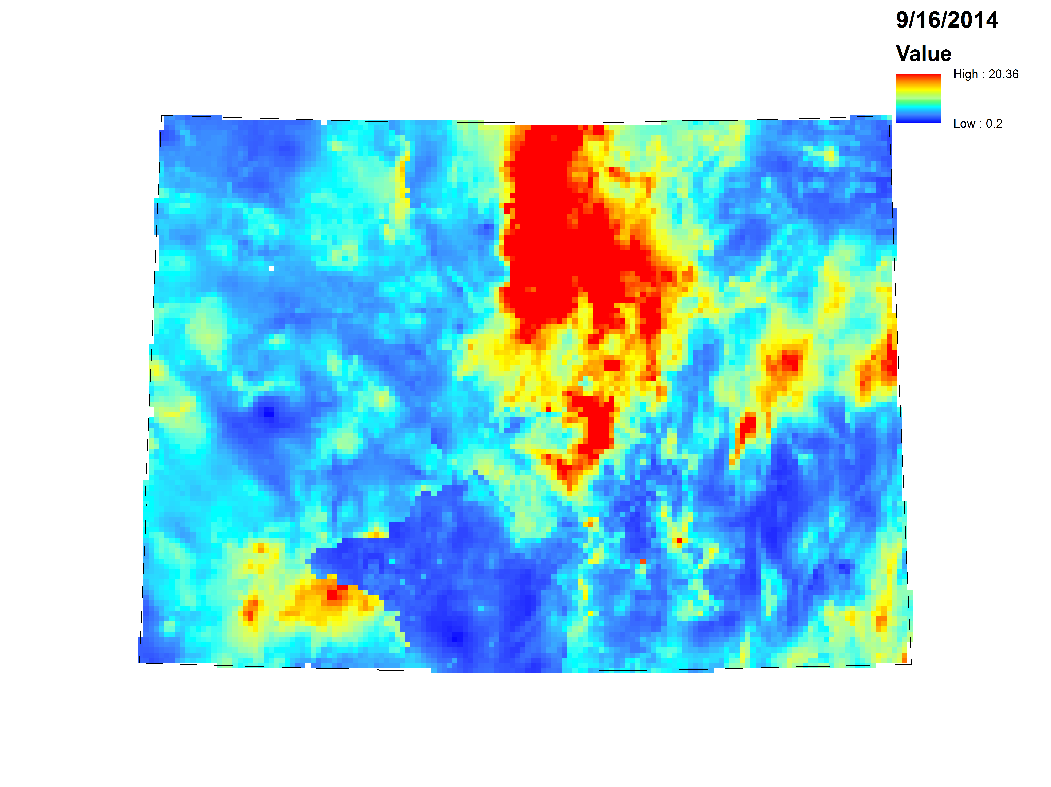
Cumulative Precipitation (9/09/2014 - 9/16/2014)
in
Notes:
Final accumulated precipitation results from NOAA dataset. Estimates from this data show that areas got as much as 20 inches in less than 6 days. This is greater than the recorded values from CoCoRaHS, but it is still close. A significant amount of rain fell in this period (over 600% of the average).

Slide 18
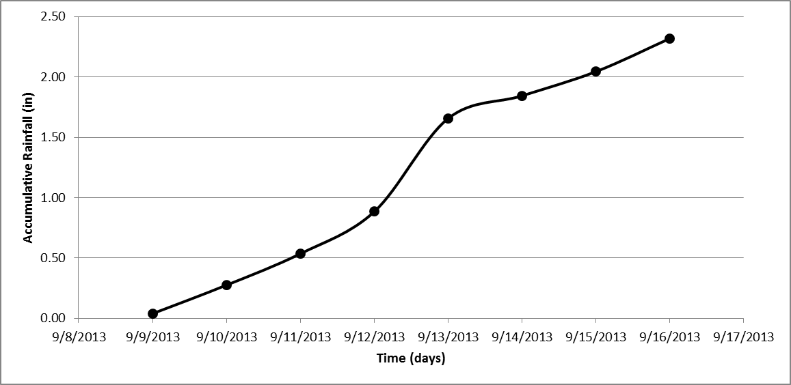
Accumulative Rainfall All CO

Slide 19
Tabulated Results for All of CO
Date | Average Cumulative Rainfall (in) | Volume(Millions of Acre-ft)
9/9/2013 | 0.04 | 0.22
9/10/2013 | 0.28 | 1.63
9/11/2013 | 0.54 | 3.17
9/12/2013 | 0.88 | 5.22
9/13/2013 | 1.66 | 9.78
9/14/2013 | 1.84 | 10.90
9/15/2013 | 2.04 | 12.08
9/16/2013 | 2.32 | 13.70

Slide 20
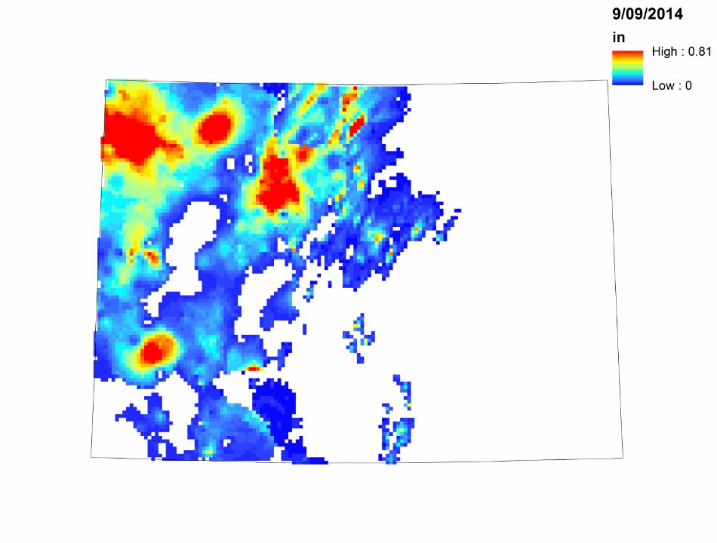
Daily Rainfall (NOAA)
Notes:
THIS IS A VIDEO! Data was downloaded, processed, and organized by Justin Kattnig. Data is from NOAA. Note that maximum rainfall intensity occurred during the 12th. Precipitation decreased after this date, but was still significant. The majority of rainfall occurred in northern Colorado. Communities to the east were more affected by flooding that large rainfall events. Massive flows in the South Platte caused flooding (Olga will talk about this). Storm characteristics were similar to a tropical storm. Latent heading, recirculation, and rainfall accumulation around Boulder.

Slide 21
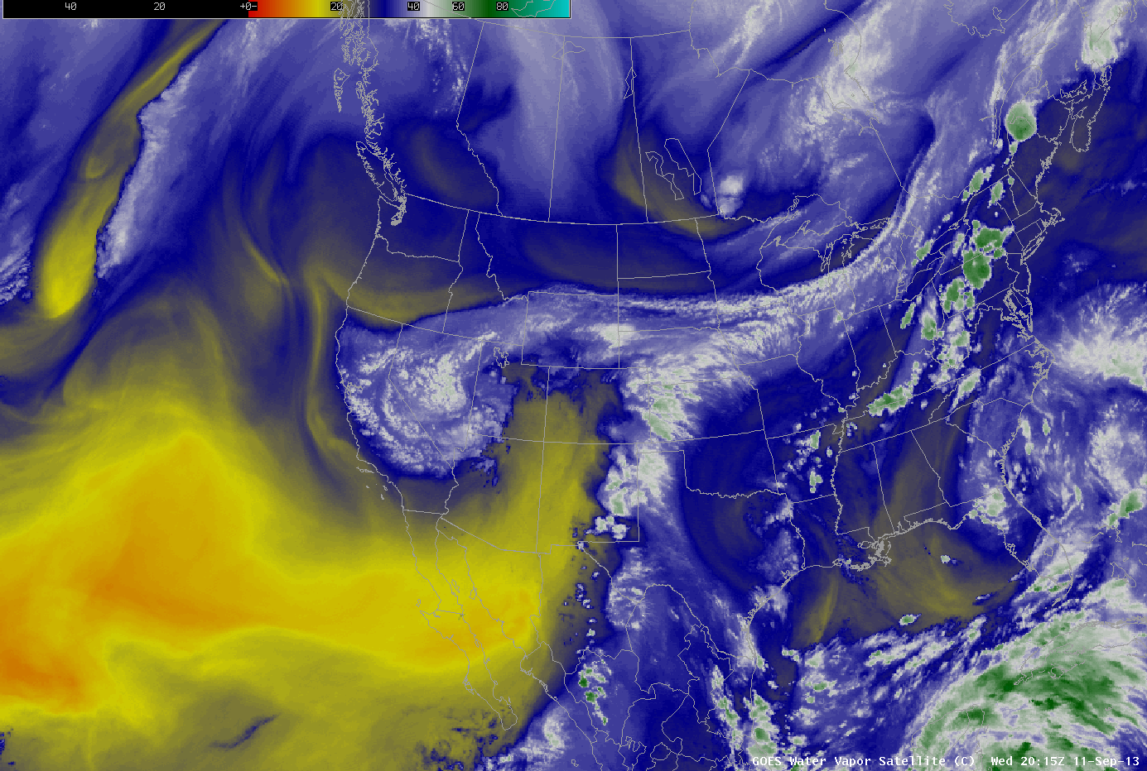
Notes:
Satellite Imaging from CIMMS Satellite Blog.

Slide 22
Infiltration
Occurs when water enters the soil from the surface vertically downward through the pore spaces
Infiltration rate is the rate at which water seeps into the soil from the surface.
Knowing the infiltration rate is important
    It affects the extent to which a given part of a watershed is submerged during a flood
Factors that affect infiltration:
The Antecedent moisture conditions .
Soil properties like the hydraulic conductivity, porosity and permeability.
Surface water velocity and depth.

Slide 23
Infiltration calculation methods
Infiltration can be calculated theoretically using any of the following equations .
The Horton's Infiltration equation given as
………………………… …..(1)
The Philips equation
………………………………(2)
The Green Ampt
……………………………….(3)
……………………………….(4)

Slide 24
Description of parameters
Where for the four equations above
is the initial infiltration rate
is the infiltration at equilibrium rate
is the sorptivity
is the moisture content
is the suction head
is the cumulative infiltration
is the infiltration time
is the infiltration rate
is the hydraulic conductivity

Slide 25
Soil characteristics in colorado
Figure 1: Soil Characteristics of the Colorado State

Slide 26
Infiltration estimate during the flood
Rainfall data gathered from the United State Geological Survey USGS
Soil data collected from various online sources including the US soil survey website
Green Ampt parameters for different soil types were obtained from River Mechanics by Julien and from Ven Te Chows book ‘Applied Hydrology’
A rough combination of various soils were assumed around the Big Thompson river and the infiltration approximated.
Assumption: initial saturation is zero before the rainfall events increased.
Analysis: Excel and Matlab were used to implement the one layer Green Ampt model
Rainfall data used in estimating the infiltration rate is shown on the next slide

Slide 27
Rainfall data
Rainfall at the Big Thompson during the flood

Slide 28
Estimated maximum infiltration trends
Estimated infiltration rates for the flood of 2013 around the Big Thompson

Slide 29
COMPUTED Infiltration around the Big Thompson River
Cumulative Infiltration
Comparison of both Cumulative and Infiltration Rate during the flood of 2013 around the big Thompson basin

Slide 30
Conclusion
The following conclusions can be made from the results of the various simulations and studies carried out
Infiltration is a function of surface water volume. The more water is available the more infiltration takes place subject to other equally important conditions that affect infiltration
The soil properties play an equally important role. As shown in Figure 3 soils like sand and loam have higher infiltration rate and subject to the availability of adequate water for infiltration than silts and clays.
Soil water conditions play an important role too. As can be seen in Figure 4 infiltration is high in a dry soil but as the soil gets saturated during the infiltration process both the infiltration rate and the cumulative infiltration decrease with time.

Slide 31
Surface and stream runoff
Excess Rainfall = Rainfall – Infiltration
Excess Rainfall → Overland flow → Stream flow
Overland Flow
Rainfall rate exceeds infiltration rate → Detention storage begins to fill
Detention storage is full → Runoff will begin
Stream flow
Stage—discharge relationships are used to obtain discharge for a given stage in a channel

Slide 32
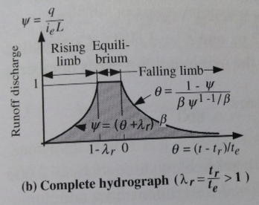
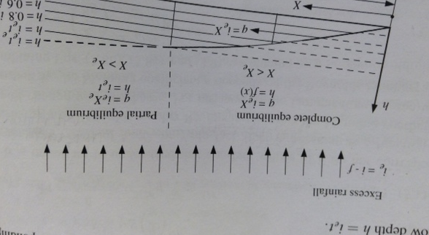
Overland Flow
Resistance to flow
    Chezy, Manning, Darcy Weisbach
    Can also be written as a stage-discharge relationship
      q=αh^{β}
    Where, q is unit discharge, α is a resistance coefficient, and β is exponent for overland flow on a rectangular plane
  Complete hydrograph : rainfall duration exceeds time to equilibrium

Slide 33
Runoff
During the period Sep. 10th - 15th, the Boulder NWS Office issued
    64 Flash Flood Warnings
    38 Flood Warnings.
Big Thompson, Boulder Creek, Poudre River
    September 9th → Normal flows
    September 12th → flows were over 10,000 % of average

Slide 34
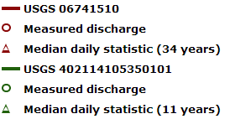
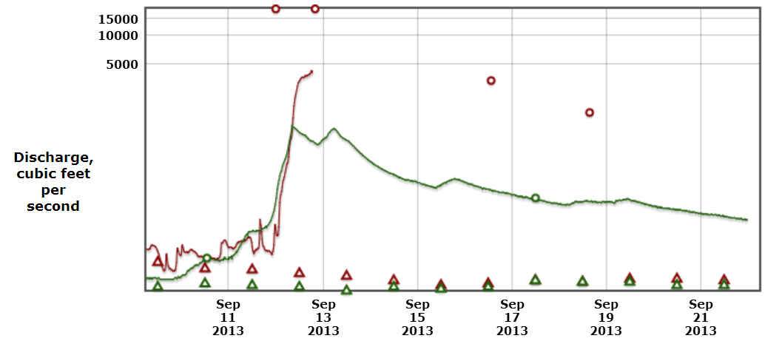
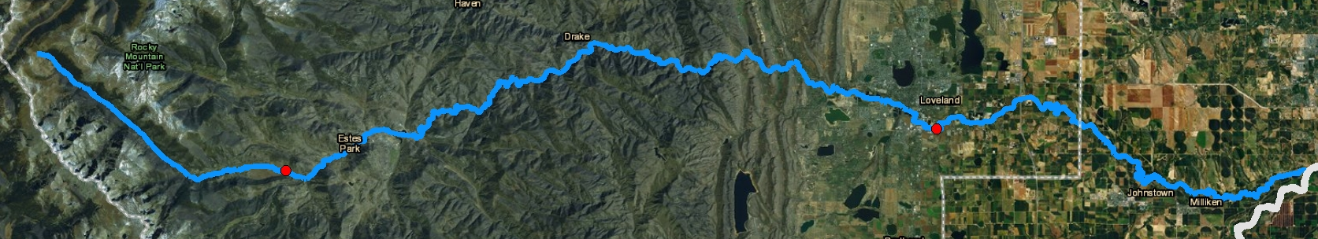
Big Thompson Creek
1. Max Q = 1130 cfs
9/12/13 @ 8:15 am
2. Max Q = 4250 cfs
9/12/13 @ 6:45 pm
2
1
flow

Slide 35
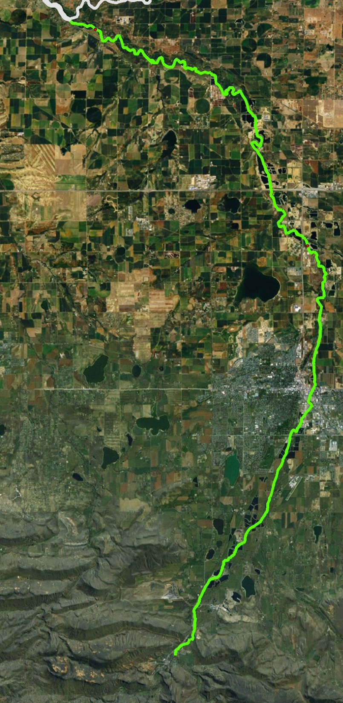
Saint Vrain Creek
2
1
2. Max Q = 3340 cfs
9/12/13 @ 5:15 pm
1. Max Q = 2620 cfs
9/12/13 @ 4:15 am
flow

Slide 36
South Platte river
Big Thompson, Boulder Creek, Saint Vrain, Poudre are tributaries to South Platte River
Fort Morgan on South Platte
Normal flows in September are 200 cfs
Large flows reached Fort Morgan two days after the flows increased near foothills towns.
September 14th – peak flow of 50,000 cfs
25,000 % of average

Slide 37
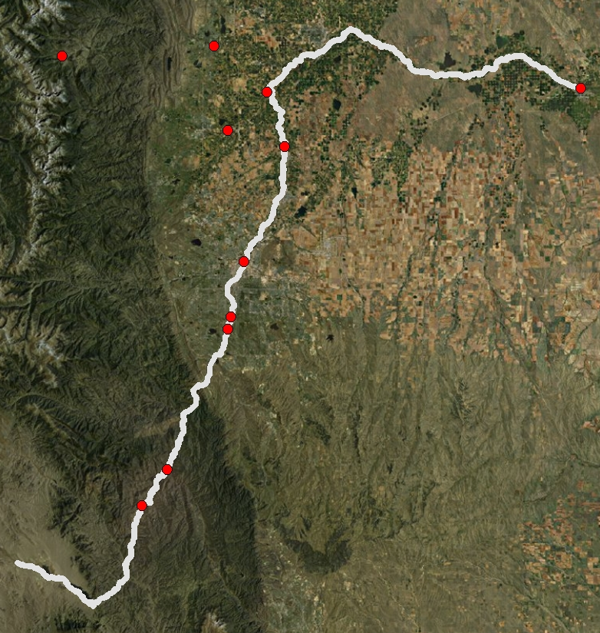
South Platte River
Fort Morgan
Fort Lupin
Commerce
Union
Englewood
Max Q = 60,000 cfs (?)
9/14/13 @ 10:30 pm
Max Q = 10,300 cfs
9/13/13 @ 2:45 am
flow
Max Q = 5220 cfs
9/12/13 @ 1:00 pm
Max Q = 1140 cfs
9/12/13 @ 5:00 am
Max Q = 445 cfs
9/10/13 @ 9:15 pm

Slide 38
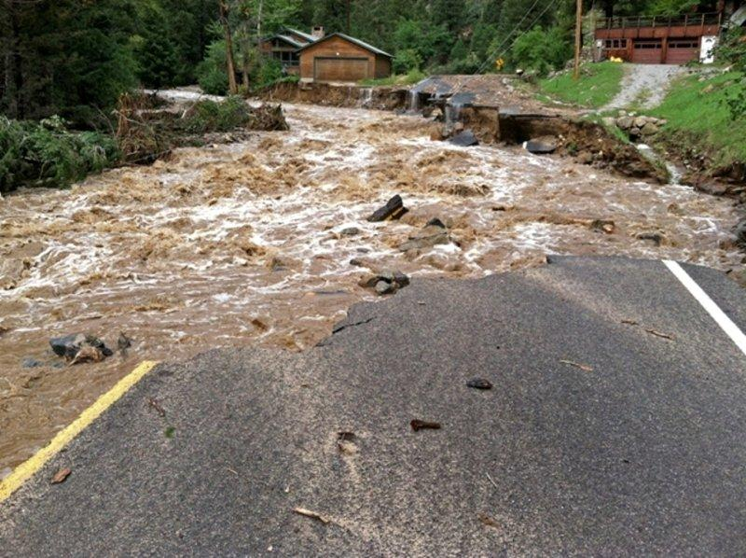
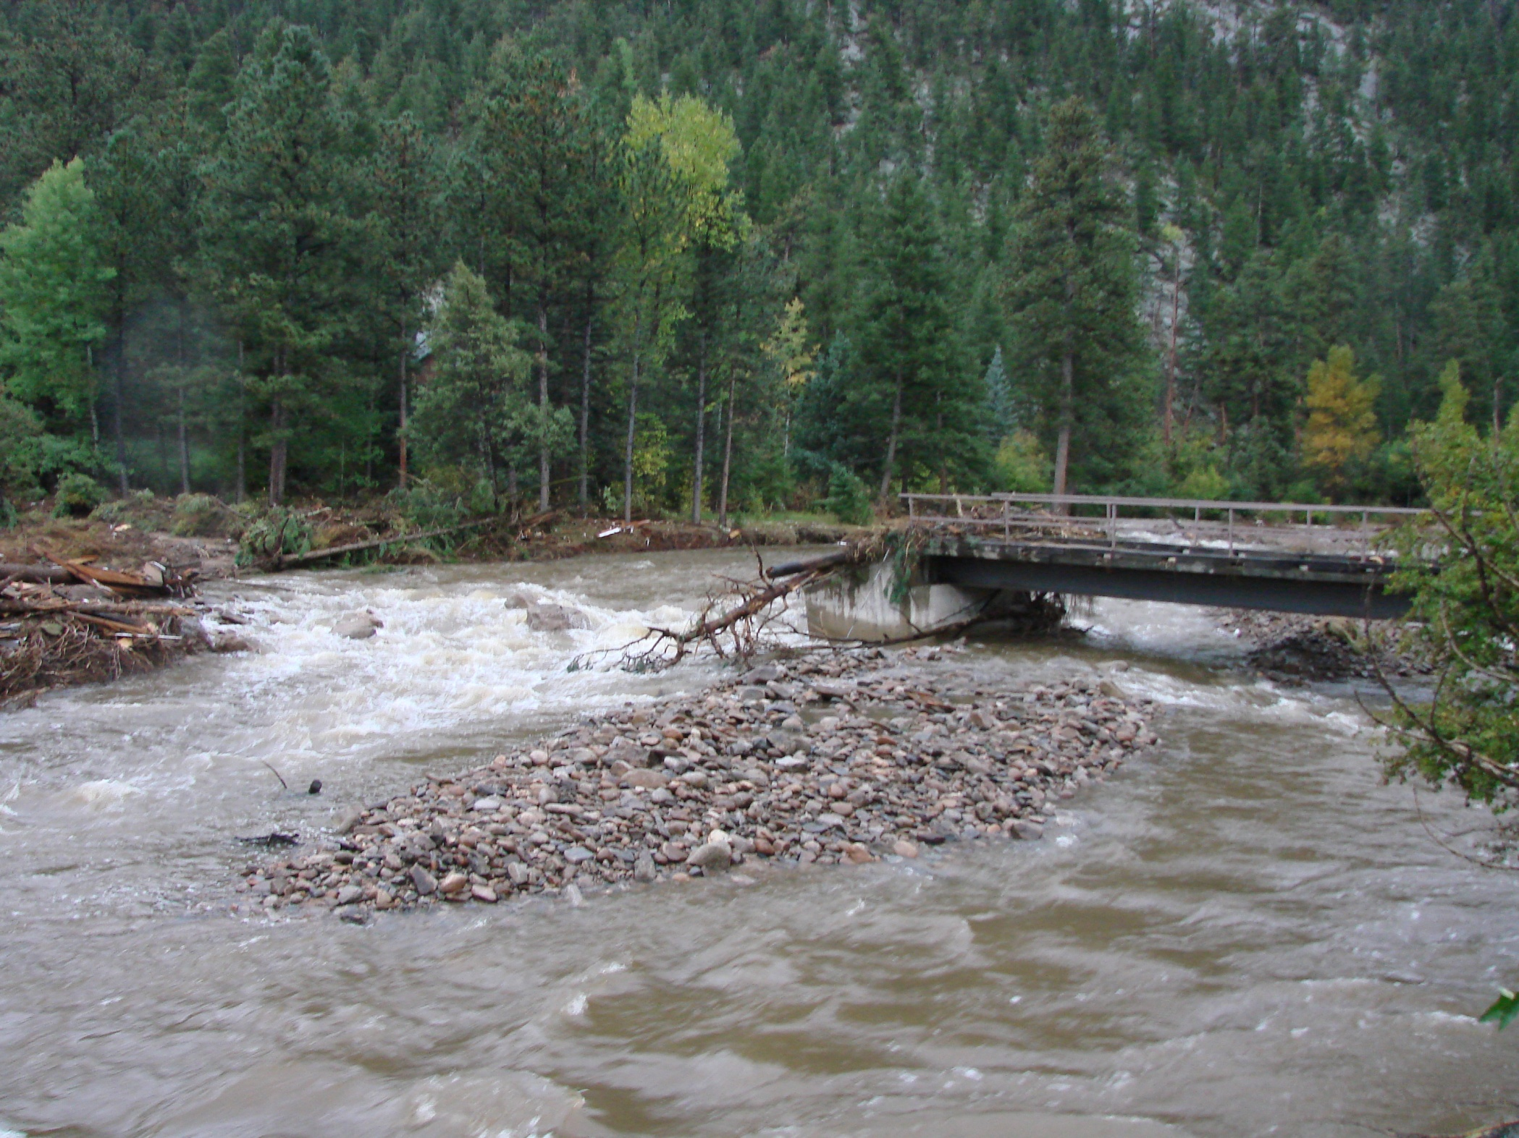
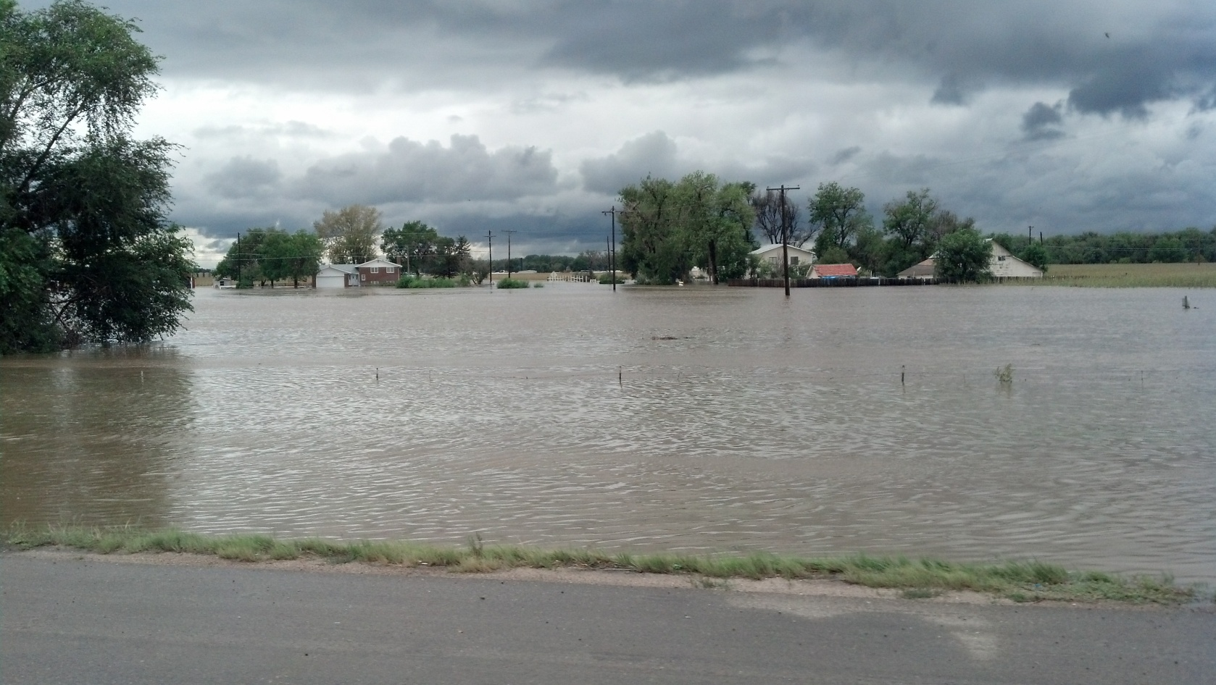
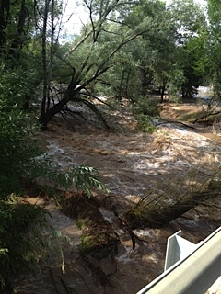
Boulder County
Big Thompson
South Platte River
Saint Vrain

Slide 39
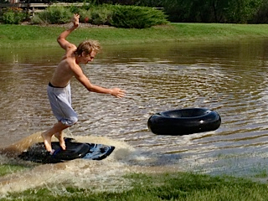
Questions?

Slide 40
References
Colorado Climate Center: http://coflood2013.colostate.edu/index.html
http://climate.atmos.colostate.edu/
NOAA
http://water.weather.gov/precip/index.php
Colorado Division of Water Resources: http://www.dwr.state.co.us/SurfaceWater/Default.aspx
Julien, Pierre Y. "Surface Runoff." River Mechanics. Cambridge: Cambridge UP, 2002. 53-59. Print.
USGS Current Stream flow data: http://waterdata.usgs.gov/co/nwis/current/?type=flow&group_key=huc_cd

