Slide 1
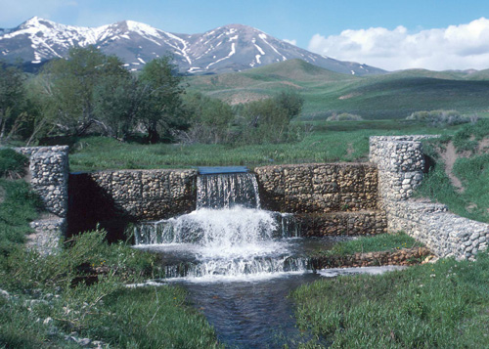
Grade Control Structures
Chris Shrimpton and Jonathan McIntosh
CIVE 717 River Mechanics
Spring 2012

Slide 2
Objectives
General objectives are to stabilize channel banks and bed by:
Reducing the slope of the channel
Reducing flow velocity
Dissipating energy from the flow
Reducing bank height
Best for smaller rivers and streams

Slide 3
Channelization
Lane’s relationship: QS+ α Qs+Ds
Plan View
A
B
Profile View

Slide 4
Reduce bank height
h < h_{c}
h > h_{c}
Reduce bed slope

Slide 5
Grade Control Placement
Upstream of headcut
Downstream of headcut
Headcut
Aggradation
Headcut

Slide 6
Types of Grade Control
Log Crib Drop Structures
Sloping Sills
Sloping Riprap
Grouted Boulder
Baffle Shoot
Weirs
Sheet Pile
Concrete
Rock

Slide 7
Log Crib Drop Structures
Best for small streams and gullies
Low cost for materials and simple construction
Most effective for small drops
Can be implemented in series with other log crib structures

Slide 8
Sloping Sills
Popular, versatile drop structures
Can facilitate various drop heights
Frequently constructed with grouted riprap or boulders, as observed on the CIVE 717 field trip
Two categories for design: above and below ground

Slide 9
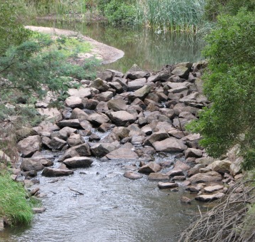
Primary Design Considerations
Above Ground
Up and downstream hydraulics
Height of drop
Aesthetics, public safety, etc.
Below Ground
Foundation
Seepage control
Soil and groundwater conditions

Slide 10
Primary Design Considerations
Special attention where design intersects channel bed/soil
Sufficient excavation and soil compaction to prevent undercutting by the flow
Utilize filters to prevent erosion of underlying material
Armor channel on downstream end to prevent scour

Slide 11
Types of Sloping Sills
Sloping Riprap Drop:

Slide 12
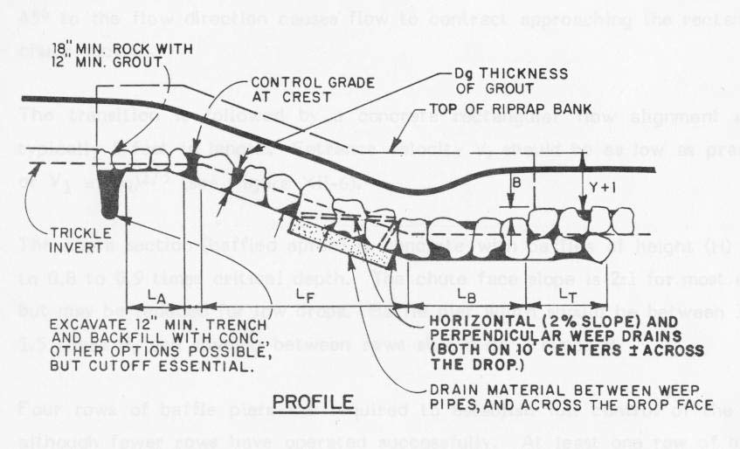
Types of Sloping Sills
Grouted Sloping Boulder Drop:

Slide 13
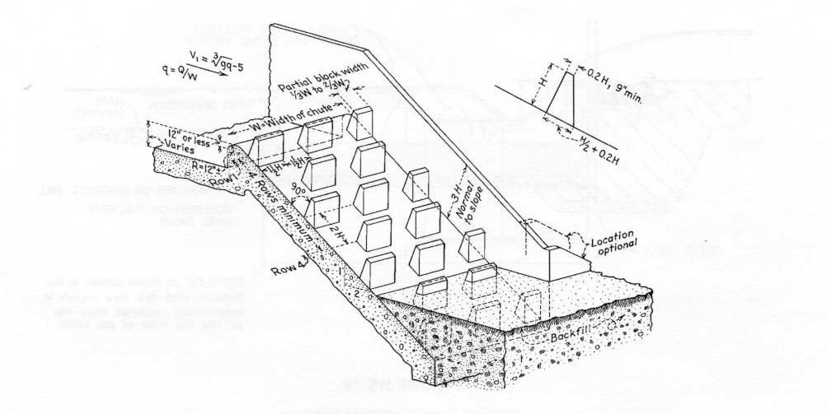
Types of Sloping Sills
Baffle Shoot Drop Structure:

Slide 14
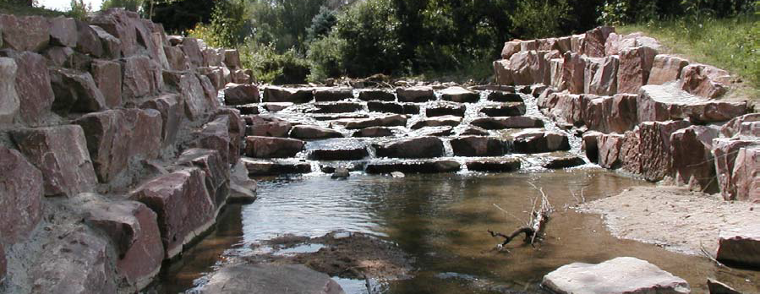
Comparison of Sloping Sill Types
Study by Urban Drainage and Flood Control District in Denver area
Grouted sloping boulder drops more effective than traditional sloping riprap structures.

Slide 15
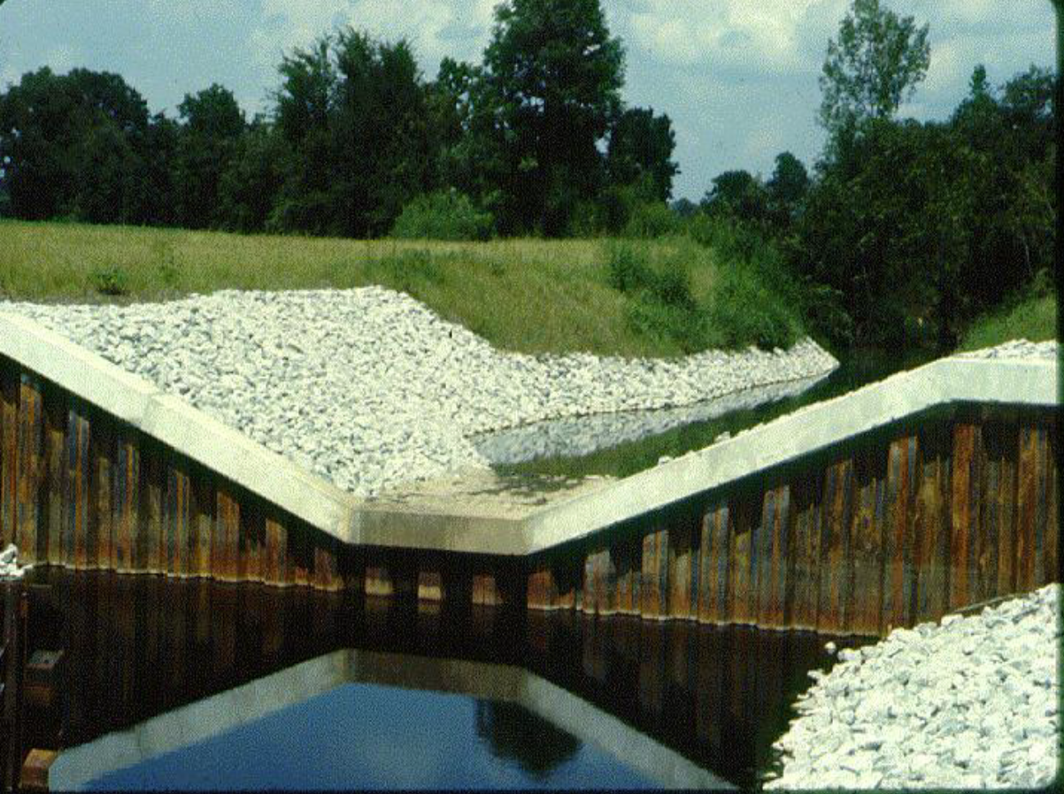
Weirs - Sheet pile
Advantages
Simple to design
Inexpensive
Good for wide rivers
Disadvantages
Bad for deep rivers
Poor aesthetic quality

Slide 16
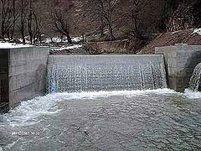
Weirs - Concrete
Advantages
Durable
Can be used for flow measurement
Disadvantages
Expensive
Cost prohibitive for large rivers
Prevent fish passage

Slide 17
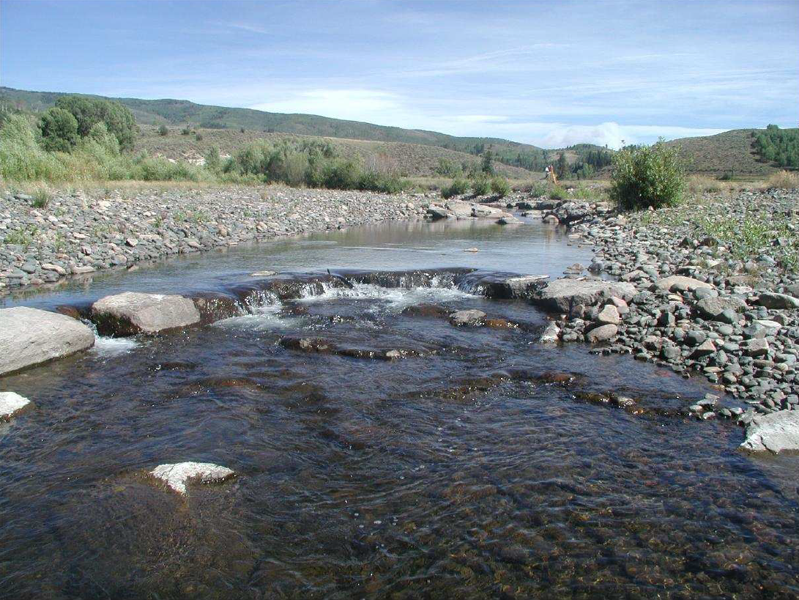
Weirs - Rock
Advantages
“Natural” appearance
Inexpensive to construct
Allow fish passage
Disadvantages
Only for small streams
Easily mobilized
Large boulders may not be available

Slide 18
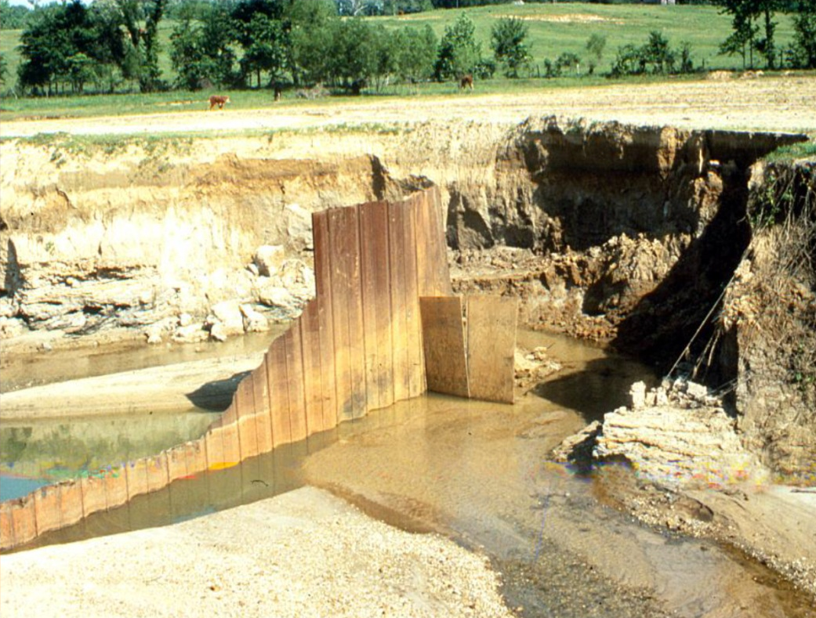
Prevent Structural Failure
Size appropriately
Dissipate energy
Riprap upstream and downstream
Concrete slab
Tie into banks
Prevent flow from flanking
Use filters

Slide 19
Conclusions
Objectives:
Reduce channel slope
Stabilize banks
Energy dissipation
Constraints:
Consider size/depth of river
Cost
Available materials
Design:
Tie into banks
Maintain conveyance

Slide 20
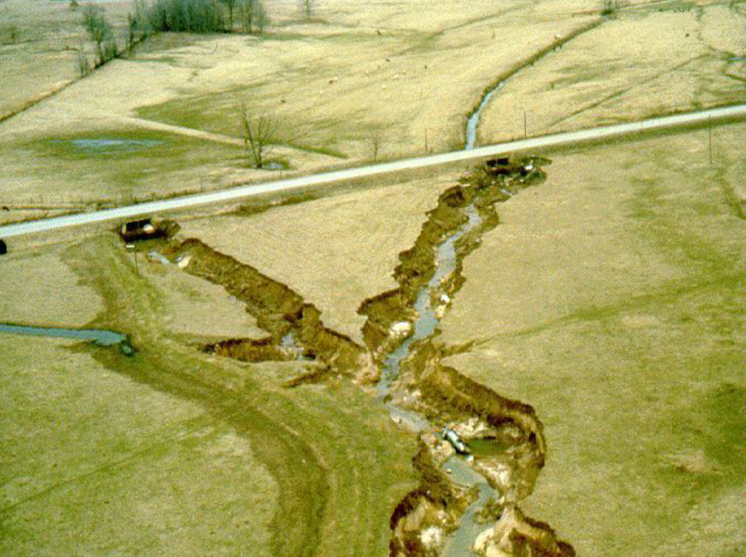
Questions?

Slide 21
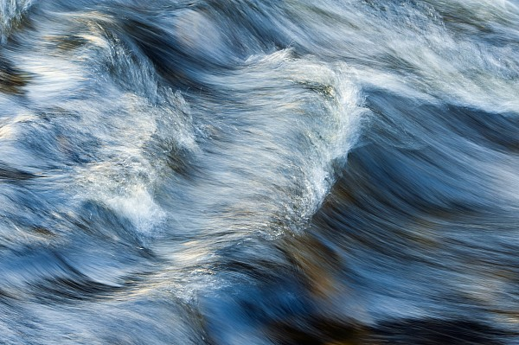
References
Introduction to Grade Control Structures by Chester Watson
River Mechanics by Pierre Y. Julien, Ph.D.
http://www.alluvium.com
http://www.nrcs.usda.gov
http://www.udfcd.org

