Slide 1
Rivers in the Urban Environment
Urban Channel Stabilization
By
Dan Woolley and Zach Elliott

Slide 2
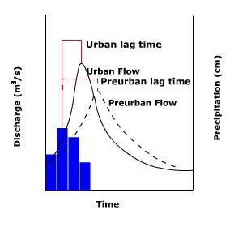
Reasons For Urban Channel Stabilization
The Urbanized Flow Regime
  Altered hydrologic regime
  Altered sediment regime
  Reduced floodplain connectivity
  Ineffective riparian zones

Slide 3
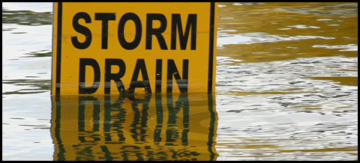
Modified Hydrology
Urban Development / Infrastructure
  Imperviousness
    Decreased infiltration / water storage
    Increased runoff
Efficient Water Drainage
  Stormwater delivery systems
    Rapid hydrologic response

Slide 4
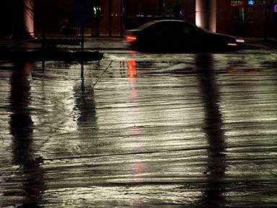
Reduced Sediment Supply
Land Use Changes
  Reduced erosion
  Reduced sediment delivery

Slide 5
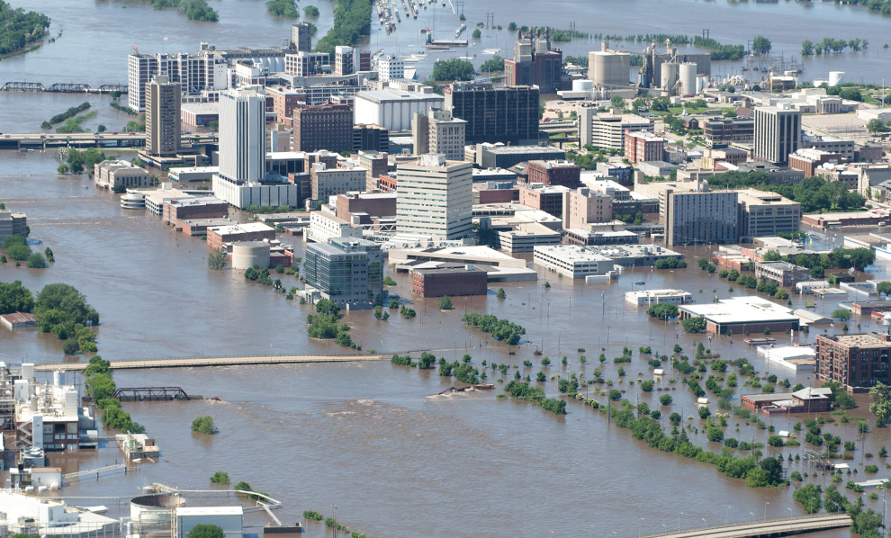
Limited Floodplain Connectivity
Channel Incision
Floodplain Encroachment
Flood Control

Slide 6
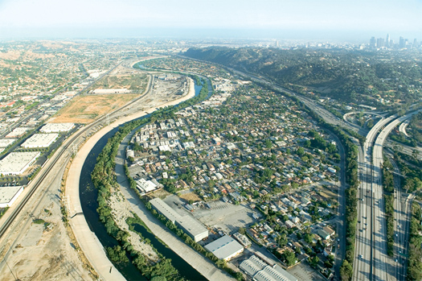
Diminished Riparian Zones
Reduced Bank Stability
Reduced Flood Attenuation

Slide 7
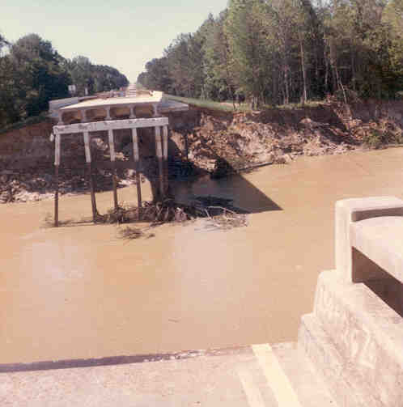
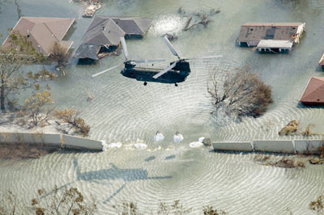
Channel Stabilization Methods
Bank Stabilization
Bed Stabilization
Infrastructure Protection

Slide 8
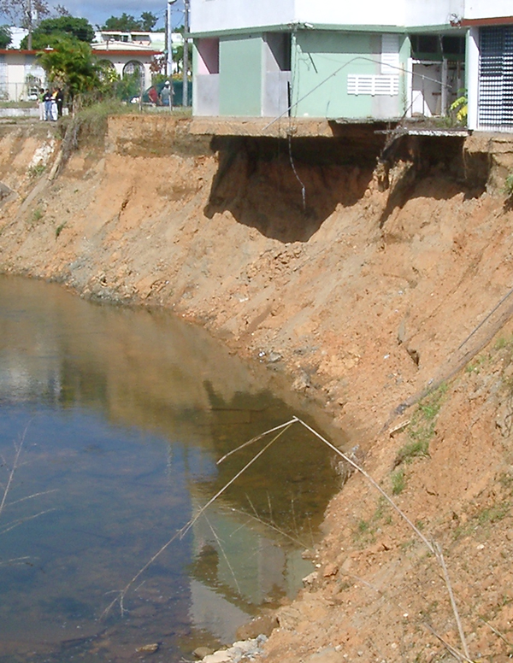
Bank Stability
Riprap
Retaining Walls
Gabions
Concrete Armor Units
Concrete Reinforcement
Bioengineering

Slide 9
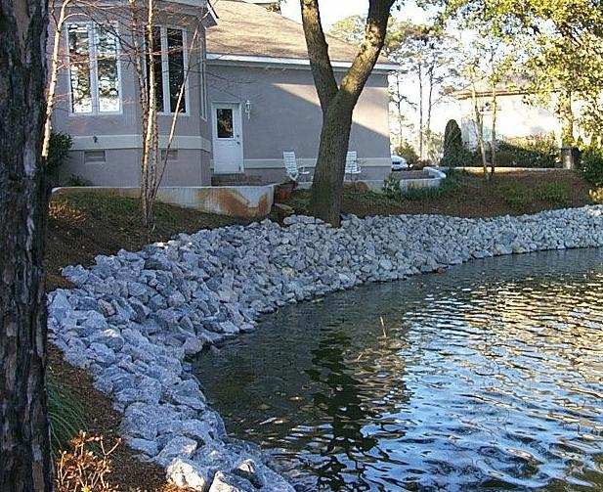
Riprap
Design Approaches
  Shear stress method
  Velocity method
Design Considerations
  Angular well graded stone
  Use of a filter blanket
    Gravel filter
    Synthetic filter cloth
Pros
  Flexible
  Economical
  Does not require special tools for placement
Cons
  Prone to failure when improperly placed or designed

Slide 10
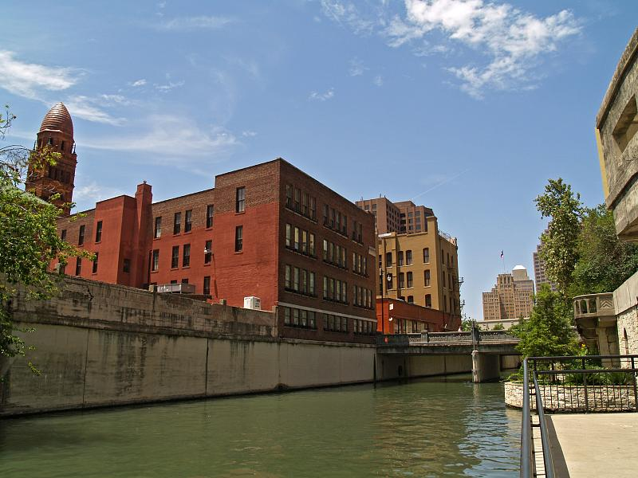
Retaining Walls
Design Approaches /Considerations
  Gravity walls
    Relies on the mass of the wall to prevent bank failure
    Failure often results from toe scour followed by overturning
  Cantilever walls
    Relies on the mass of the soil above a horizontal concrete base to resist motion
    Requires reinforced concrete for construction
  Sheet-piling walls
    Relies on the stiffness of the sheet pile to resist the overturning moment of the bank
    Anchors and tie-backs can increase the height of the effective wall
Design Requirements
  Groundwater control
Pros
  Prevents bank failure
  Provides permanent stability
Cons
  Often expensive
  Aesthetically unattractive

Slide 11
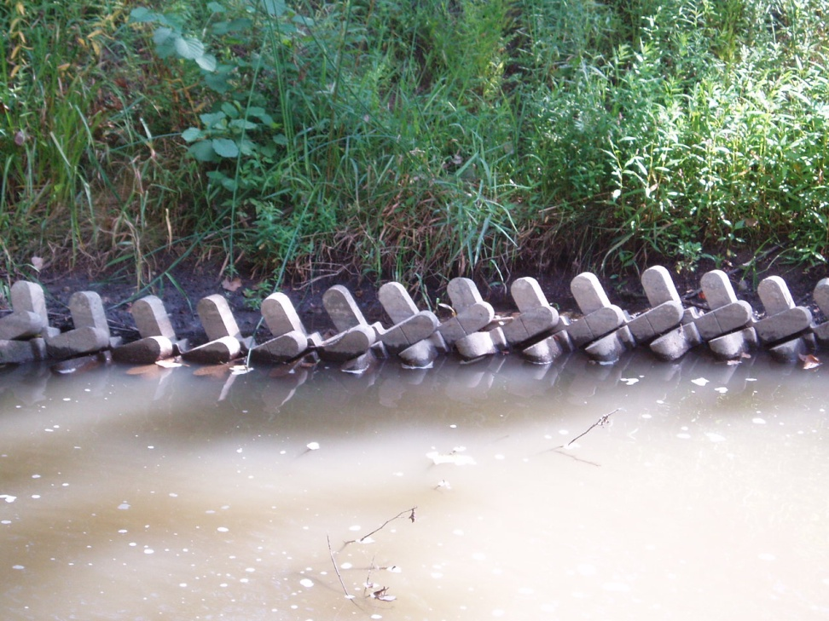
Concrete Armor Units
Precast cement blocks of varying geometric shapes and sizes
  Several products available
  Requires filter blanket or synthetic filter cloth
  Can be placed by hand or with equipment depending on size
Pros
  Interlocking mesh creates a flexible unit
  Can be applied on steep slopes
  Allows for riparian plantings in gaps
Cons
  Expensive
  Not aesthetically pleasing

Slide 12
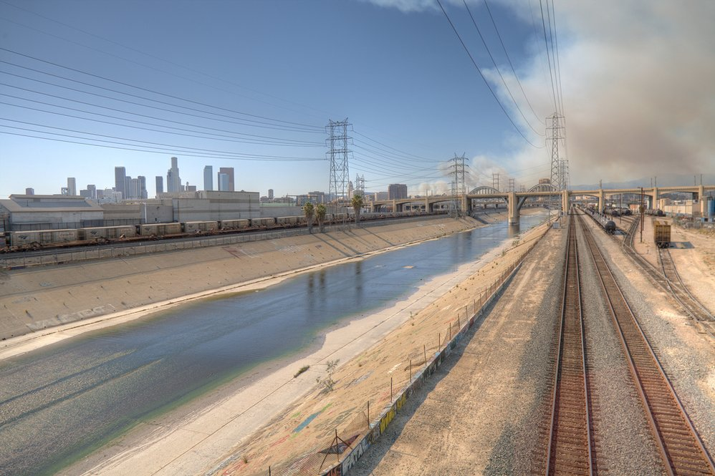
Concrete Channel Lining
Extreme Countermeasure Design
  Often implemented for flood control
  Reduces channel geometry to simplified geometric form
  Stabilizes
    River bed
    River banks
Pros
  Locks channel into desired form
Cons
  Expensive
  Eliminates all ecological components

Slide 13
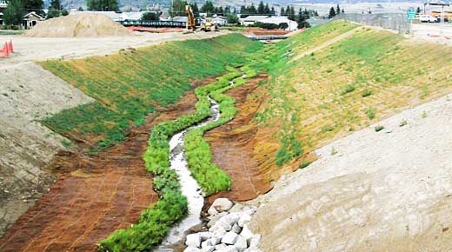
Bioengineering
Vegetation Categories
  Woody vegetation
    Extensive root systems usually offer greater erosion protection
    Mass of plant can lead to additional bank failure
  Grasses
    Less expensive than woody plants
    Shorter establishment period
Pros
  Environmentally desirable
  Economical
  Self healing
Cons
  May not meet short term goals
  Susceptible to grazing

Slide 14
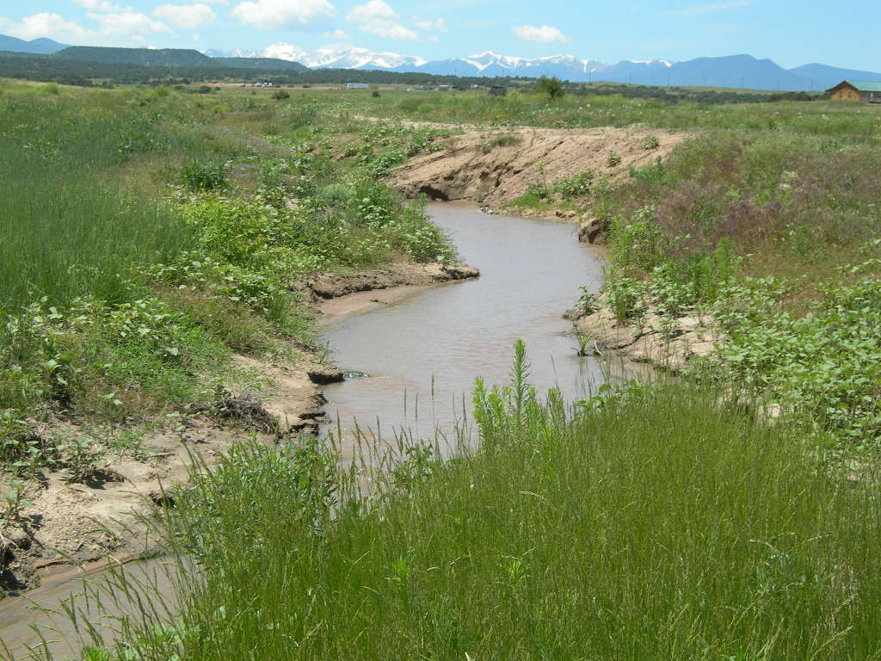
Bank Stabilization Conclusions
Several Methods are Available to Improve Bank Stability
  Methods should be evaluated based on unique project conditions
    Cost varies greatly between methods
    Practicality of methods will differ between sites
    The success of the project will be gauged by multiple interest groups with differing perspectives

Slide 15
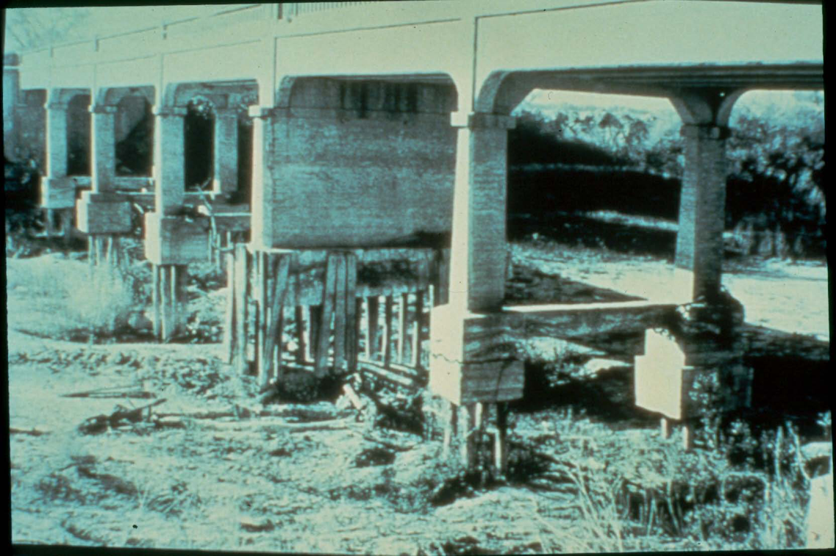
Why Consider Bed Stabilization?
Lower Slope Of
  Channel bed
  Water surface
  Energy grade
Protect Against
  Incising
  Headcutting
  Erosion
  Infrastructure at risk

Slide 16
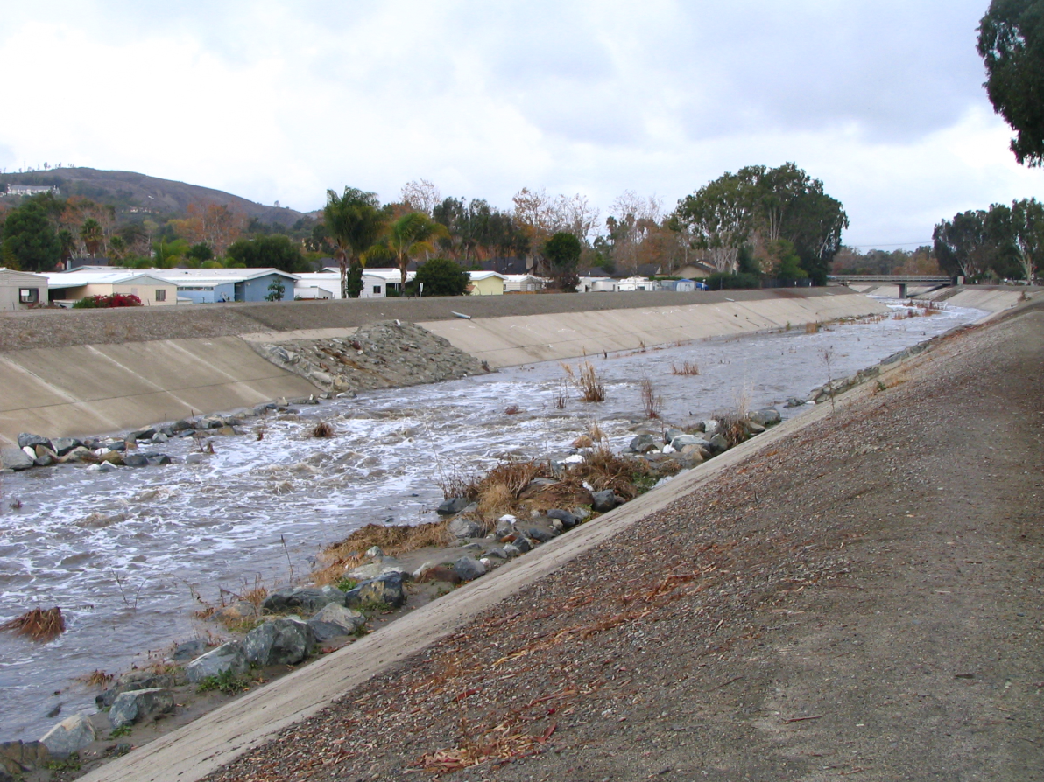
Bed Stability
Weirs
Riprap Structures
Block Ramps
Gabions
Riffle and Pools
Roughened Channels
Combination

Slide 17
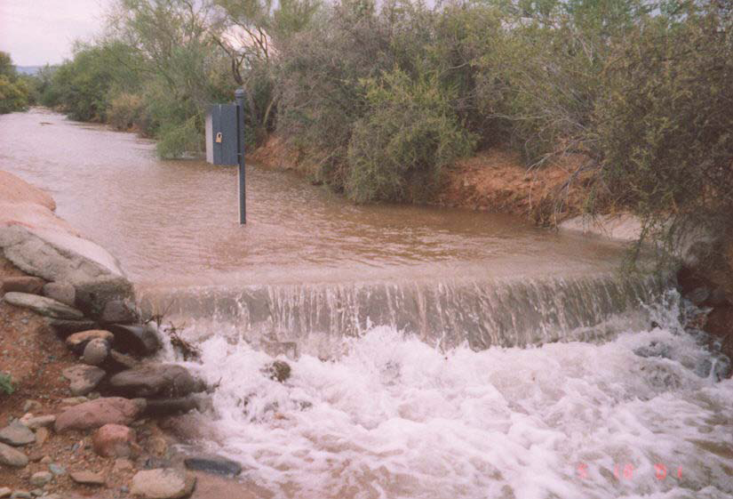
Weirs
Low-level Drop Structures
  Convert kinetic energy to potential energy upstream
  Dissipate energy downstream
  Also protects banks
Pros
  Economical
  Maintain channel capacity
  Flow measurement
Cons
  Susceptible to erosion and foundation failure
  Deposition of sediment

Slide 18
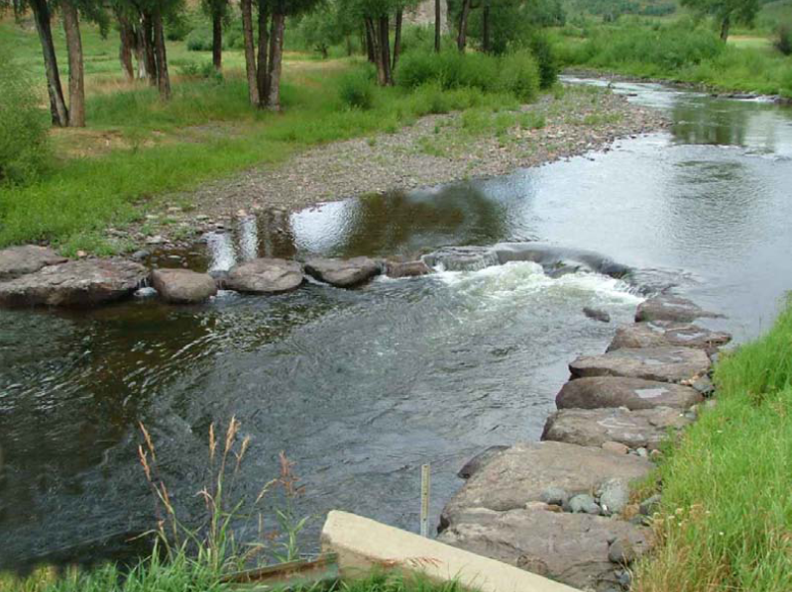
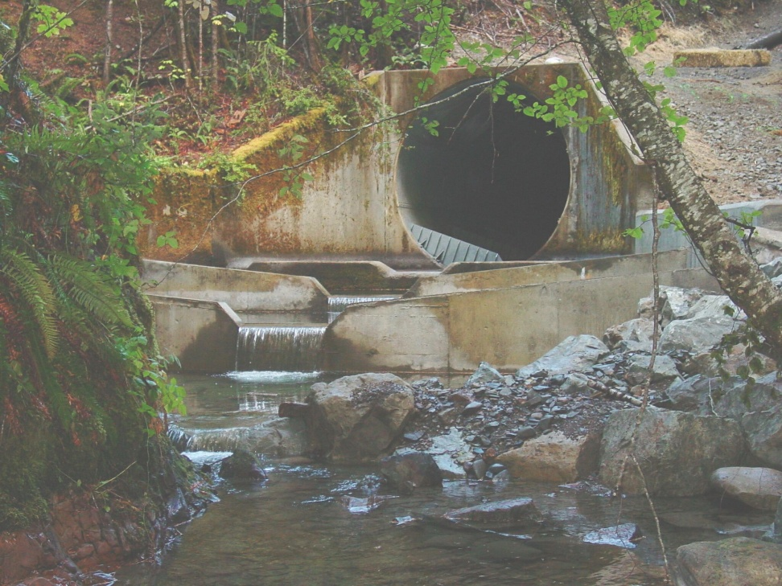
Weirs
Design Considerations
  Change in elevation
  Drop spacing
  Upstream and downstream flow depth
  Scour depths
Material/Construction Considerations
  Concrete
  Sheetpiles
  Rocks and Boulders
  Combination

Slide 19
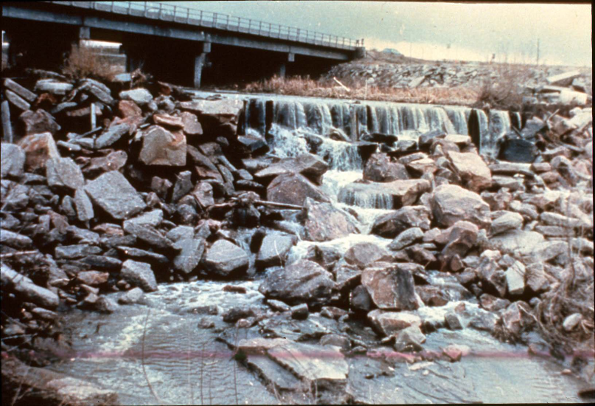
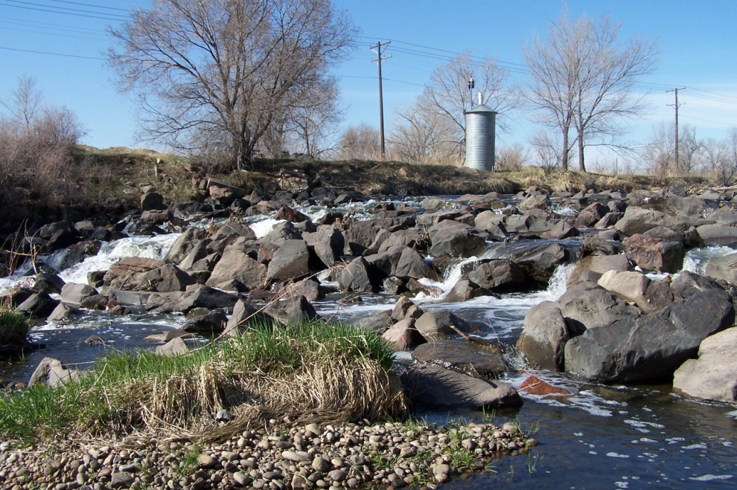
Riprap Structures
Design Considerations
  Size of riprap
  Grouted vs. Non-grouted
  Can be used with sheetpiles or other type of weir
Pros
  Dissipate extra energy
  Aesthetically appealing
  Protect against erosion and headcutting
Cons
  Can be expensive and labor intensive to install

Slide 20
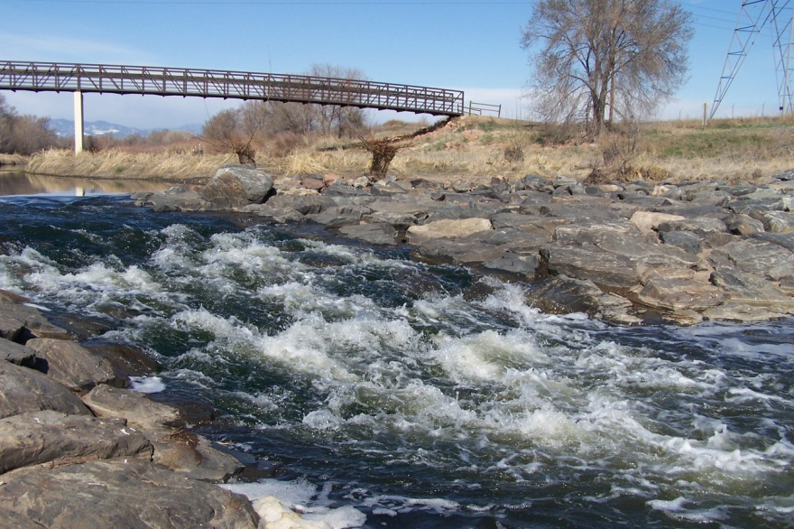
Block Ramps
Design Considerations
  Slope to create critical depth at upstream end
  Stilling basing to contain hydraulic jump downstream
  Ramp material roughness
Pros
  High energy dissipation
  Maintain biological exchange between upstream and down
Cons
  Riprap material can become unstable and fail

Slide 21
Block Ramps
Design Equations
  Energy Dissipation
    Where: E₀ = upstream energy, E₁ = downstream energy, D = height of the ramp, k = critical depth, α = slope of ramp
  Block Stability
    Where: q = critical unit discharge, γs = specific weight of the rocks, γw = specific weight of water, α = slope of ramp, d50 = nominal diameter of the material for which 50% is finer by weight

Slide 22
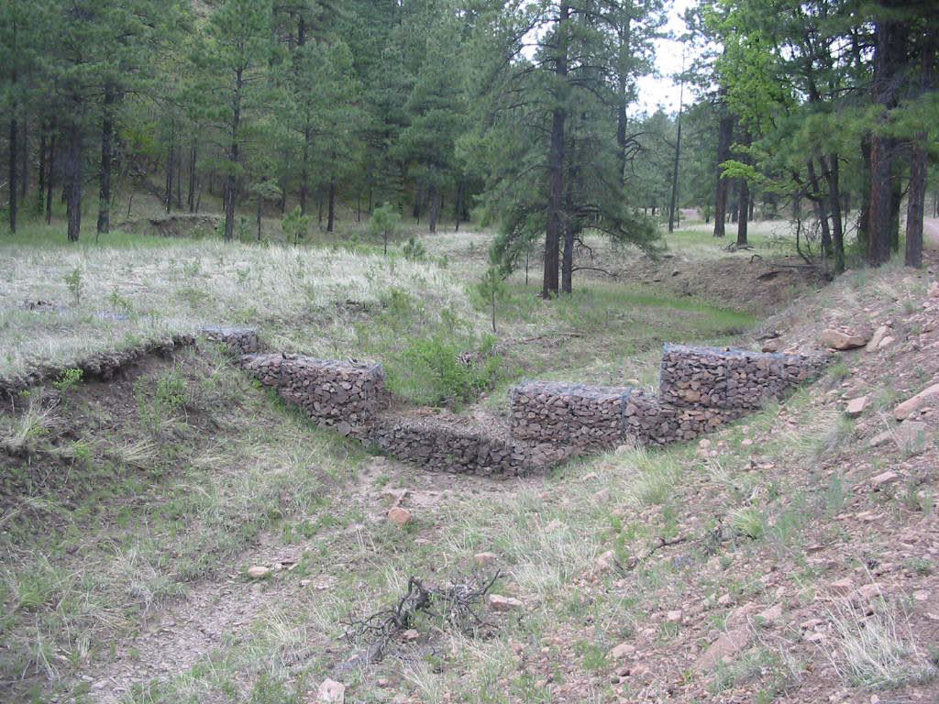
Gabions
Patented rectangular wire boxes filled with relatively small sized stone
  Can be used in bank and/or bed stabilization
Pros
  Easy to construct and pre-fabricate
  Available in a range of shapes and sizes
Cons
  Limited by velocity of flow
  Expensive
  Require frequent maintenance and inspection

Slide 23
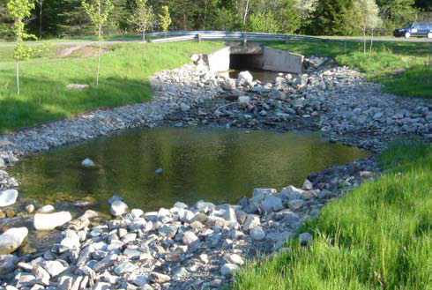
Riffle and Pools
Design Considerations
  Sloped pile of rocks
    4:1 upstream slope
    20:1 downstream slope
  Central part of riffle should be design lower than sides
    Forces flow down the middle and allows for fish passage at low flow
Pros
  Can reproduce natural riffles if designed properly
  Advantage for fish habitats
Cons
  Filler sediment necessary

Slide 24
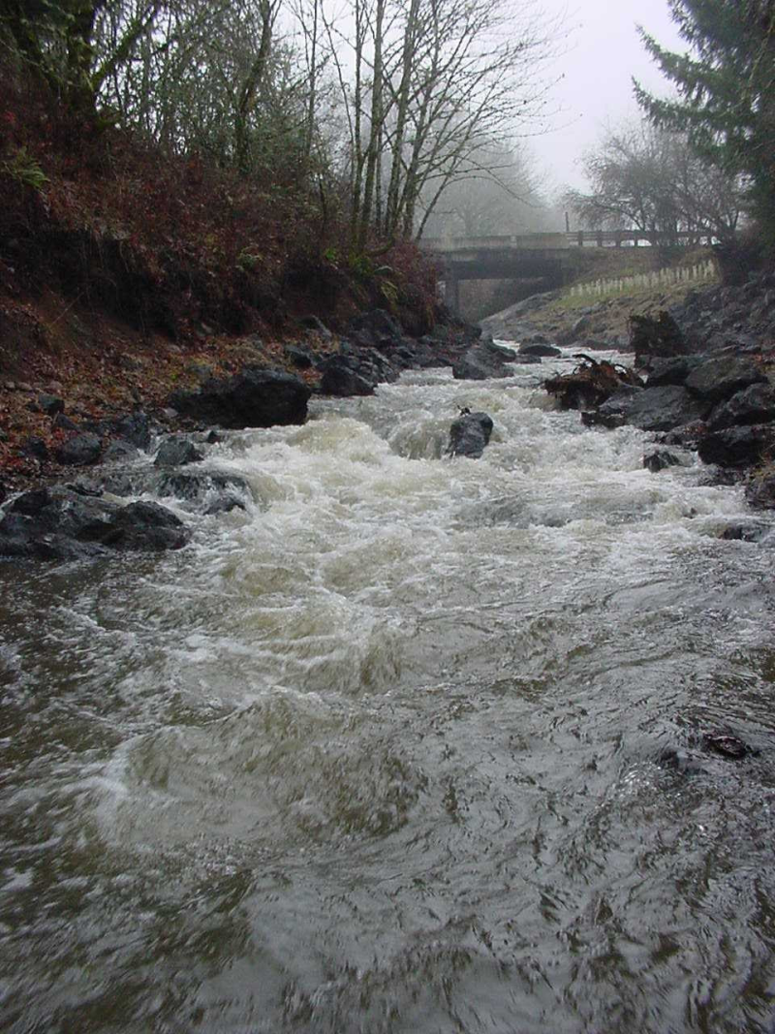
Roughened Channels
High bed roughness provides grade control by
  Limiting flow velocity
  Limiting energy grade and water surface steepness
Pros
  Maintain biological exchange between upstream and down
  Often inexpensive
Cons
  Material susceptible to erosion and mobility

Slide 25
Grade Control Considerations
Hydraulic Considerations
  Hydraulic system as a whole (i.e. backwater and downstream hydraulic response)
  Sediment Transport
Geotechnical Considerations
  Bank material stability
  Channel bed stability
Environmental Considerations
  Structures should be designed consistently with the goals of the system to maintain biological equilibrium

Slide 26
Final Design Considerations
Impacts on Existing Structures and Channel
  Restoration can cause unwanted aggradation and/or degradation
  May need to realign channel in some cases
  Bed degradation and bank erosion can affect bridges, culverts, pipelines, and other infrastructure
Flood Control
  Flood control measures and channel stability measures often conflict
  Consider safe return of overbank flows back into channel

