Slide 1
Headcut Prevention
CIVE 717: Assignment #4
John Quebbeman, Andrew Steininger, Rachel Williams
April 12, 2012

Slide 2
This presentation is presented in three sections:
Headcut Equations- John Quebbeman
Physical Process and Model- Andrew Steininger
Design and Prevention Methods- Rachel Williams

Slide 3
Headcut Equations
April 12, 2012

Slide 4
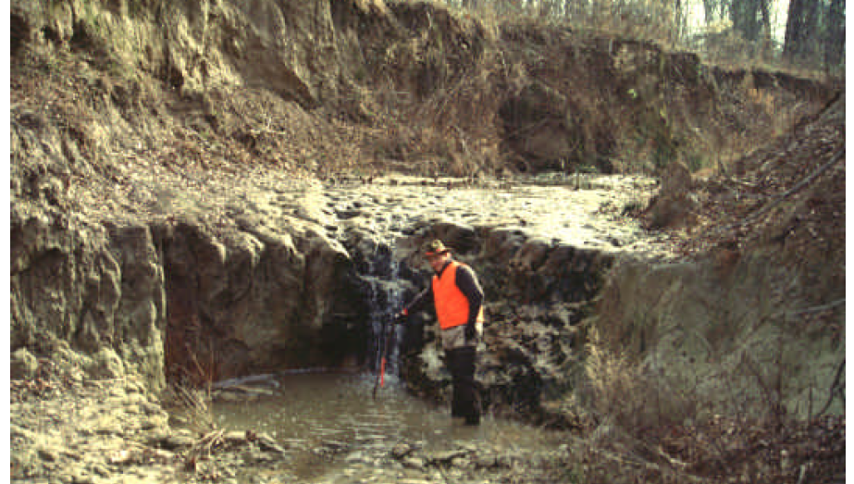
Headcut Equations
Hydraulic Equations
Sediment Transport Equations
Numerical Models (SITES)
Empirical Quantification
Photo Source: WES Stream Investigation and Streambank Stabilization Handbook, US Army Corps of Engineers, October, 1997

Slide 5
Hydraulics
Critical Depth – Occurs over top of headcut
Normal Depth – Commonly assumed for downstream channel below headcut
Used for Shear Stress Calculations
Shear Stress – Bed Shear used for determining transport capacity
hc=critical depth
hn=normal depth
V=velocity
n=Manning Roughness
g=gravitational constant
S=Friction Slope
h=depth
γ=Specific Weight

Slide 6
Sediment Transport
Downstream Erosion & Channel Deepening
Sufficient Capacity to Transport Bed Sediment
Supply<Capacity, Simplified Estimate
Transport Capacity Estimates (Julien, 2002)
Sediment Discharge by Volume
Approaches may be used to find unstable channel conditions

Slide 7
Numerical Model
Software Available for Calculating Headcut
USDA – NRCS developed SITES Model
Mainly developed for Headcut Calculation of Earthen Embankments (may be applied for instream applications)
Headcut Phases in SITES Model
Phase 1 – Erosion of Vegetal Surface Layer
Phase 2 – Deepening of erosion, Start of Headcut
Phase 3 – Headcut Migration Upstream

Slide 8


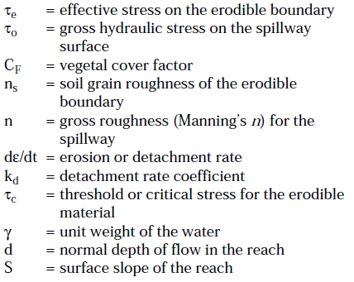


SITES Model - Phase II
USDA Ch. 51, Part 628 Dams, Earth Spillway Erosion Model
Surface Detachment
Partial Vegetal Cover
Erosion Deepening
Erosion Rate
Effective Shear w/ Partial Vegetal Cover
Shear Stress
Erodibility Coefficient

Slide 9


SITES Model – Phase III
Phase III Erosion
Depth >Critical Depth
Upstream Advance & Deepening
Checks for Normal Depth Shear vs. Drop Shear
Check for Maximum Shear:
Normal Depth Shear
Drop Depth Shear

Slide 10
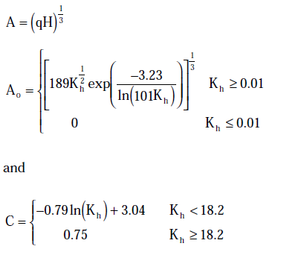

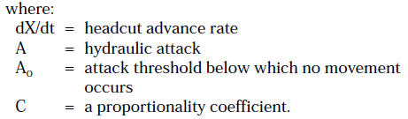
SITES Headcut Advancement
Phase III Erosion
Headcut advances upstream if threshold exceeded
<A0 is No Movement
Based on Shields Approach for Incipient Motion

Slide 11
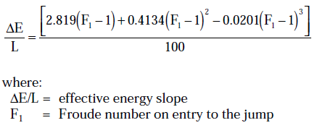
SITES Hydraulic Jump
Stress Estimate Uses Simplified Horizontal Assumptions
Normal Depth in Downstream Channel
Energy Slope & Sequent Depth used to determine Shear Stresses

Slide 12
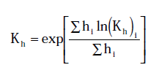
SITES Erodibility of Multiple Layers
Erodibility Index Kh
Steps through time considering eroded layer i
Thickness
Layer ‘i'
Erodibility Index
Layer ‘i’
Composite
Erodibility Index
Total Thickness

Slide 13
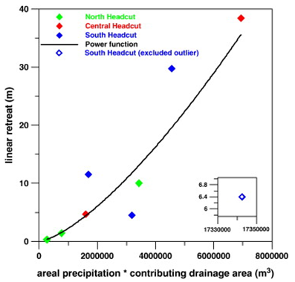
Empirical Headcut Advancement Rate
Studied in SW US
Migration Upstream
F(x) of Precipitation times Drainage Area
May vary with different regions
Rieke-Zapp, D., Nichols, M. Headcut Retreat in a Semiarid Watershed in the Southwestern United States Since 1935, Catena, Vol 87, Issue 1, October, 2011.

Slide 14
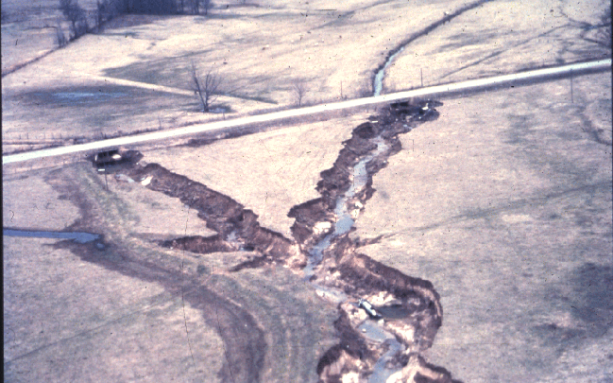
The Physical Process Model of Headcutting
Watson etal 2007 Stream Rehabilitation

Slide 15
Headcutting Causes:
Natural:
Base level drop
Earthquakes or tectonic processes
Ground water sapping
Topographically caused ground water concentration
piping
Change in sediment regime
fire induced runoff
Draught or Flooding
Human Induced:
Change in sediment regime
Increased sediment input to a reach from agriculture or timber harvest
Decreased sediment input to a reach due to stream bank armoring
Change in flow regime
Increased runoff from urban areas
Change in base level
Change in output elevation/water level (i.e. reservoirs)

Slide 16
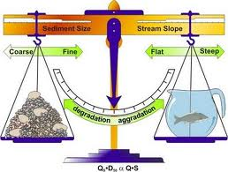
The overall controls on headcutting conditions
Streams naturally tend toward a state of “dynamic equilibrium”. This state is typified by the following characteristics:
Longitudinally uniform energy dissipation (limited local areas of large energy head change)
Sediment continuity (the sediment input to a stream equals the output)
A sediment capacity supply ratio (CSR) of 1
Constant Slope (no substantial aggradation or degradation)
Lane’s Balance represents the balance of driving variables in a stream system
http://weltanschuuang.blogspot.com/2009_11_01_archive.html

Slide 17
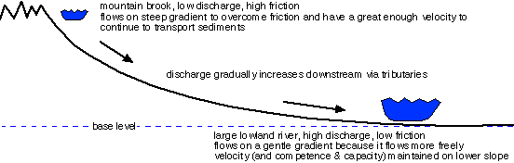
Natural Stability and Headcut Prevention
Headcuts can be prevented by maintaining the natural watershed condition with regard to flow, sediment and slope.
http://myweb.cwpost.liu.edu/vdivener/notes/streams_basic.htm

Slide 18
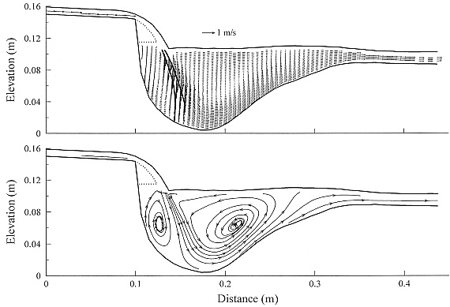
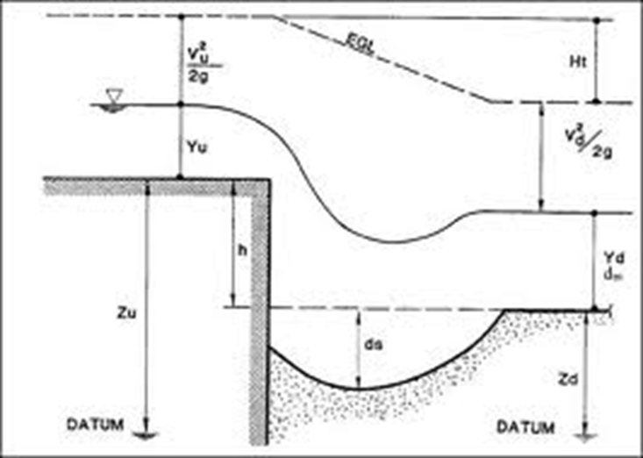
The Local Physical Mechanism for a Headcut
Increased flow velocity over a headcut continues erosion at the head cut depth in the upstream direction manifesting the head cut feature head ward.
Example of a numerical model simulation of the headcut flow
Diagram of water level and energy distribution at a headcut
http://www.agu.org/journals/wr/wr0509/2004WR003752/

Slide 19
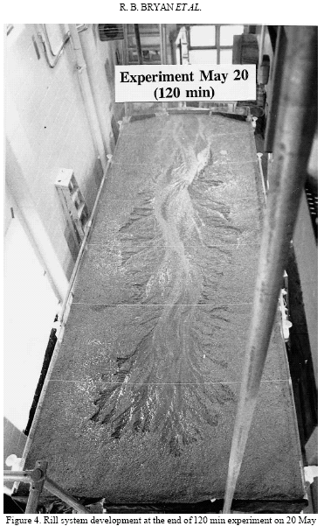
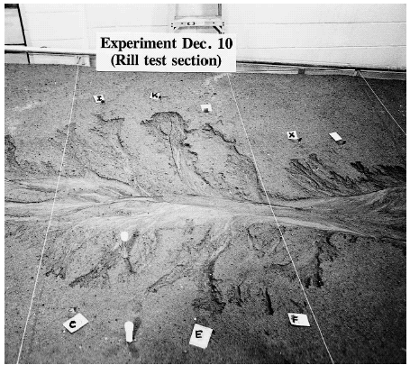
Physical Modeling of the Headcutting Process
http://www.colorado.edu/geography/geomorph/rosenberry/

Slide 20
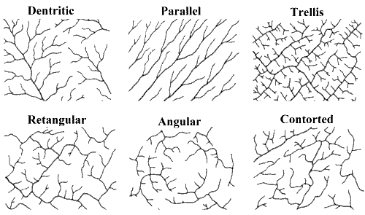
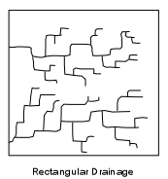
Common Drainage Patterns Caused by Head ward Erosion
Trellis – form in repeating layers of stronger and weaker substrate material
Rectangular Pattern – form in bedrock which is jointed at 90 degree angles
Dendritic Pattern– form in homogenous landforms where substrate material has no control over flow direction

Slide 21
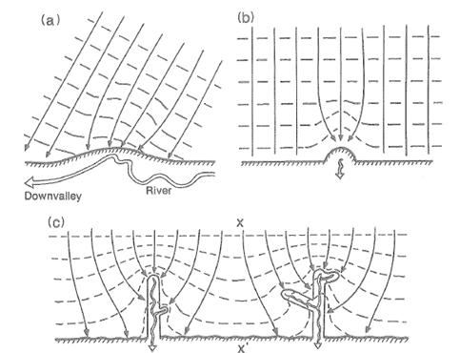
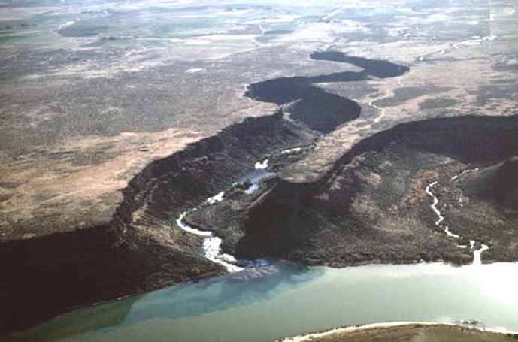
Ground water Seepage Headcutting
Dunne, 1980. (a) A stream valley erodes into a headland, causing a slight deflection and concentration of ground-water discharge; (b) the concentrated ground-water discharge results in sapping which erodes a small cut into the side of the headland, which further concentrates ground-water discharge and sapping; (c) the newly formed headcut erodes further, and sidecuts may develop and erode in the direction of sediment jointing or faulting.
http://www.colorado.edu/geography/geomorph/rosenberry/

Slide 22
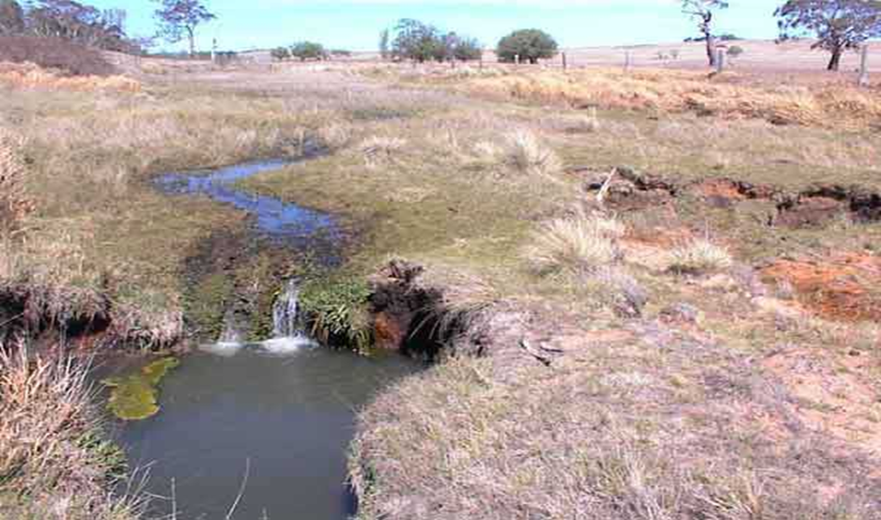
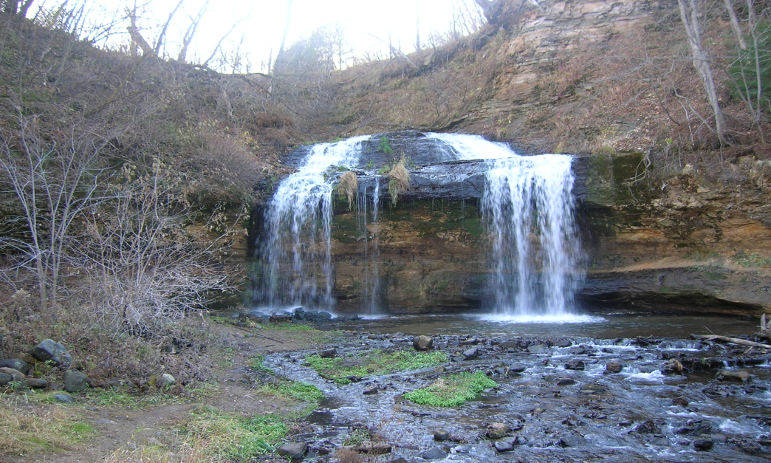
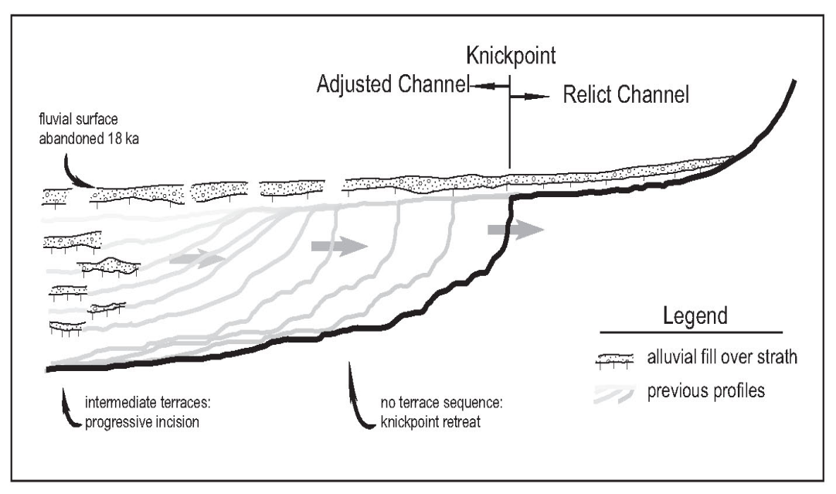
Base level lowering Headcut
Headcutting is commonly a mechanism for channel adjustment to a large scale change in slope.
http://www.colorado.edu/geography/geomorph/rosenberry/

Slide 23
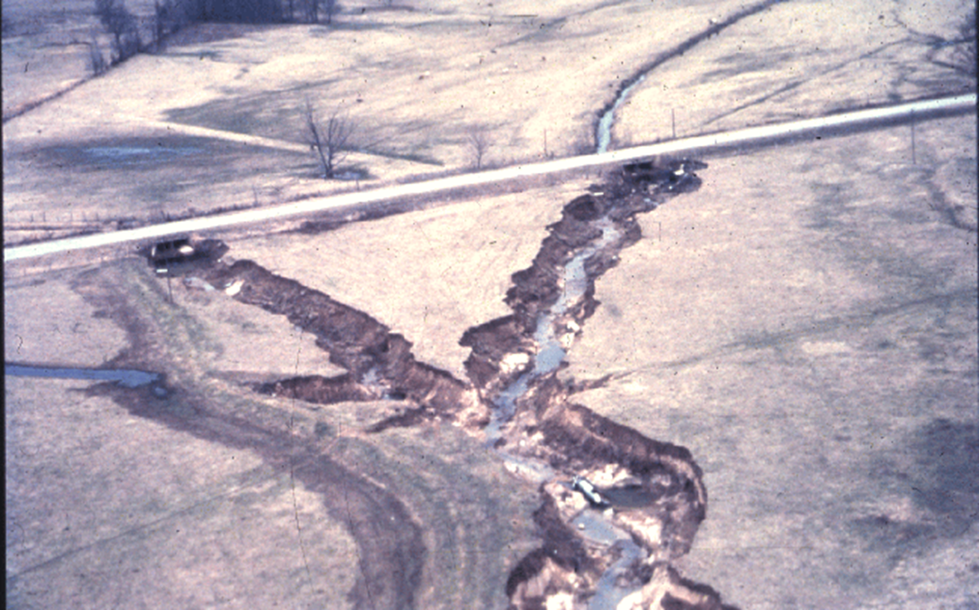
Channel Widening
Headcutting can cause downstream incision and bank failure causing channel widening
Watson etal 2007 Stream Rehabilitation

Slide 24
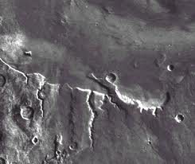
Headcutting is out of this world!
Short, deep, stream-like channels on Mars may be the result of ground-water sapping (Gulick, 2001).
Features on Mars generated substantial interest in studies of ground-water sapping during the 1980s and early 1990s.
http://www.colorado.edu/geography/geomorph/rosenberry/

Slide 25
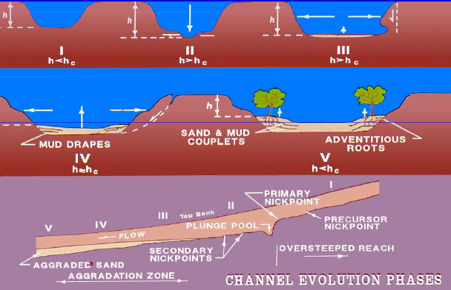
Design and Prevention Methods
This section discusses considerations for the prevention of forming headcuts and the control of existing headcuts.
Headcuts can be described with a channel evolution model. Ideally they should be controlled at Phase 1 before they begin or before Phase 3 when bank failure occurs.

Slide 26
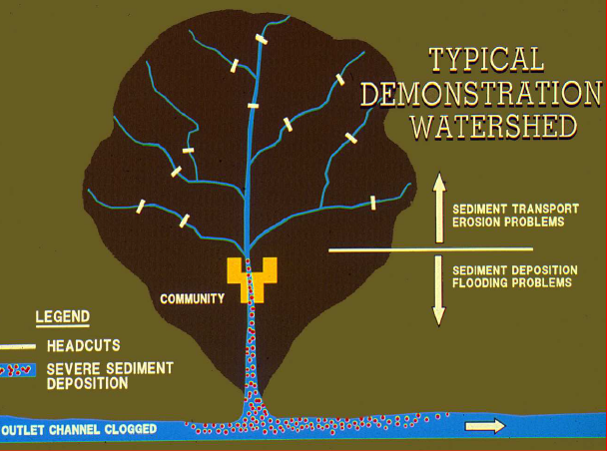
Headcut Prevention
Preventing head cuts can be done by avoiding practices that cause change in hydraulic or sediment continuity including:
Straightening channels (ΔS_{o})
Gravel mining (ΔD₅₀)
Land Use change (ΔQ & D₅₀)
inc. Farming, road construction, grazing, mining, urbanization
Bledsoe, Stream Rehabilitation, 2011

Slide 27
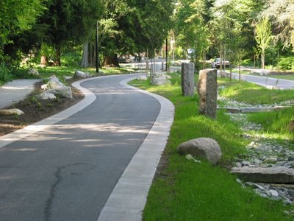
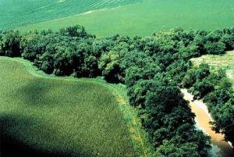
Mitigating Land Use Change
Land Use change cannot always be avoided but the impacts on flow regime change can be mitigated with stormwater management by:
encouraging groundwater infiltration
retaining storm runoff and slowly releasing it
natural plant cover buffers around streams
http://landscapeandurbanism.blogspot.com
http://www.apexnc.org/services/public-works/

Slide 28
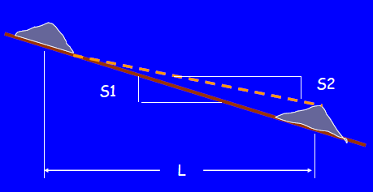
Grade Control Structures
Existing headcuts can be controlled with grade control structures placed either above or below the headcut. The structure causes the aggradation of sediment above it and decreases the bed slope from S1 to S2 as in the figure.
Height of structure = (S1-S2)*L
The equilibrium bed slope (S2) is found by analyzing the stable slopes for a sediment transport rate. Methods such as SIAM and Copeland’s can be utilized.

Slide 29
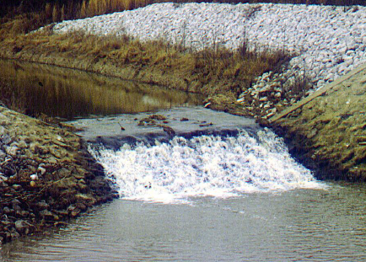
Types of Grade Control Structures
In choosing the type of structure you must consider frequency and number of structures and other criteria such as cost, material availability, environmental impacts, and risk.
Some examples include:
Large, single drop structures
Drop box culvert
Smaller drops (Sheet pile, rock, gabien)
Rock Ramps (Newbury riffles)
Rosgen structures
Chester Watson, USACE

Slide 30
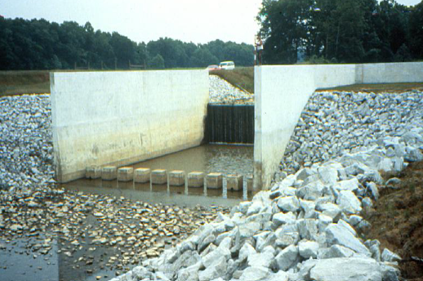
Large single-drop structure
Grade control for large head cuts can be achieved with single large structures.
Advantages:
Only one structure
Lower risk of failure
No scour hole with concrete slab
Disadvantages:
Expensive
No fish passage
Flood management
Appearance
Chester Watson, USACE

Slide 31
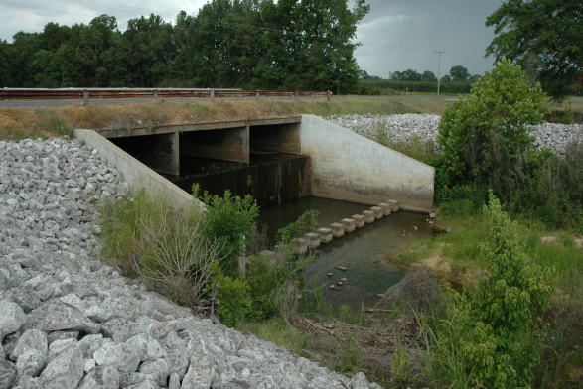
Drop Box Culvert
A drop box culvert controls a hydraulic jump at a bridge structure. It is similar to the previous example
Advantages:
Only one structure
Limits risk to bridge infrastructure
No scour hole with DS concrete slab
Disadvantages:
Expensive
No fish passage
Flood management
Appearance
Chester Watson, USACE

Slide 32
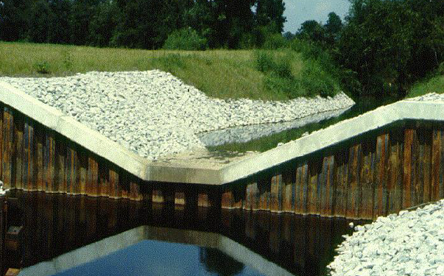
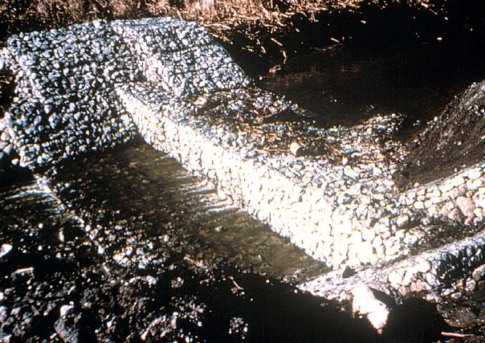
Smaller Weir Structures
Grade control for a head cut can also be achieved with smaller, cheaper structures. Depending on the scenario one or more weirs may be necessary. They can be constructed using various materials. Locally they are often large rocks.
Sheet Pile Weir: Useful when rock is not readily available, but can still prevent fish passage
Rock Gabiens: The gabiens function as a weir and are cheaper than large rock but are more succeptible to erosion failure
Chester Watson, USACE

Slide 33
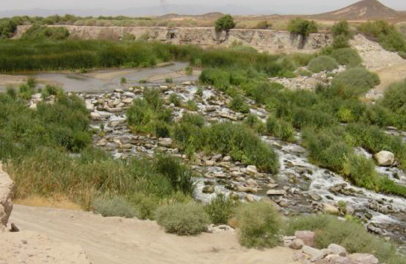
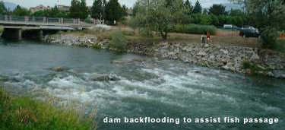
Smaller Weir Structures
Rock ramps dissipate energy over a longer area with large rocks
Advantages: cheaper, can allow fish passage, natural looking
Disadvantages: requires rock, rocks may more in large floods
Newbury Riffles (below) are another example of rock ramps that allow fish passage and grade control.
Newbury, Newbury Hydraulics
Chester Watson, USACE

Slide 34
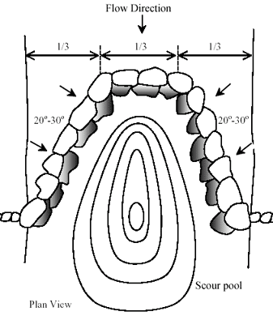
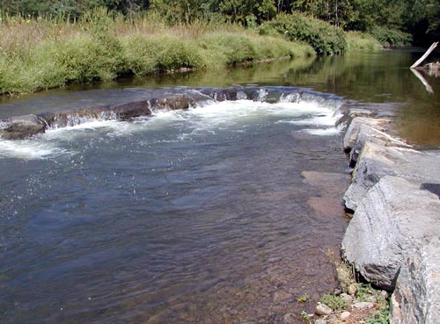
Smaller Weir Structures
Rosgen has designed several structures that are used as grade control including cross-vanes, J-hooks, and W-weirs. They are constructed of large rocks, and often can allow fish passage.
Rosgen, Wildland Hydrology

