Slide 1
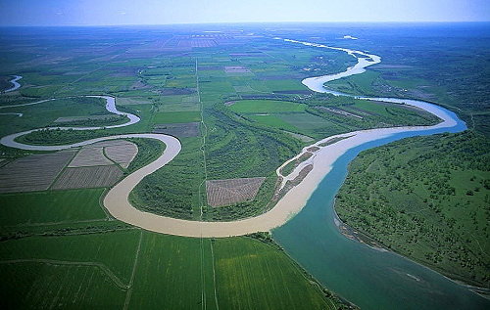
River Confluences
Farid Karimpour
Josh Smalley

Slide 2
Definition/Objective
The meeting of two or more rivers is called a river confluence.
Usually a river is the main stream and others are the tributaries.
Objective is to study the river confluences effects and characteristics

Slide 3
Physical Processes
Downstream of a river confluence, if the sediment concentration and grain size remain constant, can be expected to be:
Significantly wider
Deeper
Experiences more shear stress
Slightly faster
Slight decrease in slope

Slide 4
Physical Relationships

Slide 5
Confluence Formation
Confluences primarily form as the drainage network originally forms, but can also form through:
River capture
Human induced changes
Teay River capture by the Ohio

Slide 6
Confluence Migration
River Confluences tend to be static through time
Slackwater zones form downstream of wide bars
This induces rapid deposition and maintains a streamline confluence
From Julien, 2002

Slide 7
Mississippi confluence with the Red
Atchafalaya provides shorter distance
Naturally would have captured Mississippi
Flow diversion from Mississippi is managed
Human managed confluence

Slide 8
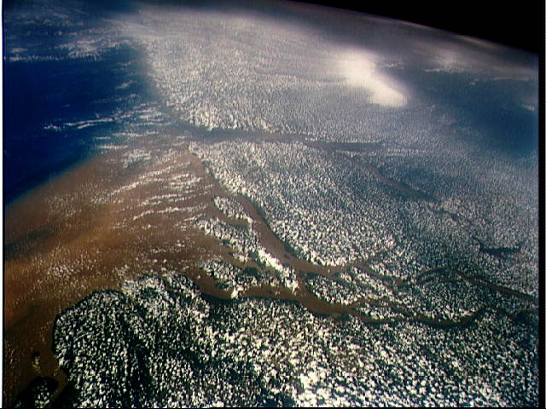
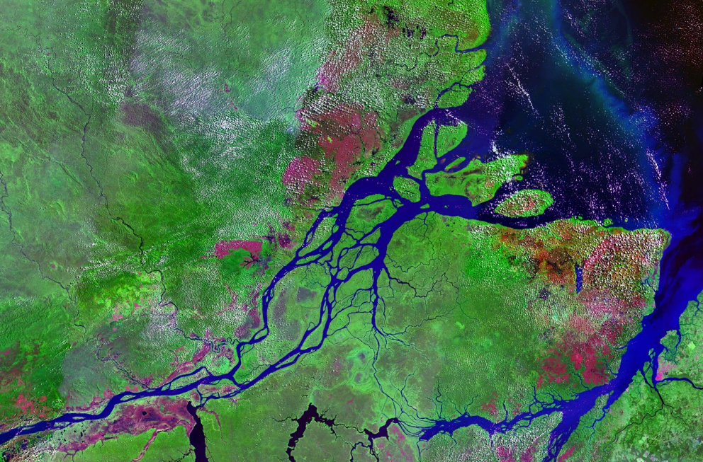
Amazon River

Slide 9
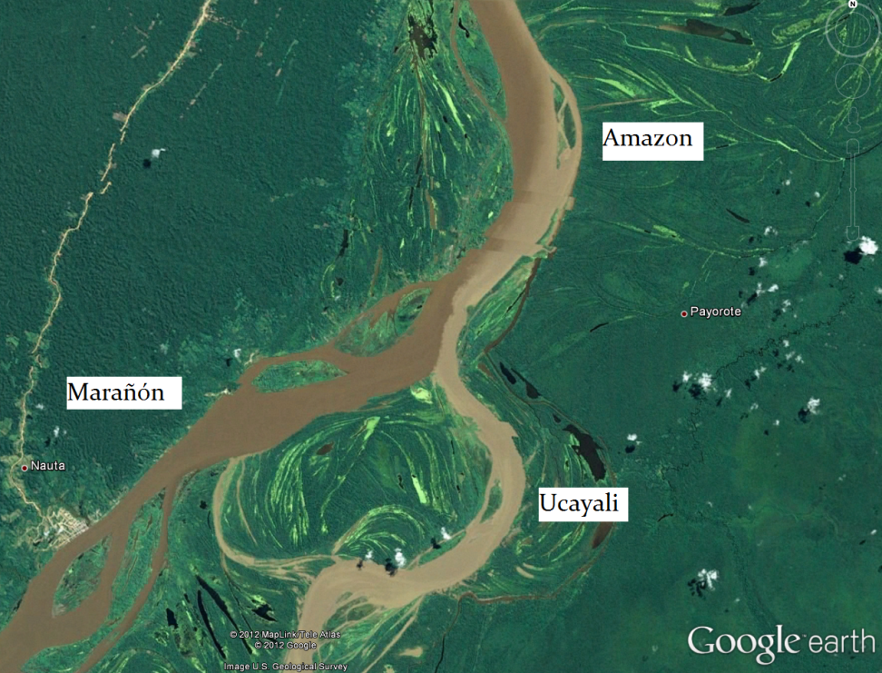
Amazon Confluences
Confluence of the Marañón and the Ucayali
15,000 sub-branches join the Amazon

Slide 10
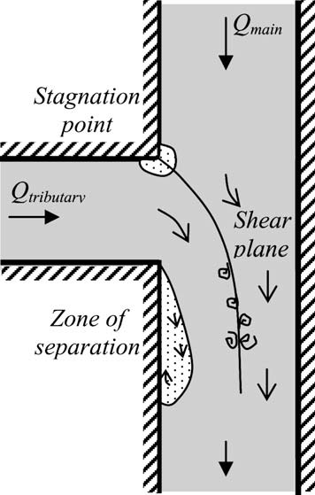
Flow diagram at a 90 river confluence

Slide 11
Mixing Zones
Mixing zones occur downstream of river confluences
Distance till mixing can be approximated by:
Where:

Slide 12
Mixing length depends primarily on width, depth, velocity, and shear velocity
An increase in shear velocity or depth will decrease mixing length
An increase in width or velocity will increase mixing length

Slide 13
Numerical Simulations

Slide 14
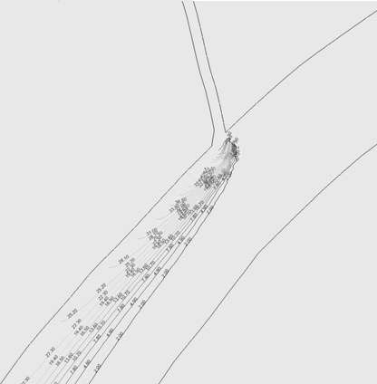
Iso-concentration curves(left figure), Dispersion (right figure)

Slide 15
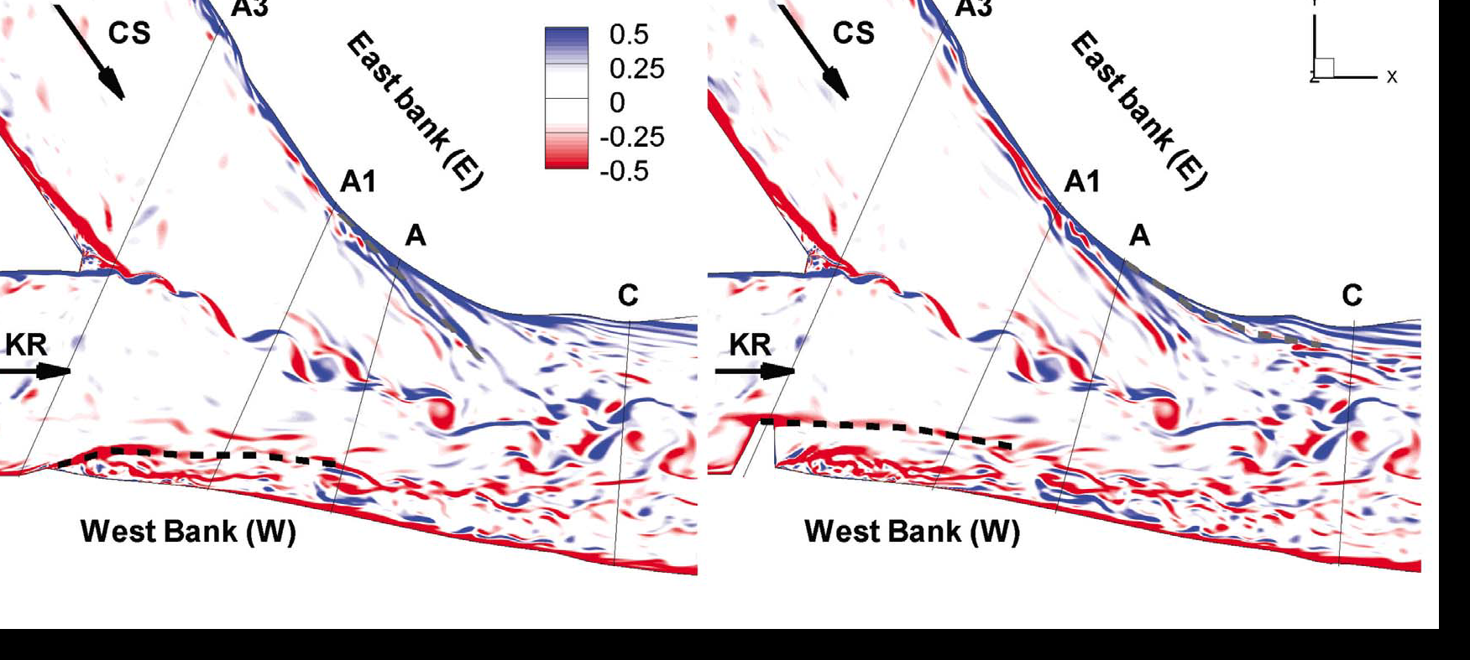
Distribution of the vertical vorticity, in the instantaneous flow in a horizontal surface situated at (left) 0.1 D and (right) 0.5 D below the free surface.

Slide 16
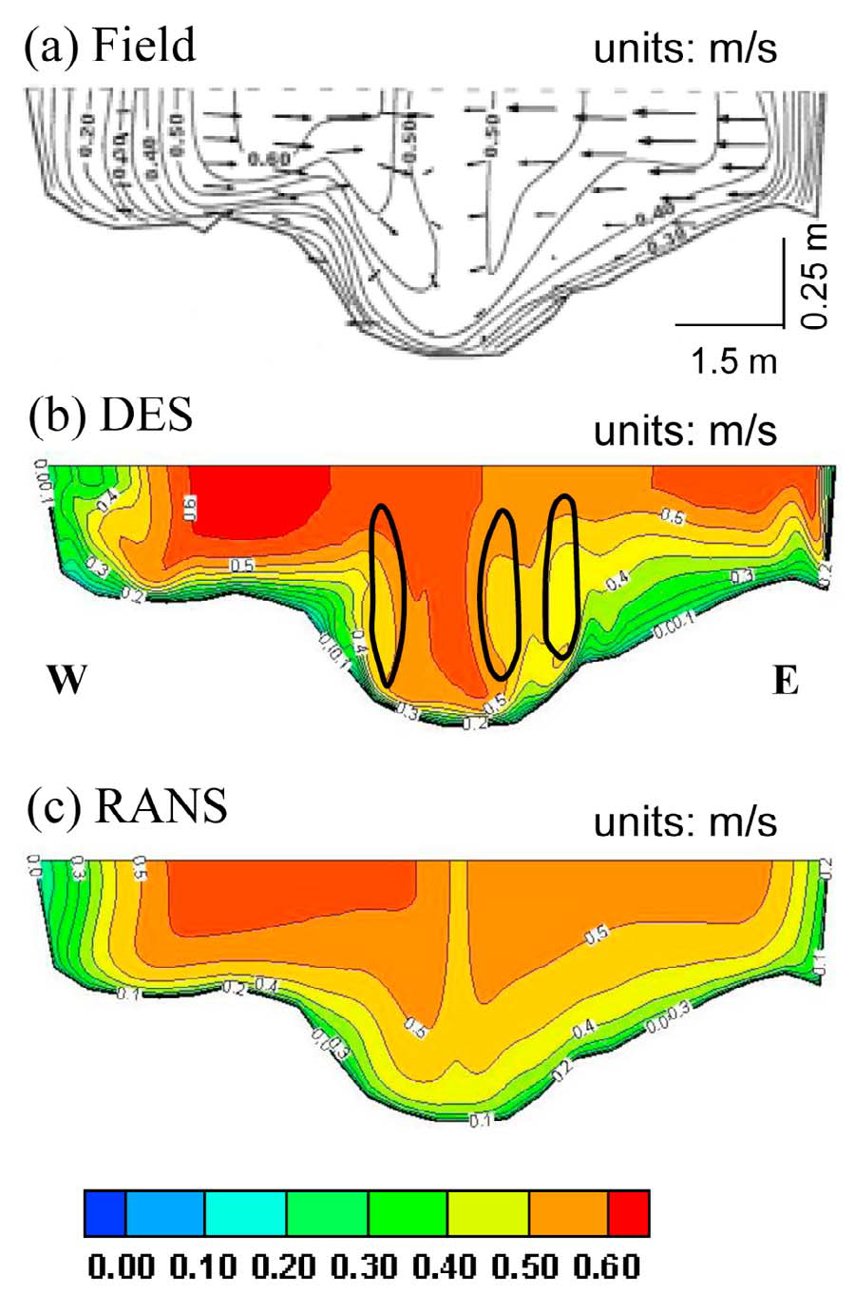
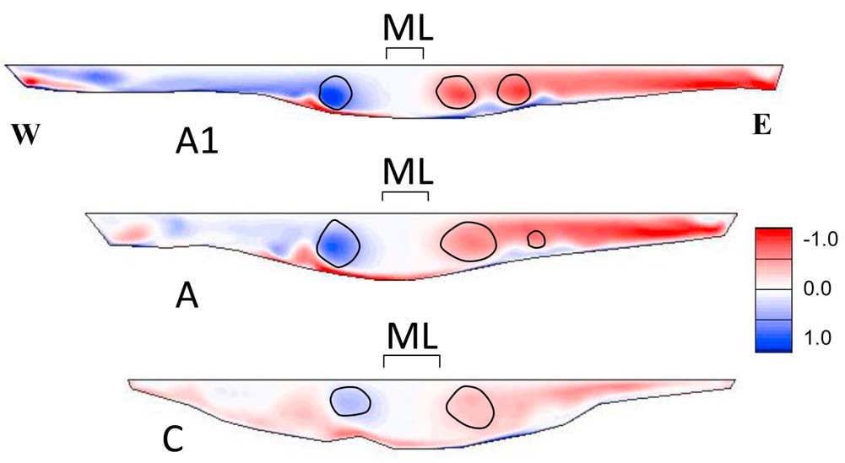
Left) Distribution of the mean streamwise velocity, u_{s} (m/s), in section A1.
Right) Distribution of the streamwise‐oriented vorticity, in the mean flow at sections A1, A, and C (As shown in slide 15)

Slide 17
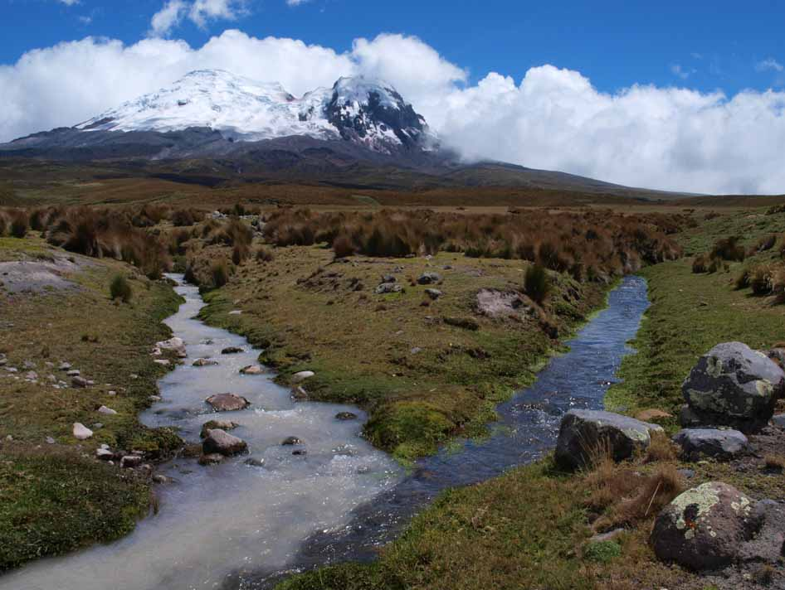
Natural Confluences
Glacier and spring fed streams in Ecuador

Slide 18
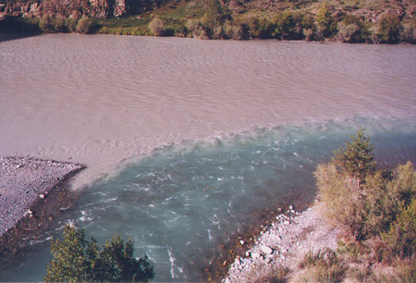
Shallow mixing layers developing at the river confluences

Slide 19
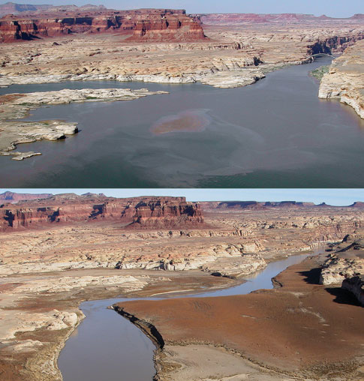
Photographs of Lake Powell at the confluence with the Dirty Devil River (entering from left).

Slide 20
References
Constantinescu, G., Miyawaki, S., Rhoads, B., Sukhodolov, A., Kirkil, G., “Structure of turbulent flow at a river confluence with momentum and velocity ratios close to 1: Insight provided by an eddy‐resolving numerical simulation”, Water Resources Research, vol. 47, w05507, doi:10.1029/2010wr010018, 2011
Julien, P. Y., “Erosion and Sedimentation”, Cambridge Press, 2010
Julien, P. Y., “River Mechanics”, Cambridge Press, 2002
Petrescu, V., Sumbasacu, O., “Comparison between numerical simulation and measurements of the pollutant dispersion in a river. case study”, U.P.B. Sci. Bull., Series D, Vol. 72, Iss. 3, 2010
Roca, M., Martín-Vide, J.P., Moreta, P.J.M., ” Modelling a torrential event in a river confluence”, Journal of Hydrology 364 (2009) 207–215

