Slide 1
Fountain Creek Digest
Bobak (Ali), Robbie, Nate, Susan, Scott

Slide 2
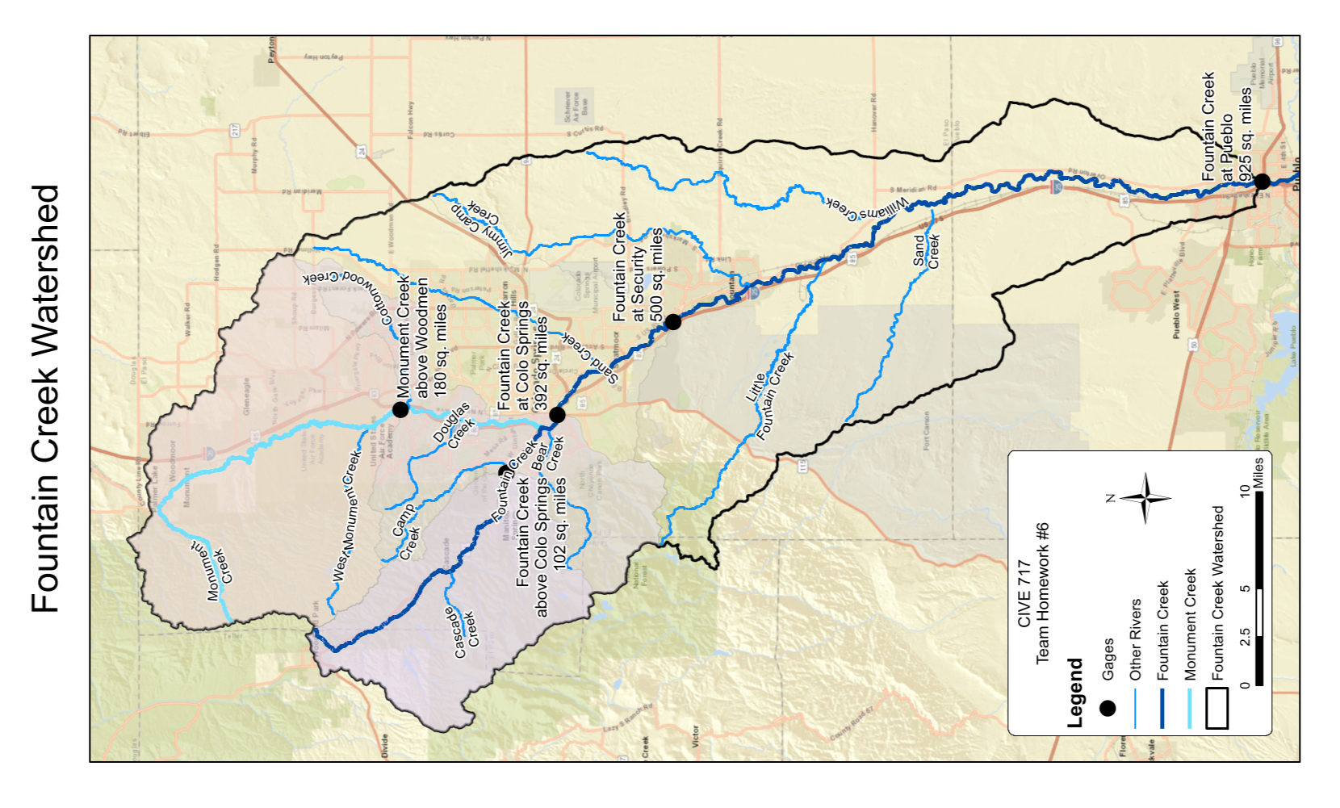
Map

Slide 3
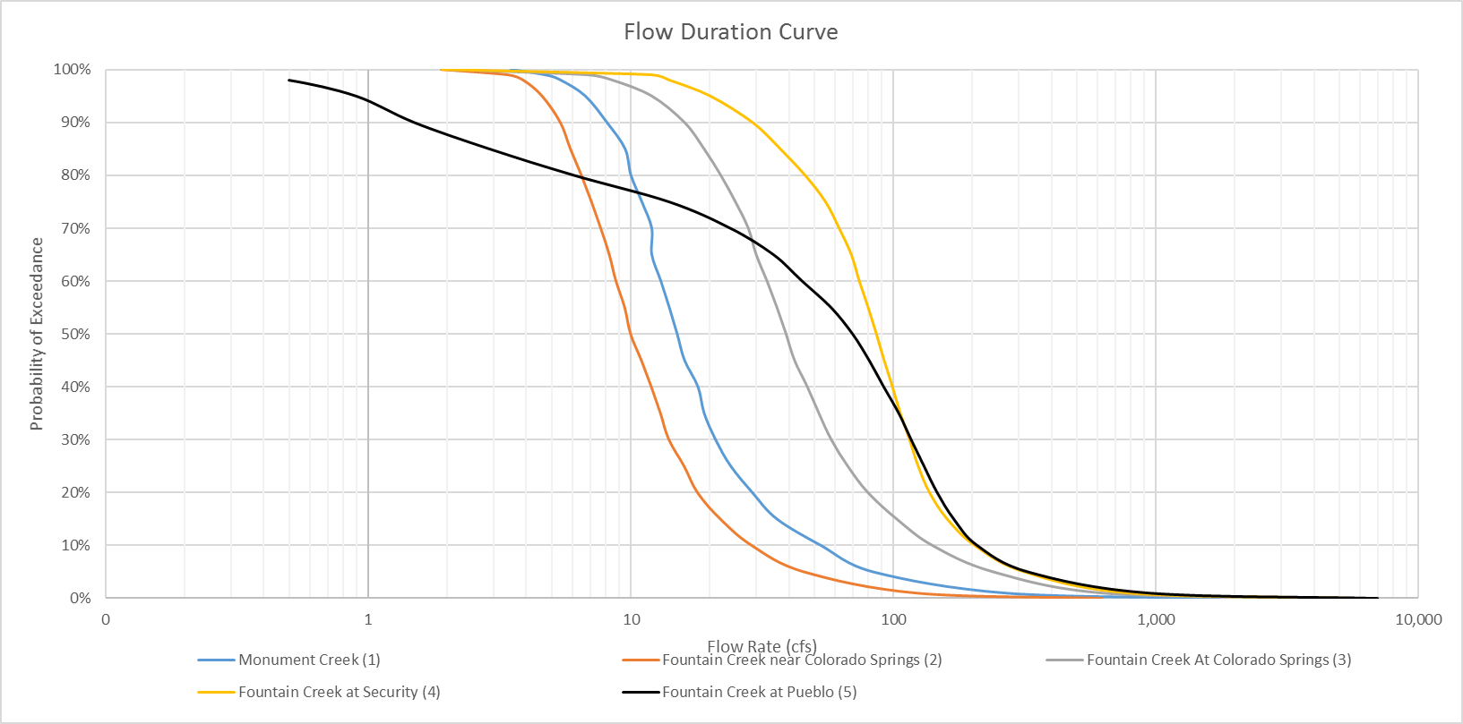
Flow Duration Curves

Slide 4
Flow Duration Data

Slide 5
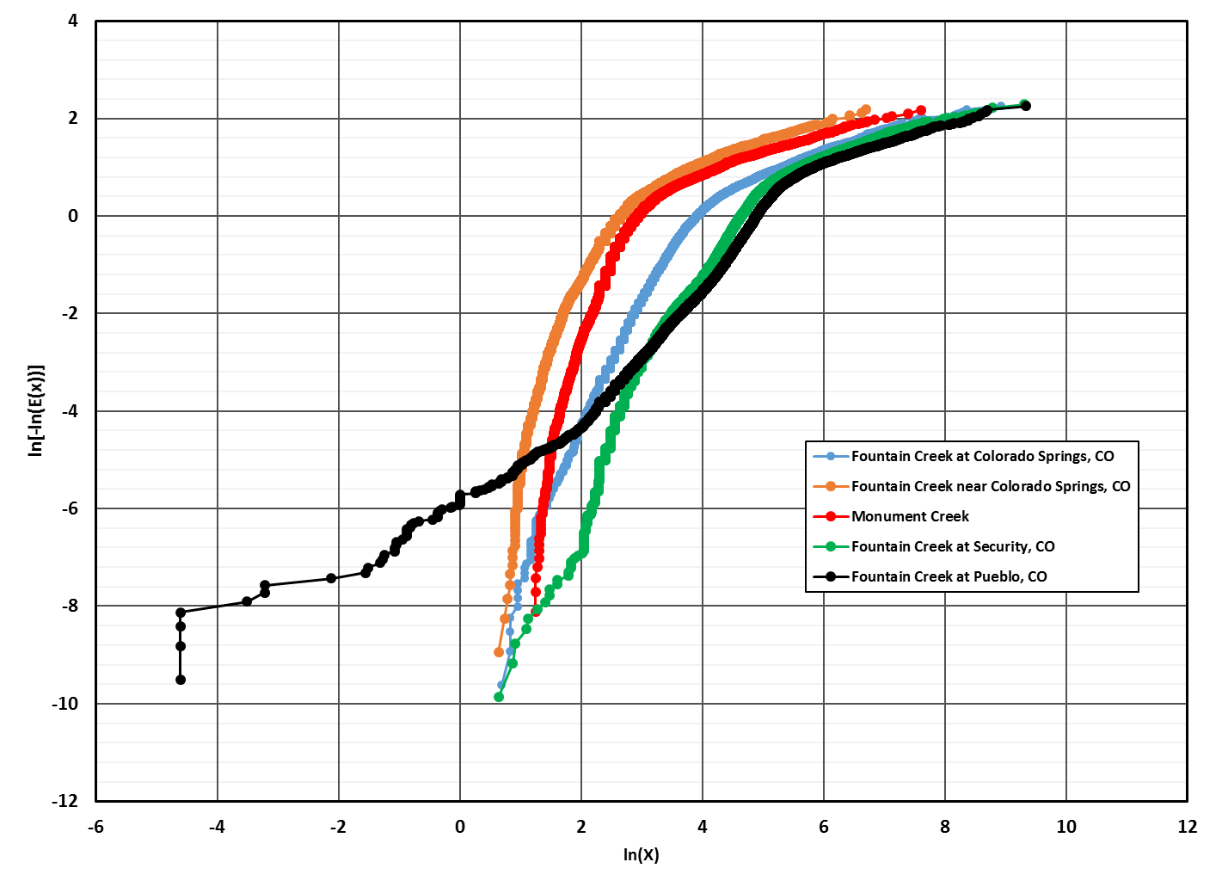

$$\hat{b}$$

Slide 6
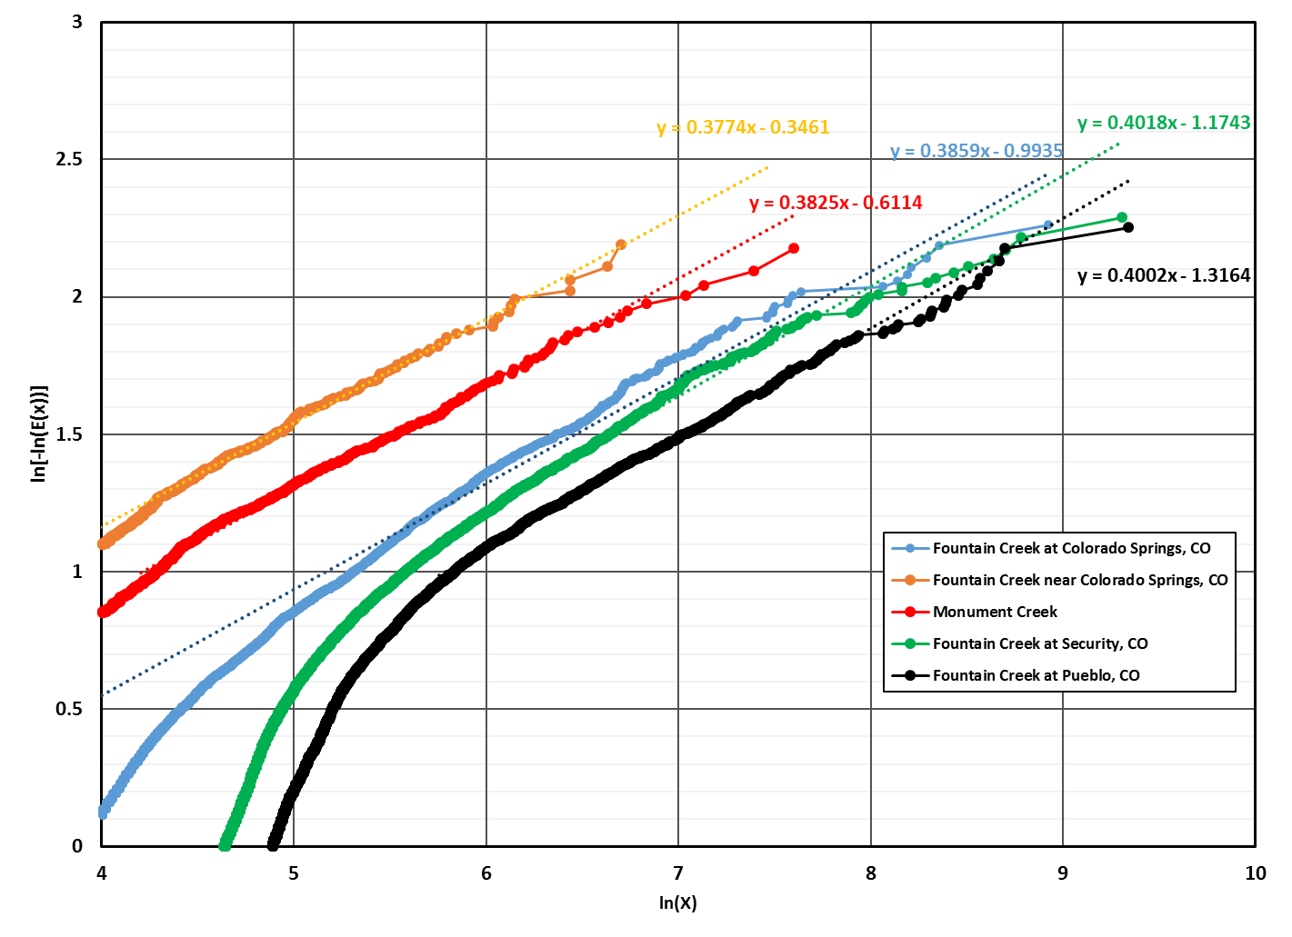
$$\hat{b}$$

Slide 7
Sediment Rating Curves

Slide 8
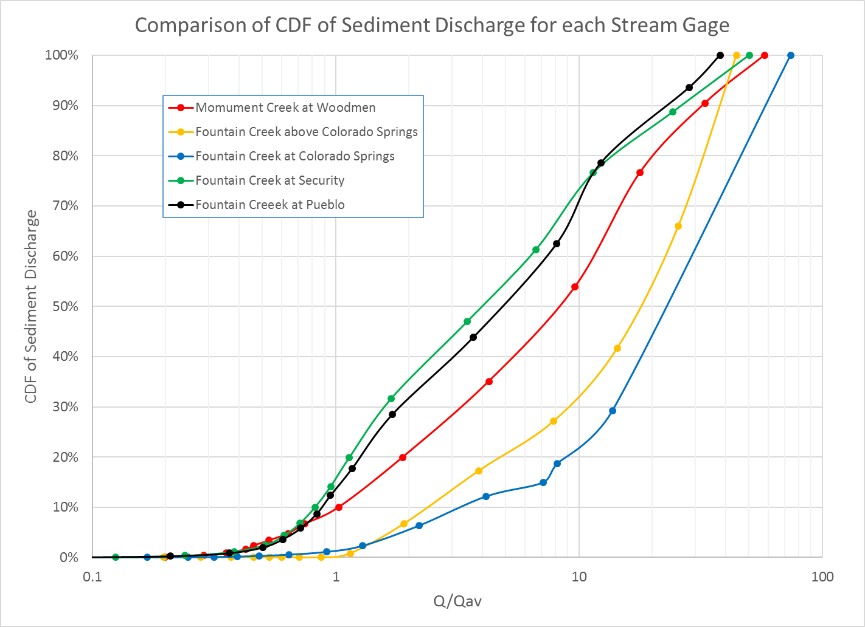
Flow-duration/sediment Rating curve

Slide 9
Total Sediment Load

Slide 10
Total Sediment Load

Slide 11
Map

Slide 12
