Slide 1
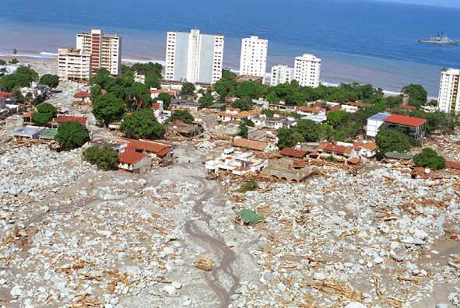
Understanding Debris Flow Mechanics to Reduce Urban Disasters
Pierre Y. Julien
Colorado State University
3rd Asia Conference on Urban Disaster Reduction
Seoul, South Korea, November 28, 2015

Slide 2
Objectives
Provide guidelines for designing mitigation countermeasures based on the type of hyperconcentrated flow

Slide 3
Classification and Rheology
Total shear stress :
τ = τ y+ τ _{v}+ τ _{t}+ τ _{d}
Landslides Yield stress
Mudflows Viscous stress
Mudfloods Turbulent stress
Debris flows Dispersive stress

Slide 4
1. Landslides

Slide 5
Landslides
Yield strength
Steep hillslopes
High rainfall precipitation
High Infiltration
Saturated yield strength ~ 1kPa
Duksan Creek modeling with TREX
from Dr. Jaehoon Kim, CSU and KFRI

Slide 6
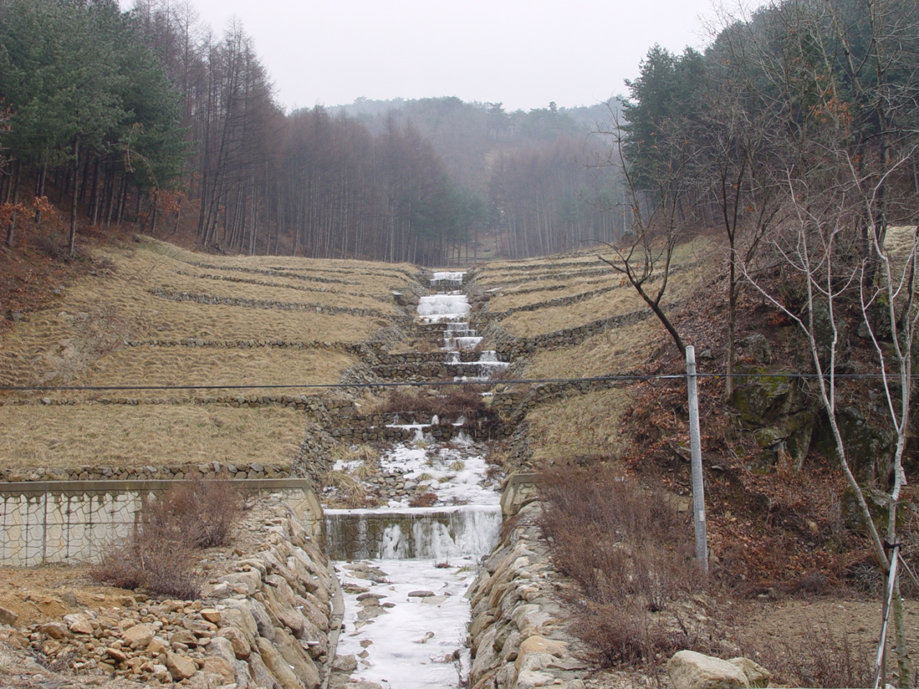
Landslide Countermeasures
Effective Solution
Slope reduction, drain, vegetation
Terraces
Drainage

Slide 7
2. Mudflows

Slide 8
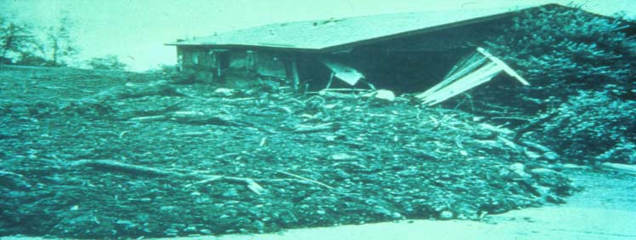
Mudflow
Viscous
High concentration of silts and clays
• 45% < Cv < 55%
Low velocity and Froude number
Large flow depth and pressure
No abrasion

Slide 9
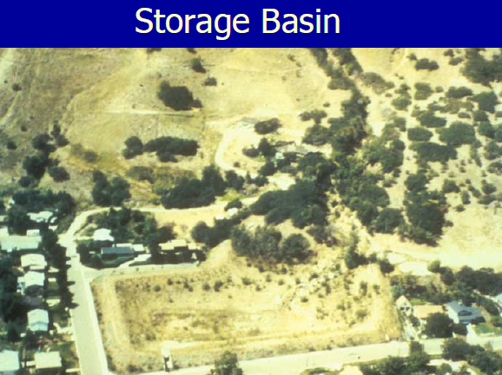
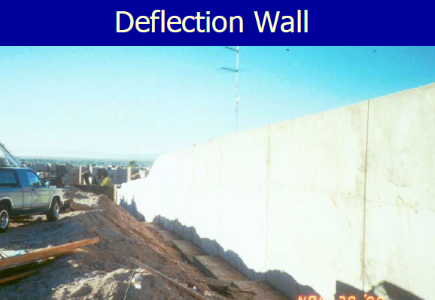
Mudflow Countermeasures
Effective Solution
Store, Deflect, Spread
Storage basins
Deflection walls
Rudd Creek, Utah
from Dr. Jim O’Brien

Slide 10
3. Mudfloods

Slide 11
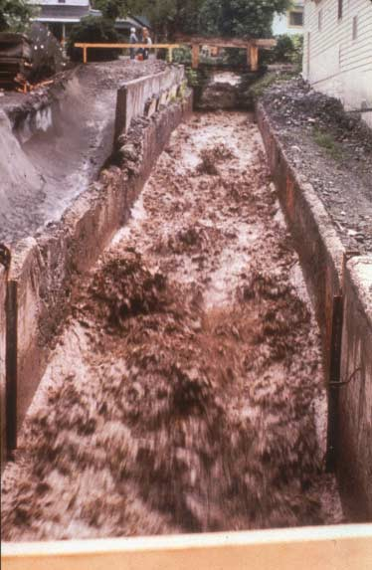
Mud Flood
Turbulent
Non-cohesive particles
Sands and silts
Cv as high as 40%
High velocity and Froude Number
Abrasive

Slide 12
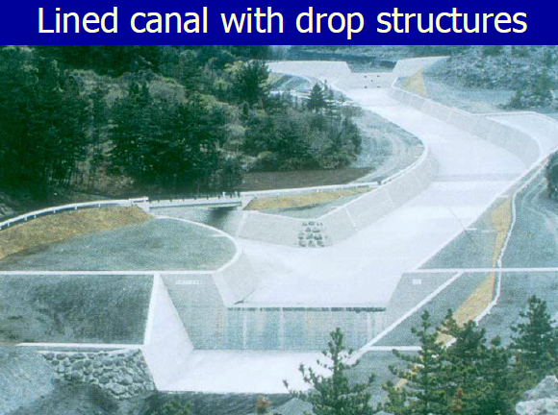
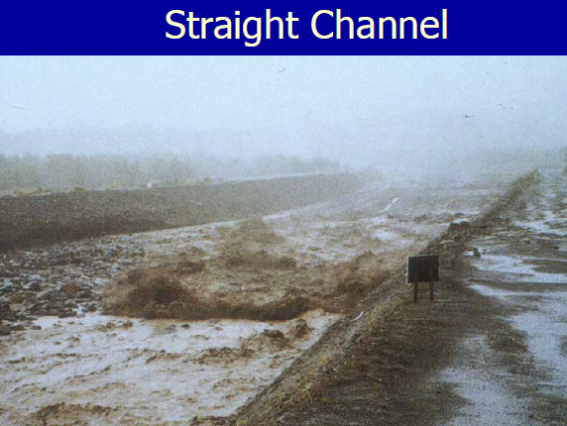
Mudflood Countermeasures
Increased conveyance
Effective Solution
Straight channel
Lined canal
Berm and levee
Drop structure

Slide 13
4. Debris Flows

Slide 14
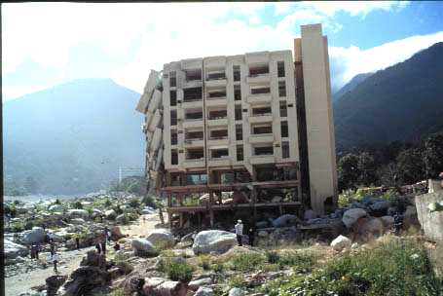
Los Corales, Venezuela

Slide 15
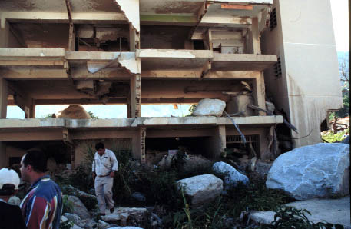
Los Corales

Slide 16
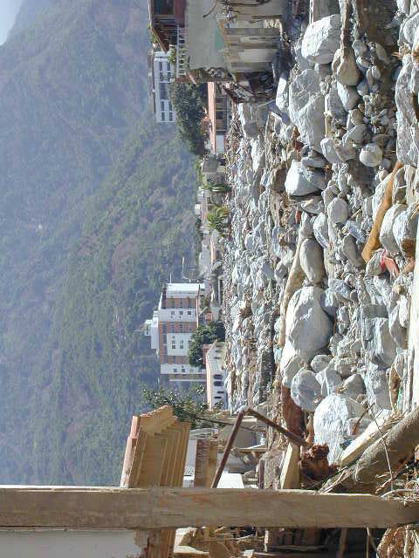
Debris Flow
Dispersive
Large rocks
Non cohesive
Low viscosity
High velocity
Destructive impact force

Slide 17
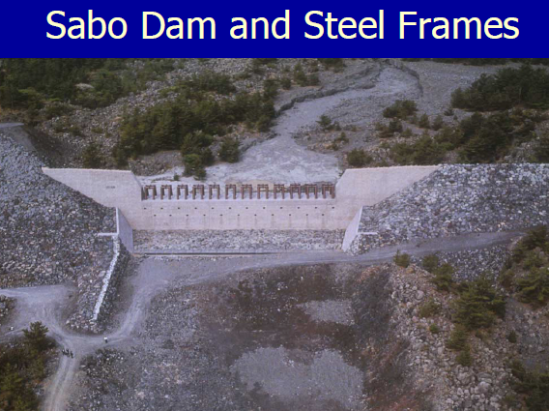
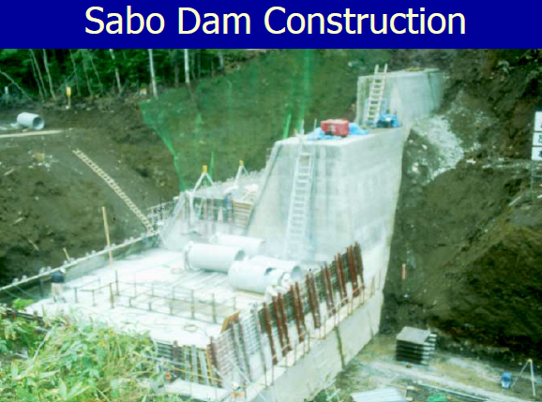
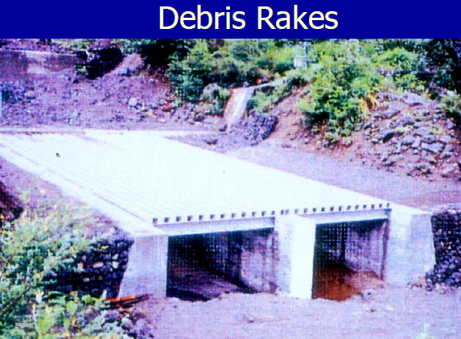
Debris flow Countermeasures
Retain large rocks
Drain water
Effective Solution
Concrete sabo dams
Steel Frames
Debris Racks

Slide 18
Example Mt Umyeon

Slide 19
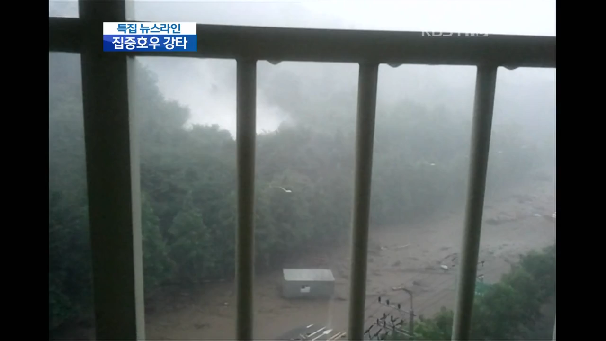

Slide 20
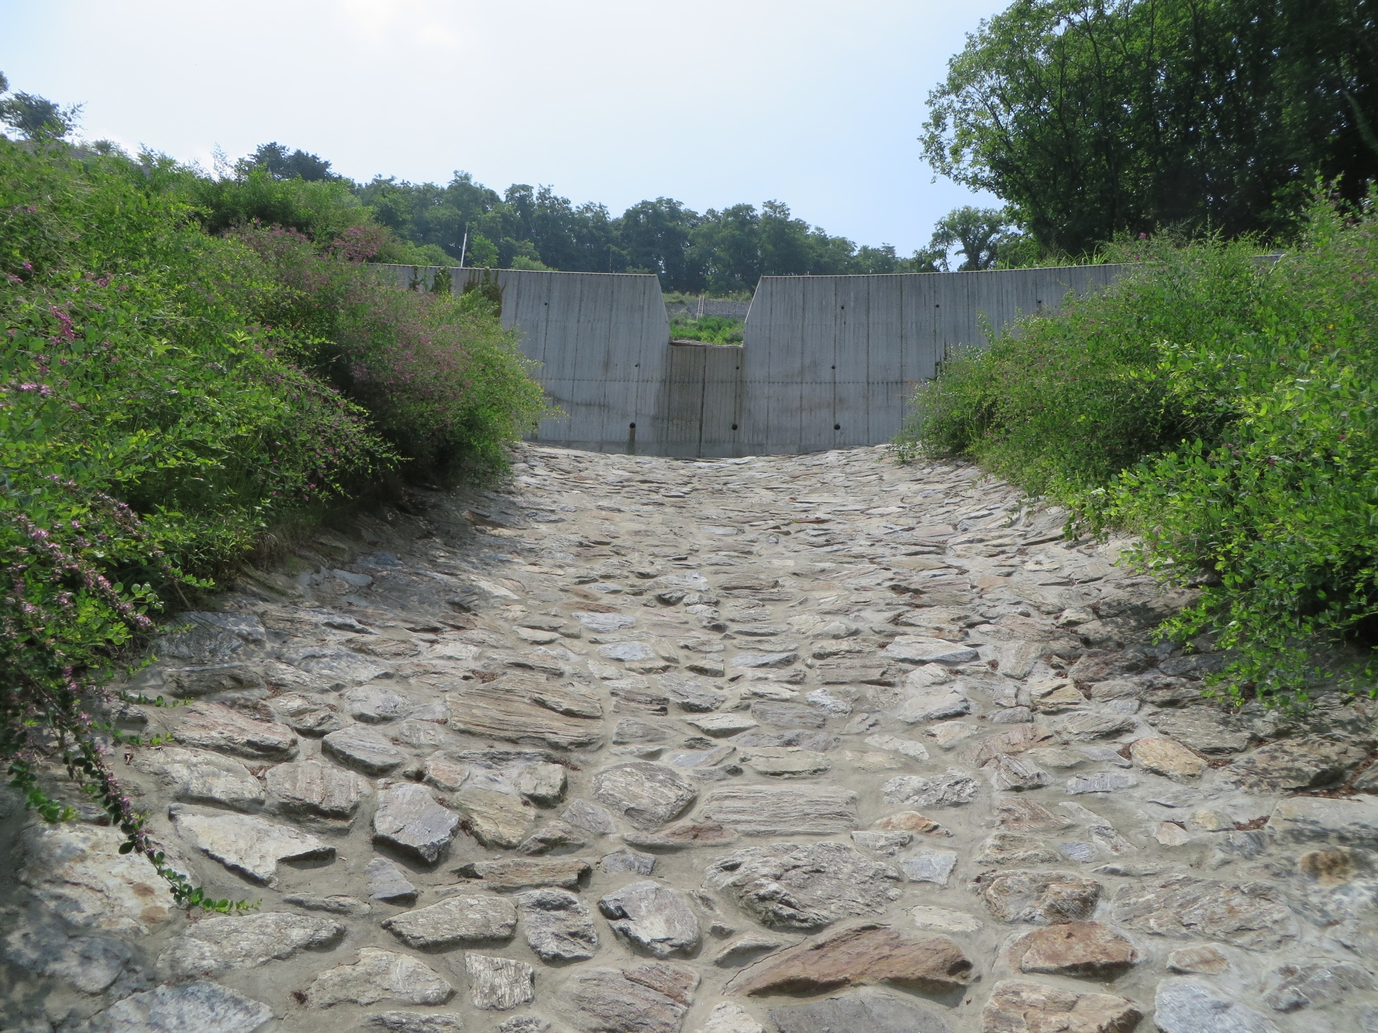

Slide 21
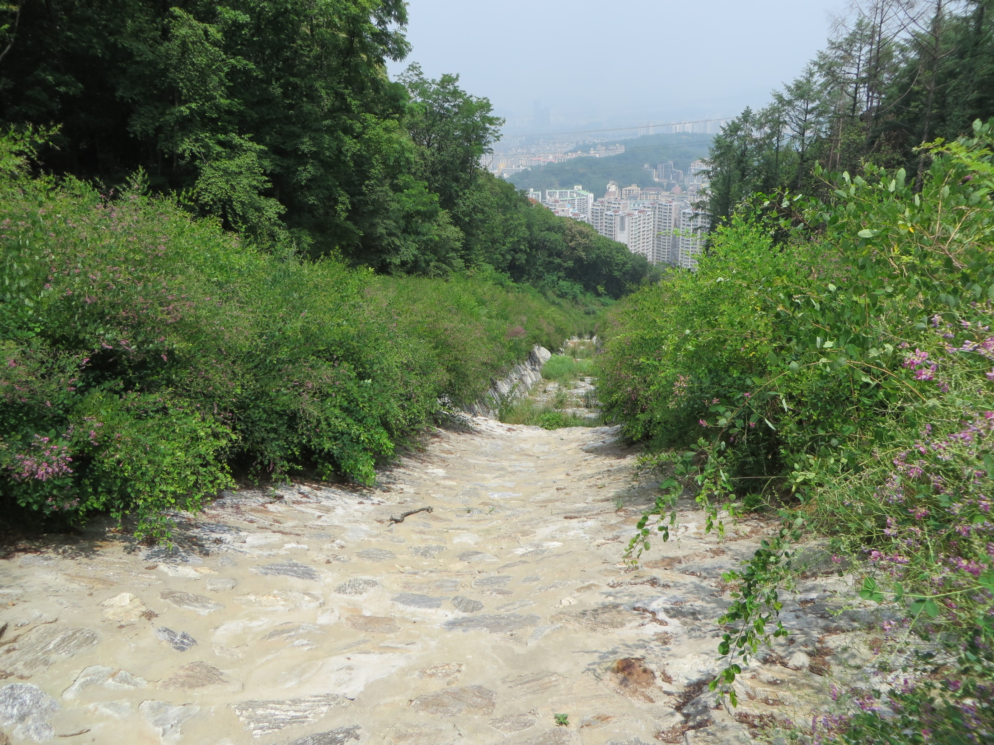

Slide 22
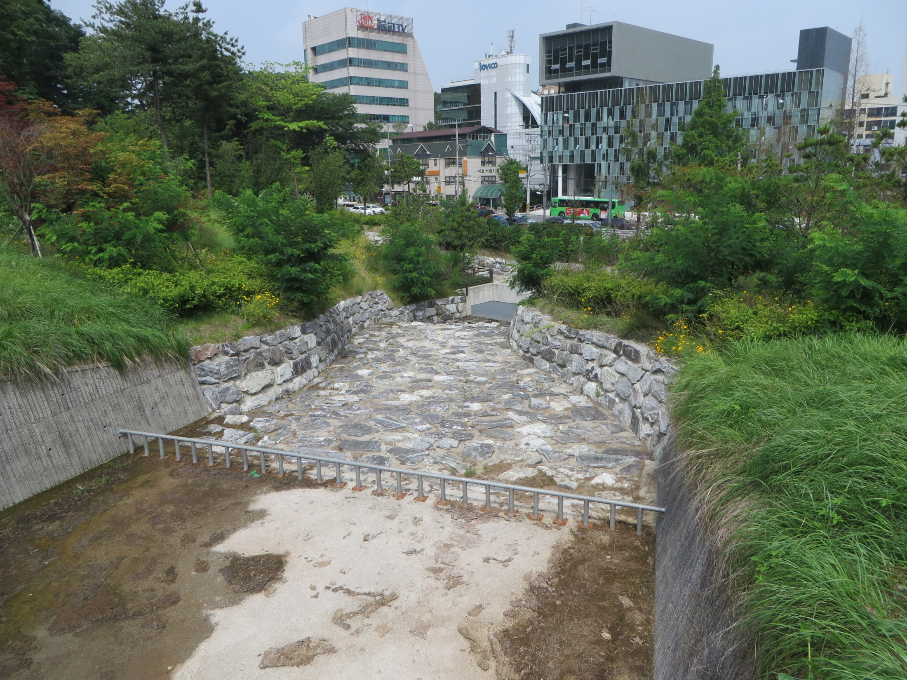

Slide 23
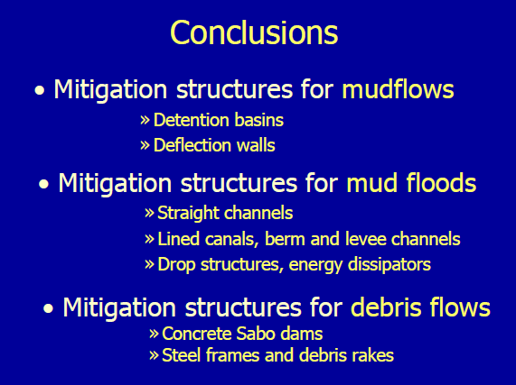

Slide 24
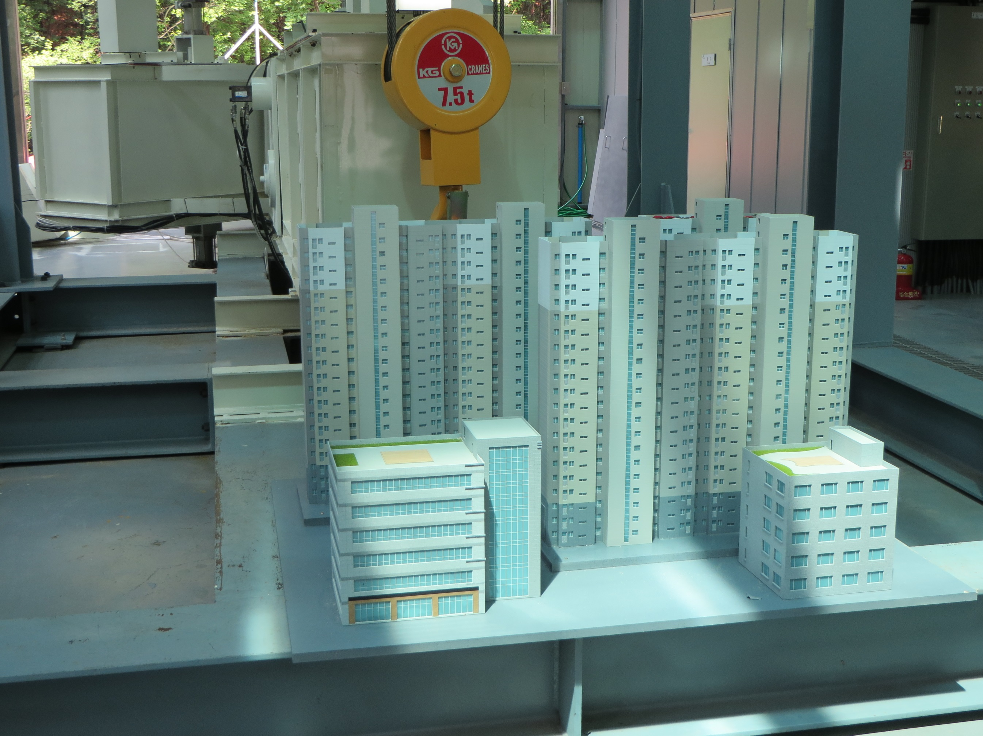
ACKNOWLEDGMENTS
Dr. Jaehoon Kim, KFRI, South Korea
Dr. Jai Hong Lee, CSU, USA
Dr. Un Ji, KICT, South Korea
Hwayoung Kim, K-Water, South Korea
Dr. Claudia Leon, RTI, USA
Dr. Kate White, USACE, USA
Dr. Jose Salas, CSU, USA
Dr. Jose Batista Anderson, UNICAMP, Brasil
Dr. Jazuri Abdullah, UiTM, Malaysia
Dr. Shazwani N. Muhammad, UKM, Malaysia
… so many others …
감사합니다
Thank You!

