Slide 1



GeoPhilately Workshop – 19 March 2022 An Introduction to Meteorology and Space Weather in Philately
Garry Toth
Notes:
Good day. I’m Garry, a meteorologist retired from Environment Canada. This presentation is an introduction to Meteorology and Space Weather on stamps.

Slide 2
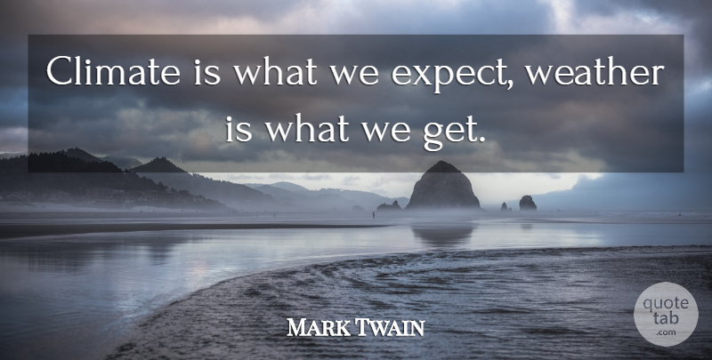
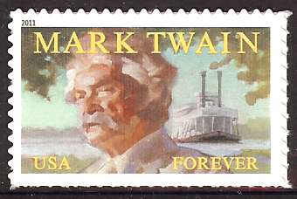
Part 1 – Meteorology (includes Weather and Climate)
Notes:
“Meteorology” includes both “weather” and “climate”. Mark Twain’s aphorism about the difference between the two always makes me laugh.

Slide 3
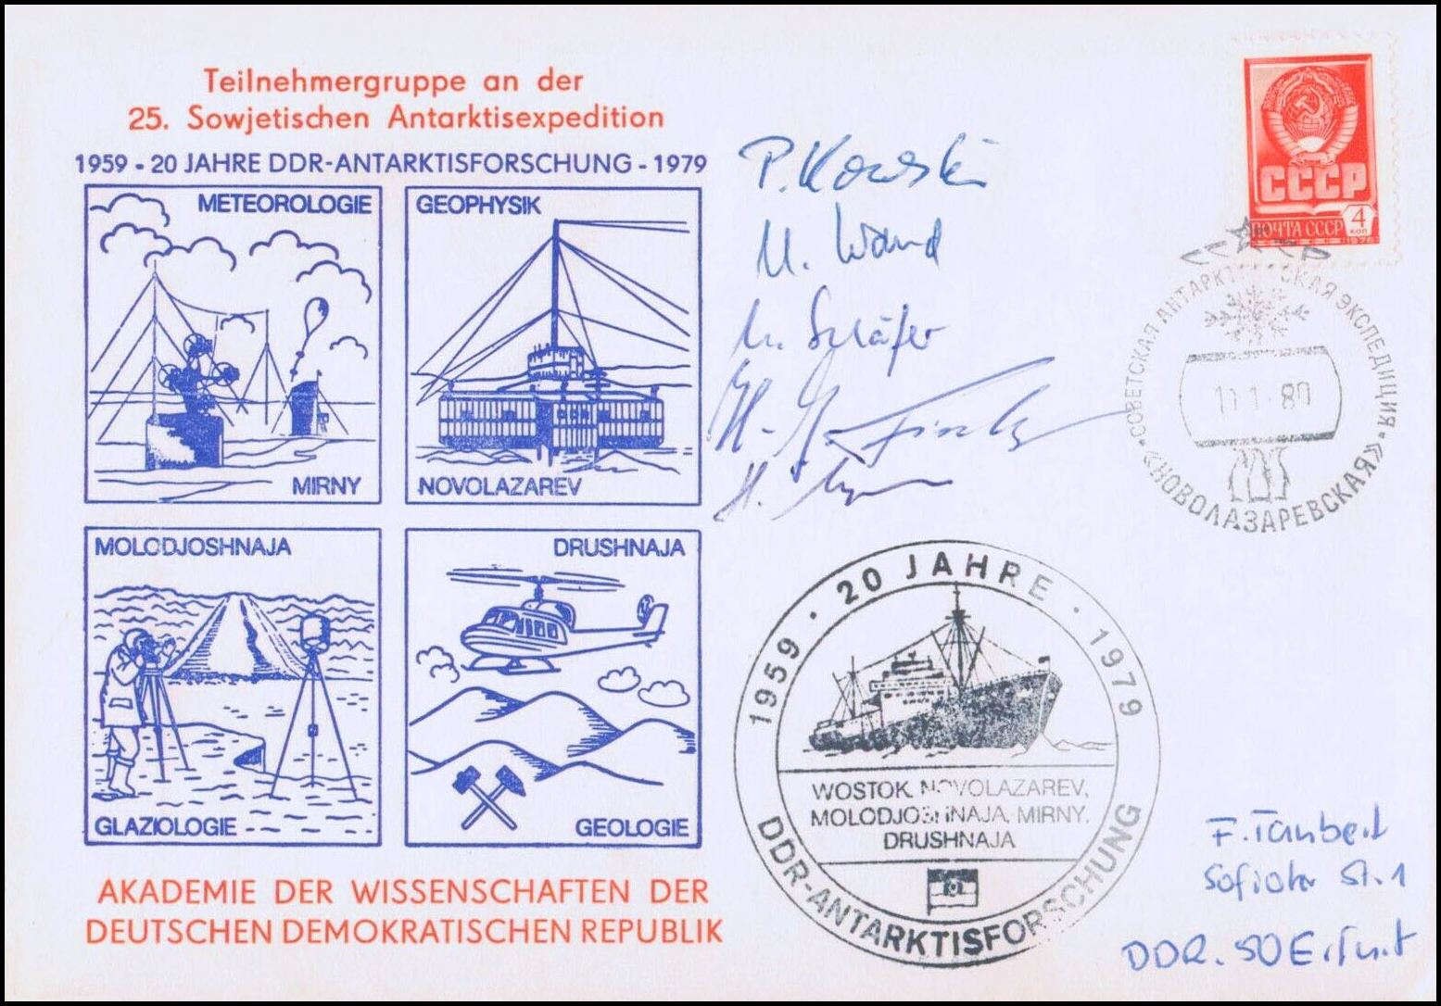
Geophysics / Earth Sciences include meteorology
Notes:
Various areas of scientific study, including meteorology, are part of the broad area of science known as geophysics. This Antarctic research cover refers to geophysics, meteorology, glaciology and geology.

Slide 4
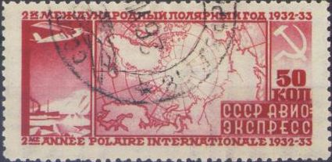
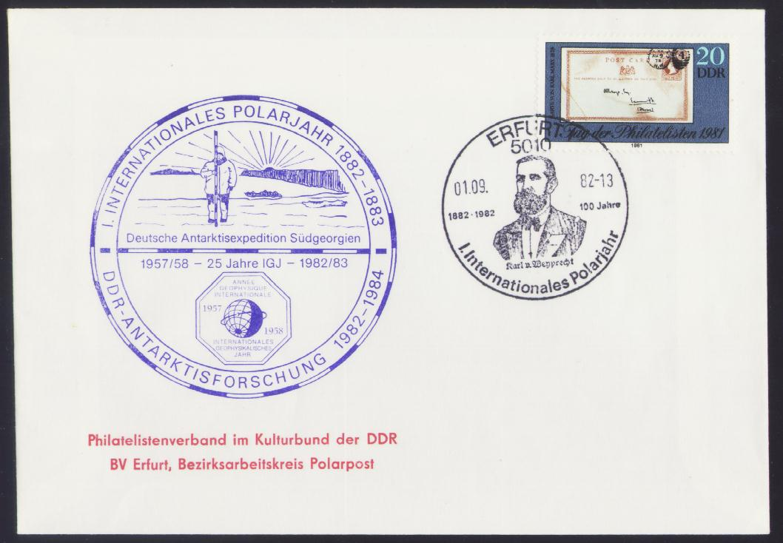
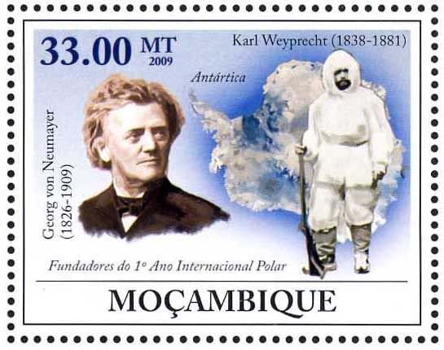
International Cooperation – the IPYs (International Polar Years)
2nd IPY – 1932-1933
1st IPY – 1882-1883 – 100th anniversary
Notes:
Let’s look at some items involving international cooperation. The cover is for the 100th anniversary of the first International Polar Year, which took place in 1882-1883. In it, 11 nations collaborated in the first-ever coordinated international polar research program. Karl Weyprecht, in the cancel, was an Austrian scientist, explorer and naval officer who proposed the program in 1875 and has been called the “father” of the IPYs. Georg von Neumayer, the director of the German Maritime Observatory, organized the research program. Both men are depicted in the Mozambique stamp. The Soviet stamp commemorates the second IPY, in which 40 nations participated in 1932-1933.

Slide 5

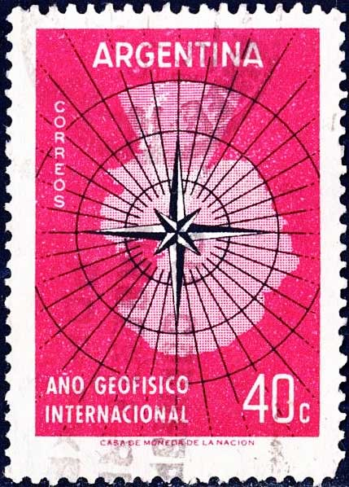
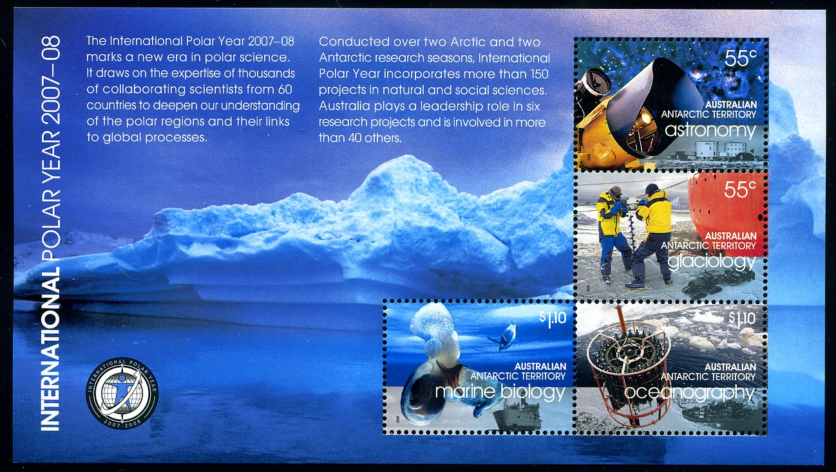
3rd and 4th IPYs (3rd IPY is the IGY – the International Geophysical Year)
3rd IPY – 1957-1958
4th IPY – 2007-2008
Notes:
The third IPY, in 1957-1958, involved 67 nations and is better known as the International Geophysical Year. The IGY is one of Rob Sternberg’s specialties. 125 years after the 1st IPY, the 4th IPY of 2007-2008 was the most ambitious polar research program ever.

Slide 6
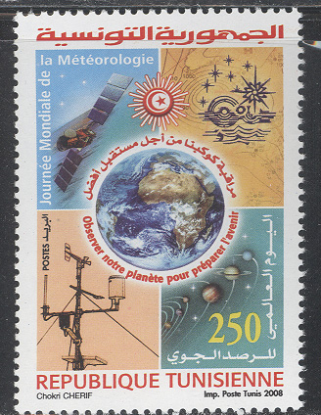
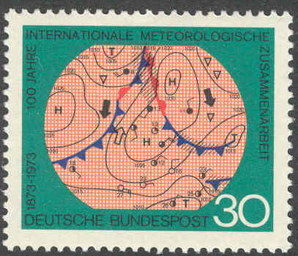
World Meteorological Organization (WMO) (originally IMO – International Meteorological Organization)
World Meteorological Day – each 23 March since 1961
100th anniversary IMO/WMO, in 1973
Notes:
The German stamp issued for the 100th anniversary of the World Meteorological Organization in 1973 includes a weather map. The Tunisian stamp, with an automatic observing station and a satellite image from a Meteosat weather satellite, was issued in 2008 for the World Meteorological Day, sponsored by the UN and celebrated each March 23.

Slide 7
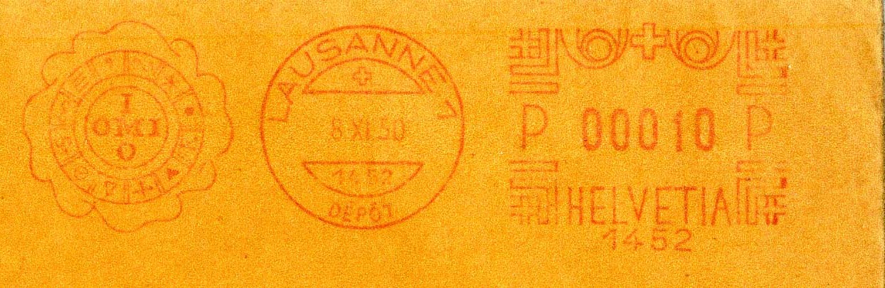
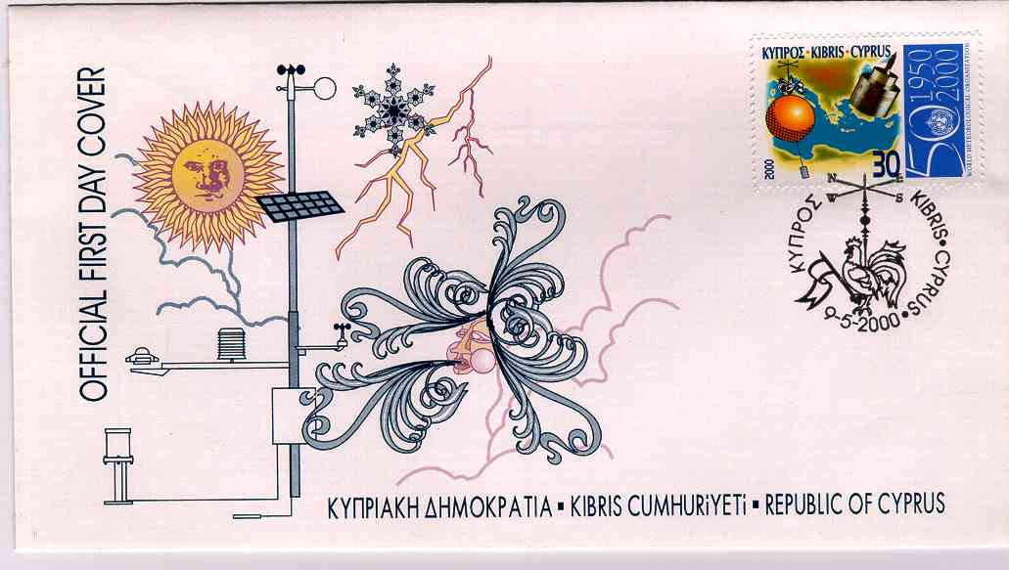

The IMO became the WMO (the World Meteorological Organization) in 1950
WMO 50th Anniversary (in 2000)
WMO logo
Notes:
In 1950, the WMO was created from the IMO. The meter, from 1950, still has the IMO-OMI English and French acronyms for the organization. The WMO logo is shown in the Swiss stamp. In it, a compass rose representing wind directions has been added to the UN logo. Many stamps were issued for the 50th anniversary of the WMO in 2000. One of them is from Cyprus, whose first day cover includes several meteorological elements in its stamp, cancel and cachet.

Slide 8
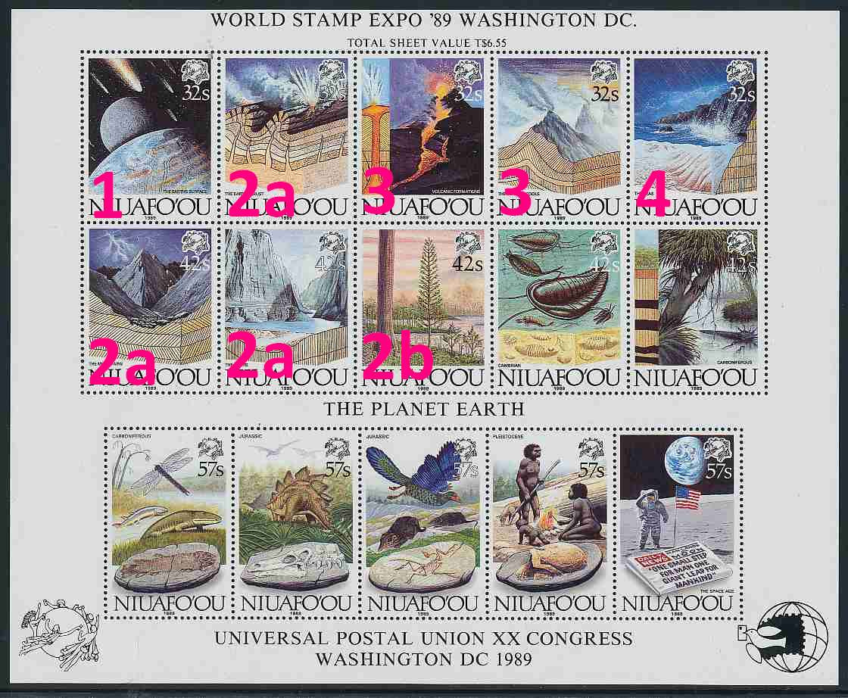
Some elements of geophysics related to meteorology
Asteroid/Meteorite strike
Continental Drift
Vulcanism
Oceans
Notes:
This minisheet includes stamps that made me think of various aspects of meteorology in the context of geophysics, as listed in red at the left. What is going on with the stamp labeled 2b, you ask? We’ll see shortly.

Slide 9
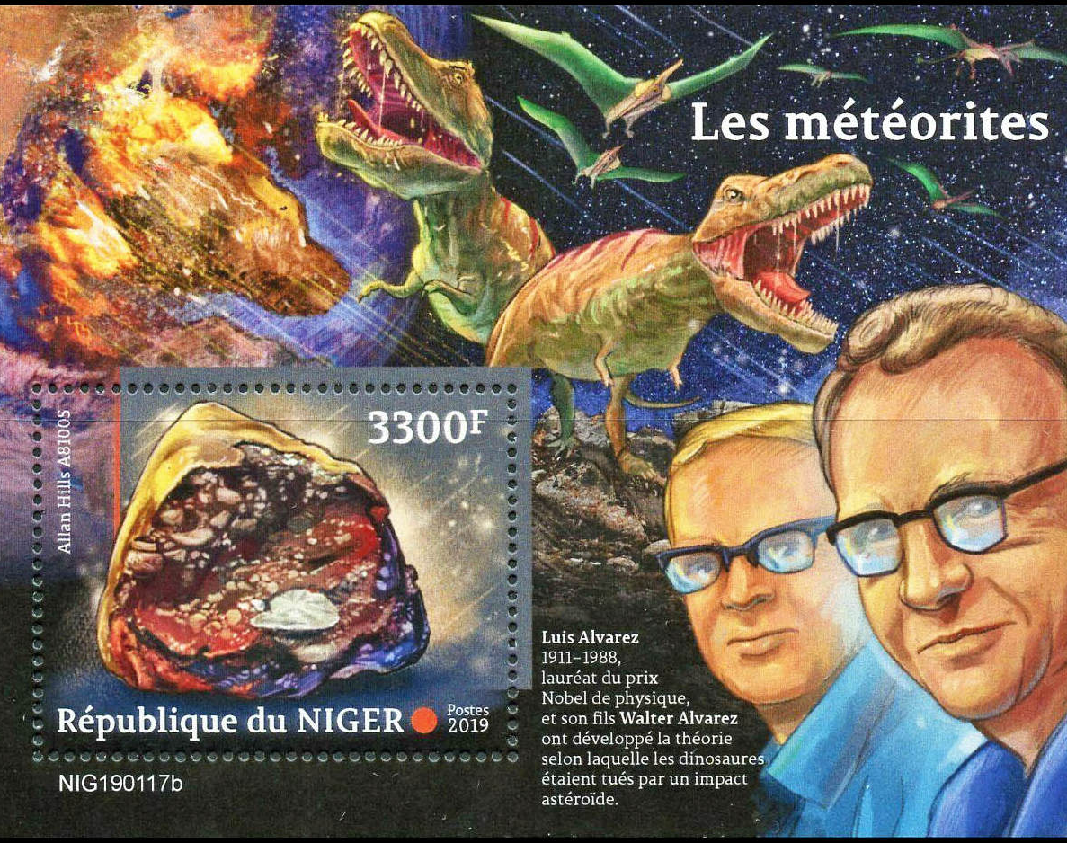
Alvarez theory - ~10 km diameter meteorite (asteroid) impact
65 million years ago
Changed climate
Chicxulub crater (Yucatan)
Alvarez (father & son) – iridium layer at Cretaceous-Tertiary (K-T) boundary
→ K-T extinction event
Notes:
Luis and Walter Alvarez (father and son) found evidence of a large meteorite impact that formed what is now known as the Chicxulub crater in the Yucatan area of Mexico around 65 million years ago. The vast amount of material it threw into the atmosphere changed the climate so much that the dinosaurs eventually died out. This is known as the K-T extinction event.

Slide 10
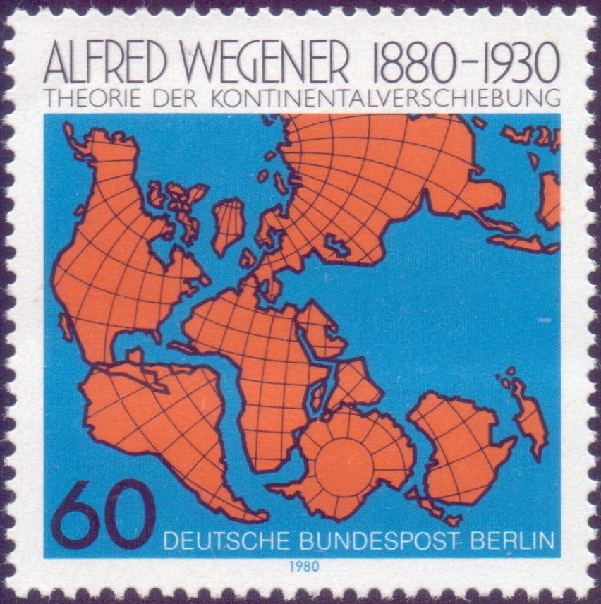
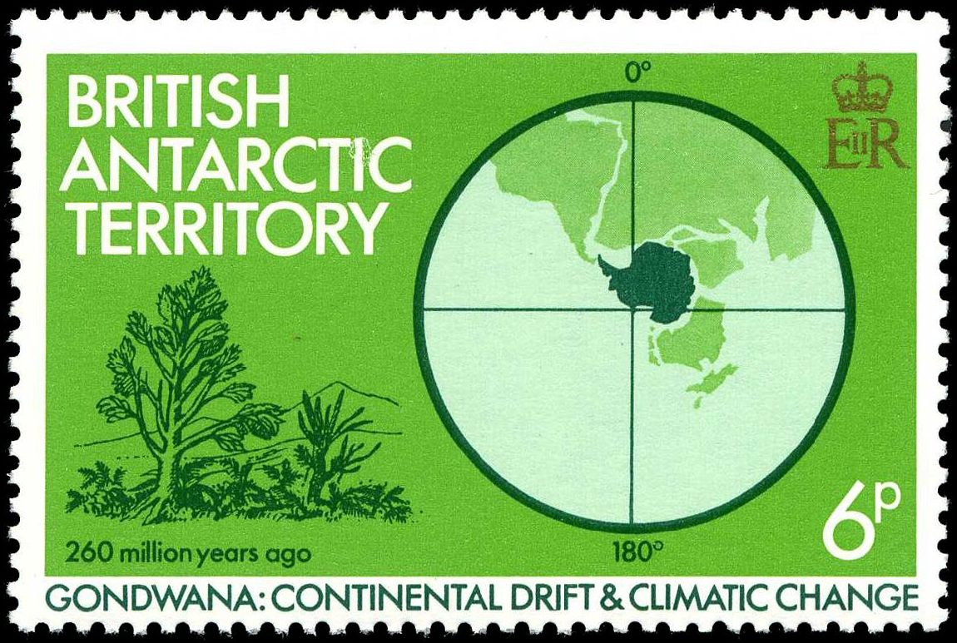
Continental Drift & Climate Change
Wegener – meteorologist who developed continental drift theory
Notes:
Alfred Wegener was a meteorologist who developed the theory of continental drift in the 1920s. When land “drifts” to different locations over tens of millions of years, its climate must change over that time period as well. The British Antarctic stamp shows warm weather-type plants and shrubs in Antarctica 260 million years ago.

Slide 11
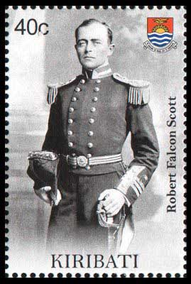
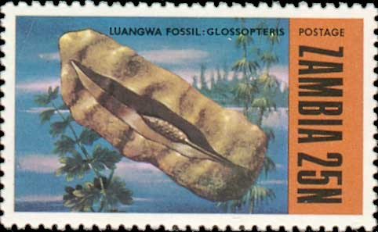
The disastrous Scott South Pole expedition collected fossilized Glossopteris leaves, recovered after their bodies were found. From a warm and wet climate, they were one piece of evidence supporting the idea of continental drift
Notes:
Scott of the Antarctic left a legacy that is partly scientific. His South Pole expedition collected fossilized Glossopteris leaves as it returned from the Pole. I thought of those Antarctic fossils when I looked at the stamp labeled ‘2b’ from a few slides ago. Scott’s devotion to science must have told him that the discovery could be important. Though he did not live to see it, those fossils did indeed become one line of evidence in the theory of continental drift.

Slide 12
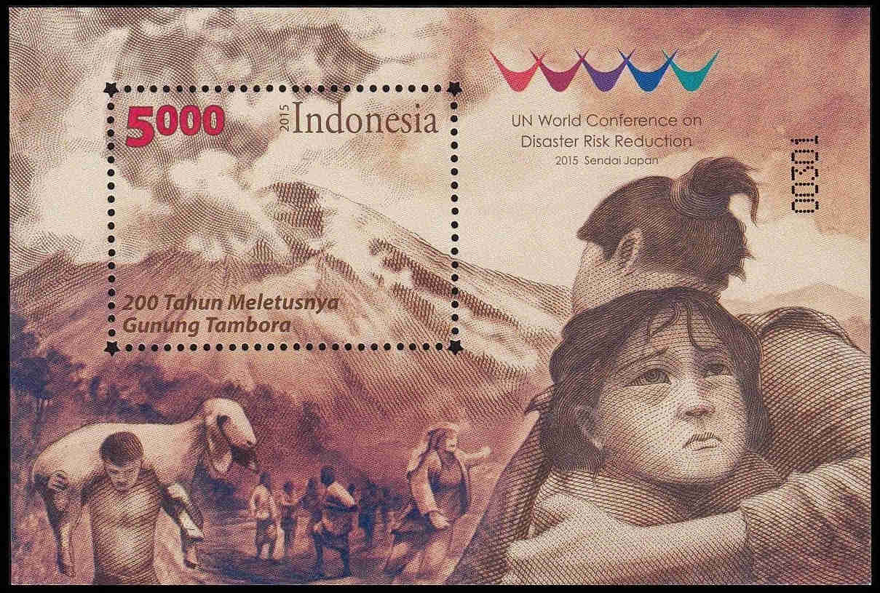
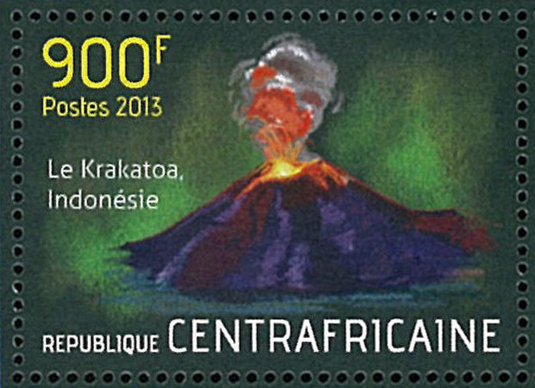
Major Volcanic Eruptions in Recorded History
Tambora’s eruption in 1815 was followed in 1816 by what was called in some areas a “year without summer”. Krakatoa’s eruption in 1883 also had significant climate effects.
Notes:
Tambora’s gigantic eruption of 1815 was followed by a calamitous “year without summer”. Research has shown that 1816 was the coldest northern hemisphere year since around 1400, with the exception of 1601 (which itself followed a major volcanic eruption, that of Huaynaputina in Peru). Krakatoa’s 1883 eruption, while weaker than that of Tambora, was still followed by significant climate effects in various parts of the world.

Slide 13
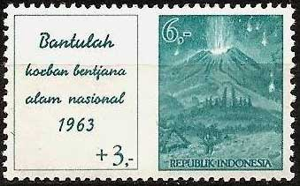
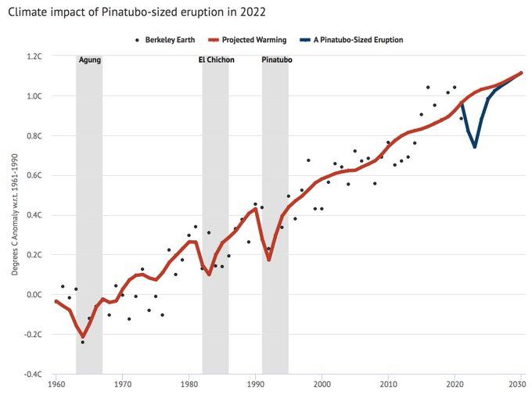
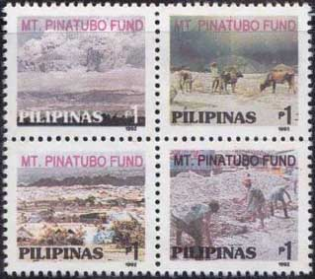
Recent Large Eruptions
Agung (1963)
Climate impact (~0.2°C of cooling for ~3 yr) of Pinatubo, Agung and El Chichón (1982) – dotted observations and red model forecasts
Pinatubo (1992)
blue is for the recent Hunga Tonga eruption if similar size (but it was much smaller, so that cooling won’t happen)
Notes:
Three recent large eruptions are presented here: those of Agung, El Chichón and Pinatubo. In the graphic, the forecast global temperature from a climate model that “knows” about those eruptions is shown in red. In each case a cooling of about 0.2 degrees Celsius, over a period of about 3 years, is forecast. The observations, in dots, are noisy but the volcanic cooling can be identified in each case. The global effects of these three eruptions were measurable, but nowhere near the effects of Krakatoa and Tambora. The recent Hunga Tonga eruption (20 December 2021 to 15 January 2022) was not large enough to cause similar cooling.

Slide 14
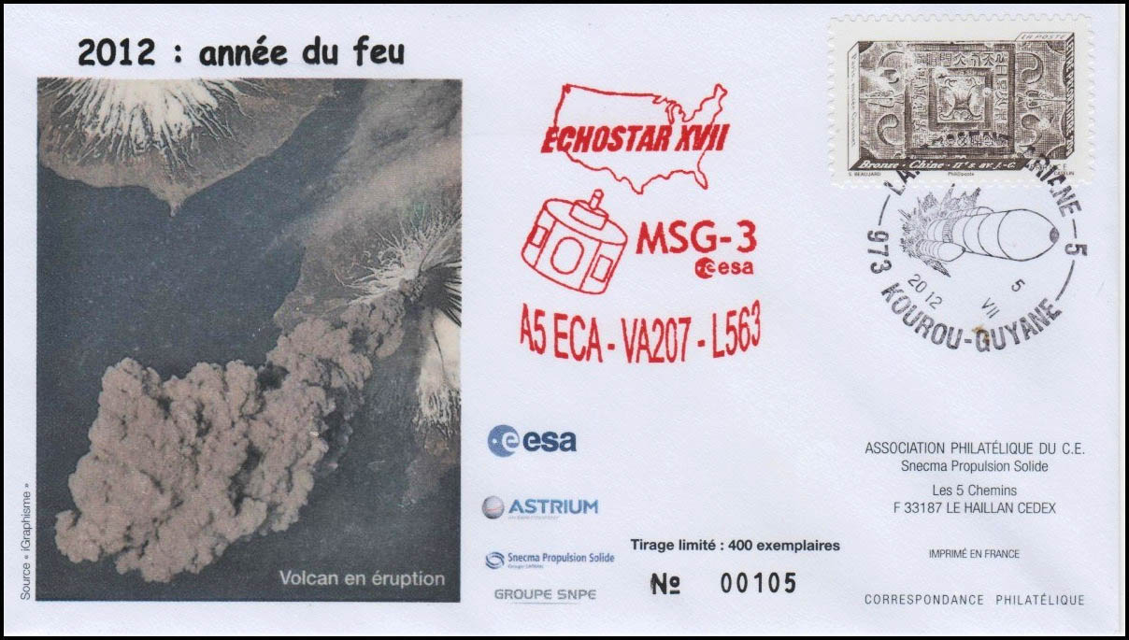
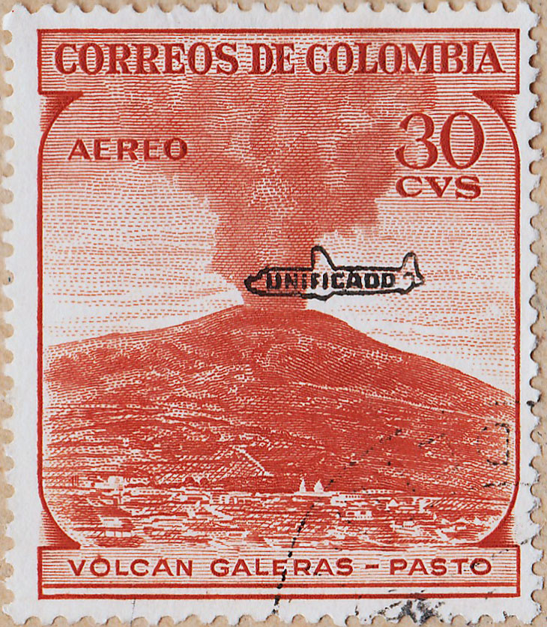
Volcanoes and Aviation
Eruption seen from ISS (Cleveland Volcano, Aleutians, 23 May 2006)
Volcanoes and airplanes don’t mix!
Notes:
Here are a volcanic plume seen from space and a stamp with a symbolic aircraft near an erupting volcano. Aircraft and volcanoes don’t mix! Volcanic ash can cause engine flameouts and other ugly aviation problems. Airspace gets closed when volcanoes erupt.

Slide 15
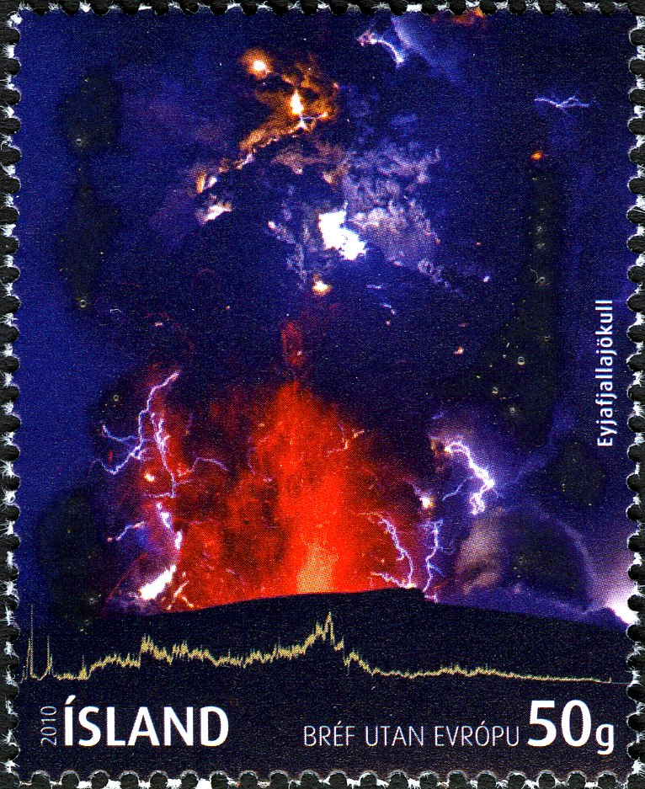
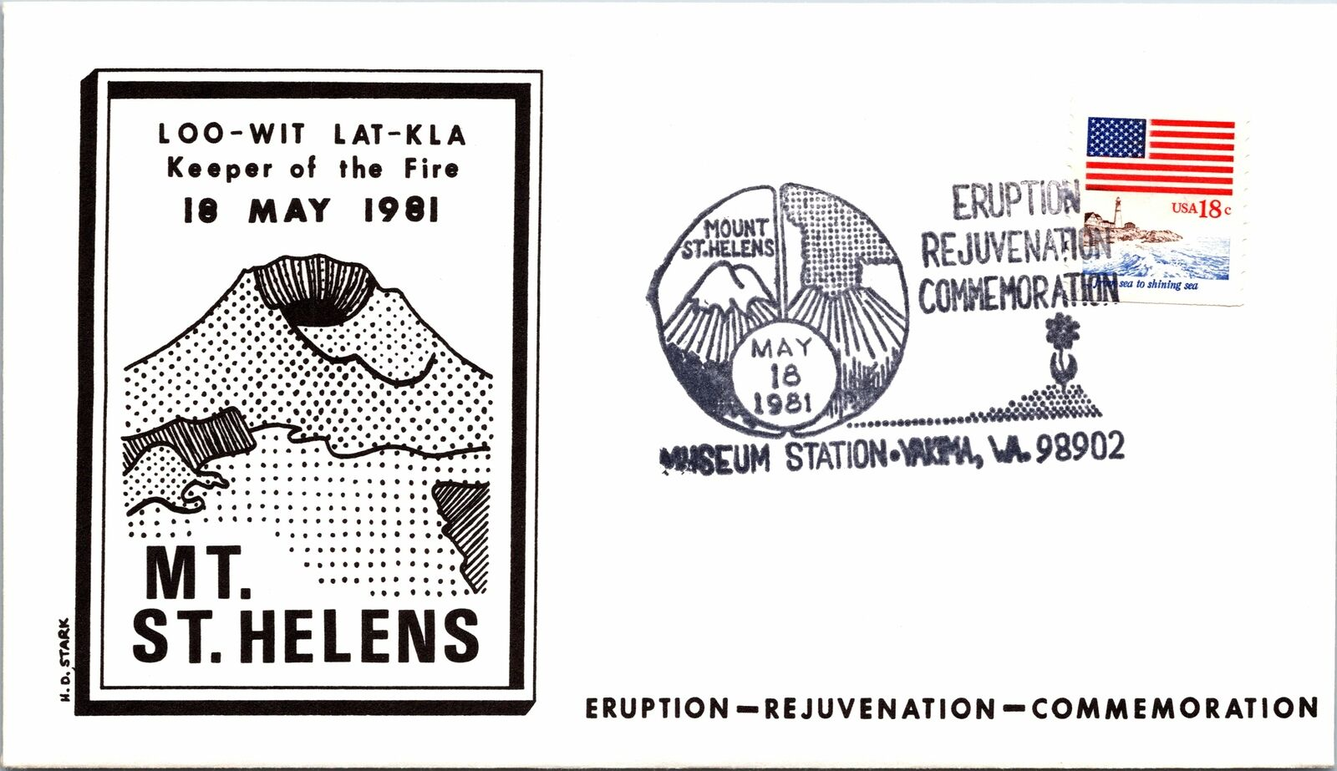
Two volcanoes that caused aviation problems and closed airspace
Eyjafjallajokull (Iceland, April 2010 eruption)
Mt. St. Helen’s, Washington State (18 May 1980 eruption)
Notes:
I was on duty in May 1980 in the Vancouver Weather Office during part of the Mt. St. Helen’s eruption, which affected Washington State and surrounding areas. We had to add VOLCANIC ASH to the aviation forecasts: a first for most of us. We had no forecast aids for ash. Forecast techniques and computer-based models were subsequently developed to guide forecasters in such situations. The second volcanic example will tax my limited Icelandic pronunciation skills: it shows the volcano Eyjafjallajokull, which erupted for 6 days in April 2010 and caused major disruptions to air travel across western and northern Europe.

Slide 16
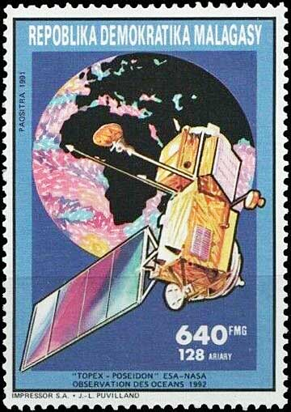
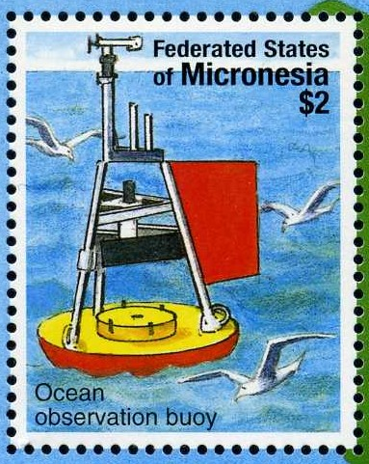
Ocean SST
Weather buoy observations
Satellite observations
Notes:
Sea surface temperature, with the common acronym “SST”, is an essential physical field in meteorology. It is measured by some satellites such as Topex-Poseidon and by a network of ocean weather buoys with water temperature sensors. It is also measured by many ocean-going ships.

Slide 17
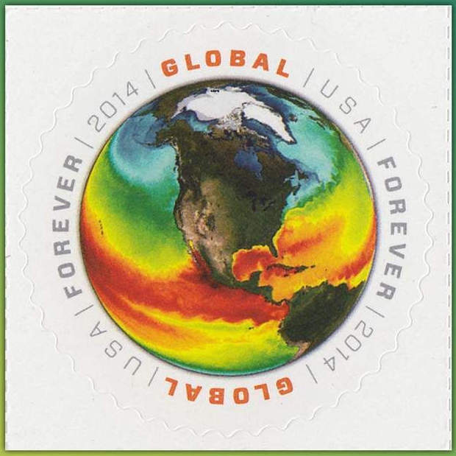
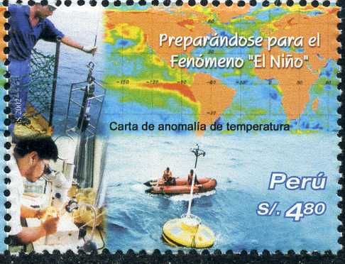
Sea Surface Temperatures (SSTs)
SST anomalies (in this map, with El Niño off Peru)
Notes:
SSTs can be visualized in two different ways. As in the stamp at the left, the actual values can be plotted, with the warmest waters in red tones and the coldest in blue tones. SST anomaly maps are common. They show the differences between the observed and the average SST values. This makes areas that are colder or warmer than normal stand out. The Peruvian stamp shows a red area over the eastern Pacific that is much warmer than normal: an El Niño situation. In such a pattern, Peru can expect heavy rain with flooding and mudslides, and other areas of the world can also experience unusual weather.

Slide 18
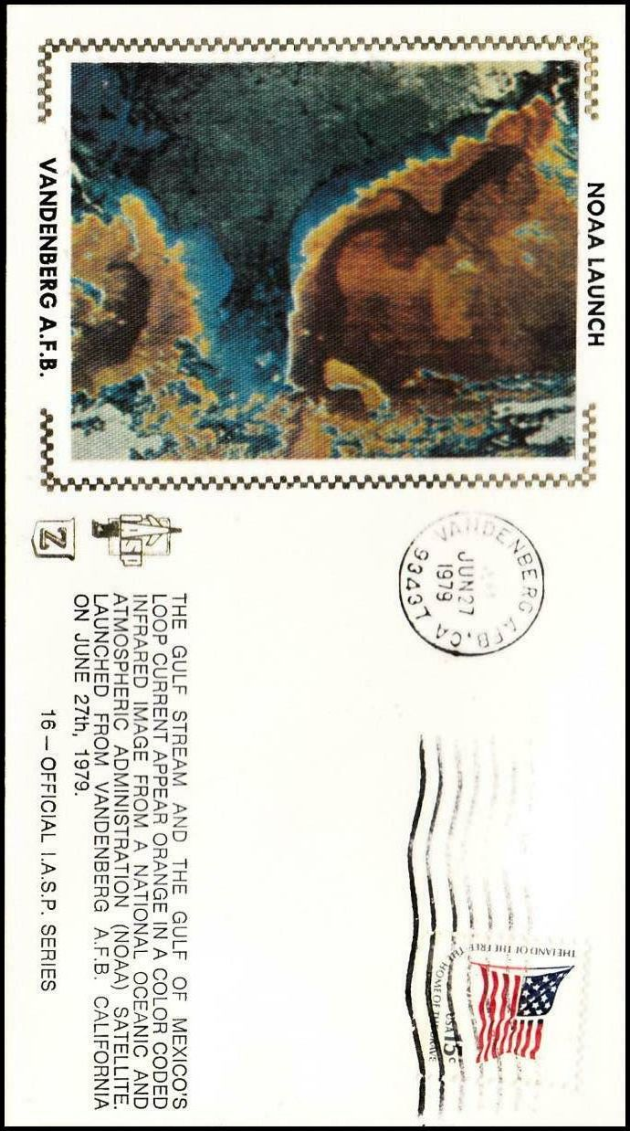
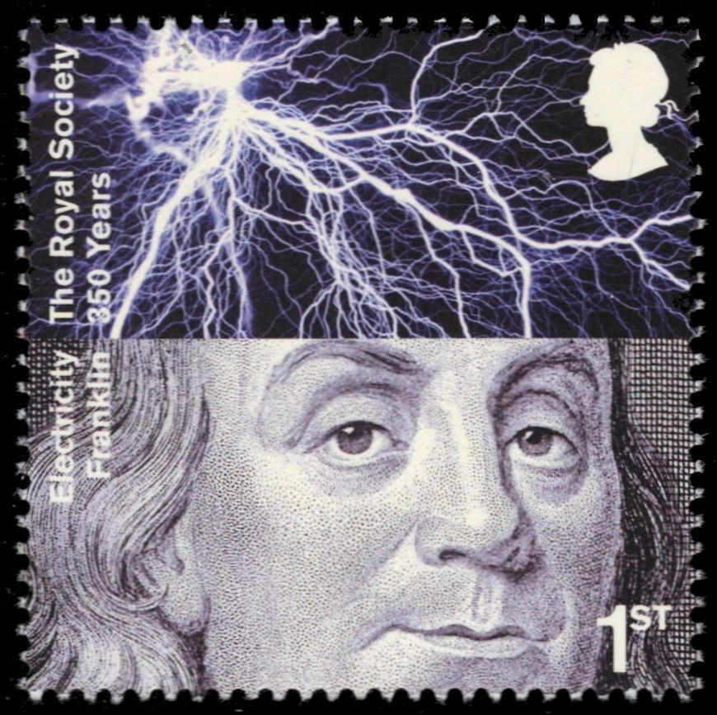
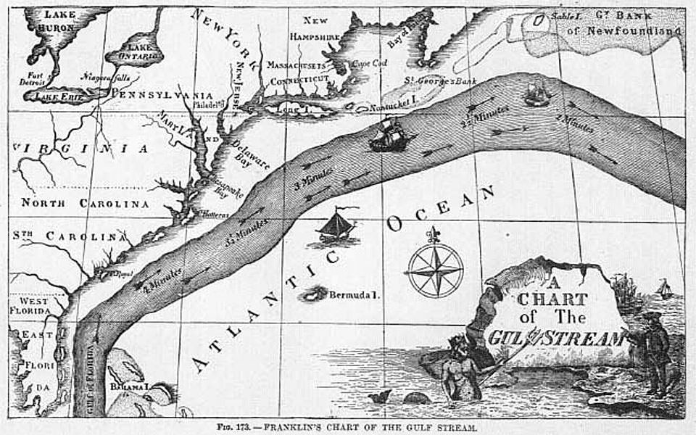
In 1769, Benjamin Franklin published the first known map of the Gulf Stream
Warm Gulf Stream (and Gulf of Mexico Loop Current) seen from space (by NOAA-6)
Notes:
The cachet of the cover at the left shows a satellite image of the SSTs in the Gulf of Mexico and the western Atlantic. The warm Gulf Stream is clearly visible in brown tones off the US East Coast. It is important because it moves massive amounts of heat northward. Benjamin Franklin studied the Gulf Stream and in 1769 published the first map known to show it.

Slide 19
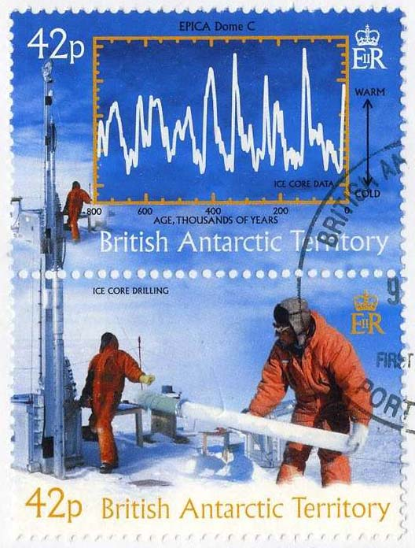
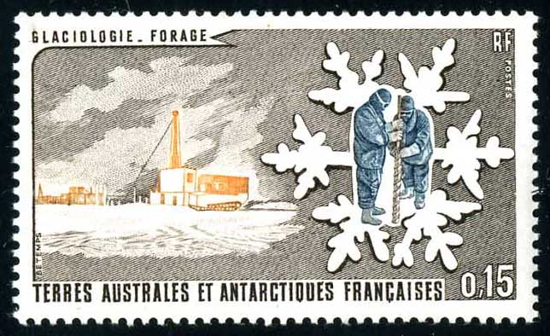
Glaciology and Ice Coring
Historical temperatures can be estimated from ice cores
Glaciology, Ice Coring and Snowflake
Notes:
The first regular meteorological observations date from roughly 1850. Ice cores are important in climatology since they can provide estimates of historical temperatures and their natural variations through long periods of time. A 3053-meter-long ice core from the Greenland ice sheet has provided a record through at least 110,000 years, while some Antarctic cores provide information as far back as 800,000 years, as shown in the graphic in the British Antarctic stamp. The snowflake, a sort of universal meteorological symbol, represents ice coring and glaciology in the stamp at the right.

Slide 20
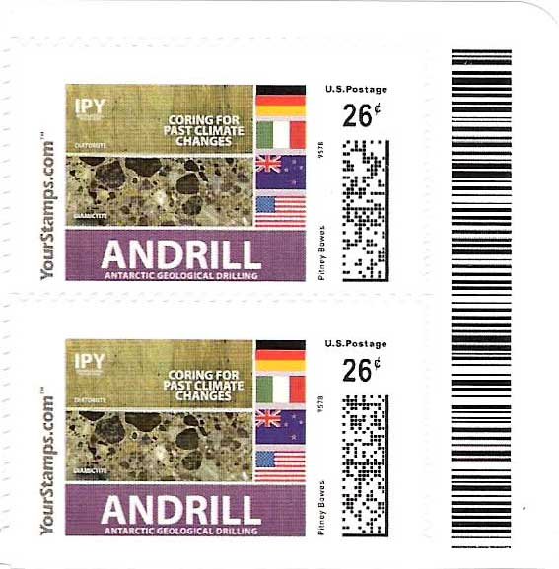
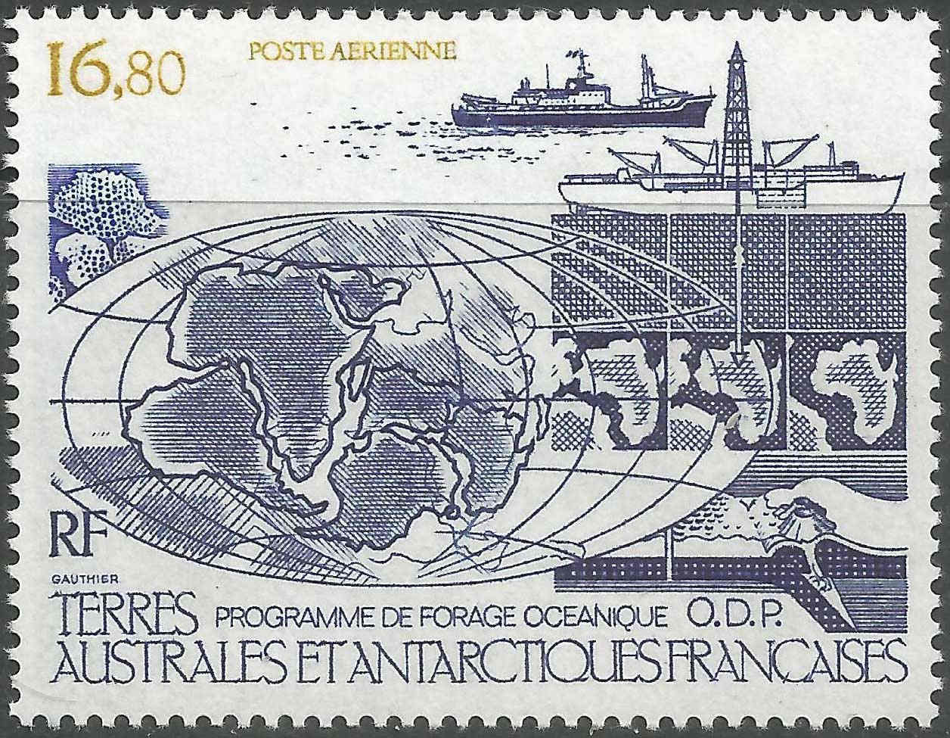
Ocean Floor Sediment Coring
Ocean sediment “coring for past climate changes”
Ocean sediment coring and continental drift
Notes:
Coring of the ocean floor can also reveal information about past climates, which in turn can be used as further support for the science of continental drift and plate tectonics.

Slide 21
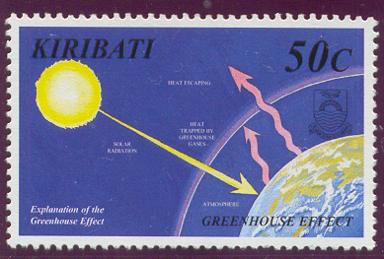
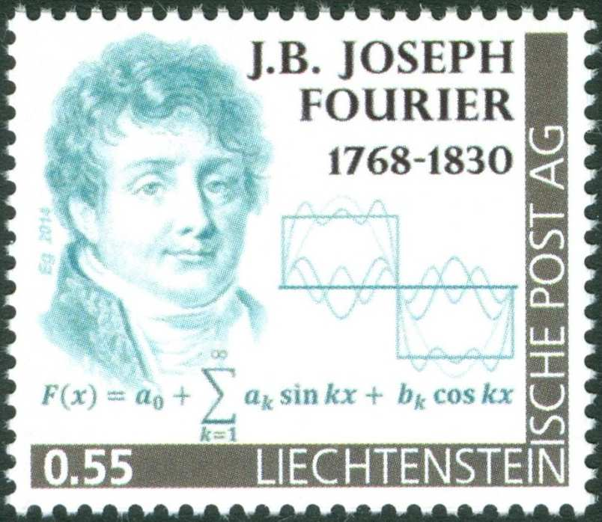
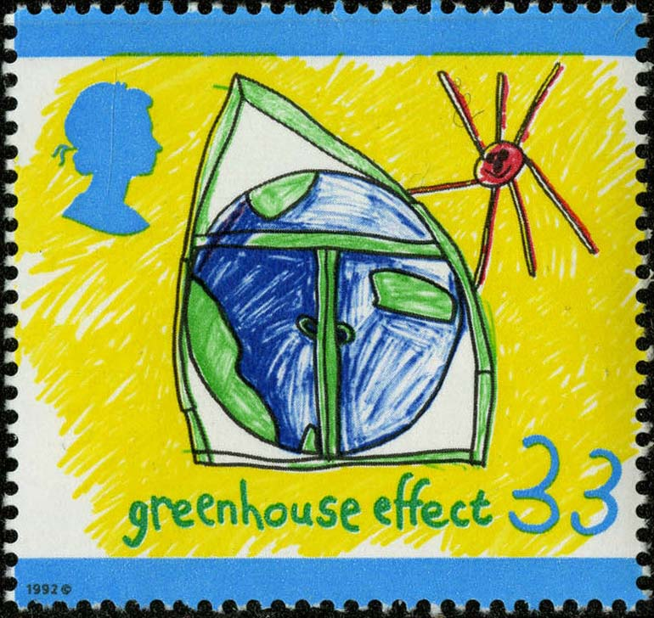

Global Warming and Climate Change
~1825 – Fourier - 1st to present the idea of the atmosphere as an “insulator” (the atmospheric “greenhouse effect”)
Atmosphere traps some outgoing L/W radiation. More greenhouse gases → more trapping → temperature rises
Venus – extreme greenhouse effect – surface temperature ~462° C
Notes:
In the mid-1820s, the French mathematician Fourier was the first to propose that the atmosphere acts as a sort of “insulator” that warms Earth by trapping some of its outgoing long wave radiation. This idea came to be known as the greenhouse effect. If there were no atmosphere, Earth’s surface temperature would be about 33 degrees Celsius colder than it is now. The burning of fossil fuels adds greenhouse gases to the atmosphere, which trap more long wave radiation than before, so that the temperature is forced to rise. The planetary champion of the greenhouse effect is Venus, where at the surface it is a balmy 462 degrees Celsius!

Slide 22

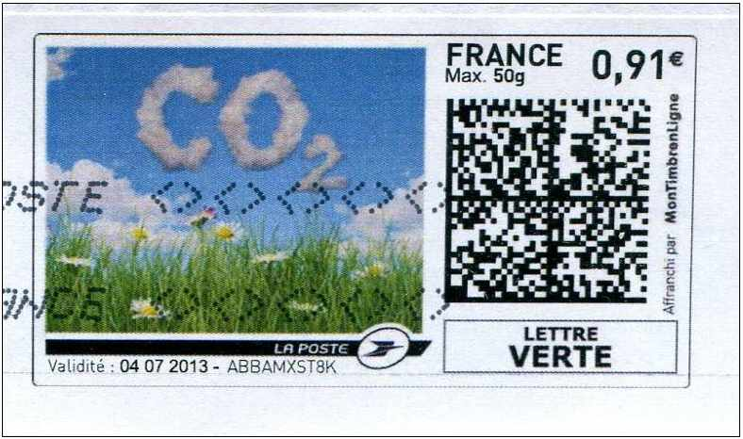
Fossil fuel burning increases CO2 in Earth’s atmosphere
Notes:
Fossil fuel burning is one of the causes of increased carbon dioxide, a greenhouse gas, in the atmosphere, and therefore one of the causes of anthropogenic global warming and climate change.

Slide 23
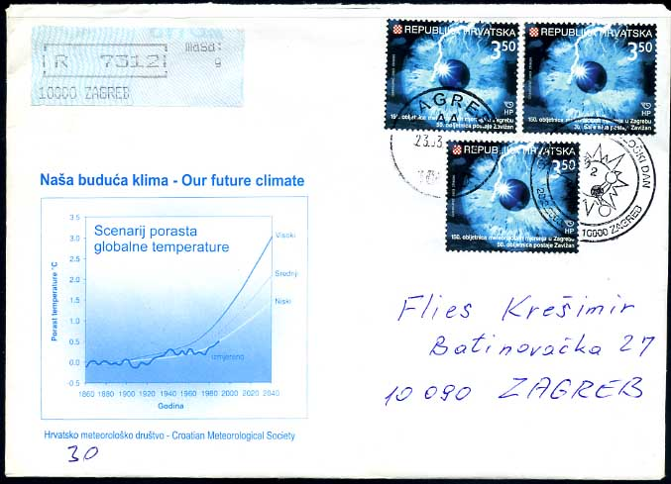
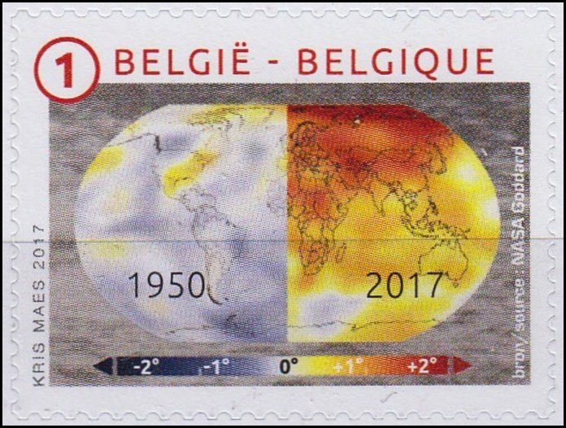
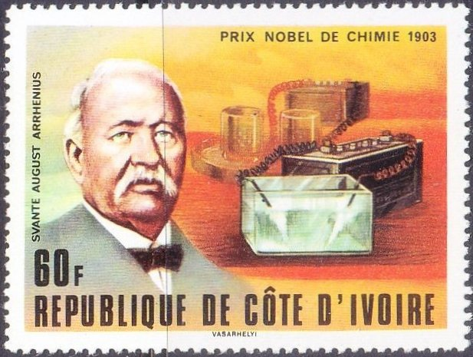
Global Warming
Forecast
Observed
Arrhenius – 1896 – 1st forecast of warming due to CO2 release
Notes:
The temperature anomalies in the Belgian stamp illustrate the global warming from 1950 through 2017. The graphic in the Croatian cover shows global warming information in another way: it presents climate model forecasts of rising global temperature anomalies through 2040 under three different scenarios. Climate models are a key tool in climate research. The first very simple forecast of global warming due to fossil fuel burning was done by Swedish chemist Svante Arrhenius in 1896. He based his work on an equation known as the Stefan-Boltzmann law. Modern climate and weather prediction models are in a different world in their complexity and completeness.

Slide 24
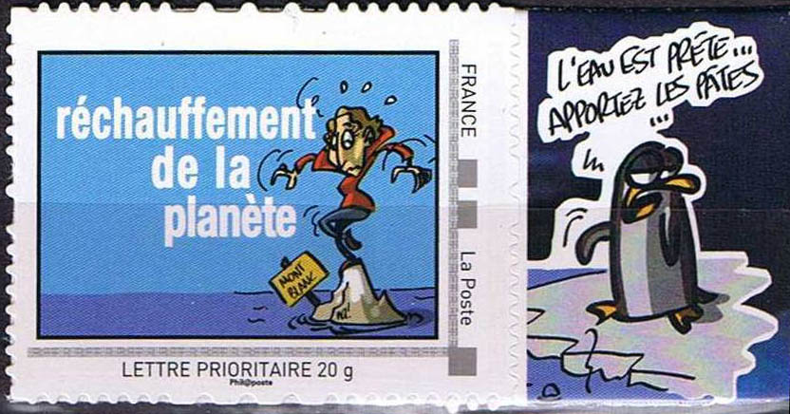
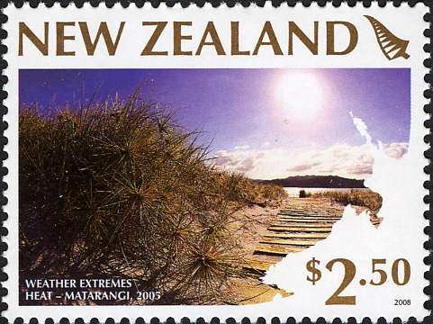
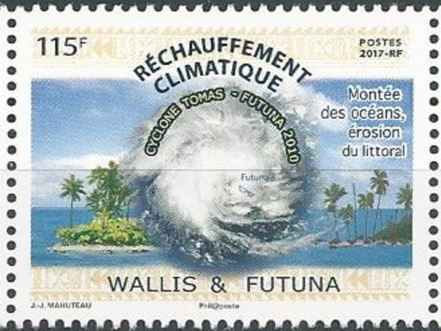
Some Impacts of Global Warming and Climate Change
Sea level rise, flooding and coastal erosion
Heat waves
Notes:
Climate change impacts include sea level rise, increased episodes of coastal flooding and coastal erosion, and heat waves that are more frequent and more intense than before. As an example of the latter, the town of Lytton in southwestern British Columbia broke the all-time Canadian heat record for three days in a row in June 2021: 46.6 degrees Celsius on the 27th, 47.5 on the 28th and 49.5 on the 29th. The town then burned down on the 30th. The previous Canadian record, from July 5, 1937, was 45 degrees C in southern Saskatchewan.

Slide 25
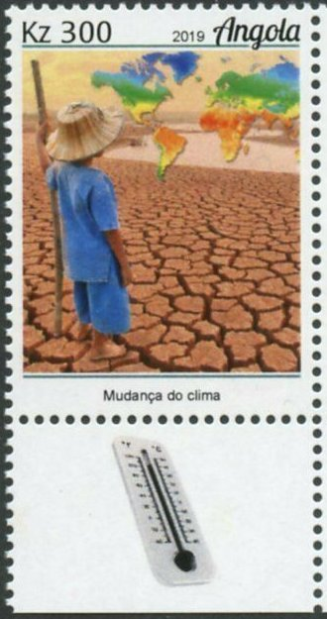
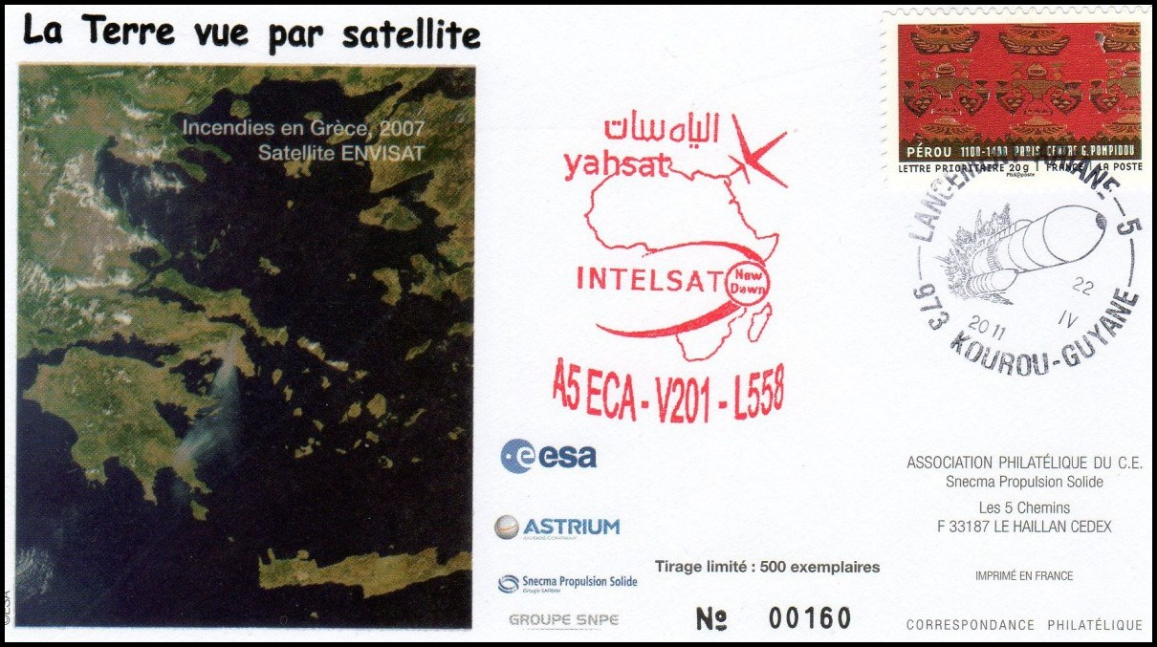
Drought
Wildfires (in forests, but also in built-up areas)
Notes:
Drought and wildfires are expected to be more frequent and more intense as a result of climate change. Serious wildfires can occur in built-up areas as well as in forests. In the stamp, parched and cracked ground symbolizes drought. The cachet of the cover shows a view from the Envisat satellite of a plume of smoke from the major Greek wildfires of 2007.

Slide 26

Health effects (e.g. due to heat waves, poor air quality, changing patterns of disease and migration of insects, severe weather, etc)
Notes:
Climate change also impacts human health. The cancel in the cover encourages us to protect health in the face of climate change. The colorful cachet presents a worldwide map of the “Estimated Deaths Attributed to Climate Change in the Year 2000, by Subregion”. Recent numbers are undoubtedly worse.

Slide 27



Ozone
Molina and ozone equation
Antarctic ozone hole
Healing the hole – 1987 Montréal Protocol – phase out CFCs
Also, World Ozone day, each year on 16 September
Notes:
In the early 1980s scientists such as Dr. Mario Molina showed that chlorofluorocarbons (CFCs) released into the atmosphere were destroying ozone. An Antarctic ozone “hole’ had formed. It is depicted in the Cuban stamp. A simplified equation in the Mexican stamp carries the essence of the process: chlorine combines with ozone to yield chlorine monoxide and oxygen. In a rare display of unity, the nations of the world agreed to phase out the use of CFCs in an agreement known as the 1987 Montréal Protocol. It was a success and has since been updated. To emphasize the importance of ozone, the UN sponsors the International Ozone Day each September 16. The Bangladeshi stamp commemorates the Protocol and the Ozone Day from 2012.

Slide 28


Ice Ages
1930s – Milankovic – mathematical relationships between the cycles of the Ice Ages and changes in Earth’s orbital eccentricity, axial tilt and precession
16,000 BC - maximum glaciation and minimum sea level
Notes:
The Ice Ages reflect natural variations of climate. The Jersey stamp estimates that in 16,000 BC, sea levels were about 100 m lower than they are now because so much water was locked up in the ice. In the 1930s, the Serbian physicist Milutin Milankovic developed a mathematical theory explaining Ice Age cycles through known long-term changes in several of Earth’s orbital parameters.

Slide 29


Some Storms 1
Hurricanes/Typhoons/Cyclones
Notes:
I conclude Part 1 of this presentation with some examples of storms on stamps. Here we have a nice 3-dimensional depiction of the airflow in a hurricane, and the extensive damage caused by Cyclone Tracy in Darwin on Christmas Day of 1974. In Australia and the Indian Ocean, the storms that we call “hurricanes” are termed “cyclones”.

Slide 30

Some Storms 2
Tornadoes
Notes:
Here is a tornado. It looks much more destructive than what Dorothy experienced in the tornado that carried her to Oz. In the stamp and the part of the cachet that matches it, a tornado beneath a massive, dark and threatening cumulonimbus supercell appears to be obscured by the dust and debris around it.

Slide 31


Some Storms 3
Windstorm
Blizzard (US Scott 292, year 1898)
Notes:
Here we see Santa fighting a windstorm in a British design. To the right, the “Western Cattle in Storm” stamp can be interpreted as illustrating a High Plains blizzard. Issued in 1898, this is the earliest known stamp that includes a meteorological theme. Interestingly, the image was taken from a painting called Vanguard by the Scottish artist John MacWhirter. That painting is based on a scene from the Scottish Highlands!

Slide 32

Part 2 – Space Weather
The auroras symbolize space weather
The effects of “storms” of solar energy and particles on Earth’s atmosphere, on its biology and technology, and on the near-Earth space environment
“near Earth” – as far as the Moon
Such effects also exist elsewhere in solar system (e.g. deep space, other planets)
Iceland Scott C17, year 1934
Notes:
Part 2 of this presentation discusses Space Weather, which I define as “the effects of ‘storms’ of solar energy and particles on Earth’s atmosphere, on its biology and technology, and on the near-Earth space environment”. Related effects farther out in the solar system will be mostly ignored. The auroras are a common manifestation of space weather and can even be said to symbolize it. The Icelandic stamp, issued in 1934, is the earliest known stamp that unambiguously depicts an aurora.

Slide 33



Antecedents 1 – Earth magnetism
An early Chinese compass (ca 400 BC) – magnetized iron spoon on bronze plate
Halley’s map of lines of magnetic variation of the compass (1701)
Notes:
The fact that Earth acts as a magnet was known to the early Chinese, who by 400 BC had built an early compass consisting of a magnetized iron spoon on a decorative bronze plate. Others also studied magnetism, and in 1701 Edmund Halley published the first map of the lines of magnetic variation of the compass. In 1716 he suggested that the auroras are caused by what he termed ‘magnetic effluvia’ moving along Earth’s magnetic field lines.

Slide 34



Antecedents 2 - Auroras
Spirits of the Dead in the sky, playing a ball game with a walrus head?
Angels in the sky?
Von Humboldt -1805 – observed strong variations of the magnetic field in the presence of auroras → term “Magnetischer Sturm”. BUT was its origin terrestrial or external?
Notes:
Mythology had its own ideas. The auroras might be angels in the sky, or Spirits of the Dead playing a ball game with a walrus head! Various scientists considered the question in their own way. In 1805, Von Humboldt observed strong variations of the magnetic field in the presence of auroras, and so coined the term “Magnetic Storm”. He didn’t know, however, whether the origin of such a storm was terrestrial or external.

Slide 35


The Carrington Event
Magnetic & electric fields
What relation to solar storms and auroras?
Earth-based research →
Some balloons & rockets →
IGY & Space Age satellites
Notes:
The Carrington event was a massive geomagnetic storm whose solar origins, in the form of “white light flares”, were observed by chance by British astronomer Richard Carrington. Around 17 hours later, things went haywire on Earth. Brilliant auroras were seen as far south as Panama, and telegraph communications failed. Maxwell had demonstrated the link between magnetic and electric fields. Research turned to trying to understand what link, if any, those fields had with geomagnetic storms and auroras. Scientists also wondered about the relations between solar storms and geomagnetic storms. These were questions about what eventually would be called “space weather”.

Slide 36




The Space Age – A Great Leap Forward in Space Weather
Sputnik-1: begin the Space Age
Explorer-1 discovers the Van Allen Radiation Belts – 31 Jan, 1958)
Solar Wind – stream of charged particles from the Sun; average 400 km/s (1.5 million km/h); ~4 days Sun-Earth but can be MUCH faster – 17 hr in the Carrington event
Mariner-2 discovers the solar wind in 1962
Notes:
The beginning of the Space Age can be defined by the launch of Sputnik-1 on October 4, 1957. Artificial satellites would provide great advances in the science of space weather. For example, Explorer-1, launched January 31 1958, discovered the Van Allen Radiation Belts. Mariner-2, on its way to a fly-by of Venus in 1962, discovered the solar wind. What is the solar wind? A stream of charged particles constantly emitted by the Sun that can undergo major changes in composition, energy and speed due to solar storms.

Slide 37


The Magnetosphere
Notes:
Earth’s magnetic field, symmetrical if in isolation, is distorted by the pressure exerted on it by the solar wind. It is compressed on Earth’s dayside and stretched out on the nightside, forming what is termed the magnetosphere, which has a pattern of magnetic field lines as shown in the British Antarctic stamp.

Slide 38



Solar storms → Energetic solar wind → Complex interactions in the magnetosphere among that solar wind & magnetic & electric effects → geomagnetic storm → energetic particles accelerated into polar regions → Auroras
Helios-1 was launched in 1974, and OGO-4 in 1967
Notes:
Satellites such as Helios-1, and the fourth Orbiting Geophysical Observatory (OGO), measured the solar wind and magnetic and electric fields in near-Earth space. Some solar storms intensify the solar wind, which can in turn interact in a complex way with magnetic and electric fields in Earth’s magnetosphere, creating a geomagnetic storm and accelerating high-energy particles into the polar regions, thus causing the auroras. The Soviet stamp hints at some of this complexity in an artistic fashion.

Slide 39



Auroral research – involves the study of high-energy solar particles in polar regions
Auroral research rocket
e.g. by satellites such as ESRO-4 and Swedish Viking, and by research rockets
Swedish Viking satellite (launched in 1986)
Notes:
The study of high energy solar particles in polar regions is therefore important in auroral research, whether it be by satellites such as ESRO-4 or the Swedish Viking, or by research rockets.

Slide 40

OSO-1 – An Early Solar-Observing Satellite
Notes:
OSO-1 was one of the first satellite solar observatories. Already in 1962, scientists were interested in the “stormy surface of the Sun”.

Slide 41


Biological effect of space radiation levels – for Apollo program – Explorer-35
Notes:
Some high-energy particles in the solar wind can affect living tissue. If the exposure is great enough over a long enough period, cancer can develop. Explorer-35 was sent into lunar orbit in 1967 “to study radiation hazards facing the Moon-bound Apollo astronauts”. Many other satellites had similar missions.

Slide 42


Solar Wind Composition Experiment (SWCE)
Buzz Aldrin beside the SWCE (Apollo-11)
Stamp design based on this photo
Notes:
And speaking of the Moon, here is little-known Apollo experiment. A metal foil sail deployed by five different Apollo Moon missions was designed to sample the solar wind outside Earth’s magnetosphere. It was set up, exposed to the solar wind, and then taken back to Earth for analysis.

Slide 43


Two operational Solar & Space Weather Observing Satellites
DSCOVR SOHO
SOlar Heliospheric Observatory
Notes:
The satellites SOHO, an old-timer launched in 1995, and DSCOVR, the new kid on the block launched in 2015, “float” in orbit the Lagrange Point L1 at around 1.5 million km from Earth. They constantly monitor the Sun and are essential tools in space weather research and forecasting.

Slide 44


Major Space Weather Storms – and Impacts
Biological
Telecommunications
Aviation (ATC, navaids, landing aids)
Navigation (e.g. 13 Dec 2006 – GPS outage on sunlit side of Earth)
Power grids (e.g. QC 13 Mar 1989)
Satellites (anomalies, damage and even loss, or orbital decay)
Auroras
Solar Flares CMEs (Coronal Mass Ejections)
Notes:
Among other observations, SOHO and DSCOVR watch for solar flares (intense white light storms) and Coronal Mass Ejections (huge explosive ejections of solar matter, often looking like giant loops). Such solar storms can induce geomagnetic storms which impact Earth in various ways, as in the text at the right. One example is power grid failures due to induced currents in transmission lines. I was on duty in Montreal the night of March 13, 1989, when a geomagnetic storm knocked out the Québec power grid, with spillover effects into the northeastern US. Similar outages have happened elsewhere, in other geomagnetic storms. As a result, Hydro companies have worked to better insulate their grids from this effect. Some other impacts will be briefly discussed in subsequent slides.

Slide 45

Impacts - Damage to Satellites due to Electrical Charging and Static Effects
Notes:
Some satellites have been damaged or even lost due to geomagnetic storms which caused induced electrical charging and static effects on electronic circuits or other equipment. The SCATHA satellite studied the problem. Satellite constructors have since hardened their designs in an attempt to minimize such impacts.

Slide 46


Impacts - Ionospheric effects (radio transmission and communications)
Notes:
Geomagnetic storms induced by solar flares can disrupt the ionosphere and the radio communications that take advantage of its normal structure. Many satellites, including Ariel-4, have studied geomagnetic storms in the ionosphere. In the stamp, scientists are studying the effects of the ionosphere on radio communications in northern Canada, an area where auroras are frequent.

Slide 47


Impacts - Loss of Satellites due to Atmospheric Density Effects
Notes:
On February 3, 2022, SpaceX launched 49 Starlink satellites into a low parking orbit, about 205 km high. However, a geomagnetic storm triggered by strong solar flares heated the atmosphere, and therefore expanded it, making it denser at the level of the satellites. This unexpected event caused significantly increased drag on the satellites. The orbits of up to 40 of them decayed enough that they were lost.

Slide 48


Closing Space Weather Stamp Images
Saturn aurora
IHY (2007)
Notes:
In addition to the SOHO satellite, the souvenir sheet issued by Guinea in 2007 for the International Heliophysical Year depicts the magnetospheric research satellite Cluster and symbolic lines of magnetic force all twisted up in space. It even throws in Carl Sagan for good measure! And finally, the souvenir sheet from Palau, issued in 1999, depicts a space weather effect from elsewhere in the solar system: the auroras of Saturn.

Slide 49

Hillger & Toth Weather and Climate Philately website https://rammb.cira.colostate.edu/dev/hillger/index.html
Notes:
I close this presentation with some references for the audience. My friend and colleague Dr. Don Hillger and I have been working together for 21 years on a philatelic website dedicated to Meteorology and to Un-Manned Satellites. The images in this presentation come from that website and we encourage interested collectors to consult it.

Slide 50

The Philately of Space Weather – Toth & Hillger references
1. Web page https://rammb.cira.colostate.edu/dev/hillger/space-wx.htm
2. Space Weather Handbook (Toth and Hillger) available through the ATA as Handbook 166E, or in DVD format
Notes:
As part of our Weather and Climate website, Don and I have a web page dedicated to Space Weather, which we attempt to keep up to date. Another resource is our handbook “Space Weather: A Philatelic Journey”, available from the American Topical Association in print and DVD formats.

Slide 51

https://www.swpc.noaa.gov
Notes:
Last but not least, NOAA’s Space Weather Prediction Center has a website with a wealth of information along with its space weather forecasts.

Slide 52

End
Thanks for listening.
Questions?
Notes:
Thank-you for your attention.

