Slide 1
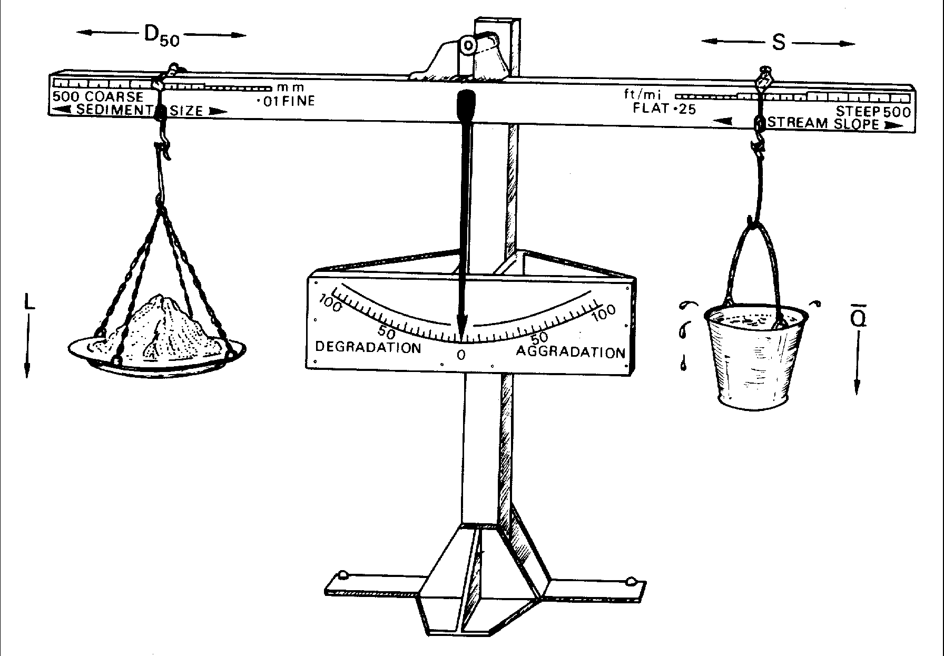
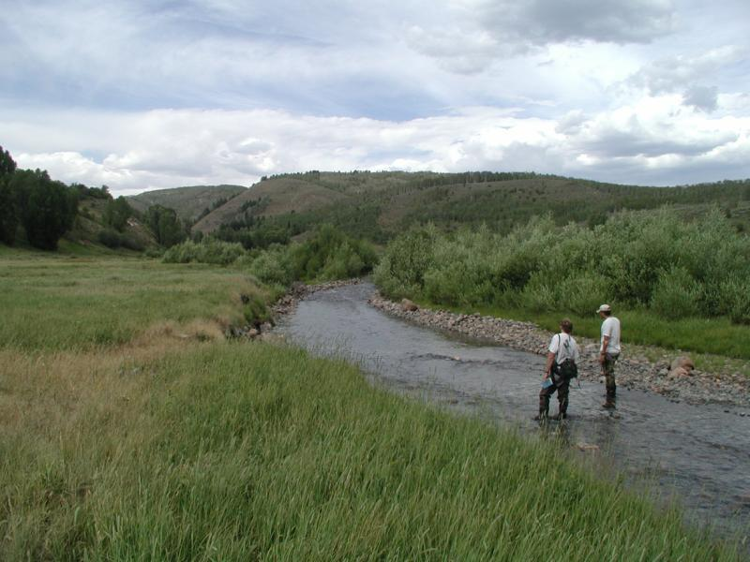
More Tools from Fluvial Geomorphology
Brian Bledsoe
Department of
Civil and Environmental Engineering
Colorado State University

Slide 2
Tools we will focus on at present:
Classifications – previous presentation
Hydraulic geometry
Planform geometry
Meandering / braiding ‘threshold’
Qualitative response models
Historical analysis

Slide 3
Hydraulic Geometry
An analog or regime approach

Slide 4
Regime Theory / Hydraulic Geometry
(e.g. Lacey 1929, Leopold and Maddock 1953)
Channel parameters may be sufficiently described with power functions utilizing Q as the sole independent variable

Slide 5
Hydraulic Geometry - Exponents
At-a-Station
Downstream
b is width, f is depth, and m is velocity

Slide 6
Downstream hydraulic geometry

Slide 7
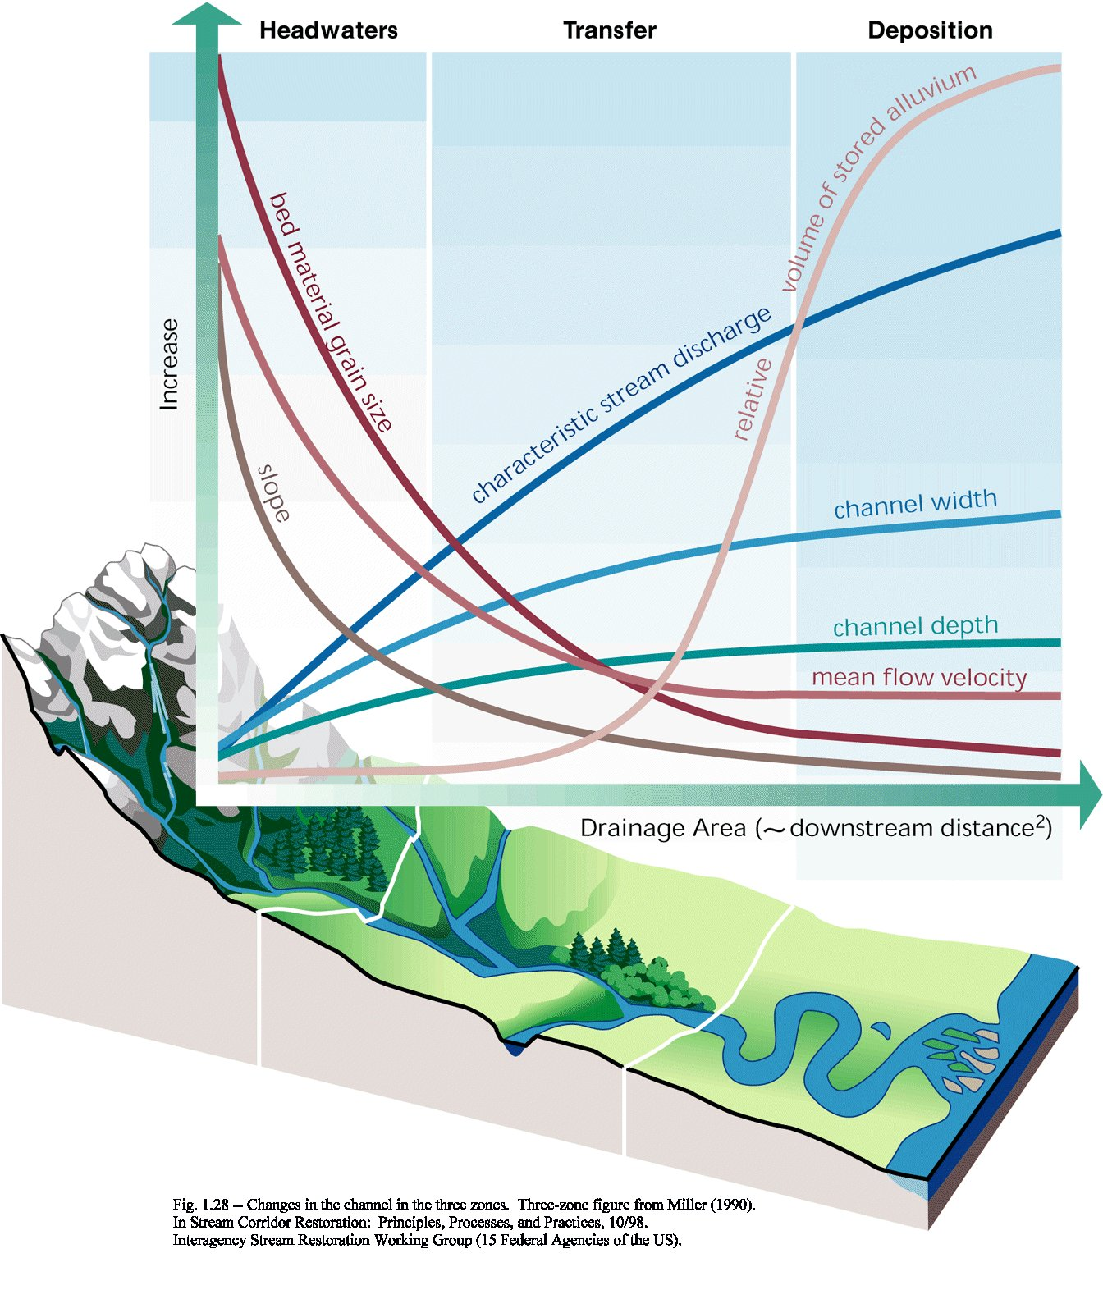

Slide 8
The Basic Issue
Predicting channel width / depth in the context of heterogeneous bed and bank conditions
  w, h, S, v
  Continuity
  Friction loss
  Sediment transport or incipient motion
  ???

Slide 9
Hydraulic Geometry Approach in Stable Channel Design
  Rooted in regime theory of Anglo-Indian engineers
    Canal design
    Low sediment loads
    Low variability in Q
  Does not directly consider sediment load (slope equations are dangerous for sand bed channels)
  Neglects energy principles and time scales of different adjustment directions
  Fluvial system is actually discontinuous,
  e.g. tributaries, variability in coefficients

Slide 10
Downstream hydraulic geometry equations for width provide an important channel design and analysis tool
Depth, velocity, and slope equations are less reliable

Slide 11
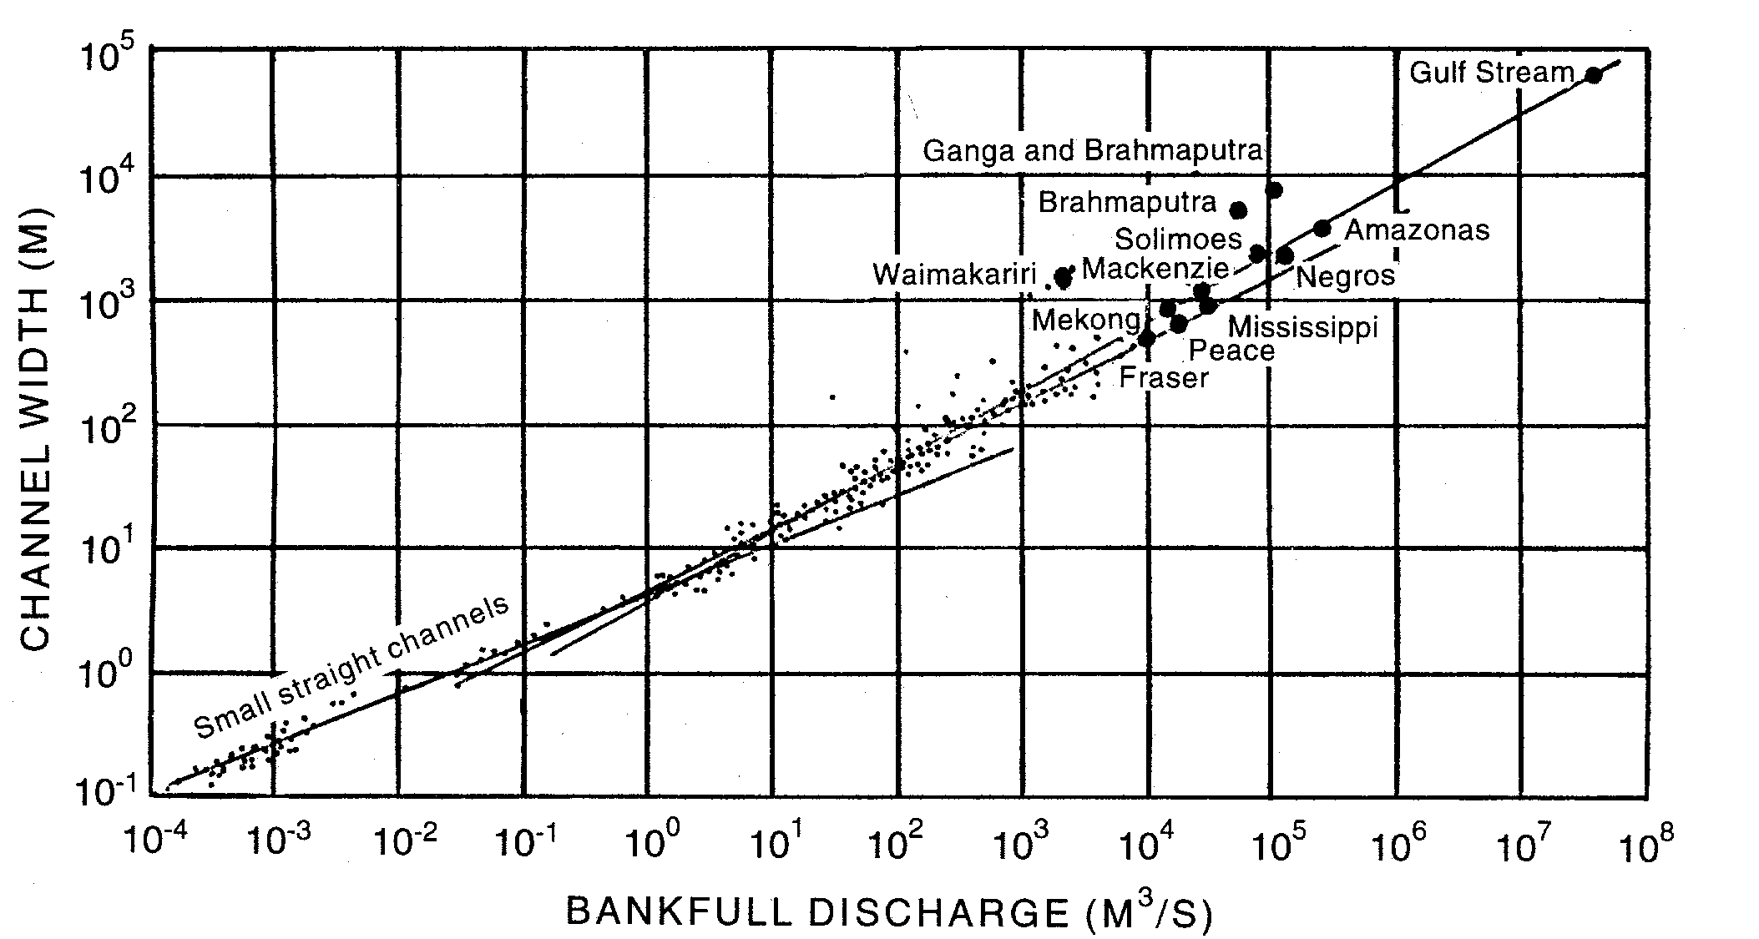

Slide 12
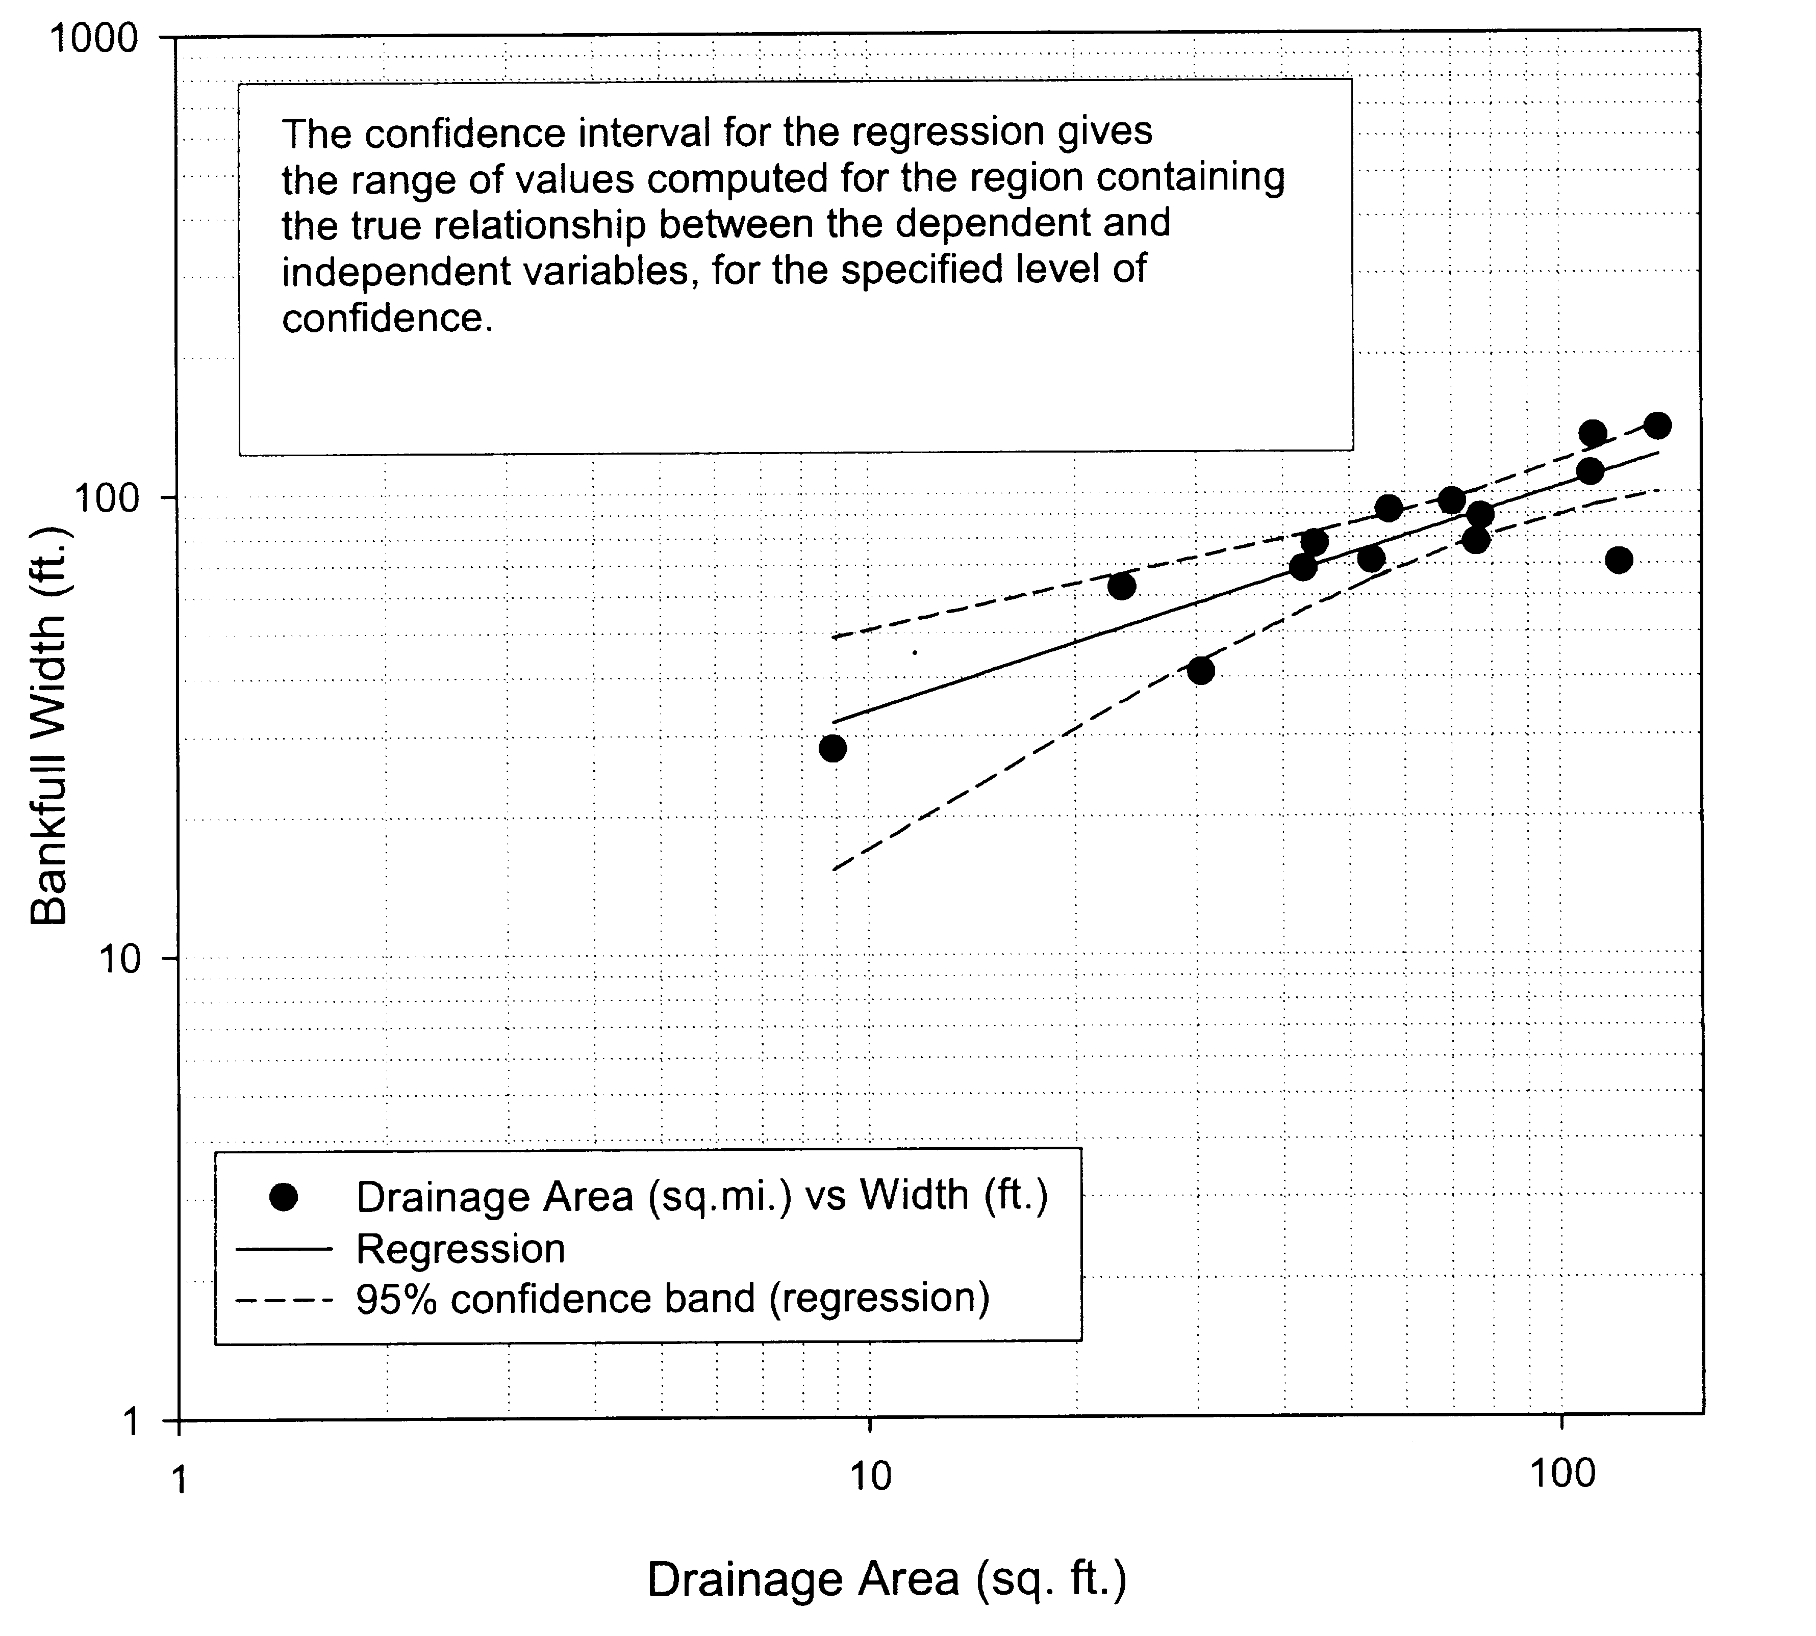

Slide 13
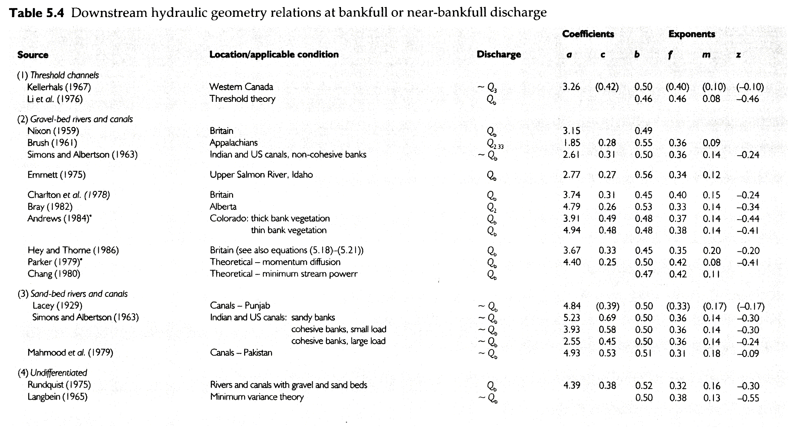

Slide 14
Some Factors Affecting a
Vegetation / soils / light interactions
Root reinforcement and depth / bank height
Woody debris inputs and bank roughness
Bank cohesion / stratigraphy / drainage
Freeze / thaw
Sediment load
Flow regime (e.g. elevation of veg. on banks)
Return period of extremes vs. recovery time
Lateral vs. vertical adjustability / time
Historical context

Slide 15
Downstream Hydraulic Geometry and Boundary Sediments
Schumm (1960)
Richards (1982)

Slide 16
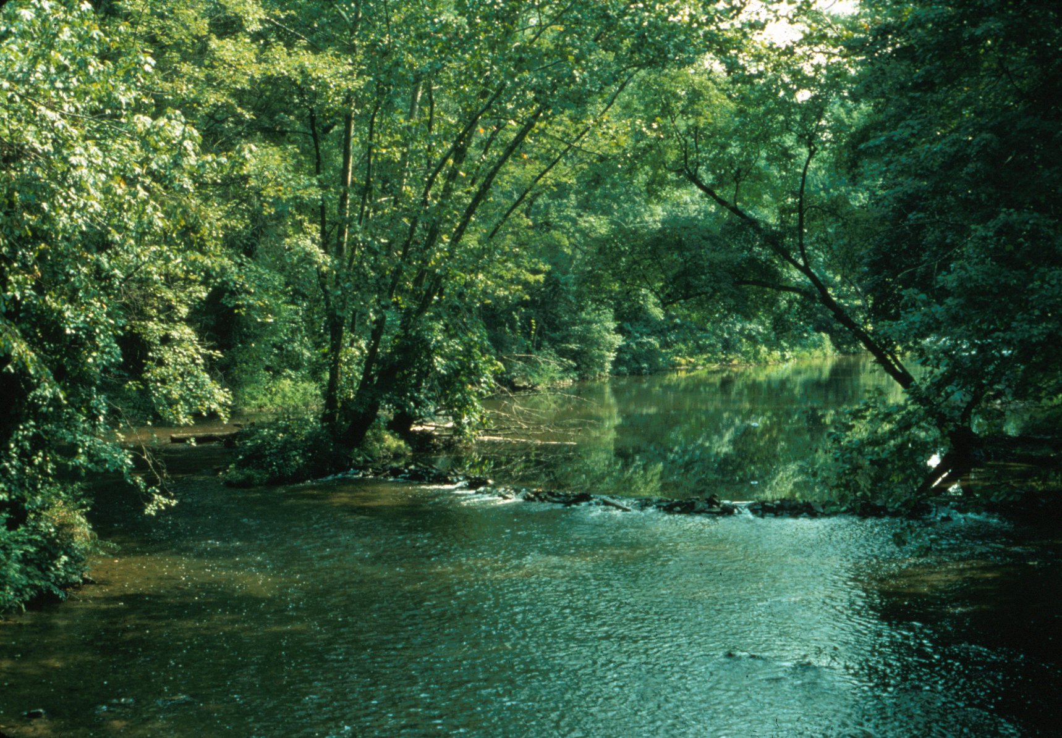

Slide 17
Hey and Thorne (1986)
All Veg. Types

Slide 18
Hey and Thorne (1986)
Separate Vegetation Types

Slide 19
Downstream Hydraulic Geometry and Vegetation – Gravel Channels
Hey and Thorne (1986)
Grassy banks → a = 4.33
1-5% tree / shrub → a = 3.33
5-50% tree / shrub → a = 2.73
> 50% tree / shrub → a = 2.34
Andrews (1984)
Thin → a = 4.3
Thick → a = 3.6

Slide 20
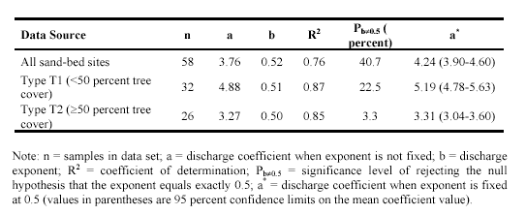
Downstream Hydraulic Geometry and Vegetation – Sand Channels
Small rivers are not well represented in the data set, and extrapolation is required if applied when discharge is less than 17 m³/s and 38 m³/s in type T1 and T2 channels, respectively
Soar and Thorne (2001)

Slide 22
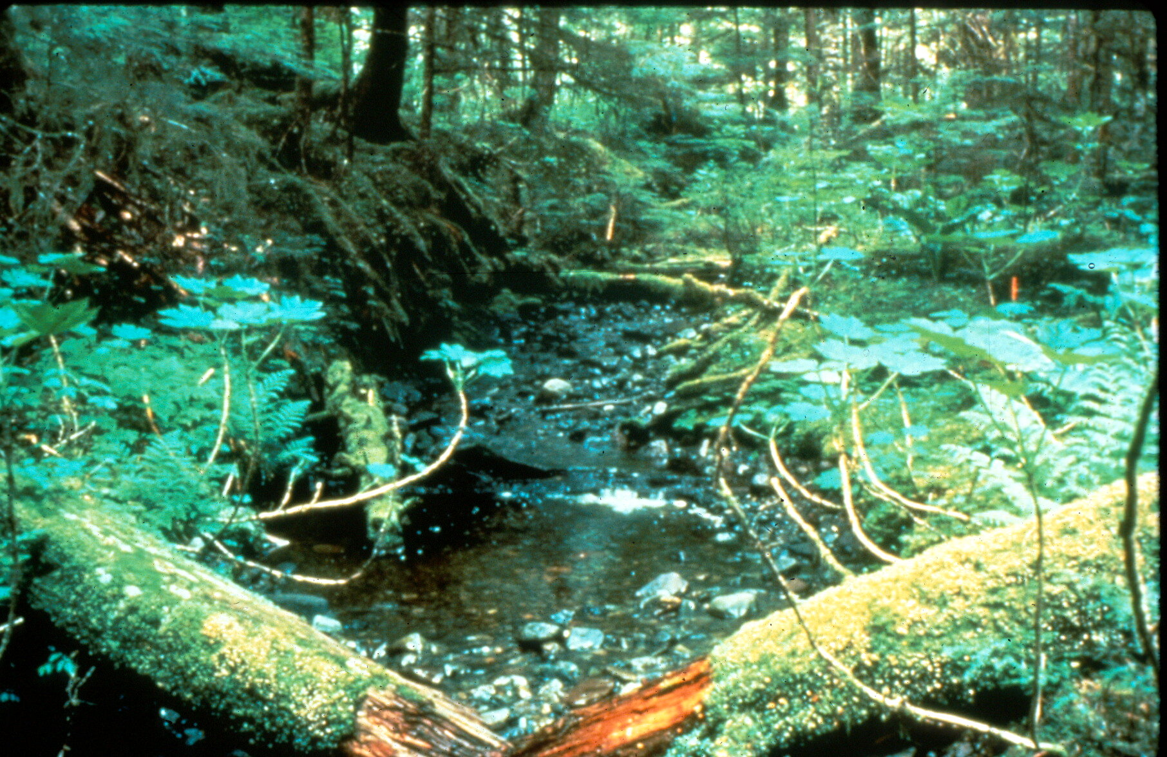

Slide 23
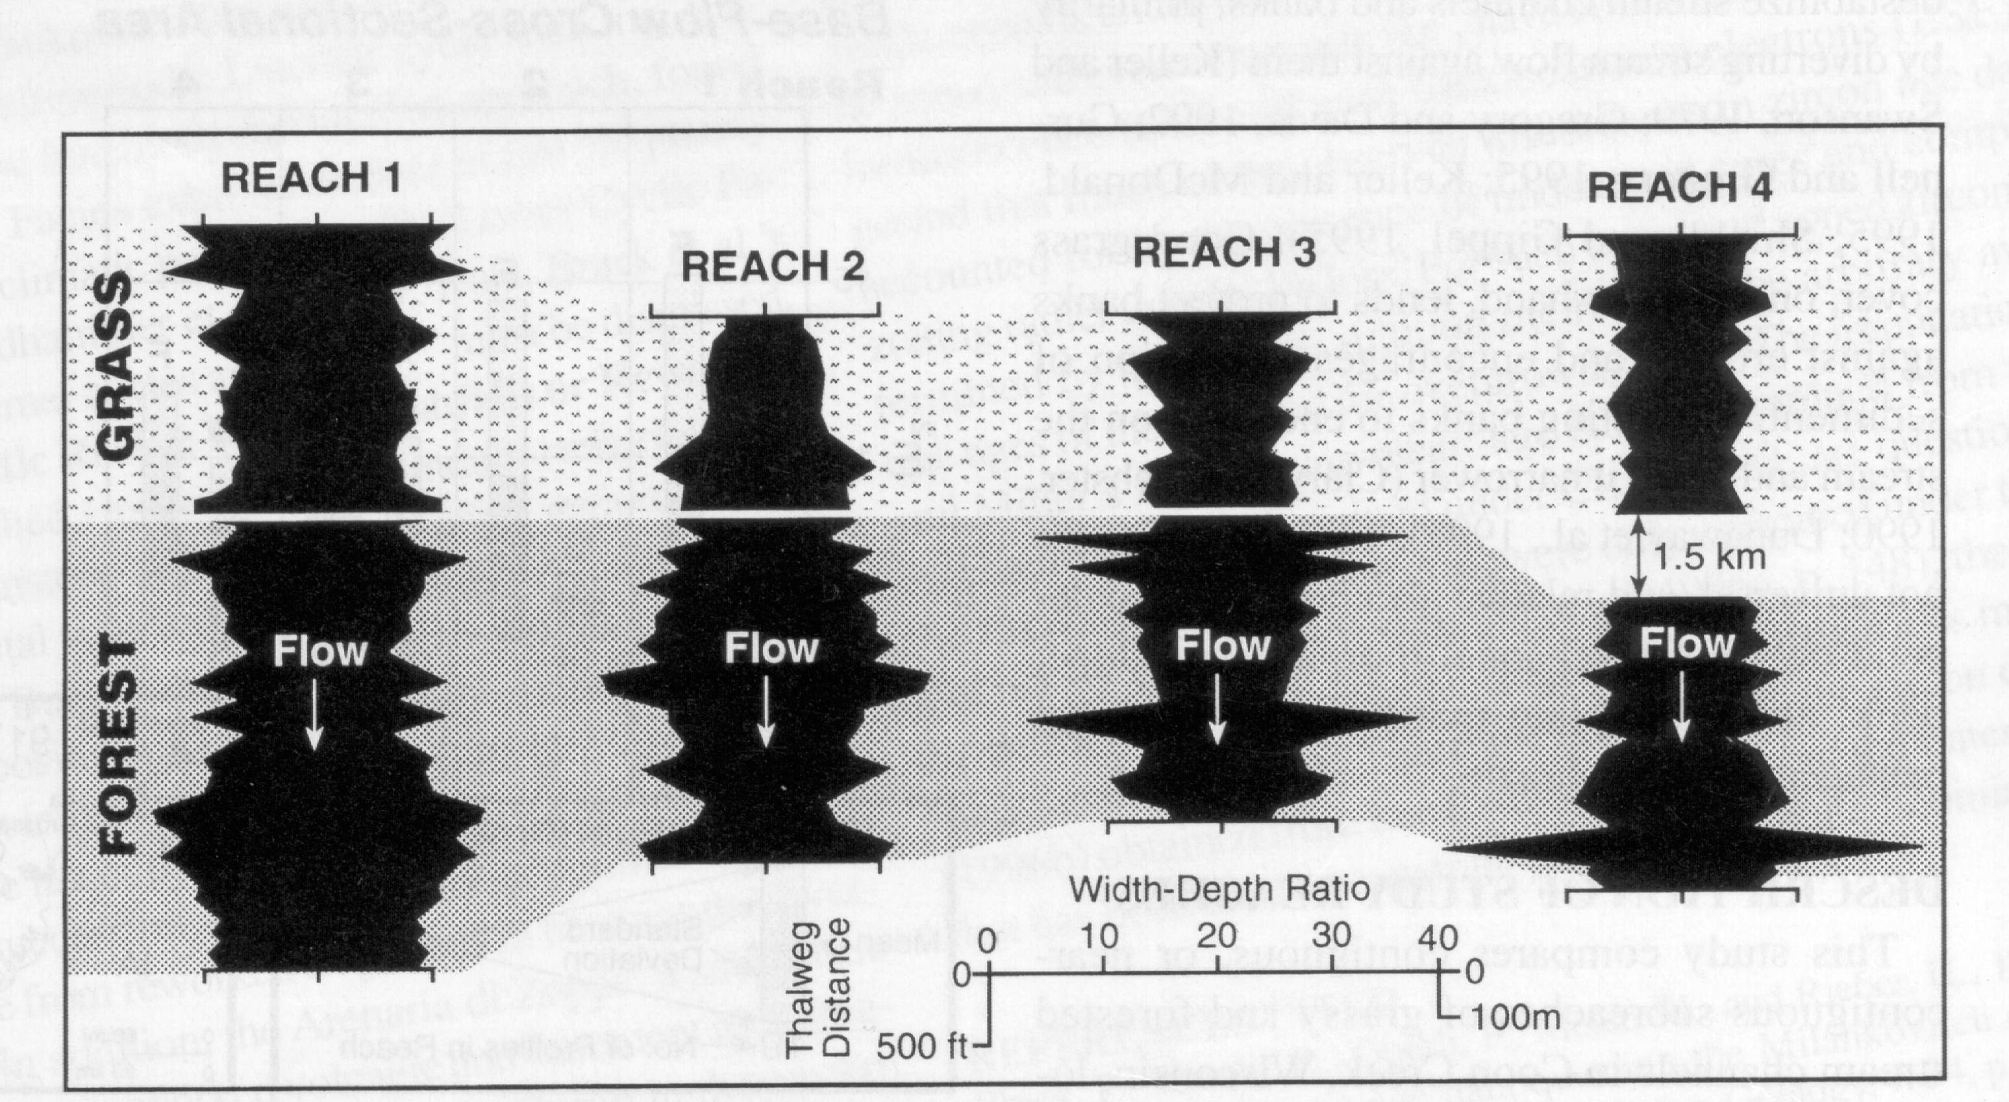

Slide 24
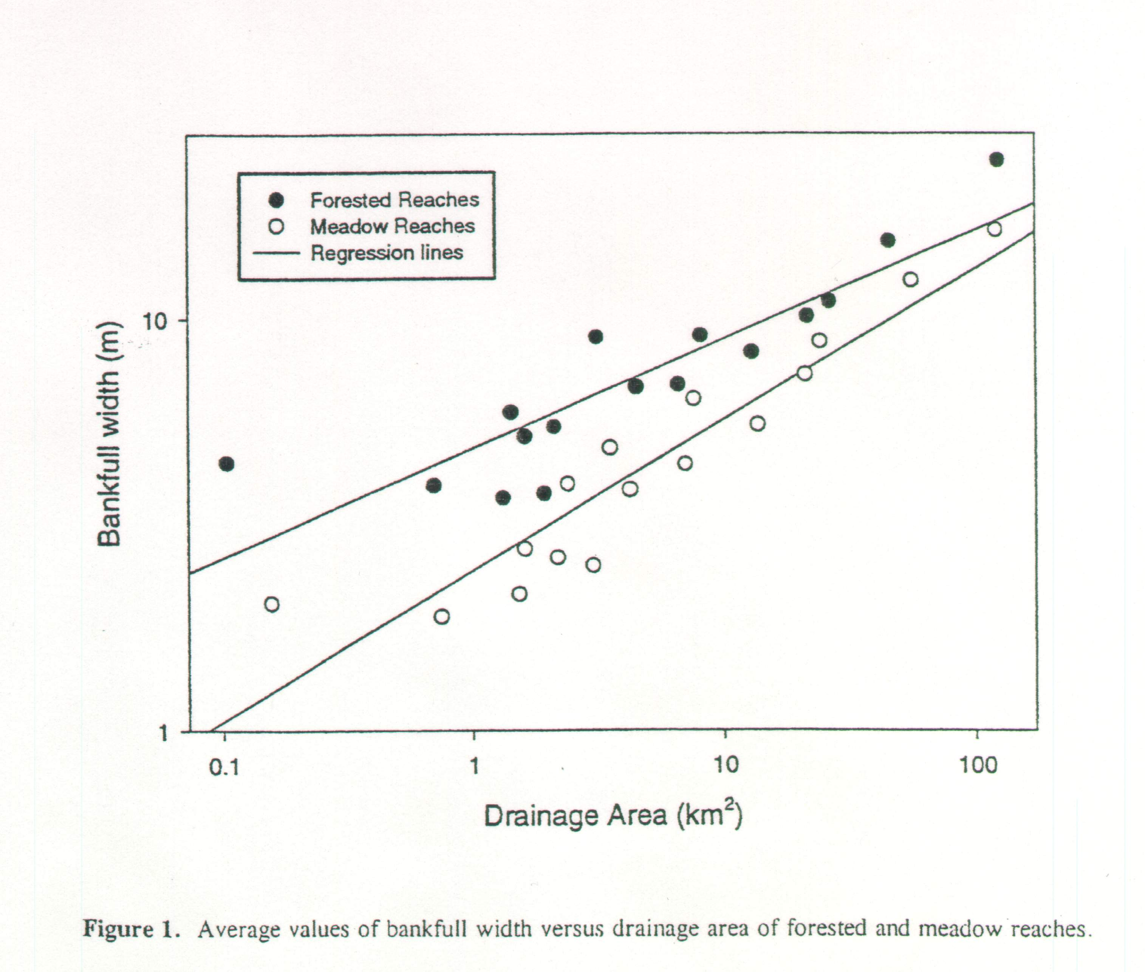

Slide 25
Hey and Thorne (1986) and Charlton et al. (1978) data

Slide 26
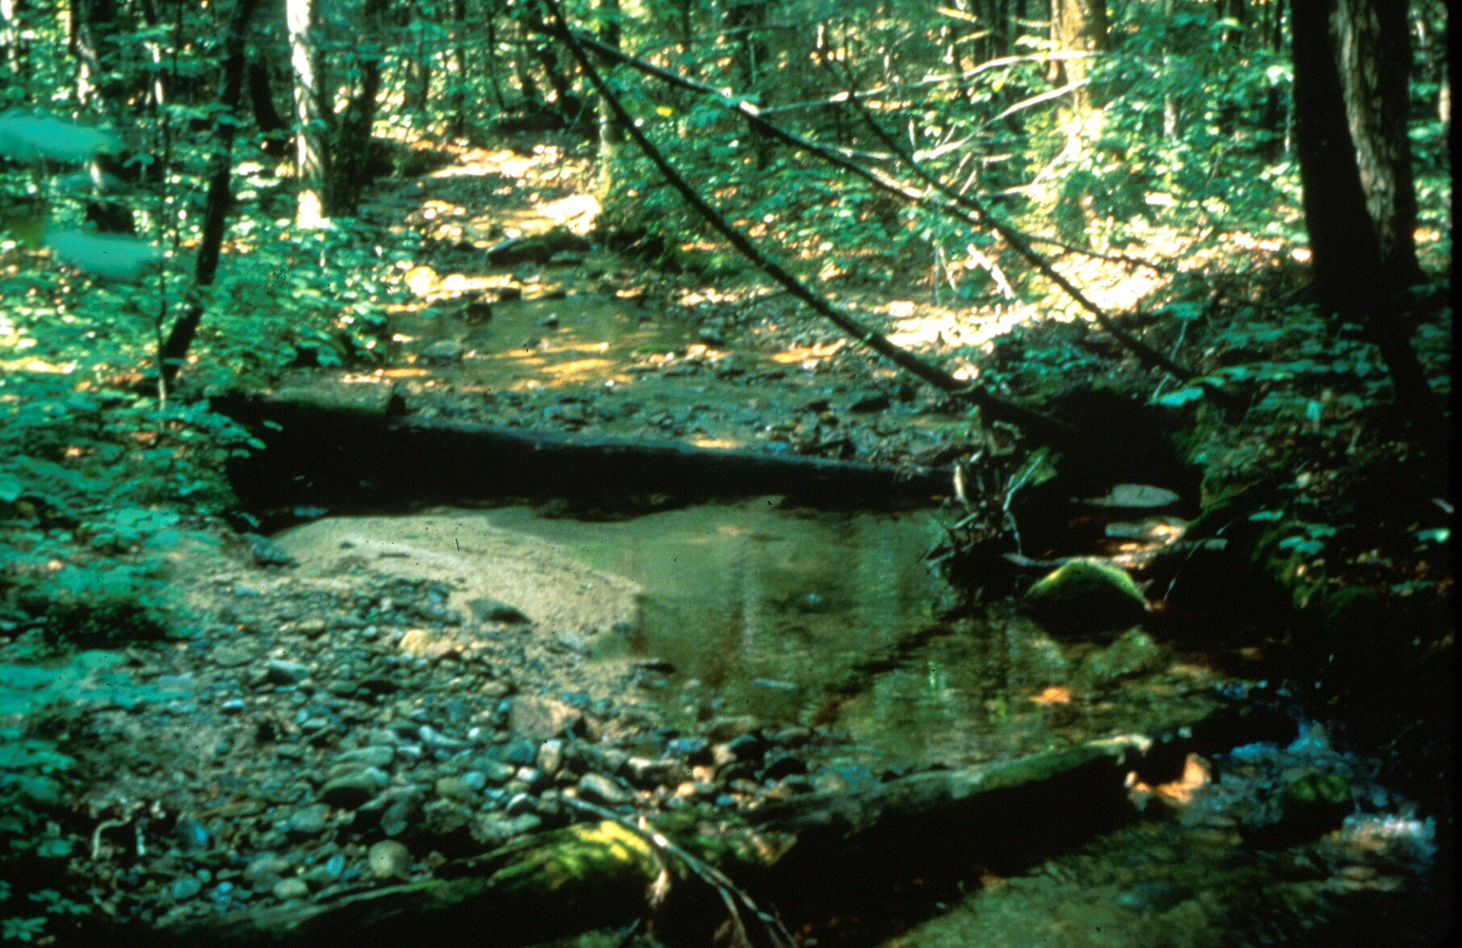

Slide 27
Davies-Colley (1997) and Hession et al. (2003) data

Slide 28
Grass
Forest
Log Channel Width
10 -100 km²
Log Watershed Area

Slide 29
Root Density (ml l⁻¹)
% Silt and Clay

Slide 31
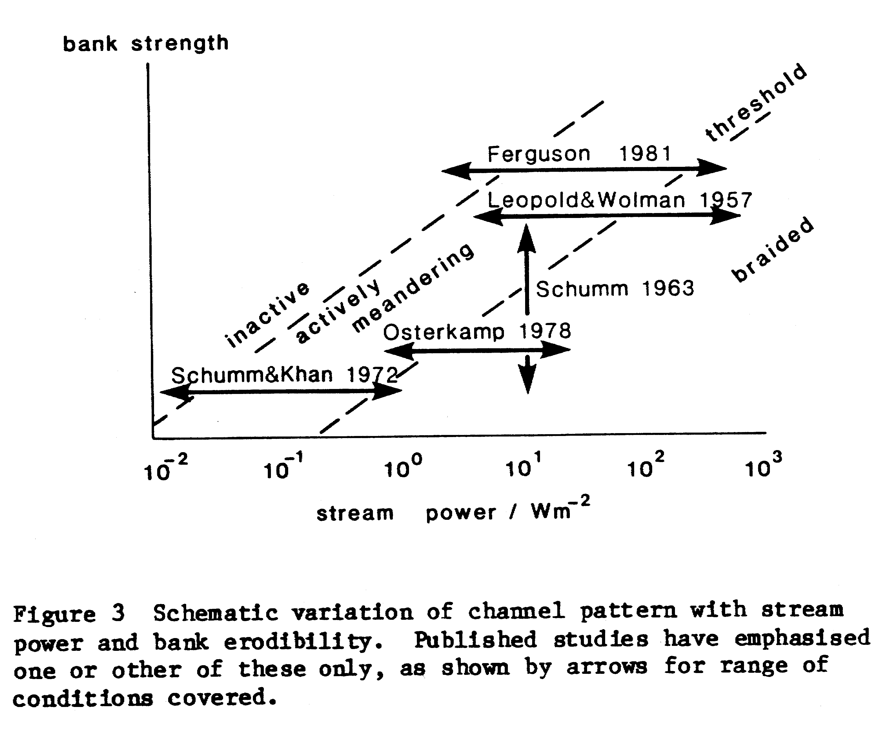

Slide 32
Values of a in w = aQ^{0.5}
Unit System | Very Wide | Average Width | Very Narrow
English | 2.7 | 2.1 | 1.3
SI | 4.9 | 3.8 | 2.3
Vegetation Density, Stiffness, Root Reinforcement
Bank Cohesion
?
Suspended Sediment Load
Bed Material Size / Braiding Risk

Slide 33
Summary
Downstream hydraulic geometry relationships for width can provide a useful, additional relationship in channel design
Selection of the coefficient a is complicated and requires consideration of many factors
Vegetation effects tend to override sedimentary effects
Processes are scale-dependent?

Slide 34
Planform Geometry
Direction of response is much easier to predict than direction of response

Slide 35
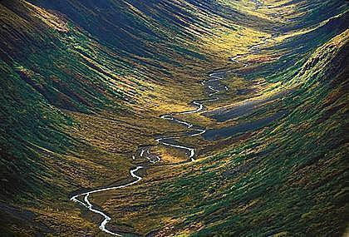
Meandering and Planform Design
Photo by Frans Lanting

Slide 36
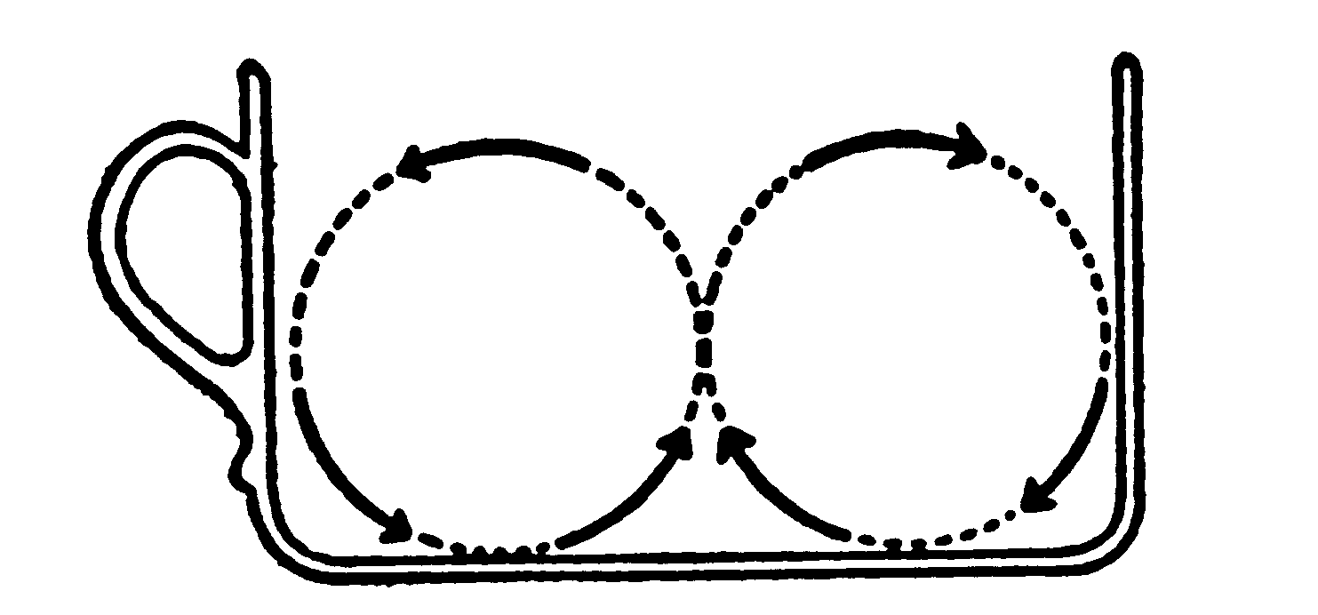

Slide 37
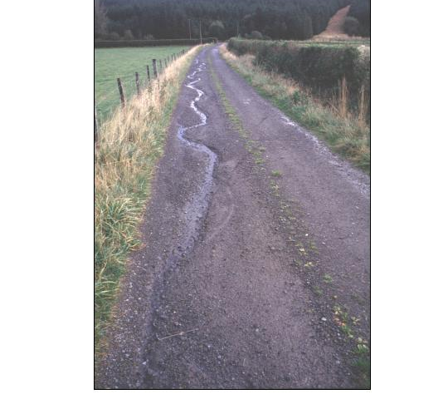

Slide 38
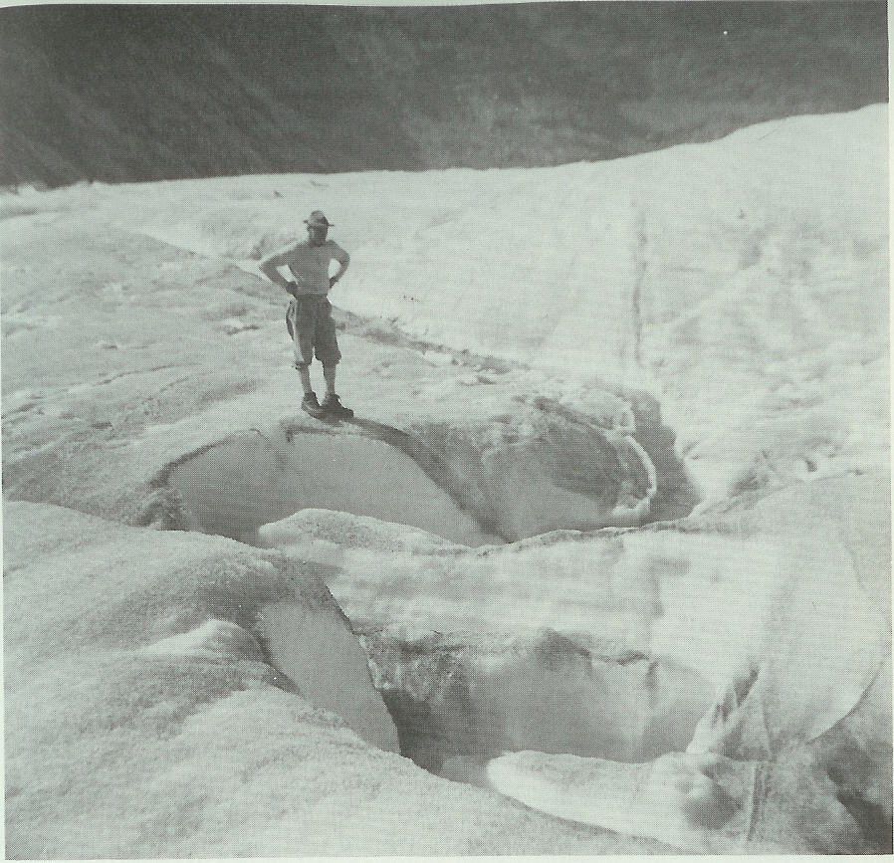
From Leopold (1994)

Slide 39
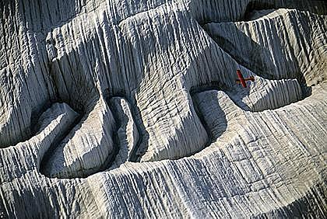
Photo by Frans Lanting

Slide 40
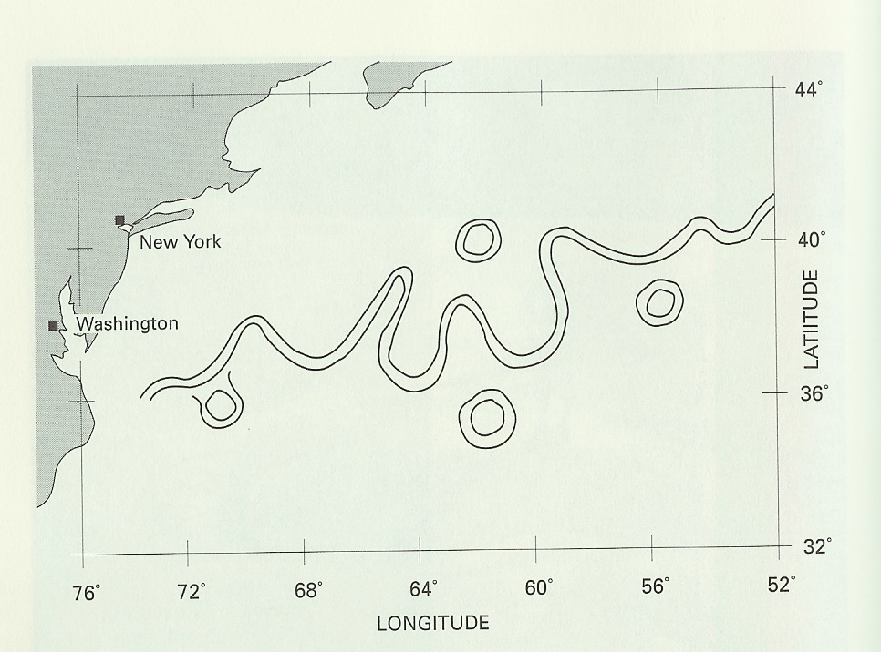

Slide 41
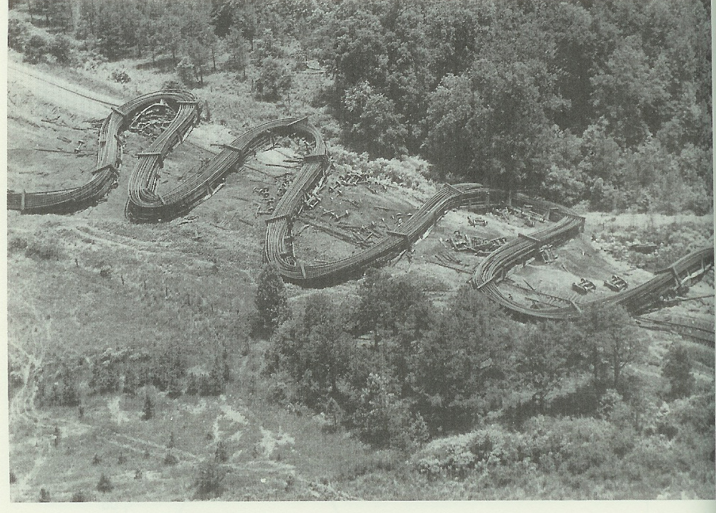
From Leopold (1994)

Slide 42
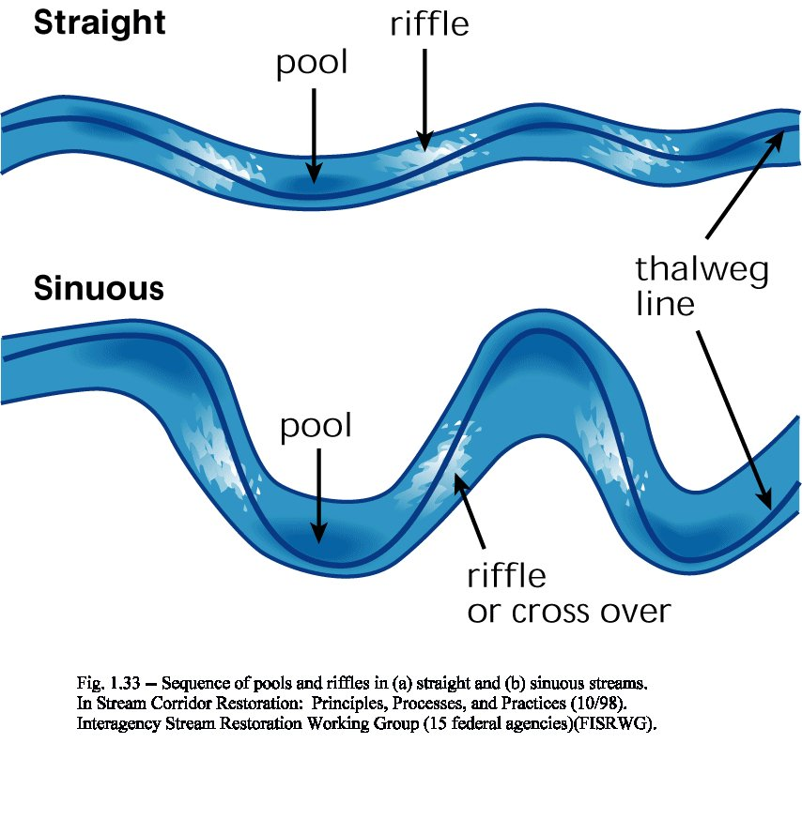

Slide 43
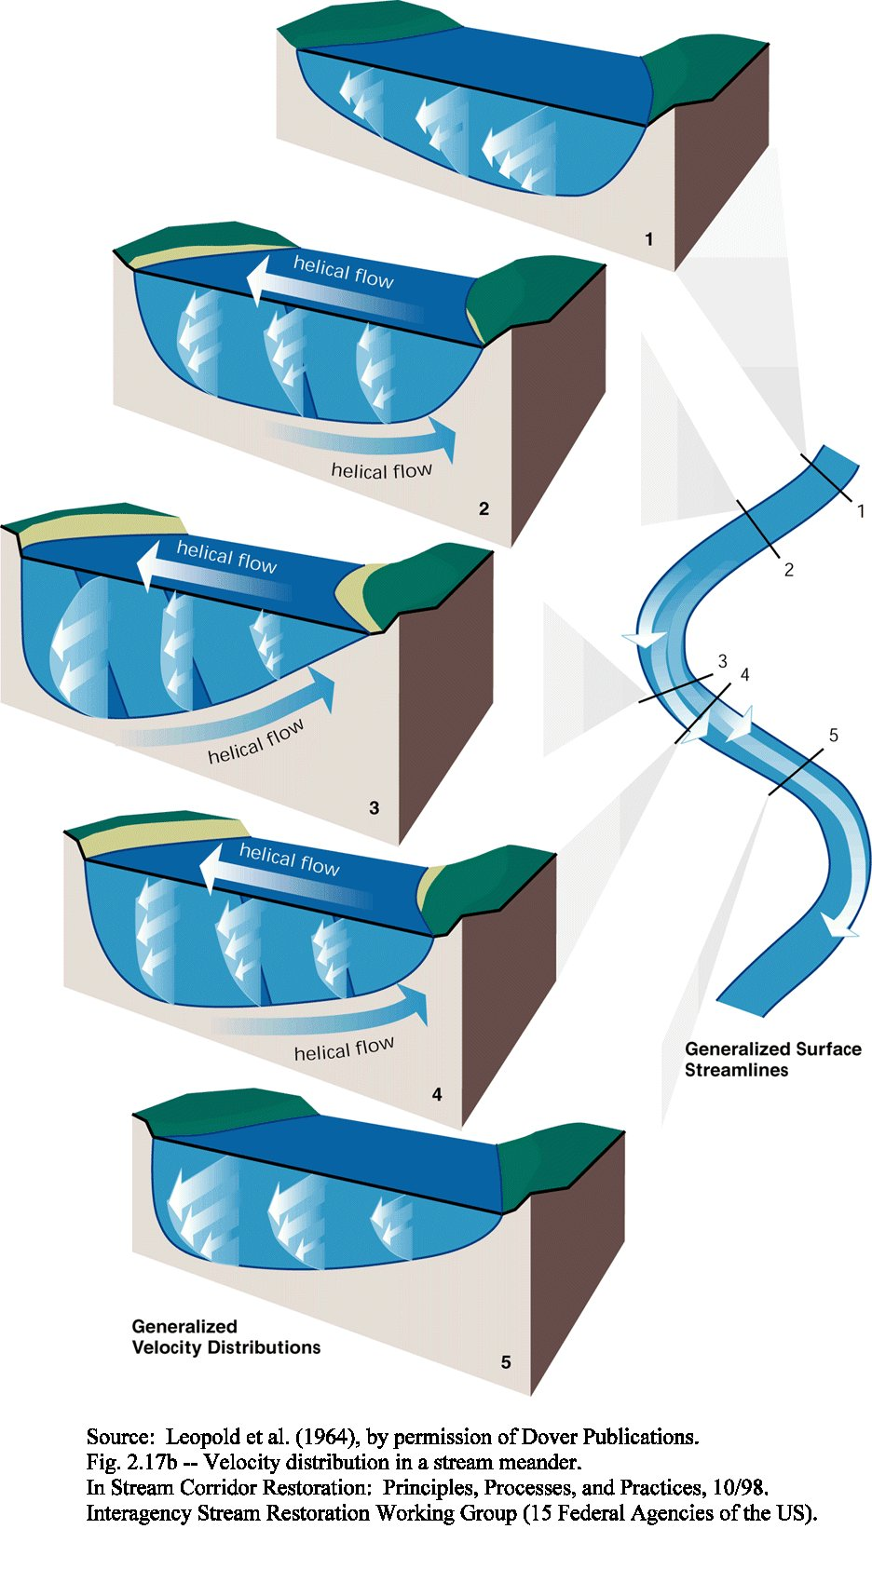

Slide 44


Slide 45
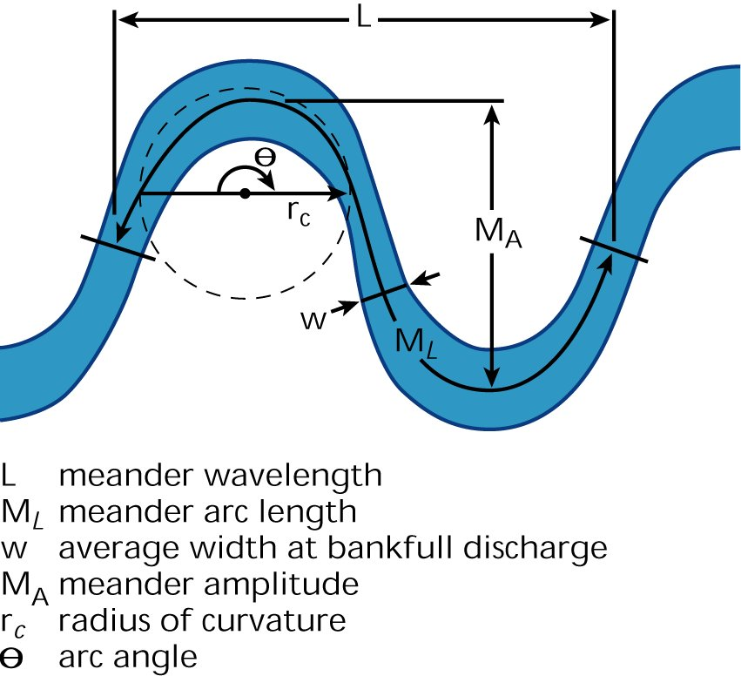

Slide 46
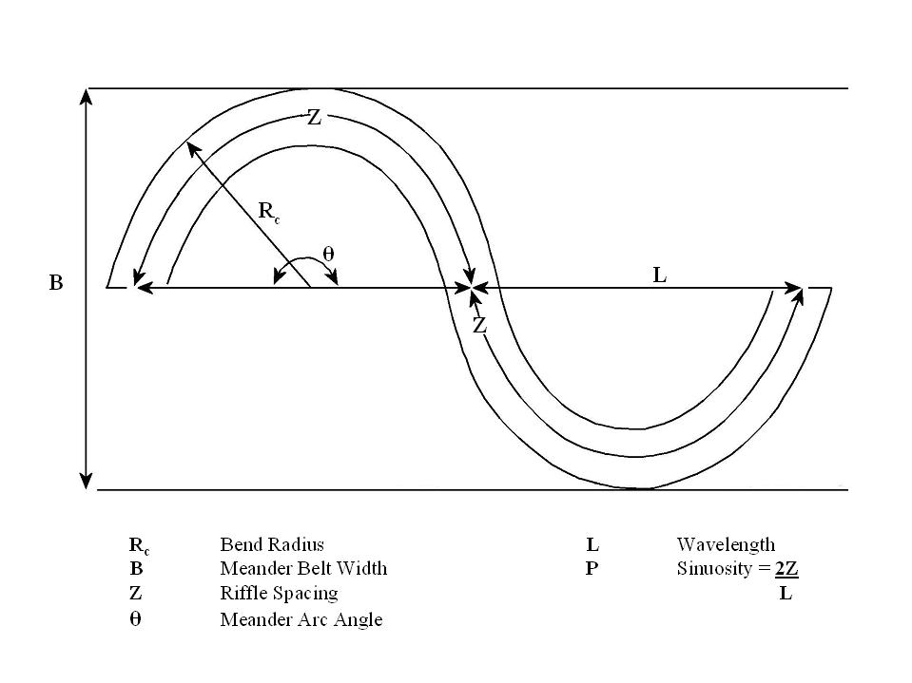
After Thorne (1997)

Slide 47
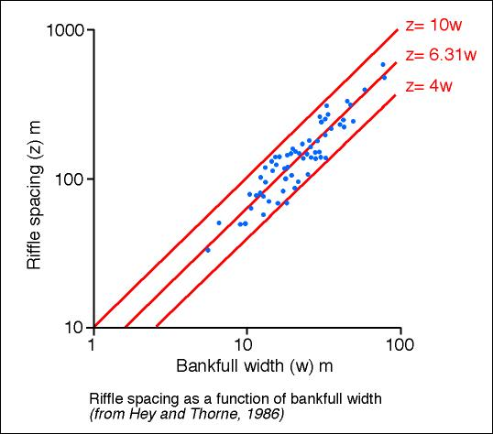

Slide 48
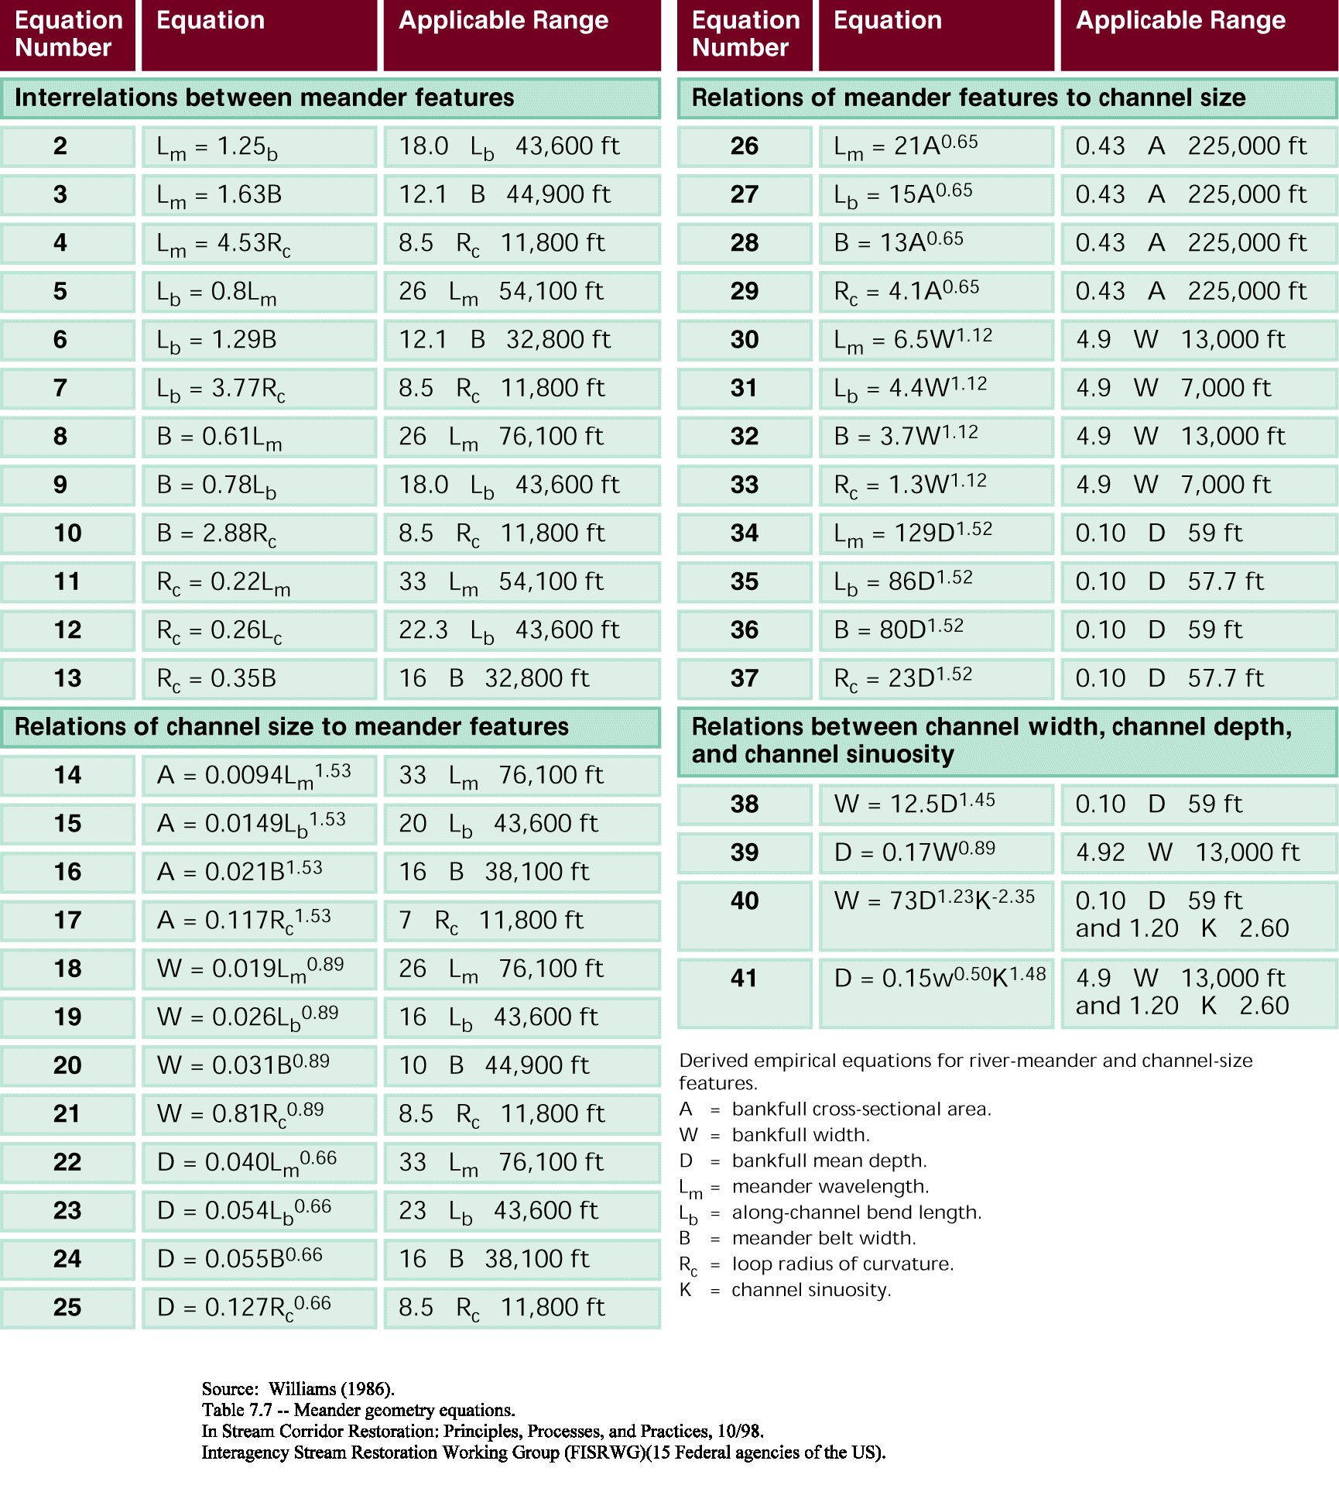

Slide 49
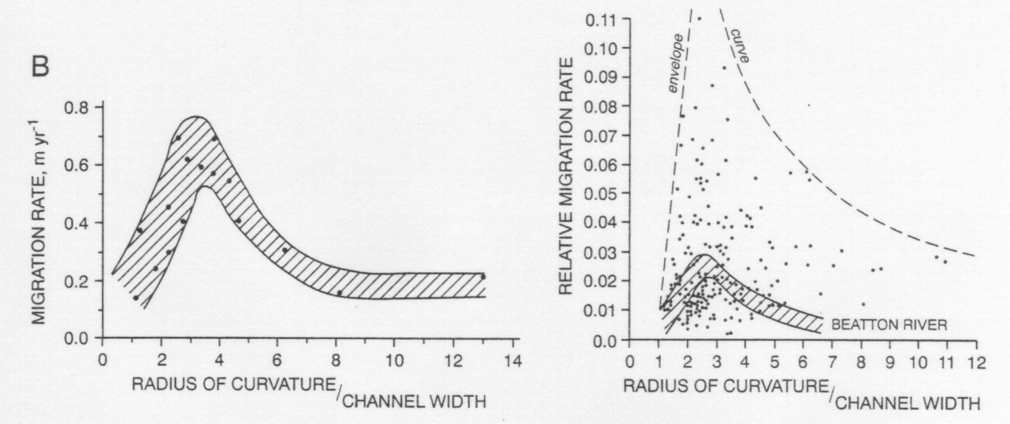
ccc

Slide 50
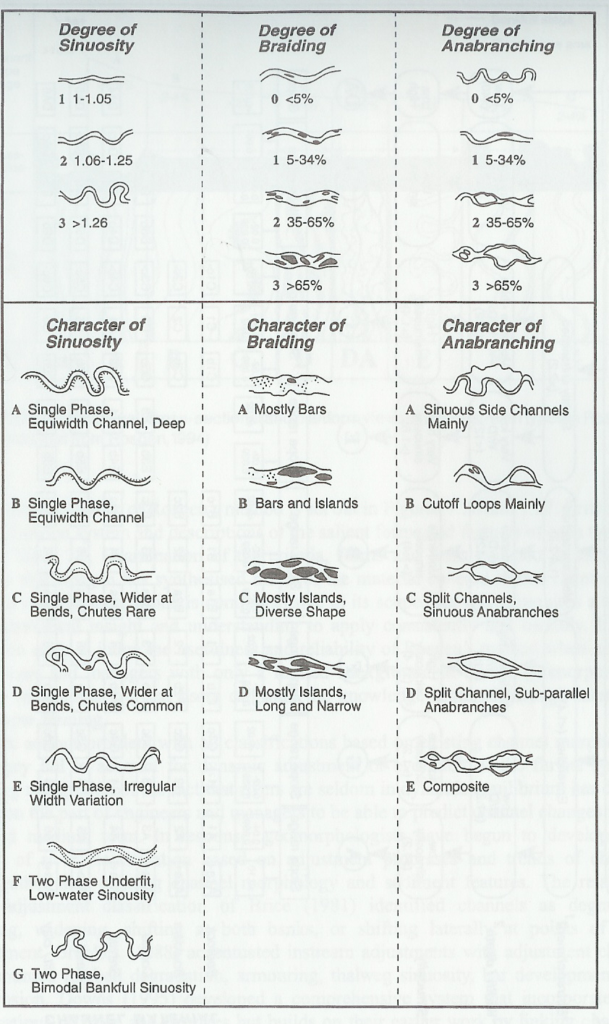

Slide 51
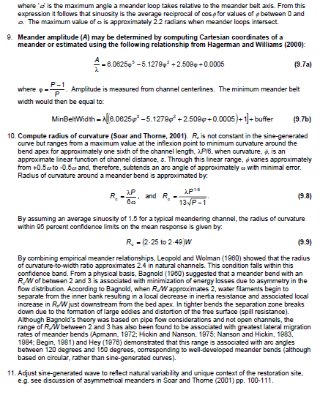
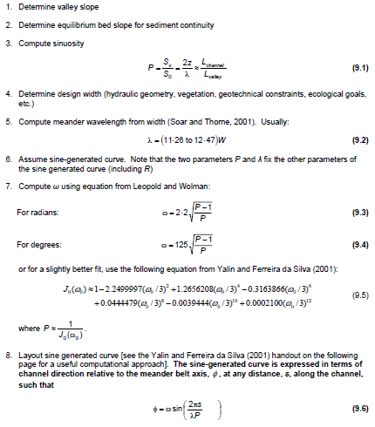
Initial planform layout

Slide 52
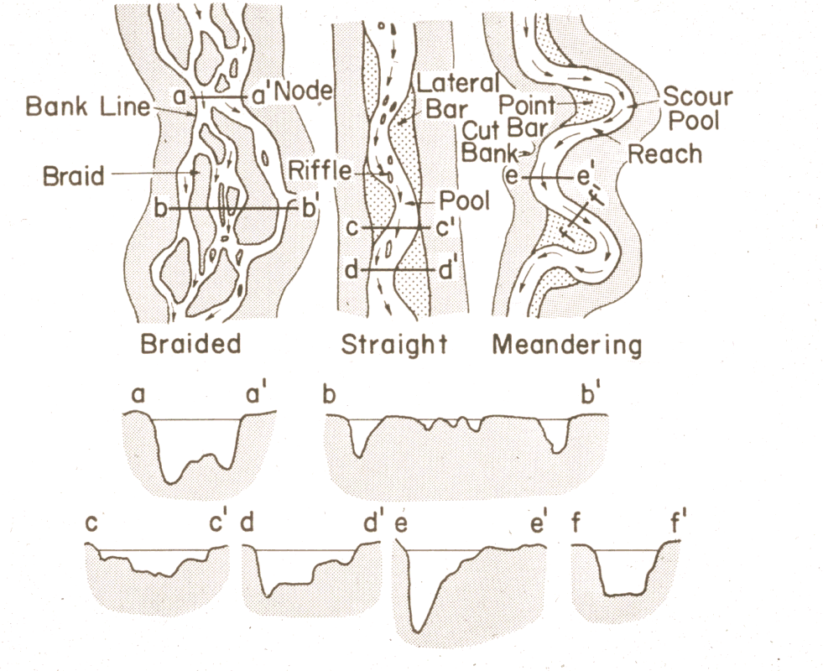
Meandering – Braiding Threshold

Slide 53
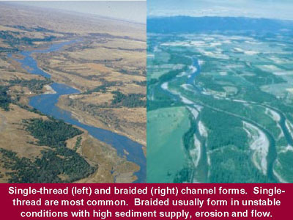

Slide 54
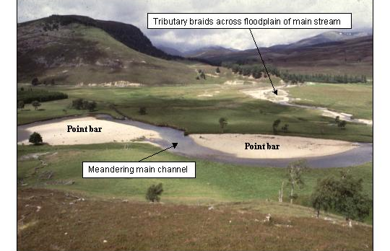

Slide 55
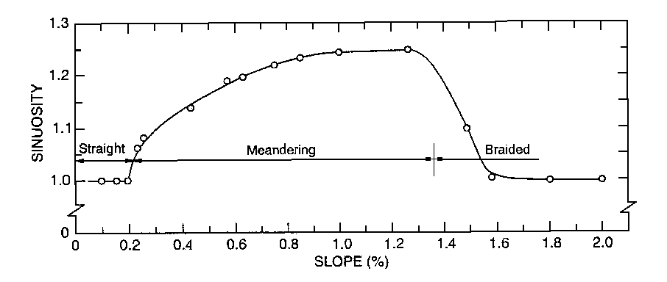

Slide 56
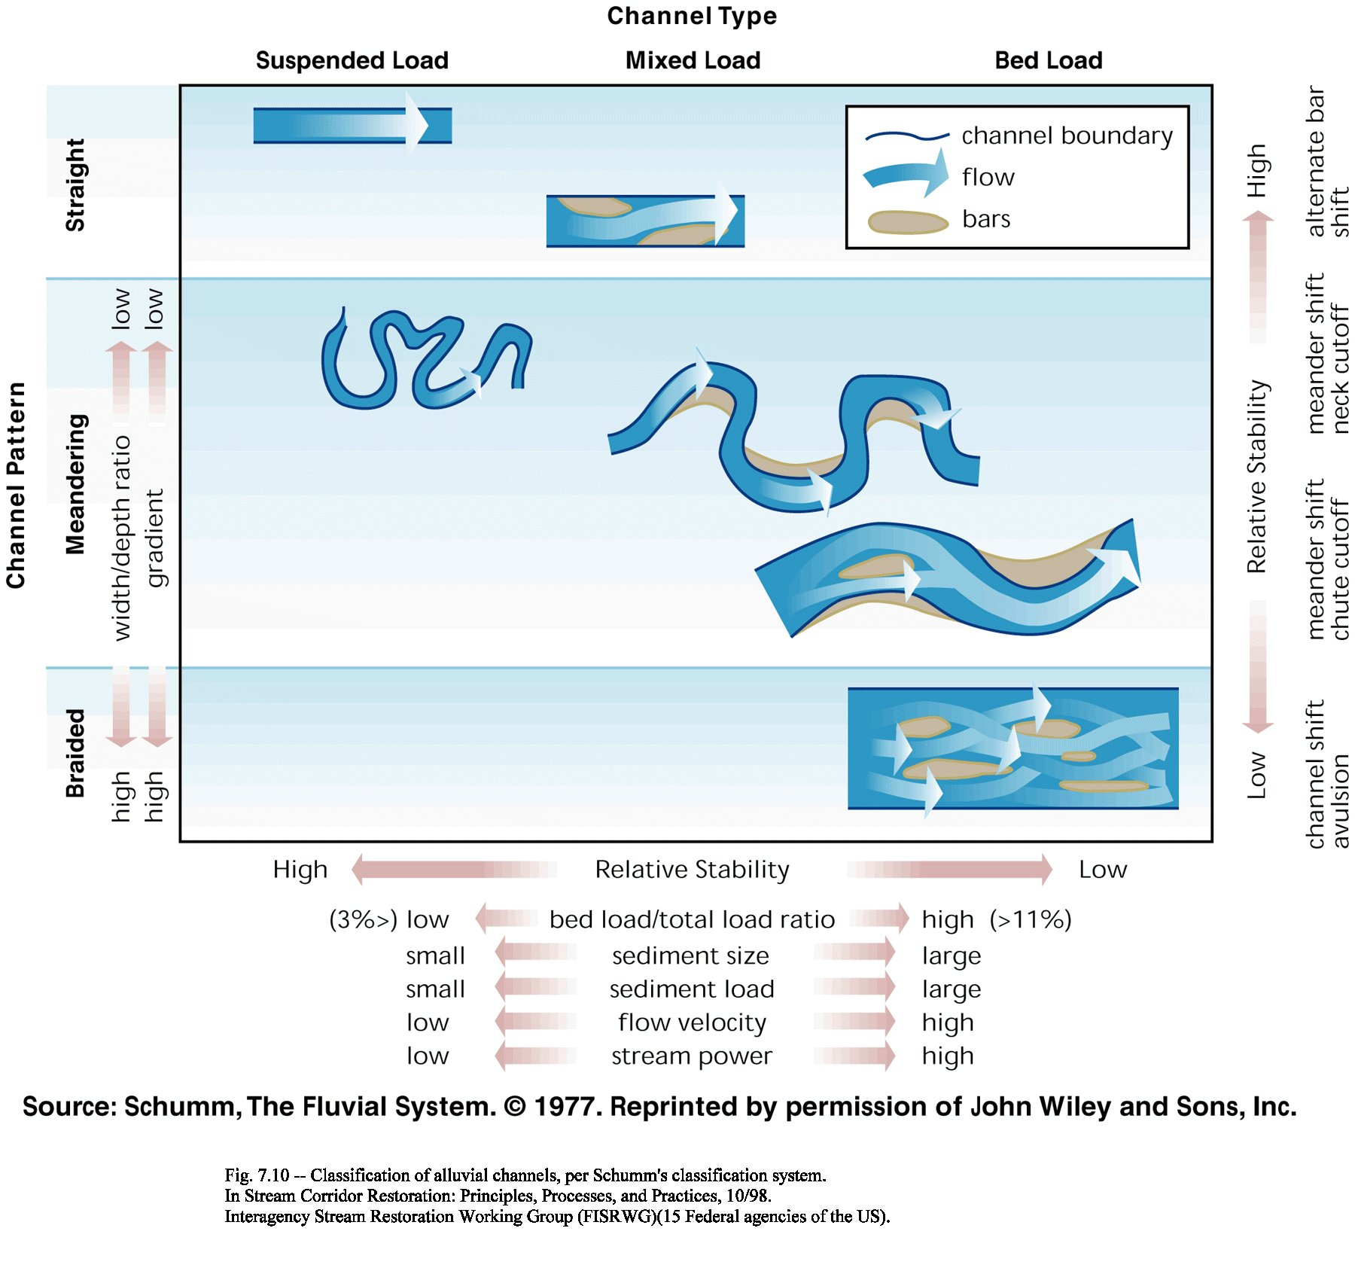

Slide 57
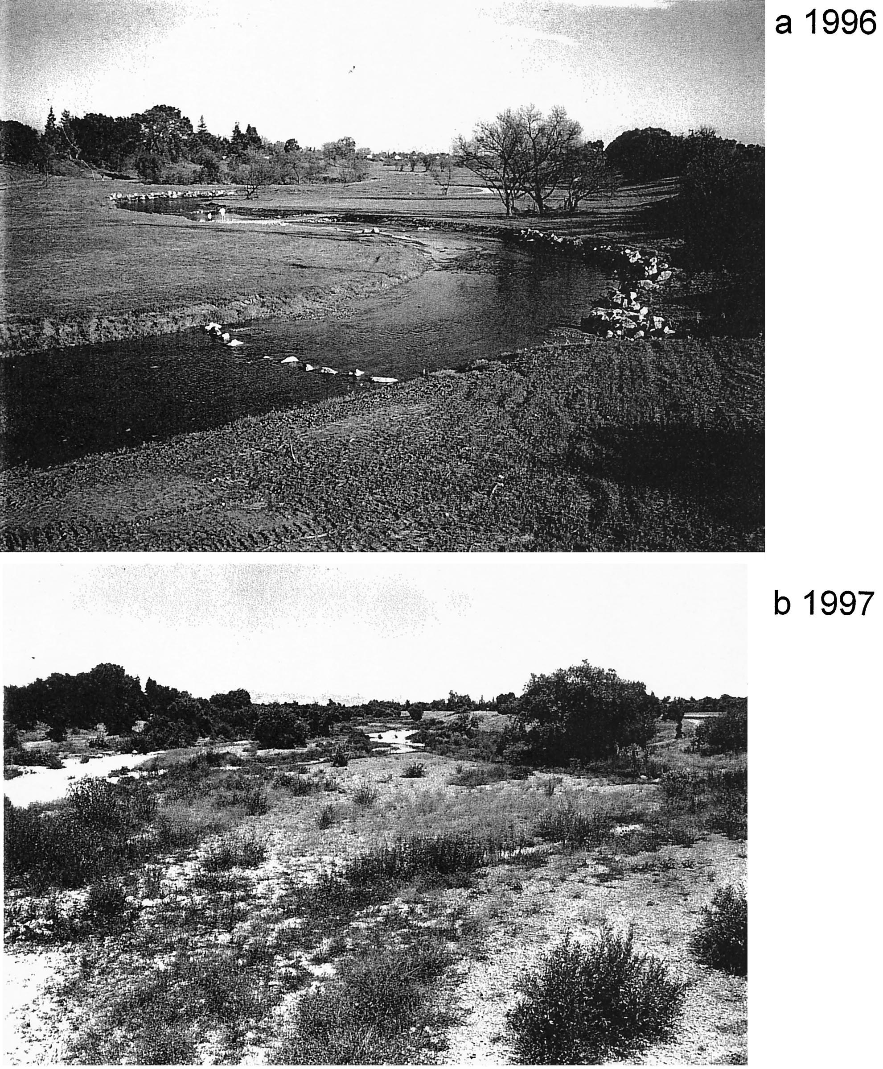
Uvas Creek

Slide 58
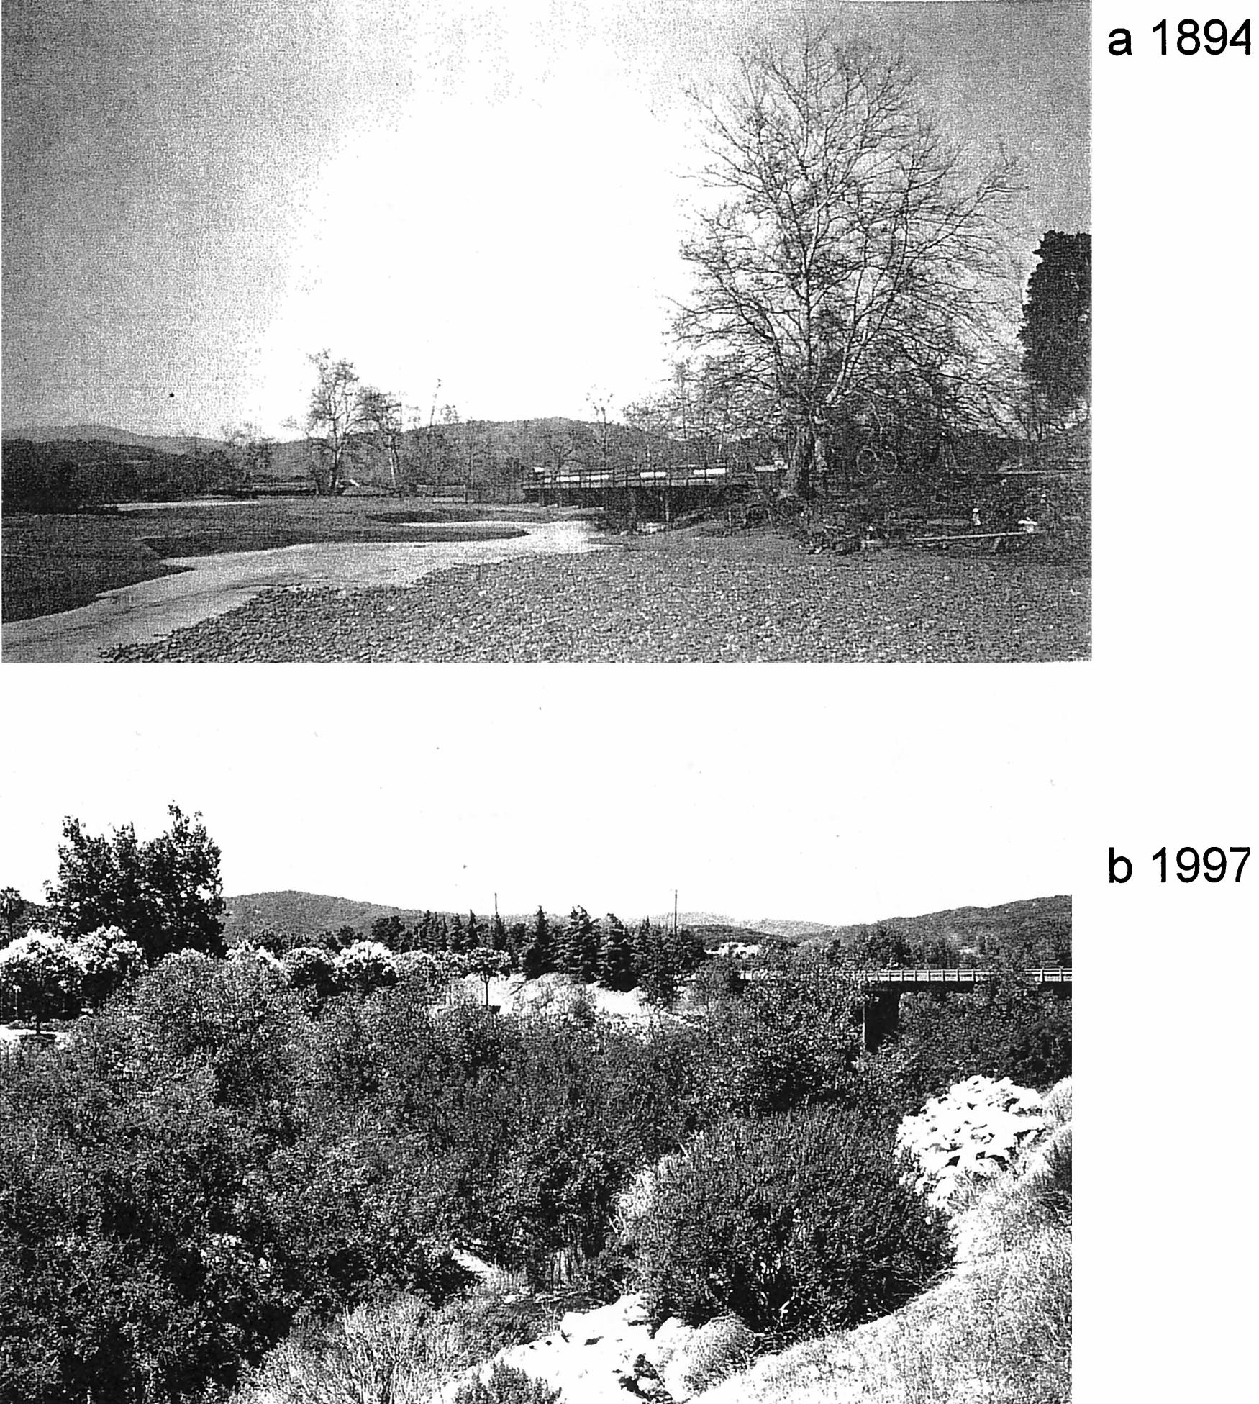
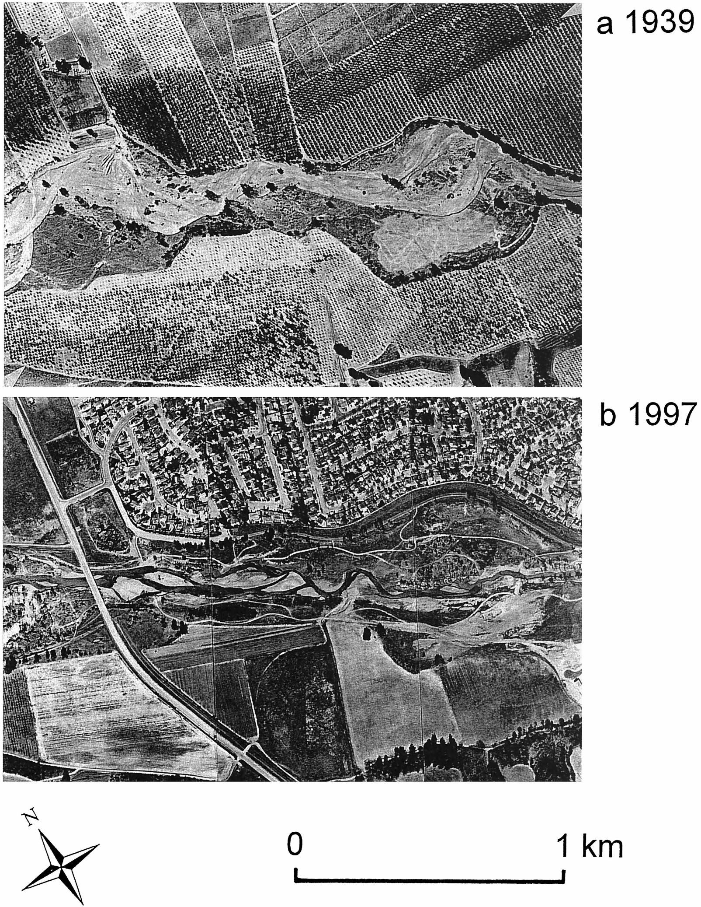
Uvas Creek

Slide 59
Planform Predictors
Meandering-Braiding Threshold

Slide 61
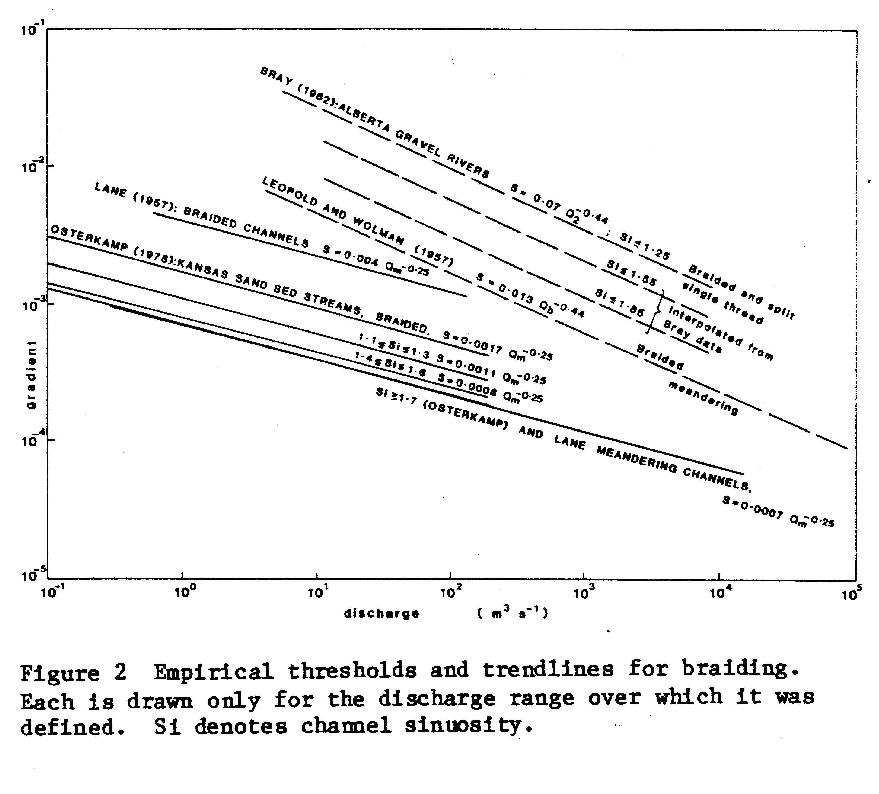

Slide 62
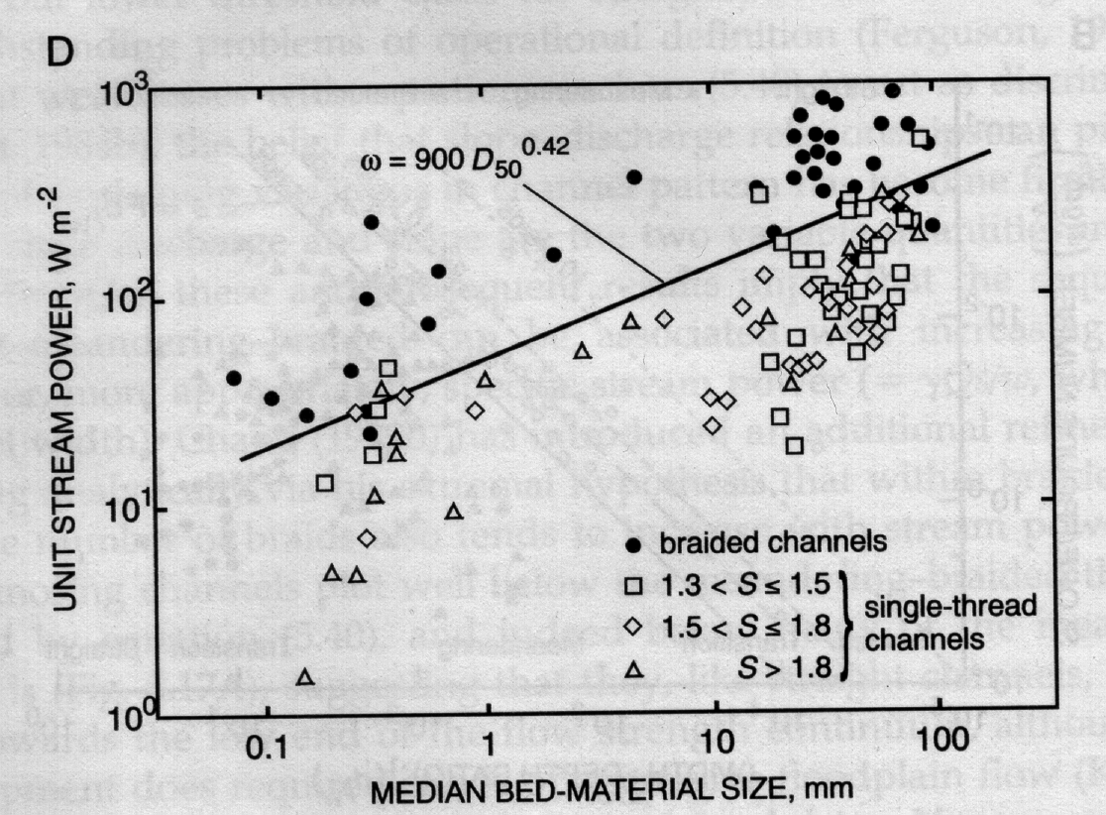

Slide 63
The units for ω and d₅₀ in the equation for the braiding threshold in the previous slide are W/m² and meters, respectively. Be sure to use valley slope in the van den Berg equation.
for sand channels
for gravel channels

Slide 65
A useful guideline:
In many contexts, as width/depth at ~Q2 approaches 40-50, braiding becomes likely

Slide 66
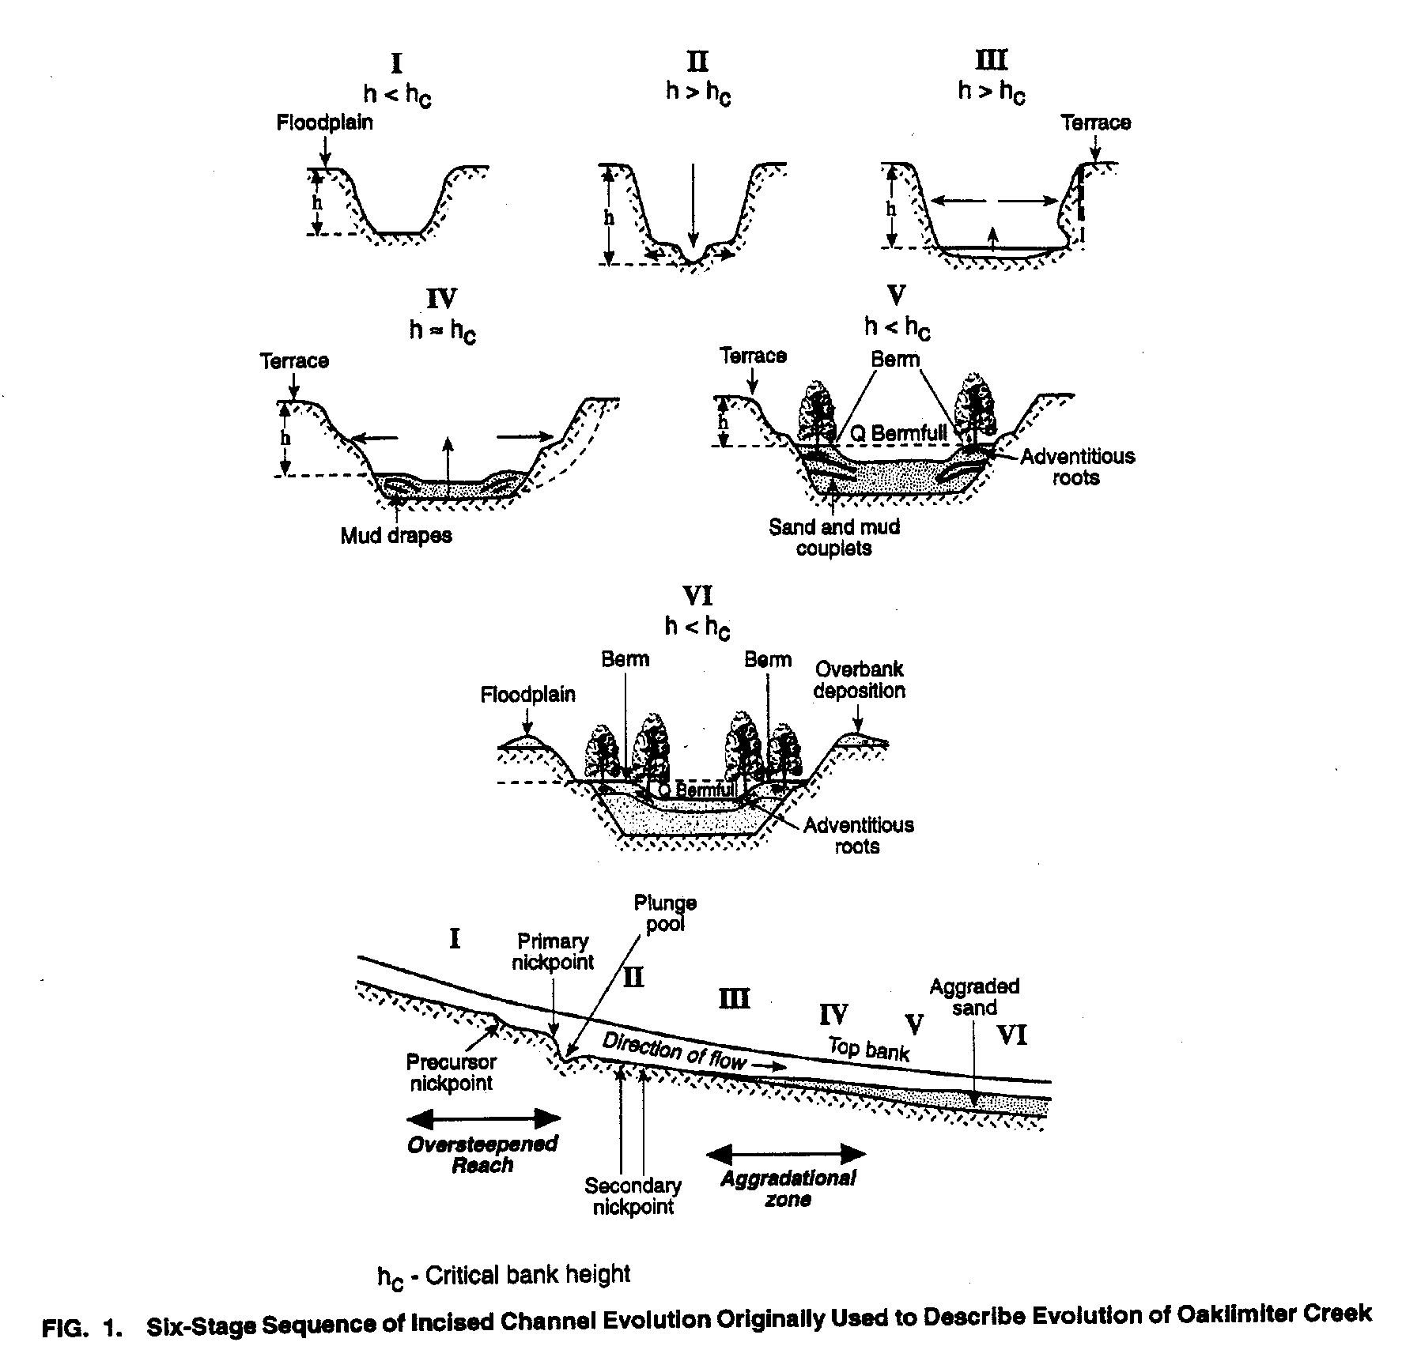

Slide 69
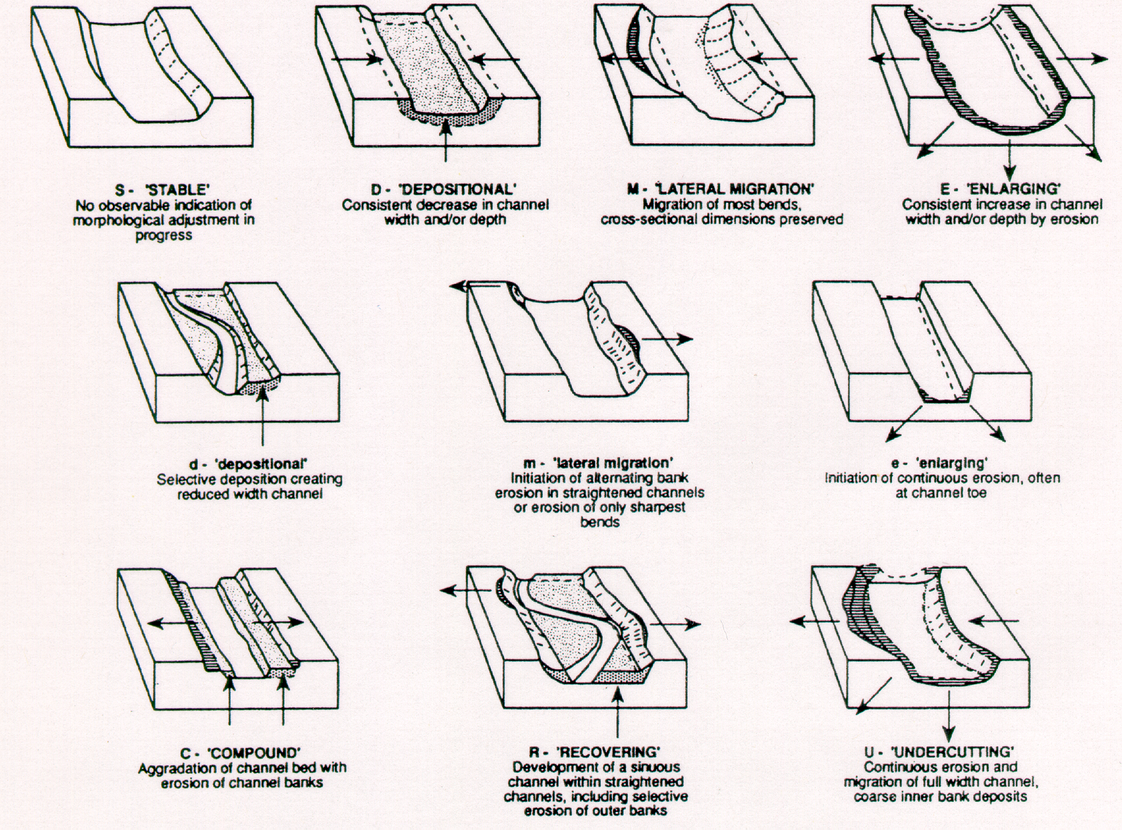

Slide 70
Qualitative Response Models
Direction of response is much easier to predict than magnitude of response

Slide 71
LANE’S BALANCE

Slide 73
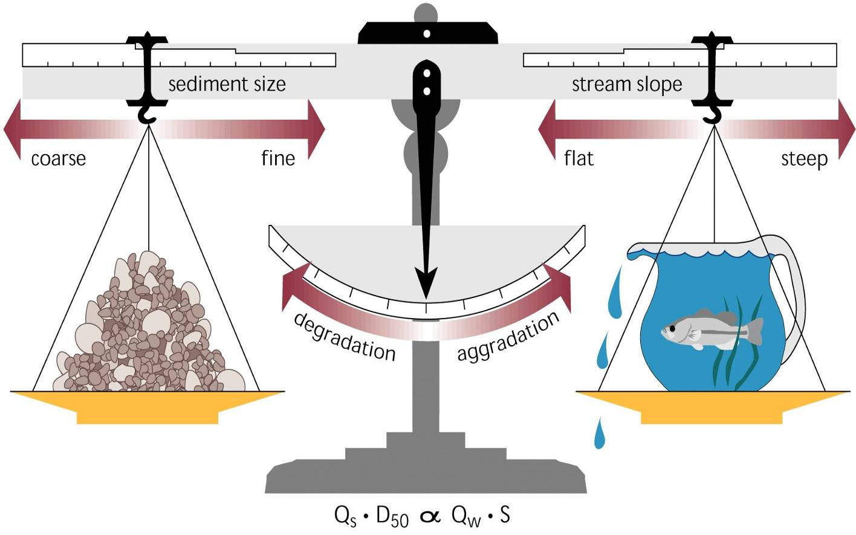
Construction Phase - Sediment Delivery ↑
Q⁺S ~ Q_{s}⁺d_{s}
Post-Construction - Sediment Delivery ↓
Q⁺⁺S⁻⁻ ~ Q_{s}⁻ d_{s}⁺
Incision and Widening

Slide 74
Schumm’s River Metamorphosis
 | Response
 | Slope S_{o} | Grain Size d₅₀ | Width w | Depth d | Ratio w/d | Meander Wavelength λ | Sinuosity P
Q⁺ | - | + | + | + | + | +
Q⁻ | + | - | - | - | - | -
Q_{sb}⁺ | + | - | + | - | + | + | -
Q_{sb}⁻ | - | + | - | + | - | - | +
Alteration
Notes:
Q⁺ ➔ Urbanization, transbasin diversion
Q⁻ ➔ flow diversion
Q_{s}⁺ ➔ increased erosion (logging, poor agricultural practices, construction)
Q_{s}⁻ ➔ downstream of dam, urbanization,

Slide 75
Schumm’s River Metamorphosis – Part II
 | Response
 | Slope S_{o} | Grain Size d₅₀ | Width w | Depth d | Ratio w/d | Meander Wavelength λ | Sinuosity P
Q⁺ Q_{sb}⁺ | ± | ± | + | ± | + | + | -
Q⁻ Q_{sb}⁻ | ± | ± | - | ± | - | - | +
Q⁺Q_{sb}⁻ | - | + | ± | + | ± | ± | +
Q⁻Q_{sb}⁺ | + | - | ± | - | ± | ± | -
Alteration
Notes:
Q⁺ Q_{s}⁺ ➔ post forest fire
Q⁻ Q_{s}⁻ ➔ downstream of dam
Q⁺Q_{s}⁻ ➔ urbanization
Q⁻Q_{s}⁺ ➔ diversion with poor land use practices

Slide 76


Slide 77
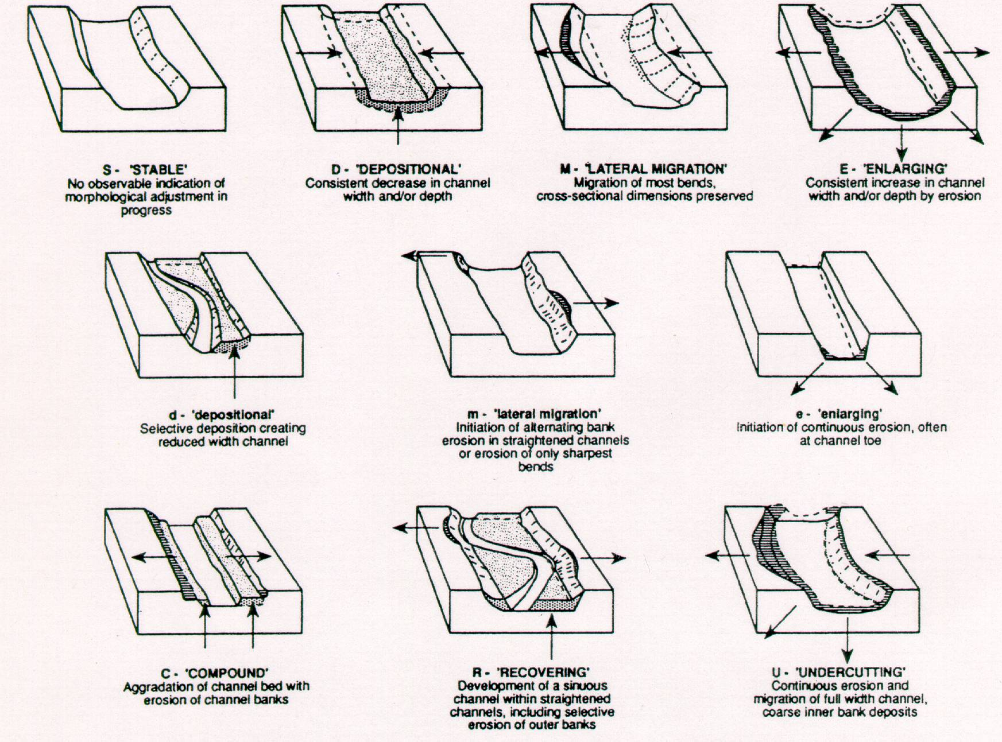
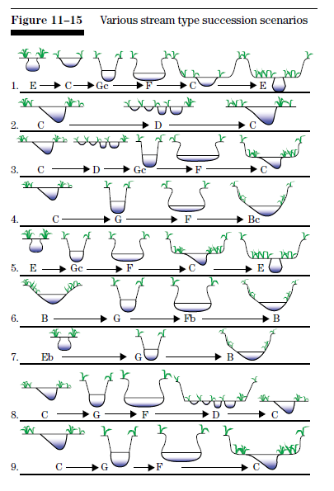
Downs (1995)
Rosgen in NRCS (2007)

Slide 78
Historical analysis

Slide 79
A few examples
Aerial photos
Early surveys / maps
Comparative surveys – x-sections, thalweg
Sediment budgets
Specific gage analysis

Slide 80
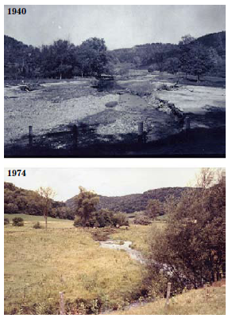
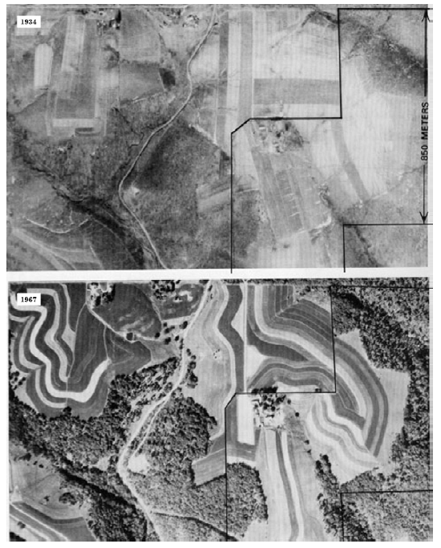

Slide 81
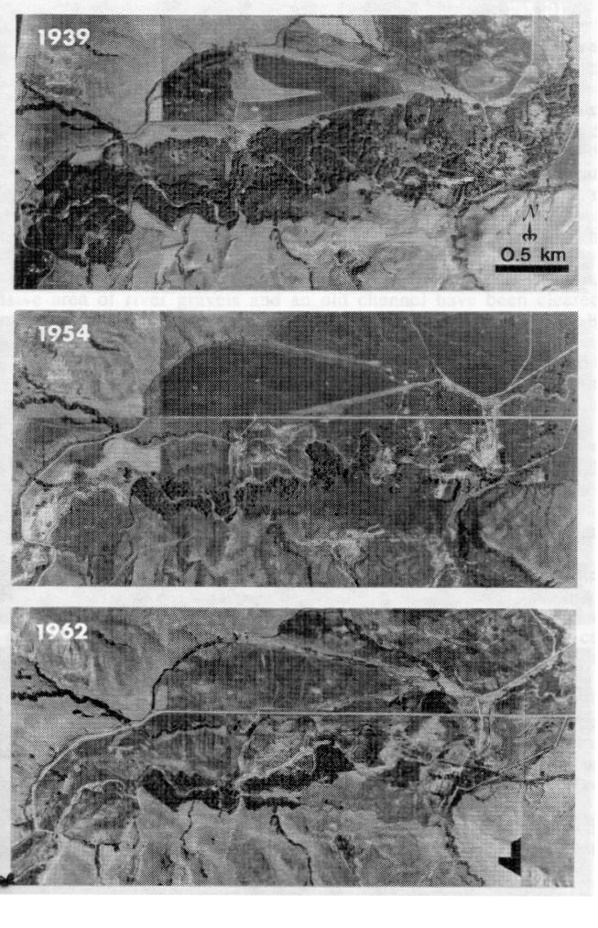
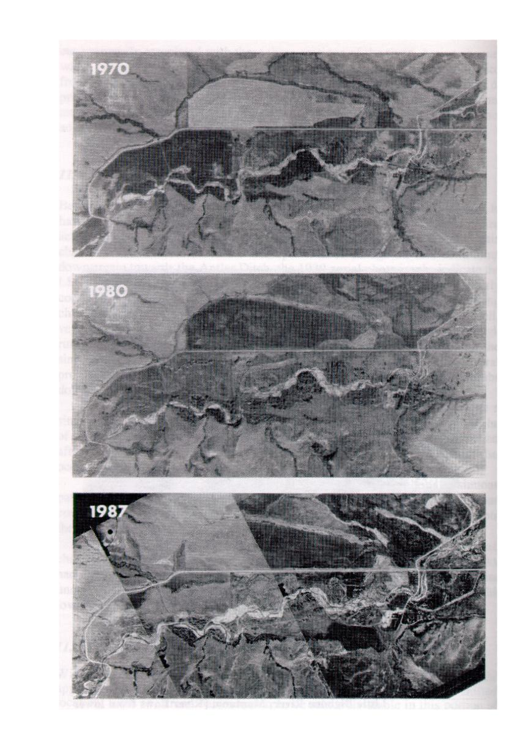

Slide 82
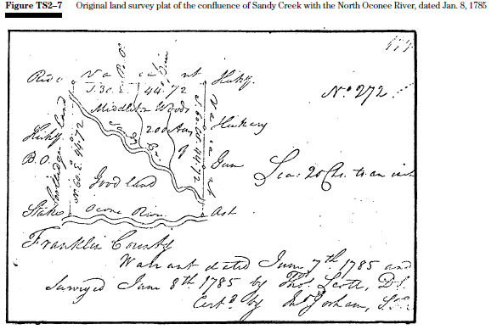
Historical surveys / maps

Slide 83



Repeat surveys

Slide 84


Slide 85

Sediment budgets

Slide 86



Specific gage

Slide 87


Slide 88


Slide 89


Slide 90

NRCS (2007) adapted from Copeland et al. (2001)

Slide 91


