Slide 1
Introduction to CSU IRB
Kathy Kioussopoulos, M.B.A., RN
Director, Human Research Protection Program
Office of the Vice President for Research

Slide 2
Learning objectives:
What is the human research protection program at CSU, and how to know when the project requires interacting with the CSU IRB.
What is required if the project does require IRB review.
What are the responsibilities after receiving IRB approval.

Slide 3
What is a Human Research Protection Program?

Slide 4
Colorado State University (CSU) fosters a research environment that promotes the respect for the rights and welfare of individuals recruited for, or participating in, research conducted by or under the auspices of the Organization. In support of this, Colorado State University has established a Human Research Protection Program (HRPP). The Colorado State University HRPP, in partnership with its research community, is responsible for ensuring the ethical and equitable treatment of all human subjects in research conducted under Colorado State University’s auspices.
The CSU HRPP consists of various individuals and committees including IRB Staff, Institutional Biosafety Committee, Radiation Safety, Conflict of Interest, Legal Counsel, investigators, research staff, health and safety staff, and research laboratory staff. The objective of this system is to assist the organization in meeting ethical principles and regulatory requirements for the protection of human subjects in research.
Notes:
What is the human research protection program at CSU, and how to know when their project requires interacting with the CSU IRB

Slide 5
HRPP Mission
Safeguard and promote the health and welfare of human research subjects by ensuring that their rights, safety, and well-being are protected.
Provide guidance and support to the research community in the conduct of research with human subjects;
Assist the research community in ensuring compliance with relevant regulations
To provide timely and high-quality education, review, and monitoring of human research projects; and
To facilitate excellence in research with human subjects.

Slide 6
Some HRPP Duties
Monitor, evaluate and continually improve the protection of human research participants
Exercise responsible oversight of human subjects research
Educate IRB members, investigators, and staff about their ethical responsibility to protect research participants
When appropriate, intervene in research and respond directly to concerns of research participants.

Slide 7

What exactly is a “human subject” ?

Slide 8
Human Subject as Defined by DHHS:
A living individual about whom an investigator (whether professional or student) conducting research (1) obtains information or biospecimens through Intervention or Interaction with the individual, and uses, studies, or analyzes the information or biospecimens; or (2) obtains, uses, studies, analyzes, or generates identifiable private information or identifiable biospecimens.
For the purpose of this definition:
Intervention: Physical procedures by which information or biospecimens are gathered (for example, venipuncture) and manipulations of the subject or the subject’s environment that are performed for research purposes.
Interaction: Communication or interpersonal contact between investigator and subject.
Private Information: Information about behavior that occurs in a context in which an individual can reasonably expect that no observation or recording is taking place, and information which has been provided for specific purposes by an individual and that the individual can reasonably expect will not be made public (for example, a medical record).
Identifiable Private Information: Private Information for which the identity of the subject is or may readily be ascertained by the investigator or associated with the information.
Identifiable Biospecimen: A biospecimen for which the identity or the subject is or may be readily ascertained by the investigator or associated with the biospecimen.

Slide 9
Who can be a human subject?
Faculty and Students
Employees
Any living individual with whom you interact with in the context of conducting research.

Slide 10


What is Human Subject Research?

Slide 11
Definition of Research as defined by DHHS
A systematic investigation, including research development, testing and evaluation, designed to develop or contribute to generalizable knowledge.

Slide 12
What requirements apply when a project is subject to IRB review?
Follow the Belmont Principles

Slide 13
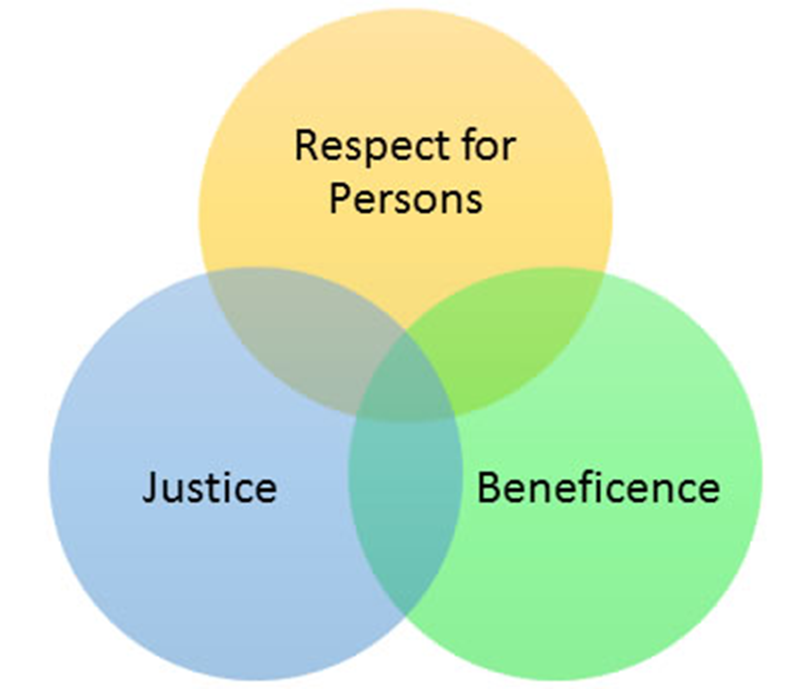
Three Principles of Belmont Report

Slide 14
How to submit an IRB Application what do you need to know?
Gather all the required documents/attachments prior to working in Kuali.
Make sure that everyone you list on the protocol has the required training complete.
Undergraduate/Graduate Students are not allowed to be listed as the Principal Investigator with the IRB, therefor you must list an advisor or a faculty member who is willing to review your submission prior to our office reviewing it.
Most graduate student projects are eligible for an exemption determination (see exemption categories)

Slide 15
Additional considerations
Please write your application in a professional tone and carefully proofread prior to submitting.
Please be sure that what you write in the application matches what you write in your consent document and any participant facing materials.
Please allow our office sufficient time(average 10 business days) to review the submission and know that if we have questions, you will receive the package back with action items that will need to be fully addressed prior to our issuing a determination.

Slide 16
Studies that can not be Exempted
Research
- involving prisoners as subjects
Research
- involving children as subject (there are some exceptions to this with a limited review).
Research
- investigating an FDA regulated product. (think drugs and devices)

Slide 17
Exemption Category 1
Research conducted in established or commonly accepted educational settings, that specifically involves normal educational practices that are not likely to adversely impact students’ opportunity to learn required educational content or the assessment of educators who provide instruction. This includes most research on regular and special education instructional strategies, and research on the effectiveness of or the comparison among instructional techniques, curricula, or classroom management.

Slide 18
Exemption Category 2
Research that only includes interactions involving educational tests (cognitive, diagnostic, aptitude, achievement), survey procedures, interview procedures or observation of public behavior (including visual or auditory recording) if at least one of the following criteria is met:
​​​ (i) The information obtained is recorded by the investigator in such a manner that the identity of the Human Subjects cannot be readily ascertained, directly or indirectly through identifiers linked to the subjects; OR
​​ (ii) Any disclosure of Human Subjects’ responses outside the research would not reasonably place the subjects at risk of criminal or civil liability or be damaging to the subjects’ financial standing, employability, educational advancement, or reputation; OR
​​​ (iii) The information obtained is recorded by the investigator in such a manner that the identity of the Human Subjects can be readily ascertained, directly or indirectly through identifiers linked to the subjects, AND an IRB conducts limited IRB review. (See HRP-319 – WORKSHEET – Limited IRB Review and Broad Consent)

Slide 19
Exemption Category 3
(i). Research involving benign behavioral interventions in conjunction with the collection of information from an adult subject through verbal or written responses (including data entry) or audiovisual recording if the subject prospectively agrees to the intervention and information collection and at least one of the following criteria is met:
​​​ (A) The information obtained is recorded by the investigator in such a manner that the identity of the Human Subjects cannot readily be ascertained, directly or indirectly, through identifiers linked to the subjects; OR
​​ (B) Any disclosure of the Human Subjects’ responses outside the research would not reasonably place the subjects at risk of criminal or civil liability or be damaging to the subjects’ financial standing, employability, educational advancement, or reputation; OR
​​ (C) The information obtained is recorded by the investigator in such a manner that the identity of the Human Subjects can readily be ascertained, directly or indirectly, through identifiers linked to the subjects; AND an IRB conducts limited IRB review. (See HRP-319 – WORKSHEET – Limited IRB Review and Broad Consent)

Slide 20
Exemption Category 4
Secondary research for which consent is not required: Secondary research uses of identifiable private information or identifiable biospecimens, if at least one of the following criteria is met:
​​​ (i) The identifiable private information or identifiable biospecimens are publicly available; OR
​​(ii) Information, which may include information about biospecimens, is recorded by the investigator in such a manner that the identity of the human subjects cannot readily be ascertained directly or through identifiers linked to the subjects, the investigator does not contact the subjects, and the investigator will not re-identify subjects; OR
​​(iii) The research involves only information collection and analysis involving the investigator’s use of identifiable health information when that use is regulated under 45 CFR part 160 and 164 (HIPAA), subparts A and E, for the purposes of “health care operations” or “research” as those terms are defined at 45 CFR 164.501 or for “public health activities and purposes” as described under 45 CFR 164.512(b)

Slide 21
My application has been approved now what?
Carefully document consent of each participant
Maintain your training
If you have any changes to the participant facing materials (ie consent script, recruitment flyer, recruitment email, survey instrument, data collection elements), please submit an amendment to your protocol in Kuali prior to implementing any of the changes.
If you receive a participant complaint about the research, send it into the IRB office.

Slide 22
Resources
CITI Training Program:
www.Citiprogram.org
Kuali Protocol Submission System:
Kuali Apps
Kuali Protocols Sandbox System:
Kuali Apps
IRB Office Main Website:
IRB - Vice President For Research
Contact for the office:
CSU_IRB@colostate.edu

