Slide 1
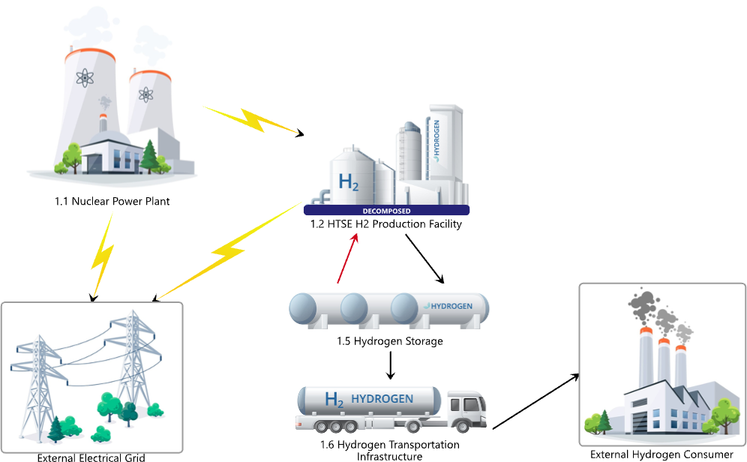
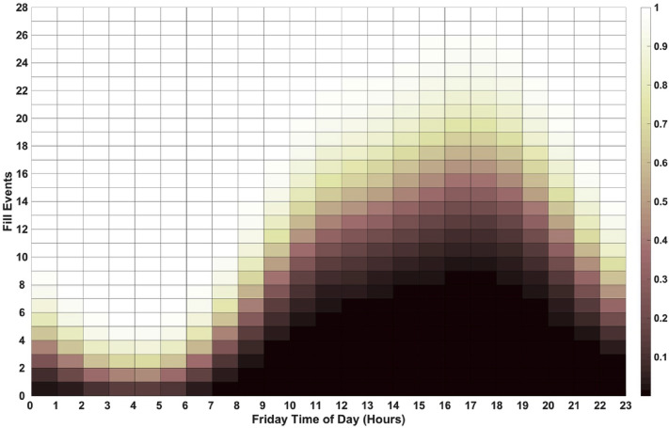



Make your title large and readable: Do not let it get too close to the edges &
leave a gap between the title and body (break titles at “&,” “or,” and colons)
Intro: Try to format everything within a single text box like this
The font we use is Poppins regular and Poppins medium. Text size can vary if you need but try to keep it to 2 sizes in the body, one for headers and one for paragraphs. The fewer the words the better. You will explain the complicated parts, the visual just needs to be useful so people can understand and take an interest. Of course, read and follow your conference’s requirements.
Do not use italics if you can avoid it. Do not make the text a lighter shade of gray if you can avoid it.
Methods: Try to put visuals at the end of sections with more space following the caption
You are encouraged to use simple bullet points. But remember, bullet points are only effective if they are simple:
We found significance at a 95% confidence interval
We examined economic, social, and technical aspects of hydrogen use
We learned that simplicity rules; people don’t want to read endlessly
Leaving some white space at the end of a column is acceptable
Try not to split bullets between columns. Instead switch to paragraph form to round out your description. Or use an image to the left and continue with bullets starting at the top center. Too much method discussion will make your audience zone out. Better to leave it for discussion if you can, with key insights listed only.
Results: I don’t know about you, but I love getting to results
This is where we usually have issues visually. Yes, we want images that show our results. We want them to be large and readable. We do NOT want them to crowd out the center of our poster. It looks bad to the eye and can confuse the reader’s sense of flow. The solution is to use visuals that fully cross columns or to place them between text so they aren’t all directly next to each other. Also, limit the number. Key images only.
If your graphs or tables look too small set within a single column but they are too big stretched out across two columns, see if you can export your image at a different scale to fit wider or taller.
Results also showed the need for us to include the requirements of multiple stakeholders in this complex system.
Future research: Keep it brief, ideal is 3 short bullets
Study the impact of more Xs on Ys, controlling for X2
Qualitative research for deeper understanding of X
Complete phase two for more robust data and address the design weaknesses of this study
Conclusion: This should connect to the bigger picture of your research
Example: “As hydrogen fueling stations grow to comparable scope of gasoline infrastructure, there is a need to understand the demand for hydrogen fueling. This study proposes a statistical model to predict the hour-by-hour demand for hydrogen fueling. Results can help operators make informed decisions on operations and maintenance strategies that will impact U.S. economics of hydrogen infrastructure.”
References & credit
We recommend you list key contributors like authors, research partners, and funders. Include a link or QR code to full reference page, article, or draft.
System stakeholders in model
Figure 3: This model is a simplification of a complex system that involves many stakeholders, each with requirements included in our analysis.
Never forget the titles on graphs, same font and size as caption
Figure 1: This graph is an example of the type of simple graphic we want to use to explain our research if possible. It’s OK to have explanation of graphs in detail, but make sure it doesn’t crowd the other text on the page and that it is visible to the reader. Remember the “so what?” of the graph you were using. Leave nuanced details to Q&A.
Figure 2: Use visuals that show only the noteworthy results. Keep the caption short but clear.
For full reference page and draft scan this code.

Slide 2

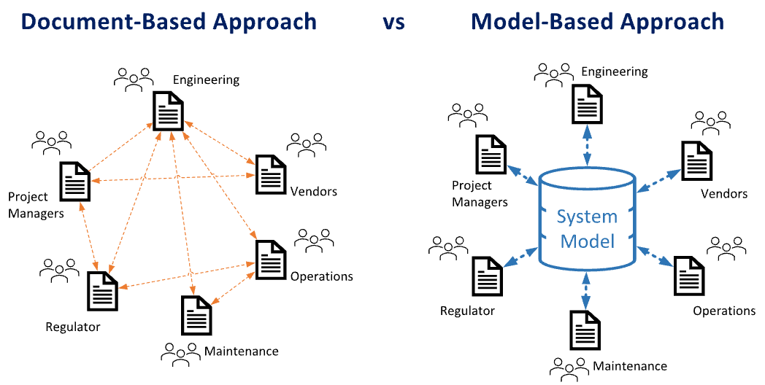
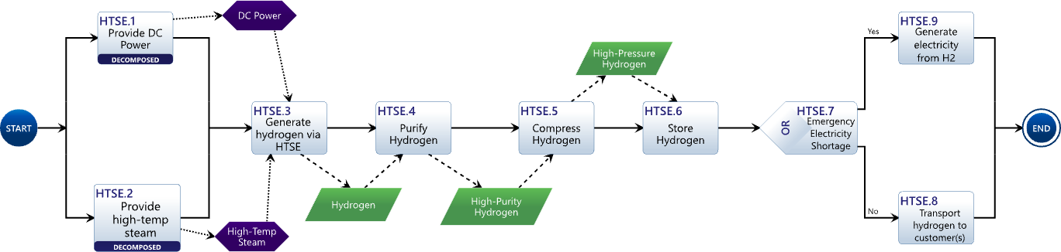
Make your title large and readable: Do not let it get too close to the edges &
leave a gap between the title and body (break titles at “&,” “or,” and colons)
Intro: Try to format everything within a single text box like this
The font we use is Poppins regular and Poppins medium. Text size can vary if you need but try to keep it to 2 sizes in the body, one for headers and one for paragraphs. The fewer the words the better. You will explain the complicated parts, the visual just needs to be useful so people can understand and take an interest. Of course, read and follow your conference’s requirements.
Do not use italics if you can avoid it. Do not make the text a lighter shade of gray if you can avoid it.
Methods: Try to put visuals at the end of sections with more space following the caption
You are encouraged to use simple bullet points. But remember, bullet points are only effective if they are simple:
We found significance at a 95% confidence interval
We examined economic, social, and technical aspects of hydrogen use
We learned that simplicity rules; people don’t want to read endlessly
Leaving some white space at the end of a column is acceptable
Results: I love getting to results
This is where we usually have issues visually. Yes, we want images that show our results.
We want them to be large and readable.
We do NOT want them to crowd the center
The solution is to use visuals that fully cross columns or to place them between text, so they aren’t all directly next to each other.
Also, limit the number. Key images only.
Future research: Keep it brief, ideal is 3 short bullets
Study the impact of more Xs on Ys, controlling for X2
Qualitative research for deeper understanding of X
Complete phase two for more robust data and address the design weaknesses of this study
Conclusion: This should connect to the bigger picture of your research
Example: “As hydrogen fueling stations grow to comparable scope of gasoline infrastructure, there is a need to understand the demand for hydrogen fueling. This study proposes a statistical model to predict the hour-by-hour demand for hydrogen fueling. Results can help operators make informed decisions on operations and maintenance strategies that will impact U.S. economics of hydrogen infrastructure.”
References & credit
We recommend you list key contributors like authors, research partners, and funders. Include a link or QR code to full reference page, article, or draft.
[1] My above example uses more text than you’ll likely need or want.
[2] If you don’t go on and on like me, you’ll have all the space you need for key references
[3] Remember, if your graphs or tables look too small set within a single column but they are too big stretched out across two columns, see if you can export your image at a different scale to fit wider or taller.
[4] Thanks for reading and using this template!
Figure 2. Don’t let perfection getting the way of good enough.
Figure 1: This graph is an example of the type of simple graphic we want to use to explain our research if possible. It’s OK to have explanation of graphs in detail, but make sure it doesn’t crowd the other text on the page and that it is visible to the reader. Remember the “so what?” of the graph you were using. Leave nuanced details to Q&A.
For full reference page and draft scan this code
Figure 3: Use visuals that show only the noteworthy results. Keep the caption short but clear. Graphs need titles but not all figures need a title. All images need captions.

Slide 3
Make your title large and readable: Do not let it get too close to the edges &
leave a gap between the title and body (break titles at “&,” “or,” and colons)
Authors: Kevin Fleming, CSU Systems Communicator; Dan Herber, Assistant Professor; Tom Bradley, CSU Systems Department Chair
Intro: Try to format everything within a single text box like this
The font we use is Poppins regular and Poppins medium. Text size can vary if you need but try to keep it to 2 sizes in the body, one for headers and one for paragraphs. The fewer the words the better. You will explain the complicated parts, the visual just needs to be useful so people can understand and take an interest. Of course, read and follow your conference’s requirements.
Do not use italics if you can avoid it. Do not make the text a lighter shade of gray if you can avoid it.
Methods: Try to put visuals at the end of sections with more space following the caption
You are encouraged to use simple bullet points. But remember, bullet points are only effective if they are simple:
We found significance at a 95% confidence interval
We examined economic, social, and technical aspects of hydrogen use
We learned this simplicity rules; people don’t want to read endlessly
Leaving some white space at the end of a column is acceptable
Results: I love getting to results
This is where we usually have issues visually. Yes, we want images that show our results.
We want them to be large and readable.
We do NOT want them to crowd the center
The solution is to use visuals that fully cross columns or to place them between text, so they aren’t all directly next to each other.
Also, limit the number. Key images only.
Future research: Keep it brief, ideal is 3 short bullets
Study the impact of more Xs on Ys, controlling for X2
Qualitative research for deeper understanding of X
Complete phase two for more robust data and address the design weaknesses of this study
Conclusion: This should connect to the bigger picture of your research
Example: “As hydrogen fueling stations grow to comparable scope of gasoline infrastructure, there is a need to understand the demand for hydrogen fueling. This study proposes a statistical model to predict the hour-by-hour demand for hydrogen fueling. Results can help operators make informed decisions on operations and maintenance strategies that will impact U.S. economics of hydrogen infrastructure.”
References & credit
We recommend you list key contributors like authors, research partners, and funders. Include a link or QR code to full reference page, article, or draft.
[1] My above example uses more text than you’ll likely need or want.
[2] If you don’t go on and on like me, you’ll have all the space you need for key references
[3] Remember, if your graphs or tables look too small set within a single column but they are too big stretched out across two columns, see if you can export your image at a different scale to fit wider or taller.
[4] Thanks for reading and using this template!
Figure 2. Don’t let perfection getting the way of good enough.
Figure 1: This graph is an example of the type of simple graphic we want to use to explain our research if possible. It’s OK to have explanation of graphs in detail, but make sure it doesn’t crowd the other text on the page and that it is visible to the reader. Remember the “so what?” of the graph you were using. Leave nuanced details to Q&A.
For full reference page and draft scan this code
Figure 3: Use visuals that show only the noteworthy results. Keep the caption short but clear. Graphs need titles but not all figures need a title. All images need captions.

Slide 4
CSU Engineering Colors for Print (CMYK)
Delete this page before printing
Primary Brand Colors
Neutral Colors
C92 M18 Y94 K61
C11 M6
Y64 K13
C0 M0
Y0 K80 Please do not use for text in posters
C0 M0
Y0 K0
C40 M30 Y20 K100
C10 M7
Y8 K0
C10 M17
Y30 K0
Energy Palette For Engineering
C22 M0
Y93 K0
C100 M20
Y30 K0
C0 M26
Y100 K0

