Slide 1
Risk
Perception, Communication, & Democracy
Vincent Paglioni, Ph.D.
Assistant Professor of Systems Engineering
Vincent.Paglioni@colostate.edu

Slide 2
Opening Gambit
Exercise: Which do you think is riskier regarding only radiation?
Living within 50 miles of an operating nuclear power plant
Living along Colorado’s Front Range
Why did you make your choice?
Activity | Yearly Effective Dose | Total Dose after 50 years
Living in U.S. (avg. background)* | 56 mrem | 2,800 mrem
Living in Ft. Collins (avg. background)* | +64 mrem | +3,200 mrem
Living near NPP | +0.01 mrem | +0.5 mrem
Chest x-ray once per year | +2 mrem | +100 mrem
*From all terrestrial and cosmic sources excluding radon exposure. ~50% of homes in CO have radon levels higher than U.S. EPA recommended action level (4pCi/L).

Slide 3
What is risk really?
How do you define risk?
Kaplan & Garrick (1981) use three questions to define risk:
Scenario: What can go wrong?
Probability: What is the likelihood of the occurrence?
Consequence: What are the consequences?
Why should we care about risks?
We all engage in risky activities every day
We all rely on critical infrastructure, which comes with risks

Slide 4
Public Risk Perception vs Expert Risk Analysis
Exercise: How does your perception of risk differs from experts?
This is a selection from 30 activities, but rank 1-8
1 = highest risk
Public Ranking | Activity/Technology | Expert Ranking
6 | Alcohol | 3 $\left(↑3\right)$
3 | Hand guns | 4 $\left(↓1\right)$
5 | Motorcycles | 6 $\left(↓1\right)$
2 | Motor vehicles | 1 $\left(↑1\right)$
1 | Nuclear power | 20 $\left(↓↓↓19\right)$
8 | Police work | 17 $\left(↓↓9\right)$
7 | Private aviation | 12 $\left(↓↓5\right)$
4 | Smoking | 2 $(↑2)$
Risks associated with direct benefits more acceptable
Familiarity with technology is a HUGE factor in risk perception
Modarres, M. (2006). Risk Analysis in Engineering: Techniques, Tools, and Trends. Boca Raton, FL: Taylor & Francis.

Slide 5
Risk Analysis vs. Risk Perception
Psychometric theory of risk perception: Predict perception based on characteristics of the risk and population
Public Risk Perception
Esoteric risk characteristics, e.g.:
“Dread” associated with consequences
Aversion to “tampering with nature”
Distributive effects of risk
Trust in institution
Familiarity with technology
Perception based on risk object and personality
Influenced heavily by cognitive heuristics
Expert Risk Analysis
Measurable aspects of risk
Probability, Consequences
Rigorous determination of:
Probability of risk events in the system
Consequences of different failures
Risk determined only by scenario, probability, consequences
“System I”
“System II”
Slovic, P. (2009). The Perception of Risk. London, UK: Earthscan Ltd.

Slide 6
Heuristics & Biases: How we make risk decisions
Heuristics
Mental shortcuts that help us simplify complex tasks
Availability: memorable events deemed more likely
Media attention
Representative: using preconceived mental models rather than actual data
Stereotyping
Anchoring: adjusting assessment (of, e.g., probability) from an initial value
We are not good at doing this
Biases
Systematic errors in thinking
Gambler’s Fallacy: rationalizing random events as “predictable”
Sometimes, things are just random
Priming: heavy influence of first presentation of issue
Why first impressions actually matter
Framing: tendency to choose a narrow view of situation
Narrowing our decision landscape
Notes:
Availability: are there more words in the English language that start with “K”, or that have “K” as the third letter? (third letter)
Representative: we tend to categorize things (objects, events, people) based on our perception of a “prototype”
Anchoring: How many African countries are in the UN? If I give you a random number (e.g., higher or lower than 50), you’ll likely start at 50 and then try to adjust up or down.

Slide 7
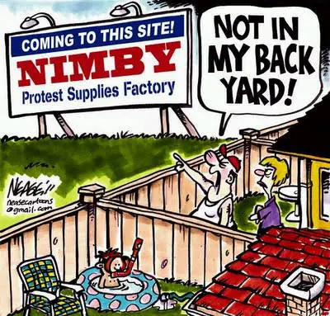
Attitudes towards risk: Heavily dependent
The “acceptability” of a risk (to the public) is dependent on several factors:
The benefits of the activity
More benefits = more acceptable
The voluntary nature
Voluntary = more acceptable
Consequence distribution
NIMBYs…
Personal vs. societal effect
Societal risks = I can avoid it… (also NIMBYs…)
Frequency
Many low-consequence >> few high-consequence
Control
Some level of personal control = more acceptable
Slovic, P. (2009). The Perception of Risk. London, UK: Earthscan Ltd.
Notes:
1: nuclear medicine vs. nuclear energy generally seen as more acceptable (higher benefits)
2: no real push for safety regulations in voluntary activities (e.g., skiing, climbing, skydiving, etc.)
3: bad things close == worse than bad things far away; not many people clamoring to live next to a coal power plant
4: seatbelts, vaccines, etc.
5: natural gas is familiar – we all use it or know someone who does. It must therefore be safer than coal, nuclear
6: car accidents tolerated far more than airline crashes
7: do you like riding in the car or driving more? I thought so…
8: airplane crashes, any disease outbreak, etc.

Slide 8
Risk acceptance: How safe is safe enough?
Generally, activities with a fatality risk greater than $1/1,000$ (${10}^{−3}$) per year are unacceptable to the general public
There is one exception to this rule…
General considerations for absolute risk acceptance criteria:
Fatality risk level per year | Considerations
$${10}^{−3}$$ | Unacceptable to everyone. Immediate action should be taken to reduce the hazard at this level.
$${10}^{−4}$$ | Generally acceptable, although most people would support public funding to reduce risks at this level.
$${10}^{−5}$$ | Acceptable, but general public is still able to recognize that risk exists. People may accept inconveniences to avoid this level of risk.
$${10}^{−6}$$ | Generally acceptable with no concerns. Even if aware of the risks, general public will feel that the risk is not applicable to them. This is “act of God” level of risk.
$$<{10}^{−6}$$ | Acceptable. The general public is usually unaware of risks at this level.
Risk Event/ Activity | Representative Risk (deaths/person-yr)
Cars | $$\sim 3×{10}^{−3}$$
Drowning | $$\sim 4×{10}^{−5}$$
Fires | $$\sim 4×{10}^{−5}$$
Poisoning | $$\sim 1×{10}^{−5}$$
Lightning | $$\sim 8×{10}^{−7}$$
Modarres, M. (2006). Risk Analysis in Engineering: Techniques, Tools, and Trends. Boca Raton, FL: Taylor & Francis.

Slide 9
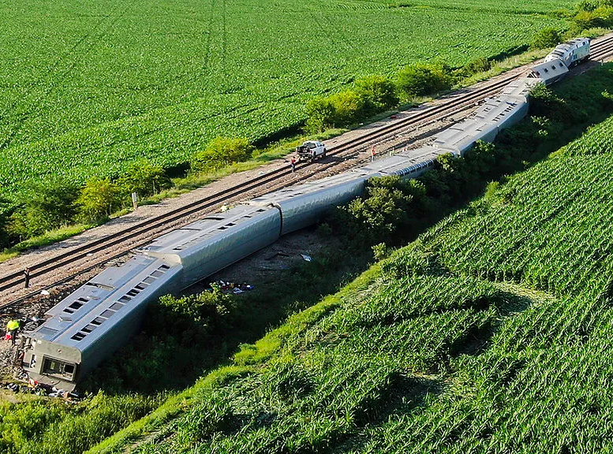
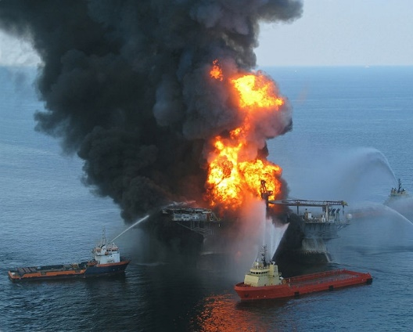
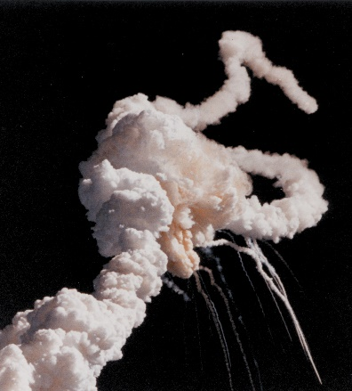
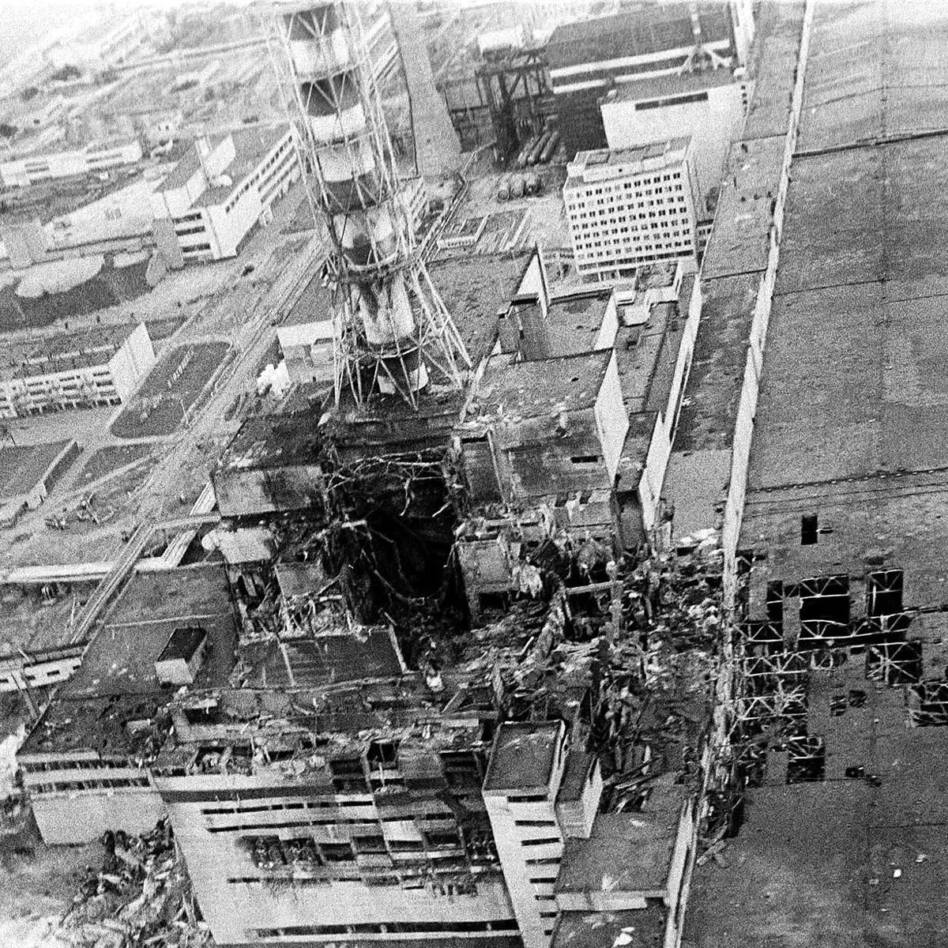
Risk Perception → Risk Reality
For people who do not study risk, their perception becomes reality
Perception based on qualitative factors not included in risk assessments
E.g., “dread”, controllability, familiarity, distributive impact, etc.
Communicating risk with an affected population requires understanding how and why they perceive a risk
Notes:
Experts understand the risk triplet and probabilities, and still fall victim to the same perceptual factors as the general public

Slide 10
Risk Communication
Much of this information comes from:
Modarres, M. (2006). Risk Analysis in Engineering: Techniques, Tools, and Trends. Taylor & Francis.

Slide 11
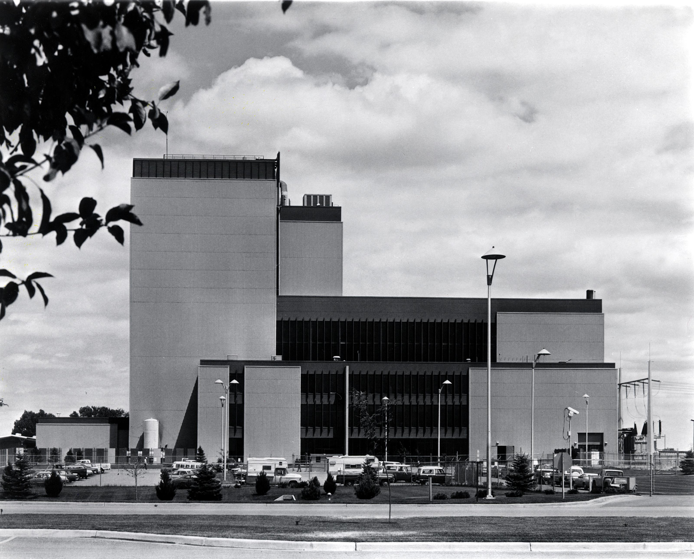
Why is risk communication important?
Systems are:
Designed, built, operated by experts
Relied upon by everyone
The public is trusting engineers to act responsibly
People lack the expertise to assess complex risks
Trust informed by communication
Democracy: governing power vested in people
People understand the needs of their community and deserve a voice in decisions that affect them
Notes:
Top: Fort St. Vrain generating station (once an advanced nuclear reactor – HTGR – now a natural gas generating station)
Bottom: Airbus A320; the plane that caused Boeing to pursue a course of action that would eventually result in 346 deaths

Slide 12
Basic rules of risk communication
Accept & involve the public as a legitimate partner
People and communities have a right to participate in decisions that affect their lives, property, and things they value
Plan carefully and evaluate performance
Listen to specific concerns from the public
Be honest, frank, and open
Coordinate and collaborate with credible sources
Be clear and compassionate
Technical jargon is a barrier to successful communication with the public
Modarres, M. (2006). Risk Analysis in Engineering: Techniques, Tools, and Trends. Taylor & Francis.

Slide 13
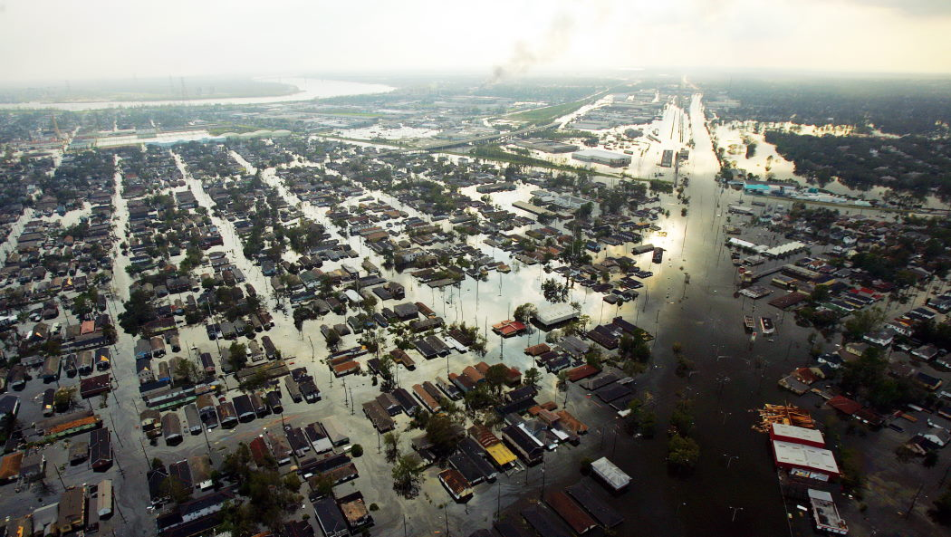
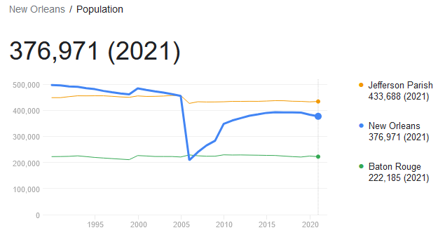
Example: Hurricane Katrina (2005)
New Orleans, Louisiana
Population: 484,674 (at the time)
Hurricane Katrina
Category 3 at landfall on August 29, 2005
One of the costliest tropical cyclones
1200+ fatalities, $125 Billion in damage
New Orleans has still not fully recovered
Sources:
Cole, Terry W. and Fellows, Kelli L. (2008) Risk Communication Failure: A Case Study of New Orleans and Hurricane Katrina, Southern Communication Journal, 73:3, 211-228.
Elder, K., et al. (2007): African Americans’ Decision Not to Evacuate New Orleans Before Hurricane Katrina: A Qualitative Study, American Journal of Public Health, 97:S1, S124-S129
Seeger, Matthew W. (2006) Best Practices in Crisis Communication: An Expert Panel Process, Journal of Applied Communication Research, 34:3, 232-244.

Slide 14
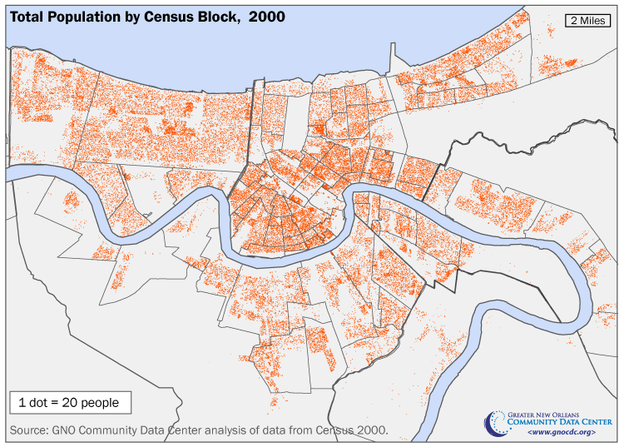
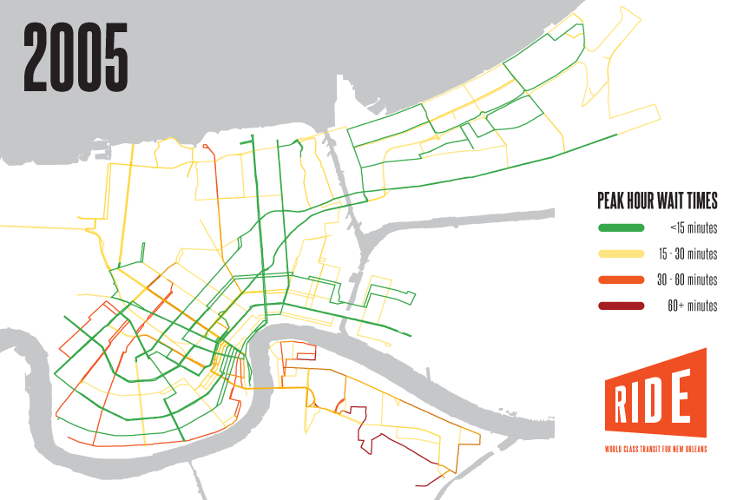
Hurricane Katrina – 1) Involve
Lake Pontchartrain
Emergency plans developed (seemingly) without community input
Evacuation: 80% of city relied on public transit…
Little official discussion of actual risk with NOLA community
LSU found large storm could destroy NOLA
New Orleans Times-Picayune series detailing the lack of storm defenses
High poverty areas
Pre-storm risk communication did not feature government-community dialogue
Top figure: https://www.datacenterresearch.org/reports_analysis/shifts-in-population-and-loss-of-children-across-the-new-orleans-metro-area/
Bottom figure: https://rideneworleans.org/state-of-transit-ten-years-after-katrina/
Notes:
South of the Mississippi: reasonably dense population, almost no public transit
North of the Mississippi: denser, better (but still not ideal) public transit

Slide 15
Hurricane Katrina – 2) Plan & 3) Listen
Communication with public before/during Katrina was scattered and aimless
Mixed messages from state, city, parish governments
Evacuation recommended alongside with stockpiling supplies
Little effort to engage with reluctant, underserved African American community
State-run program to engage churches to help evacuation efforts was not utilized
Particularly, residents of the 9th Ward were essentially abandoned with no feasible evacuation plans
Don’t wait for the city, don’t wait for the state, don’t wait for the Red Cross, LEAVE.
- Instructional video for low-income neighborhoods
(never distributed)
We need to get as many people out as possible… There may be intense flooding…
Hopefully … [the hurricane] could move just a little bit in one direction or another and not keep New Orleans in its sights.
-Evacuation announcement by New Orleans Mayor (Aug. 29, 2005)
Notes:
30,000 videos urging residents to leave HAD been made, but never distributed
Community avoided the ISSUE, not the risk – assumed the risk would not occur

Slide 16
Hurricane Katrina – 4) Honest & 5) Coordinate
Decades of eroded trust in communicators
Why should they listen to communicators now?
Led public to engage in avoidance strategies
No effort to rebuild credibility in communities
Communications from agencies were not coordinated, resulting in confusion and inaction
Uncertainties were NOT communicated effectively
~70,000 residents did not evacuate, because:
Parishes received different advice at different times
Communicators avoided perception of mandatory evacuation
If you get conflicting information from people you’re not sure of, then inaction may be, from your perspective, the most prudent form of action.
- Margaret Sims, Vice President of Joint Center for Political and Economic Studies (2006)

Slide 17
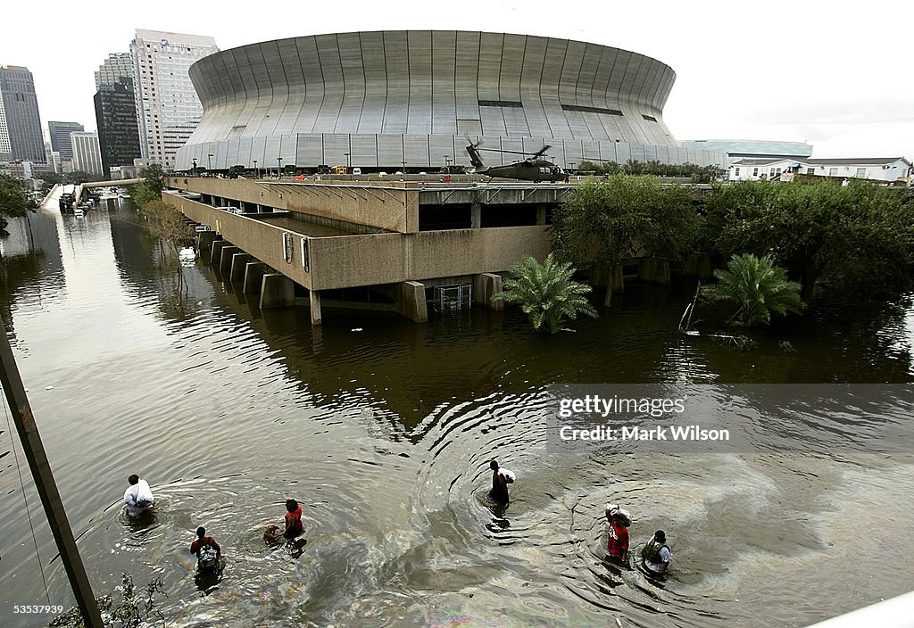
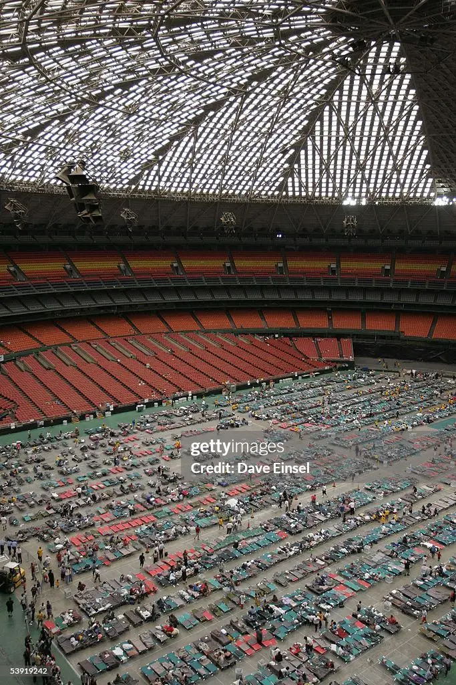
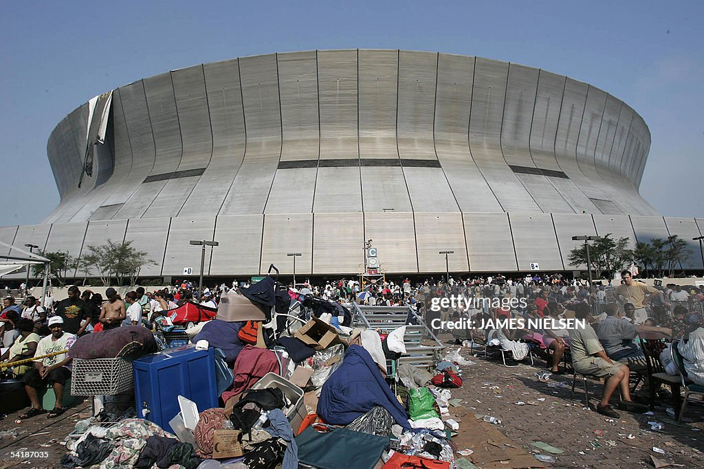
Hurricane Katrina – 6) Clarity & Compassion
Evacuation messages muddled by jargon
E.g., “overtop” vs “breach”: people just needed to know to leave
Evacuation messages confusing and issued too late
Evacuation not characterized mandatory
24 hours before landfall and again after the levees had failed
Actual response lacked care and compassion
Evacuation buses did not go into many (poor) neighborhoods
Evacuation centers were still in the city – stranded anyway
Notes:
“overtopping” vs “breaching” is an important distinction for experts – but regular people just need to know when they should leave

Slide 18
Hurricane Katrina – Could it have gone better?
“Risk learners gather appropriate feedback from their environment… If that environment diminishes the risk (i.e., provides poor feedback), the tendency is to withhold.”
(Cole and Fellows, 2008)
YES
One issue to overcome: apathy
Risks fail to materialize → apathy → 30 years of complacency
Bigger issue: breakdown of local democracy
Community disaffected by local government
Large minority/female population: generally lower trust in govt
Segregation: low-income neighborhoods neglected by city
Result: population largely did not trust the government
City not engaged with community
No dialogue after earlier storms (Betsy ‘65, Georges ‘98)
Evacuation plans could have met community needs
Because I mean I made it through Vietnam and I figured my Lord ain’t gonna let me die in nothing like this here.
- Katrina survivor
(Elder, et al., 2007)
Notes:
Government perspective: if it ain’t broke, don’t fix it
Community perspective: We’ve survived before, we’ll survive now
Use this slide as bridge to democracy – failing democracy led to/caused by failed risk communication

Slide 19
Democracy and Risk

Slide 20
Risk Perception and Trust
Trust in the system/technology caretakers is critical to how we perceive risk
Trust is necessary in both risk & democracy
Trust
Democracy
Breakdown of democratic process in New Orleans exacerbated the risk.
Continuous exposure to risk without mitigation can erode democracy.
Risk

Slide 21
Democracy and Risk
The conflicts and controversies surrounding risk management are […] a side effect of our remarkable form of participatory democracy
- Paul Slovic
Public input on (infrastructure) risk is somewhat unique to U.S.
Respects the autonomy of communities, despite complications
E.g., French vs. American nuclear industries…
Experiences with risk tend to erode trust (and democracy):
Great Recession, COVID-19 eroded public trust in government
Three Mile Island, Boeing 737MAX eroded trust in industry
Trust is asymmetric: Trust-destroying events more visible and carry more weight than trust-building events
Notes:
Why don’t I have any examples of building trust? Trust is incredibly fragile and is destroyed much more easily than it is built (Slovic’s “trust asymmetry”)

Slide 22
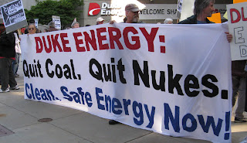
Democracy & Risk: Should risk perception affect risk management?
Two views on risk perception in risk management:
Paternalistic: Decisions based on risk assessment alone
E.g., Cass Sunstein – separation of fact and value
Participatory: Decisions based on assessment & perception
E.g., Sheila Jasanoff & Brian Wynne – risks as social constructs
Related to different approaches to risk perception:
Psychometric: Predict risk perception based on characteristics of the risk object and population
Social-cultural: Understand perception as a social/cultural construction and our adherence to archetypical worldviews
Kusch, M. (2007). Towards a Political Philosophy of Risk. In T. Lewens (Ed.), Risk: Philosophical Perspectives (1st ed., pp. 131–155). Taylor & Francis Group: Routledge.
Peschard, I., Benetreau-Dupin, Y., & Wessels, C. (2023). Philosophy and Science of Risk: An Introduction (1st ed.). Taylor & Francis Group: Routledge.
Notes:
These authors represent extreme views on either side

Slide 23
Democracy and Risk: The paternalistic view
Outsized role for experts & cost-benefit analysis for risk decisions
Public reliant on “rapid, intuitive, and error-prone” cognitive processes
Experts “more deliberative, calculative, slower, and likely to be error free”
Experts should be insulated from the public fears
Cost-benefit analysis corrects for the public’s cognitive biases
Cost-benefit analysis assesses risks unbiased by divisive social/moral issues
E.g., assess risks of stem cell research without public fight over meaning or value of human life
Problems with the paternalistic view:
Ecological/population fallacy: average conclusion $≠$ individual conclusion
Experts are prone to the same biases as the public
Is it ethical to remove agency in this type of decision?
Kusch, M. (2007). Towards a Political Philosophy of Risk. In T. Lewens (Ed.), Risk: Philosophical Perspectives (1st ed., pp. 131–155). Taylor & Francis Group: Routledge.

Slide 24
Democracy and Risk: The participatory view
Public: more reflective, questioning, engaged than scientists think
Science (as institution) lacks self-critical reflection (i.e., finding their limits)
Scientists tend to frame risks more narrowly than the public
Public motivated by more than just risk assessment
Trust, institutions, morality, distribution, etc.
“Upstream engagement” between experts and public
Address aspects of risk that are important to public prior to deployment
Scrutinize the practice of the risk assessment (normative consensus)
Problems with the participatory view:
Would this actually account for the public opinion, or the loudest opinion?
Social-cultural theory of risk perception is weakly supported in experiment
How to account for differing social/cultural values in a large public?
Kusch, M. (2007). Towards a Political Philosophy of Risk. In T. Lewens (Ed.), Risk: Philosophical Perspectives (1st ed., pp. 131–155). Taylor & Francis Group: Routledge.

Slide 25
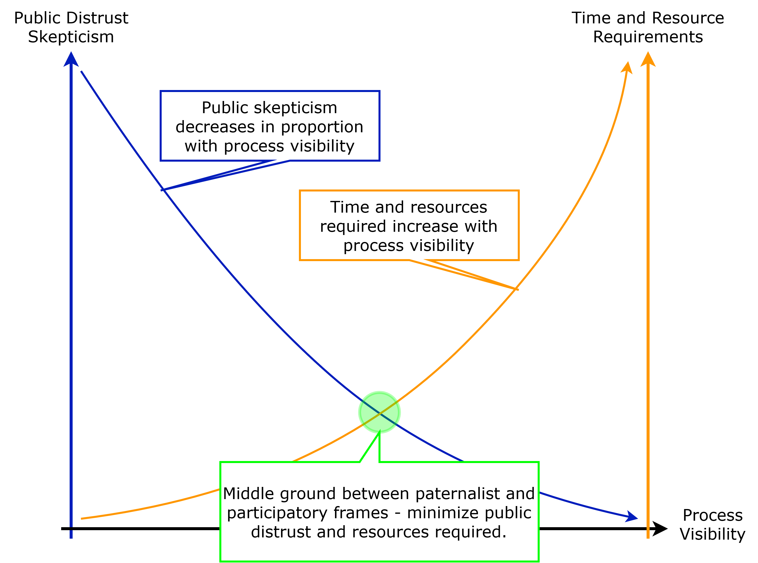
Democracy and Risk: Where do we go?
Proposal: normative framework for risk management
Blend paternalistic and participatory views
Risk analysis with public buy-in and discussion
Allow the experts to handle the actual analysis
What ought to be done
Guidelines, not specific courses of action
“Perfect world” framework – no resource constraints
Allows for flexibility of implementation
Goal: improve trust, not persuade public
Organization: willing to consider public input
Public: willing to consider organizational needs

Slide 26
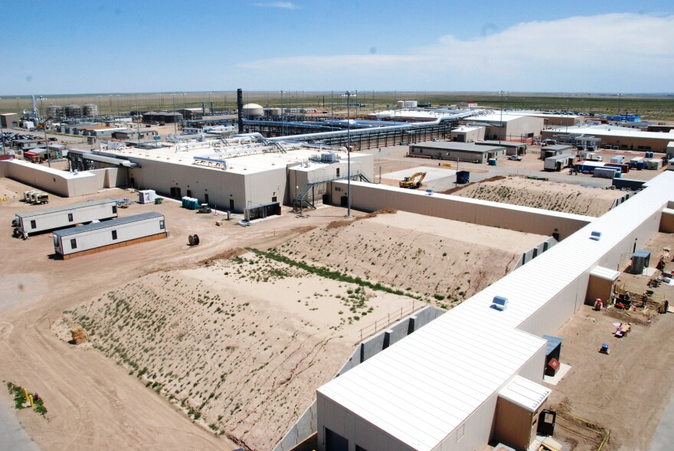
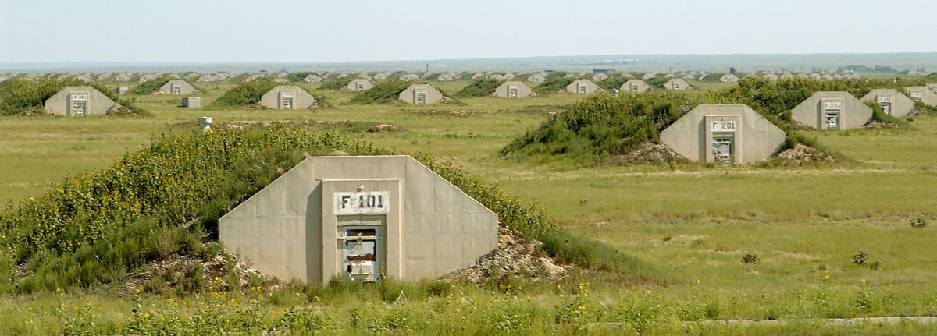
Inspiration: Colorado Chemical Demilitarization Citizens’ Advisory Commission (CAC) in Pueblo
CACs implemented in states with chemical weapons stockpiles
Pueblo: Team of 7 community members & 2 state officials
Monthly public meetings with U.S. Army representatives
Good:
Public engagement with community risk
Organization willing to hear community
Locally-appointed members
Not so Good:
Limited expertise in risk psychology
Unclear authority (but seems good!)
Pueblo Chemical Depot
Notes:
Also state medical boards that have non-expert participation, Diablo Canyon Independent Safety Committee

Slide 27
Normative framework for democratic risk management
Goal:
Allow for public engagement with the risk-relevant decisions on infrastructure projects that will impact their community
Start Rule:
Identified consequence that will affect the health of surrounding population with frequency $≥$ [value] per year
Below this level, risks are essentially invisible to the public
Process:
Public fora addressing:
Identified risks to the public
Mitigating and contingency actions
Uncertainties remaining
Citizen Advisory Committee established
Intermediary between experts and public
Active role in risk analysis
Affected Public
Diverse Team of Experts
Citizen Advisory Committee
Risk Mgmt.
Notes:
Ideas for [value]: 1/100,000 (10^-5), 1/population, or min{1/100,000, 1/community}

Slide 28
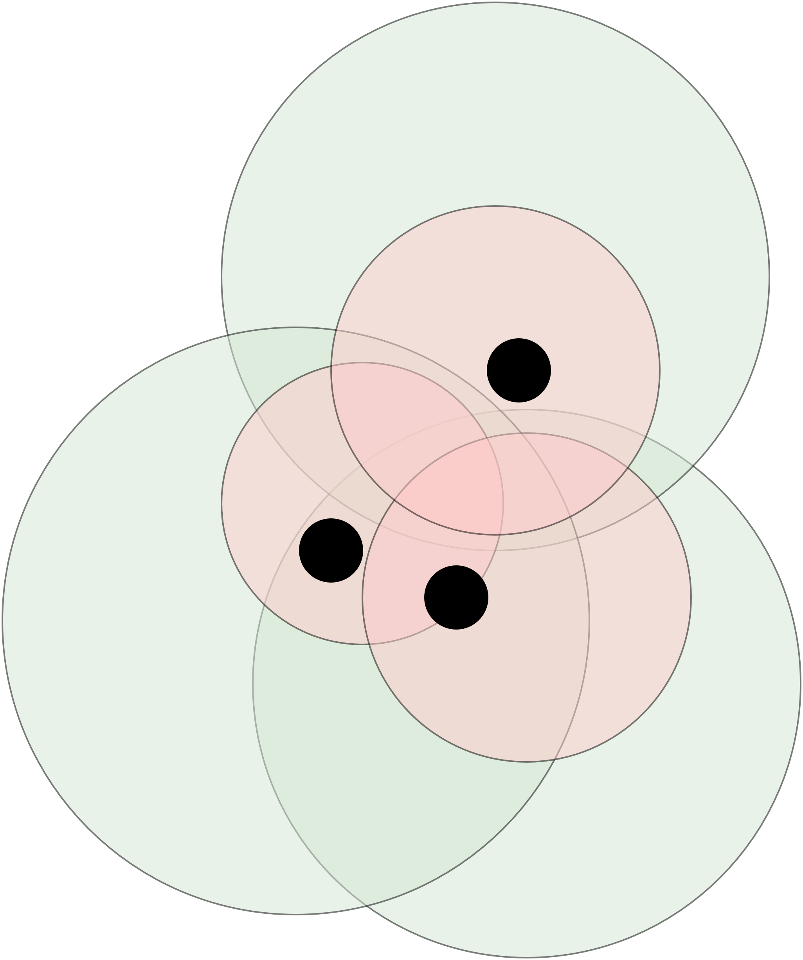
Anticipated outcomes with public risk engagement
Immediate benefits of normative approach:
Pathway for communities to raise and address their concerns
Allow communities to understand risk and mitigation actions
Improve community agency
Long-term benefits of normative approach:
Develop effective incentive mechanisms for assuming risks
DOE Consent-based Siting, Coal2Nuclear programs
Reverse cycle of underserved communities shouldering more and more risk (consequence localization)
Inequitable distribution of (negative) consequences and benefits
Theoretical overlay of infrastructure (black), consequences (red), benefits (green). Consequences are more localized than benefits.

Slide 29
Summary: Risk and Democracy
The public deserves a voice in decisions that will affect their lives
The only way to accomplish this is with risk communication
Two distinct frameworks for incorporating democracy and risk
Paternalistic – experts need to make decisions independently of public
Participatory – public deserves to have a voice
We should pursue a blended normative framework to risk assessment – to give the public appropriate agency
Requires us to get involved

Slide 30
Get involved with democracy and risk
Functioning democracy and appropriate risk decisions both rely on an informed public
How can you get involved with democracy?
Educate yourself on the issues, processes, and candidates
Involve yourself in local, state, and national political scenes
Communicate your concerns and interests to lawmakers
How can you get involved with risk?
Educate yourself on risk, risk perception, and risk management
Learn how to spot your (and others’) biases and risk sensitivity
Involve yourself: pay attention to what’s happening in your area
New infrastructure projects?
Communicate your concerns/interests – lawmakers and experts rely on public to accept their project
VOTE, VOTE, VOTE!

Slide 31
Thank you! Questions?
Dr. Vincent (Vinnie) Paglioni
Assistant Professor,
Department of Systems Engineering
Risk, Reliability, and Resiliency Characterization (R3C) Lab
Vincent.Paglioni@colostate.edu

Slide 32
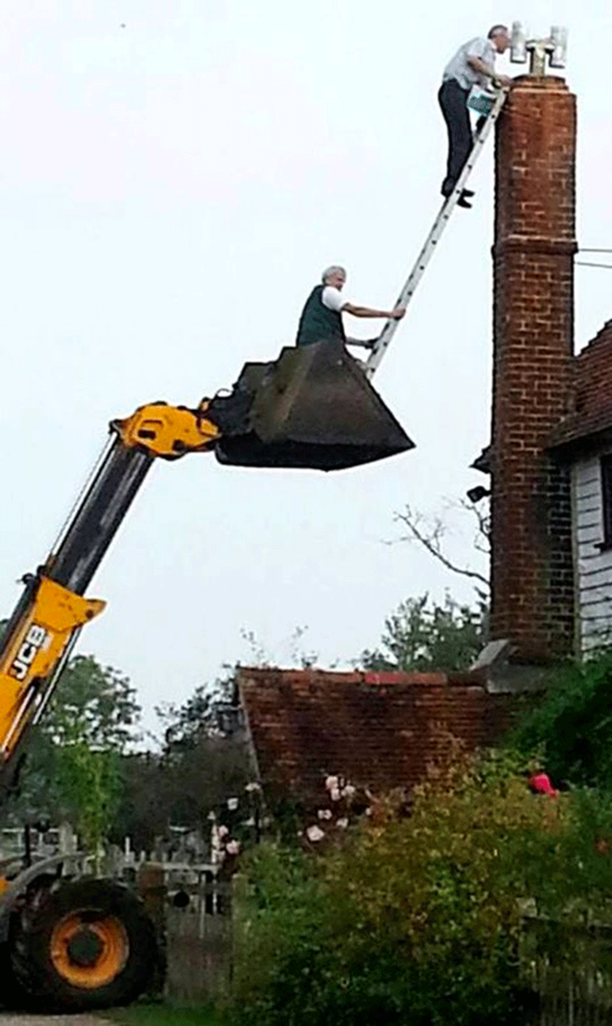
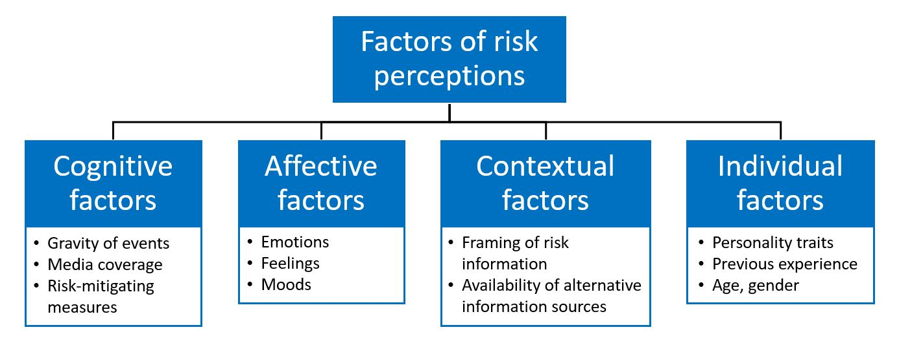
Risk Perception: how do we think about risks?
People (and organizations) can be tricky
Risk preferences: averse, neutral, seeking
We don’t usually think about probabilities…
Many other factors affect our perception of risk
40+ factors thought to affect risk perception…

Slide 33
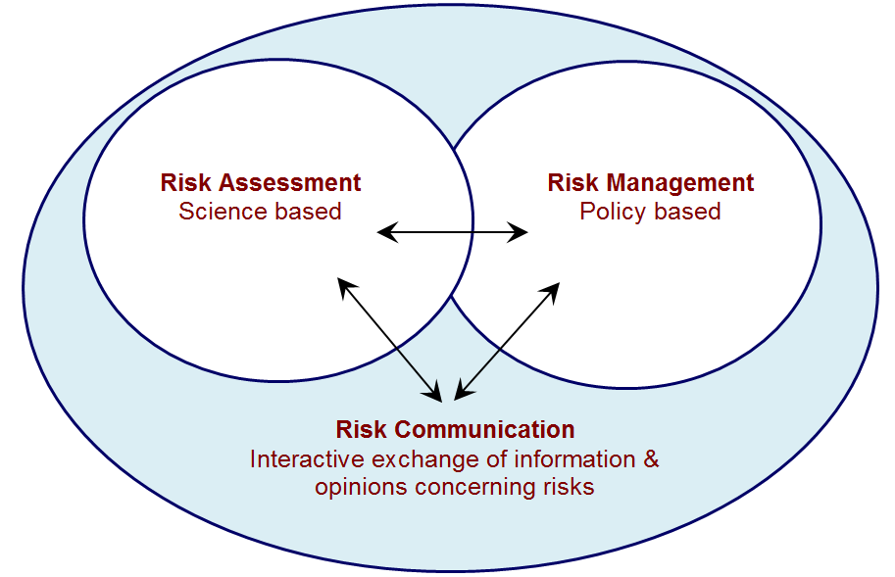
Overview
Risk perception
Risk communication
Risk and democracy
https://www.foodstandards.gov.au/science/riskanalysis/riskcommunication/pages/risk-communication.aspx

Slide 34
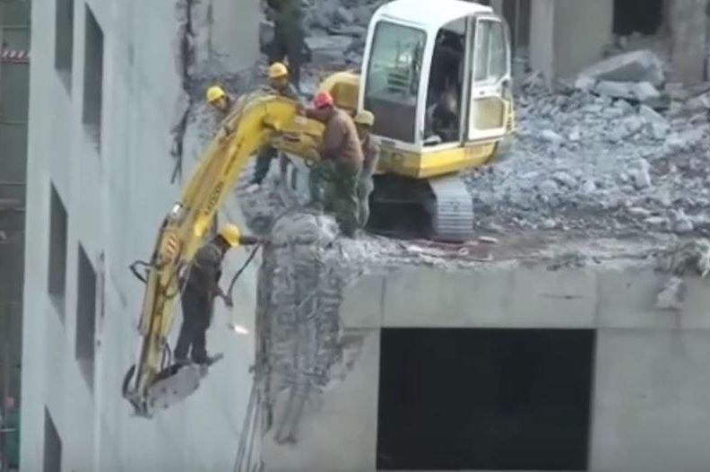
What is risk?
How do you define risk? What are some examples of common risks in your life?
Undesired outcome, or absence of desired outcome, that can possibly occur and disrupt the project
Uncertainty in achieving a goal, objective, or requirement
Possibility of loss or injury
Understanding risk involves understanding potential problems that might occur

Slide 35
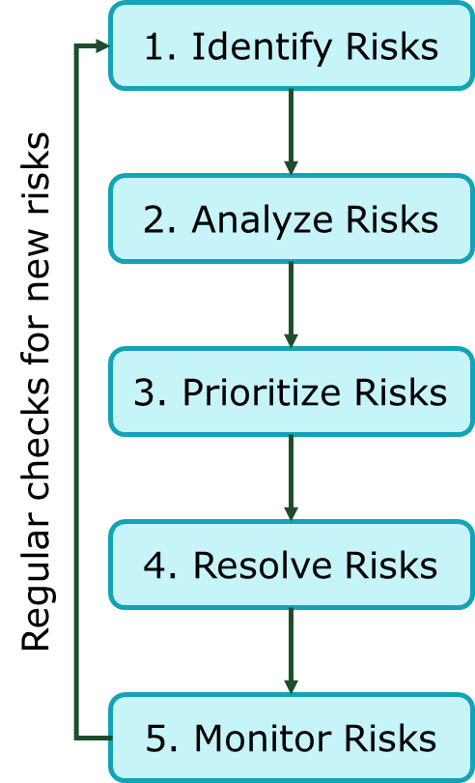
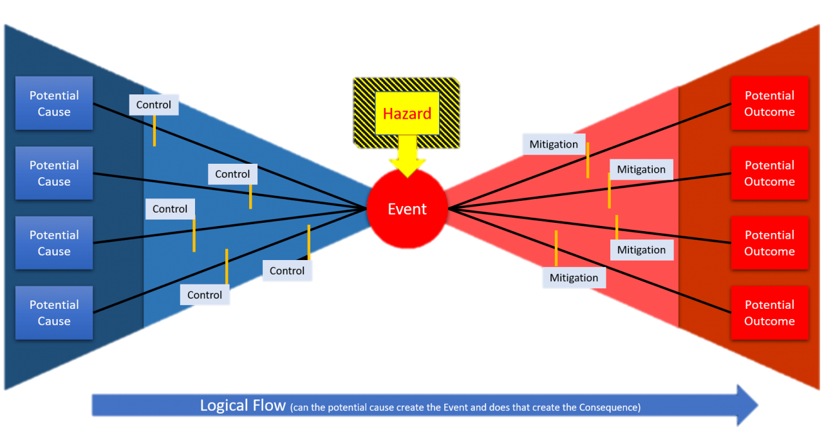
How do experts assess risks?
Qualitative (early stage) | Quantitative (late stage)
Probability Impact Matrix | Expected Monetary Value Analysis
Risk Categorization | Monte Carlo Analysis
Expert Judgment/Elicitation | Decision Trees
FMEA (Failure Modes & Effects) | FMECA (Failure Modes, Effects, & Criticality)
PHA (Process Hazard Analysis) | Probabilistic Risk Assessment
HAZOP (Hazard & Operability) | Bayesian Networks
Practically, risk viewed as a function of likelihood and impact:
$$Risk=f\left(likelihood, impact\right)$$

Slide 36
Attitudes towards risk: Acceptance criteria
Absolute risk acceptance criteria establish maximum or minimum values to different characteristics of risk:
Frequency/probability of occurrence of risk event or significant precursor
Rate/duration/frequency of exposure
Individual risk of early death
Societal risk of early death
Absolute risk acceptance criteria difficult to establish
Personal nature of many risks
Variance in risk aversion
We can derive relative risk acceptance criteria
Acceptability relative to other common risks

Slide 37
Social-cultural theory of risk perception
Theory: Risk perception is socially or culturally constructed
Not rooted in aspects of risk object or personality
Goal: Risk perception predicted by adherence to social-cultural archetypes (worldviews)
Organization of social relations influences perception & response
Hierarchist: strong group boundaries and role prescriptions
(Anthropogenic) risks can and should be controlled
Egalitarian: strong group boundaries with few prescriptions on roles
(Societal) risks correlated with actions viewed as inequitable or selfish
Individualist: weak group boundaries and few prescriptions on roles
(Economic) risks are opportunities and threatened by societal ordering
Fatalist: weak group boundaries but strong role prescriptions
(General) risks are part of external social change with little bearing on them

Slide 38
Public Risk Perception vs Expert Risk Analysis
Exercise: How do you think the public ranking of risk differs from that of experts?
This is a selection from 20 activities, but rank 1-8
1 = highest risk
Public Ranking | Activity/Technology | Expert Ranking
6 | Alcohol | 3 $\left(↑3\right)$
3 | Hand guns | 4 $\left(↓1\right)$
5 | Motorcycles | 6 $\left(↓1\right)$
2 | Motor vehicles | 1 $\left(↑1\right)$
1 | Nuclear power | 20 $\left(↓↓↓19\right)$
8 | Police work | 17 $\left(↓↓9\right)$
7 | Private aviation | 12 $\left(↓↓5\right)$
4 | Smoking | 2 $(↑2)$
Modarres, M. (2006). Risk Analysis in Engineering: Techniques, Tools, and Trends. Boca Raton, FL: Taylor & Francis.

Slide 39
Risk Perception – Public vs. Experts
Public Ranking | Activity/Technology | Expert Ranking
1 | Nuclear power | 20
2 | motor vehicles | 1
3 | handguns | 4
4 | smoking | 2
5 | motorcycles | 6
6 | alcohol | 3
7 | private aviation | 12
8 | police work | 17
9 | pesticides | 8
10 | surgery | 5
11 | firefighting | 18
12 | large construction | 13
13 | hunting | 23
14 | spray cans | 26
15 | mountain climbing | 29
16 | bicycles | 15
17 | commercial aviation | 16
18 | electric power | 9
19 | swimming | 10
20 | contraceptives | 11
21 | skiing | 30
22 | x-rays | 7
23 | high school or college football | 27
24 | railroads | 19
25 | food preservatives | 14
26 | food coloring | 21
27 | power mowers | 28
28 | prescription antibiotics | 24
29 | home appliances | 22
30 | vaccinations | 25
Risks associated with direct benefits usually more acceptable
Familiarity with technology is a HUGE factor in risk perception
Larger perceived benefit usually more acceptable
Trust in “gatekeepers” is essential for risk perception
Risks assumed voluntarily usually more acceptable
Modarres, M. (2006). Risk Analysis in Engineering: Techniques, Tools, and Trends. Boca Raton, FL: Taylor & Francis.
Notes:
Orange = public over-ranking of risk
Blue = public under-ranking of risk

Slide 40
Why do we communicate risk?
Democracy: governing power is vested in the people
People MUST have a say in decisions that will affect their lives
General public does not have expertise or time to fully evaluate every project
Relies on engineers to communicate the most salient issues (risks)
Implicit trust in engineers to perform robust, reliable analyses
This is their community – they will have useful insight
They know the needs of the community
Ideally have community representation throughout the process

Slide 41
Risk Communication & Risk Perception
Risk communicators understand how audience perceives risks
Why does the audience think the scenario is risky?
What aspects of the scenario are concerning to the audience?
Build understanding of the technology and risk in audience
DO: discuss the relevant aspects of technology, risk, and risk management
DO NOT: attempt to persuade the audience that the risk is not important
Communication needs to match the audience
Other experts: Technical, detailed language
Public: Characterizing risks (probability & consequence) in familiar terms

Slide 42
Forms of Risk Communication
Communication from Public: public expressing their concerns
Example: public meetings, protests, letter writing campaigns, etc.
Communication to Public: Rarely about risk per se, but often qualitative discussions of various hazards
Communication by Professionals: More formal communication rife with technical language and specific details
Communication by News Media:
Passive transmitter of information
Active producer/interpreter of information
Typically tend to highlight short-term impacts and immediate events
Modarres, M. (2006). Risk Analysis in Engineering: Techniques, Tools, and Trends. Taylor & Francis.

Slide 43
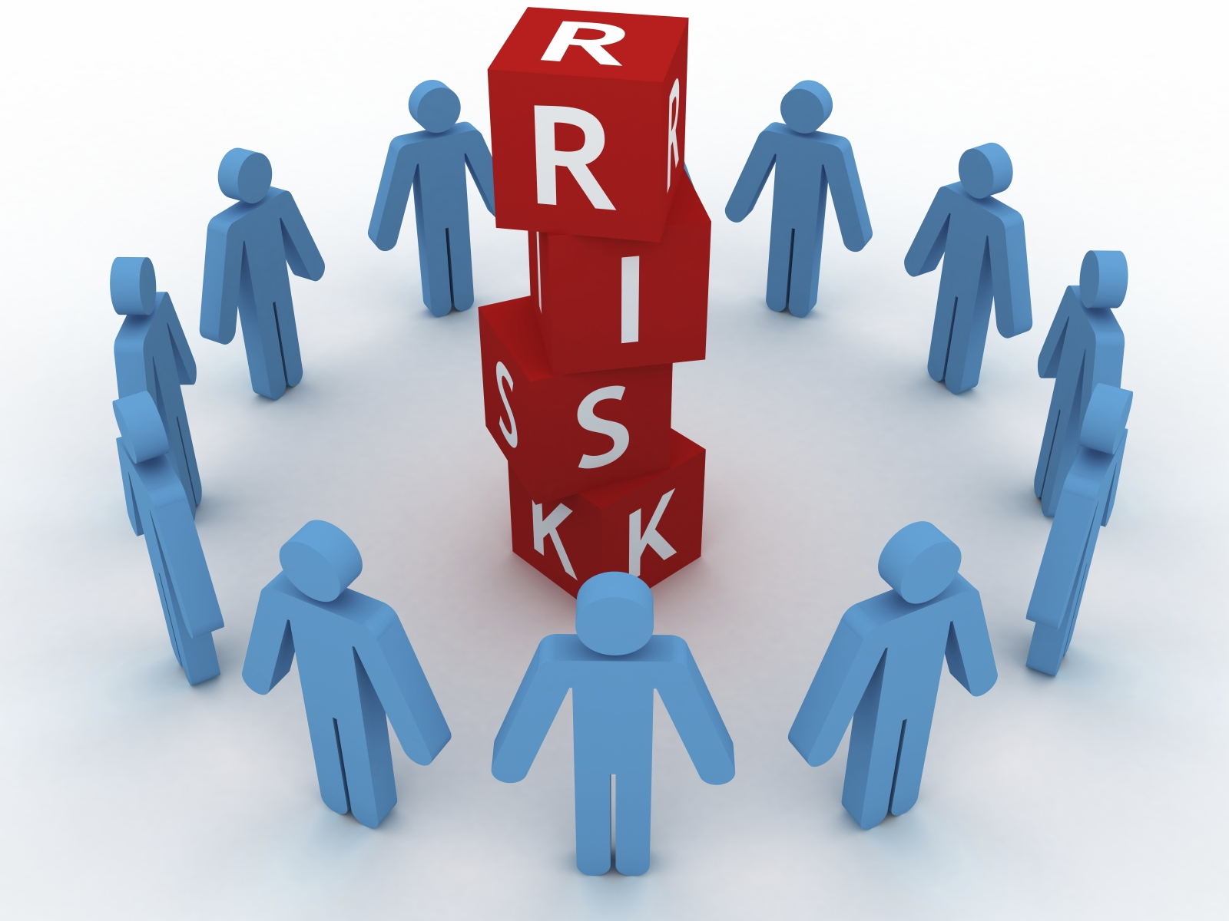
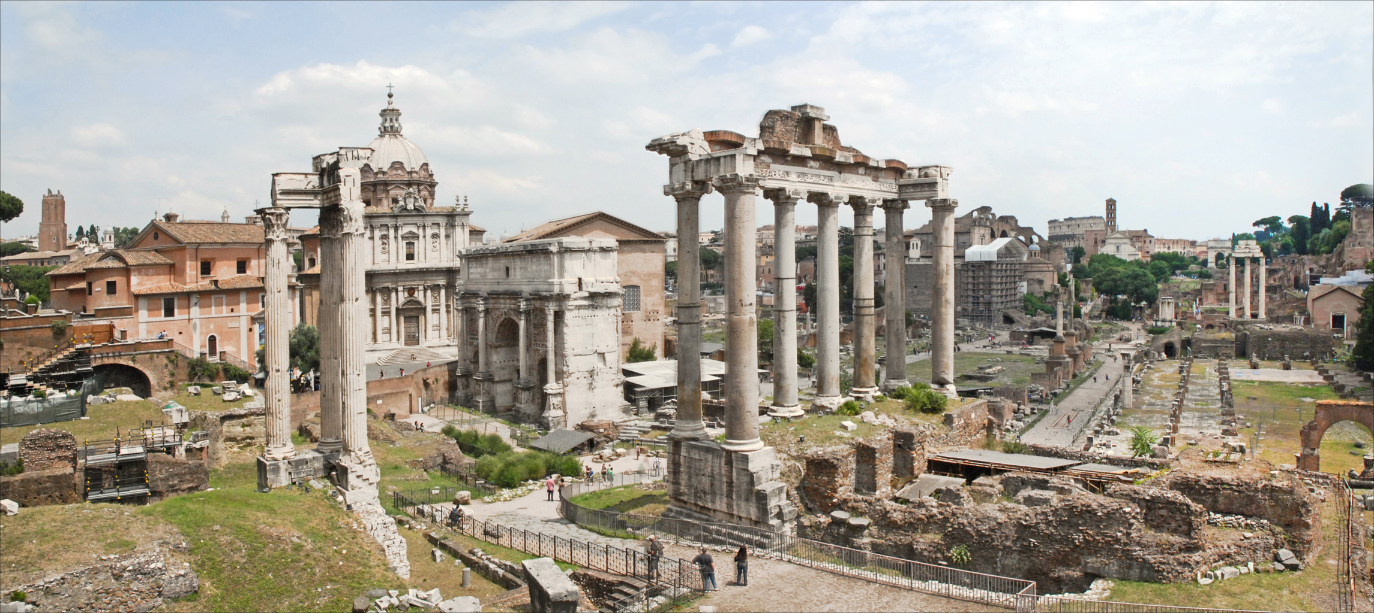
1. Accept and Involve the Public
The goal of risk communication to the public is NOT to diffuse concern or avoid action
The goal is to produce an informed public that is:
Involved
Interested
Reasonable
Thoughtful
Solution-oriented
Collaborative
Demonstrate respect and sincerity by:
Involving the community early
Being clear that you are interested in their concerns and opinions
The public will be more inclined to participate if communicators are respectful, reasonable, and willing to engage them.

Slide 44
2. Plan Carefully and Evaluate Performance
Communication strategies vary with the goals, audiences, and media used
Begin with clear, explicit objectives
What are you trying to accomplish with communication?
Providing information to the public?
Motivating people to act?
Stimulating emergency response?
Aim your communications at specific subgroups
Your audience is NOT a monolith – everyone approaches with different goals and background
Tailor parts of your communication so that you don’t leave anyone out
Pre-test messaging and learn from mistakes

Slide 45
3. Listen to Your Audience
Mortality statistics and quantitative details are usually NOT the top concerns for the public
Public often much more concerned with:
Trust
Credibility
Fairness
Caring
Compassion
Control
Competence
Voluntariness
Don’t make assumptions about your audience – take the time to learn what they’re thinking
Interviews, focus groups, surveys, etc.
Communicators can project these qualities when talking with the public.
Communicators can emphasize these aspects of the organization and the risk.

Slide 46
4. Be Honest, Frank, and Open
Trust and credibility are your most important assets
Difficult to obtain
Almost impossible to regain once lost
Don’t expect or ask for trust – it’s earned
State your credentials
If you don’t know an answer (or are uncertain), say so!
When in doubt, err on the side of more information
Disclose information as soon as possible
Be appropriate with discussing reservations, uncertainties, analysis strengths/weaknesses

Slide 47
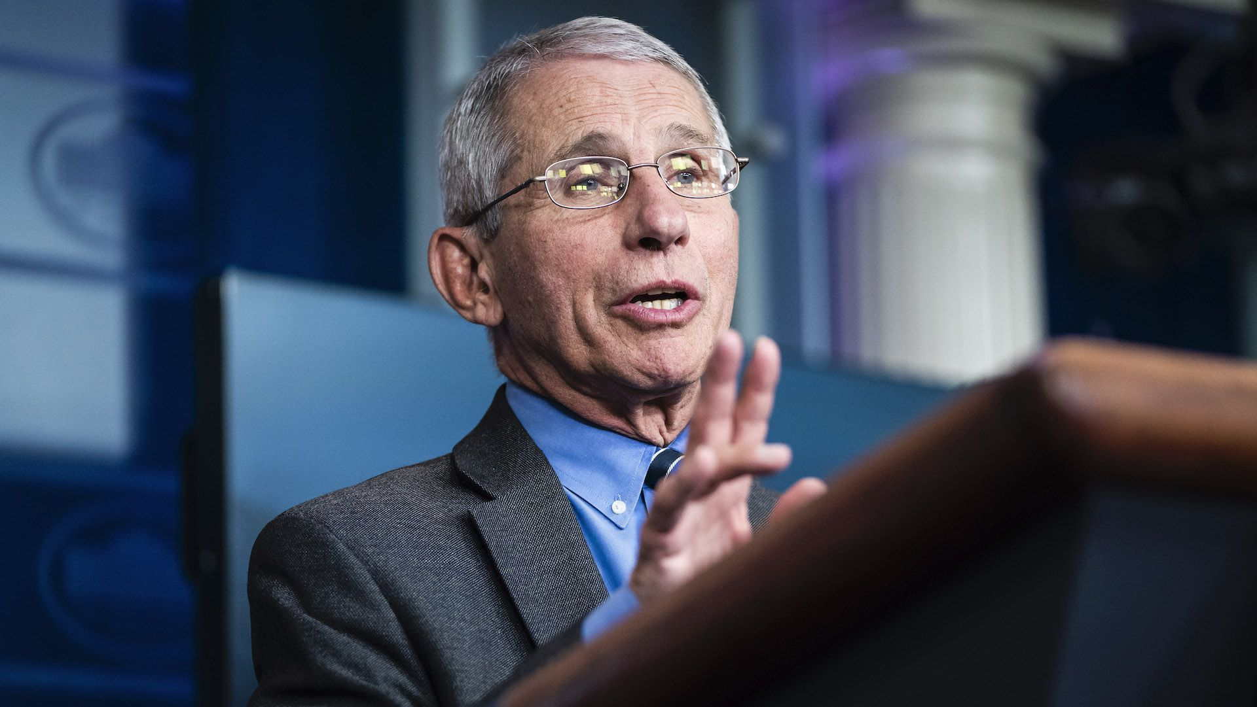
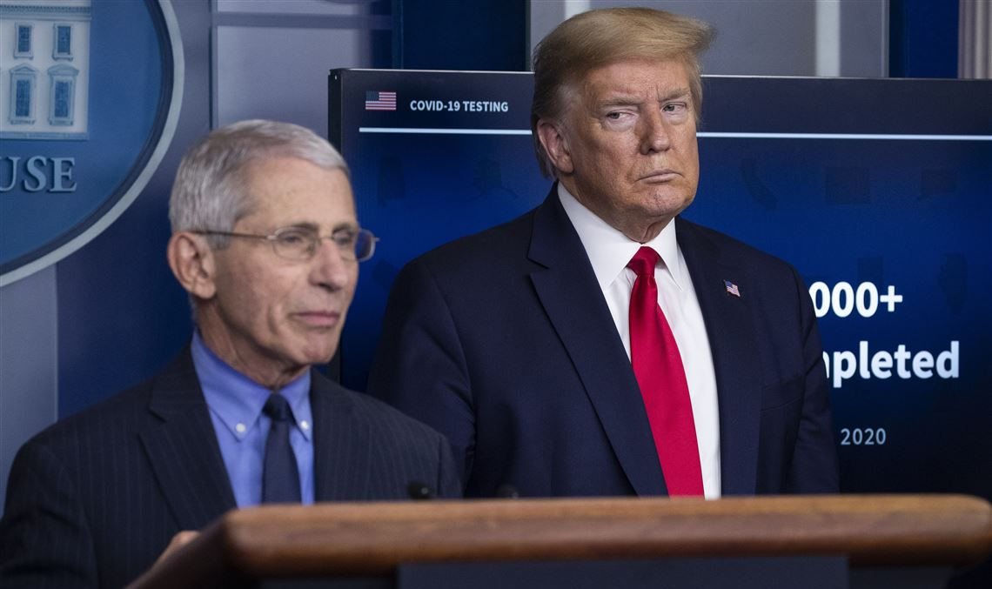
5. Coordinate and Collaborate
Allies can be helpful for communicating effectively
Communication becomes very difficult if there are public conflicts or disagreements with other credible sources
Coordinate all inter- and intra-organization communication
Build bridges with other organizations
Long process that pays off
Issue communications with other trustworthy sources
Scientists
Physicians
Trusted (local) officials
Opinion leaders
Generally, risk communicators should settle disagreements prior to engaging the public…

Slide 48
6. Be Clear and Compassionate
Technical language and jargon are useful in professional settings
When communicating with the public, overly-technical language can be a barrier to success
Use simpler, less technical language (without talking down to the audience)
Use vivid, concrete examples and anecdotes with which the audience will connect
Acknowledge and respond to emotions expressed
Acknowledge and respond to what the public views as important
They may have different priorities than experts, that must be respected
Discuss actions underway or can be taken to address public concerns
Never let your informative efforts prevent you from acknowledging that any illness, injury, or death is a tragedy

Slide 49
Hurricane Katrina – 2) Plan & 3) Listen
Communication from experts to decision makers before Katrina was clear
Multiple warnings about levee reliability
Experts were clear about the risks and what to do
Communication with public before/during Katrina was scattered and aimless
Mixed messages from state, city, and parish governments
Instructional videos never disseminated to community
30,000 videos urging residents to evacuate promptly
Particularly, residents of the 9th Ward were essentially abandoned with no feasible evacuation plans implemented
Don’t wait for the city, don’t wait for the state, don’t wait for the Red Cross, LEAVE.
- Instructional video for low-income neighborhoods
(never distributed)

Slide 50
Hurricane Katrina – 3) Listen
Decision makers were unconnected with the communities in and around New Orleans
Evacuation plans made little sense for the communities at risk
Communicators had little credibility
New Orleans residents lived for decades abiding large storms with no government action
With no faith in adequate response, the public is likely to engage in avoidance strategies
Denial/evasion of the issue, not avoidance of risk…
No attempts to build credibility before Katrina
Risk communications were not clear and not followed by action
Pre-planned evacuation procedures not implemented
We are facing a storm that most of us have feared …
We need to get as many people out as possible …
There may be intense flooding …
Hopefully … [the hurricane] could move just a little bit in one direction or another and not keep New Orleans in its sights.
-Evacuation announcement by New Orleans Mayor Nagin (August 29, 2005)

Slide 51
Hurricane Katrina – 4) Honest & 5) Coordinate
Uncertainties were NOT communicated effectively
Result was an uncertain public
Decades of inaction eroded trust in communicators
9th ward residents lived in a state of “abandonment”
Why should they listen to communicators now?
Little effort to reach and engage with reluctant and underserved African American community
State-run program to engage churches to help evacuation efforts was not utilized
Even though the churches were de facto authorities to the community
If you get conflicting information from people you’re not sure of, then inaction may be, from your perspective, the most prudent form of action.
- Margaret Sims, Vice President of Joint Center for Political and Economic Studies (2006)

Slide 52
Hurricane Katrina – 5) Coordinate
Communications from federal, state, and local agencies were not coordinated, resulting in confusion and inaction
National Hurricane Center and local weather reports were successful in evacuating ~90% of population
Approximately 70,000 residents did not evacuate, because:
Language was not clear – evacuation was discussed at the same time as recommendations to stock up on critical supplies
Different parishes received different advice at different times
Most communicators avoided the perception that evacuation was mandatory
Messaging was unclear about how to evacuate
People did not trust the police to protect their homes

Slide 53
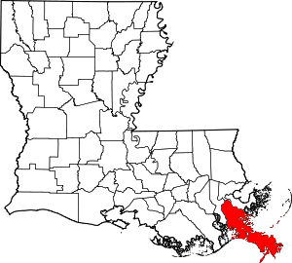
Hurricane Katrina – Counterexample
Plaquemines Parish (landfall site of Katrina)
~26,000 people around 2005
~23,000 people today
18% of community lived below poverty line
4.5 times larger (area) than Orleans Parish
There are no incorporated places in the Parish
Good risk communication helped weather Katrina
Clear and concise evacuation order made two days before landfall
House-by-house visits from law enforcement after evacuation order
Result: 97% of population evacuated, only 3 fatalities
New Orleans

Slide 54
Hurricane Katrina – Could it have gone better?
“Risk learners gather appropriate feedback from their environment that guides their decision… If that environment diminishes the risk (i.e., provides poor feedback), the tendency is to withhold. In the 30 years of warnings regarding the levee failure, no significant failure had occurred.”
(Cole and Fellows, 2008)
YES
One issue to overcome: apathy
Federal, state, local decision makers aware of the risks posed by large hurricanes, but did nothing
Somewhat true of population – information was available, but little could be done on an individual level
Decision makers ignored repeated warnings about levees
Repeated federal budget cuts despite LA lawmaker requests
Risks failing to materialize reinforced apathy
30 years of warnings and the levees did not fail
Government and community grew complacent
Government perspective: if it ain’t broke, don’t fix it
Community perspective: We’ve survived before, we’ll survive now
Because I mean I made it through Vietnam and I figured my Lord ain’t gonna let me die in nothing like this here.
- Hurricane Katrina survivor
(Elder, et al., 2007)
Notes:
Use this slide as bridge to democracy – failing democracy led to/caused by failed risk communication

Slide 55
Hurricane Katrina – Could it have gone better?
“Risk learners gather appropriate feedback from their environment that guides their decision… If that environment diminishes the risk (i.e., provides poor feedback), the tendency is to withhold. In the 30 years of warnings regarding the levee failure, no significant failure had occurred.”
(Cole and Fellows, 2008)
YES
One issue to overcome: apathy
Risks failing to materialize reinforce apathy
30 years of warnings and the levees did not fail
Government and community grew complacent
Government perspective: if it ain’t broke, don’t fix it
Community perspective: We’ve survived before, we’ll survive now
Because I mean I made it through Vietnam and I figured my Lord ain’t gonna let me die in nothing like this here.
- Hurricane Katrina survivor
(Elder, et al., 2007)
Notes:
Use this slide as bridge to democracy – failing democracy led to/caused by failed risk communication

Slide 56
Hurricane Katrina – Could it have gone better?
Another big issue: breakdown of local democracy
The community already disaffected by local government
Women and minorities generally have lower trust/confidence in government
Segregation still a big issue in New Orleans (got worse post-Katrina)
Long-term neglect of low-income neighborhoods by city
Result was a population that largely did not trust the government
IF the city had listened to the community:
Community dialogue after earlier storms (Betsy 1965, Georges 1998) could have emphasized issues with preparation, mitigation, evacuation
Evacuation plans could have heeded community-specific needs
Evacuation orders could have been clarified to serve everyone

Slide 57
Democracy and Risk: The paternalistic view
Somewhat supported by psychometric approach to risk perception
Real differences in how public and experts view risks
Public perception consistently influenced by “esoteric” aspects of risk:
“Dread” factor
Anthropogenic vs. natural (aversion to “tampering with nature”)
Distributive effects of risks (costs and benefits)
Risk decisions might be easier to make without falling prey to these issues (i.e., if public is not involved)
Problems with the paternalistic view:
Ecological/population fallacy: average conclusion $≠$ individual conclusion
Experts are prone to the same biases as the public
Is it ethical to remove agency in this type of decision?
Peschard, I., Benetreau-Dupin, Y., & Wessels, C. (2023). Philosophy and Science of Risk: An Introduction (1st ed.). Taylor & Francis Group: Routledge.

Slide 58
Democracy and Risk: The participatory view
The participatory view is somewhat supported by the social-cultural theory of risk perception
People view risks as important or trivial based on their adherence to social and/or cultural views
It is important for people to have a say in their own lives, especially when experts are not attentive to the same issues
Problems with the participatory view:
Would this approach actually account for the public opinion, or simply the loudest opinions?
Social-cultural theory of risk perception is weakly supported in experiment
How to account for differing social/cultural values in a large public?
Kusch, M. (2007). Towards a Political Philosophy of Risk. In T. Lewens (Ed.), Risk: Philosophical Perspectives (1st ed., pp. 131–155). Taylor & Francis Group: Routledge.
Peschard, I., Benetreau-Dupin, Y., & Wessels, C. (2023). Philosophy and Science of Risk: An Introduction (1st ed.). Taylor & Francis Group: Routledge.

Slide 59
Normative Framework for Risk Democratization
Goal:
Allow for public engagement with the risk-relevant decisions on infrastructure projects that will impact their community
Start Rule:
Identified consequence that will affect the health of surrounding population with frequency $≥$ [value] per year
Below this level, risks are essentially invisible to the public
Process:
Public fora addressing:
Identified risks to the public
Mitigating and contingency actions
Uncertainties remaining
Citizen Advisory Committee established
Intermediary between experts and public
Active role in risk analysis
Affected Public
Normative:
At each stage in system lifecycle
Diverse Team of Experts
Citizen Advisory Committee
Risk Analysis
Prescriptive:
Prior to system deployment
Notes:
Ideas for [value]: 1/100,000 (10^-5), 1/population, or min{1/100,000, 1/community}

Slide 60
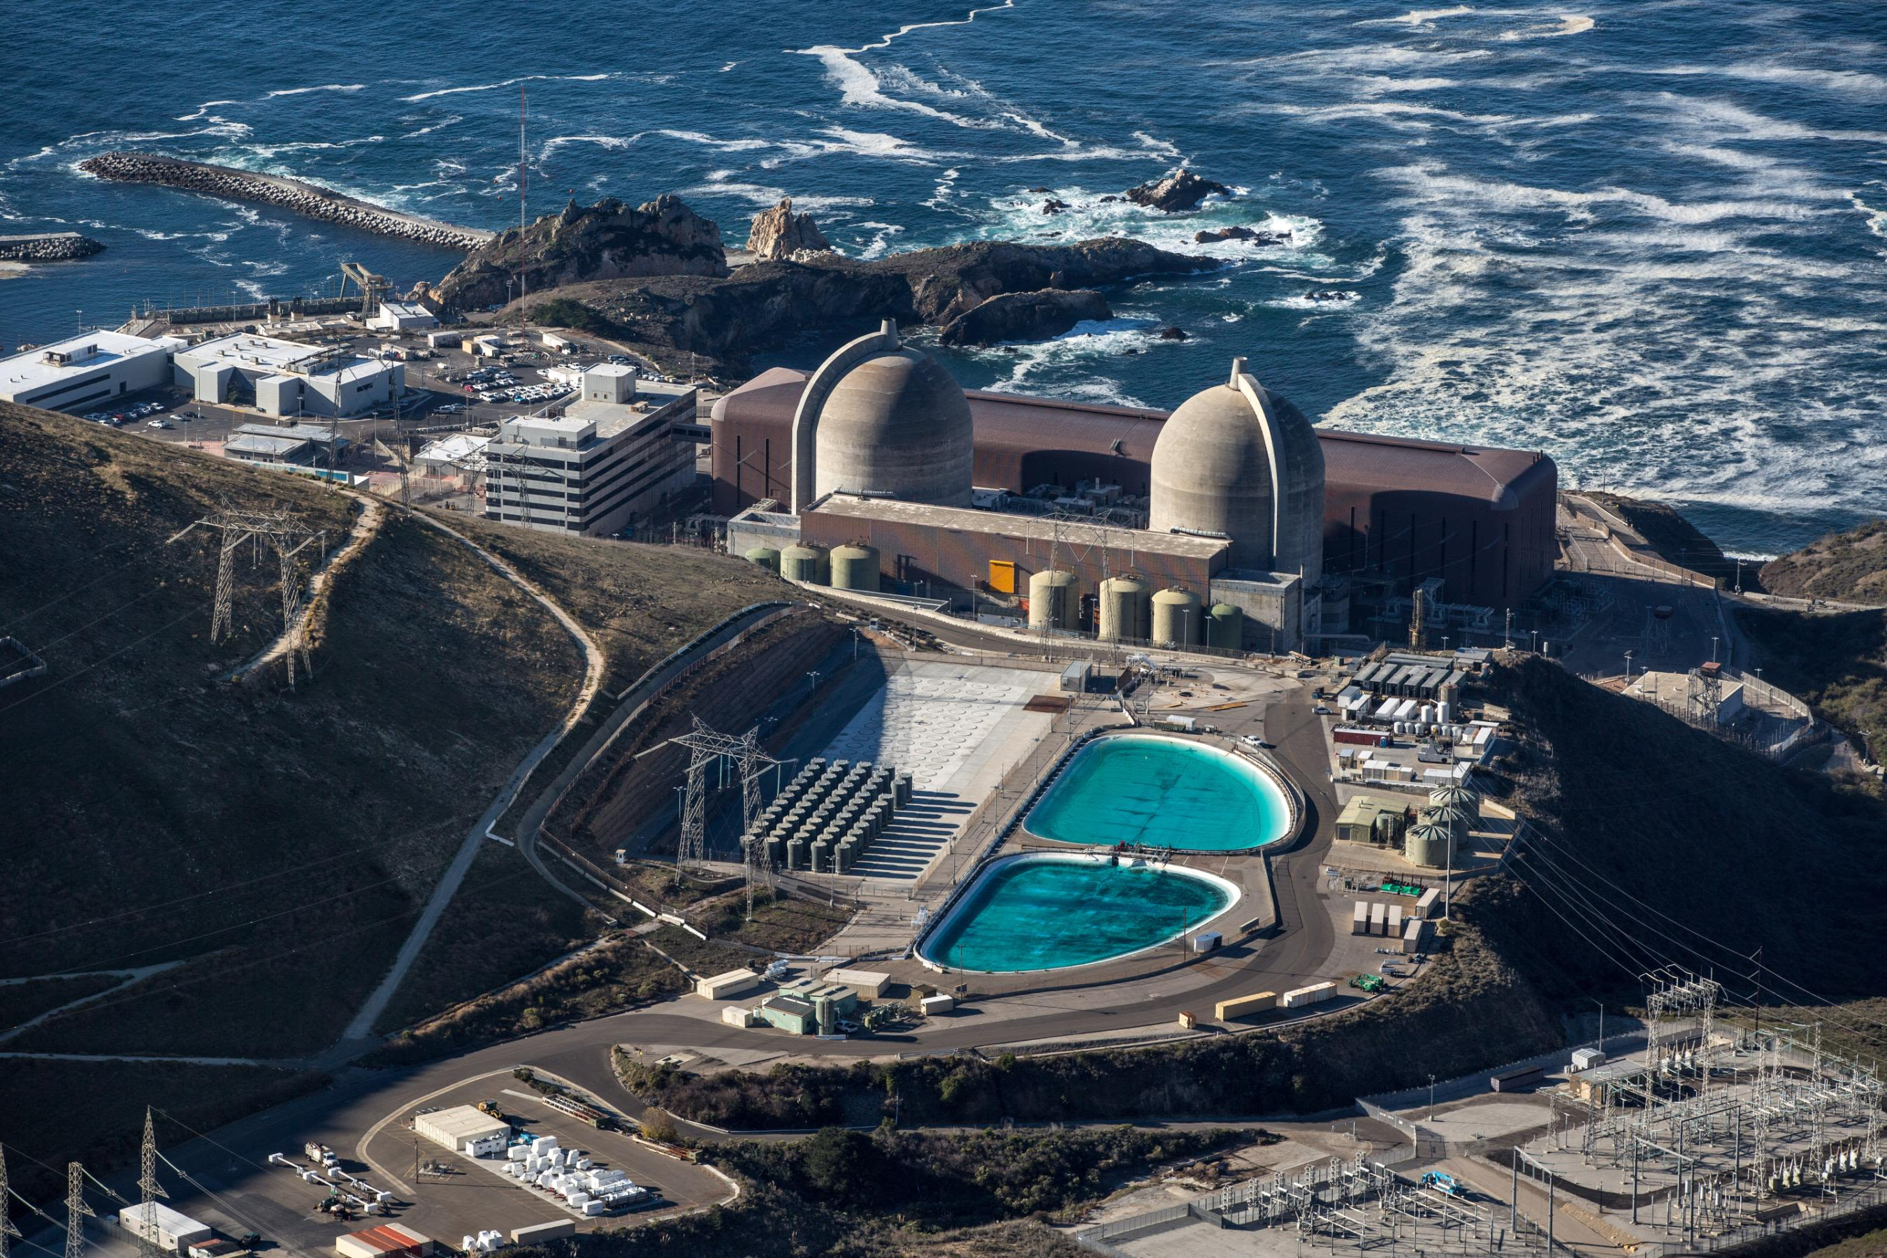
Inspiration: DCISC
The Diablo Canyon Independent Safety Committee (DCISC) is a good archetype for public engagement
Team of independent experts established by state government in California
3 public meetings per year to hear from the public and discuss risks
Good:
Nuclear engineering rock stars
Public engagement
Bad:
Limited expertise in psychology
No authority to direct PG&E personnel
Diablo Canyon Power Plant
Dr. Robert Budnitz

