Slide 1
Communications Assets & the Facilitation of Value
Kevin Fleming, Communications, CSU Systems Engineering

Slide 2
Kevin Fleming
Kevin.Fleming@colostate.edu
Systems Engineering Communications
UW-Madison PhD Candidate
Former Public Affairs Specialist U.S. Army
CSU Alumnus

Slide 3
What I do?
An ambitious question for 60 mins

Slide 4
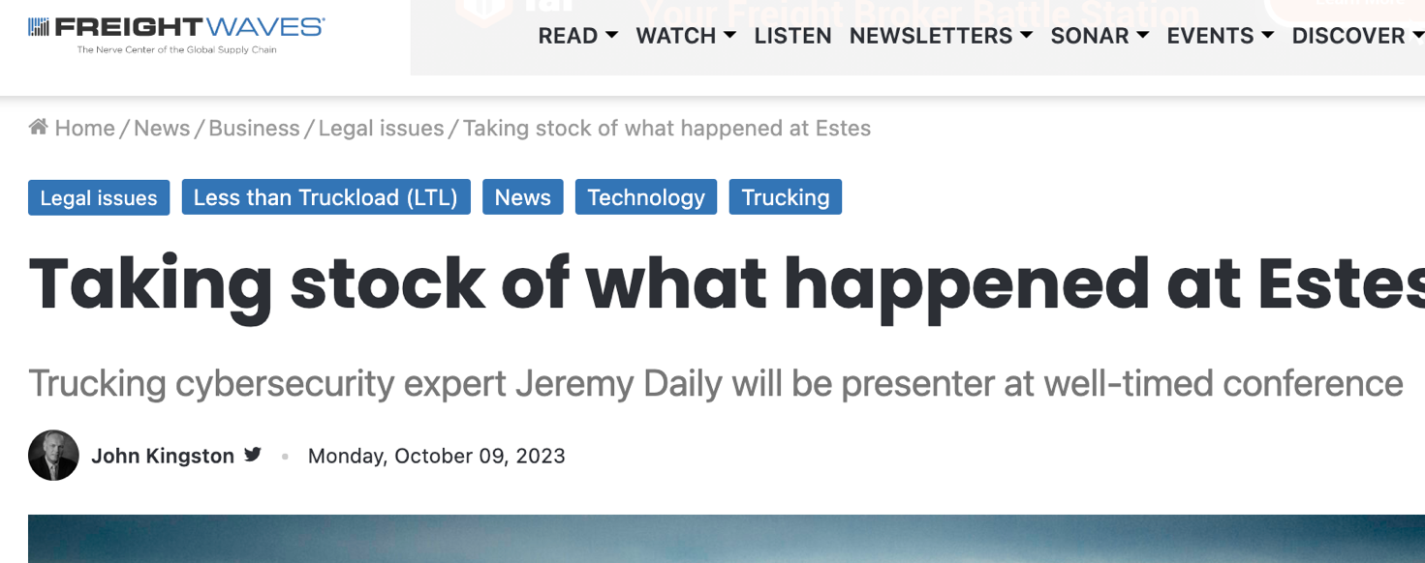
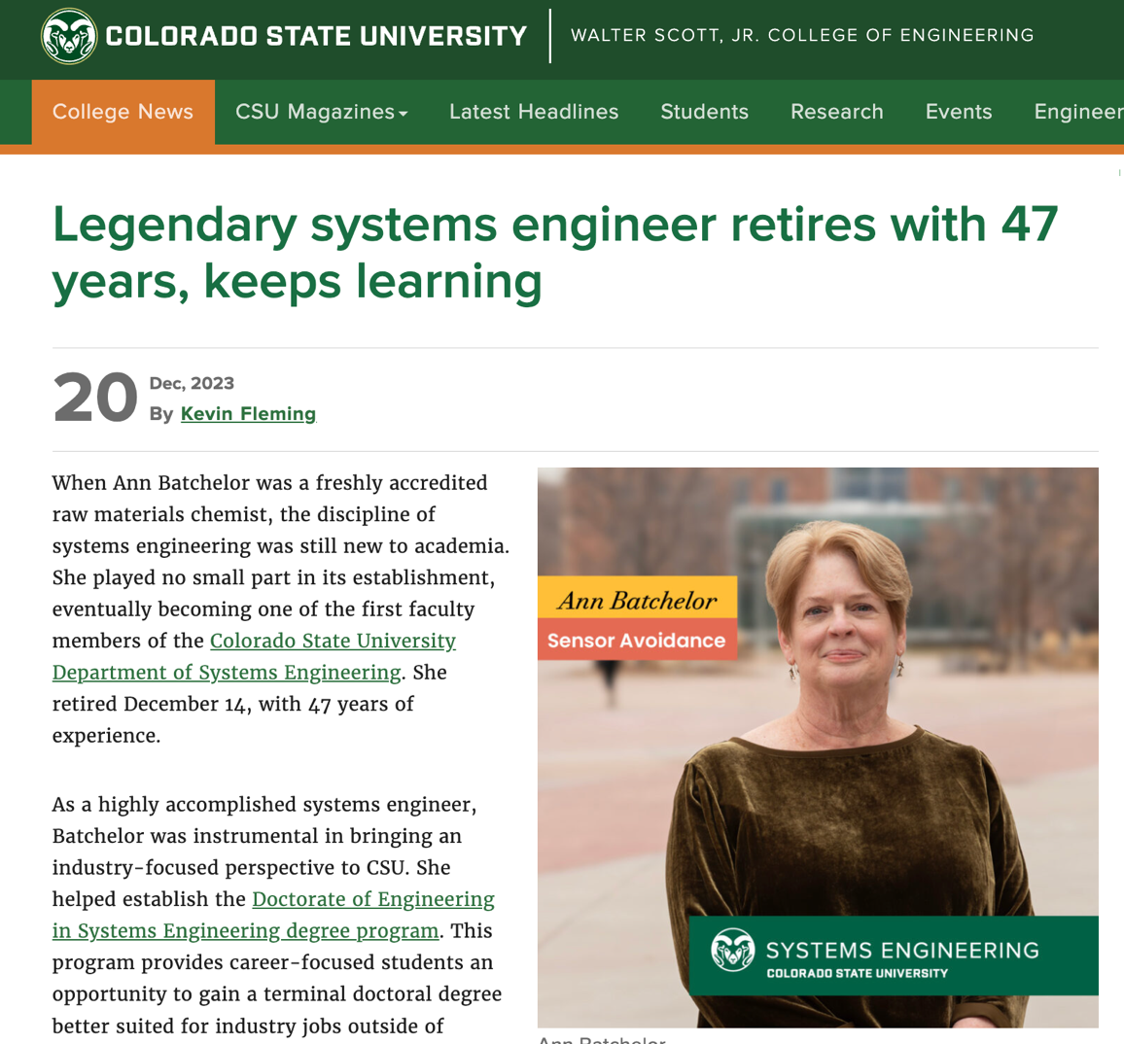
3 main areas of concern
Public relations
Internal Communication
Marketing

Slide 5
But what is my actual job?

Slide 6
To protect & promote your credibility.
Why credibility? Because it’s how you are valued in public arenas
More credible, more valuable
Less credible, less value
Okay… but what is credibility?

Slide 7
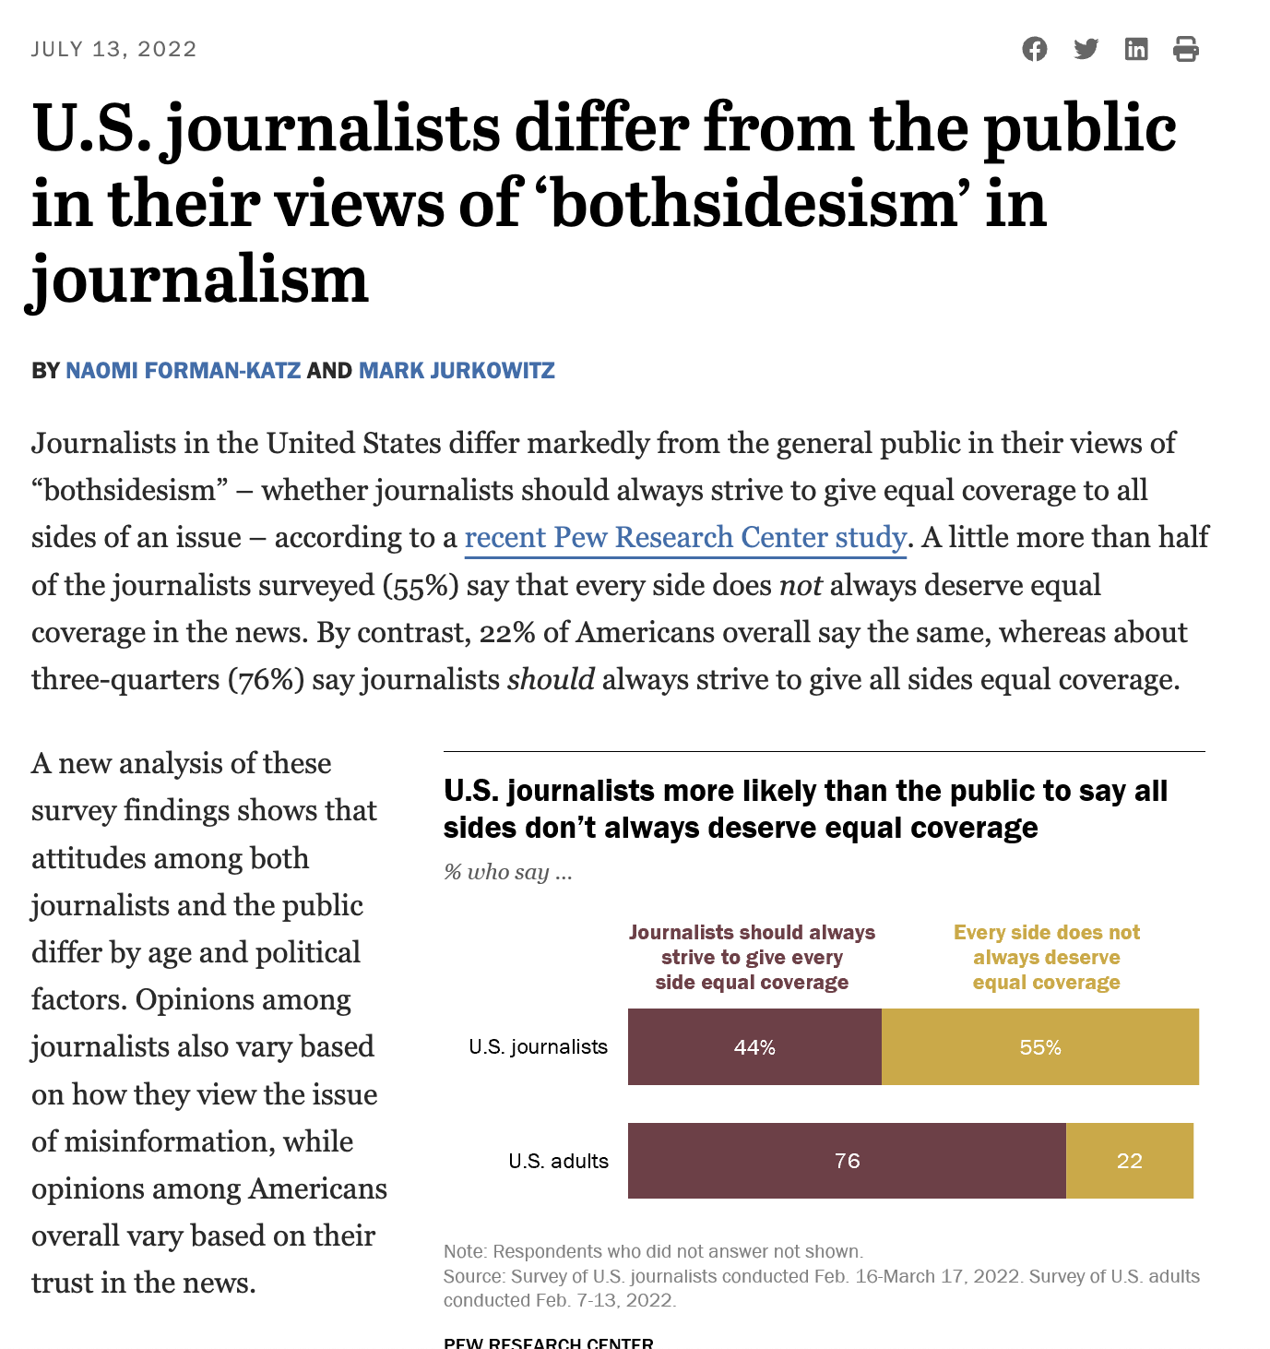
Grounded vs. Plebiscitary
Notes:
https://www.pewresearch.org/short-reads/2022/07/13/u-s-journalists-differ-from-the-public-in-their-views-of-bothsidesism-in-journalism/ft_2022-07-13_bothsidesjournalism_01/

Slide 8
Grounded
Was the source in a position to know?
Is the content verifiable & contextualized?
Have the sources done the work to understand?
Were you there & did you understand?
Notes:
https://www.pewresearch.org/short-reads/2022/07/13/u-s-journalists-differ-from-the-public-in-their-views-of-bothsidesism-in-journalism/ft_2022-07-13_bothsidesjournalism_01/

Slide 9
Plebiscitary
Does your position align ideologically?
Does your position speak to particular ethics?
Usually what we mean by “know your audience.”
Read the room.
Notes:
https://www.pewresearch.org/short-reads/2022/07/13/u-s-journalists-differ-from-the-public-in-their-views-of-bothsidesism-in-journalism/ft_2022-07-13_bothsidesjournalism_01/

Slide 10
1. Know your story
Leverage comm assets to become an asset: Ask for help
Learn the difference between messages & information
Message: What we care about, what is important
Information: Facts, events, verifiable

Slide 11
Messaging guide
Theme 1: Quality education to manage a complex world
Message: We address the most important socio-technical systems problems of our time.
Message: We hold ourselves to the highest standards of integrity, rigor, and quality.

Slide 12
Messaging guide + Information
Theme 1: Quality education to manage a complex world
Message: We address the most important socio-technical systems problems of our time.
Info (ex): We publish research in the following areas: Aerospace, human factors, digital engineering, energy, transportation…
Message: We hold ourselves to the highest standards of integrity, rigor, and quality.
Info (ex): We hire published professors, engage in peer review, partner with outside experts, and regularly update course material

Slide 13
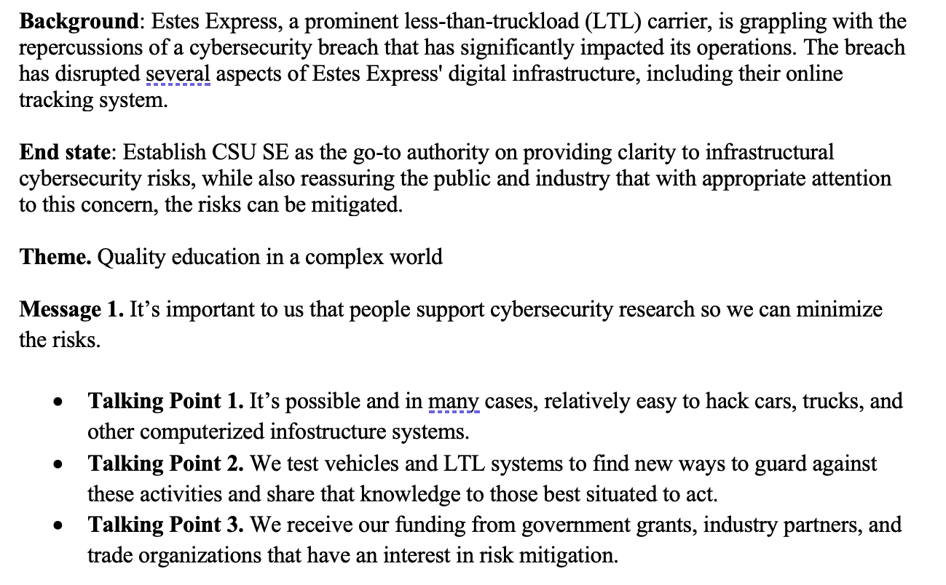
Guides & practice can prepare you for key engagements

Slide 14
We hunger for information…
…we are useless to you w/out it.

Slide 15
2. Get to know your communicators.
Almost every organization has at least one.

Slide 16
You must communicate.
Fill the void of uncertainty in a crisis. If you don’t, someone will.
Tell your story. No one else will.
Defend your credibility.
It can be risky.
Know your battle buddies.

Slide 17
Dynamic Skills
Website admin
Storytelling
AI & SEO knowledge
Teaching
Networking
Public speaking
Coordination
Functional to expert knowledge of their area of operation
Comm policy, law, & procedure
Strategic planning
Content creation
Social media management
Digital marketing
Brand management
Editing
Public relations
Graphic design & layout
Crisis/risk communication
Data analysis
Event planning & management
Audio, video, & photo production
Qualitative research
Investigation
Facilitation & interviewing

Slide 18
No one will be an expert in it all.
Know limits & leverage strengths.
We will do it for you.

Slide 19
Do not underestimate our ability to
understand & use
the information you have.

Slide 20
3. Professional development
Take care of your communicators.

Slide 21
This is not an easy job
Often the only comm people in the org.
Quality communicators require mentorship from people who are in leadership roles

Slide 22
Value is cultivated
Can you fill a comm job with a warm body for $40k per year? Sure.
That’s entry level.
Comm people have a lot of options to move.

Slide 23
Everyone wants a piece
A lot of staff jobs can relate
The volume can become overwhelming
Patience, care, team

Slide 24
Concluding
Science & engineering are far more than what happens on our laboratories and publications.
Knowledge is made, forged, built with the blood of our work, through controversies, and into uncertainty.

Slide 25
Concluding
“Be not the one who debunks but the one who assembles, not the one who lifts the rugs from under the feet of the naive believers but the one who offers arenas in which to gather.”
- Bruno Latour (1947 – 2022)

Slide 26
We assemble pathways through a complex word.

