Slide 1
Guide to Creating a CAB Associate Account
Created 5/16/23

Slide 2
1. Open www.incose.org. Click “Join” in the top right corner.

Slide 3
Read “Steps to Join:” under CAB Associate Select “Join INCOSE”

Slide 4
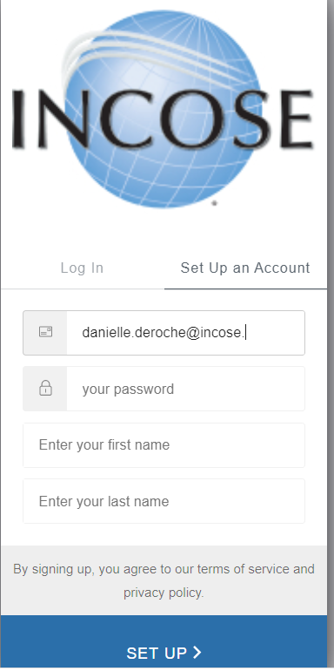
3. Select the tab for “Set up an account.” Enter your contact data. Click Set Up.

Slide 5
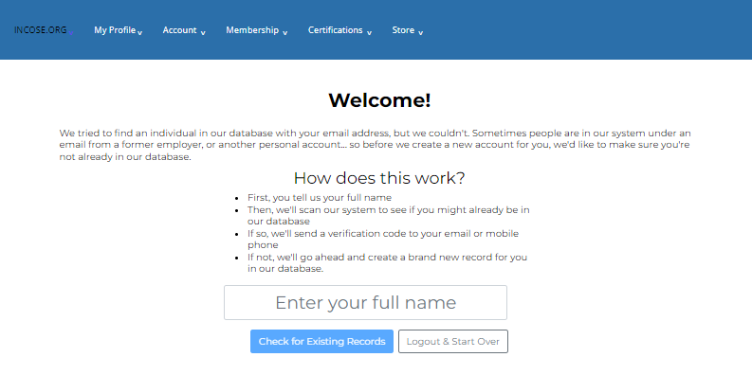
4. Enter your full name to check for duplicate accounts. Click “Check for Existing Records.”

Slide 6
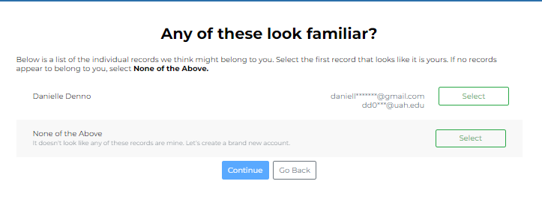
5. If none of the existing accounts belong to you, select “None of the Above.” Click Continue.

Slide 7
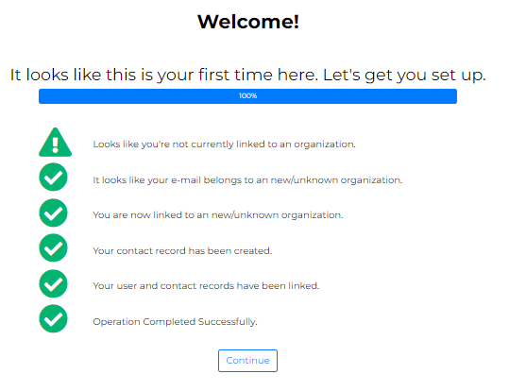
6. Click Continue

Slide 8
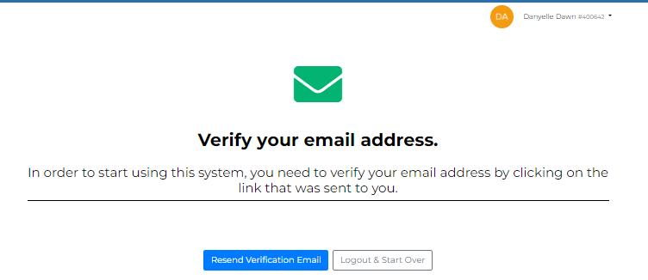
7. Your account has been created. Check your email for a verification email. Be sure to check your spam folder as well. - You will not be able to log back in if you do not click on the link provided in your email
Note: Your account has been created. Your INCOSE ID will be in the top left corner, next to your name.

Slide 9
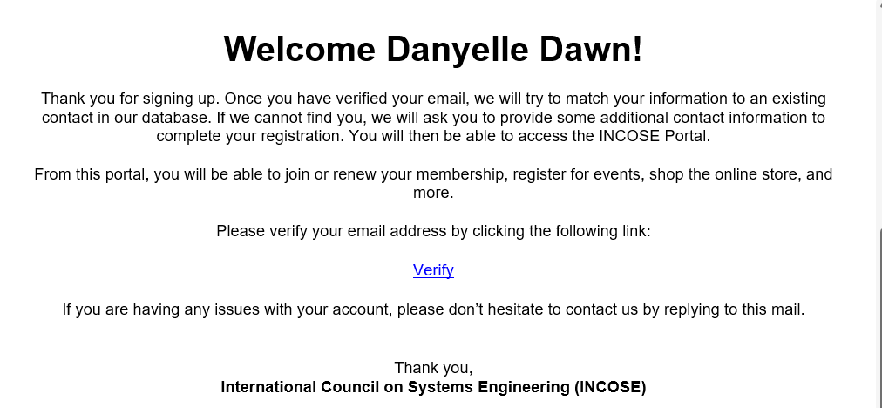
8. From your email, click on the “Verify” link. You will be prompted to log back in with the credentials you created in Step 3.

Slide 10
9. Enter contact information. Click Save.

Slide 11
10. Complete the Primary Email and CAB Organization: - Select the CAB Organization you are affiliated with. - You must use your organization email.

Slide 12
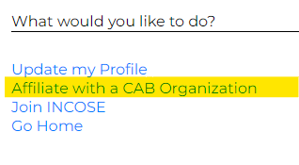
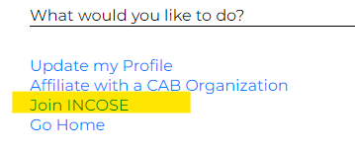
11. Select Affiliate with a CAB Organization option on the right-hand menu option, save changes.
12. Join INCOSE Confirm Information and click Save Changes

Slide 13
13. Select Membership type “CAB Associate” and check: I acknowledge Legal disclaimer and then “Next”

Slide 14
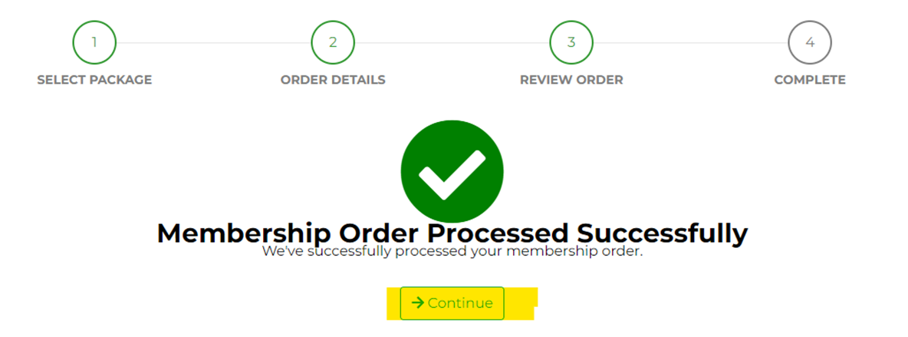
14. Confirm Order “Process Order” and then select Continue

