Slide 1
Low Vanes
CIVE 717
Parker Maddocks
April 22, 2021

Slide 2
Comparison
High Vanes
Slightly below water surface.
Guide near-surface streamlines toward the centerline of the channel.
Protect riverbank.
Low Vanes (a.k.a. Bendway weirs)
Below water surface acting as a low sill.
Secondary flows are reduced at high flows and streamlines are redirected perpendicular to the weir at low flows.
Do not protect riverbank.

Slide 3
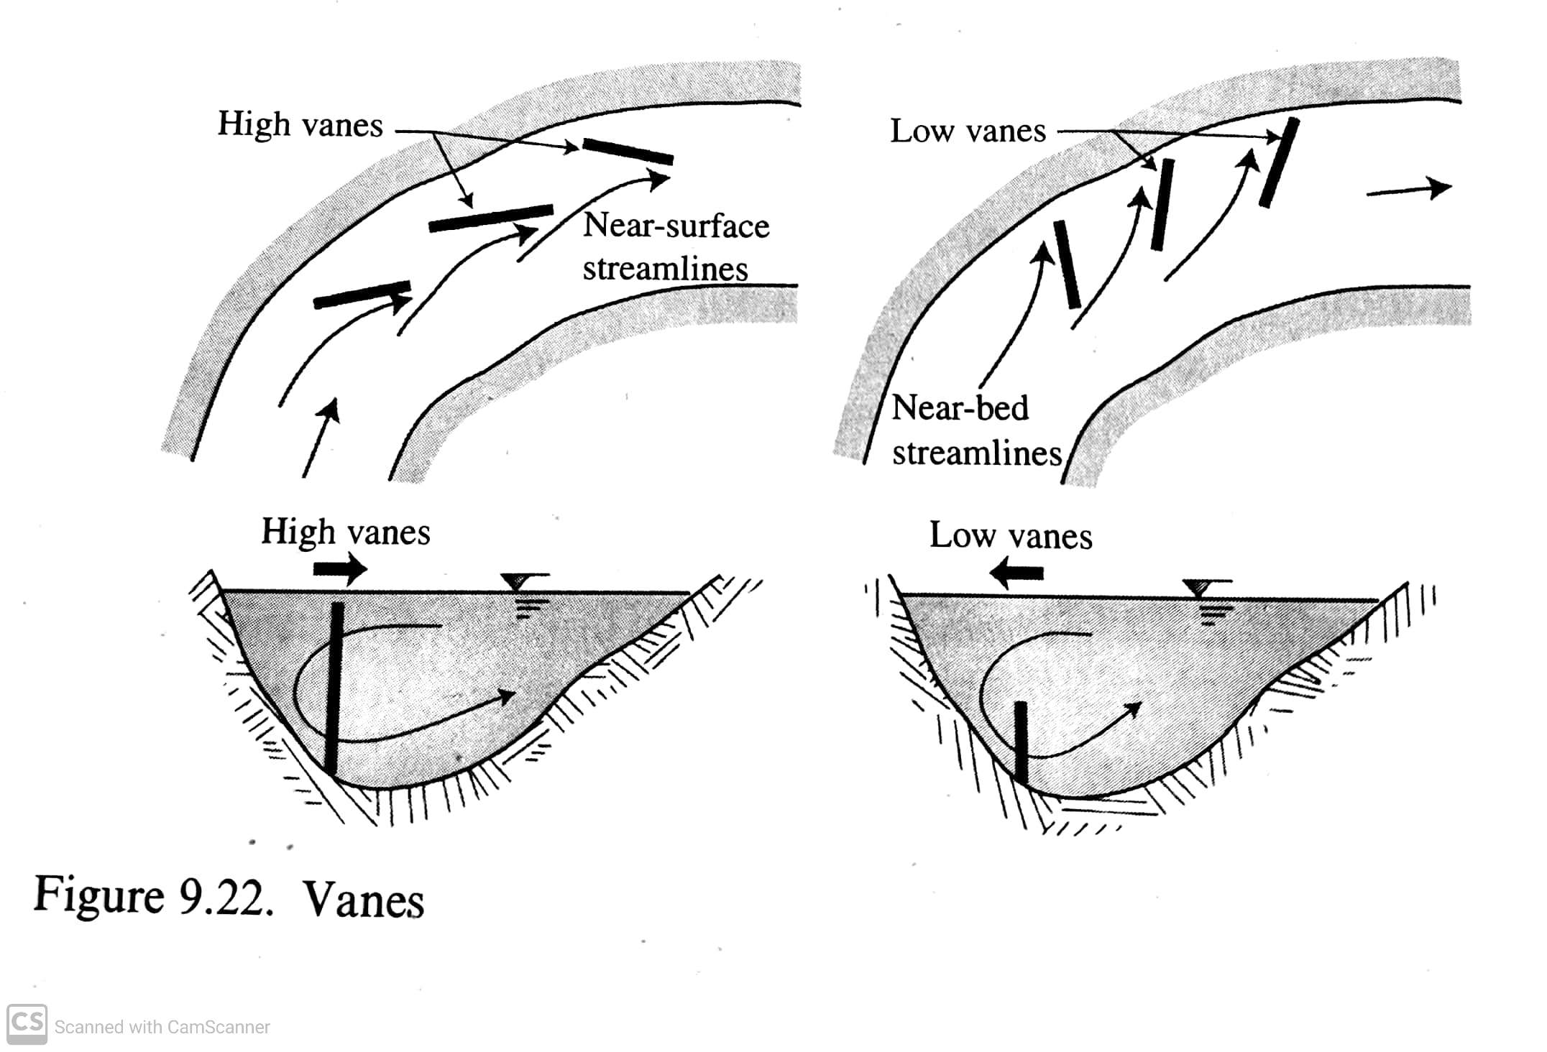
Comparison (Cont.)
The figure on the right from River Mechanics II depicts the different streamlines caused by high and low vanes.

Slide 4
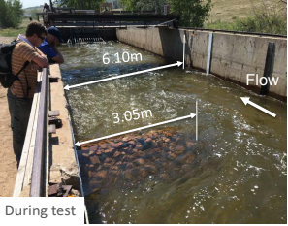
Low Vanes in Large Channels
Improved Navigation.
Sediment deposition at the toe of the revetment.
More uniform surface water velocities.
Flow patterns generally parallel with the banks.
The thalweg being moved away from the outer bank.
Clear-water scour testing at CSU Hydraulics Lab

Slide 5
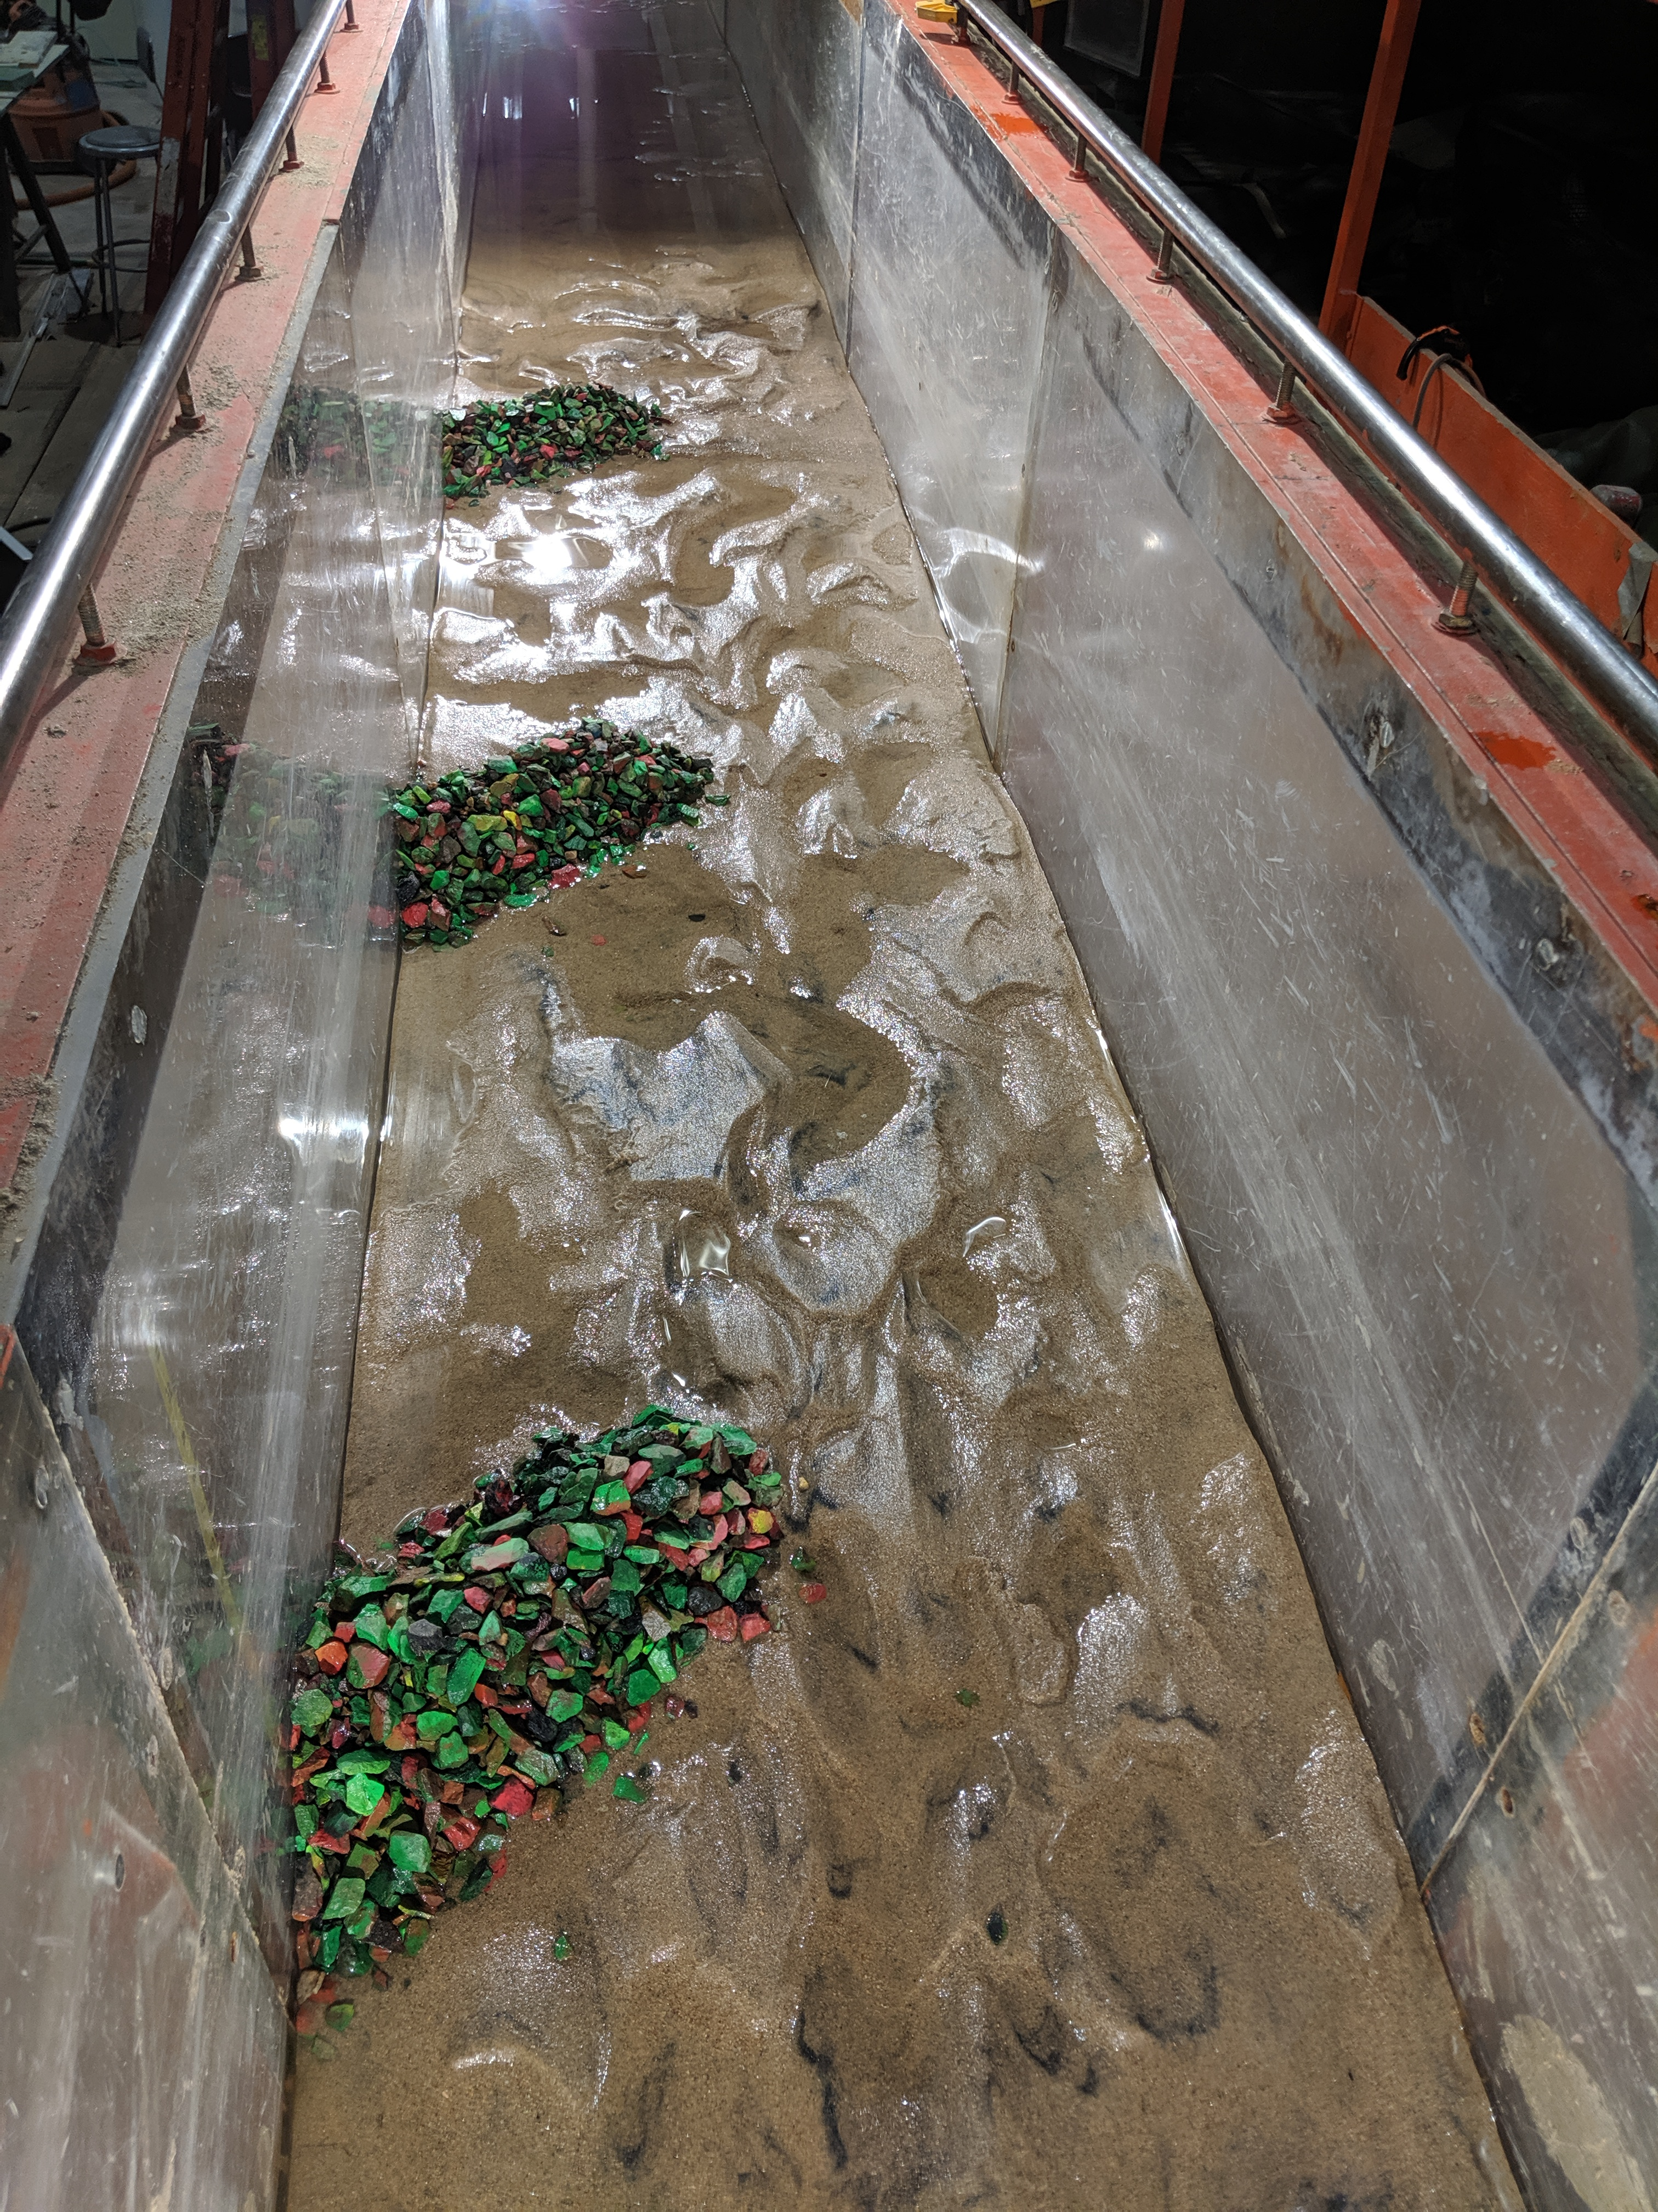
Low Vane Failure (live-bed scour testing)
A physical model representing a portion of the Rio Grande river.
The low vane are angled at approximately 45 degrees to mimic a bend in the river and the placement angle.
The flume recirculates sediment to model live bed conditions.

Slide 6
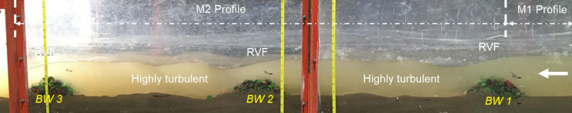
During Testing

Slide 7
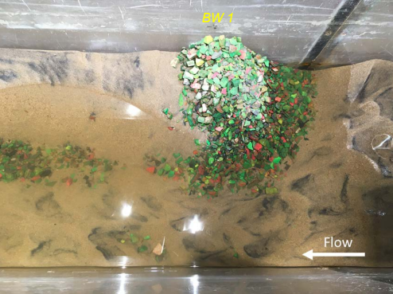
Testing Results
Contraction scour along the tip of the low vane.
Upstream face failed due to dune-trough presence.
Rock swept from crest.
Black-sand (magnetite) indicates regions of high bed shear stress.

Slide 8
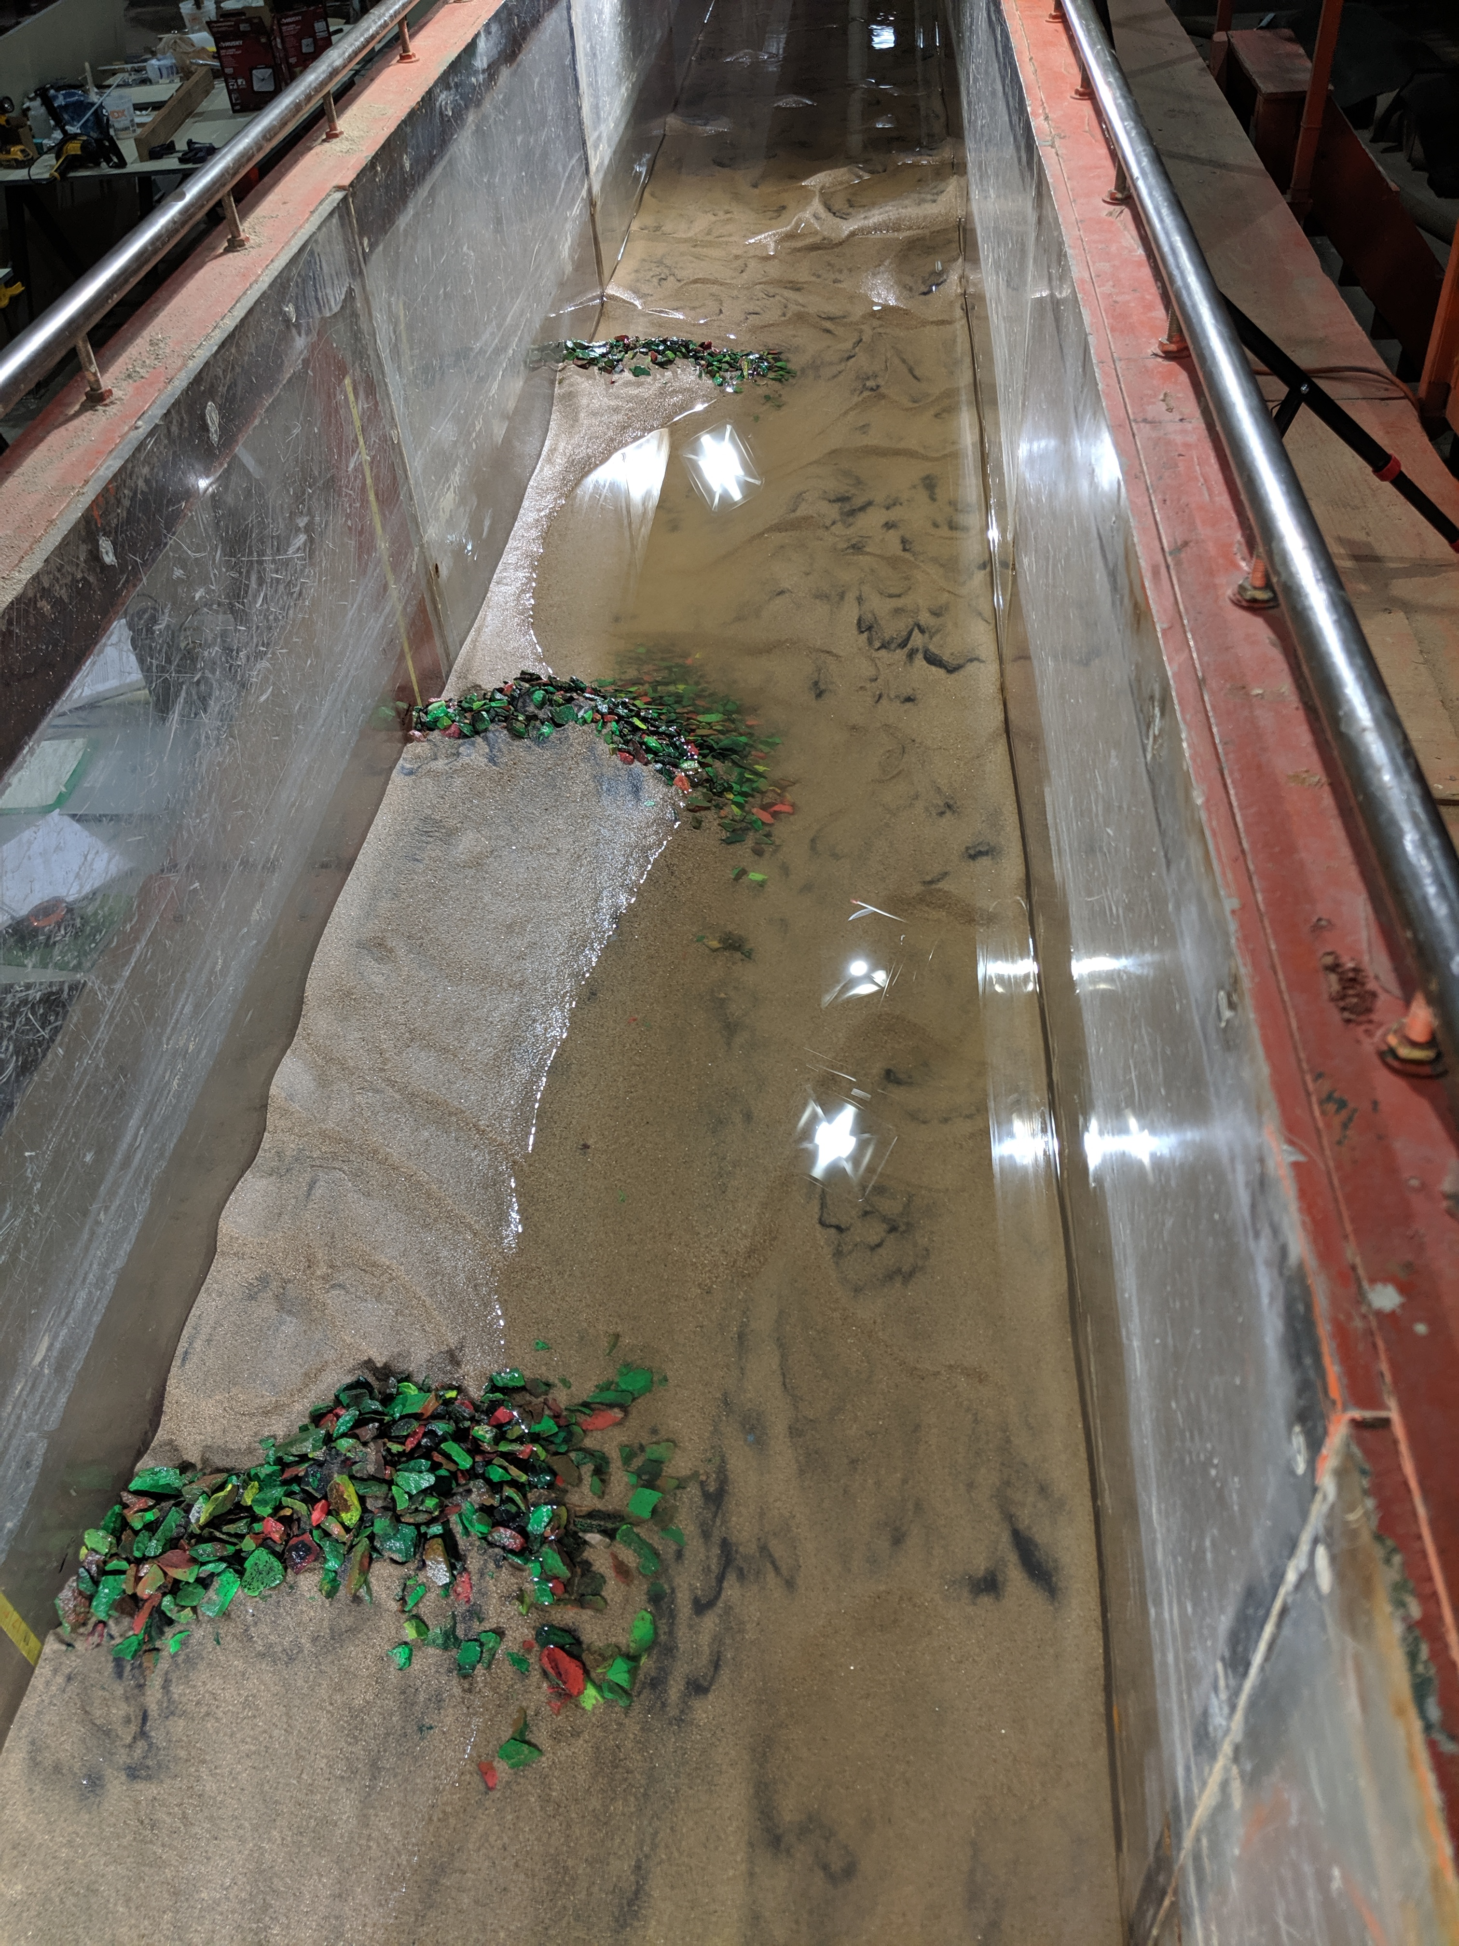
Testing Results (Cont.)
Thalweg
Scalloping
Test results resemble current problems depicted in the next slide.
Tests are typically run for 4 – 6 hours or until there are no significant changes in bed conditions.
Toe Scour
Sediment Deposition within vane

Slide 9
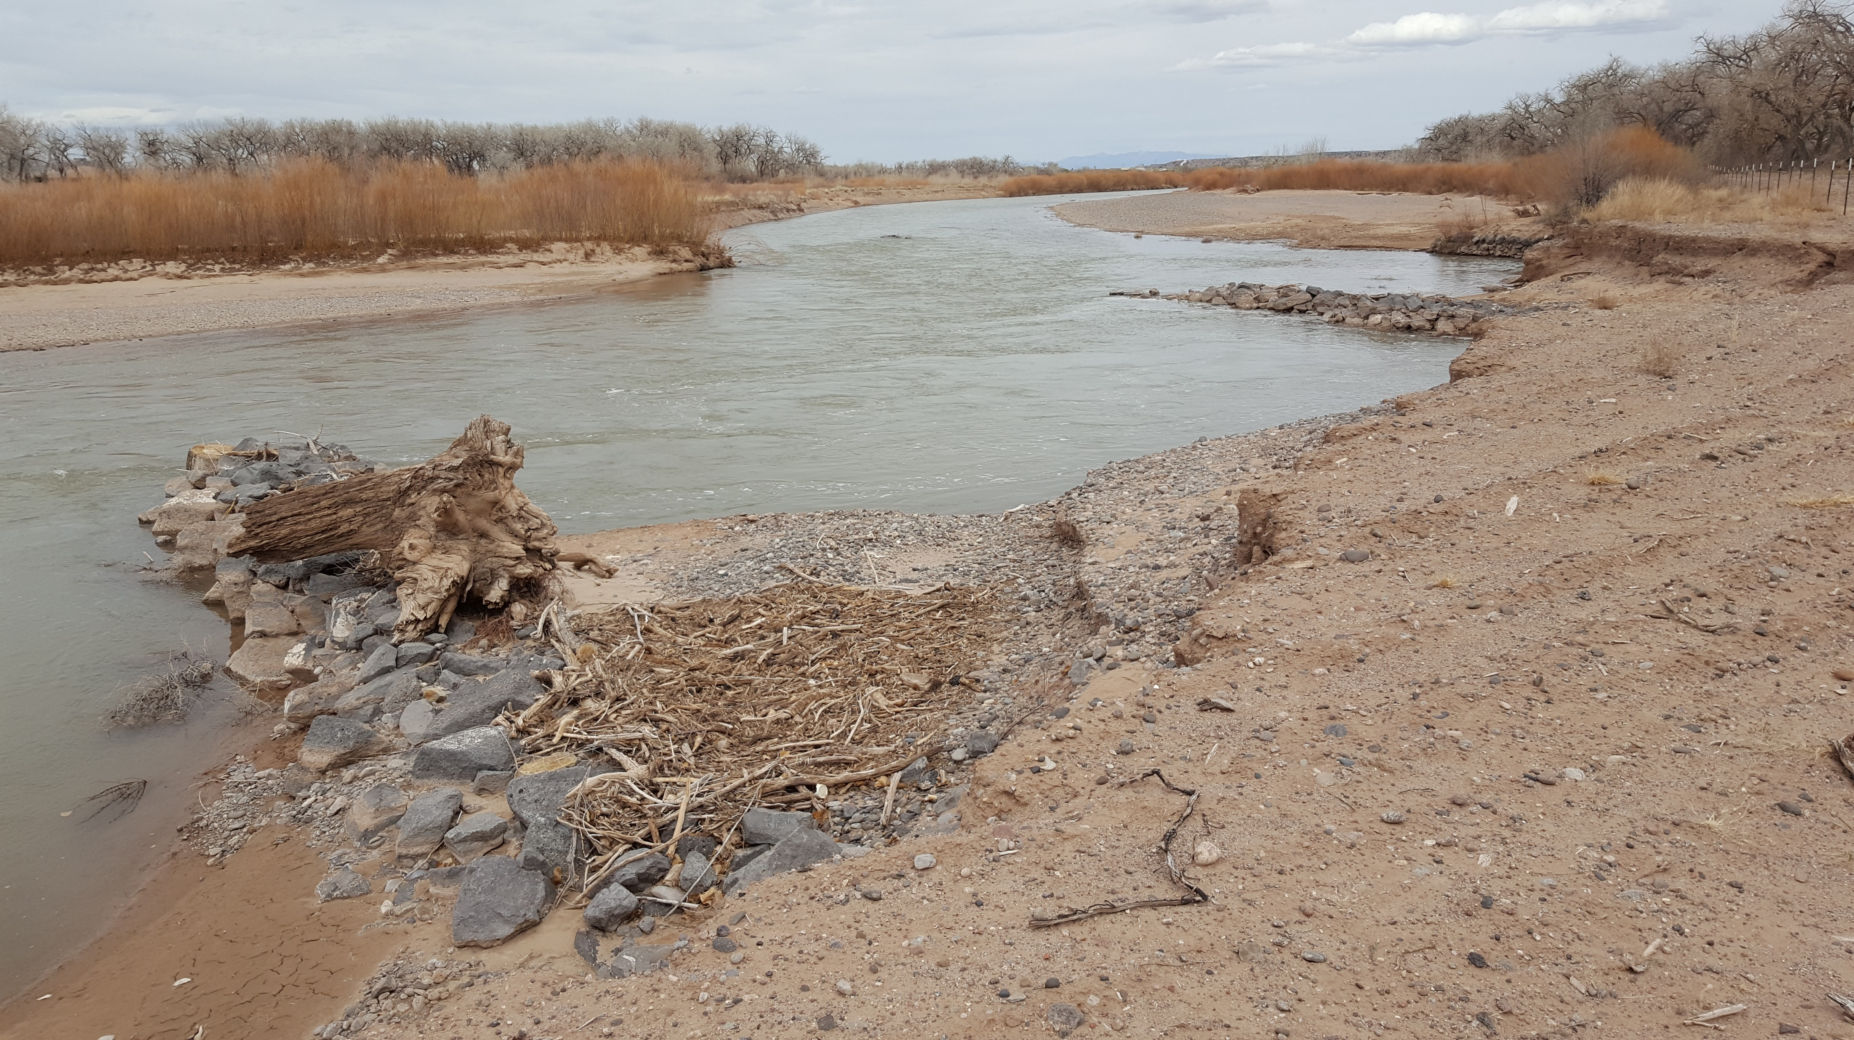
Introduce a complex flow field
Scalloping along banks.
Sediment deposition

Slide 10
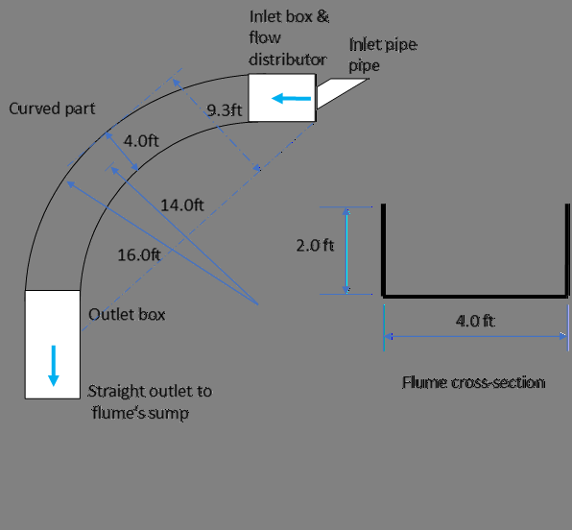
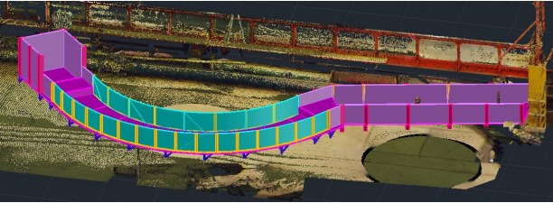
Future Testing

Slide 11
Future Testing (Cont.)
Sediment recirculating pump for live-bed scour testing.
Curved flume to model the bend in the Rio Grande.
The flume is 4 ft wide to model the full channel width, rather than half the channel width (previous testing).
The model will have a ratio channel curvature/channel top width = 3.6 (similar to many bends in the Rio Grande and other mid-size rivers).
Results will be used to enhance the understanding of low vane failure modes.

