Slide 1
Jetty Fields
An Overview
By David Cortese

Slide 2
Presentation Contents
Description
Function and Placement
Common Application
History
Examples and Photos
References and Additional Information

Slide 3
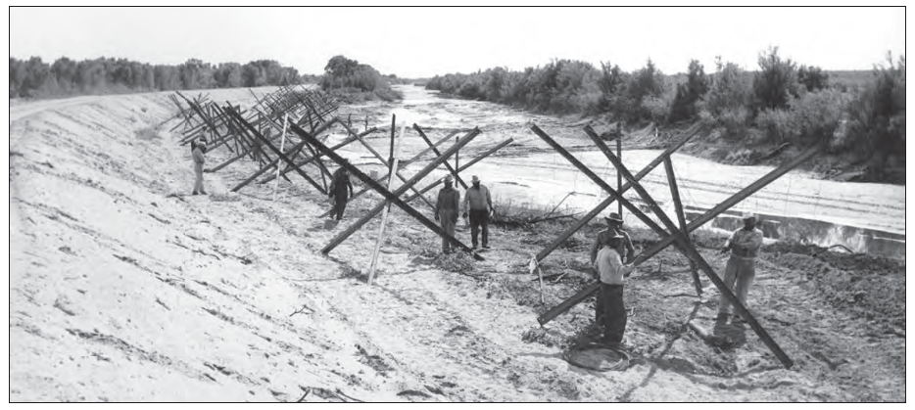
Description
  Permeable stabilization structures for channel banks and overbank areas
  Flexible structure that adds roughness to the channel
  Promotes sediment deposition and bank stabilization
  Work in streams with high suspended sediment loads

Slide 4
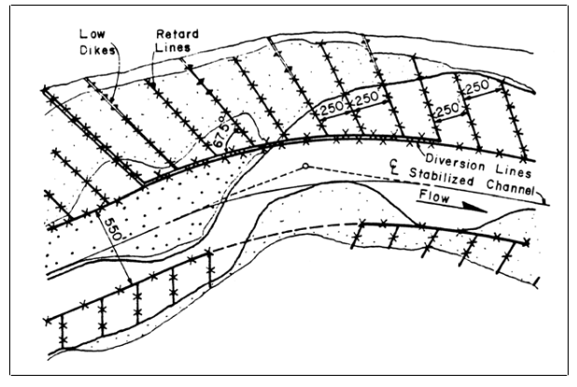
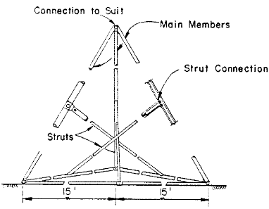
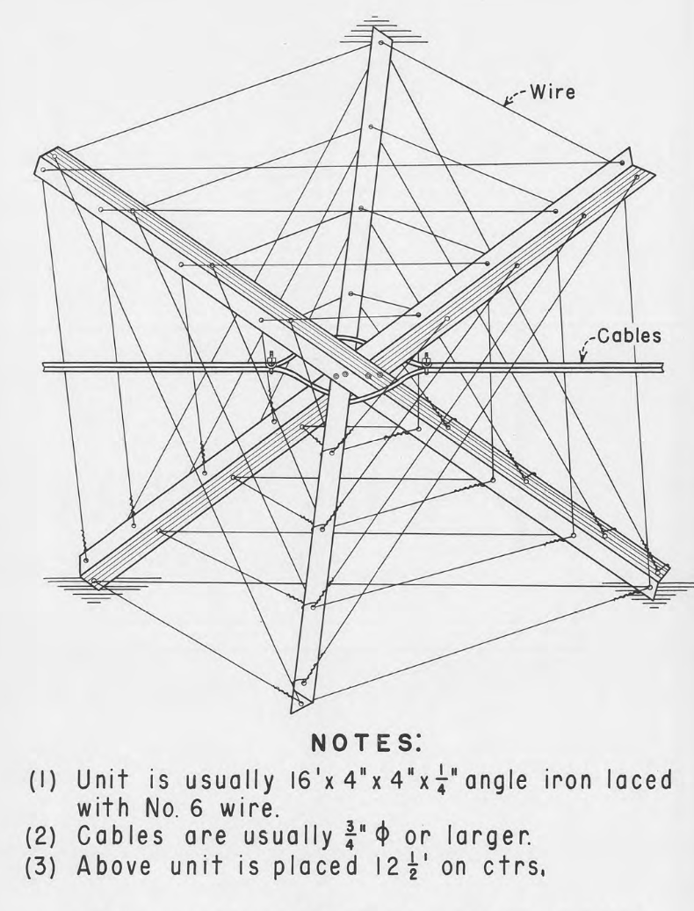
Description
  Jetty fields are comprised of a layout of individual units, or “jacks” that are cabled together and tied into the banks.
  Jacks are typically 3 beamed members or triangular frames tied together to form a stable units.
  Fields are laid out with diversion lines parallel to flow and transverse that are tied into the banks.

Slide 5
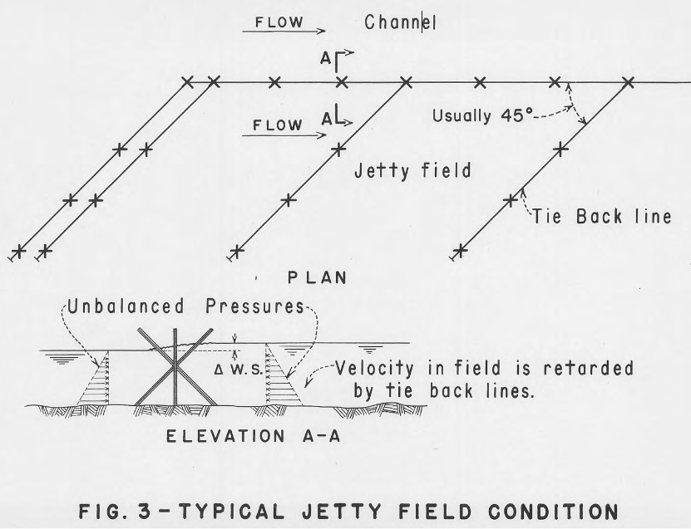
Function and Placement
  Jetty Fields add channel roughness
  Flexible and resilient to channel scour
  Train main streamflow along desired path
  Promote energy loss and reduce velocities
  Capture debris and induce sedimentation
  Vegetation helps to lock in deposited sediment
  REQUIRE HIGH SUSPENDED SEDIMENT LOADS
    Else there will be no material to build up the bed
  Typical Alignment
    Aligned 45 to 70 degrees downstream from bank.
    Spacing Varies, usually 15 to 75m apart.
    Tiebacks spaced every 30m
    Space between jacks should not exceed with of the jack

Slide 6
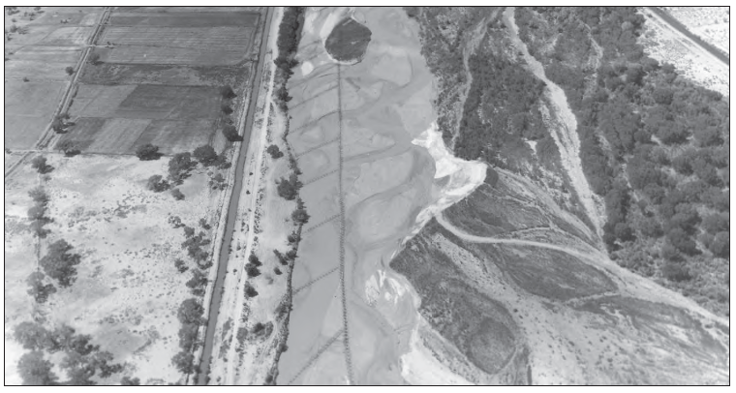
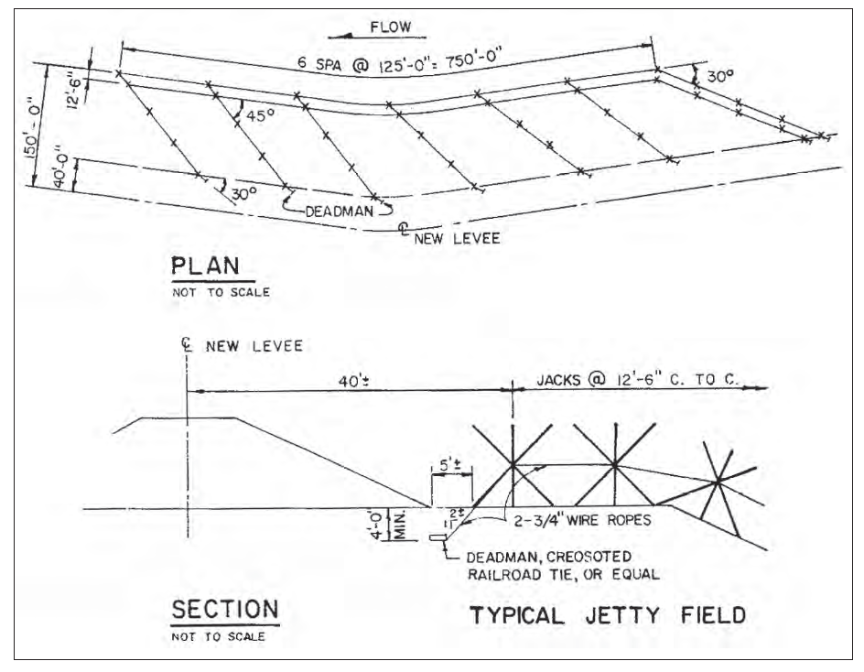
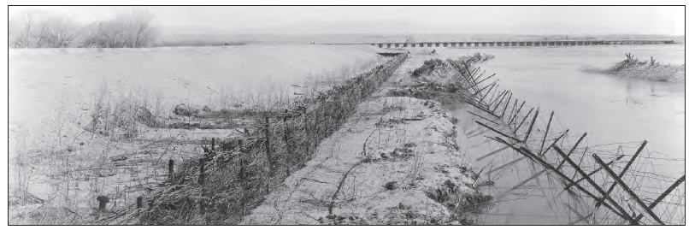
Common Applications
  Used to protect eroding banks
  Used to protect the toe of Levees
  Help rebuild banks through sedimentation

Slide 7
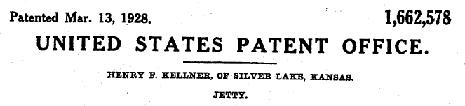
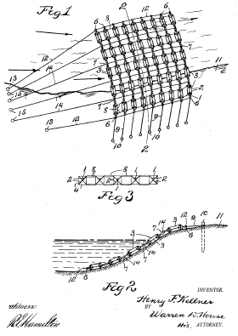
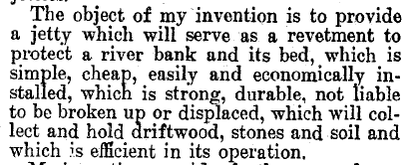
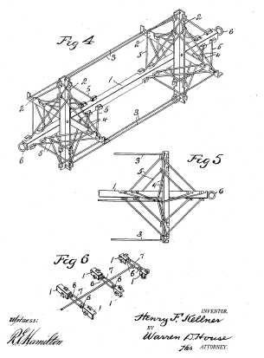
History
  Invented in 1920’s by H.F. Kellner.
  Have since been modified from original design
  First application by Santa Fe Railroad (1937)
  to protect railroad embankments
  USBR used jetty fields extensively in 1950’s
  along the Rio Grande (high sediment loads)
  to help stabilization and channelization
    Over 100,000 placed from 1950 to 1967

Slide 8
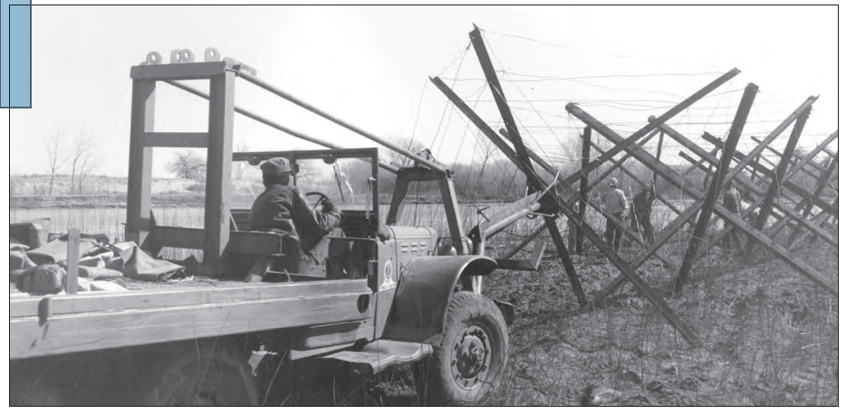
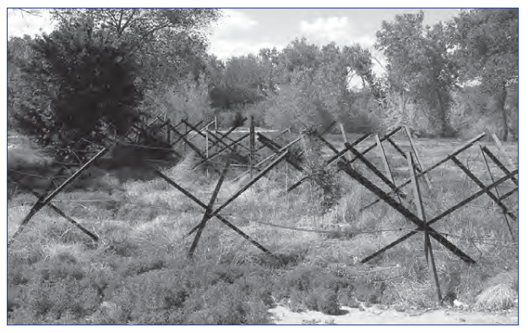
Examples and Photos

Slide 9
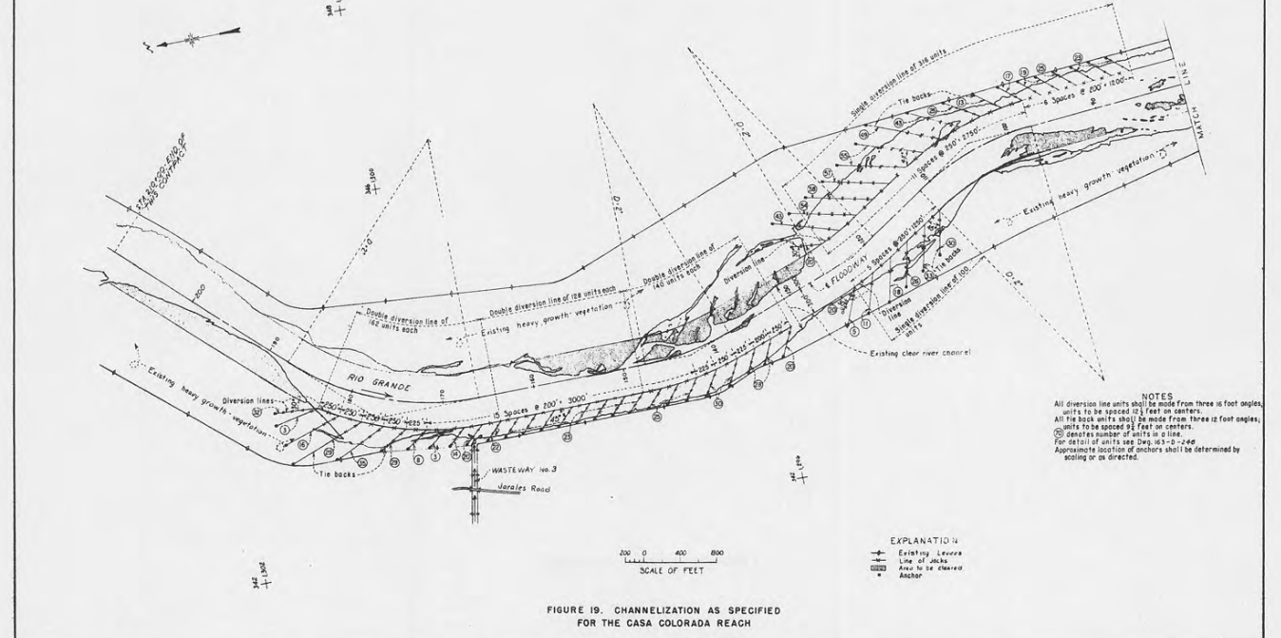
Examples and Photos

Slide 10
References and Resources
  Carlson, Enos J., and Philip F. Enger, 1956. Use of Steel Jetties for Bank Protection and Channelization in Rivers. A paper presented at Hydraulics Division meeting, ASCE Madison, Wisconsin.
  Carlson, E. J. and Dodge, R. A., 1962. Control of Alluvial Rivers by Steel Jetties. A paper to be presented at The First Water Resources Engineering Conference of The American Society of Civil Engineers, Omaha
  U.S. Army Corps of Engineers, Albuquerque District, 2002. Controlling the Floods: The Role of the U.S. Army Corps of Engineers in the History of the Middle Rio Grande Conservancy District.
  Federal Highway Administration, 2001. Hydraulic Design Series Number 6: River Engineering for Highway Encroachments.
  Kellner, Henry F., 1928. United States Patent Application No. 1,662,578: Jetty.
  U.S. Army Corps of Engineers, Albuquerque District, 1953. Use of Kellner Jetties on Alluvial Streams, a Civil Works Investigation Report on Measures for Bank Protection. Albuquerque, New Mexico.

