Slide 1
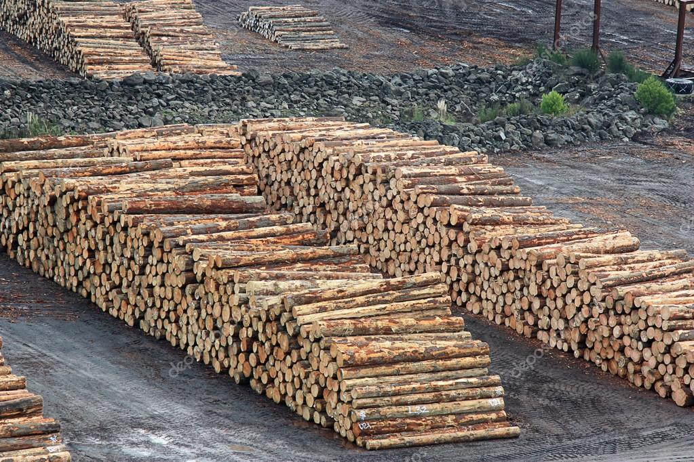
Timber Pile Dikes
Anthony Keene
Kristin LaForge
CIVE 717
Spring 2018

Slide 2
Objectives:
Longitudinal dikes modify channel alignment for certain project requirements:
  Some are put in place reduce hydrodynamic forces and thus minimize shear stress on banks that cause erosion
  Others can also be used for navigation purposes to control flows in waters

Slide 3
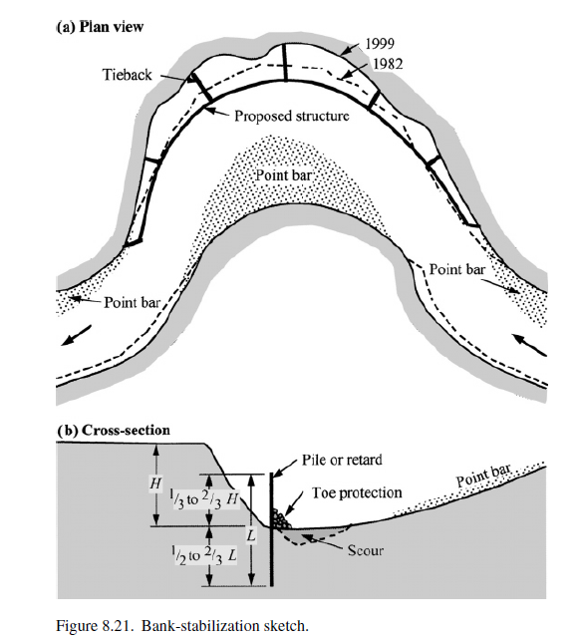
Bank Stabilization with Timber Pile Dikes
The dike is put in place longitudinally to prevent erosion on the outer bank
- River Mechanics- Julien (2002)

Slide 4

One definition according to USACE:
"Dikes, sometimes referred to as wing dams or spur dikes, are structures placed in a river to redirect the river's own energy to provide a variety of effects. The structures are usually constructed out of stone, but other materials have been used for construction including but not limited to timber piles, concrete, and sand filled geotextile bags and tubes. On larger rivers, dikes are used to manage sediment response distribution within the channel to deepen the channel and provide adequate depth for navigation. On smaller rivers and tributaries, they have been used primarily to divert flow and stabilize eroding banks.
Dikes are usually built perpendicular to the river flow and vary considerably in height and length. On large rivers, they are built approximately at a height midway up the channel and lengths can vary depending upon a variety of factors."
http://www.mvs-wc.usace.army.mil/arec/Basics_Dikes.html

Slide 5
Dikes versus Spurs
Dikes are not as commonly used as spurs
The terminology between dikes and spurs can also cause confusion. Some organizations interchange the two terms
This presentation defines the two structures as:
  Dikes: Structures oriented longitudinally in the river parallel to the banks
  Spurs: Structures perpendicular to the flow that jut out from the bank into the river
    Note: When the dikes are made of wood, we classify them as timber pile dikes

Slide 6
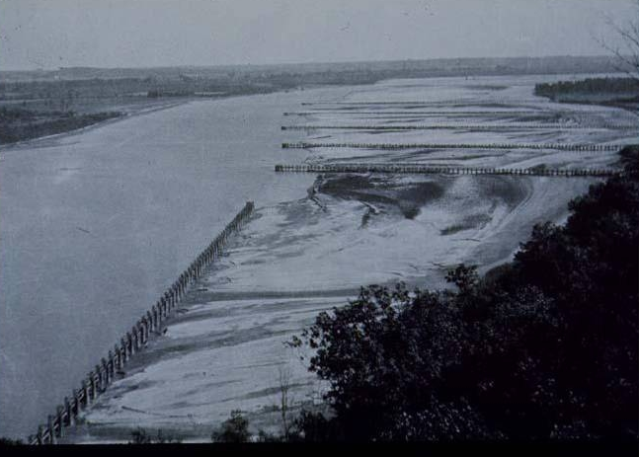
https://www.google.com/search?q=dikes+rivers+timber&tbm=isch&tbs=rimg:CUHSDi-UD30LIjhE31utafsNmB3t79zg28enoCMKzCRryZpgNkgpJK615YVqKyhoZBXWebRVOcT5i5cmIwh1vW5IeCoSCUTfW61p-w2YEdRa9sruf7IrKhIJHe3v3ODbx6cRMof0WRXVpogqEgmgIwrMJGvJmhEiImcRHA5qsCoSCWA2SCkkrrXlESIiZxEcDmqwKhIJhWorKGhkFdYRXtvsQrHDwLgqEgl5tFU5xPmLlxFe2-xCscPAuCoSCSYjCHW9bkh4Eew3Sh2SM1p8&tbo=u&sa=X&ved=2ahUKEwj51b3Ej4PaAhVkzoMKHeZ1CLwQ9C96BAgAEBg&biw=1920&bih=910&dpr=1#imgrc=wNRmzxyFPXqG5M:
Timber Pile Dikes and Spurs

Slide 7
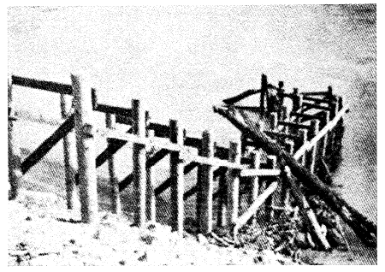
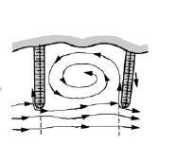
Physical Processes -Timber Pile Spur
-The timber pile spur will deflect flow away from the bank and reduce any velocity of flow toward the bank that makes it past a longitudinal dike (if one is present)
- The spur can also cause an eddy, which is a pocket of slow moving water often times flowing in the opposite direction of the river flow. The eddy will also redirect flow away from bank, as shown below
- Perpendicular to flow
https://www.nrcs.usda.gov/Internet/FSE_DOCUMENTS/stelprdb1043222.pdf

Slide 8
Physical Processes – Longitudinal Dike
Similar to the spur, the timber pile dike will redirect flow and dissipate velocity. The difference is the dike will intend to do this farther away from the bank and ultimately redirect flow in the downstream direction earlier, thus keeping the erosive forces away from the bank
Because of the distance away from the bank, the dike is subject to higher attack from the hydrodynamic forces. The channel will become narrower and deeper after sedimentation processes from the piles

Slide 9
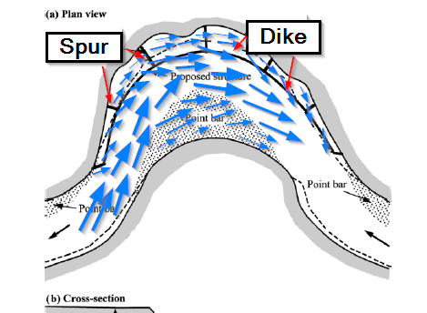
Physical Processes
The presence of timber pile dikes and spurs reduce the hydrodynamic forces of the river. Specifically, they reduce or change velocity, direction, and sometimes depth of the flow
In the photo to the right, the arrows represent the general direction and magnitude of the velocity. As the flow nears the dikes, velocity decreases from impact with the dike (and other turbulent flow caused by the structures), and the direction may be slightly altered away from the bank and in a more downstream direction
Flow still moves along the bank, but at a slower pace. This is shown as the arrows get skinnier as they pass through the dikes toward the bank

Slide 10
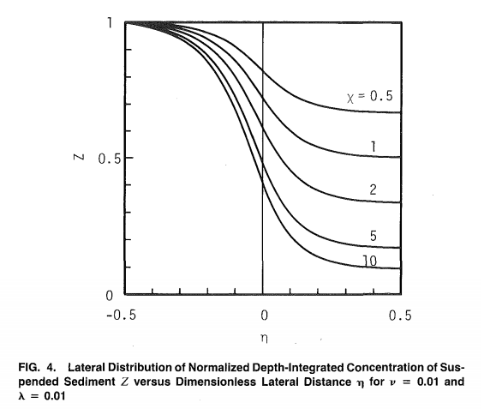
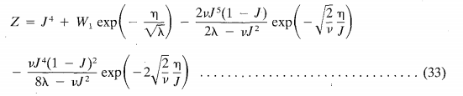
Suspended Sediment
Governing Equations
- The dimensionless suspended sediment concentration around a pile dike is given above
- The dimensionless depth- integrated of suspended sediment is correlated with dimensionless lateral distance from the dike (@ location 0)
It is shown that suspended sediment concentration decreases sharply when it approaches the pile dike
*Parameters defined on next slide
https://ascelibrary-org.ezproxy2.library.colostate.edu/doi/pdf/10.1061/%28ASCE%290733-9429%281991%29117%3A11%281459%29
Notes:
https://ascelibrary-org.ezproxy2.library.colostate.edu/doi/pdf/10.1061/%28ASCE%290733-9429%281991%29117%3A11%281459%29

Slide 11
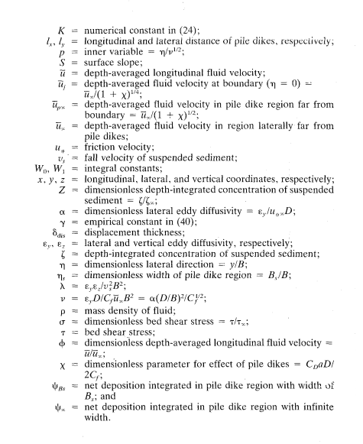
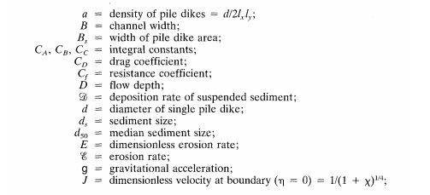
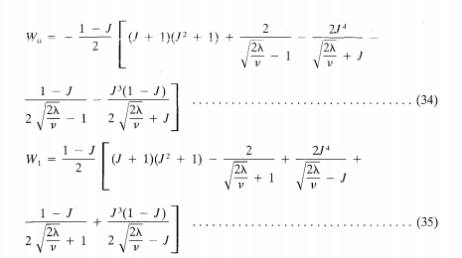
Equation Variables Defined According to Source
https://ascelibrary-org.ezproxy2.library.colostate.edu/doi/pdf/10.1061/%28ASCE%290733-9429%281991%29117%3A11%281459%29

Slide 12


Velocity
-ф is a dimensionless velocity term
The velocity is shown to decrease near pile dikes, showing that the structures definitely retard the flow
Notes:
https://ascelibrary-org.ezproxy2.library.colostate.edu/doi/pdf/10.1061/%28ASCE%290733-9429%281991%29117%3A11%281459%29

Slide 13
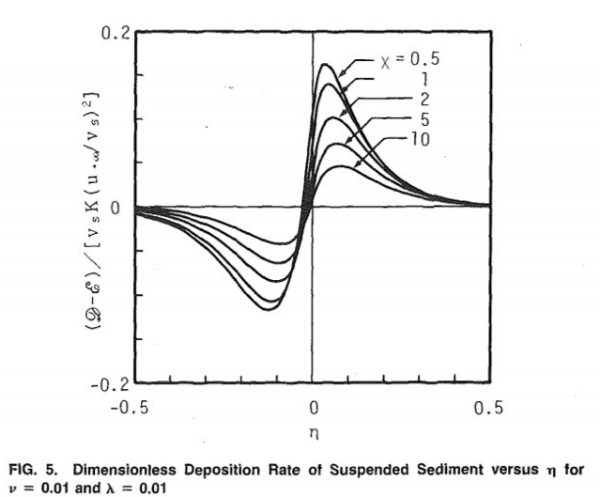
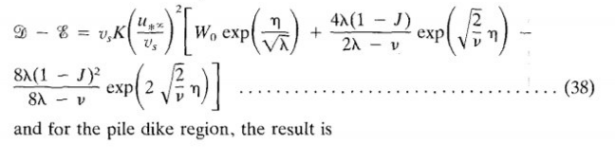
Scour and Deposition
-Deposition versus erosion is given by equation (38) in the figure on the right
- Erosion tends to occur before the dike and deposition on d/s side of the dike
- Overall, the dike tends to cause deposition of sediment
Notes:
https://ascelibrary-org.ezproxy2.library.colostate.edu/doi/pdf/10.1061/%28ASCE%290733-9429%281991%29117%3A11%281459%29

Slide 14
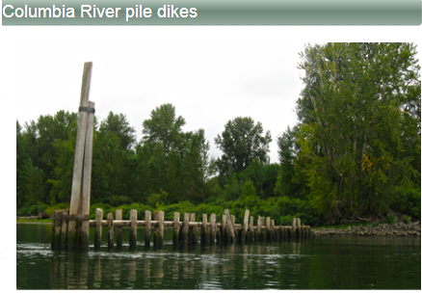
Timber Pile Dikes Used for Navigation Purposes
Case study: US Army Corps of Engineers has 233 timber pile dikes in the Columbia River
  Constructed in stages from 1885-1969
  Put in the river as part of a navigation project
  Starting to fail and funding to improve conditions is limited
  Dikes also benefit salmon habitat (especially juvenile salmon- lower flows and shallower habitat help the juvenile survive)
  http://www.nwp.usace.army.mil/Missions/Navigation/Pile-dikes/

Slide 15
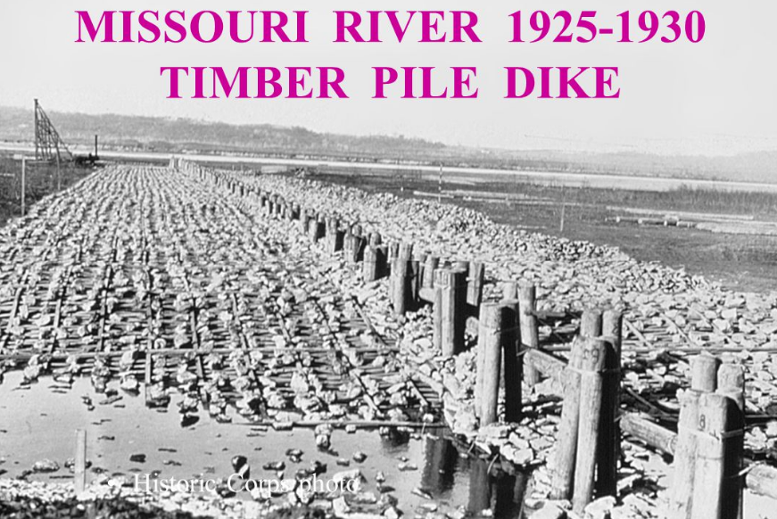
Timber Pile Dikes Used for Navigation Purposes
-The Missouri River also has a lot of timber pile dikes for navigation purposes
- The dikes serves to increase soil composition and allow vegetation to grow
https://esajournals.onlinelibrary.wiley.com/doi/epdf/10.2307/1930968

Slide 16
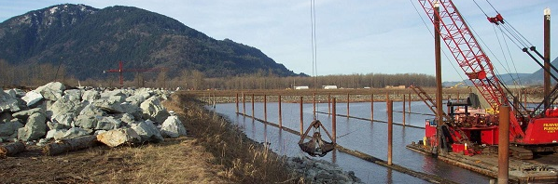
https://www.google.com/search?rlz=1C1GCEA_enUS789US789&biw=1920&bih=910&tbm=isch&sa=1&ei=K0y1WuHwH42jjwTlmJfYDQ&q=dikes+rivers+timber&oq=dikes+rivers+timber&gs_l=psy-ab.3...218064.218064.0.218396.1.1.0.0.0.0.37.37.1.1.0....0...1c.1.64.psy-ab..0.0.0....0.kd0Ss3pgLaY#imgrc=vcBJTobid0EELM:
Timber Pile Dikes Being Constructed
- Parallel to bank

Slide 17
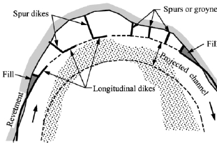
Design Considerations:
Before designing timber pile dikes, a preliminary study of the river should be done. Characteristics such as channel geometry, bed/bank material, flow, drift material, and overall stream-meander pattern
Toe protection is most often recommended and should be placed downstream of the point that has the most heavy attack from flow
Projected length of permeable spurs such as timber pile spurs should be held to less than 25% of the channel width
Spacing of the spurs is a function of the spurs length, angle, permeability, and the bend's degree of curvature. Spacing should be 3-5 times the projected length
The longitudinal dikes should mimic the natural curvature of the bank and should be a smooth curve
Julien, River Mechanics (2002)

Slide 18
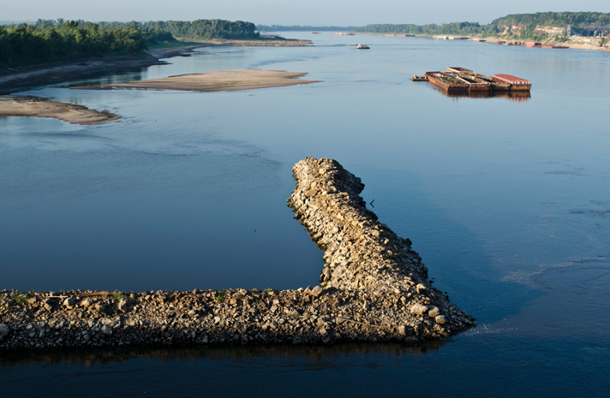
Spur with Longitudinal Dike (Wing Dam)
An article on a fishing website broadcasts this wing dam as a method to manage river flow but also creates good fishing habitat: "Wing Dams Spell “Dam Good” Fishing"

