Slide 1
Overview of vanes
Brian murphy and Emily valenzuela
Cive 717
Homework No. 4 – Spring 2018

Slide 2
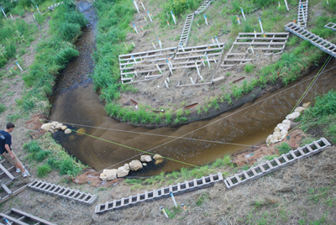
What are vanes
Vanes are structures constructed in a stream to redirect flow by changing rotational eddies (i.e., secondary flows).
They are used as part of natural stream restoration efforts to improve instream habitat and prevent bank erosion.
There are several variants on vanes

Slide 3
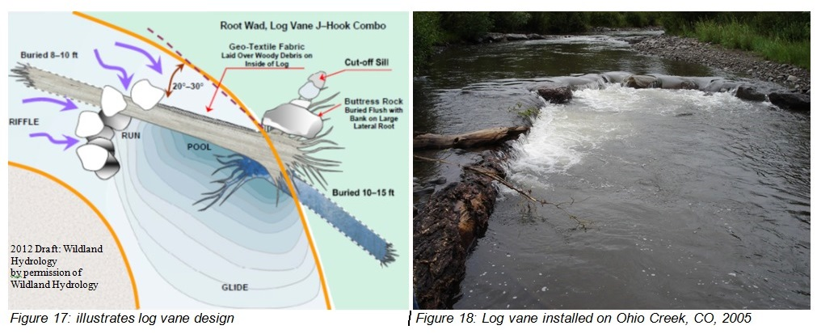
Physical Properties
Vanes are typically formed with rock, woody debris, or the combination of the two.
Vanes can also be made with concrete (i.e. iowa vanes)
Large boulders are used to anchor the vane

Slide 4
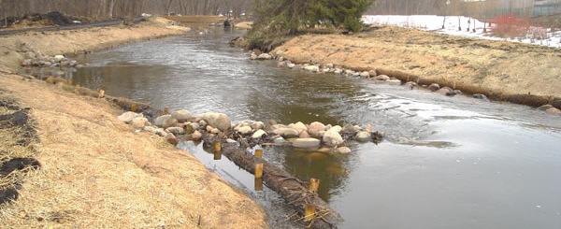
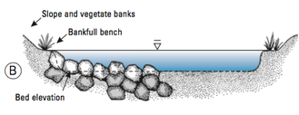
Physical Properties
Vanes consist of:
  an anchor section that is keyed to bank
  a section that extends partially or fully in to the bankfuLl width of a stream
Rocks vanes should be constructed with rock that is angular, flat, or cubed
Rocks used should be hard enough to resist weathering, free of cracking, and not porous

Slide 5
Physical processes
Vanes:
  Modify flow direction away from streambanks
    The upstream angle of the structure is critical.
    For the structure to work properly the upstream angle needs to be into the bank in the downstream direction.
    The resultant flow will be at a 90 ° angle perpendicular to the vane.
  Create depositional zone near banks to reduce streambank erosion
  Create local scour near center of stream

Slide 6
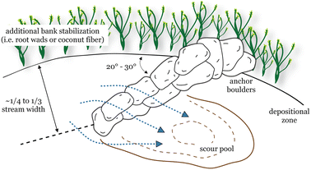
Physical processes
local scour forms a pool that Is used for energy dissipation and to increase pool habitat for fish
IT IS SUGGESTED TO USE VANES IN CHANNELS THAT HAVE A WIDTH TO DEPTH RATIO OF 12 OR GREATER

Slide 7
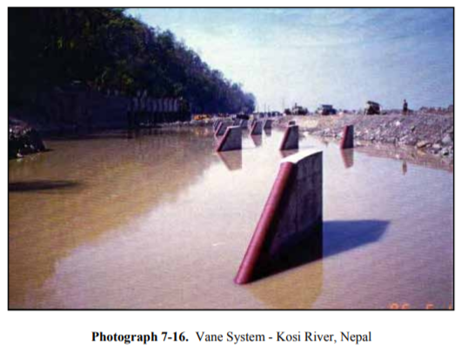
Types of vanes
Iowa Vanes
Cross Vane
Double Cross Vane
J-hook cross vanes

Slide 8
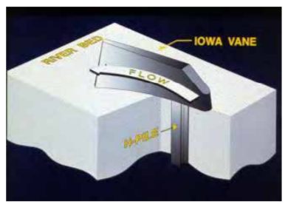
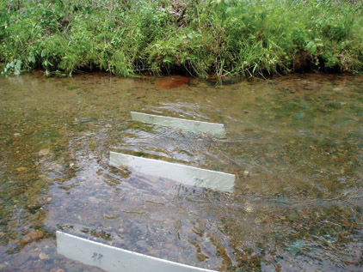
Iowa Vane
Iowa vanes are structures placed in an eroding streambed that cause the flow to be redirected, which results in the deposition of sediment on the eroding bank.

Slide 9
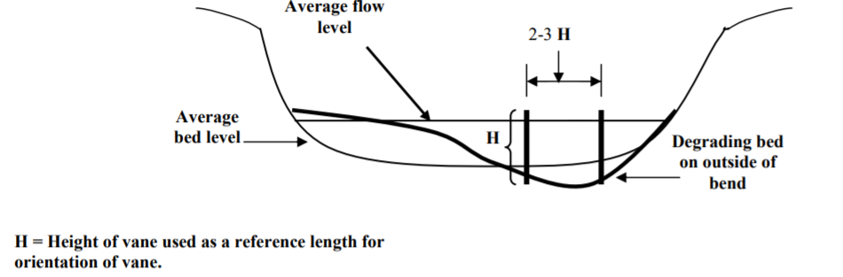
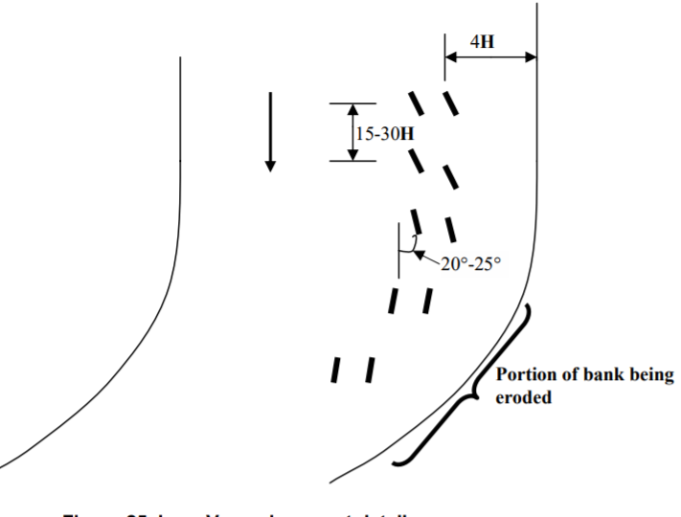
Iowa Vane
Iowa vane placement details
Profile view
Plan view

Slide 10
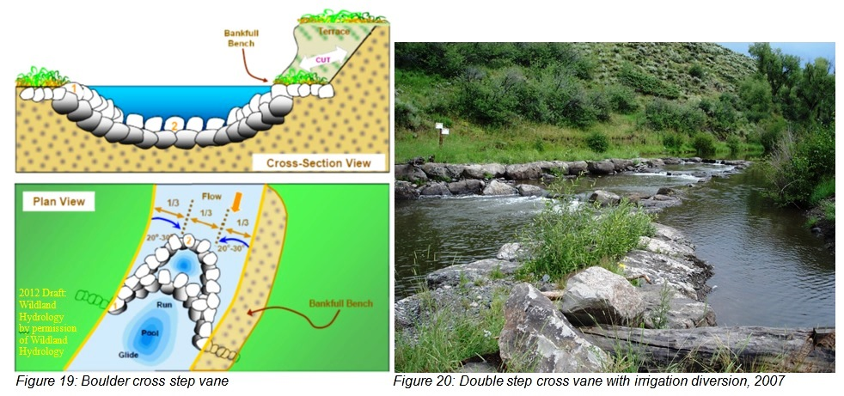
Cross vane & Double Cross Vane
cRoss vanes and double cross vanes are used to offset adverse effects from straight weirs and check dams, which create backwater and flat slopes
From USDA

Slide 11
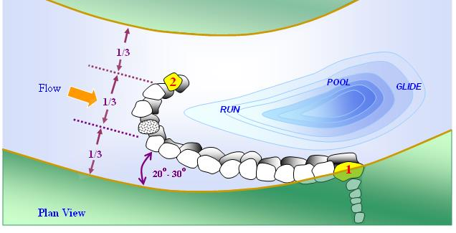
J-hook Cross Vane
J-hooks are vanes with a downstream pointing “j” configuration
J-HOOK vanes REDIRECT FLOW VELOCITY DISTRIBUTION AND HIGH VELOCITY GRADIENT IN THE NEAR BANK REGION to dissipate energy and stabilize streambanks
The “j” configuration forms a scour hole for the fish habitat
From USACE 2012

Slide 12
Vane Design
Two design procedures from U.S Bureau of Reclamation (2015)
  Geometry based procedure
  Bankline velocity reduction procedure

Slide 13
Vane Design
Geometry based procedure
  Determine design flows and hydraulic conditions
  Determine desired bank line and thalweg location
  Determine vane length
    Lw = Le/sinθ where Lw = total vane length, Le = effective vane length, and Θ = horizontal angle b/t bank and vane axis
  Determine bank vane elevation
  Determine positions throughout the bend
  Calculate vane spacing

Slide 14
Vane Design
Geometry based procedure
  Determine vane orientation angle
  Determine vane crest slope
  Determine vane key length
  Determine riprap size
  Determine vane top width
  Estimate scour and launch riprap volume
  Check constructability

Slide 15
Vane Design
Bankline velocity reduction procedure (Scurlock et al., 2012)
  Determine bend hydraulics and design water surface
  Determine bank vane elevation
  Estimate vane length, angle, spacing and slope
  Initial calculation of A* (cross sectional area of vane)
  Initial and iterative calculation of velocity reduction
  Determine vane positions throughout the bend

Slide 16
Vane Design
Bankline velocity reduction procedure
  Determine final vane length, spacing, and depth to vane tip
  Determine the final centerline and inside-of-bend velocity changes
  Determine vane key length, riprap size, vane top width, scour, and launch riprap volume
  Review constructability

Slide 17
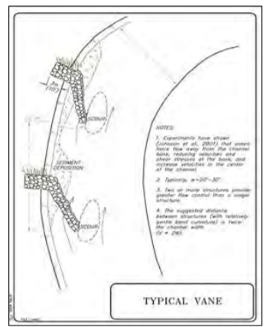
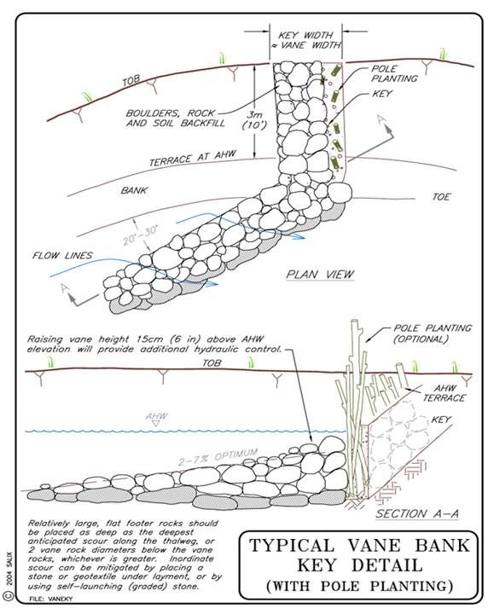
Typical vane details

Slide 18
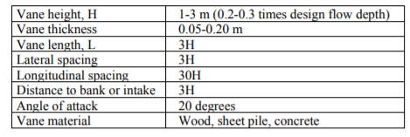
Typical vane Dimensions
From USACE 2012

Slide 19
Risks and failures
Most comment vane failure
  undermining due to scour
  flanking by the river (bank erosion around and behind the structure)
entrance angle changing due to upstream channel migration
  larger flow entrance angle with concurrent increases in velocity and scour.
Bank scalloping between vanes is common

Slide 20
takeaways
Vanes redirect flow by changing the rotational eddies
Design of vanes is typically based on bankfull depth
Key Design/construction elements
  Length
  Crest orientation angle
  Crest elevation and slope
  Channel Width
  Channel centerline radius of curvature for the bend
Vanes are typically oriented upstream 20 to 30 degrees to the bank tangent

Slide 21
References
NRCS, 2007, “Flow Changing Techniques”, In: National Engineering Handbook Part 654J, August.
NRCS, 2007, “Bank stabilization Techniques”, In: National Engineering Handbook Part 654J, August.
Rosgen, Dave. 2001. The Cross-Vane, W-Weir and J-Hook Vane Structures…Their Description, Design and Application for Stream Stabilization and River Restoration. Updated from the Paper Published by ASCE Conference, Reno, NV, August, 2001.
Scurlock, S.M., Thornton, C.I., Baird, D.C., and Abt, S.R., 2015. “Quantification of Transverse In-Stream Structure Hydraulics” Journal of Hydraulic Engineering, ASCE, 2015.141.
USACE, 2012, “RIVER TRAINING STRUCTURES AND SECONDARY CHANNEL MODIFICATIONS”, UPPER MISSISSIPPI RIVER RESTORATION ENVIRONMENTAL MANAGEMENT PROGRAM ENVIRONMENTAL DESIGN HANDBOOK, Chapter 7.
USBR, 2015, “BANK STABILIZATION DESIGN GUIDELINES”, Report No. SRH-2015-25, June.
Iowa department of natural resources, 2006, “Iowa vanes”, in: how to control streambank erosion.
“Habitat Restoration.” US Fish and Wildlife Service, Partners for Fish and Wildlife, 31 May 2016, www.fws.gov/northeast/njfieldoffice/landowners.html.
Natural Channel and Floodplain Restoration, Applied Fluvial Geomorphology. USDA, Sept. 2014, www.nrcs.usda.gov/wps/portal/nrcs/detail/nd/technical/engineering/?cid=stelprdb1247762.
Harman, Will, and Rachel Smith. “Using Root Wads and Rock Vanes for Streambank Stabilization.” NC State Extension, NC State Publications, 1 June 2000, content.ces.ncsu.edu/using-root-wads-and-rock-vanes-for-streambank-stabilization.

