Slide 1
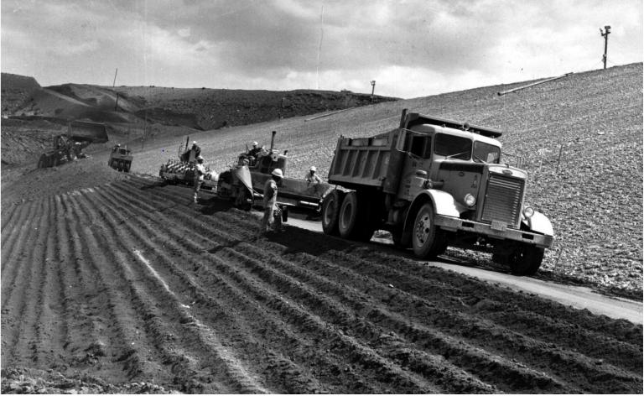
Soil Cement
Taylor Hogan and Marissa Karpack
Starvation Dam, Utah, via USBR

Slide 2
Objectives
The purpose of soil cement in river engineering is to construct drop structures and armor embankments, dikes, levees, channels, and coastal shorelines
  Dry regions are perfect for the application of soil cement
Soil-cement is used where riprap rock is scarce or difficult to transport
  Common in the Central and Southwestern US
Soil-cement can be installed beneath banks with fill above to protect to an anticipated total scour depth

Slide 3
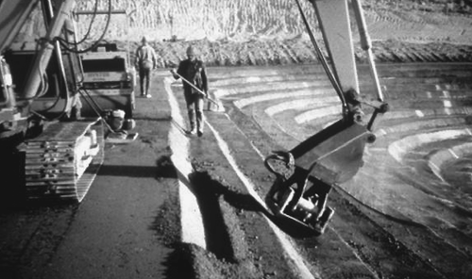
Soil-Cement Basics
Soil-cement is a mixture of existing soil on site with standard cement
Placed in lifts, usually using heavy equipment
Compacted using rollers to increase density
Cured with water so cement hydrates and strengthens
  Unlike typical concrete, soil particles will not be entirely coated in cement paste
  Pockets of un-cemented soil remain within the mixture
Flat blanket on shallow slopes, stair-stepped if steep
Smoothing and compaction of Soil-cement lifts (via ACI)

Slide 4
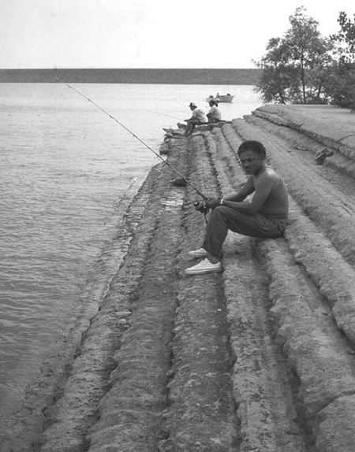
History of Soil-Cement
Post WWII: Many water resource projects planned in the Southwest and Central US
  Riprip not locally available for dams, and therefore expensive
1940’s: USBR begins research on soil-cement as alternative to riprap
1951: Full scale test at Bonney Reservoir, CO
  Test site experiences waves, ice, and repeated freeze-thaw
  10 year observation period of test section
1961: USBR approves of soil-cement use for Merritt and Cheney Dams
1961-Present: More than 400 major soil-cement slope protections projects in US and Canada
Bonney Reservoir Soil Cement 57 years after placement (from ACI)

Slide 5
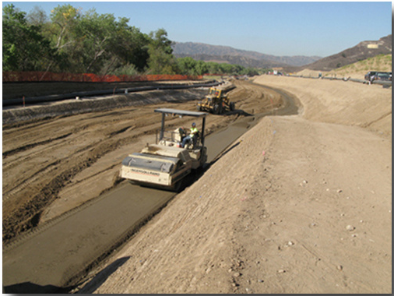
Advantages
Significant cost reduction over riprap if rock is not locally available
Can be visually appealing compared to riprap
Design and construction are quick and simple relative to traditional concrete structures
Can be constructed with local and/or recycled materials
Demonstrated history of effective slope protection since initial test section in 1951
LA soil cement project: http://sewardgeo.com/projects.html

Slide 6
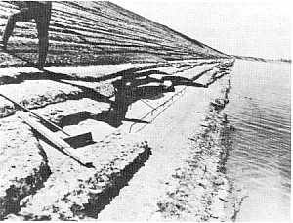
Disadvantages
Higher up-front cost than most riprap
  Requires more heavy machinery to transport, place, and compact
  More skilled labor required than riprap placement
Cannot be installed in inclement weather
Relatively impermeable
  Can fail if soil behind and beneath the cement layer is saturated
Very brittle
  Can crack with freeze-thaw cycles
  Minimal applied loading from people/vehicles can crack surface
Soil cement in need of repair at Cheney Dam (from USBR)

Slide 7
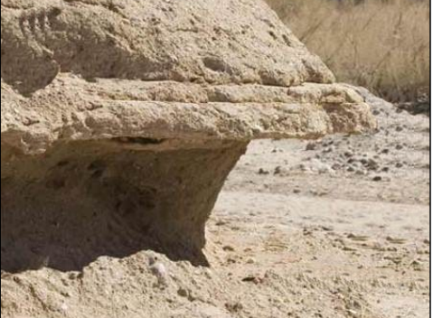
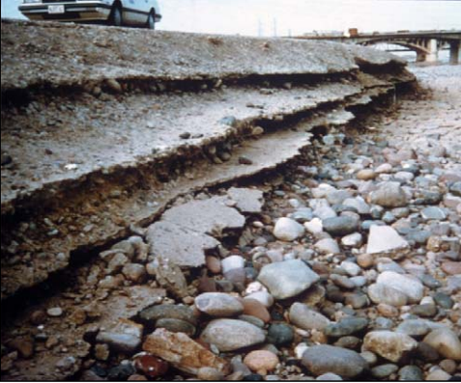
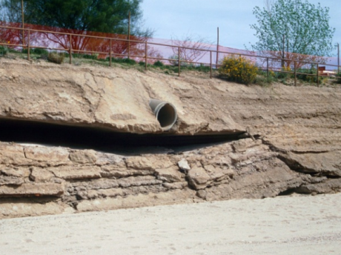
Soil Cement Failure Mechanisms
Undercutting: occurs with bed degradation, or when cement is not extended deep enough
Scour: occurs with high flows and heavy sediment loads, especially with cobbles/boulders
Loss of support: occurs when water is able to erode sediment behind soil-cement blanket
Rillito River, AZ
Salt River, AZ
Rillito River, AZ
All images from Hansen et al. 2011

Slide 8
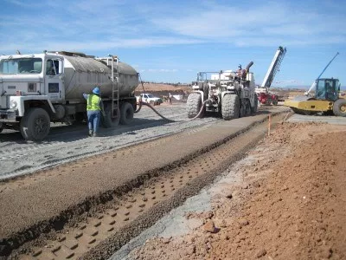
Design Considerations- Material Composition
Soil Composition
  Easily pulverized soils with at least 5% but no more than 35% silt and clay
  Finer soils will be harder to pulverize and will require more cement
  100% Granular soils (No materials passing No. 200 sieve) will also require more cement
Cement Composition
  Typically 8-15% cement is mixed with the soil
If the flow carries enough bedload to be significantly abrasive and the flow velocities exceed 6-8 ft/s then special attention to aggregates is needed
  Aggregates should contain at least 30% gravel particles retained on a No. 4 sieve in these flow conditions
https://m2ukblog.wordpress.com/2017/04/05/soil-cement/

Slide 9
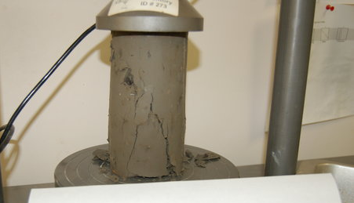
Design Considerations - Soil Cement Strength/Mix Design
Must have a 7-day compressive strength of 750 psi
  24 hour test is run to monitor the mix design. These samples are usually about 50-60% of the 7 day compressive strength
  A 24 hour test is completed every day for the mix coming from the plant
Two main cementitious material options
  100% portland cement
  85% portland cement and 15% fly ash by weight
https://www.test-llc.com/strength-testing/

Slide 10
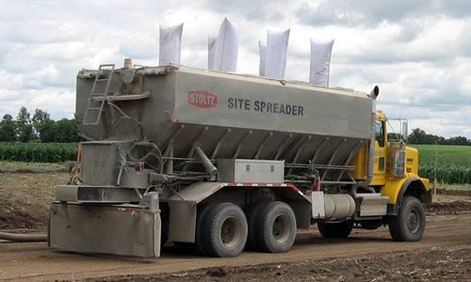
Design Considerations - Material Location
Does the on-site soil match the requirements of soil cement?
  If not, off-site material will be considered. This will be more expensive but better quality
  If it does then it will be significantly cheaper
In the case that the soil is not adequate, an offsite plant can be used to premix suitable soil and cement to form the soil-cement
  The location cannot be further than 30 minutes from the project site
  Must be closer if the temperature exceeds 90F or there is wind that promotes drying
https://www.stoltzspreaders.com/

Slide 11
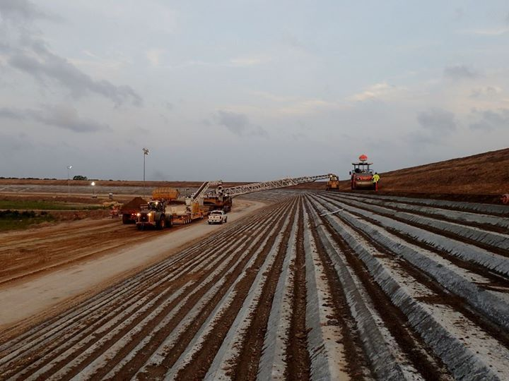
Design Considerations - Slope
Soil Cement has been found to work on many slopes
  Best results at or below 3H:1V
  No steeper than 2H:1V
  If the slope is too steep then the layers cannot be very wide
Based on the slope and application, two different methods can be used
  Stair Step Method
    Layers of soil cement stacked and staggered on each other
  Plating Method
    A single layer of soil cement installed on an embankment
https://allevents.in/wharton/soil-cement-slope-protection-lane-city-reservoir-course-tour/1692370244126491

Slide 12
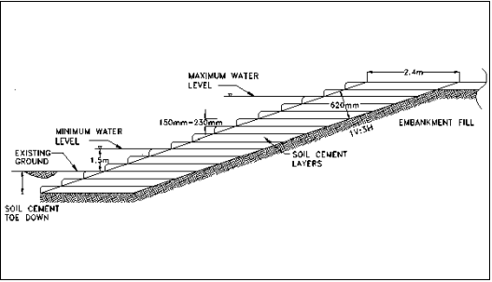

Design Considerations - Stair Step Method
The stair step method is appropriate for larger slope protection projects
  Each layer is approximately 6 inches thick and 6-9 ft wide
    8 ft is preferred to accommodate the necessary equipment
Relationship between the horizontal layer width (W), slope of embankment (S), thickness of compacted layer (v) and minimum facing thickness measured normal to the slope (t_{n}) is:

Slide 13
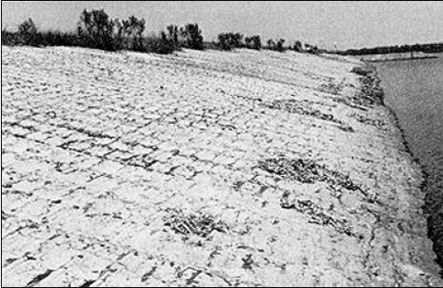
Design Considerations - Plating Method
Practical for smaller slope protection projects
Consists of a single layer of soil cement placed parallel to the embankment
Applied to slopes of 3H:1V or less
The edge of the soil cements layer should be tied into a non-erodible section or abutment to prevent undermining of the rigid soil cement layer
  Common methods include riprap aprons, extending soil cement layer below the anticipated degradation/scour depth, or installing a cutoff wall below the degradation depth

Slide 14
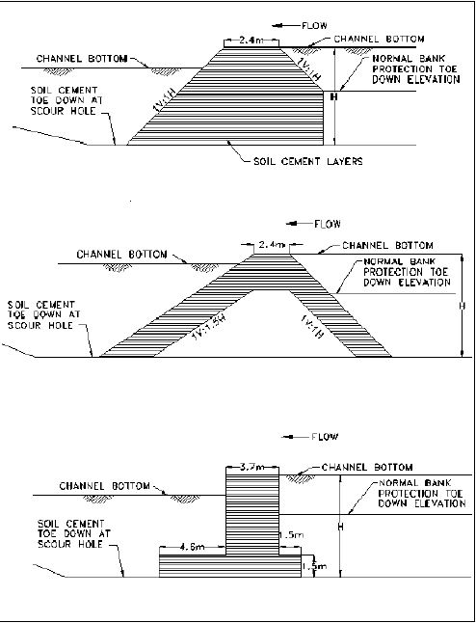
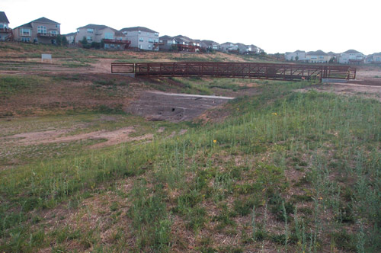
Design Considerations - Grade Control Structures
Soil Cement can be compacted in layers to form grade control structures that are very cheap compared to their concrete counter parts
The picture below shows a drop structure that is one of 18 installed on Marcy Gulch in Highlands Ranch, CO to decrease the slope of the ephemeral stream and help prevent further degradation

Slide 15
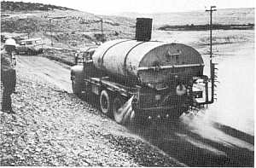
Placement Process
Soil cement can be mixed on site or in a batch plant
  Batch plant is higher quality but more expensive
Soil cement is placed on top of moistened subgrade
  Can be placed on top of older soil cement to retrofit or extend the bank protection
Successive layers should be placed immediately
  Drying between layers creates weak seams
Must be compacted within 30 minutes of placement
Exposed surfaces must be kept moist to cure
  Typically 7 days to acceptable cure
  Covered with a protective curing material
Watering soil cement to prevent cracking at Starvation Dam (from USBR)

