Slide 1
River-groundwater impact on bank stability
CIVE 717 Presentation
April 7, 2015
David Criswell
Rod Lammers

Slide 2
Objectives
Explore the following components associated with river-groundwater impact on bank stability
Physical Processes
2. Governing Equations
3. Field and Laboratory Observations
4. Design Methods

Slide 3
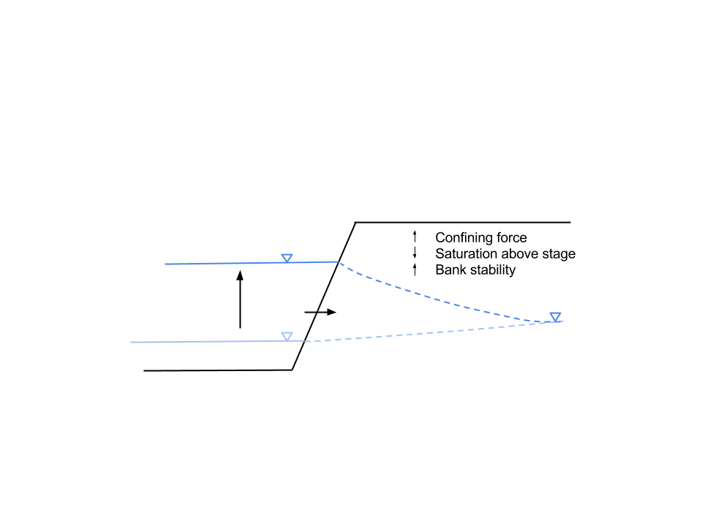
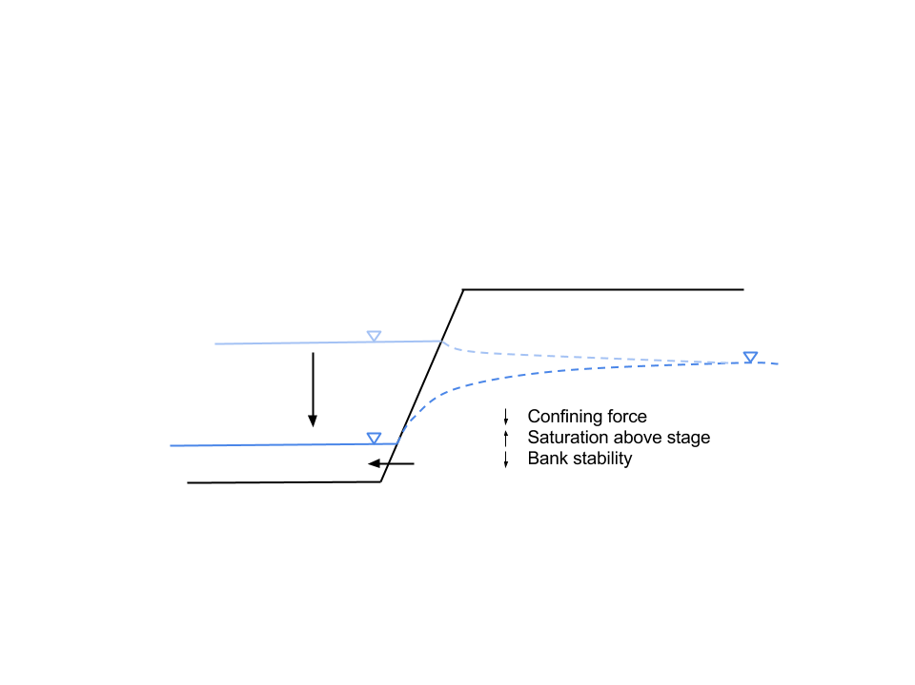
Physical Processes: Stage-Groundwater Dynamics
A
Water in stream can apply a confining force on the streambank, increasing stability
Saturated soils are less stable than unsaturated soils
Rising limb: More stable
Falling limb: Less stable
B
Rising (A) and falling (B) limb of a hydrograph and its impacts on bank stability (adapted from Julien, 2002).

Slide 4
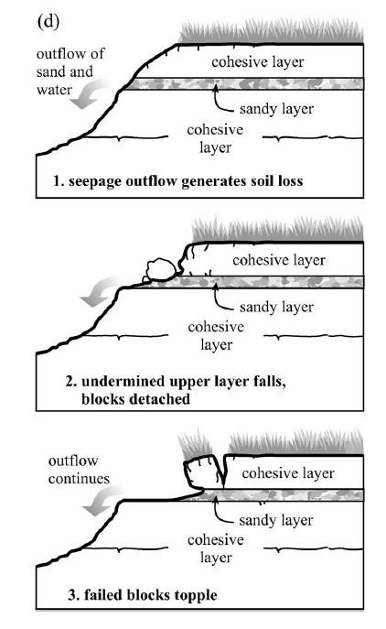
Physical Processes: Seepage Erosion
Groundwater outflow from bank face directly removes bank soil
Overlying layers are destabilized and fail
Process accelerated if permeable layer present
Langendoen and Simon, 2008

Slide 5
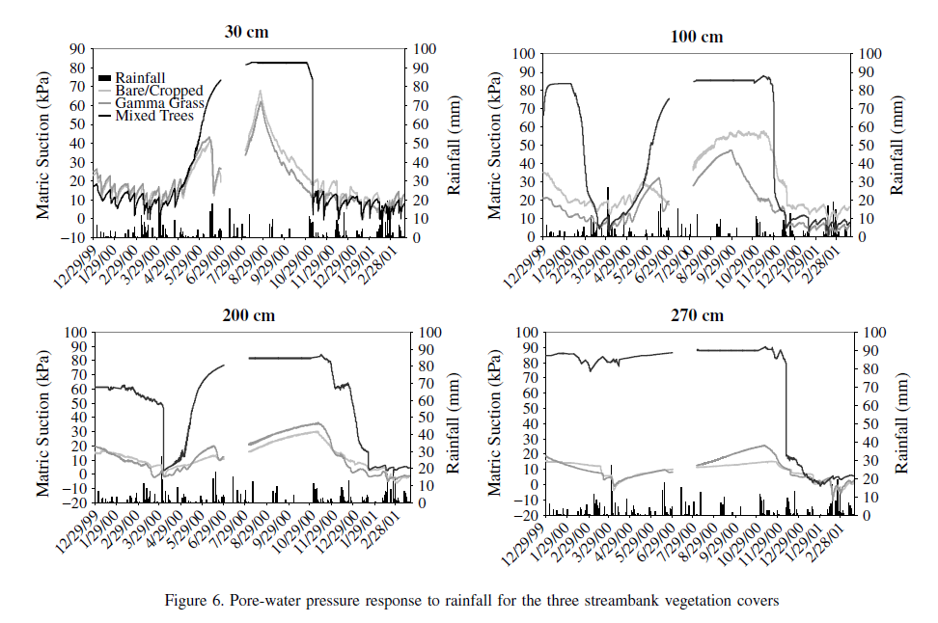
Physical Processes: Vegetation
Vegetation changes pore-water pressure in banks due to transpiration
Drying the soil, in addition to mechanical root reinforcement, strengthens banks
Banks with trees dry out faster (and to a greater extent) following rainfall than banks with grass or no plants (higher matric suction corresponds to dryer banks) (Simon and Collison, 2002)

Slide 6


Governing Equations: Bank Strength
Saturated bank strength (Mohr-Coulomb)
$$S_{r}=c^{′}+\left(σ−μ\right)\tan{φ^{′}}$$
Unsaturated bank strength (Fredlund et al. 1978)
$$S_{r}=c^{′}+\left(σ−μ_{a}\right)\tan{φ^{′}}+\left(μ_{a}−μ_{w}\right)\tan{φ^{b}}$$
Sr = shear strength of soil [kPa]
c‘ = effective cohesion of soil [kPa]
σ = normal stress [kPa]
μ = pore-water pressure [kPa]
ϕ‘ = effective friction angle [°]
μ_{a} = pore-air pressure [kPa]
μ_{w} = pore-water pressure [kPa]
ϕ^{b} = angle describing rate of increase of shear strength from matric suction

Slide 7

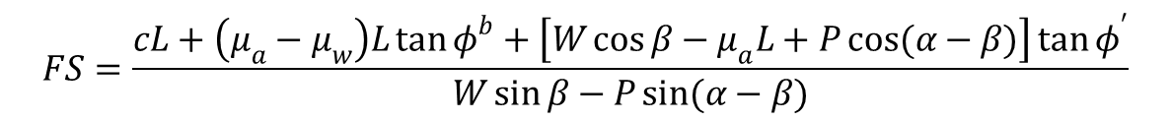
Governing Equations: Bank Stability
Stability with hydrostatic processes (Simon et al. 2000)
$$FS=\frac{cL+\left(μ_{a}−μ_{w}\right)L\tan{φ^{b}}+\left[W\cos{β}−μ_{a}L+P\cos{(α−β)}\right]\tan{φ^{′}}}{W\sin{β}−P\sin{(α−β)}}$$
Stability with seepage processes (Chu-Agor et al. 2008)
$$FS=\frac{\frac{c}{bγ_{w}}+\left(\frac{γ^{′}}{γ_{w}}+1\right)\sin{α}\tan{φ^{′}}}{\sin{α}\cot{λ}−\frac{γ^{′}}{γ_{w}}\cos{α}}$$
c = apparent cohesion [kPa]
L = length of the failure plane [m]
W = saturated soil weight [kN]
P = hydrostatic confining force of stream water [kN/m]
ϕ‘ = effective friction angle [°]
μ_{a} = pore-air pressure [kPa]
μ_{w} = pore-water pressure [kPa]
ϕ^{b} = angle describing rate of increase of shear strength from matric suction [°]
α = bank angle from horizontal [°]
β = failure plane angle from horizontal [°]
γ’ = submerged unit weight of the soil [kN/m³]
γ_{w} = unit weight of water [kN/m³]
λ = direction of the seepage vector measured clockwise from the inward normal to the bank slope

Slide 8
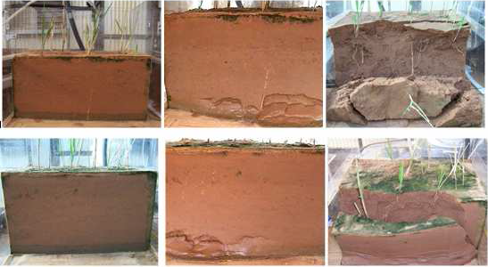
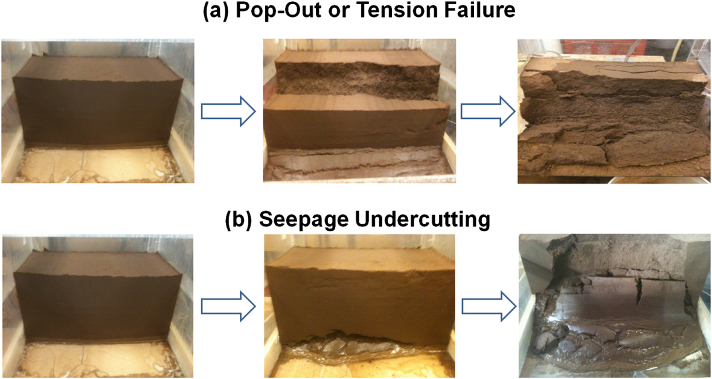
Laboratory Analysis
Progression of seepage failure in sand soils with vegetation. Undercutting leads to slumping failure. (Cancienne and Fox, 2008)
Pop-out or tension failure and seepage undercutting in sandy loam soils (Fox and Felice 2014)

Slide 9
Design Methods
Direct alteration to streambank
“Natural” restoration (excavation/fill and use of native vegetation)
Man-made stabilization (mattresses, gabions, retaining walls, etc.)
Alteration to stream flow
Retards, dikes, jetties, fences, etc.
Julien (2002)

Slide 10
Design Method: Bank Sloping
A simple stabilization method is to slope the banks (either by excavation or fill)
Rule of thumb is 3:1
Table 8.3 Recommended maximum side slope, z, in various materials (Chow, 1959)
Material |  |  |  |  | Maximum side slope (z)
Rock |  |  |  |  | Nearly vertical
Muck and peat soils |  |  |  |  | 0.25
Stiff clay or earth with concrete lining |  |  |  |  | 0.5-1
Earth with stone lining, or earth for large channels |  |  |  |  | 1
Firm clay or earth for small ditches |  |  |  |  | 1.5
Loose sandy earth |  |  |  |  | 2
Sandy loam or porous clay |  |  |  |  | 3

Slide 11
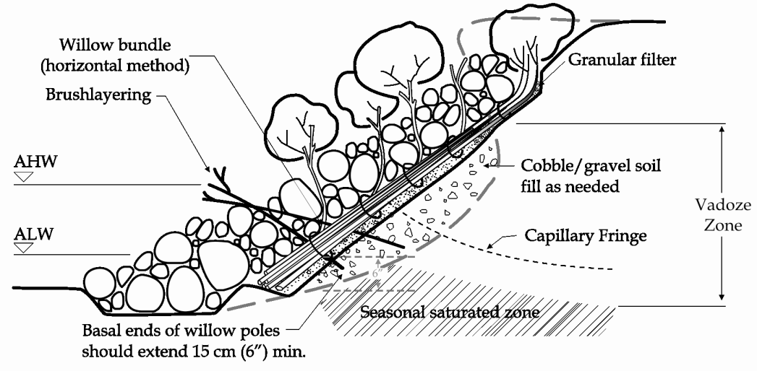
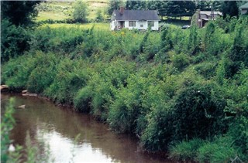
Design Method: Bioengineering
Vegetation can both reduce near-bank groundwater levels, prevent seepage erosion, and increase bank stability
Generally takes time to establish but is generally inexpensive and low-maintenance
Can either allow riparian buffers to establish naturally or undertake planting programs
Combination of rip-rap and vegetation to stabilize banks and lower groundwater levels (Holanda and da Rocha, 2011)

Slide 12
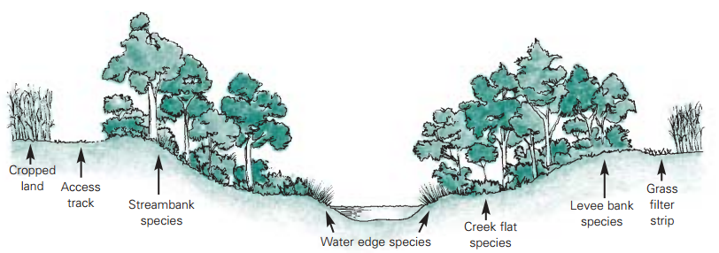
Design Method: Bioengineering
Additionally, riparian vegetation increases resistance to flow (e.g. Manning n)
During overbank flow, this reduces the shear stress induced by the flood, decreasing the risk of streambank failure

Slide 13
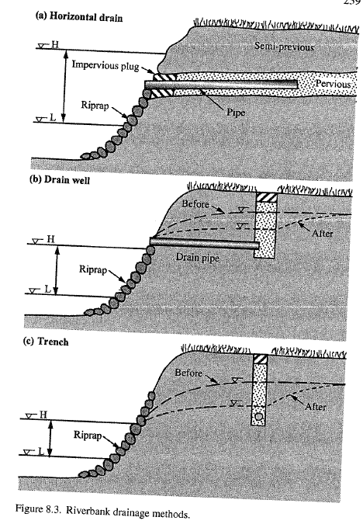
Design Methods: Bank Drainage
Drain pipes can be installed parallel or perpendicular to the bank face to reduce near-bank groundwater levels
Impervious surfaces can also be placed on top of the bank to reduce near-bank infiltration
Julien (2002)

Slide 14
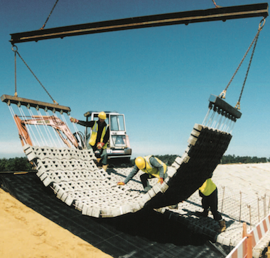
Design Method: Articulated Concrete Mattresses
Precast concrete blocks held together by cables or rods
Flexible
Open to allow hydrostatic pressure
www.pondsuk.co.uk
Julien (2002)

Slide 15
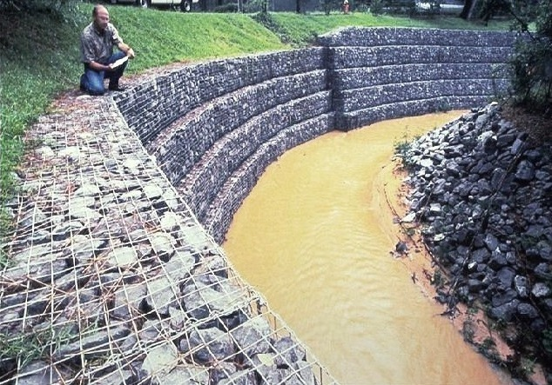
Design Method: Gabions
Wire boxes filled with smaller stones usually less than 8 in.
Used where flow velocities would make stone size unstable in rip-rap blanket
Max velocity: 8 – 15 ft/s
Petersen (1986)
www.gabion1.com

Slide 16
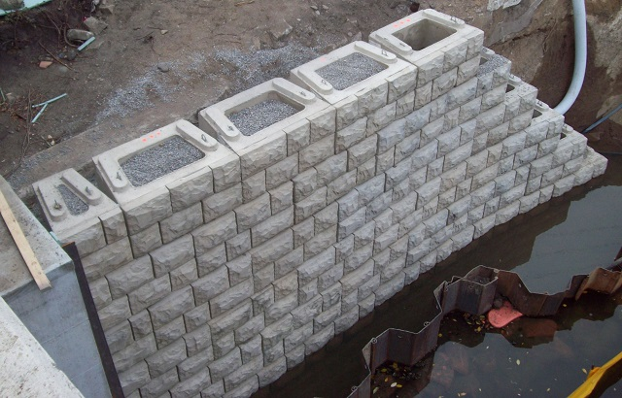
Design Method: Retaining Walls
Near-vertical structures designed to prevent erosion and streambank failure while maximizing usable land area
Three types:
Gravity walls
Cantilever walls
Sheet-piling walls
Can be porous to allow for bank drainage
Example of a Gravity Wall (www.verti-crete.com)
Julien (2002)

Slide 17
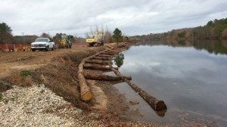
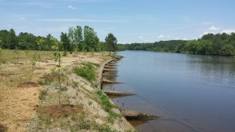
Design Method: Dikes
Two types of dikes:
Stone Fill Dikes
Timber pile dikes
Below is an example of a small-scale timber dike on Marshyhope Creek in Maryland
Before
After
www.duffnet.com
Julien (2002)

Slide 18
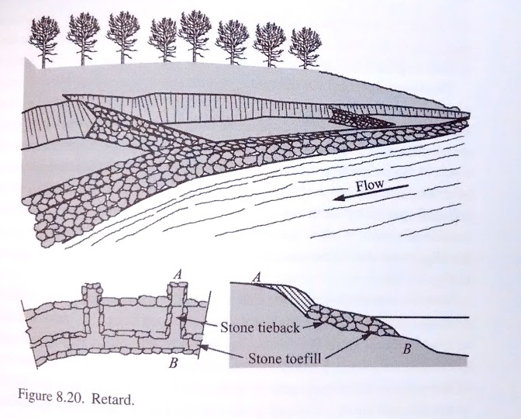
Design Method: Retards
Low permeable structure placed near bank toe used to reduce velocity and induce deposition and vegetation growth
Often 1/3 to 2/3 height of streambank
Julien (2002)

Slide 19
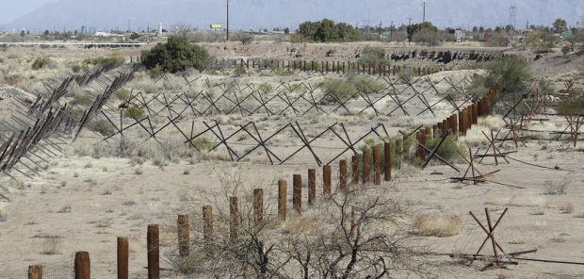
Design Method: Jetties
Kellner Jacks (steel posts tied with cables) placed in rows are called Jetties
Increase roughness, lower velocities, and encourage sediment deposition
Most effective when river contains large amounts of debris (tree limbs, sage brush, etc.)
Petersen (1986)
Jacks along the Santa Cruz River (www.tuscon.com)

Slide 20
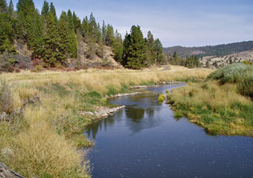
Design Method: Vanes
Structures designed to redirect high velocities away from streambanks
Often built of rock or timber
Water is free to pass over or around the structure
www.pitriveralliance.net
Petersen (1986)

Slide 21
References
Cancienne, R. M. and G. A. Fox. 2008. Laboratory experiments on three-dimensional seepage erosion undercutting of vegetated banks. ASABE Annual International Meeting, Providence, RI 2008.
Chu-Agor, M. L., G. V. Wilson, and G. A. Fox. 2008. Numerical modeling of bank instability by seepage erosion undercutting of layered streambanks. Journal of Hydrologic Engineering, 13: 1133-1145.
Fox, G. A. and R. G. Felice. 2014. Bank undercutting and tension failure by groundwater seepage: predicting failure mechanisms. Earth Surface Processes and Landforms, 39: 758-765.
Francisco Sandro Rodrigues Holanda and Igor Pinheiro da Rocha (2011). Streambank Soil Bioengineering Approach to Erosion Control, Progress in Molecular and Environmental Bioengineering - From Analysis and Modeling to Technology Applications, Prof. Angelo Carpi (Ed.), ISBN: 978-953-307-268-5, InTech, DOI: 10.5772/20659.
Fredlund, D. G., N. R. Morgenstern and R. A. Widger. 1978. The shear strength of unsaturated soils. Canadian Geotechnical Journal, 15: 313-321.
Julien, P. 2002. River Mechanics. Oxford Press: 434p.
Langendoen, E. J. and A. Simon. 2008. Modeling the evolution of incised streams II: Streambank erosion. Journal of Hydraulic Engineering, 134: 905-915.
Petersen, M.S. 1986. River Engineering. Prentice Hall: 149-224.
Simon, A. and A. J. C. Collison. 2002. Quantifying the mechanical and hydrologic effects of riparian vegetation on streambank stability. Earth Surface Processes and Landforms, 27: 527-546.
Simon, A., A. Curini, S. E. Darby, and E. J. Langendoen. 2000. Bank and near-bank processes in an incised channel. Geomorphology, 35: 193-217.

