Slide 1
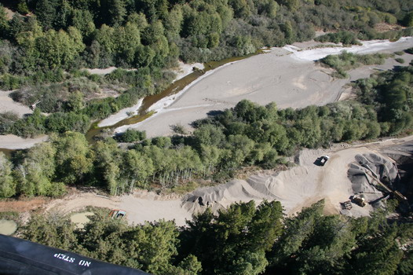
Gravel Mining
Gualala River, California fly-over, Courtesy: Jamie Hall
Ryan Kindt
Kristina Lowthian
CIVE 717
April 9, 2012

Slide 2
Content
Purpose of gravel mining
Physical processes
Governing equations
Gravel mining operations
Design methods
Gravel mining effects
Geomorphic impacts
Environmental impacts
Conclusions
References

Slide 3
Purpose of Gravel Mining
Navigation
Agricultural drainage
Flood control
Channel stability
Construction aggregate – largest mining industry in most states
Uses:
Base material and asphalt for transportation projects
Bedding for pipelines
Drain rock in leach field septic systems
Aggregate mix in concrete for transportation and buildings

Slide 4
Physical Processes
Adapted from Knighton, 1998

Slide 5
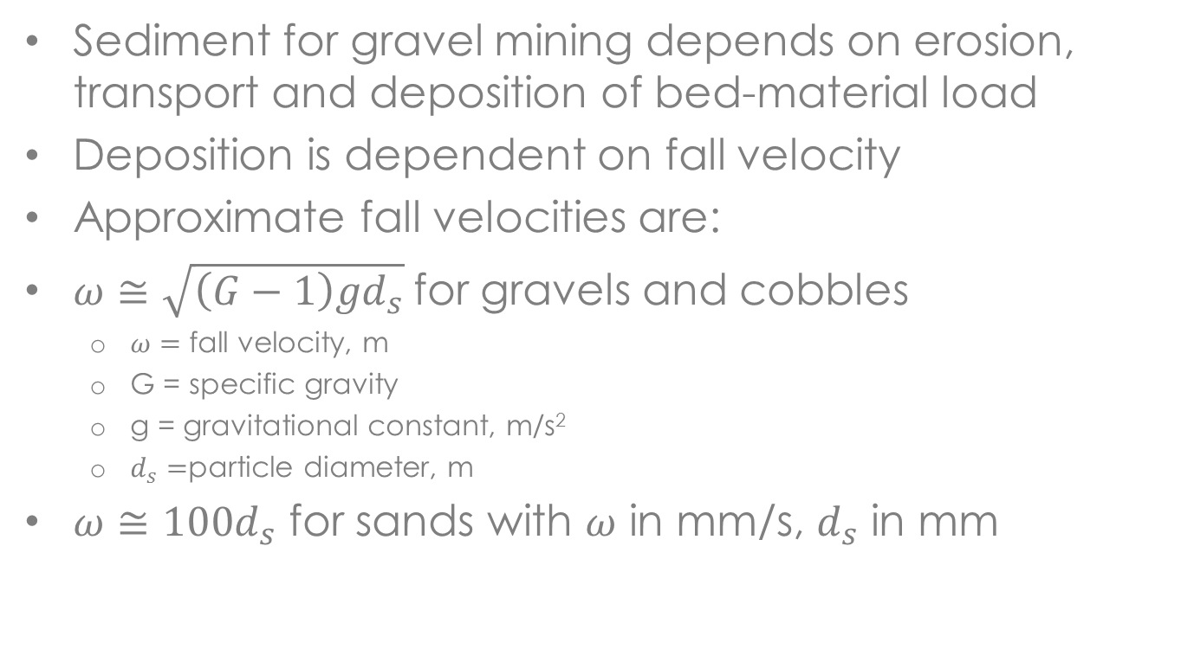
Governing Equations

Slide 6
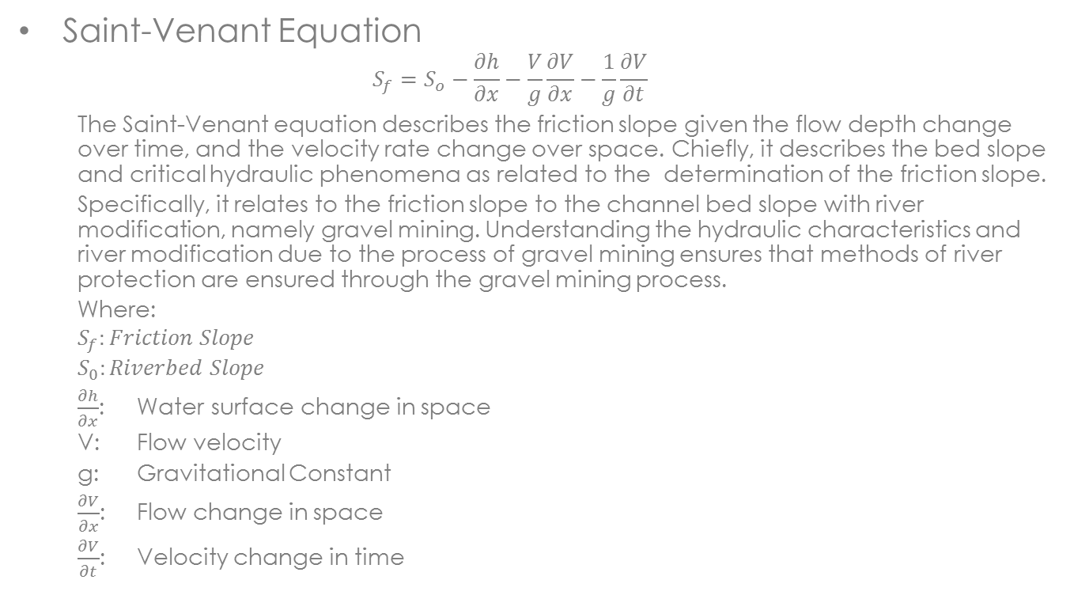
Governing Equations

Slide 7
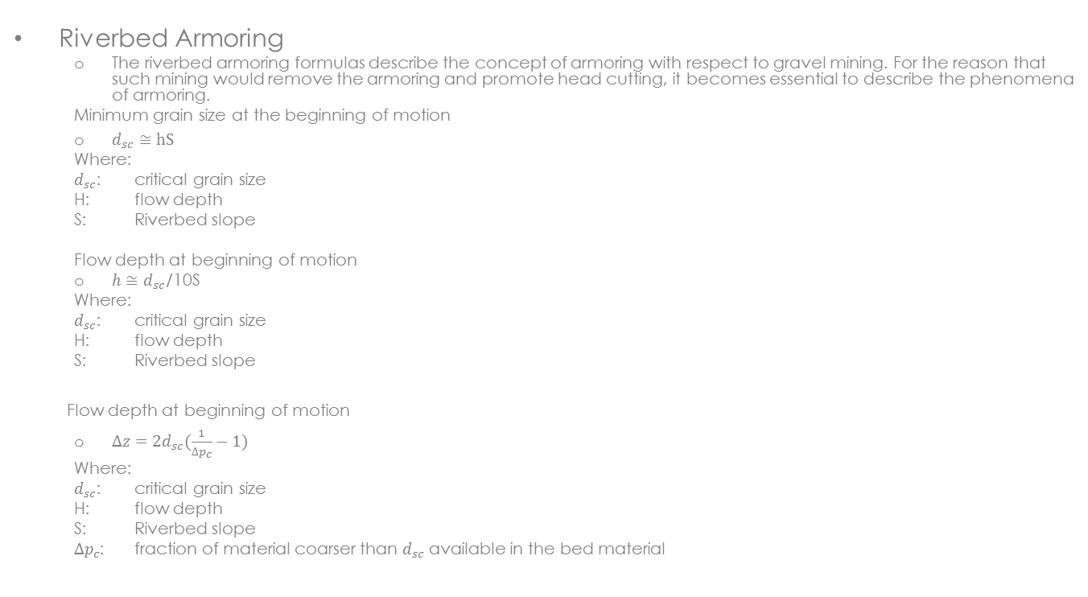
Governing Equations

Slide 8
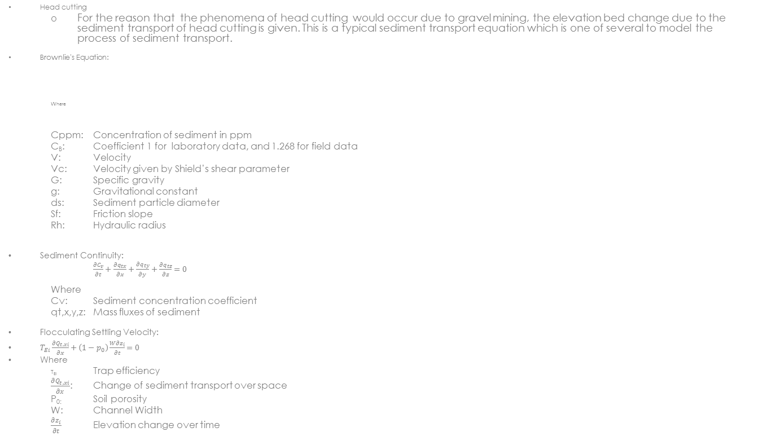
Governing Equations

Slide 9
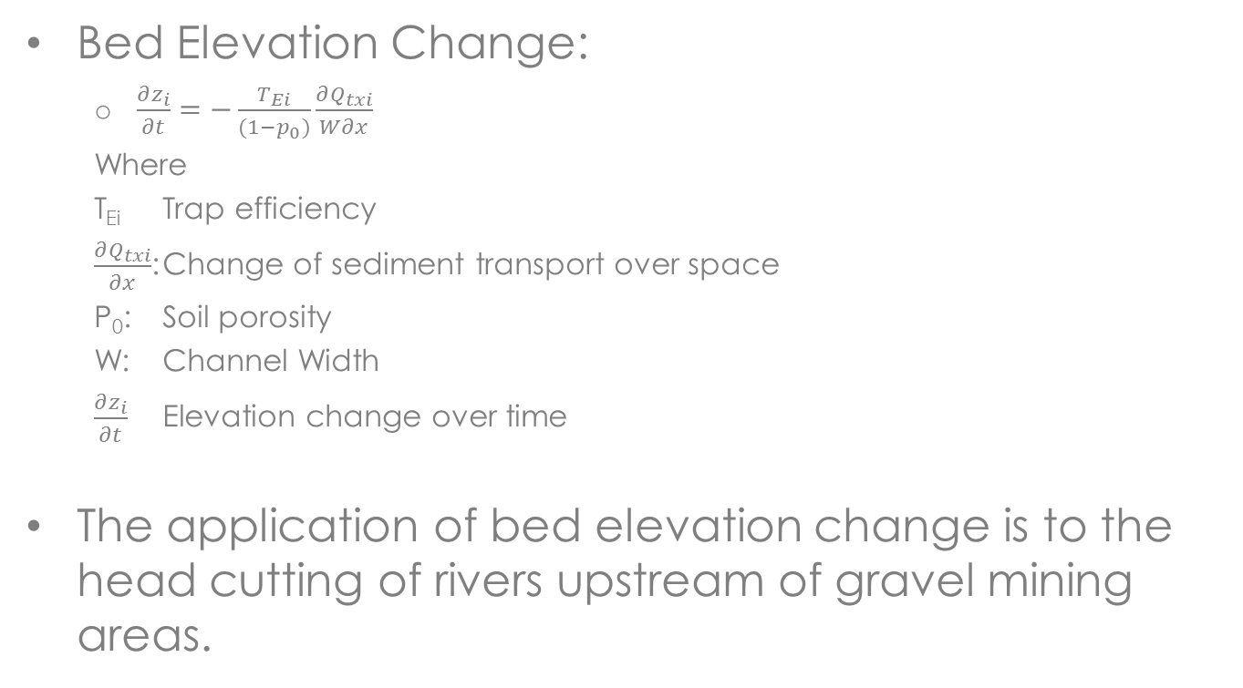
Governing Equations

Slide 10
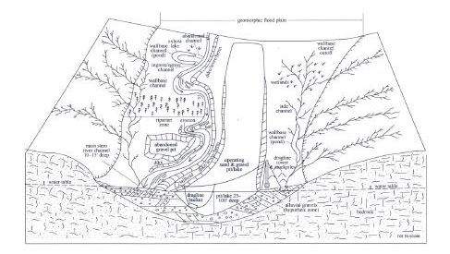
Gravel Mining Operations
In the United States, gravel excavation of rivers and their floodplains occurs in most States
The dragline excavation of floodplains opens such areas for the commercial production of gravels for mining.
Uses for gravels include heavy construction and development.
Obvious impacts are the environmental degradation and compromise to riverbed and riverbank stability.
Dragline excavated floodplain for gravel mining, courtesy: Norman et al. 1998 in Kondolf et al. 2001

Slide 11
Gravel Mining Operations
Operations include the wet excavation of riverbeds for gravels and the dry pumped excavation of floodplains.
The advantage in the later method is the ease of excavation, whereas the pumping comes at a cost as well.
Gravel mining operations on Wynoochee River being excavated by dragline, Courtesy: Kondolf, 1994

Slide 12
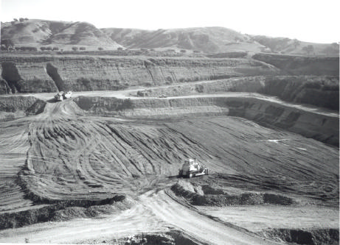
Gravel Mining Operations
The dry pumping of floodplains allows for an ease of excavation and a general area for which gravel mining is allowed. Floodplain excavation should also consider the effects of impacts to floodway design when excavating for protection of the river corridor.
Gravel pit dewatered by pumping, Alameda Creek at Sunol, California (Courtesy: Kondolf, 1990).

Slide 13
Design Methods
Grade Control Structures to prevent excessive head cutting
Rip-Rap bank protection to prevent erosion to bank due to the excavation of bed material
Gualala River, California fly-over, Courtesy: Jamie Hall

Slide 14
Design Methods
A general method for protecting riverbeds from head cutting would be to install a deep footer on a grade control structure which penetrates the depth of head cutting to prevent the undercutting of bridge piers.
Method would protect the upstream area from further head cutting and the infrastructure from damage.

Slide 15
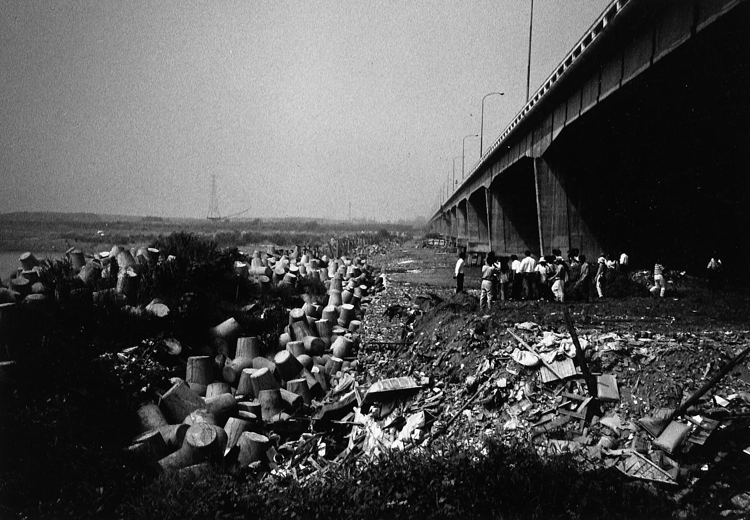
Design Methods
A method similar to the proposed method is used in Taiwan to prevent further head cutting at a bridge upstream of a large gravel mining area. The use of large cinderblocks is used to prevent incision of the channel.

Slide 16
Gravel Mining Effects
Adapted from Kondolf and Matthews, 1991

Slide 17
Geomorphic Impact
Gravel mining:
Changes the sediment budget
Decreases the sediment supply to the downstream reach which impacts channel form and stability
Lowers the water table
Increases lateral migration
Increases bank erosion
Potential damage to infrastructure
Increases turbidity
Increases channel incision
Increases bed armoring
Decreases beach sediment
Mitigation
Replenish gravel to increase sediment supply
Extract a “safe sustainable yield”
Install structures to suspend headcutting
Recycle aggregates

Slide 18
Environmental Impact
Gravel mining:
Increases stream temperature
Reduces dissolved oxygen
Degrades riparian habitat through bank vegetation removal
Causes clogging and damage of fish gills due to increased suspended sediment
Reduces woody debris loading which provides cover for fish
Mitigation
Improve the geomorphic processes
Change gravel pit design (flatter sloping banks, irregular shorelines) to improve wildlife habitat after decommissioning
Revegetate stream banks to increase bank stability

Slide 19
Conclusions
Protection of rivers through engineering methods including grade control and riverbank stabilization ensure that impacts of gravel mining are mitigated in the gravel mining process.
Extraction of gravel and sand from rivers cuts off the sediment supply which degrades the channel stability and habitat functions
Gravel and sand are nonrenewable resources in the context of rivers since they alter the sediment balance of the system
Gravel mining effect can be mitigated mainly through geomorphic processes

Slide 20
References
Femmer, S.R. (2002). Instream Gravel Mining and Related Issues in Southern Missouri. United States Geological Survey, Rolla, USA.
Friends of the Gualala River. (n.d.) “Gravel Mining in the Gualala River”. http://www.gualalariver.org/river/gravel-mining.html
Julien, P.Y. (2010). Erosion and Sedimentation. Cambridge University Press, Cambridge, UK.
Julien, P.Y. (2002) River Mechanics, Cambridge University Press, Cambridge, UK.
Knighton, D. (1998). Fluvial Forms and Processes: A New Perspective. Hodder Education, London, UK.
Kondolf, G.M. (1997). Hungry Water: Effects of Dams and Gravel Mining on River Channels. Environmental Management 21:4 p. 533-551
Kondolf, G.M., Matthews, W.V.G. (1991). Management of Coarse Sediment in Regulated Rivers of California. Technical Completion Reports, University of California Water Resources Center, Berkeley, USA.
Kondolf, G.M., Smeltzer, M., Kimball, L. (2001). Freshwater Gravel Mining and Dredging Issues. University of California, Berkeley, USA.
North Carolina Chapter of the American Fisheries Society. (2002). Position Paper on Instream Sand and Gravel Mining Activities in North Carolina.

