Slide 1
Weirs and Canal Intakes
By: Nell Kolden and Taylor Barnett
Thursday April 12, 2012
CIVE 717

Slide 2
Weirs and Canal Intakes
Objectives
  To divert water from main canal into secondary canals
  To help maintain a more uniform flow rate over long periods of time
  To measure flow rates
  To maintain a constant minimum flow depth
  To control grade of river

Slide 3
Weirs and Canal Intakes
Main Types of Weirs
  Sharp Crested Weir
  Broad Crested Weir
  V-Notch Weir
Main Types of Canal Intakes
  Lateral Intake
  Bottom Intake
  Overhead Intake (Inlets in piers are used for water intake)

Slide 4
Weirs and Canal Intakes
Lateral Intake with damming
  Uses a Weir or similar hydraulic control structure to maintain a minimum stage
  Allows the off take structure to continue operating regardless of river conditions
  Harder to design and build than a lateral intake without damming
  Will have a higher environmental impact than a lateral intake without damming

Slide 5
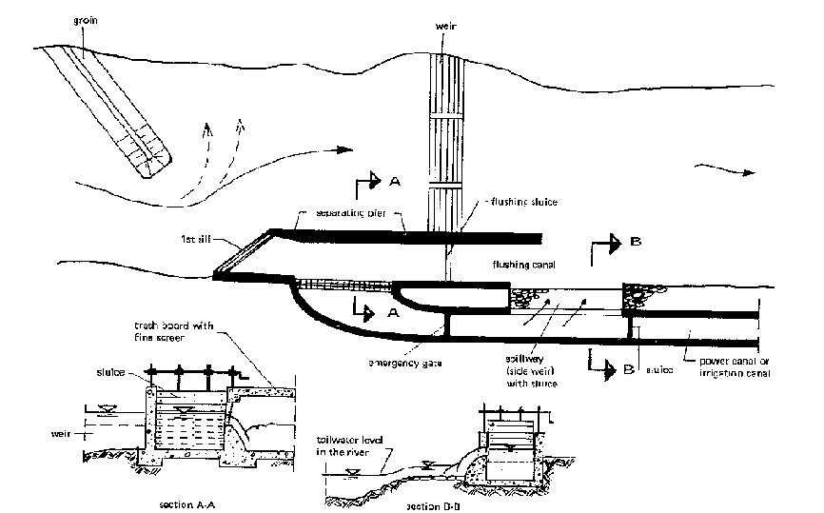
Weirs and Canal Intakes
Example of a lateral intake with damming

Slide 6
Weirs and Canal Intakes
Lateral Intake without damming
  Off take flow rate is limited to 1 or 2 cms assuming 2cms<<Q_{river}
  Off take flow rate is directly tied to river flow rate since there is no check structure to ensure a minimum river stage
  Avoids generating backwater and is cheaper to construct

Slide 7
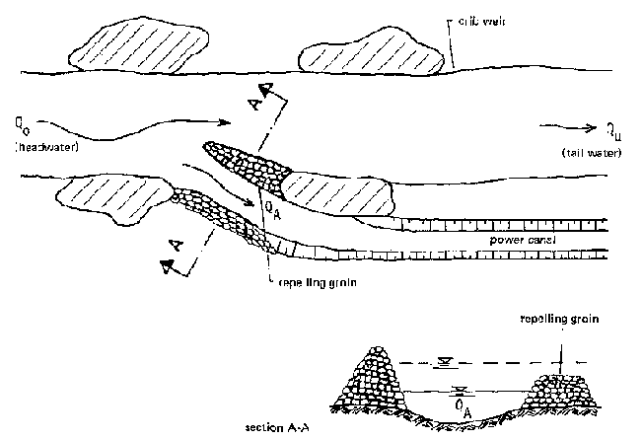
Weirs and Canal Intakes
Example of a lateral intake without damming

Slide 8
Weirs and Canal Intakes
Bottom Intakes
  Also known as Tyrolean Intakes
  Water is diverted from river using a collection canal perpendicular to the river and covered with a screen
  Particles and debris larger than the screen are washed downstream
  Flow rate in off take canal will always be at maximum so this is best suited for power production

Slide 9


Weirs and Canal Intakes
Sharp Crested Weirs
  Considered to be a sharp crested weir when , where y₁ is the upstream flow depth above the weir, and l is the weir length
  Can be used as check structure or to measure flow rates
  If used to measure flow rates:
  Where H₁ is the total energy upstream of the weir
  The weir is considered submerged if
  If the weir is submerged the discharge
  equation is multiplied by f(S)

Slide 10



Weirs and Canal Intakes
Broad Crested Weirs
  Considered to be a broad crested weir when , where H₁ is the upstream total energy above the weir, and l is the weir length
  Can be used as check structure or to measure flow rates
  If used to measure flow rates:
  Where H₁ is the total energy upstream of the weir
  The weir is considered submerged if
  If the weir is submerged the discharge
  equation is multiplied by f(S)

Slide 11
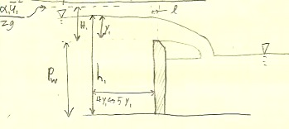
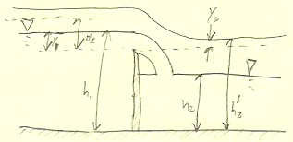
Weirs and Canal Intakes
Sharp Crested Example Un-submerged
Sharp Crested Example Submerged

Slide 12
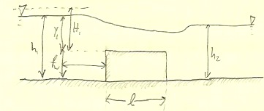
Weirs and Canal Intakes
Broad Crested Weir Example

Slide 13
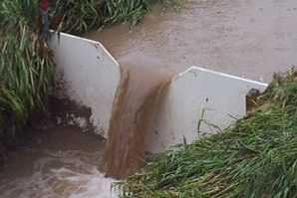
Weirs and Canal Intakes
V-notch weirs
  Found all over the world because construction and installment is very straightforward
  Used primarily as a simple flow measurement device
  A relationship between flow height through the notch and discharge is easily developed and measurable in the field
    Q=(g/2)^{1/2}*y_{c}^{5/2}
      Where: Q is discharge, g is gravity, and y_{c} is the height of the water through the notch
V-notch weir used for flow measurement

Slide 14
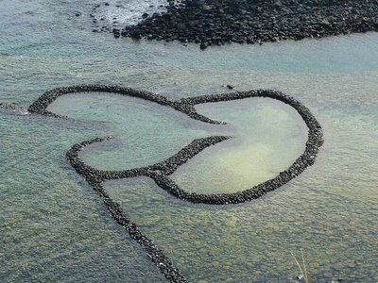
Weirs and Canal Intakes
Weirs can also be used to improve fishing conditions
  Fishing weirs found all over the world, some are very simple and some involve complex engineering
  Backup of water upstream of weir creates a holding place for fish
Fishing weir used to trap fish in a bay near Taiwan

Slide 15
Weirs and Canal Intakes
Bendway weirs are used to redirect flow in meander bends in rivers
The objective of the bendway weirs is to improve navigation through tight bends.
Usually angled 20°-30° upstream
The weirs are low enough that ships can pass even in low flow
They are high enough so that they significantly control near-bed velocities and redirect near-bed streamlines
Built in sets of approximately 4-14 weirs per bend

Slide 16
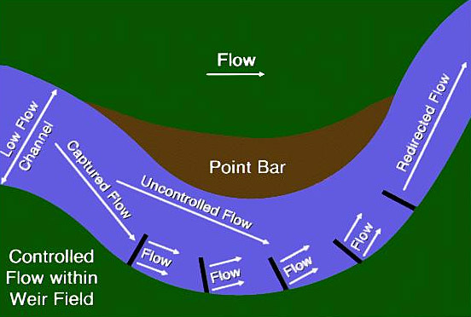
Weirs and Canal Intakes
Bendway Weir:

Slide 17
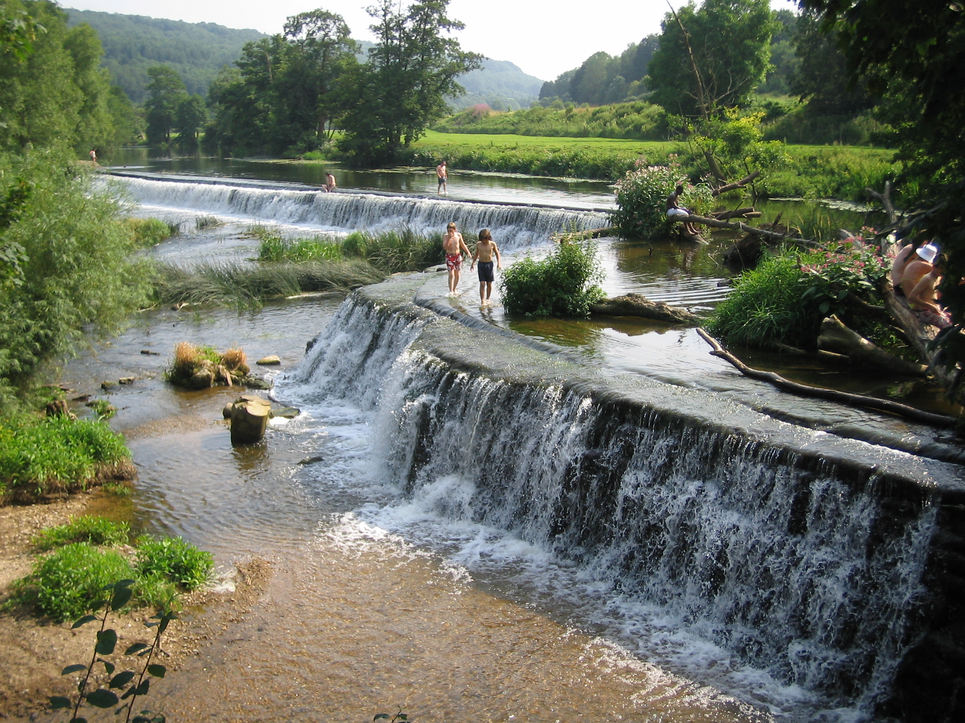
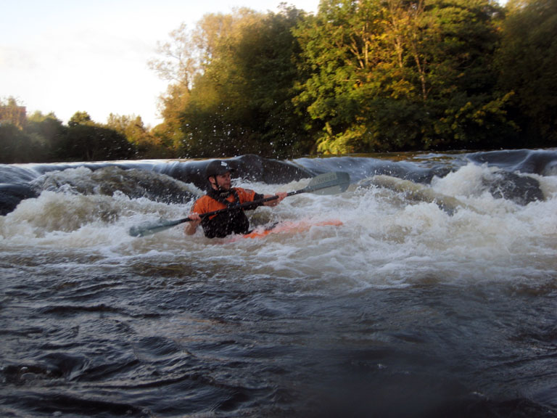
Weirs and Canal Intakes
Recreational uses:
  Weirs are often built to create pools for swimming and recreation
  The water drop created by a weir on the downstream side can be used for boating and tubing
Swimmers enjoying the pools created by a weir
Kayaker surfing downstream of a weir

Slide 18
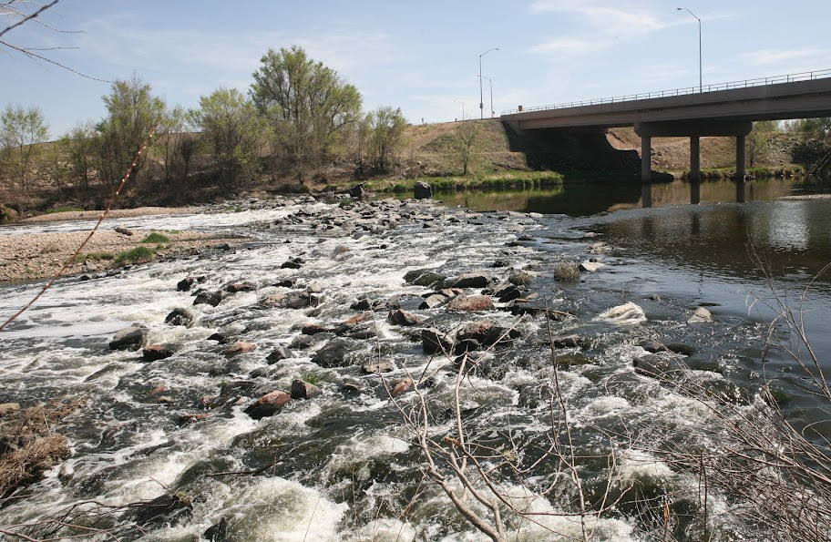
Weirs and Canal Intakes
Habitat considerations:
  A large drop off the downstream edge of a weir can create a barrier to upstream fish passage
  Weirs can be built so that they maintain or enhance fish habitat
  Rock ramps on the downstream end of weirs create riffle habitat instead of a small waterfall
This weir on the South Platte creates a backwater condition to slow velocities and prevent bridge pool scour, but also creates riffle habitat and does not impede upstream fish passage

Slide 19
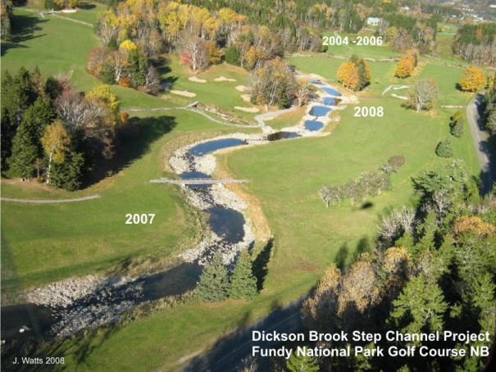
Weirs and Canal Intakes
One type of habitat-enhancing weir is a Newbury Riffle
Newbury Riffles are installed as a combination grade control structure/habitat improvement
The weir backs up water into a pool, and the riffle maintains fish passage
Series of Newbury Riffles

Slide 20
Weirs and Canal Intakes
Weir Construction:
  One simple way to construct a weir is to use sheet piles driven into the river bed to a depth 2-3 times the maximum scour rate
  Regardless of the construction material, the sides of the weir must be tied into the banks with riprap or sheet pile to keep the water from getting around the weir
  For weirs with ramps on the downstream side, rocks must be placed carefully to maintain desired slope over backside of weir
  When multiple weirs are used for grade control, they must be constructed so that the energy slope in between structures matches that needed for sediment control

Slide 21
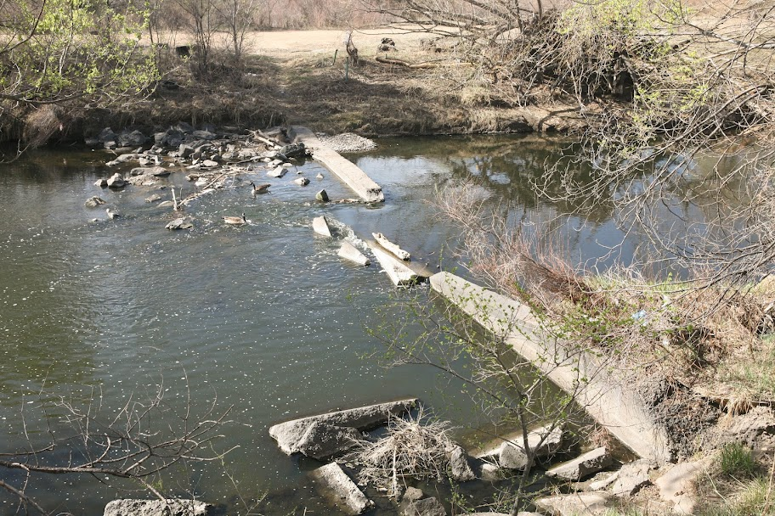
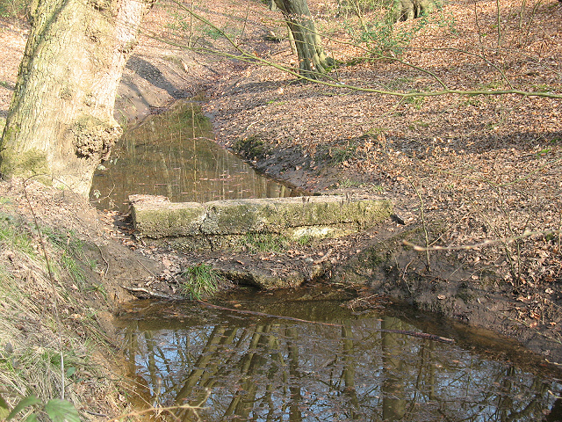
Weirs and Canal Intakes
Weir Failures:
  When weirs are not adequately constructed or not tied back into the bank, failure can occur
  Failed weirs can cause dangerous situations for animals, navigation, and recreation
Failed concrete weir on Clear Creek
Weir lacking adequate tie-back

Slide 22
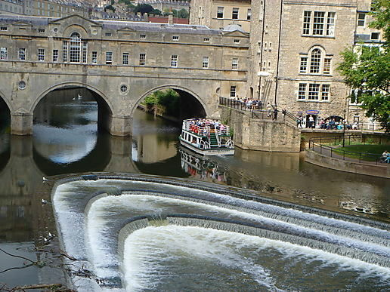
Weirs and Canal Intakes
Conclusions:
  Weirs and Canal Intakes have a huge range of uses and designs
  They must be designed properly so that they function as intended
The triple weir on the Avon River in Bath (There is a lock on the right side to allow for navigation)

