Slide 1
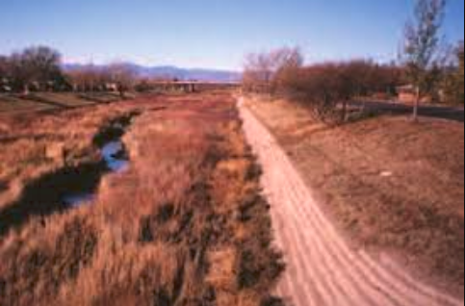
Soil Cement
Sydney D.
CIVE 717 – River Mechanics
Spring 2019
(Portland Cement Association)

Slide 2
Overview
Soil cement is a mixture of existing on-site soil with small amounts of cement and water
It is much harder than regular soil and can be used for various water resources projects including:
Embankment protection
Dikes
Levees
Channels
(Texas Department of Transportation)

Slide 3
Where is soil cement a good fit?
Effective in arid areas with minimal freeze-thaw cycles
Requires well-drained sandy soils without vegetation
It has been used extensively throughout the Southwest and Central US
Rillito River in Tucson, AZ (Jane St Clair)

Slide 4
Design Considerations - Materials
Cement should be 8-15% of total mixture
Soil must be easily pulverized and contain between 5-35% silt and clay
If velocities exceed 6-8 ft/s, aggregates must contain at least 30% gravel particles
Bonny Reservoir, CO (USBR)

Slide 5
Design considerations - Placement
Slope must be no steeper than 1V:2H
Best results no greater than 1V:3H
Stairstep method recommended for steep embankments
Typically: 6-9 ft wide x 6 in thick
Seven day curing period
Sheep’s-foot roller
Plating method recommended if steepness is not an issue
single layer of soil cement
Lane City Reservoir in Wharton, TX (allevents)

Slide 6
Failure Concerns
Failure can happen through:
Undercutting – if seepage concerns are an issue
Scour – if somewhere with fast velocities or high shear
Loss of support – if soil cement is not placed far enough into ground
Salt River, AZ (Hansen)

Slide 7
Factors to consider
Disadvantages
Advantages
Impermeability
Low Strength
Susceptibility to cold temperature variations
Cannot be built in adverse conditions
Requires more skilled labor to build in comparison to alternatives like riprap
Can be cheaper than riprap if riprap material is not available in nearby area or is expensive to transport in
Can be constructed with local materials
Design and construction much easier than traditional concrete structures

Slide 8
Sources
Richards, Dennis L., Hadley, Hans R., Soil-Cement Guide for Water Resources Applications, EB203.01, Portland Cement Association, Skokie, Illinois, 84 pages.
Hansen, Kenneth D., Ricahrds, Dennis L., and Krebs, Mark E., Performance of Flood-Tested Soil-Cement Protected Levees, 2011.
Julien, Pierre Y., River Mechanics, Cambridge University Press, 2018, pp. 242.
Kiene, Allen H., Engemoen, William O., Dewey, Robert L., and McDaniel, Thomas N., Design Stanards No. 13 Embankment Dams, Chapter 17: Soil-Cement Slope Projection, 2013.

