Slide 1
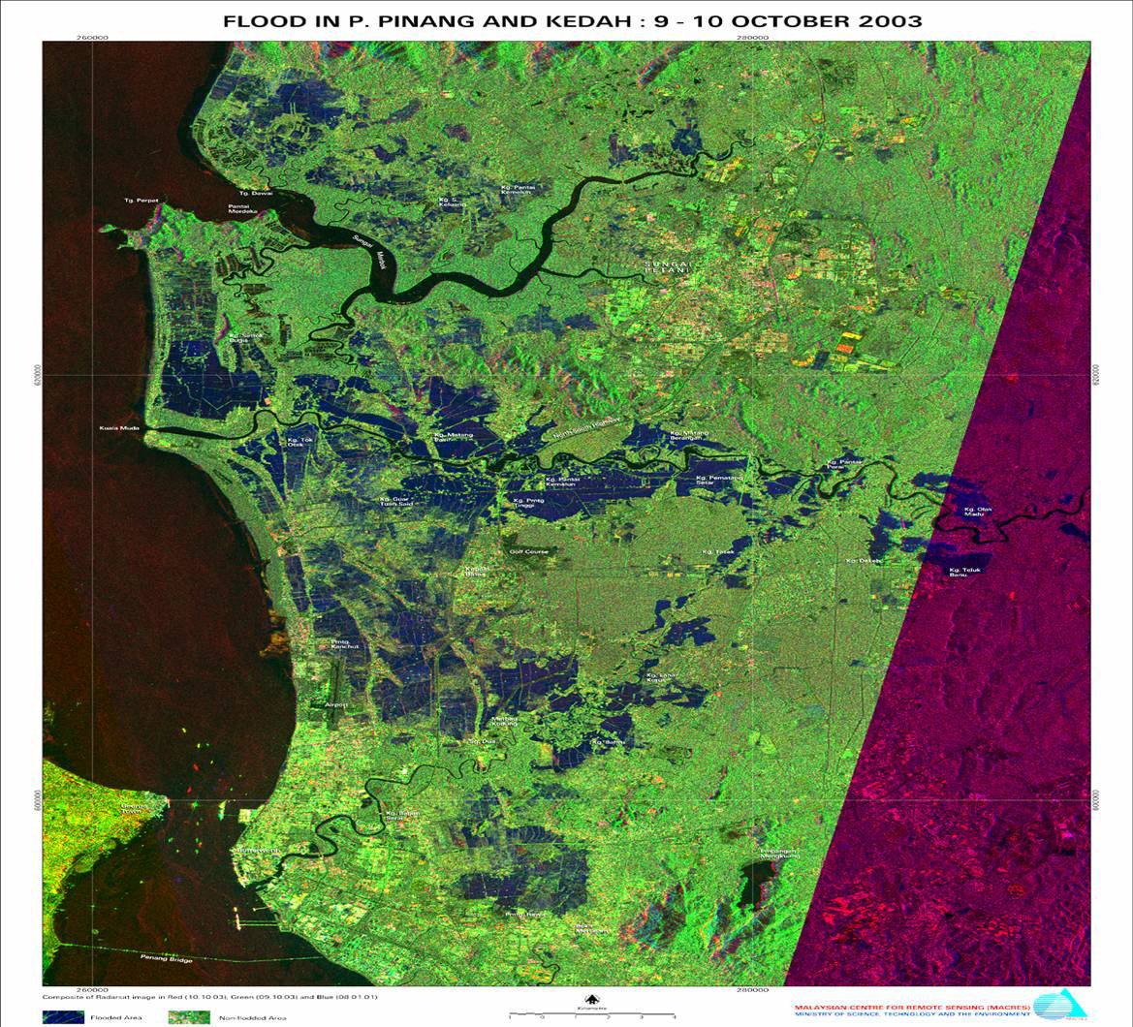
Analysis of Extreme Floods in Malaysia
Pierre Y. Julien
Colorado State University
International Symposium on Flood Research and Management 2014
ISFRAM 2014
Sabah, Borneo
September 28-October 1, 2014

Slide 2
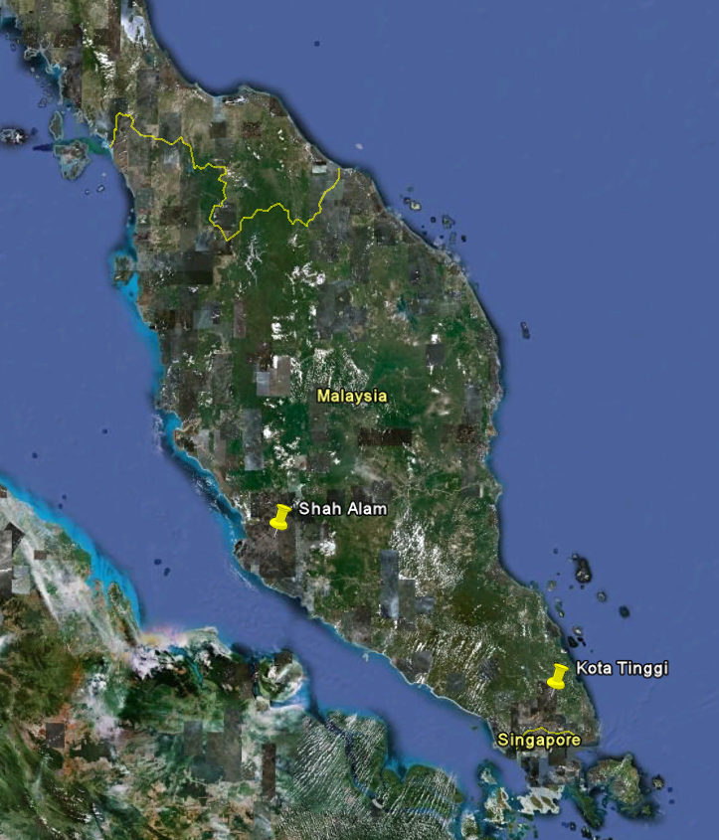
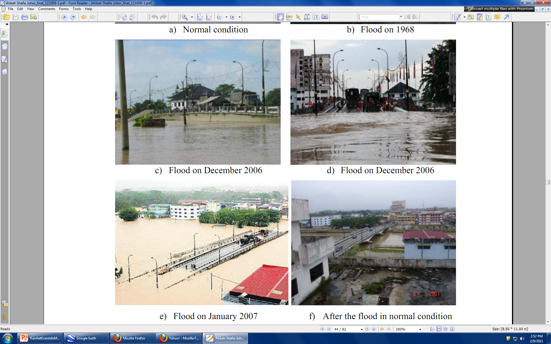
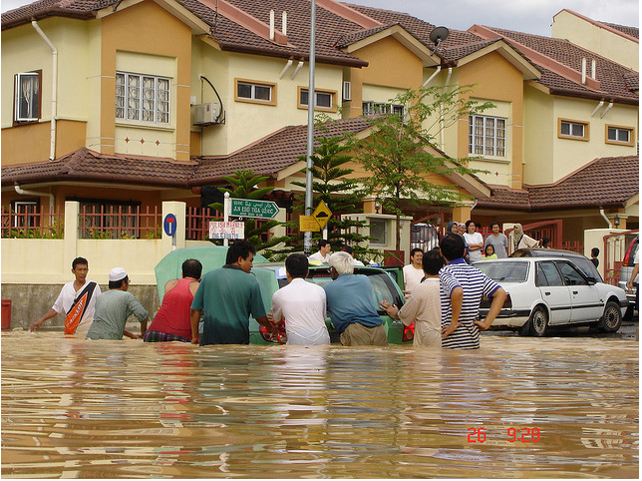
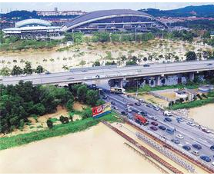
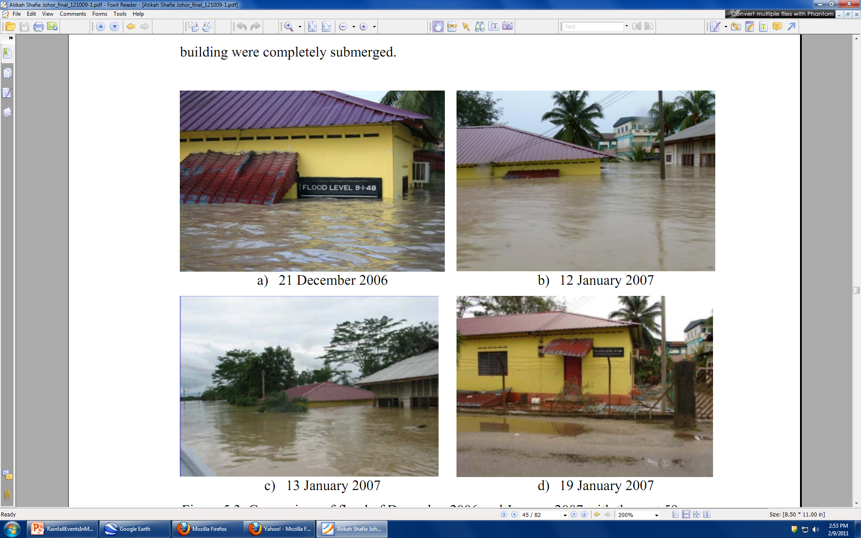
Floods in Malaysia (2006/2007)

Slide 3
Flooding in Peninsular Malaysia from 2007 to 2012
YEAR | STATES | NOTE | SOURCES
2007 | Johor, Pahang, Kuala Lumpur, Kedah, Negeri Sembilan, Kelantan | RM 1.2 Billion (USD 400 Million) 260,000 people were evacuated from more than 40,000 families | Shafie (2009); MMD (2007)
2008 | Negeri Sembilan, Kuala Lumpur, Pulau Pinang, Kelantan, Terengganu, Pahang | Major roads effected Landslide Over 6,000 people evacuated to 40 flood evacuation centers | MMD (2008)
2009 | Kuala Lumpur, Kelantan, Kedah, Selangor, Pahang | Severe traffic congestion Landslide About 60 families were evacuated | MMD (2009)
2010 | Most of the states in Peninsular Malaysia | More than 70,000 people were evacuated Traffic jams and water depth more than 1.0 m | MMD (2010)
2011 | Most of the states in Peninsular Malaysia | More than 70,000 people were evacuated Traffic jams and water depth more than 1.0 m | Taucan et al. (2011); Utusan (2011); Maslih et al. (2011); Ismail (2011); Abdullah (2011); Md.-Noor (2011); Mohd and Perimbanayagam (2011)
2012 | Most of the states in Peninsular Malaysia | More than 5,000 people were evacuated and 600 houses were submerged Water depth approximately reached 2.0 m at most of the places | Utusan (2012); Jamaluddin and Hassan (2012); Maslih (2012); Sinyang (2012); Wan-Alias (2012); Cameons and Wong (2012); myMetro (2012); Md.-Noor (2012)

Slide 4
Extreme Floods in Malaysia
Extreme Rainfall Precipitation
Extreme Flood Modeling
Kota Tinggi Flood
Muda River Flood
River Management Manual
Notes:
4

Slide 5
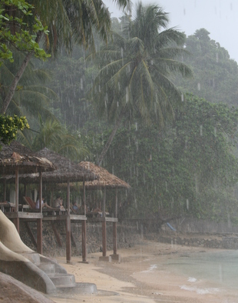
Rainfall Events in Malaysia
Malaysia receives between 2000 and 4000 mm of rainfall per year

Slide 6

CDF for Subang Station
From Shazwani Nur Muhammad

Slide 7
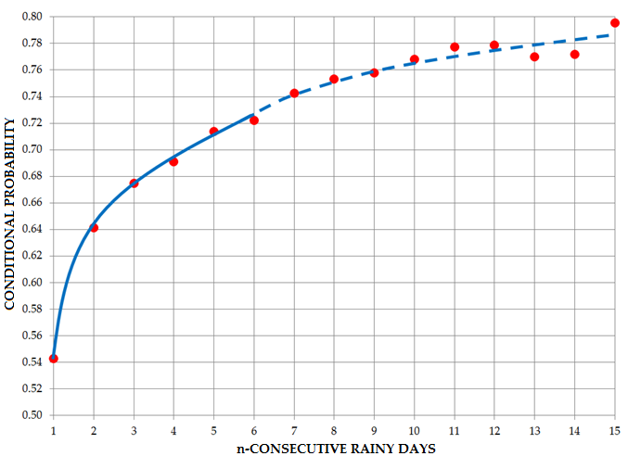

Conditional Probability of Multi-Day Rainfall Events at Subang Station
From Shazwani Nur Muhammad

Slide 8
Return Period Curves from Measured & Improved Probability Structure
From Shazwani Nur Muhammad

Slide 9
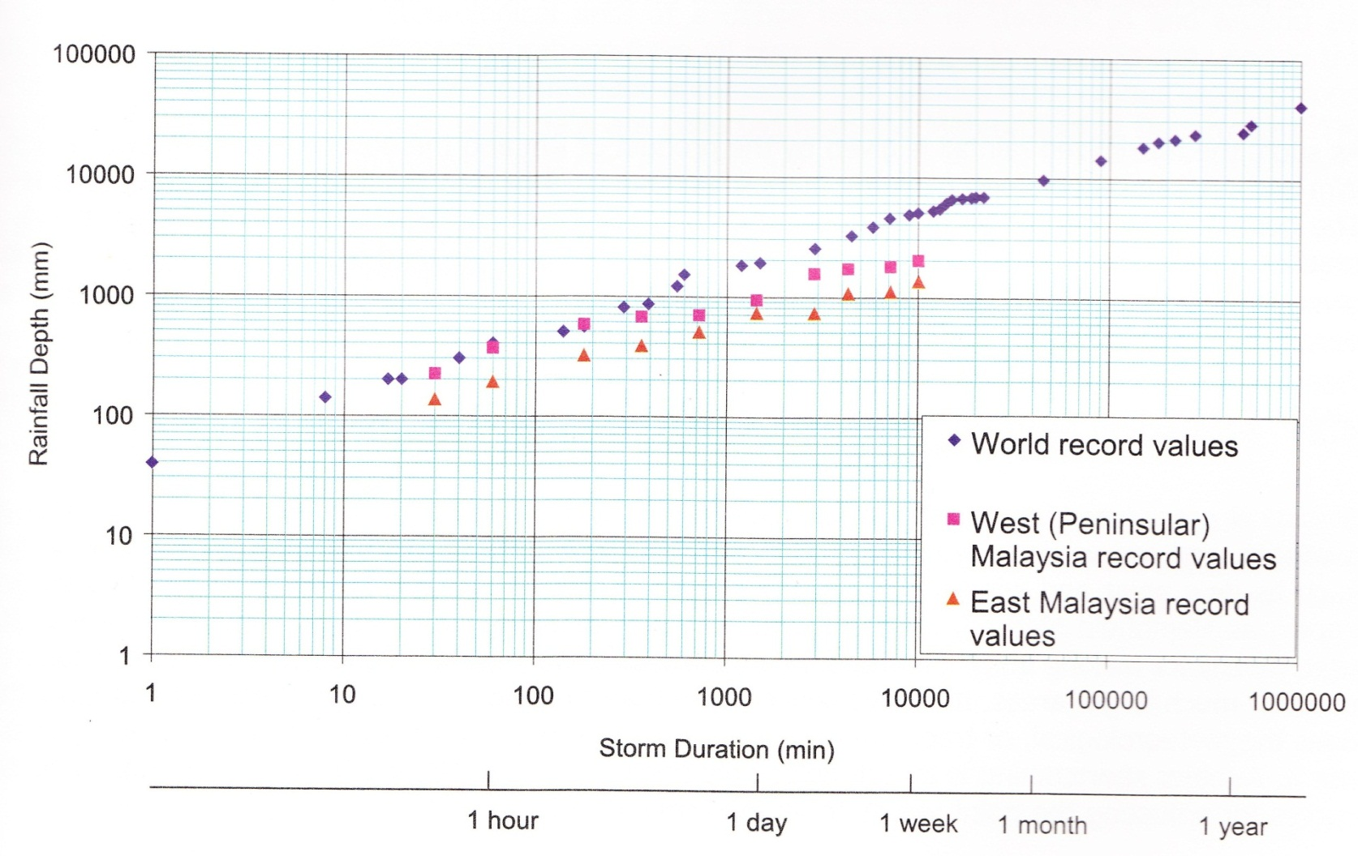
Extreme Rainfall Events

Slide 10
Extreme Floods in Malaysia
Extreme Rainfall Precipitation
Extreme Flood Modeling
Kota Tinggi Flood
Muda River Flood
River Management Manual
Notes:
10

Slide 11
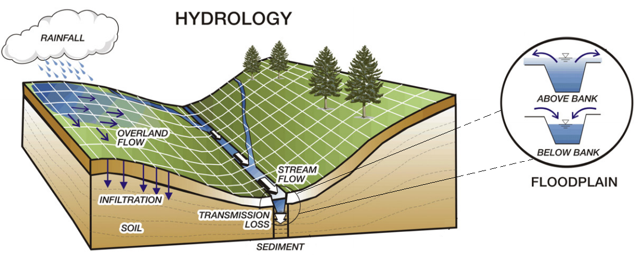
TREX model (Hydrological model)
Hydrological sub-models are:
  Rainfall and interception
  Depression storage and infiltration
  Overland flow routing (2D diffusive wave approximation)
  Channel flow (1D diffusive wave approximation)
11

Slide 12
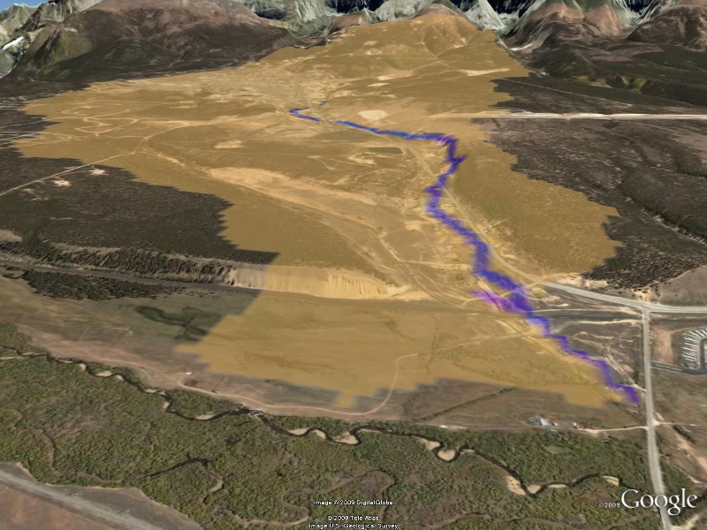
TREX Model California Gulch near Leadville, Colorado
12
Notes:
12
12

Slide 13
Extreme Floods in Malaysia
Extreme Rainfall Precipitation
Extreme Flood Modeling
Kota Tinggi Flood
Muda River Flood
River Management Manual
Notes:
13

Slide 14
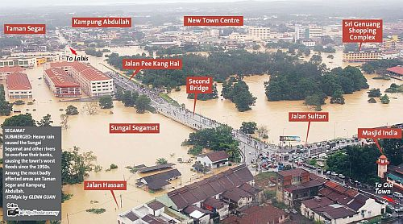

Slide 15
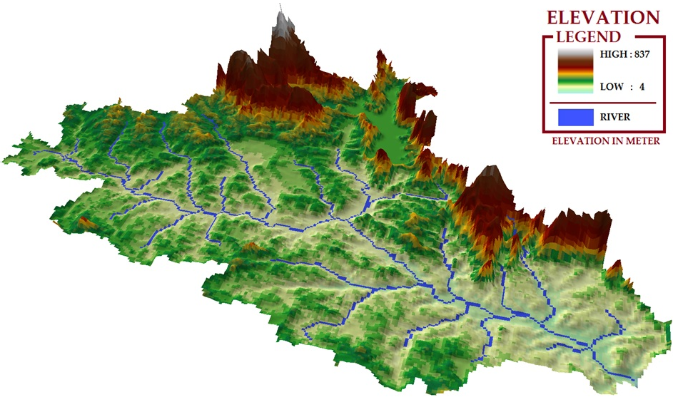
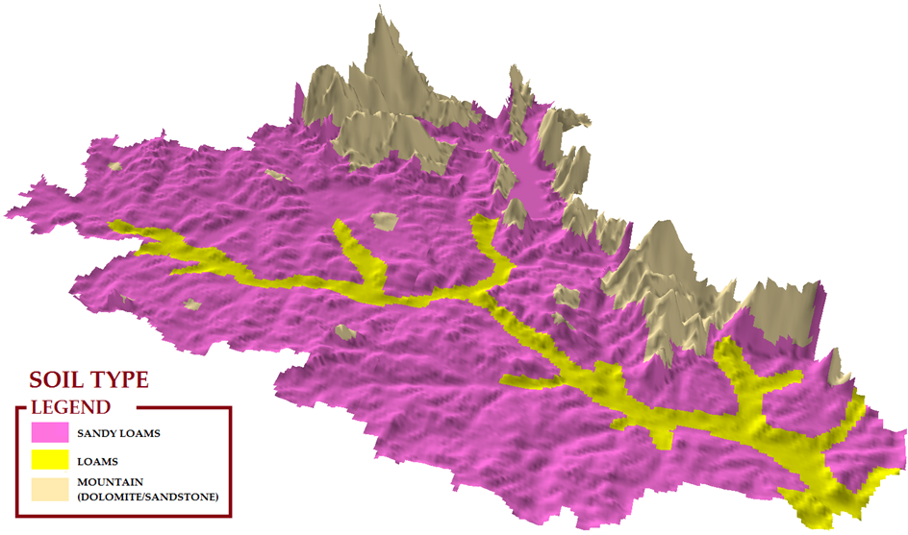
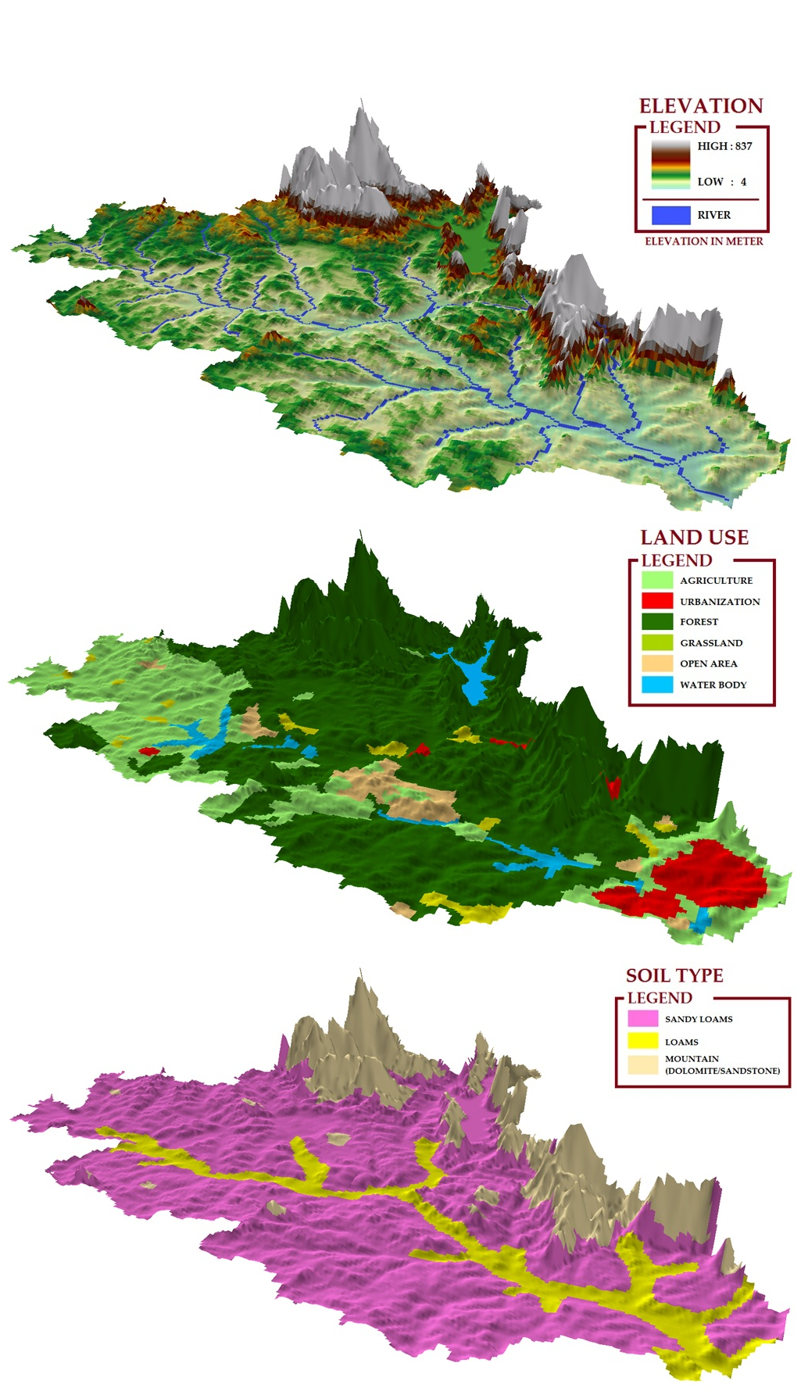
22
Modeling set-up
From GIS
GIS – watershed delineation
Area : 1,635 sq. km
Grid size : 230 x 230 m
River length : 250 km
Active grid: 30,000
From Jazuri Abdullah

Slide 16
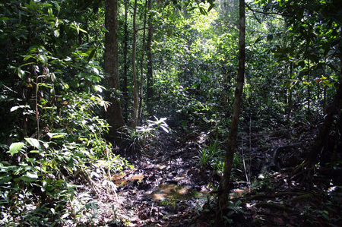
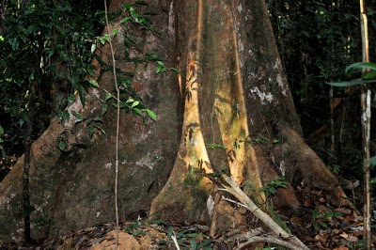
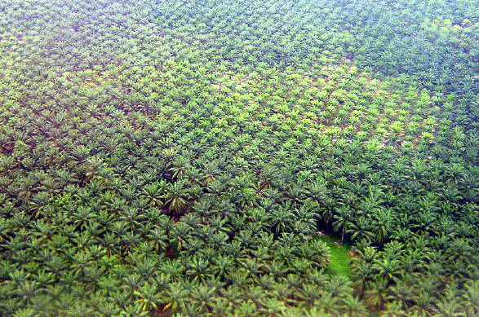
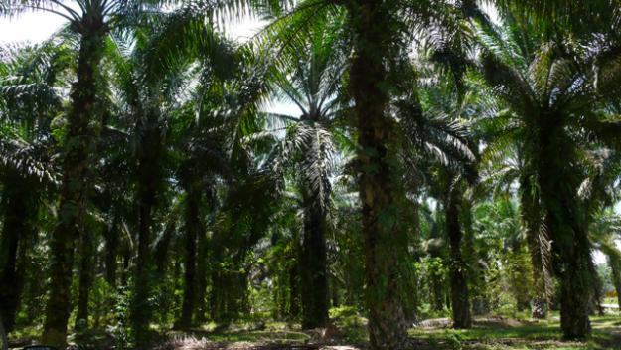
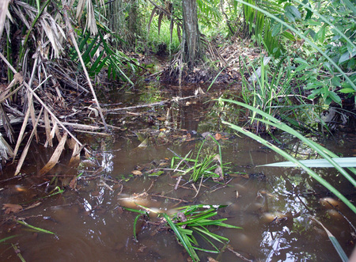
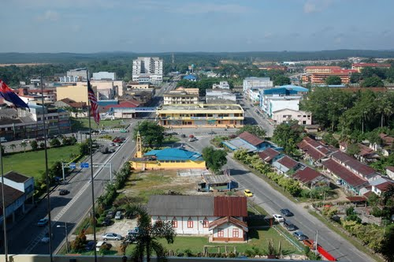
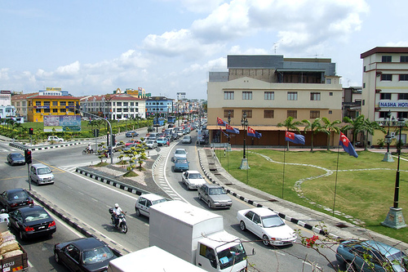
TROPICAL RAIN FOREST
PLANTATION
(OIL PALM)
URBANIZATION
23
From Jazuri Abdullah

Slide 17
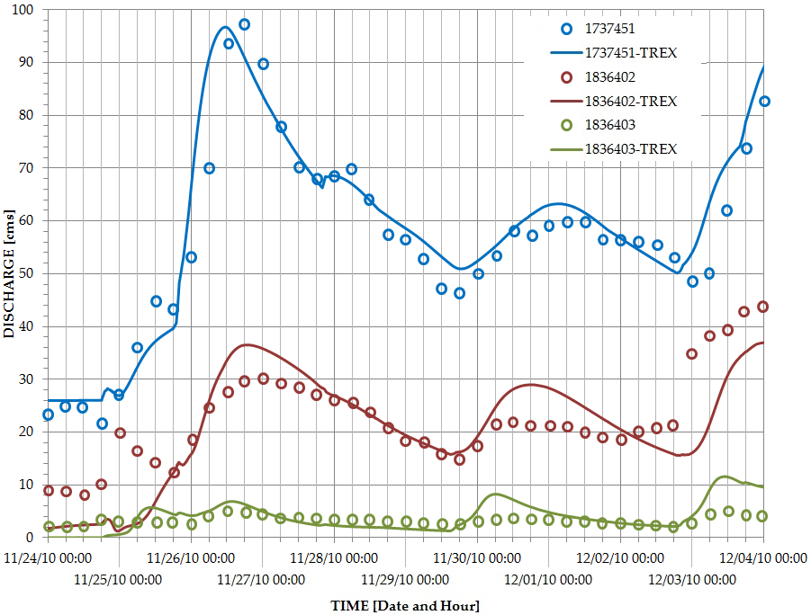
CALIBRATION
GRAPHICAL METHOD
27

Slide 18
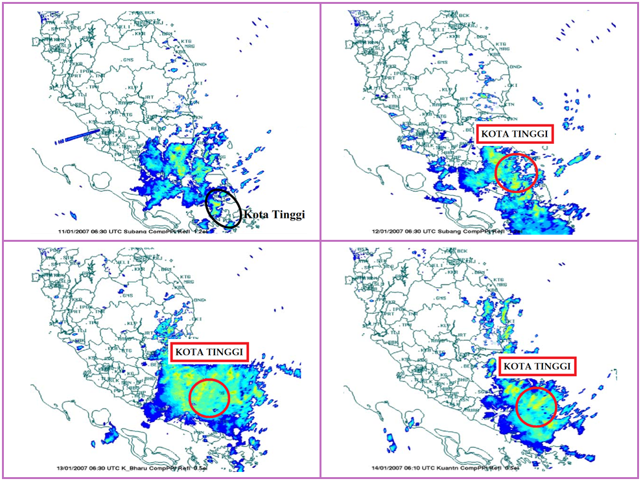

SATELLITE IMAGES – RAINFALL AT KOTA TINGGI
JANUARY 11, 2007
JANUARY 12, 2007
SOURCE: SHAFIE (2009)
33
JANUARY 13, 2007
JANUARY 14, 2007

Slide 19
Rainfall near Kota Tinggi
Date | Layang-Layang | Ulu Sebol | Bukit Besar | Kota Tinggi
December 2006
17-Dec | 66 mm | 33 mm | 29 mm | 48 mm
18-Dec | 52 mm | 23 mm | 47 mm | 43 mm
19-Dec | 156 mm | 189 mm | 200 mm | 161 mm
20-Dec | 73 mm | 78 mm | 69 mm | 39 mm
4 days total | 367 mm | 353 mm | 345 mm | 287 mm
January 2007
11-Jan | 145 mm | 124 mm | 147 mm | 167 mm
12-Jan | 135 mm | 290 mm | 234 mm | 122 mm
13-Jan | 84 mm | 76 mm | 42 mm | 49 mm
14-Jan | 20 mm | 44 mm | 35 mm | -
4 days total | 384 mm | 534 mm | 458 mm | 338 mm

Slide 20
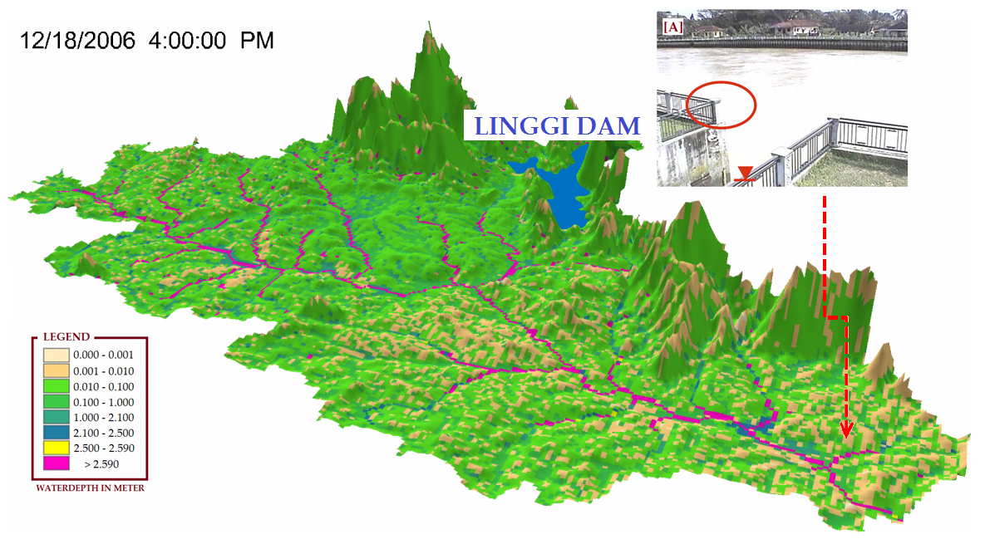
KOTA TINGGI FLOOD
DEC. 18, 2006

Slide 21
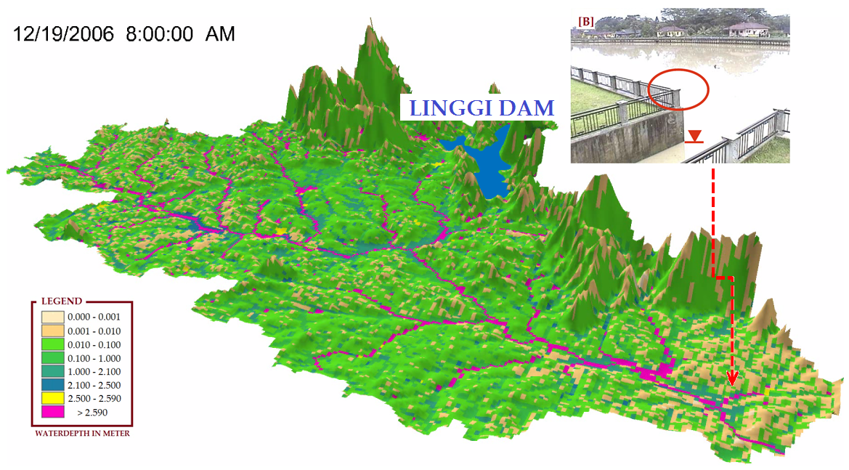
KOTA TINGGI FLOOD
DEC. 19, 2006

Slide 22
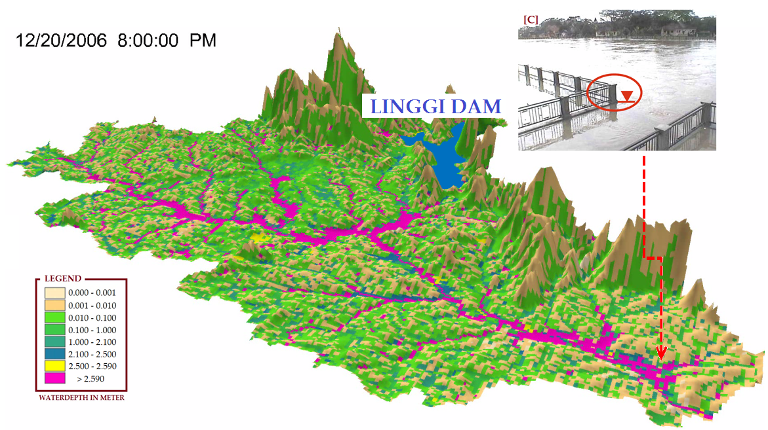
KOTA TINGGI FLOOD
DEC. 20, 2006

Slide 23
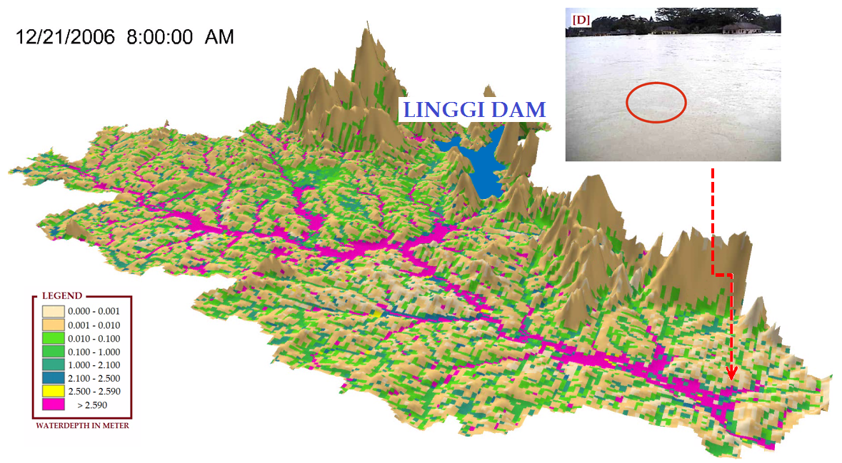
KOTA TINGGI FLOOD
DEC. 21, 2006

Slide 24
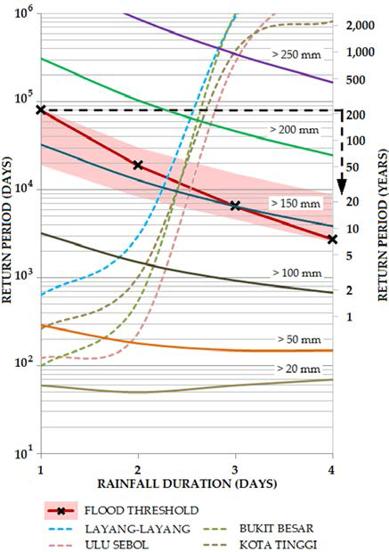

Slide 25
Extreme Floods in Malaysia
Extreme Rainfall Precipitation
Extreme Flood Modeling
Kota Tinggi Flood
Muda River Flood
River Management Manual
Notes:
25

Slide 26
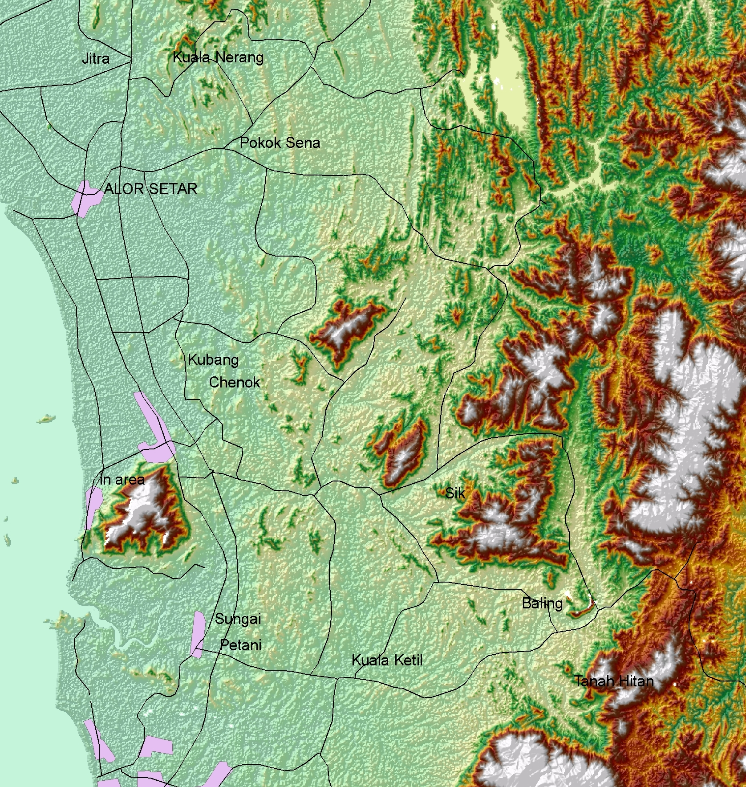
DEM

Slide 27
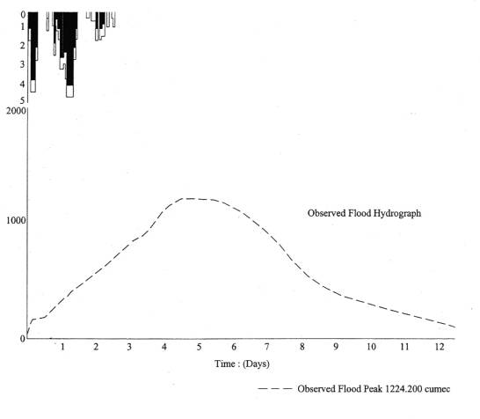
October 1998 Flood
Flood Map
Flood Prone Areas (Oct 1998 Flood)

Slide 28
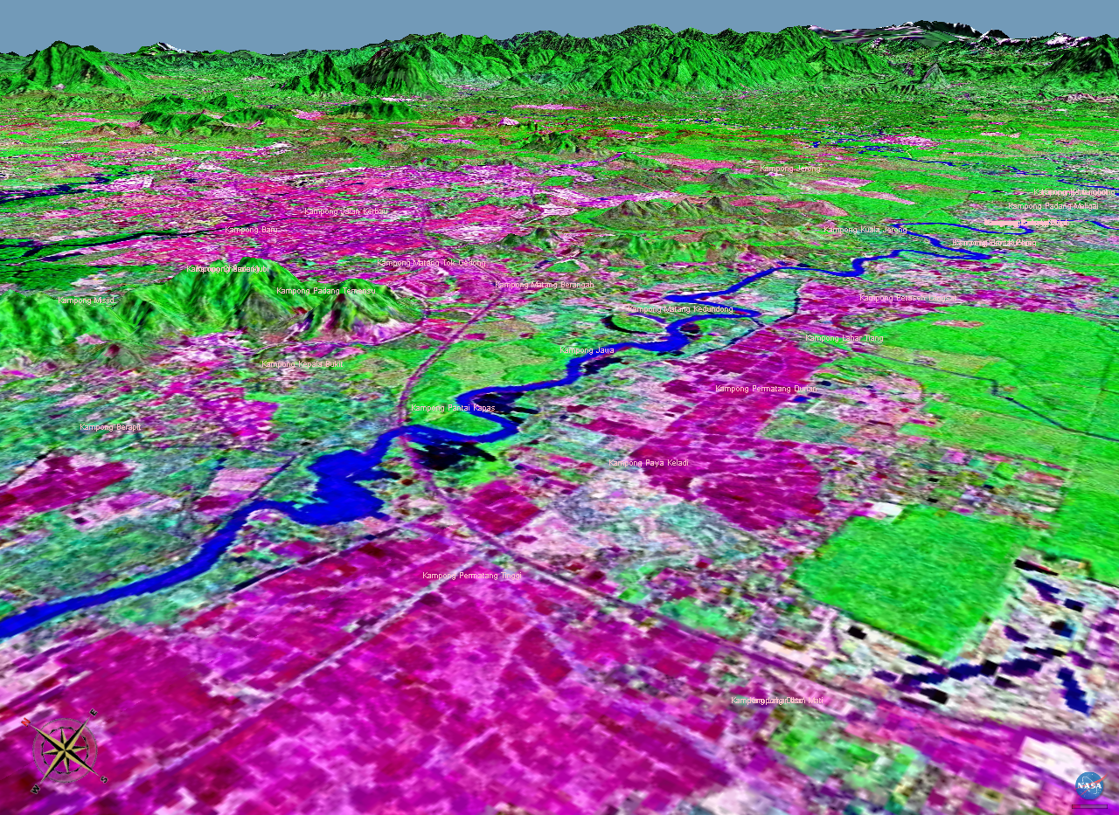
Land Use Data

Slide 29
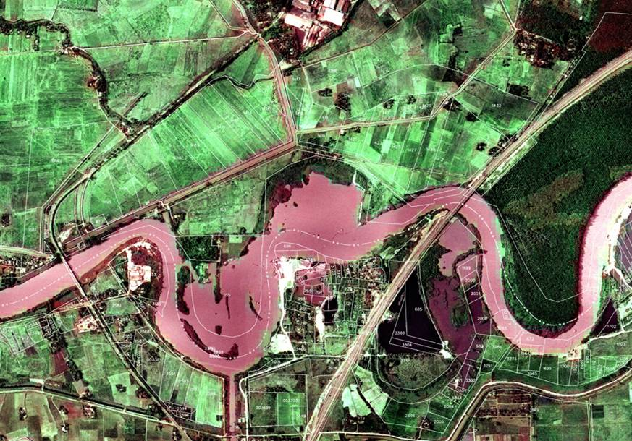
River Corridor
PLUS Highway
KG. BUKIT
LALANG
KG. JAWA
PEKULA
Merdeka Bridge
KG. BUMBUNG LIMA

Slide 30
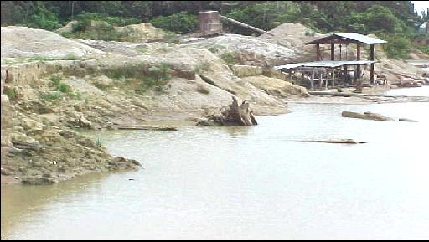
Sand and Gravel Mining
River Sand Mining

Slide 31
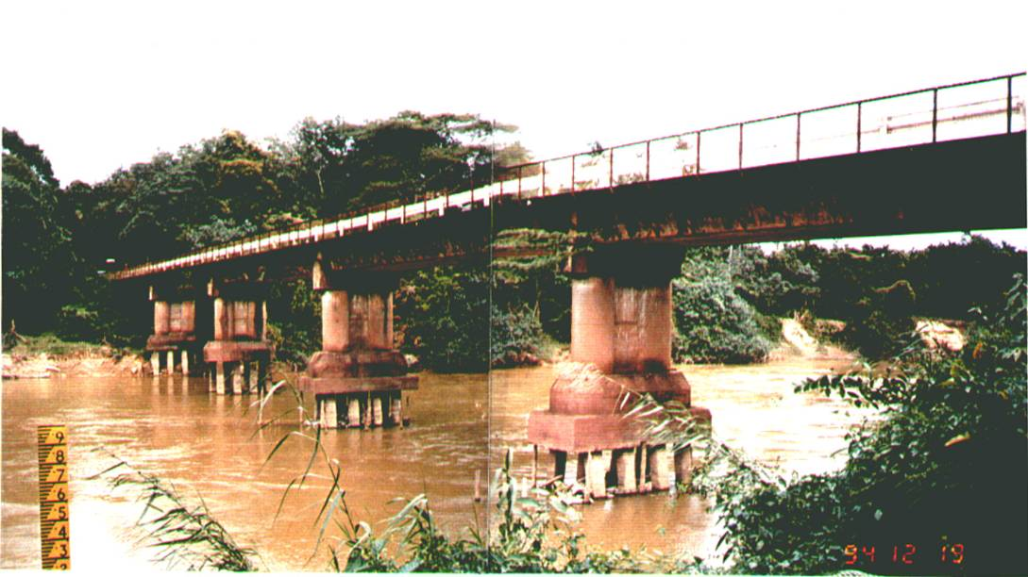
Riverbed Degradation

Slide 32
Extreme Floods in Malaysia
Extreme Rainfall Precipitation
Extreme Flood Modeling
Kota Tinggi Flood
Muda River Flood
River Management Manual
Notes:
32

Slide 33





River Management
Problems and Issues
Flood Control and Dam Safety
Navigation and Transportation
Water Supply
Irrigation and Drainage
Water Quality
Aquatic Habitat
Major Stakeholders
Federal Agencies
State Agencies
Counties and Districts
Cities and Towns
Private Sector/Companies
Public
Laws and Regulations
International Treaties
Water Delivery Compacts
Water Rights
Clean Water Act
Endangered Species Act
National
Technical

Slide 34
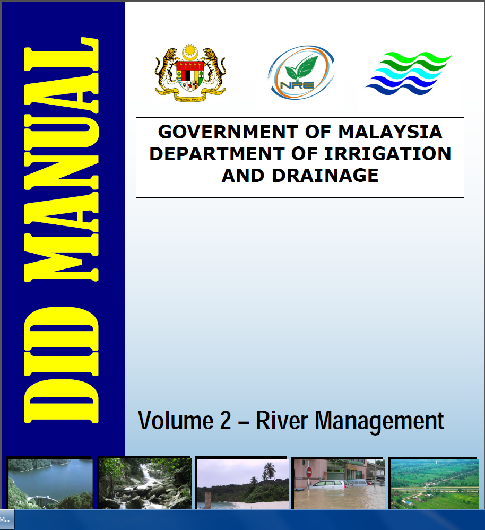

Slide 35
Summary and Conclusions
1. Extreme Rainfall Precipitation
Recent advances in the frequency analysis of multi-day rainfall events
2. Extreme Flood Modeling
Distributed models like TREX can simulate extreme floods
3. Kota Tinggi Flood
Multi-day rainfall precipitation events control floods on large watersheds
4. Muda River Flood
Concept of river corridor and problems associated with gravel mining
5. River Management Manual
Major step towards Integrated River Basin Management
Notes:
35
In my presentation, I will be reviewing the CASC2D-SED model, then, I will apply it to a case study and finally i will present some of the results as a time-series of raster maps.

Slide 36
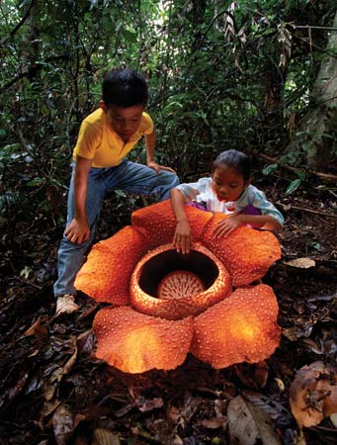

Thank You!
Terima Kasih!
ACKNOWLEDGMENTS
Dato Sahol Hamid Abu Bakar (UiTM, Malaysia)
Dr. Junaidah Ariffin (UiTM, Malaysia)
Dr. N. Azazi Zakaria (USM, Malaysia)
Dr. Aminuddin Ab. Ghani (USM, Malaysia)
Dato A. Fuad Embi (DID, Malaysia)
Atikah Shafie (DID, Malaysia)
Jazuri Abdullah (UiTM and CSU)
Shazwani N. Muhammad (UKM and CSU)
Dr. Wong W. Sam (DNA, Malaysia)
Chop A. Kuang (DNA, Malaysia)
Dr. Lariyah Mohd Sidek (UNITEN, Malaysia)
James Halgren (CSU)
Sangdo An (KICT, South Korea)
Terima Kasih atas Perhatian Anda!
Thank You!

