Slide 1
Sustainable Technology Entrepreneurship for Scientists and Engineers
MECH/AREC 581a2
The Business Plan
March 2, 2011
Rick Turley

Slide 2
The Purpose of a Business Plan
The Reason to Start a Business, Guy Kawasaki
Purpose of a Business Plan, Tom Byers
A Business Plan is a Process
Can take many forms
And serves many “customers”

Slide 3
The Art of the Start
Guy Kawasaki
What is a Business Plan?
  Who has money?
  How are you going to get some of it?

Slide 4
The Art of the Start
Guy Kawasaki
The Art of Writing a Business Plan
  “A business plan is of limited usefulness for a startup because entrepreneurs base some much of their plans on assumptions, ‘visions,’ and unknowns.”
  “However, many investors, recruits, potential board members, and internal decision makers do expect a business plan and won’t proceed without one.”
  “Plus, writing a business plan does have the benefit of forcing a team to work together to formalize intentions.”

Slide 5
Selling your Business Plan
The 10-20-30 Presentation Rule, The Art of the Start
Guy Kawasaki
  http://www.youtube.com/watch?v=liQLdRk0Ziw
    10 Slides
    20 Minutes
    30 Point Font
Don’t be Such a Scientist, Randy Olson
  http://www.youtube.com/watch?v=XjaTDA-9_sk
  http://www.youtube.com/watch?v=tqtfAkeTomU (50 min)
    Don’t be So Cerebral
    Don’t be So Literal Minded
    Don’t be Such a Poor Storyteller
    Don’t be So Unlikable
    Be the Voice of Science!
Made to Stick, Chip & Dan Heath
  http://www.youtube.com/watch?v=2zlld9TA-Vg

Slide 6
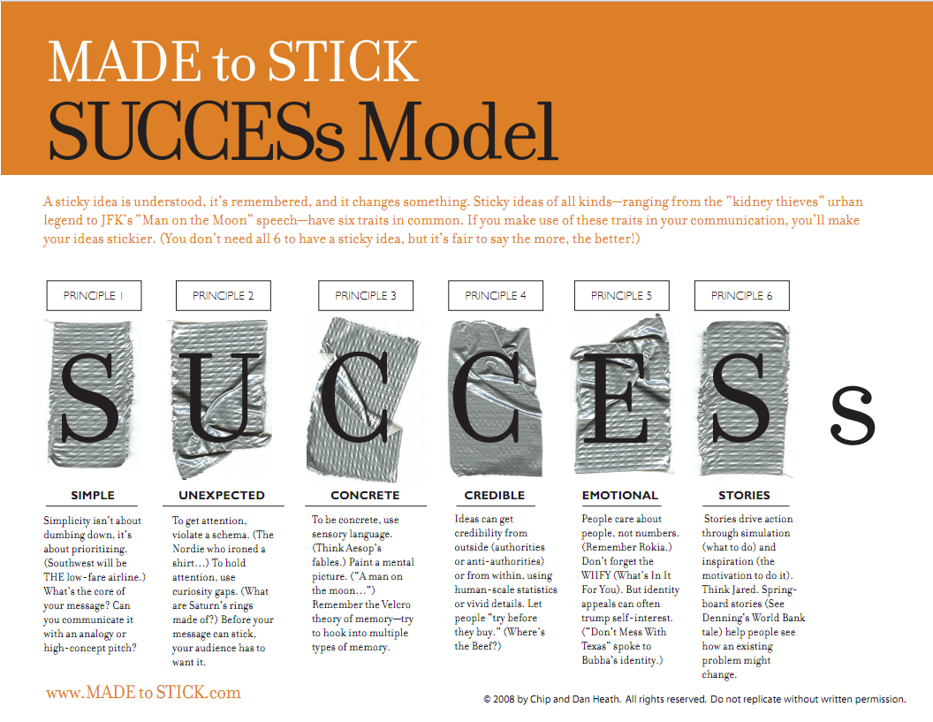
Now, Make it Stick…

Slide 7
The Business Plan
Guy Kawasaki
Write for the Right Reason
Pitch, Then Plan
Focus on the Executive Summary
  Title Slide
  Problem
  Solution
  Business Model
  Underlying Magic
  Marketing and Sales
  Competition
  Management Team
  Financial Projections and Key Metrics
  Current Status, Accomplishments to date, Timeline, and use of Funds
“Exercise: Print your current business plan. Throw away page 3 and beyond. Would the first two pages make you want to read the whole document?”

Slide 8
HP Ten-Step Business Plan
(1) Statement of Purpose
(2) Five-Year Objectives
(3) Customers and Channels
(4) Competition
(6) Development/Introduction Plan
(7) Financial Analysis
(8) Potential Problems
(9) Recommendations
(10) First-Year Plan
(5) Products and Services
Start Here…

Slide 9
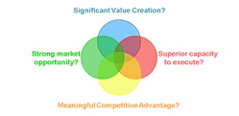
Suggested Business Plan Components/Organization
Paul Hudnut 2008
A. Cover Page
B. Executive Summary (1-2 pages)
1. What’s the problem?
2. What are you going to do about it?
3. Why should anyone care? Use 4 foundations
4. What is the deal?
5. Key metrics table (3-5 key indicators)
C. The Market Opportunity (4 pages)
1. Analysis (2 pages)
a. Customer need and profile
b. Market Size & Growth Potential
c. Existing solutions (underserved or un-served?)
d. Other stakeholders
e. Primary and Secondary Research results
2. Marketing Plan (2-3 pages)
    a. Purpose of the Product / Service
    -Technical description
    -Features and benefits
    b. Competitive strategy/positioning
    c. Market penetration assumptions
    d. Pricing, Promotion and Distribution assumptions
    e. Market development M.A.T. (Milestones, Assumptions, Tasks)
D. Business Operations (2-3 pages)
1. Organizational type and structure
2. Product development
3. Collaborators: roles and responsibilities
E. Management Team (1-2 pages)
1. Biographical info- relevant, concise.
2. Description of each person’s role
3. Advisors and directors
4. Gaps- recruiting strategy
F. Value Creation/Financial Projections (3-5 pages)
1. Key Financial Assumptions
2. Income and Cash flow projections (monthly for first two years, annual for years 3-5
3. Statement of Use of Proceeds for funds being raised
Notes:
The Executive Summary should be written to “stand alone” and should only contain non-confidential info. You may be asked to send someone your Exec Summary before meeting with them, and the full business plan may be sent as follow up after a good meeting.
I’d suggest you also have a Financial Projection Overview- five year projection with only high level detail- followed by more detailed monthly and annual projections.
It’s a good idea to always have a pdf version of both your Executive Summary and Full Business Plan available, in case you are asked to provide one to an interested party.

Slide 10
Executive Summary
What’s the Problem (What Sucks?)
What are you going to do about it?
Why does anyone care?
  Significant Value Creation
  Strong Market Opportunity
  Superior Capacity to Execute
  Meaningful Competitive Advantage
What is the deal?
Key Metrics Table

Slide 11
Team Exercise: 3x5
  Define your Business Model (<100 words)
  Pick 3 important Triple Bottom Line goals to measure what your venture will accomplish over 5 years.
  Build a matrix:
Examples | 2011 | 2012 | 2013 | 2014 | 2015
Financial
Environmental
Social

Slide 12
3x5: Envirofit Example
 | 2004 | 2005 | 2006 | 2007 | 2008
$ Gross Profit/customer | 0 | 0 | 15 | 20 | 20
CO2 Avoided (tons) | 0 | 0 | 200 | 1,000 | 10,000
Total Increased Incomes ($$) | 0 | 0 | $40k | $200k | $1M
1 ton/unit/year
$.50/day
  Example only

Slide 13
The Market Opportunity
1. Analysis
a. Customer need and profile
b. Market Size & Growth Potential
c. Existing solutions (underserved or un-served?)
d. Other stakeholders
e. Primary and Secondary Research results
2. Marketing Plan
    a. Purpose of the Product / Service
    -Technical description
    -Features and benefits
    b. Competitive strategy/positioning
    c. Market penetration assumptions
    d. Pricing, Promotion and Distribution assumptions
    e. Market development M.A.T. (Milestones, Assumptions, Tasks)

Slide 14
Product “Vintage”
Faster/Cheaper/Smaller
“Chicken Foot”
Premium/Value/Low Cost

Slide 15
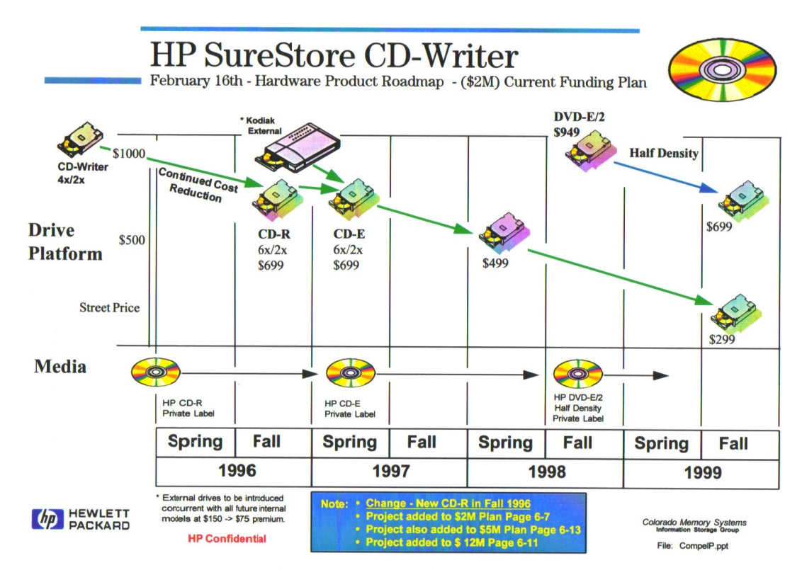
Typical “Vintage Chart”

Slide 16
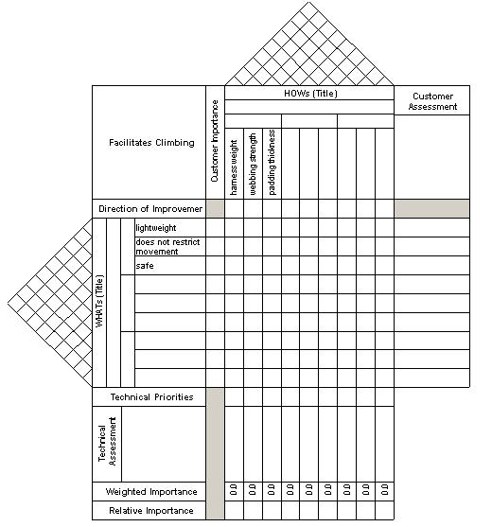
House of Quality (QFD)
http://www.guydavis.ca/seng/seng613/group/tool1.jpg

Slide 17
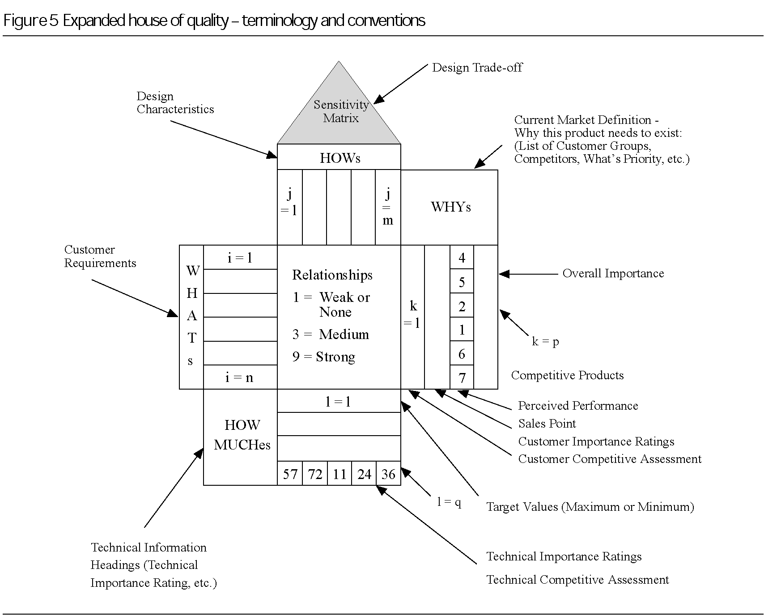
http://www.emeraldinsight.com/content_images/fig/2160010304005.png

Slide 18
At a Minimum…
Competitive Matrix
Competitor | Feature or Benefit 1 | Feature or Benefit 2 | Feature or Benefit 3 | Feature or Benefit 4 | Feature or Benefit 5
Our Solution
Competitor X |  | How Good?
Competitor Y

Slide 19
Who’s Who?
Team Bios/Roles
Advisory Board(s)
Board of Directors
Strategic Partners
Who are you? Why will you succeed?

Slide 20
The Numbers
Where’s the Beef (cashflow?)
Pro Forma Financials
  Revenues
  Costs
    Startup
    Ongoing
      Fixed
      Variable

Slide 21
Revenue Projections
  1) Determine the key revenue drivers for your business, e.g.
    a) Number of customers, transactions or units
    b) Price per customer, transaction or unit
    c) Average revenue per customer or transaction
    d) Distribution channel discount
    e) Market penetration
    f) Response rate
    g) Churn rate (proportion of customers lost each year)
    h) Growth rate
    i) New services or products
  2) Forecast revenues for the 5 years.
  3) Estimate revenues by months for years 1 & 2 and by quarters for years 3, 4 and 5. It is critical that these be estimated as accurately as possible, as it forms the basis for projections of Cost of Revenue, Operating Expenses, Plant and Equipment, Working Capital, and Funding, Consider such factors as:
    a) Timing of product or service roll-out
    b) Growth rate within the year
    c) Seasonality
    d) When orders will be received
Financial Spreadsheet Template http://leeds-faculty.colorado.edu/moyes/bplan/html/spTools.html

Slide 22
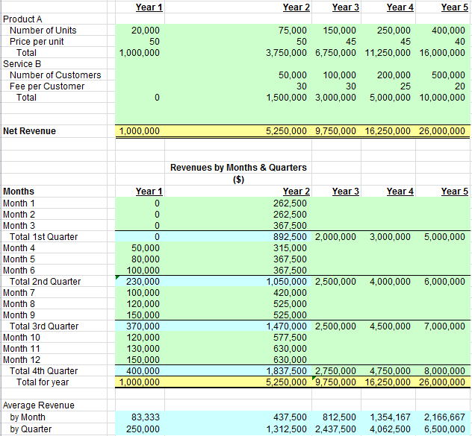
Revenue Projections
Financial Spreadsheet Template http://leeds-faculty.colorado.edu/moyes/bplan/html/spTools.html

Slide 23
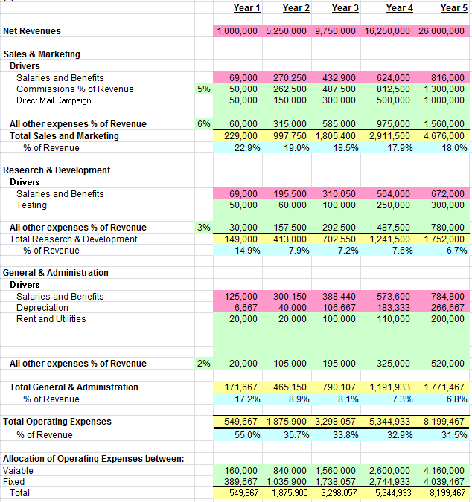
Typical Financial Report
http://leeds-faculty.colorado.edu/moyes/bplan/html/spTools.html

Slide 24
Exit Strategy
How and when do your investors get a return on their investment?

Slide 25
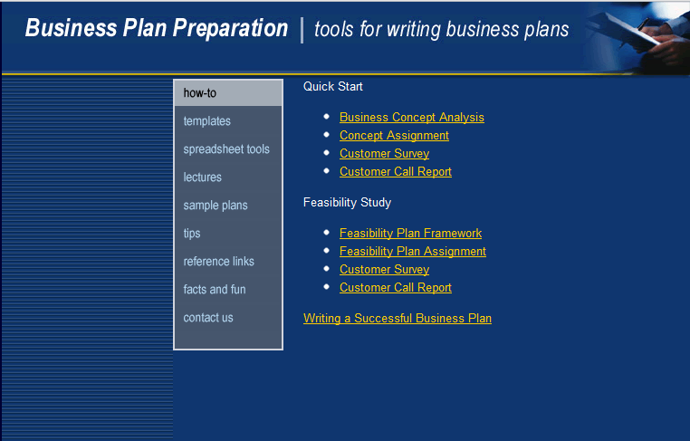
Business Plan Resources
http://leeds-faculty.colorado.edu/moyes/bplan/html/how_to.html

Slide 26
Venture Challenge
Create a draft table of contents for your venture’s business plan.
Describe the process you will use to create a business plan.
Write an executive summary for your opportunity.

