Slide 1
Sustainable Technology Entrepreneurship for Scientists and Engineers
MECH/AREC 581a2
Competitive Strategy
February 9, 2011
Rick Turley

Slide 2
Competitive Strategy
Tools
Value Proposition (handout)
Technology Lifecycle (textbook)
BMG Canvas (handout)
5/6 Forces (textbook)
SWOT/TOWS (textbook)
Value Chain (textbook)
Triple Bottom Line (textbook)
Whole Product
Purchase Process (textbook)

Slide 3
One Approach to Value Propositions…
We provide <product or service> to <target customer segment.> Unlike <next best competitor,> we offer <measurable differentiation/benefits/experiences> at <cost or price.>†
See The Customer Value Proposition: Differentiation through the Eyes of your Customer, by Pamela Hudadoff at http://www.appliedproductmarketing.com/resources/CustomerValuePropositionEssentials_eBook.pdf
†Based on Building Market Focused Organizations by Lynn Phillips

Slide 4
A Customer Value Proposition is…
A description of the experiences a target user will realize upon purchase and use of a product.
Oriented around tangible and intangible benefits
As measured by customer willingness to pay
For a specific market segment
Demographics
Psychographics
At a specific total cost/price

Slide 5
Definition of Market†
A set of actual or potential customers,
For a given set of products or services,
Who have a common set of needs or wants, and
Who reference each other when making a buying decision.
†Crossing the Chasm, Geoffrey A. Moore, Harper Collins, 1991, p. 28.

Slide 6
Let’s Do an Example
What is the Value Proposition for CSU?
Who are “we?”
Who is the Customer?
What is the product/service?
Who is the Next Best Competitor?
What is our Differentiation?
What is the Price? Cost?

Slide 7
Elevator Pitch Suggestions
What is an Elevator Pitch?
http://www.youtube.com/watch?v=Tq0tan49rmc
Succinct
Easy to understand
Greed induced
Irrefutable
Sources
The Art of the Start, Guy Kawasaki
Chapter 3, The Art of Pitching
Made to Stick, Chip Heath & Dan Heath
HBS Elevator Pitch Builder, http://www.alumni.hbs.edu/careers/pitch/

Slide 8
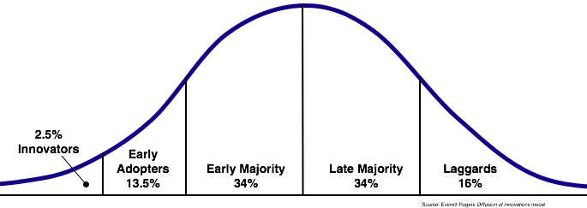
Technology Lifecycle† - Customers
Category | Definition‡
Innovators | First to adopt innovation; willing to take risks; young; high social class; social; science-oriented; interact with other innovators
Early Adopters | High opinion leadership; younger; higher social status; advanced education; socially forward
Early Majority | Slower in adoption process; above average social status; contact with early adopters; some opinion leadership
Late Majority | Skeptical of innovation; below average social status; contact with late and early majority; little opinion leadership
Laggards | Last to adopt; little to no opinion leadership; aversion to change-agents; tend to be older; focused on traditions; lowest social status; contact with family and friends
† http://en.wikipedia.org/wiki/Technology_lifecycle
‡ http://en.wikipedia.org/wiki/Diffusion_of_innovations

Slide 9
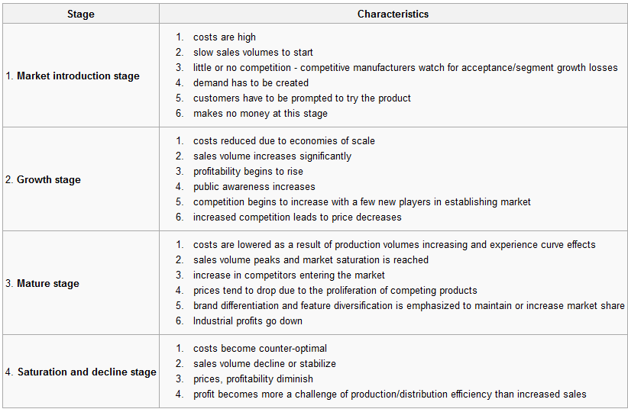
Product Lifecycle†
† http://en.wikipedia.org/wiki/Product_life_cycle_management

Slide 10
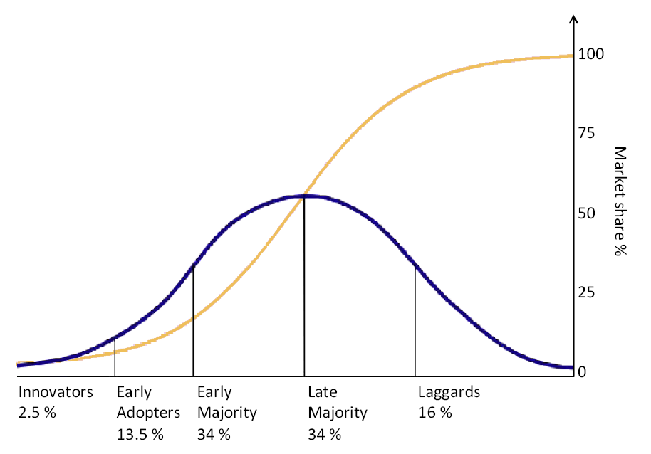
Technology Diffusion†
† http://en.wikipedia.org/wiki/Diffusion_of_innovations

Slide 11
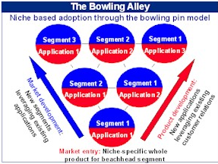
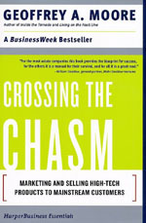
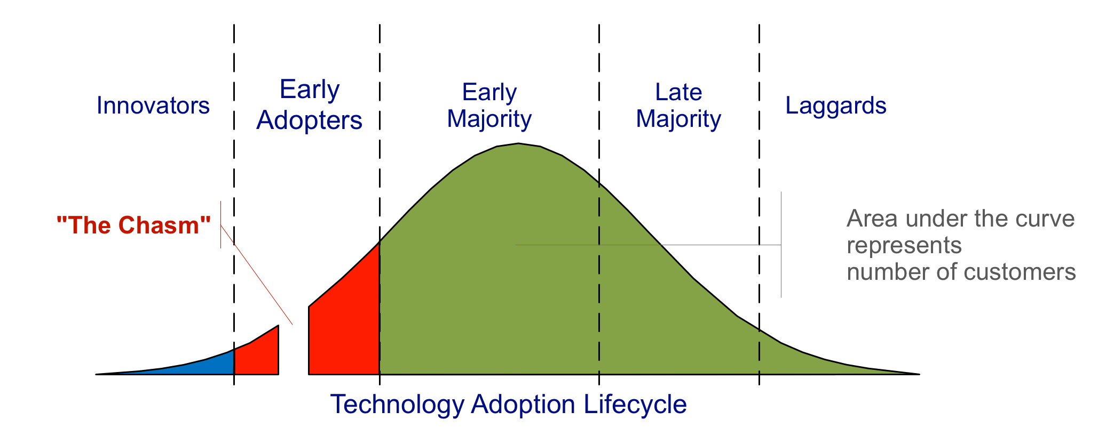
Geoffrey Moore’s Insight
† http://en.wikipedia.org/wiki/File:Technology-Adoption-Lifecycle.png

Slide 12
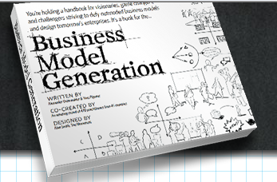
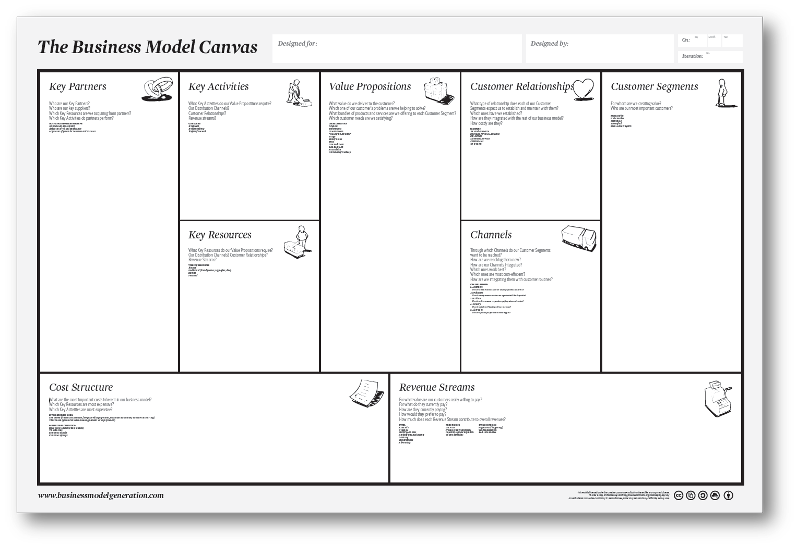
Tie it all Together with a Model
Alex describing the tool on youtube: http://www.youtube.com/watch?v=dtfNsuP2AQQ&feature=player_embedded (8:12)

Slide 13
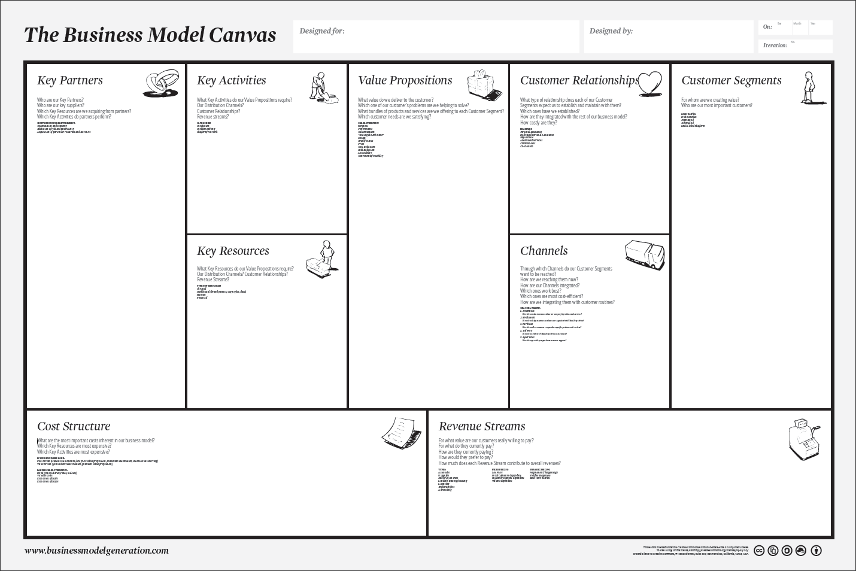

Slide 14
Industry Analysis Applying the 5 (6) Forces Model
Threat of New Entry
Source: Michael E. Porter,
Competitive Advantage
(New York: Free Press, 1985)
Economies of scale
Proprietary product differences
Brand identity
Switching costs
Capital requirements
Access to distribution
Absolute cost advantages
Government policy
Expected retaliation
Bargaining Power
of Suppliers
Bargaining Power
of Customers
Differentiation of inputs
Switching costs
Presence of substitute inputs
Supplier concentration
Importance of volume to supplier
Cost relative to total purchases
Impact of inputs on cost or differentiation
Threat of forward integration
Rivalry Among Existing Competitors
Buyer concentration
Buyer volume
Buyer switching costs
Buyer information
Ability to integrate backward
Substitute products
Price / total purchases
Product differences
Brand identity
Impact of quality / performance
Buyer profits
Industry growth
Fixed costs / value added
Overcapacity
Product differences
Brand identity
Switching costs
Concentration and balance
Informational complexity
Diversity of competitors
Corporate stakes
Exit barriers
Threat of Substitutes
Relative price performance of substitutes
Switching costs
Buyer propensity to substitute
6th Force: Other Stakeholders: Relative Power of Unions, Governments, …

Slide 15
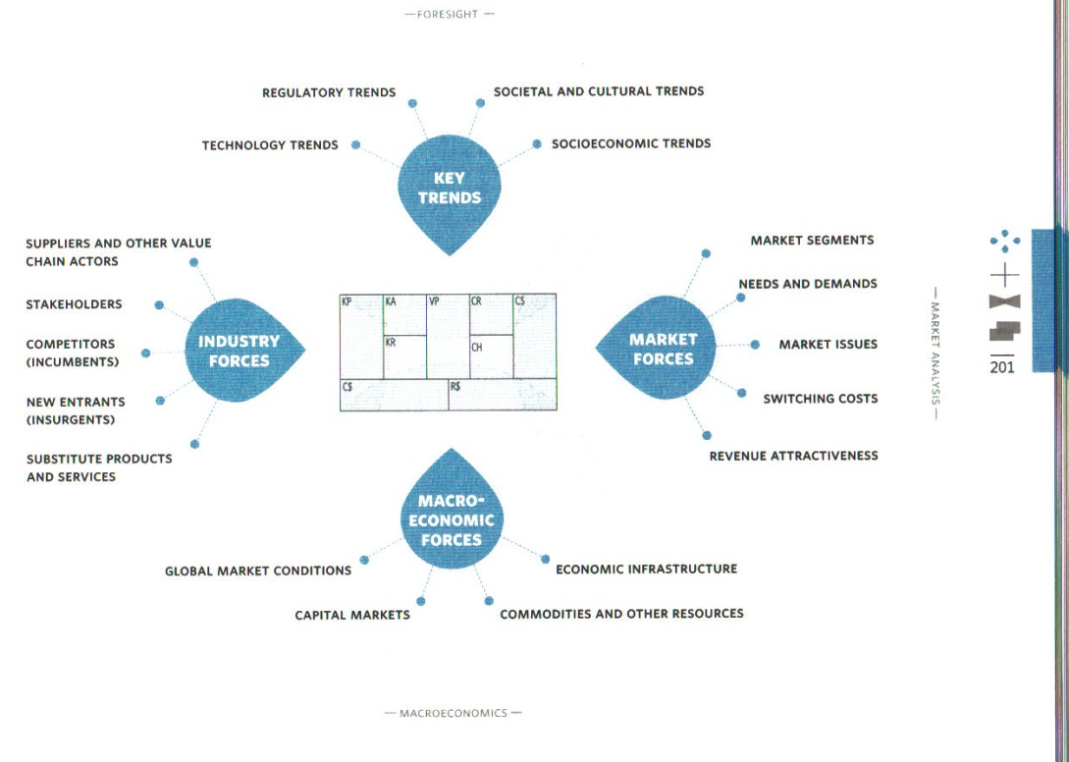
Business Model Environment – External Factors
How does this relate to Porter’s 5-Force Model?

Slide 16
The SWOT Tool
Strengths, Weaknesses, Opportunities and Threats
Internal Environment
Strengths & Weaknesses
External Environment
Opportunities & Threats
Internal Analysis (Organizational) | External Analysis (Environmental)
Strengths | Opportunities
Weaknesses | Threats

Slide 17
The External Environment Task Environment

Slide 18
Strengths and Weaknesses Internal Enviroment
Corporate Culture
Market Position / Marketing Mix
Financial Strength
R&D Capability
Technology competence
Technology transfer
Product Development
People

Slide 19
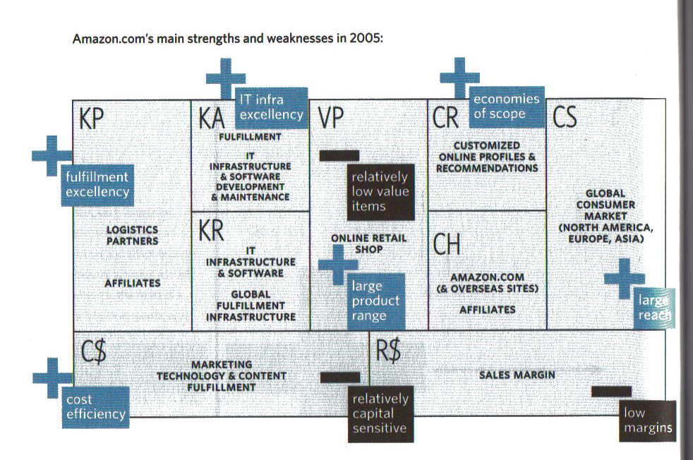
Amazon SWOT – Internal Analysis†
†Business Model Generation, Osterwalder & Pigneur, Wiley & Sons, Inc., 2010, p. 214.

Slide 20
The TOWS Matrix†
Internal Factors → External Factors ↓ | Strengths (S) List 5-10 internal strengths here | Weaknesses (W) List 5-10 internal weaknesses here
Opportunities (O) List 5-10 external opportunities here | SO Strategies Generate strategies here that use strengths to take advantage of opportunities | WO Strategies Generate strategies here that take advantage of opportunities by overcoming weaknesses
Threats (T) List 5-10 external threats here | ST Strategies Generate strategies here that use strengths to avoid threats | WT Strategies Generate strategies here that minimize weaknesses and avoid threats
†Essentials of Strategic Management, 5th Edition, Hunger & Wheelen, Prentice Hall, 2011, p. 77.

Slide 21
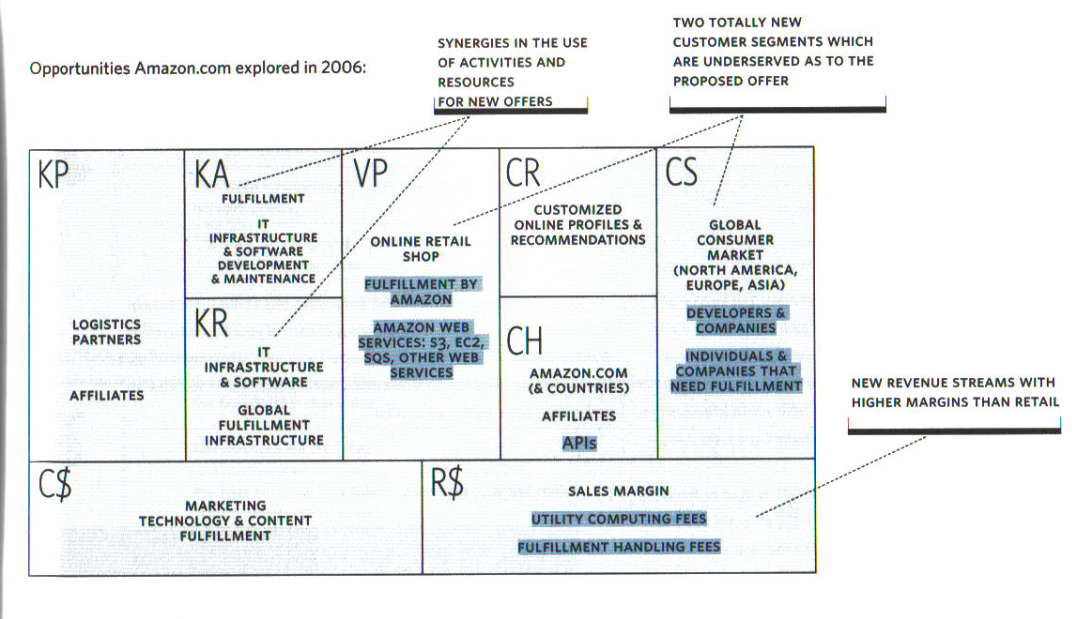
Mapping Amazon’s Opportunities
†Business Model Generation, Osterwalder & Pigneur, Wiley & Sons, Inc., 2010, p. 215.

Slide 22
Value Disciplines: A Visual Approach
Product Leadership
“Best Product”
“I want the latest, greatest thing”
Minimum
To Compete
The Customer’s view:
Operational Excellence
“Best Cost”
Customer Intimate
“Best Total Solution”
“I want it fast,
easy, reliable,and cheap”
“They understand
and serve my every need”

Slide 23
Value Disciplines: The Big Idea
Customers will buy from the supplier that best serves their needs in three basic value dimensions
Operational Excellence leaders make you confident that you are getting the most reliable product or service at a very reasonable price
Customer Intimacy leaders know every detail about their customers and tailor each product or service exactly to the needs of that individual or small segment
Product leaders make you confident you are getting the best, latest, most advanced or most sophisticated item in the product category
Treacy and Wiersema selected these three vectors from the study of hundreds of companies through the Sloan School at MIT and the CSC consulting organization

Slide 24
Leading in Operational Excellence
Lead in price and convenience
Optimize all business processes
Dell: Global supply chain, never make a PC before it is sold, only make the specific PCs the customer has bought, direct sales
Wal-Mart: Information systems, supplier management, inventory management, secondary markets
Redefine world class for the best cost/value shopper
Product Leadership
“Best Product”
●
Operational Excellence
“Best Cost”
South West
Federal Express
GE White Goods
Customer Intimate
“Best Total Solution”
Notes:
The value disciplines model is based on research with hundreds of companies and is a very useful tool looking at specific piece of a business. It can not be used as a company wide tool for a multidivisional or diversified company.
Treacy and Wiersema deliver compelling evidence that their approach is key to strategy and I have used their approach successfully several times.

Slide 25
Leading in Customer Intimacy
Lead in special/custom individual needs satisfaction
Optimize processes to maximize lifetime value
Home Depot: Sales clerks are experts in their area, stay with a customer until they are satisfied, train if needed
Frito-Lay: Sales people stock every store themselves based on sales, great flexibility to create programs for supermarket customers
Redefine world class for the perfect solution for me customer
Product Leadership
“Best Product”
●
Operational Excellence
“Best Cost”
MBNA
Staples
USAA
Customer Intimate
“Best Total Solution”

Slide 26
Leading in Products/Services
Product Leadership
“Best Product”
Apple
Sony
Nike
●
Lead in satisfying the need for the latest and greatest
Optimize processes to minimize product development cycle
Intel: Structured to obsolete its own products before competitors do, must drive Moore’s law
Nike: Change the definition of the newest and best 3 to 4 times a year, always be one generation ahead of competitors
Redefine world class for the early adopter customer
Operational Excellence
“Best Cost”
Customer Intimate
“Best Total Solution”

Slide 27
Why Is It So Hard to Do Two?
Map each of the following onto the model
Your target customers
Your competitors
Your competencies
Your time
Your capital
Your expenses
Your brand image
Your channels
Does this make sense?
What do your process produce?
Product Leadership
“Best Product”
Operational Excellence
“Best Cost”
Customer Intimate
“Best Total Solution”

Slide 28
Industry Value Chain Evolution
Know where you are on your industry value chain and who has power
Where is the industry in terms of evolution?
Fragmented Industry: No firm has large market share and each firm serves only a small piece of the total market in competition with others – young industry
Consolidated Industry: Dominated by a few large firms, each of which struggles to differentiate its products from the competition – older industry
Raw
Material
Primary
Manufacturing
Fabrication
Product
Producer
Distributor
Retailer

Slide 29
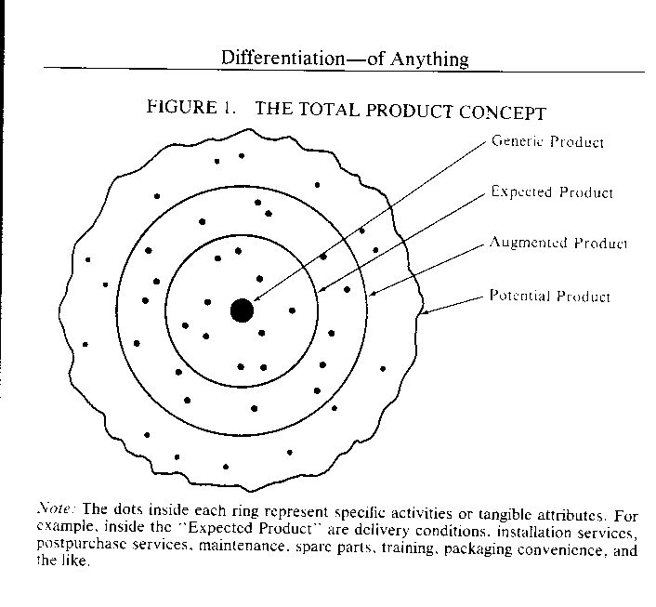
Whole Product Definition†‡
Generic Product
What is shipped in the box – covered by purchasing contract – “Device”
Expected Product
What the consumer thought they were buying – minimum configuration meeting needs
Augmented Product
Product with maximum chance of meeting needs – “Product”
Potential Product
Product’s room for growth
†The Marketing Imagination, Theodore Levitt, Free Press, 1983, p. 79.
‡Crossing the Chasm, Geoffrey A. Moore, Harper Collins, 1991, pp. 108-110.

Slide 30
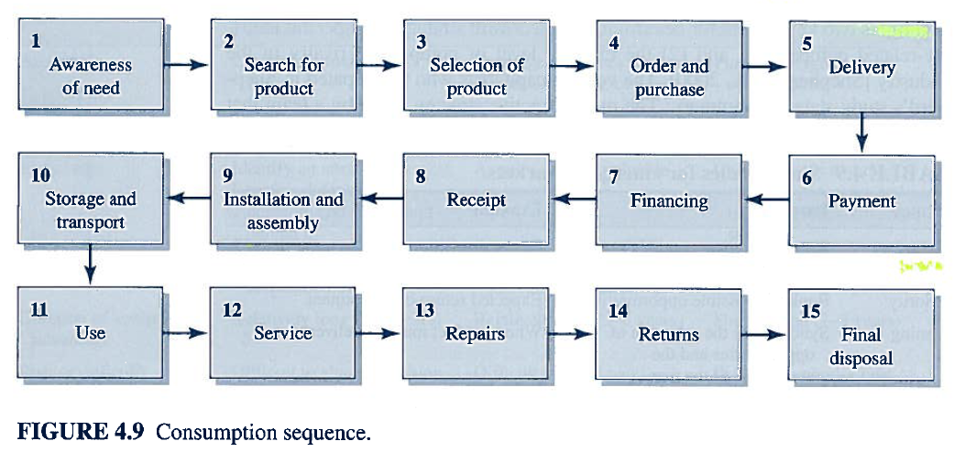
Purchase Process Lifecycle

Slide 31
Competitive Strategy Summary
It’s all about differential value
Meaningful to the customer, and
Their willingness to pay
There are a broad range of tools for analyzing competitive advantage
The BMG Canvas pulls it all together

Slide 32
Next Up…
Apply these tools to your business proposal.
Venture Challenge
Complete Venture Challenge Assignment #2 from last week
Mission Statement
Opportunity Assessment
Value Proposition
Draft Business Model
Complete Venture Challenge Assignment #3 (Byers p. 105)
Develop SWOT analysis
Select strategic approach
Create partnership strategy
Craft an “Elevator Pitch”
If appropriate, describe social and environmental aspects
Get ready for next week
Read Byers Chapter 5 and sections 11.8 & 11.9

