Slide 1

Sustainable Bioenergy Development Center - Bioenergy at CSU Seminar
October 16, 2012
Fuel Properties and Pollutant Emissions from Algal Biodiesel, Algal Renewable Diesel and Algal HTL Fuels
Anthony J. Marchese
Associate Prof. and Associate Dept. Head
Department of Mechanical Engineering
Colorado State University
http://www.engr.colostate.edu/~marchese

Slide 2














Acknowledgments
Advanced Biofuels Combustion and Characterization Laboratory
Graduate Students:
  Caleb Elwell
  Timothy Vaughn
  Torben Grumstrup
  David Martinez
  Esteban Hincapie
  Kristen Naber
  Marc Baumgardner
  Jessica Tryner
  Andrew Hockett
  Harrison Bucy, ‘11
  Kelly Fagerstone, ’11
  Bethany Fisher, ‘10
  Esteban
  Andrew
  Harrison
  Bethany
  Anthony
  Kelly
  Dave
  Kristen
  Marc
  Torben
  Jessica
  David
  Tim

Slide 3
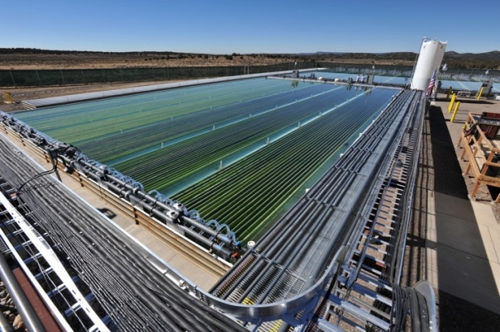
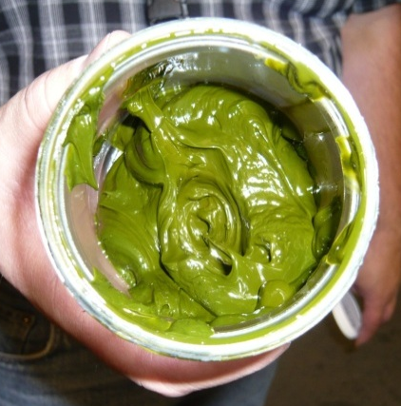
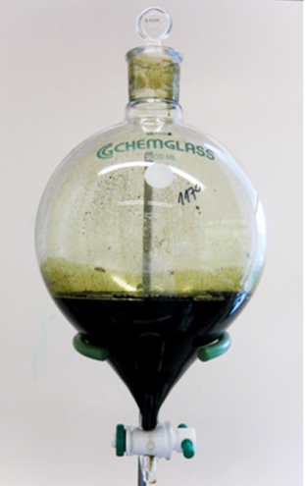
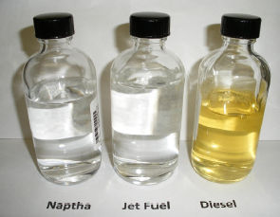
Review Algal Biofuels Conversion Technologies
Overview
  Motivation for Algal Biofuels
  The Algal Biofuel Value Chain Revisited
  Algal Methyl Ester Biodiesel Properties
  Algal Synthetic Paraffinic Diesel/Jet Fuel Properties
  Algal Hydrothermal Liquefaction Oil Properties
  Conclusions

Slide 4
Review Algal Biofuels Conversion Technologies
Overview
  Motivation for Algal Biofuels
  The Algal Biofuel Value Chain Revisited
  Algal Methyl Ester Biodiesel Properties
  Algal Synthetic Paraffinic Diesel/Jet Fuel Properties
  Algal Hydrothermal Liquefaction Oil Properties
  Conclusions

Slide 5

Peak Oil
Are we there yet?
The End of the Oil Age?

Slide 6
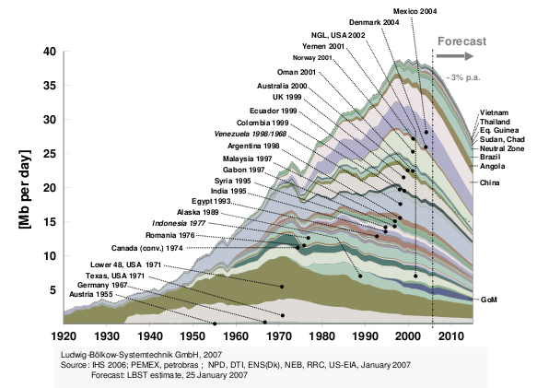
Peak Oil
Anomalous Age of Easy Oil is Nearing its End

Slide 7
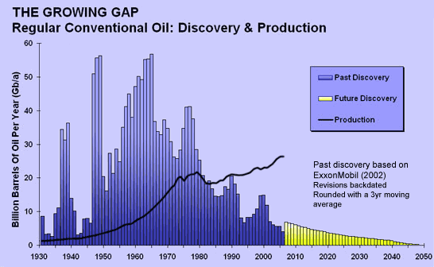
Peak Oil
Anomalous Age of Easy Oil is Nearing its End
Campbell, C. J. (2012). The Anomalous Age of Easy Energy. Energy, Transport and the Environment, Springer.

Slide 8
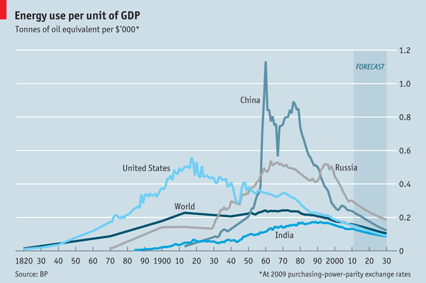
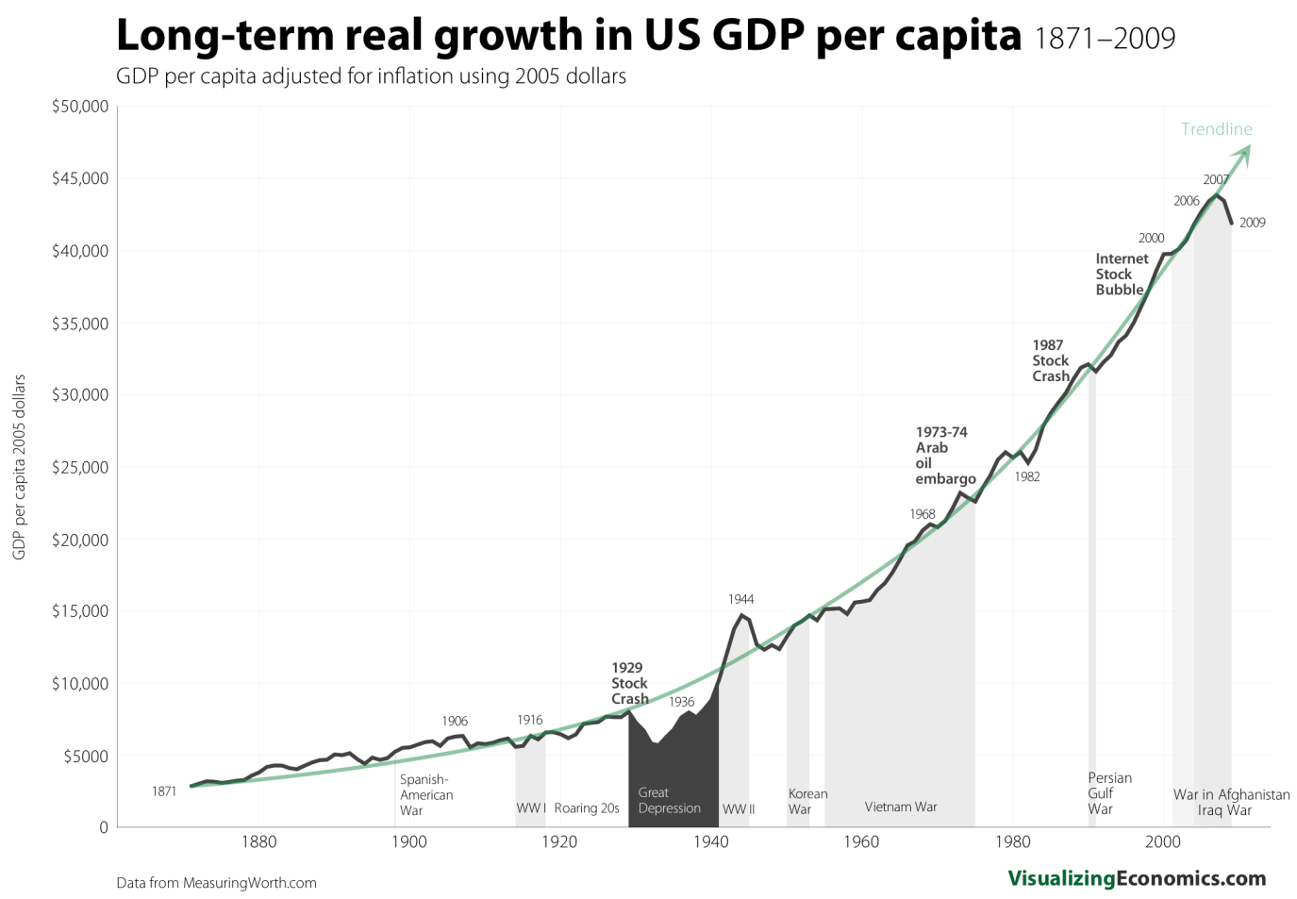

The Master Equation
Fossil Fuel Depletion (A Matter of WHEN…not IF)
FFC/GDP is fundamentally constrained by the 2nd Law of Thermodynamics!

Slide 9
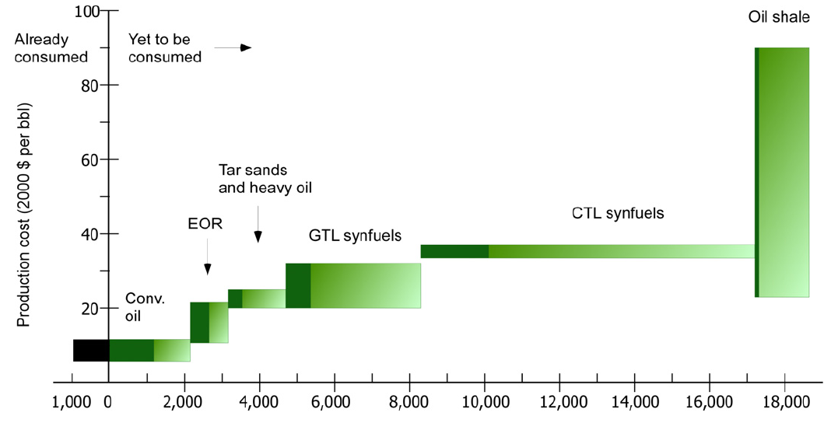
Non-Conventional Liquid Fossil Fuels
Substantial Resources Still Exist for GTL or CTL
Enhanced oil recovery
Potential Liquid Hydrocarbon Production (Gbbl)

Slide 10
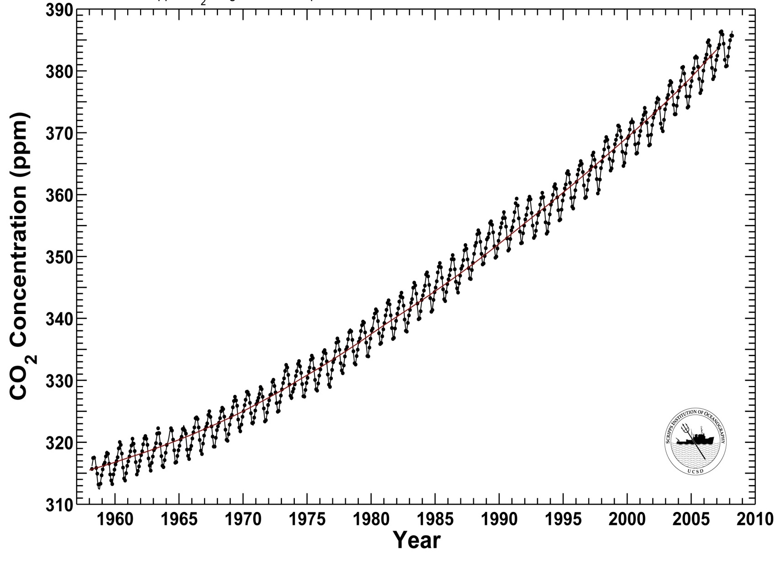
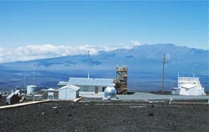
Keeling Curve, CO₂ at Mauna Loa
Non-Conventional Liquid Fossil Fuels
Do We Really Want to Release All of That Carbon?

Slide 11
U.S. Advanced Biofuels Mandate
21 billion gal/year by 2022
  The United States typically consumes 300 Billion gallons per year of liquid fuels:
    130 Billion gal/year gasoline, 70 Billion gal/year diesel, 24 Billion gal/year jet fuel
  The 2007 Energy Independence and Security Act (EISA) mandates the production of 36 billion gallons per year of biofuels by 2022
    Corn ethanol is capped at 15 billion gallons per year.
    21 billion gallons per year must qualify as advanced biofuels.
  Can Algal Biofuels help meet the advanced biofuels mandate?

Slide 12
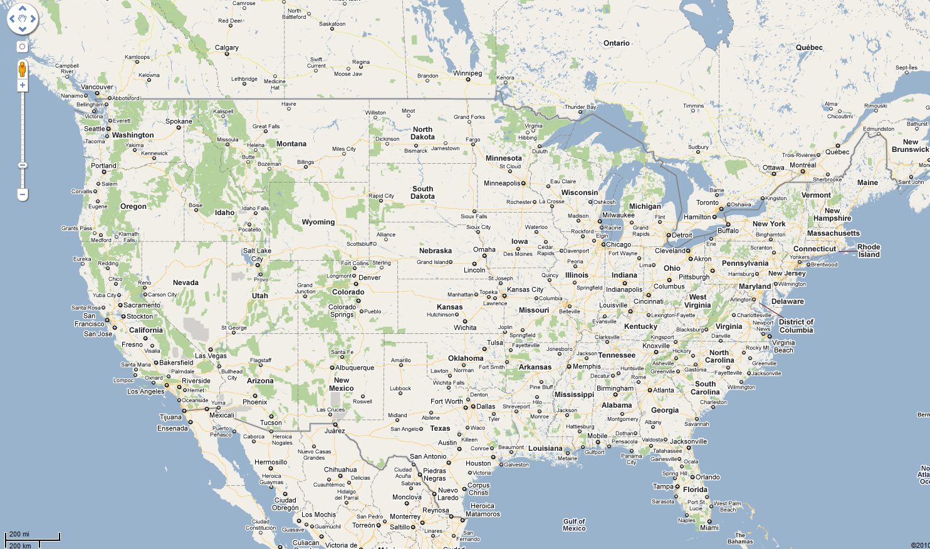
The Case for Algae
  21 billion gallons per year of “advanced biofuels” ≈ 10% of U.S. liquid on-road fuel usage ≈ how much cultivation area?
21 billion gallons per year of soy biodiesel (≈ Alaska)
21 billion gallons per year of algae biodiesel (≈ Connecticut)

Slide 13
Review Algal Biofuels Conversion Technologies
Overview
  Motivation for Algal Biofuels
  The Algal Biofuel Value Chain Revisited
  Algal Methyl Ester Biodiesel Properties
  Algal Synthetic Paraffinic Diesel/Jet Fuel Properties
  Algal Hydrothermal Liquefaction Oil Properties
  Conclusions

Slide 14
Review Algal Biofuels Conversion Technologies
Overview
  Motivation for Algal Biofuels
  The Algal Biofuel Value Chain Revisited
  Algal Methyl Ester Biodiesel Properties
  Algal Synthetic Paraffinic Diesel/Jet Fuel Properties
  Algal Hydrothermal Liquefaction Oil Properties
  Conclusions

Slide 15
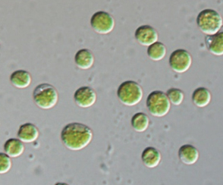
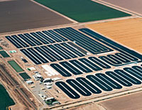
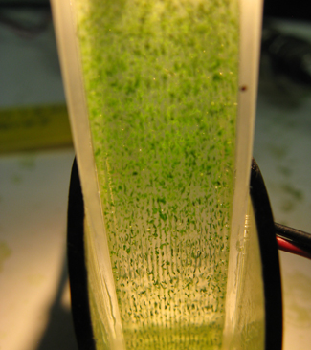

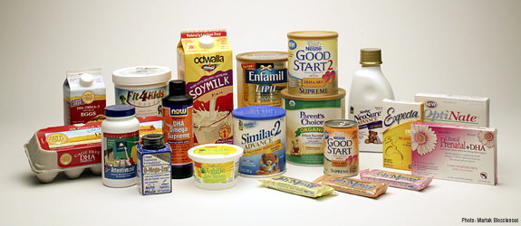
The Algal Biofuels Value Chain
The “Conventional” Route
Biology
Cultivation
Harvesting, Drying?
Nutrient Recycle
Co-products
Lipid to Fuel Conversion
Lipid Extraction

Slide 16
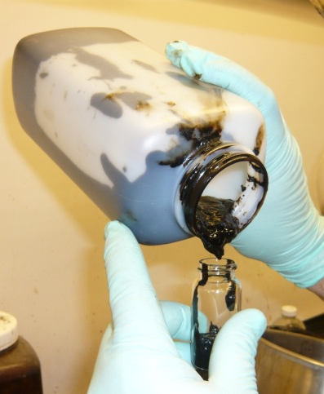
The Algal Biofuels Value Chain
Conversion of Whole Algal Biomass To Biofuels via HTL
Biology
Cultivation
Harvesting
Nutrient Recycle
Upgrading to
Drop-In Fuels
Conversion to Biocrude
Whole Wet Algal Biomass

Slide 17
Review Algal Biofuels Conversion Technologies
Overview
  Motivation for Algal Biofuels
  The Algal Biofuel Value Chain Revisited
  Algal Methyl Ester Biodiesel Properties
  Algal Synthetic Paraffinic Diesel/Jet Fuel Properties
  Algal Hydrothermal Liquefaction Oil Properties
  Conclusions

Slide 18
Review Algal Biofuels Conversion Technologies
Overview
  Motivation for Algal Biofuels
  The Algal Biofuel Value Chain Revisited
  Algal Methyl Ester Biodiesel Properties
  Algal Synthetic Paraffinic Diesel/Jet Fuel Properties
  Algal Hydrothermal Liquefaction Oil Properties
  Conclusions

Slide 19

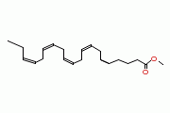
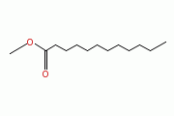
Conversion of Algal Lipids into Liquid Fuels
Algal Paraffinic Renewable Diesel vs. Algal Biodiesel
Algal Renewable Diesel
Straight and branched alkanes:
Processing requirements and fuel properties are relatively agnostic to fatty acid composition of TAG’s
Processing is susceptible to contaminants (P, S, Ca, Mg, K, etc.)
Final products compatible with existing refinery and distribution infrastructure
Properties can be tailored for gasoline, diesel, or jet fuel (ASTM D7566-11)
Large scale processing facilities are favored ( >100 million gal/year)
Currently feedstock limited
Algal Biodiesel
Alkyl esters produced via trans-esterification of TAG’s:
Fuel properties are directly related to fatty acid composition of TAG’s.
Processing susceptible to contaminants (P, S, Ca, Mg, K, etc.) and FFA’s
Only suitable for diesel engines
Small to moderate scale processing facilities ( < 100 million gal/year)
Current U.S. production capacity (3 billion gal/year) is under utilized.
Currently feedstock limited

Slide 20
Conversion of Algal Lipids to Fuels
Algal Methyl Ester Biodiesel
Fatty acid profiles of some extracted algal lipids differ from that of conventional biodiesel feedstocks.
 | 8:0 | 10:0 | 12:0 | 14:0 | 16:0 | 16:1 | 18:0 | 18:1 | 18:2 | 18:3 | 20:1 | 20:4 | 20:5 | 22:6
Soy |  |  |  |  | 11 |  | 4 | 24 | 53 | 8
Jatropha |  |  |  |  | 11 |  | 17 | 13 | 47 | 0 | 5
Coconut | 8 | 6 | 47 | 18 | 9 |  | 3 | 7 | 2
Palm |  |  |  | 1 | 39 |  | 5 | 46 |  | 9
Nannochloropsis salina |  |  |  | 3 | 30 | 39 | 1 | 8 | 1 | 1 |  | 3 | 11
Nannochloropsis oculata |  |  |  | 2 | 15 | 16 | 2 | 10 | 4 | 3 |  | 6 | 21 | 3
Isoschrysis galbana |  |  |  | 23 | 14 | 3 | 1 | 14 | 5 | 7 |  |  | 5 | 14
For algal FAME, the fatty acid profile has implications in terms of oxidative stability, cold temperature properties, ignition quality and engine emissions.
Bucy, H., Baumgardner, M. and Marchese, A. J. (2012). Chemical and Physical Properties of Algal Methyl Ester Biodiesel Containing Varying Levels of Methyl Eicosapentaenoate and Methyl Docosahexaenoate. Algal Research 1 pp. 57–69.

Slide 21
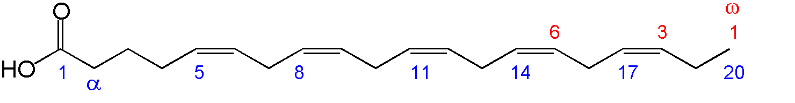
Oxidative Stability of Algal Methyl Esters
Effect of EPA and DHA
In natural oils, multiple olefinic unsaturation occurs in a methylene- interrupted configuration. The bis-allylic C-H bonds are susceptible to hydrogen abstraction, followed by oxygen addition, and peroxide formation
●
+O₂
O-O
●
O-O-H
Fuels containing long chain unsaturated methyl esters such as EPA (C20:5) and DHA (C22:6) have poor oxidative stability.

Slide 22
Oxidative Stability of FAME
Bis-Allylic Position Equivalents (BAPE) (Knothe and Dunn, 2003)
Oxidative stability of FAME has been shown to correlate with the total number of bis-allylic sites in the FAME blend.
To capture this effect, Knothe and Dunn (2003) have defined Bis-Allylic Position Equivalents (BAPE) parameter, which is a weighted average of the total number of bis-allylic sites in the FAME mixture:
For the present work, model algal methyl ester compounds were formulated to match the BAPE value of real algal methyl esters subject to varying levels of EPA/DHA removal.
bis-allylic sites

Slide 23

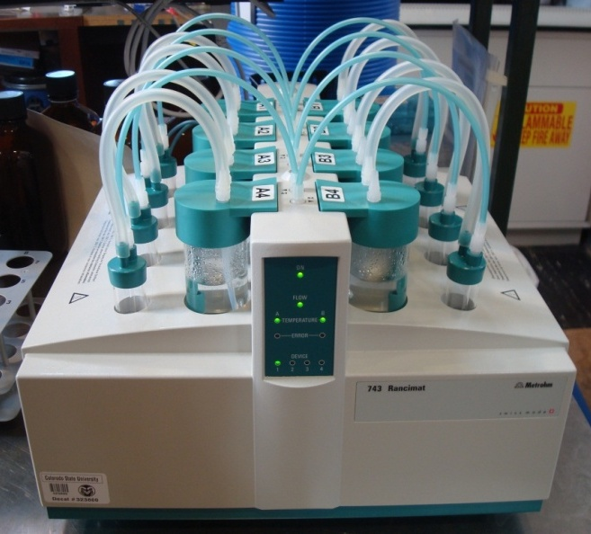
Oxidative Stability Tests
Metrohm 743 RANCIMAT Test
Instrument | Method Followed | Standard | Specification | Test Parameters
Metrohm 743Rancimat | EN 14112 | D6751 | 3 hours minimum | 10 L/h air flow | 110°C | 3 gram sample
 |  | EN 14214 | 6 hours minimum

Slide 24
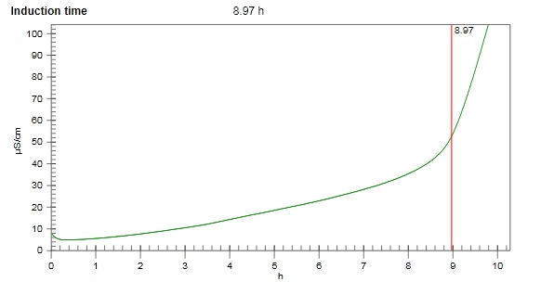
Oxidative Stability Tests
Metrohm 743 RANCIMAT Test
Instrument | Method Followed | Standard | Specification | Test Parameters
Metrohm 743Rancimat | EN 14112 | D6751 | 3 hours minimum | 10 L/h air flow | 110°C | 3 gram sample
 |  | EN 14214 | 6 hours minimum

Slide 25
Oxidative Stability Test Results
Model Compounds and Real Algal Methyl Esters Correlate with BAPE

Slide 26
Oxidative Stability
Effect of EPA/DHA Removal from Nannochloropsis oculata
Bucy, H., Baumgardner, M. and Marchese, A. J. (2012). Chemical and Physical Properties of Algal Methyl Ester Biodiesel Containing Varying Levels of Methyl Eicosapentaenoate and Methyl Docosahexaenoate. Algal Research 1 pp. 57–69.

Slide 27
Oxidative Stability Test Results
Effect of TBHQ Oxidative Stability Additive
The effect of adding an oxidative stability additive (Vitablend Bioprotect 350) is shown here. Active ingredient: tert-Butylhydroquinone (TBHQ))

Slide 28
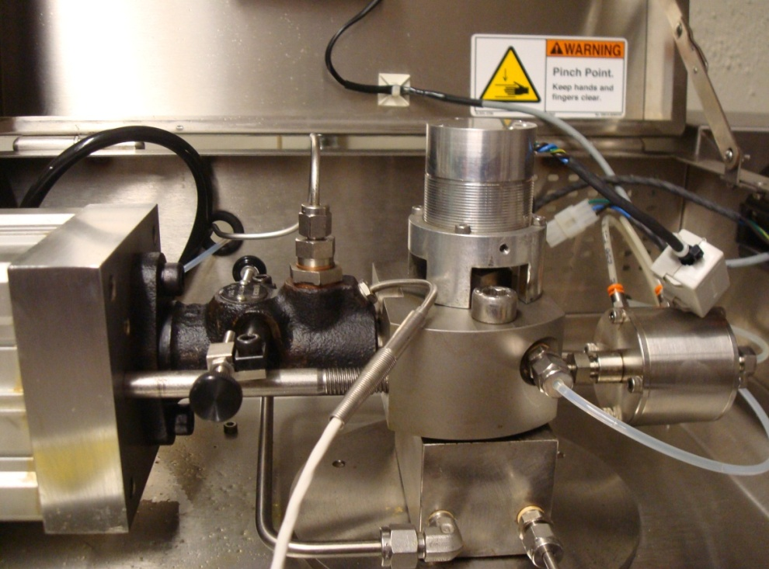
Ignition Quality Tests
Derived Cetane Number Tests with Waukesha FIT System
Cetane Number is a measure of the propensity for a liquid fuel to auto-ignite under diesel engine conditions. For biodiesel a minimum Cetane Number of 47 is required.
Instrument | Method | Standard | Specification | Test Parameters
 |  |  |  | # of Injections | Injection Period | Fuel Temperature | Coolant Temperature
Waukesha FIT | D7170 | D6751 | 47 minimum | 25 injections | 5.00+/-0.25 ms | 35+/-2°C | 30+/-0.5°C
ASTM D7170 Method
  Measures ignition delay of 25 injections into a fixed volume combustor
  DCN = 171/ID

Slide 29
Cetane Number
Effect of EPA/DHA Removal from Nannochloropsis oculata
Nannochloropsis and Isochrysis galbana based algal methyl esters were shown to have lower than acceptable Cetane Number.
As EPA and DHA are removed, Cetane Number increases.
Bucy, H., Baumgardner, M. and Marchese, A. J. (2012). Chemical and Physical Properties of Algal Methyl Ester Biodiesel Containing Varying Levels of Methyl Eicosapentaenoate and Methyl Docosahexaenoate. Algal Research 1 pp. 57–69.

Slide 30
Cloud Point and Cold Filter Plugging Point
Removal of C20:5 and C22:6 from algal methyl esters also results in an increase in the percentage of fully saturated methyl esters C16:0 and C18:0, resulting in increased cloud point and cold filter plugging point.

Slide 31
Cloud Point and Cold Filter Plugging Point
Removal of C20:5 and C22:6 from algal methyl esters also results in an increase in the percentage of fully saturated methyl esters C16:0 and C18:0, resulting in increased cloud point and cold filter plugging point.

Slide 32
Speed of Sound and Bulk Modulus
Increased bulk modulus of FAME (in comparison to petroleum diesel) results in advanced injection timing and increased NO_{x}.
Speed of sound (a) and bulk modulus (a²ρ) of the liquid FAME formulations also correlated well with BAPE.

Slide 33
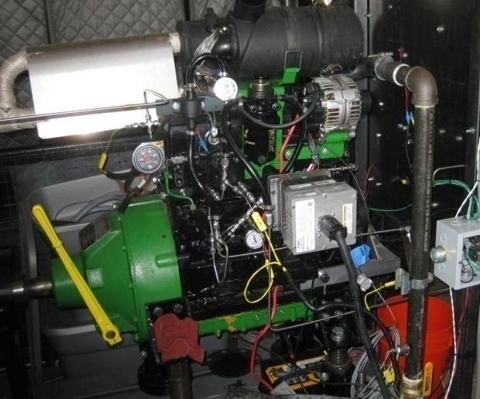
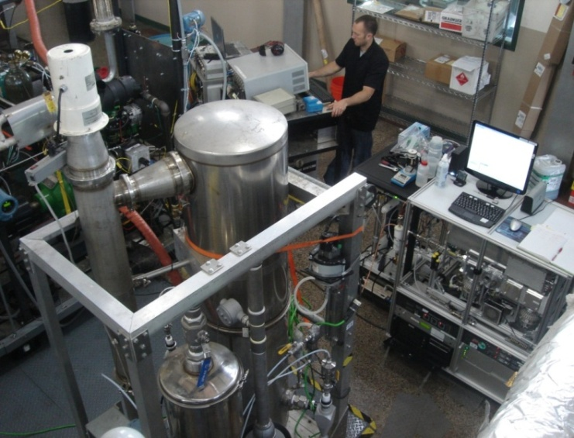
Emissions Testing (Fisher et al., 2010)
Characterization of PM and NO_{x} from Algae Based Methyl Esters
Objective: Characterize PM size distribution /composition and gaseous pollutants from algae-based methyl esters.
Approach: Engine tests were performed on a 52 HP John Deere 4024T diesel engine at rated speed at 50% and 75% of maximum load.
Fuels: Fuels tested include ULSD, soy methyl ester, canola methyl ester, and two model algal methyl ester compounds:
  Nannochloropsis oculata and Isochrysis galbana methyl ester compounds.
  B20 and B100 blends of each methyl ester were tested.
  Nine fuel blends tested in total

Slide 34
Hydrocarbon and CO Emissions
Emissions of CO and THC for the algal methyl esters were similar to that of the soy and canola methyl esters, which were similar to that reported in the literature.
Total Hydrocarbons
Carbon Monoxide

Slide 35
NO_{x} Emissions from Diesel Engines
Nannochloropsis Methyl Ester Model Compounds
Emissions of NO_{x} were shown to decrease for the algal methyl esters in comparison to the ULSD, in contrast to the soy and canola methyl esters which resulted in NO_{x} increases at the higher engine load.
10% decrease
2% decrease
Fisher, B. C., Marchese, A. J., Volckens, J., Lee, T. and Collett, J. (2010). Measurement of Gaseous and Particulate Emissions from Algae-Based Fatty Acid Methyl Esters. SAE Int. J. Fuels Lubr. 3, pp.

Slide 36
PM Mass Emissions
PM mass emissions decreased substantially for all of the B100 methyl esters in comparison to ULSD at the high engine loading condition.
At the lower engine loading condition, Algae 1 B100 had increased PM emissions in comparison to ULSD.

Slide 37
PM Size Distribution
B100 Fuels
All of the B100 methyl esters resulted in a decrease in the mean mobility diameter.
The PM size distribution from several of the methyl esters including Algae 1 B100 exhibited a nucleation mode peak centered between 10 and 20 nm.
50% Load
75% Load

Slide 38
Elemental and Organic Carbon
The PM from all of the methyl esters contained substantially higher quantities of volatile organic carbon in comparison to ULSD, particularly at the lower engine loading condition.
Algae 1 B100 had the highest ratio of OC:EC of all the fuels tested at both engine loading conditions.
50% Load
75% Load

Slide 39
Review Algal Biofuels Conversion Technologies
Overview
  Motivation for Algal Biofuels
  The Algal Biofuel Value Chain Revisited
  Algal Methyl Ester Biodiesel Properties
  Algal Synthetic Paraffinic Diesel/Jet Fuel Properties
  Algal Hydrothermal Liquefaction Oil Properties
  Conclusions

Slide 40
Review Algal Biofuels Conversion Technologies
Overview
  Motivation for Algal Biofuels
  The Algal Biofuel Value Chain Revisited
  Algal Methyl Ester Biodiesel Properties
  Algal Synthetic Paraffinic Diesel/Jet Fuel Properties
  Algal Hydrothermal Liquefaction Oil Properties
  Conclusions

Slide 41
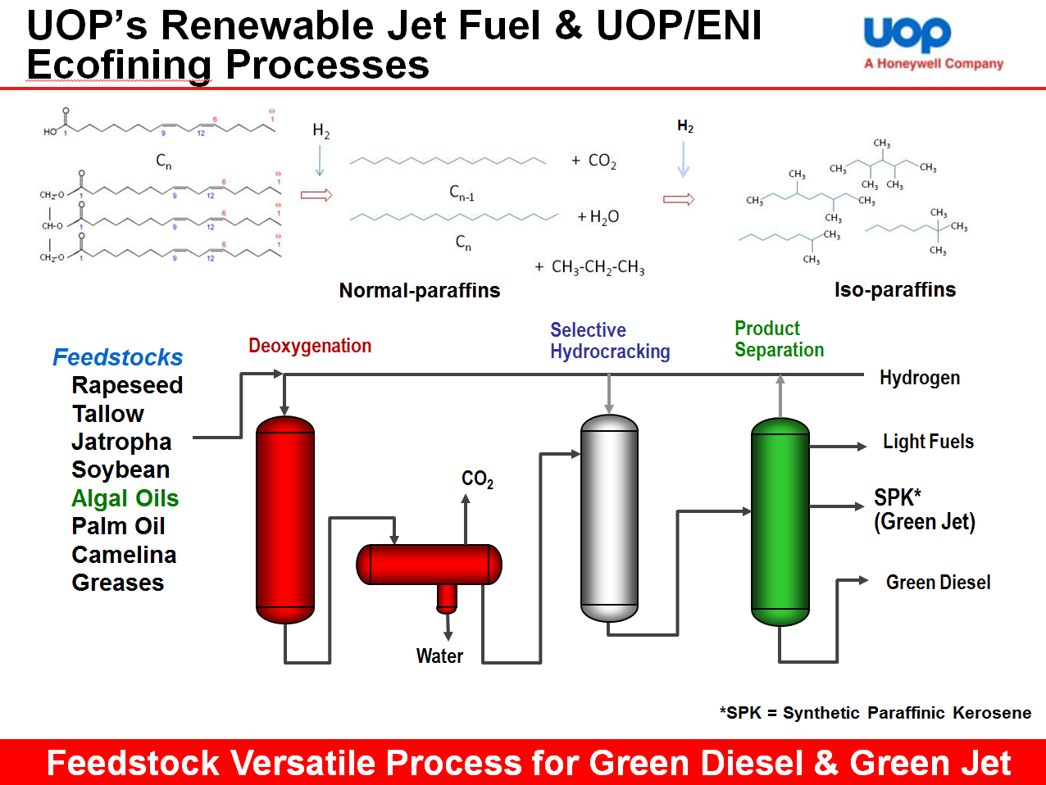
Conversion of Algal Lipids into Liquid Fuels
Algal Renewable Diesel/Jet Fuel

Slide 42
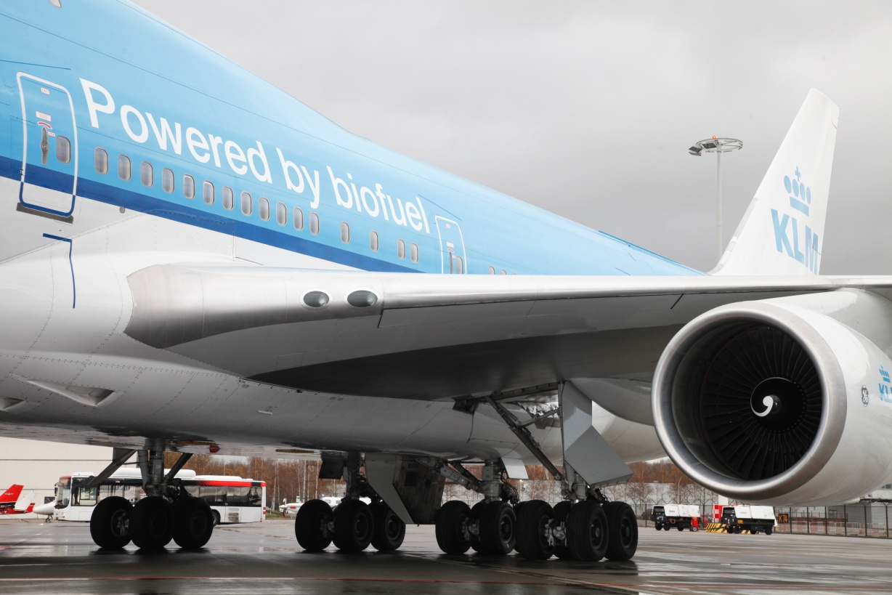
Renewable Jet Fuel from Algal Oil is Approved for Use
ASTM D7566-11
  In July 2011, ASTM passed specifications that allow use of renewable jet fuels produced from vegetable, algal oil and animal fat feedstocks.
  ASTM D7566-11 allows a 50 per cent blending of fuels derived from hydroprocessed esters and fatty acids (HEFA) with conventional petroleum-based jet fuel.
  ASTM D7655-11 is currently only valid for HEFA processes.

Slide 43
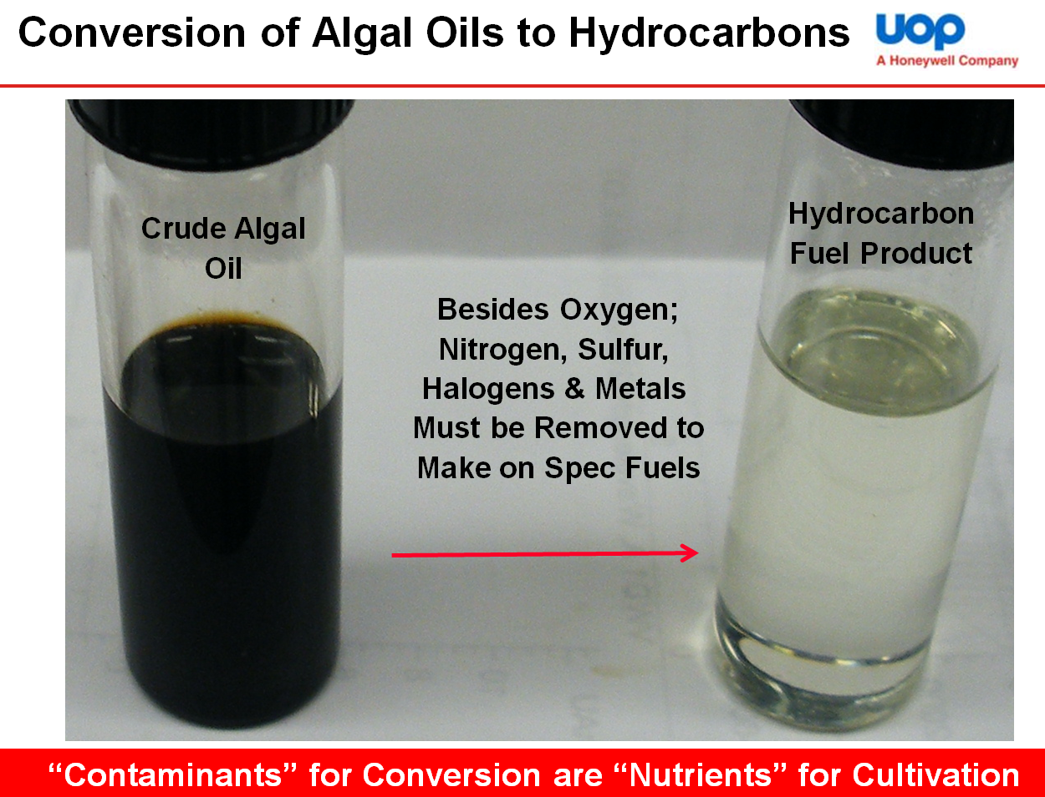
Conversion of Algal Lipids into Liquid Fuels
Algal Renewable Diesel/Jet Fuel

Slide 44
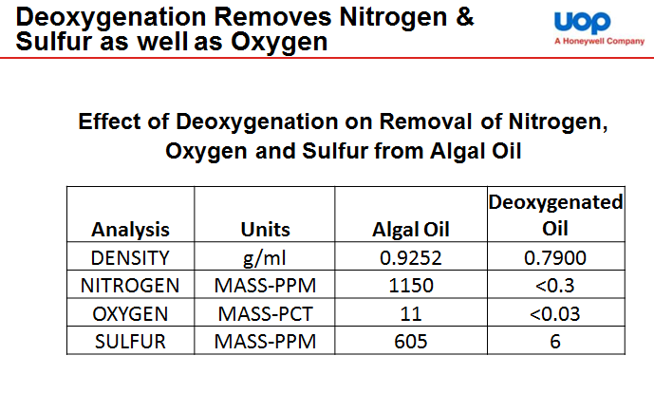
Conversion of Algal Lipids into Liquid Fuels
Algal Renewable Diesel/Jet Fuel

Slide 45
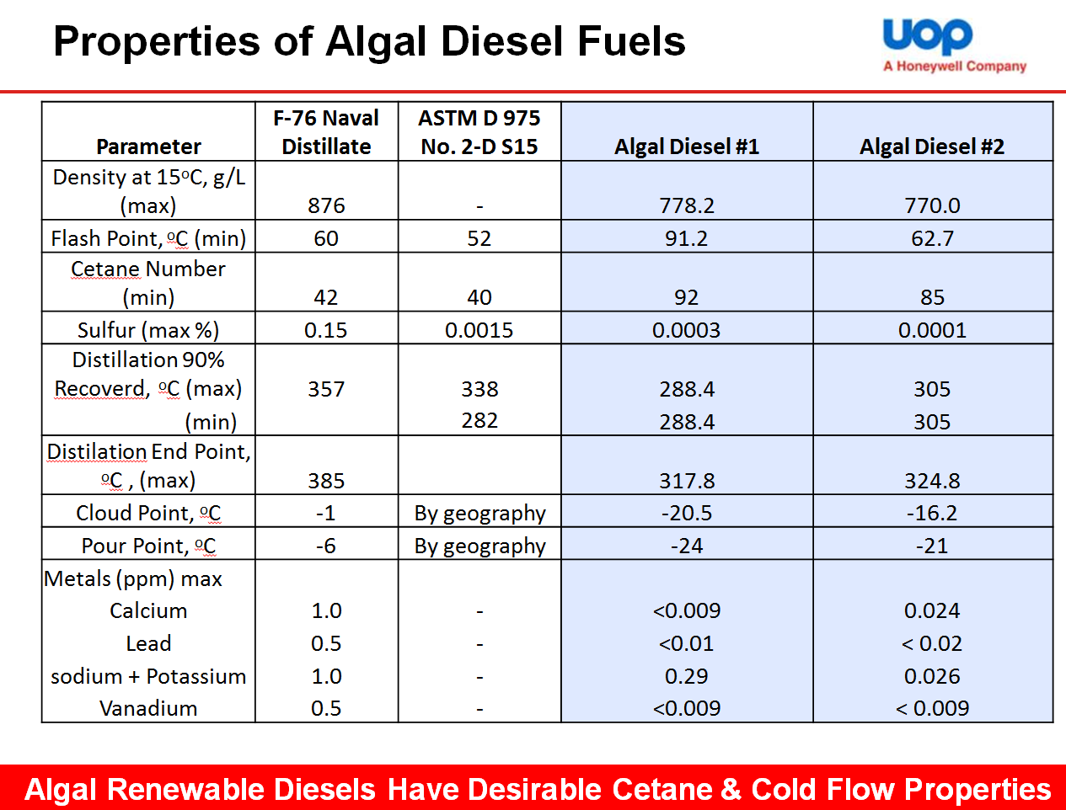
Conversion of Algal Lipids into Liquid Fuels
Algal Renewable Diesel/Jet Fuel

Slide 46
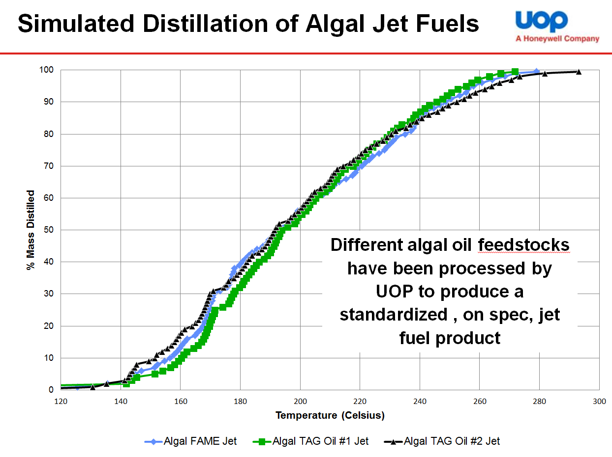
Conversion of Algal Lipids into Liquid Fuels
Algal Renewable Diesel/Jet Fuel

Slide 47
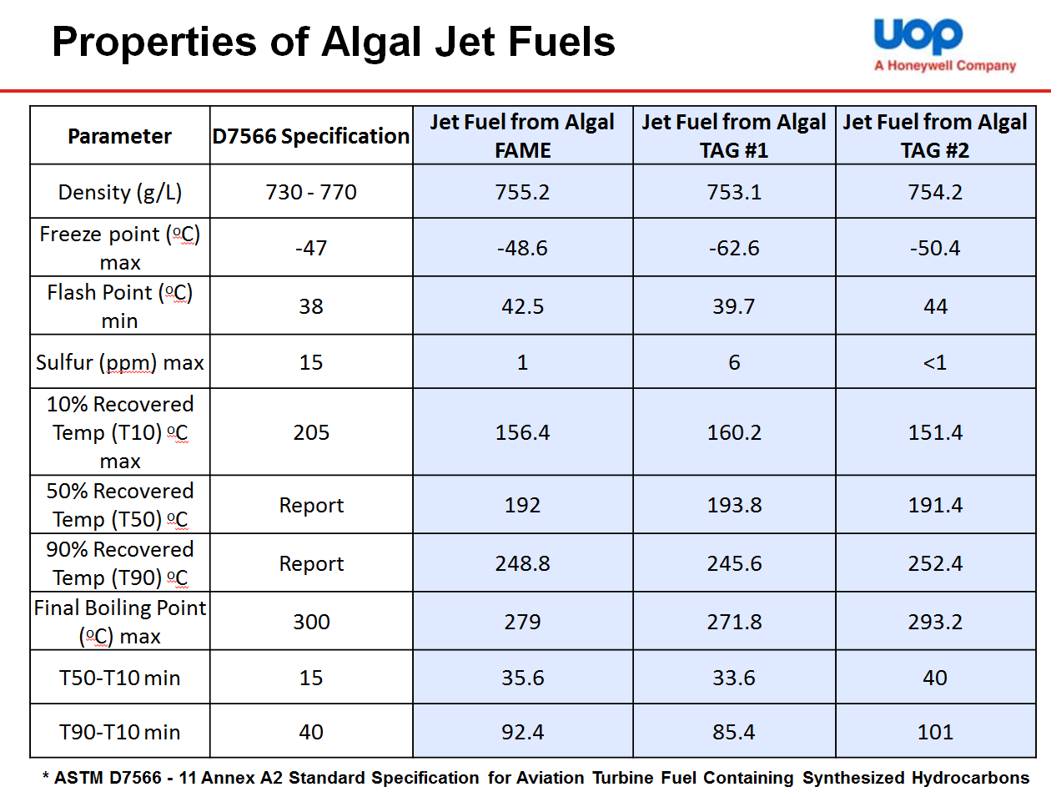
Conversion of Algal Lipids into Liquid Fuels
Algal Renewable Diesel/Jet Fuel

Slide 48
Review Algal Biofuels Conversion Technologies
Overview
  Motivation for Algal Biofuels
  The Algal Biofuel Value Chain Revisited
  Algal Methyl Ester Biodiesel Properties
  Algal Synthetic Paraffinic Diesel/Jet Fuel Properties
  Algal Hydrothermal Liquefaction Oil Properties
  Conclusions

Slide 49
Review Algal Biofuels Conversion Technologies
Overview
  Motivation for Algal Biofuels
  The Algal Biofuel Value Chain Revisited
  Algal Methyl Ester Biodiesel Properties
  Algal Synthetic Paraffinic Diesel/Jet Fuel Properties
  Algal Hydrothermal Liquefaction Oil Properties
  Conclusions

Slide 50
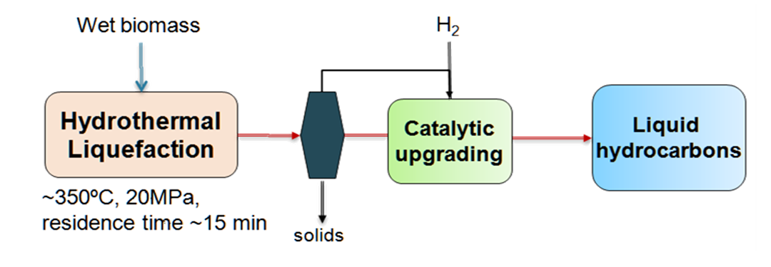
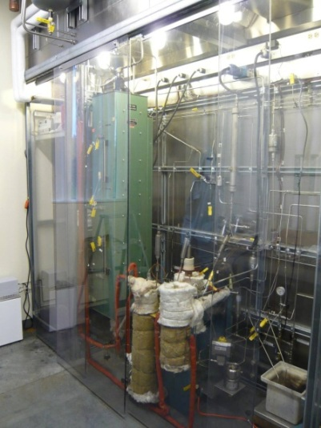

Conversion of Whole Algal Biomass into Fuels
Hydrothermal Liquefaction (HTL)
Hydrothermal liquefaction uses water at sufficient temperature and pressure to convert a wet biomass feedstock directly into a liquid bio-crude oil.
By processing the feedstock wet, the need for drying is eliminated.
Process temperatures are lower compared to dry pyrolysis.
  Current process conditions for the continuous flow system at PNNL are just below the supercritical point of water (350⁰C, 3000 psi).
Bench Scale
Reactor at PNNL
Simplified Process Diagram
Elliott, D. and Oyler, J. (2012). Hydrothermal processing: Efficient production of high-quality fuels from algae. 2nd International Conference on Algal Biomass, Biofuels and Bioproducts, San Diego, CA, June 2012.

Slide 51

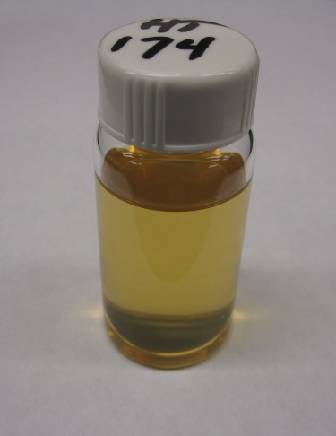
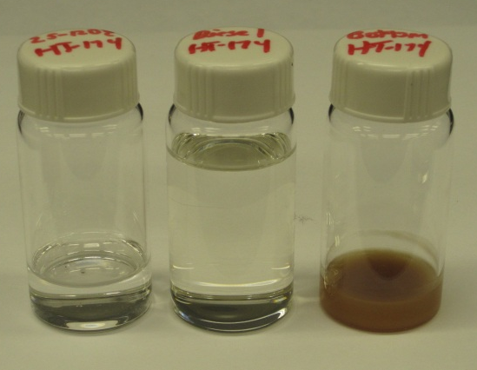
Conversion of Whole Algal Biomass into Fuels
Hydrothermal Liquefaction (HTL)
Hydrothermal liquefaction uses water at sufficient temperature and pressure to convert a wet biomass feedstock directly into a liquid bio-crude oil.
By processing the feedstock wet, the need for drying is eliminated.
Process temperatures are lower compared to dry pyrolysis.
  Current process conditions for the continuous flow system at PNNL are just below the supercritical point of water (350⁰C, 3000 psi).
Feedstock: Wet Nannochloropsis salina Paste
Fractionated cuts: naphtha, diesel, bottoms
HTL Bio-Oil
Hydrotreated HTL Bio-Oil

Slide 52
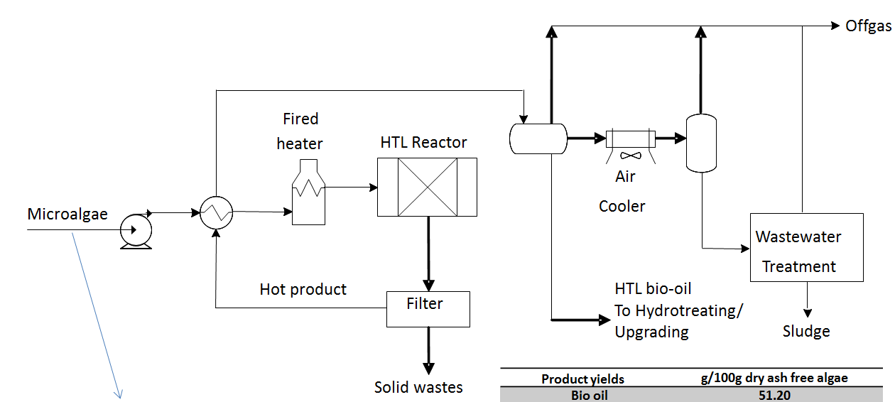
Conversion of Whole Algal Biomass into Fuels
Hydrothermal Liquefaction
PNNL Process: Continuous Flow HTL of Whole Algal Biomass

Slide 53
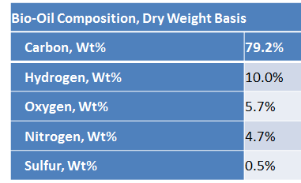

Conversion of Whole Algal Biomass into Fuels
Hydrothermal Liquefaction
PNNL Results: HTL of Whole Algal Biomass
Nannochloropsis salina from Solix BioSystems
Sample was frozen after harvest—no processing or lipid extraction
Wet algae paste, approximately 21% solids.
Parameter | Data
Lipid content of whole algae | 33%
Bio-oil from HTL as % algae mass | 58%
Bio-oil from HTL as % algae AFDW | 64%
% of algae carbon in HTL oil | 69%
Elliott, D. and Oyler, J. (2012). Hydrothermal processing: Efficient production of high-quality fuels from algae. 2nd International Conference on Algal Biomass, Biofuels and Bioproducts, San Diego, CA, June 2012.

Slide 54
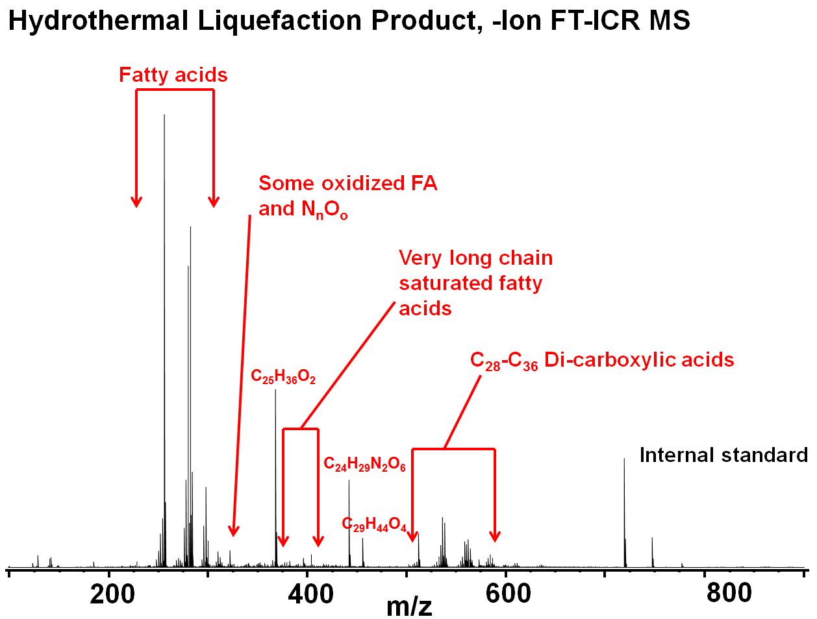
Conversion of Whole Algal Biomass into Fuels
Hydrothermal Liquefaction
Schaub, et al. (2012). Lipid Feedstocks, Produced Ester Fuel and Hydrothermal Liquefaction Products of Nannochloropsis salina: Detailed Compositional Analysis by Ultrahigh Resolution FT-ICR Mass Spectrometry 2nd International Conference on Algal Biomass, Biofuels and Bioproducts, San Diego, CA, June 2012.

Slide 55
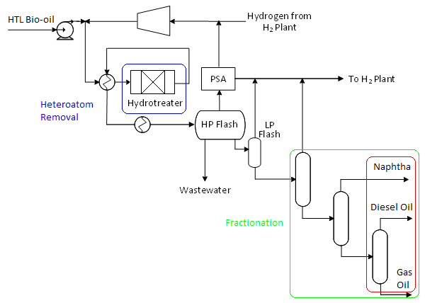
Conversion of Whole Algal Biomass into Fuels
Upgrading of Hydrothermal Liquefaction Bio-Oil
Conversion and upgrading of HTL bio-oils
  Hydrotreating for O, S and N removal
  Hydrocracking/isomerization to finished fuel
  Produces renewable (non-oxygenated) fuel

Slide 56
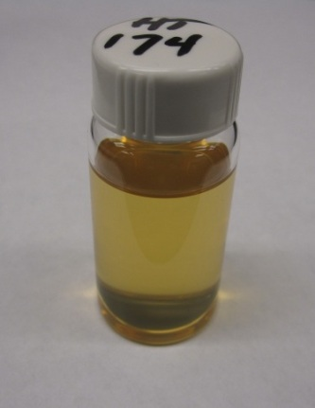
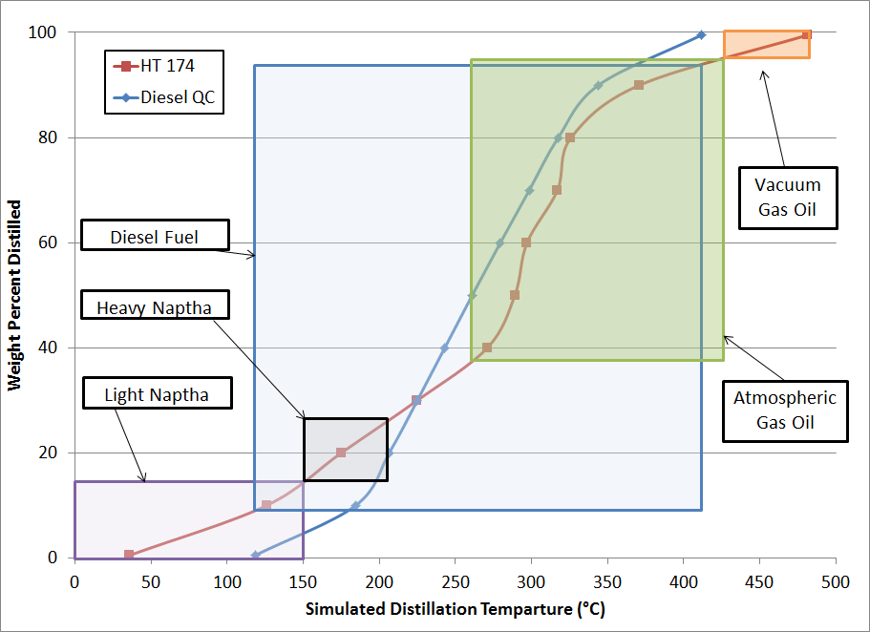
Conversion of Whole Algal Biomass into Fuels
Upgrading of Hydrothermal Liquefaction Bio-Oil
HTL Bio-Oil
Hydrotreated HTL Bio-Oil
Fractionated cuts: naphtha, diesel, bottoms

Slide 57
Review Algal Biofuels Conversion Technologies
Overview
  Motivation for Algal Biofuels
  The Algal Biofuel Value Chain Revisited
  Algal Methyl Ester Biodiesel Properties
  Algal Synthetic Paraffinic Diesel/Jet Fuel Properties
  Algal Hydrothermal Liquefaction Oil Properties
  Conclusions

Slide 58
Review Algal Biofuels Conversion Technologies
Overview
  Motivation for Algal Biofuels
  The Algal Biofuel Value Chain Revisited
  Algal Methyl Ester Biodiesel Properties
  Algal Synthetic Paraffinic Diesel/Jet Fuel Properties
  Algal Hydrothermal Liquefaction Oil Properties
  Conclusions

Slide 59
Conclusions
Phototropic microalgae is a potentially scalable liquid biofuel
The “ambitious” U.S. biofuels goal is 36 billion gal/year by 2022.
300 billion gal/year will be needed in future generations.
  Conventional Lipid to Liquid Fuel Conversion Technologies
  Fractionation necessary (and perhaps desirable) for some algal methyl esters.
  Hydrotreated renewable alkanes (diesel, jet) are ready for scale up.
  Preprocessing of crude lipid extracts must be considered. Not all extracts are alike and they differ from vegetable oil.
  Direct Conversion of Whole Algal Biomass to Liquid Fuels
  Hydrothermal liquefaction looks promising. Can be considered a high-yield, feedstock agnostic, wet extraction process.
  Upgrading to drop-in fuels for jet or diesel via hydrotreating is possible.
  New certification process would be necessary for HTL jet fuel.

Slide 60
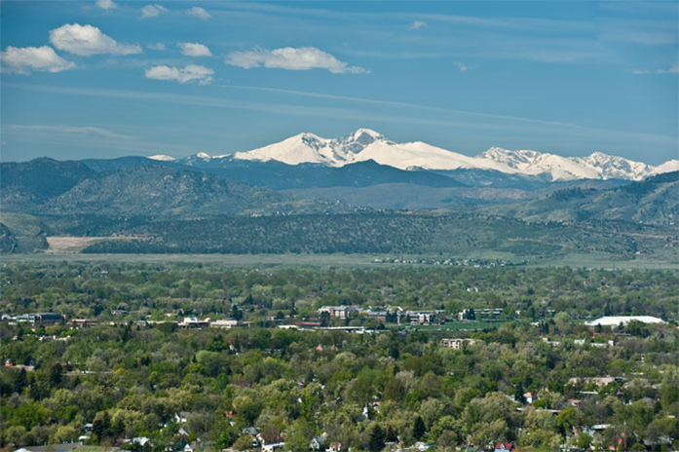
Questions?

