Slide 1
Efficient and Scalable Computation of the Energy and Makespan Pareto Front for Heterogeneous Computing Systems
Kyle M. Tarplee¹,
Ryan Friese¹, Anthony A. Maciejewski¹,
H.J. Siegel^{1,2}
¹Department of Electrical and Computer Engineering
²Department of Computer Science
Colorado State University
Fort Collins, Colorado, USA
2013-09-08

Slide 2
Problem Statement
static scheduling
single bag-of-tasks
task assigned to only one machine
machine runs one task at a time
heterogeneous tasks and machines
desire to reduce energy consumption (operating cost) and makespan
to aid decision makers
find high-quality schedules for both energy and makespan
desire computationally efficient algorithms to compute Pareto fronts

Slide 3
Outline
linear programming lower bound
recovering a feasible allocation to form an upper bound
Pareto front generation techniques
comparison with NSGA-II
complexity and scalability

Slide 4
Preliminaries
simplifying approx: tasks are divisible among machines
T_{i} − number of tasks of type i
M_{j} − number of machines of type j
x_{ij} − number of tasks of type i assigned to machine type j
ETC_{ij} − estimated time to compute for a task of type i running on a machine of type j
finishing time of machine type j (lower bound):
APC_{ij} − average power consumption for a task of type i running on a machine of type j
APC_{Øj} − idle power consumption for a machine of type j
Notes:
Bavesh said I should use “Symbol” font for the variables but I tried that and it won’t match the equations. I think I’ll stick with italics.

Slide 5
Objective Functions
makespan (lower bound)
energy consumed by the bag-of-tasks (lower bound)
note that energy is a function of makespan when we have non-zero idle power consumption

Slide 6
Linear Bi-Objective Optimization Problem

Slide 7
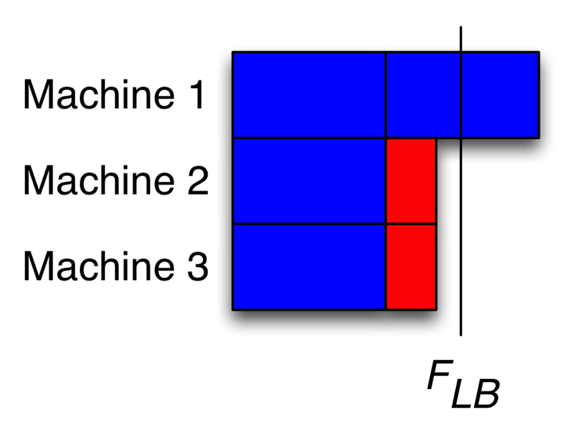
Linear Programming Lower Bound Generation
solve for x_{ij}∈ℝ to obtain a lower bound
generally infeasible solution to the actual scheduling problem
a lower bound for each objective function (tight in practice)
solve for x_{ij}∈ℤ to obtain a tighter lower bound
requires branch and bound (or similar)
typically this is computationally prohibitive
still making the assumption that tasks are divisible among machines

Slide 8
Recovering a Feasible Allocation: Round Near
find ẋ_{ij}∈ℤ that is “near” to x_{ij} while maintaining the task assignment constraint
for task type (each row in x) do
let n = T_{i}−∑_{j} floor(x_{ij})
let f_{j} = frac(x_{ij}) be the fractional part of x_{ij}
let set K be the indices of the n largest f_{j}
ẋ_{ij} = ceil(x_{ij}) if j∈K else floor(x_{ij})
x_{i} = | 3 | 0 | 6 | 5 | 0
ẋ_{i} = | 3 | 0 | 6 | 5 | 0
x_{i} = | 3 | 2.3 | 6.3 | 5.4 | 0
ẋ_{i} = | 3 | 2 | 6 | 6 | 0
x_{i} = | 3 | 0 | 6.6 | 5.4 | 0
ẋ_{i} = | 3 | 0 | 7 | 5 | 0
x_{i} = | 3.9 | 2.2 | 6.4 | 5.3 | 4.2
ẋ_{i} = | 4 | 2 | 7 | 5 | 4

Slide 9
Recovering a Feasible Allocation: Local Assignment
given integer number of tasks for each machine type
assign tasks to actual machines within a homogeneous machine type via a greedy algorithm
for each machine type (column in ẋ) do longest processing time algorithm
while any tasks are unassigned
assign longest task (irrevocably) to machine that has the earliest finish time
update machine finish time

Slide 10
Pareto Front Generation Procedure
step 1 weighted sum scalarization
step 1.1 find the utopia (ideal) and nadir (non-ideal) points
step 1.2 sweep α between 0 and 1
at each step solve the linear programming problem
step 1.3 remove duplicates
linear objective functions and convex constraints
convex, lower bounds on Pareto front
step 2 round each solution
step 3 remove duplicates
step 4 locally assign each solution
step 5 remove duplicates and dominated solutions
full allocation is an upper bound on the true Pareto front
Notes:
Maybe define delta E and delta MS

Slide 11
Simulation Results
simulation setup
ETC matrix derived from actual systems
9 machine types, 36 machines, 4 machines per type
30 task types, 1100 tasks, 11-75 tasks per type
Non-dominated Sorting Genetic Algorithm II
NSGA-II is another algorithm for finding the Pareto front
an adaptation of classical genetic algorithms
basic seed
min energy, min-min completion time, and random
full allocation seed
all solutions from upper bound Pareto front

Slide 12
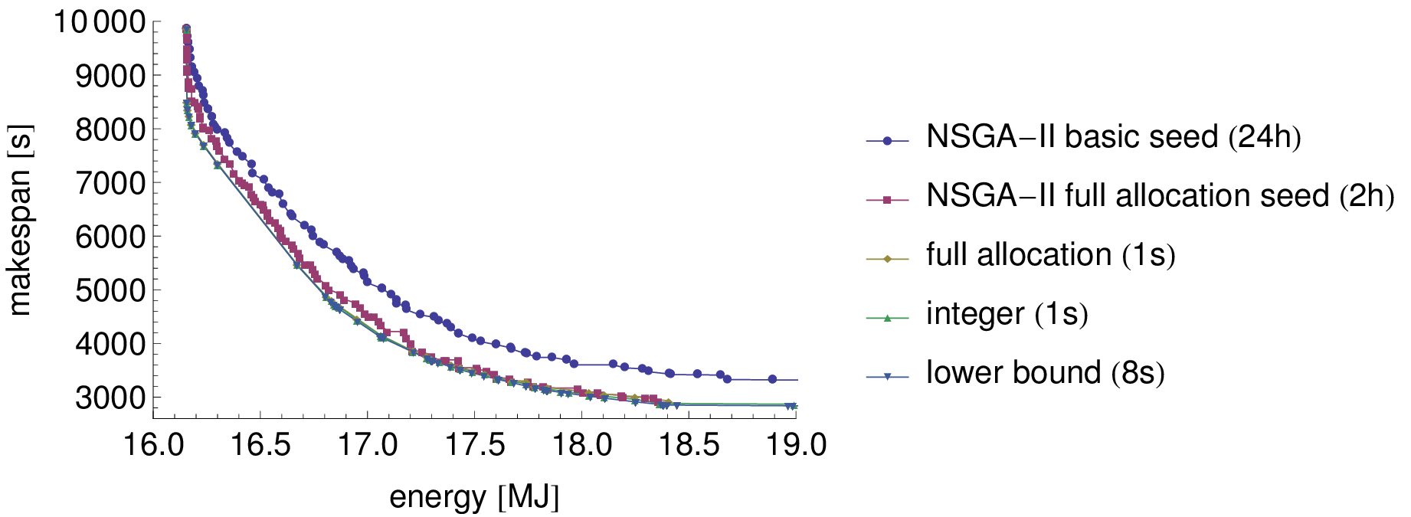
Pareto Fronts

Slide 13
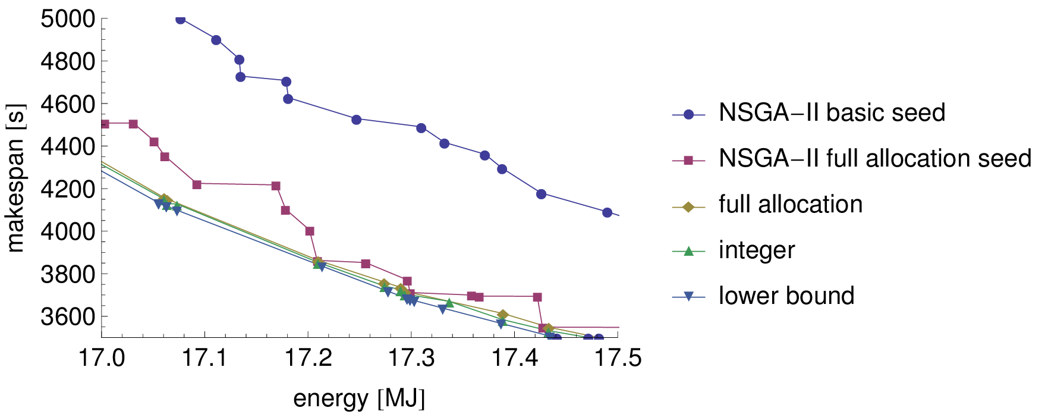
Pareto Fronts (Zoomed)

Slide 14
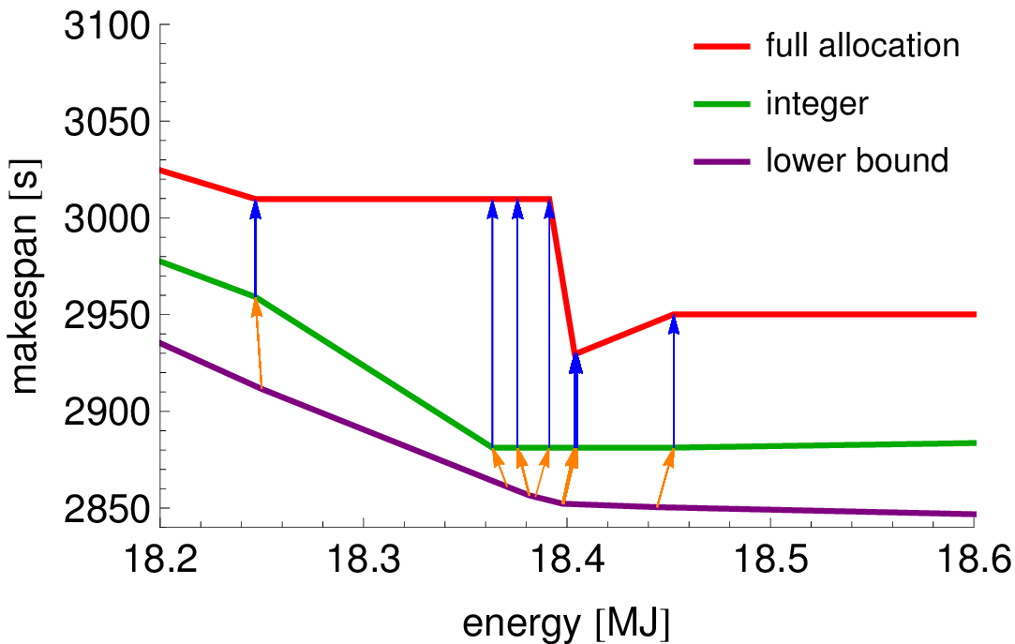
Lower Bound to Full Allocation, No Idle Power

Slide 15
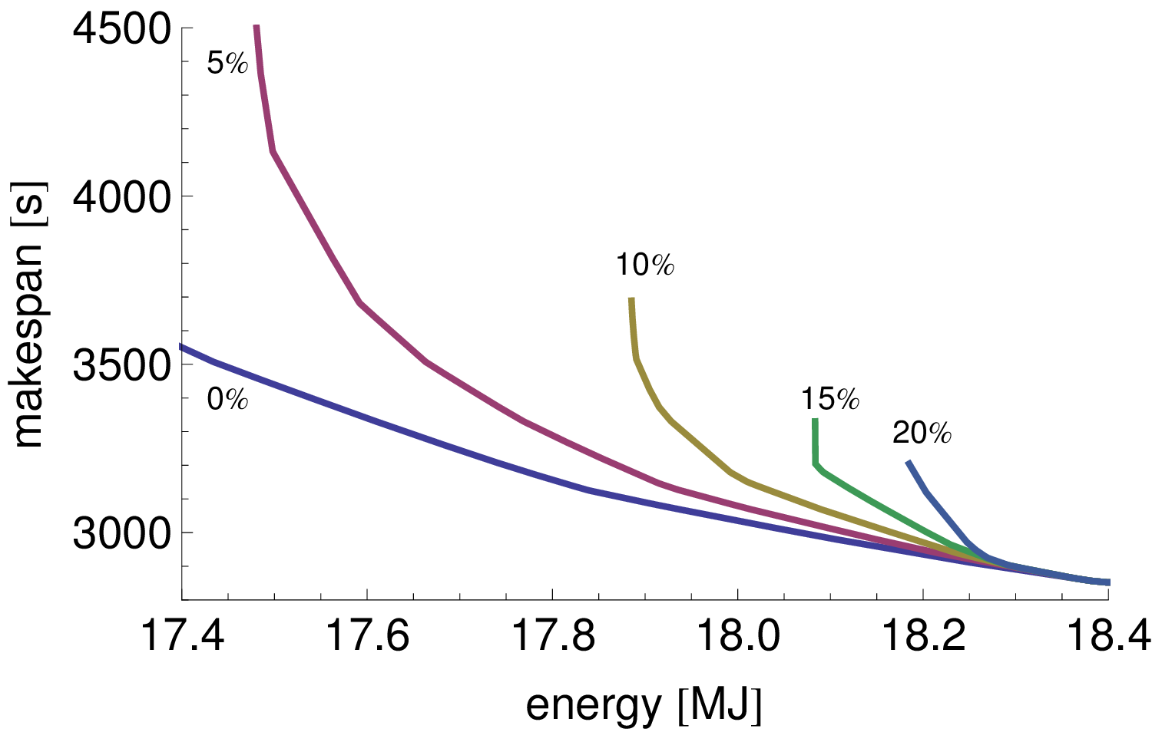
Effect of Idle Power

Slide 16
Complexity
let the ETC matrix be T×M
linear programming lower bound
average complexity (T+M)² (TM+1)
rounding step: T(M log M)
local assignment step:
number of tasks for machine type j is n_{j} = ∑_{i} x_{ij}
worst cast complexity is M max_{j} (n_{j} log n_{j} + n_{j} log M_{j})
complexity of all steps is dominated by either
linear programming solver
local assignment
complexity of linear programming solver is independent of the number tasks and machines
depends number of task types and machine types

Slide 17
Impact of Number of Tasks
number of task types, machines, and machine types held constant
Notes:
FrameLabel and bigger text

Slide 18
Impact of Number of Machines
number of tasks, task types, and machine types held constant

Slide 19
Impact of Number of Task Types
number of tasks, machines, and machine types held constant

Slide 20
Contributions
algorithms to compute
tight lower bounds on the energy and makespan
quickly recovers near optimal feasible solutions
high quality bi-objective Pareto fronts
evaluation of the scaling properties of the proposed algorithms
Notes:
I removed this contribution that we had in the paper (it’s really minor).
-- inclusion of idle power consumption to the formulation of the energy/makespan problem

Slide 21
Conclusions
this linear programming approach to Pareto front generation is efficient, accurate, and practical
bounds are tight when
a small percentage of tasks are divided
a large number of tasks assigned to each machine type and individual machine
asymptotic solution quality and runtime are very reasonable

Slide 22
Questions?

Slide 23
Backup Slides

Slide 24
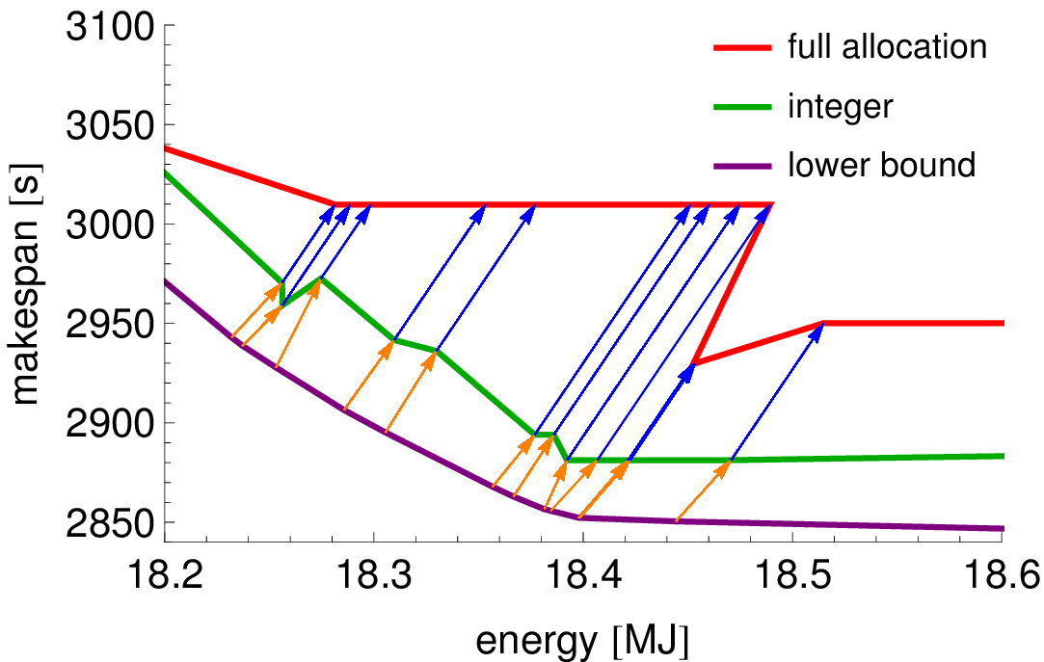
Lower Bound to Full Allocation, 10% Idle Power

Slide 25
Impact of Number of Machine Types
number of tasks, task types, and machines held constant
Notes:
I can drop this slide

