Slide 1
INTRODUCTION
Presentation Name

Slide 2
Title goes here
• BULLET POINT
• BULLET POINT
• BULLET POINT
• BULLET POINT
• BULLET POINT
• BULLET POINT
• BULLET POINT
• BULLET POINT
• BULLET POINT
• BULLET POINT
• BULLET POINT
• BULLET POINT
• BULLET POINT
• BULLET POINT
• BULLET POINT

Slide 3
Title goes here
• BULLET POINT
• BULLET POINT
• BULLET POINT
• BULLET POINT
• BULLET POINT
• BULLET POINT
• BULLET POINT
• BULLET POINT
• BULLET POINT
• BULLET POINT
• BULLET POINT
• BULLET POINT
• BULLET POINT
• BULLET POINT
• BULLET POINT

Slide 4
Title goes here
• BULLET POINT
• BULLET POINT
• BULLET POINT
• BULLET POINT
• BULLET POINT
• BULLET POINT
• BULLET POINT
• BULLET POINT
• BULLET POINT
• BULLET POINT
• BULLET POINT
• BULLET POINT
• BULLET POINT
• BULLET POINT
• BULLET POINT

Slide 5
Title goes here
• BULLET POINT
• BULLET POINT
• BULLET POINT
• BULLET POINT
• BULLET POINT
• BULLET POINT
• BULLET POINT
• BULLET POINT
• BULLET POINT
• BULLET POINT
• BULLET POINT
• BULLET POINT
• BULLET POINT
• BULLET POINT
• BULLET POINT

Slide 6
Title goes here
• BULLET POINT
• BULLET POINT
• BULLET POINT
• BULLET POINT
• BULLET POINT
• BULLET POINT
• BULLET POINT
• BULLET POINT
• BULLET POINT
• BULLET POINT
• BULLET POINT
• BULLET POINT
• BULLET POINT
• BULLET POINT
• BULLET POINT

Slide 7
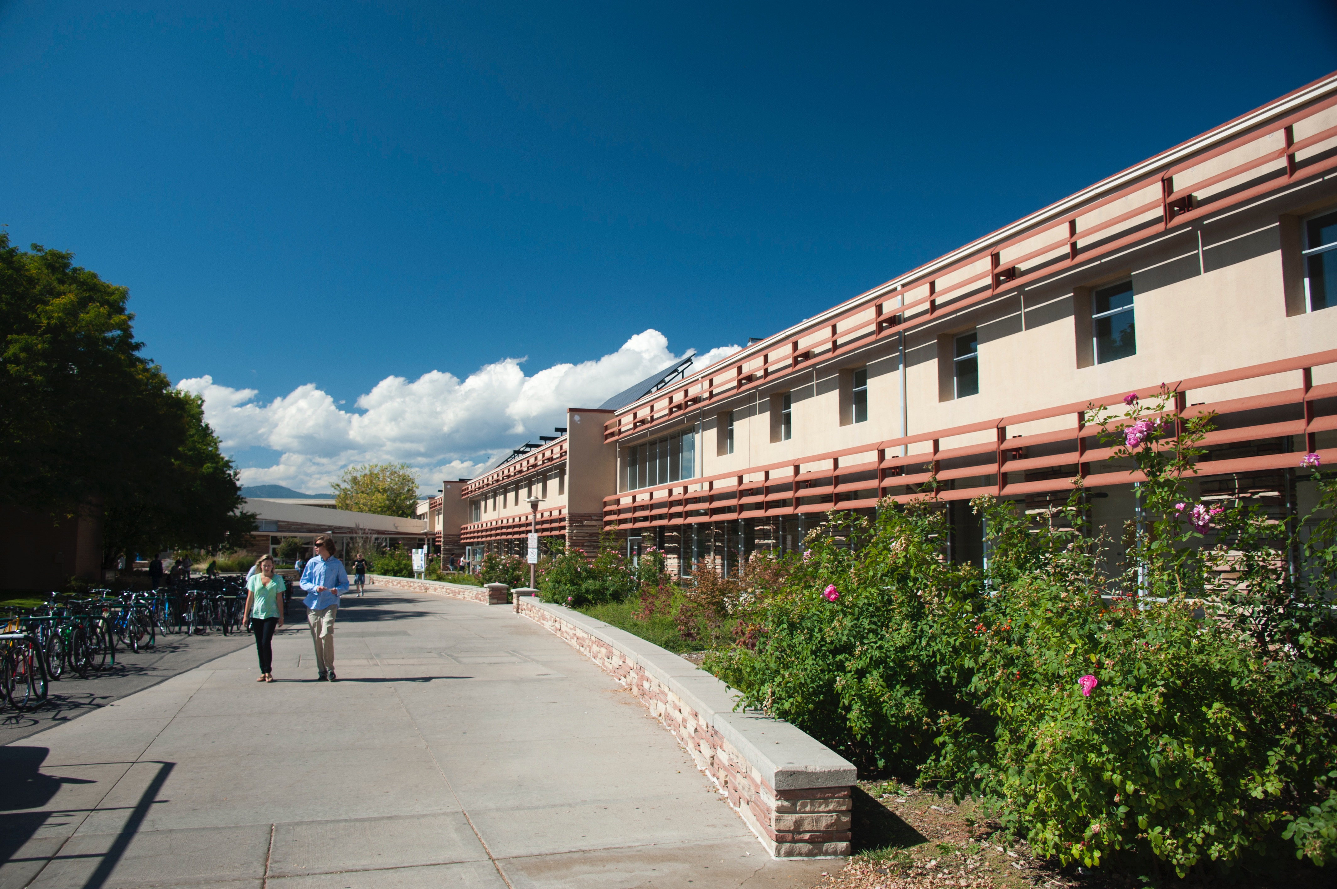

Slide 8
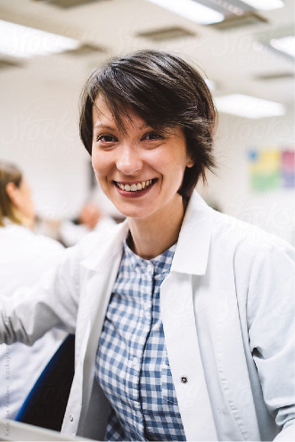
Title goes here
Our graduates are well prepared for careers and advanced study. At Colorado State, our undergraduate and graduate students work closely with faculty and each other. Student design teams have made discoveries leading to patents, new products, and start-up companies. Our alumni have gone on to distinguished careers as innovators in industry, outstanding educators, and highly ranked government leaders.

Slide 9
Title goes here
Our graduates are well prepared for careers and advanced study. At Colorado State, our undergraduate and graduate students work closely with faculty and each other. Student design teams have made discoveries leading to patents, new products, and start-up companies. Our alumni have gone on to distinguished careers as innovators in industry, outstanding educators, and highly ranked government leaders.

Slide 10
Title goes here
Our graduates are well prepared for careers and advanced study. At Colorado State, our undergraduate and graduate students work closely with faculty and each other. Student design teams have made discoveries leading to patents, new products, and start-up companies. Our alumni have gone on to distinguished careers as innovators in industry, outstanding educators, and highly ranked government leaders.

Slide 11
Title goes here
Our graduates are well prepared for careers and advanced study. At Colorado State, our undergraduate and graduate students work closely with faculty and each other. Student design teams have made discoveries leading to patents, new products, and start-up companies. Our alumni have gone on to distinguished careers as innovators in industry, outstanding educators, and highly ranked government leaders.

Slide 12
Title goes here
Our graduates are well prepared for careers and advanced study. At Colorado State, our undergraduate and graduate students work closely with faculty and each other. Student design teams have made discoveries leading to patents, new products, and start-up companies. Our alumni have gone on to distinguished careers as innovators in industry, outstanding educators, and highly ranked government leaders.

Slide 13
Title goes here
Our graduates are well prepared for careers and advanced study. At Colorado State, our undergraduate and graduate students work closely with faculty and each other. Student design teams have made discoveries leading to patents, new products, and start-up companies. Our alumni have gone on to distinguished careers as innovators in industry, outstanding educators, and highly ranked government leaders.

