Slide 1
CIVE 717 River Mechanics
Dissolved Oxygen & Contaminants / Toxicity Within Stream Restoration
By:
Joshua Sperry

Slide 2
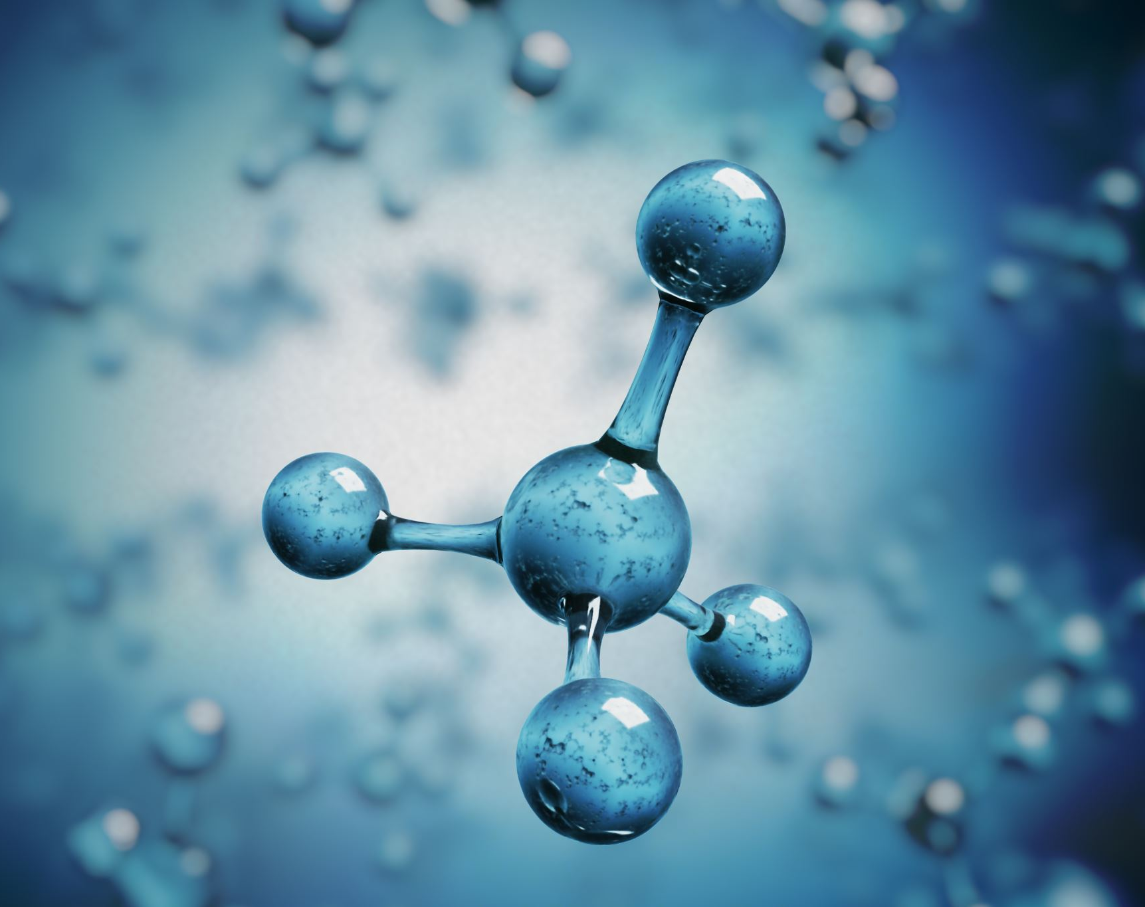
Dissolved Oxygen
Overview
Written Content:
Julien, Pg.361-365

Slide 3
Saturated Dissolved Oxygen
Drop with Temperature (fish species seek cold water during summer)
Oxygen depletion greatest during summer due to increased temperature & low river flows

Slide 4
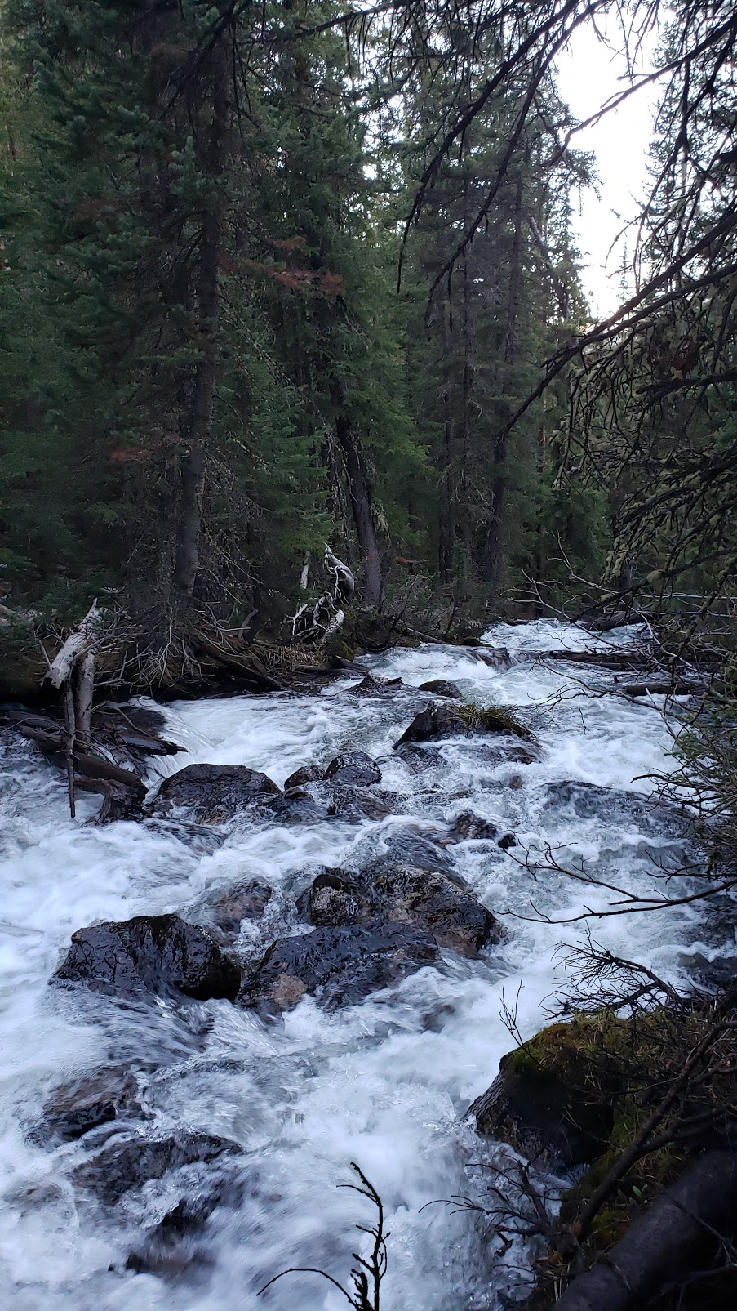
Reaeration Rates
Increases with flow velocity
Decreases with flow depth

Slide 5
Biochemical Oxygen Demand (BOD)
Dissolved oxygen consumed by living organisms under aerobic conditions.
Carbonaceous (CBOD) from carbohydrates / organic matter
Nitrogenous (NBOD) break down of organic-N to ammonia
Notes:
https://ib.bioninja.com.au/_Media/eutrophication-2_med.jpeg

Slide 6
Domestic and Industrial Waste have higher levels of BOD.
Deplete DO of surface water and decrease aquatic biodiversity
When waste is added to river the oxygen consumption can exceed the oxygen supply from reaeration.
Important Equations (Julien, Pg. 364)
$$D_{x}=\frac{k_{1}L_{0}}{k_{2}−k_{1}}\left(e^{−\frac{k_{1}x}{V}}−e^{−\frac{k_{2}x}{V}}\right)+{D_{0}}^{k_{2}x/V}$$
$x_{max}=\frac{V}{k_{2}−k_{1}}ln⁡\{\frac{k_{2}}{k_{1}}\left[1−\frac{D_{0}\left(k_{2}−k_{1}\right)}{L_{0}k_{1}}\right]$}
$${DO}_{x}={DO}_{sat}−D_{x}$$
Variables:
$k_{1}$= Oxygen Depletion Rate, $k_{2}$= Reaeration Constant, $L_{0}$= Initial Load, V =Flow velocity, $x_{max}$= Downstream Distance with max. oxygen deficit, ${DO}_{sat}$= Dissolved Oxygen, ${DO}_{x}$= Minimum Dissolved Oxygen

Slide 7
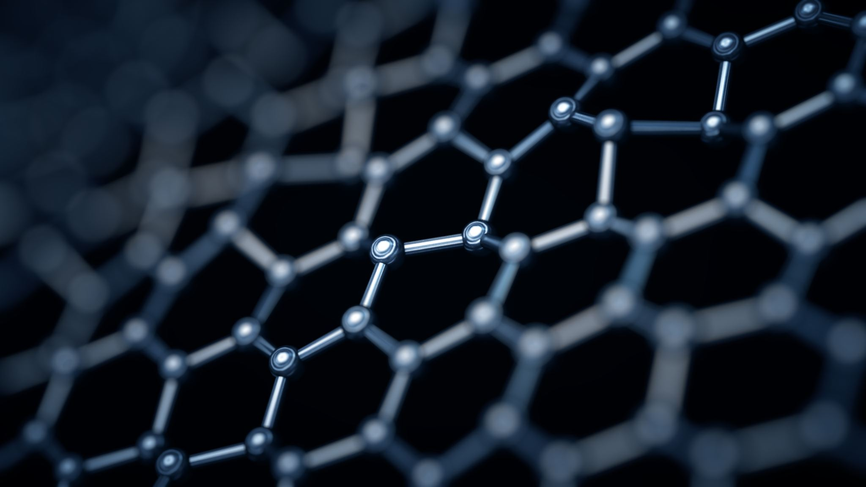
Contaminant and toxicity
Written content:
Julien, Pg. 367-371

Slide 8
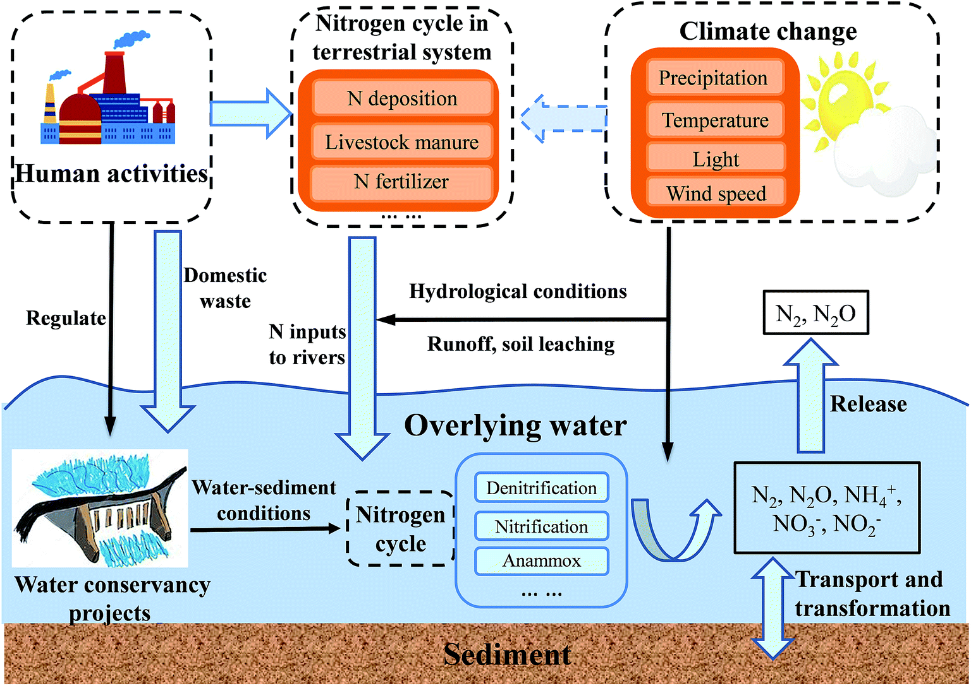
Nitrogen Cycle
Bacterial Fixation → atmospheric nitrogen (N2) → ammonia through nitrogen fixation
Plants → Incorporate Nucleic Acids and proteins that sustain the food chain
Ammonia is toxic to aquatic life
Notes:
https://pubs.rsc.org/image/article/2018/EM/c8em00042e/c8em00042e-f3_hi-res.gif

Slide 9
Nutrients
Ammonia Nitrate requires oxygen → leads to depletion of dissolved oxygen
Agricultural areas have excessive fertilizers, untreated surface water has excess phosphorus → algae growth and cause water-quality problems, oxygen depletion (which kills fish), rotting of algal mats
Increased nutrients and organic matter → causes eutrophication
Notes:
https://www.google.com/url?sa=i&url=https%3A%2F%2Fwww.britannica.com%2Fstory%2Fharmful-algal-blooms&psig=AOvVaw2cU3NXUZ28L9RKqVZ_67BY&ust=1619018985127000&source=images&cd=vfe&ved=0CAIQjRxqFwoTCMjL2L2SjfACFQAAAAAdAAAAABAD

Slide 10
Mining
Runoff can lead to yellow ferric hydroxide on stream beds → eliminates macroinvertebrate habitat in hyporheic zone.
Low pH runoff → dissolves metals → increases water hardness and dissolved solids
Notes:
https://www.google.com/url?sa=i&url=https%3A%2F%2Fskytruth.org%2F2015%2F10%2Fmapping-abandoned-coal-mines%2F&psig=AOvVaw2EJTtLKtJlPKOM8DE168E0&ust=1619019512087000&source=images&cd=vfe&ved=0CAIQjRxqFwoTCLDHyeqTjfACFQAAAAAdAAAAABAO

Slide 11
Wetland
Can remove contaminants, nitrates, and phosphates
High organic matter → increase adsorption → decrease dissolved contaminant concentration
Sand-gravel filter less effective at removing hydrophobic contaminants.
Acute Toxicity → high concentrations over short periods (hours / days)
Chronic Toxicity → high concentration over long periods (weeks to years)
Notes:
https://link.springer.com/chapter/10.1007/978-981-13-0149-0_12

Slide 12
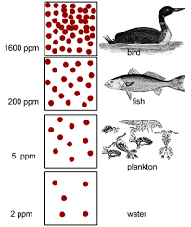
Bioaccumulation
Defined as, ”accumulation of contaminants in the biomass of aquatic species from long-term exposure” (Julien, Pg. 370)
Eating 100g of fish contains 0.03 mg of biphenyls (PCB), whereas 100 liters of water has 0.0012 mg.
Radionuclides → radioactive decay of k=0.693/t50.
Becquerel (Bq) → decay of atoms per second
Most soluble radionuclide is Sr90
Notes:
https://encrypted-tbn0.gstatic.com/images?q=tbn:ANd9GcSCCJlnZiDdLhyJI3IDjqR026qPJO4T4smM609seWAtYIgwTxbD_3k7rHEHoB1xZ7Ar6nw&usqp=CAU
https://sites.sandiego.edu/sdpollutiontrackers/files/2018/04/PCB_Food_Chain_Marine_Plankton_Herring_Salmon_Mammals.jpg

Slide 13
References:
Slide 3 Picture: Julien, Pg. 364
Slide 5 Picture: https://ib.bioninja.com.au/_Media/eutrophication-2_med.jpeg
Slide 8 Picture: https://pubs.rsc.org/image/article/2018/EM/c8em00042e/c8em00042e-f3_hi-res.gif
Slide 9 Picture: https://www.google.com/url?sa=i&url=https%3A%2F%2Fwww.britannica.com%2Fstory%2Fharmful-algal-blooms&psig=AOvVaw2cU3NXUZ28L9RKqVZ_67BY&ust=1619018985127000&source=images&cd=vfe&ved=0CAIQjRxqFwoTCMjL2L2SjfACFQAAAAAdAAAAABAD
Slide 10 Picture: https://www.google.com/url?sa=i&url=https%3A%2F%2Fskytruth.org%2F2015%2F10%2Fmapping-abandoned-coal-mines%2F&psig=AOvVaw2EJTtLKtJlPKOM8DE168E0&ust=1619019512087000&source=images&cd=vfe&ved=0CAIQjRxqFwoTCLDHyeqTjfACFQAAAAAdAAAAABAO
Slide 11Picture: https://link.springer.com/chapter/10.1007/978-981-13-0149-0_12
Slide 12 Picture: https://encrypted-tbn0.gstatic.com/images?q=tbn:ANd9GcSCCJlnZiDdLhyJI3IDjqR026qPJO4T4smM609seWAtYIgwTxbD_3k7rHEHoB1xZ7Ar6nw&usqp=CAU
https://sites.sandiego.edu/sdpollutiontrackers/files/2018/04/PCB_Food_Chain_Marine_Plankton_Herring_Salmon_Mammals.jpg
Book
Julien, Pierre Y. River Mechanics. Cambridge University Press, 2018.

