Slide 1
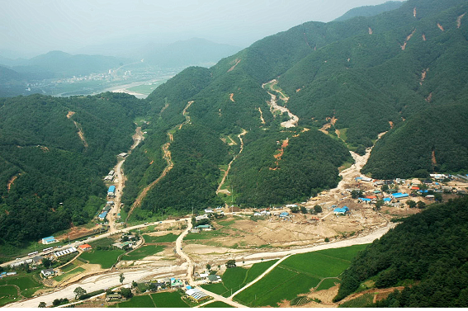
Understanding Debris Flow Mechanics to Reduce Urban Disasters
Pierre Julien
Colorado State University
3rd Asia Conference on Urban Disaster Reduction
Seoul, South Korea, November 28, 2015

Slide 2
Objectives
Provide guidelines for designing mitigation countermeasures based on the type of hyperconcentrated flow

Slide 3
Classification and Rheology
Total shear stress :
τ = τ y+ τ _{v}+ τ _{t}+ τ _{d}
Landslides Yield stress
Mudflows Viscous stress
Mudfloods Turbulent stress
Debris flows Dispersive stress

Slide 4
1. Landslides

Slide 5
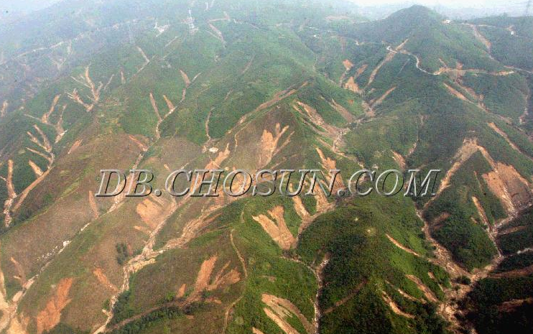
Mangun mountain, South Korea

Slide 6
Infinite Slope Model
C. TREX + Infinite Slope Model

Slide 7
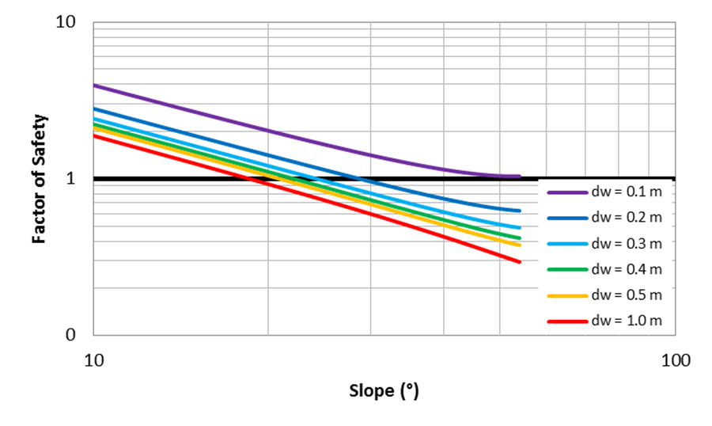
Critical Slope Analysis
C. TREX + Infinite Slope Model
Stable
C= 0.7 kPa
φ= 33°
Unstable
25°
29°

Slide 8
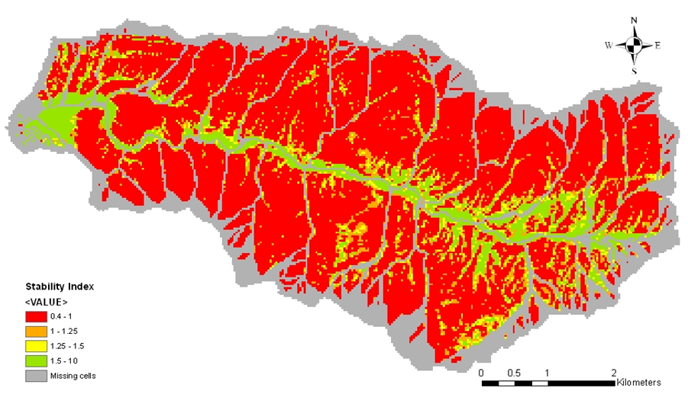
Static Modeling with SINMAP

Slide 9
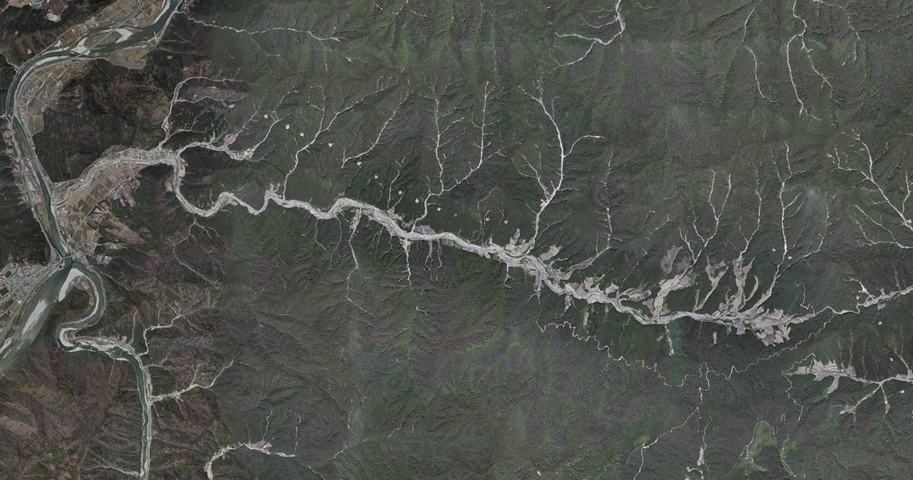
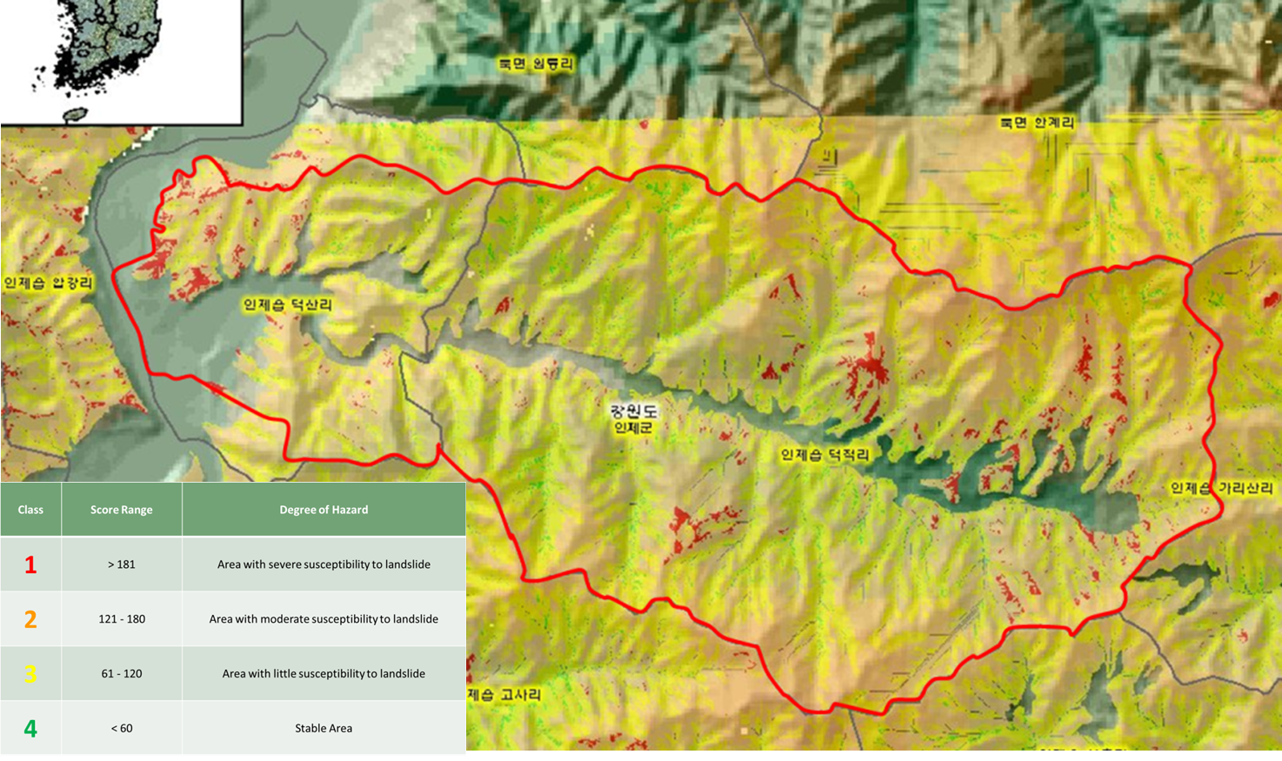
Duksan Creek, Inje Gun, SK

Slide 10
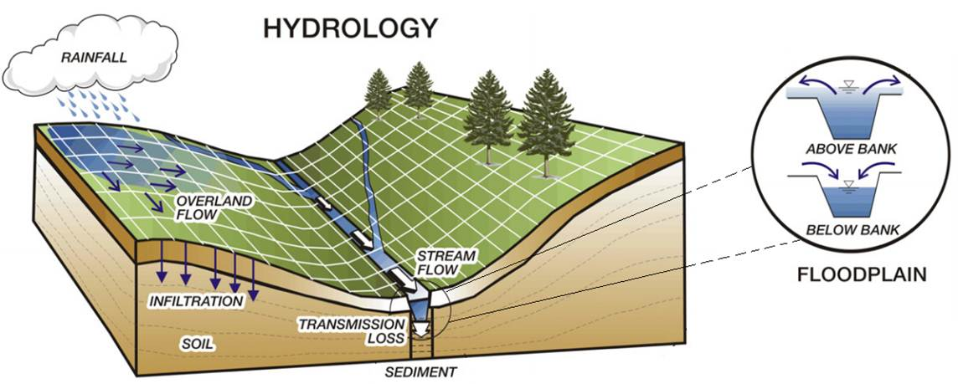
Dynamic Modeling with TREX

Slide 11
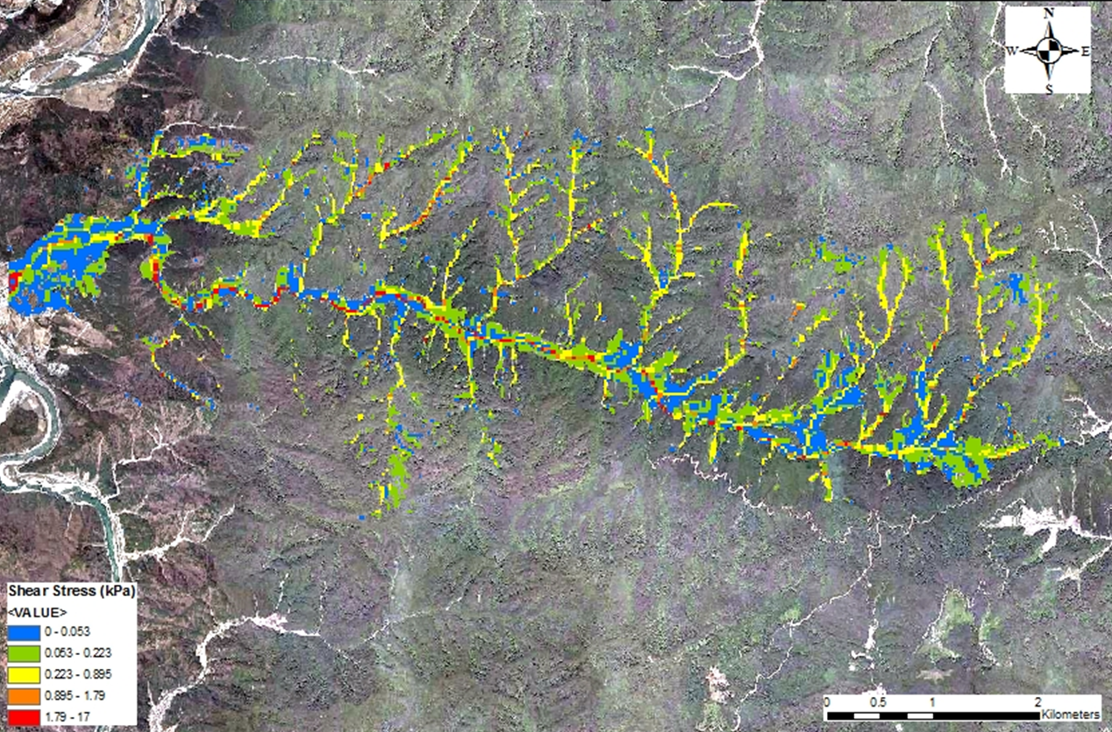
 | Shear stress (kPa) | Bed material class name | ds (mm)
 | 0 – 0.053 | Up to gravel | <=64
 | 0.053 – 0.223 | Cobble | >64
 | 0.223 – 0.895 | Small and medium Boulder | >256
 | 0.895 – 1.79 | Large Boulder | >1,024
 | 1.79 - 17 | Very large boulder | >2,048

Slide 12
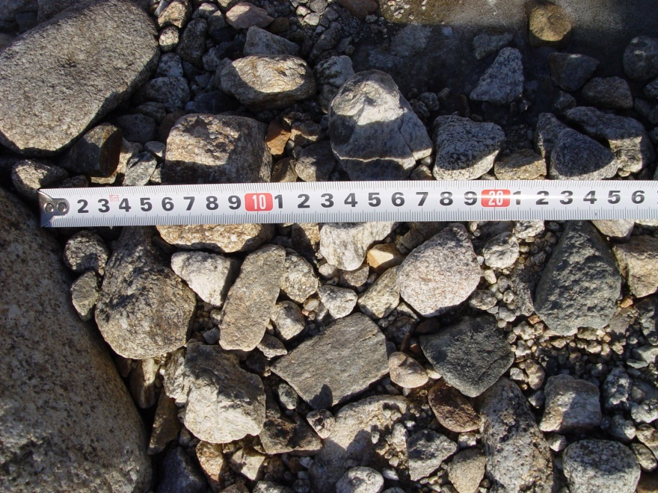
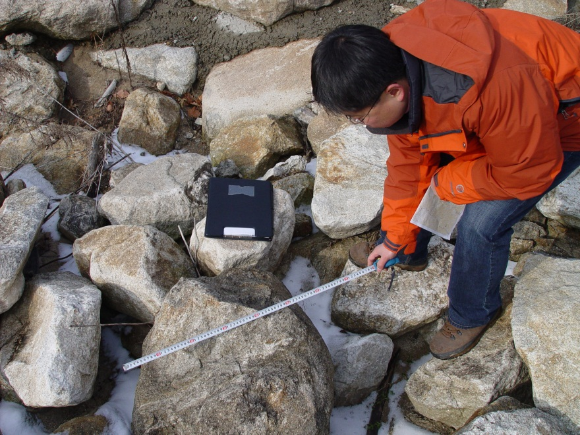
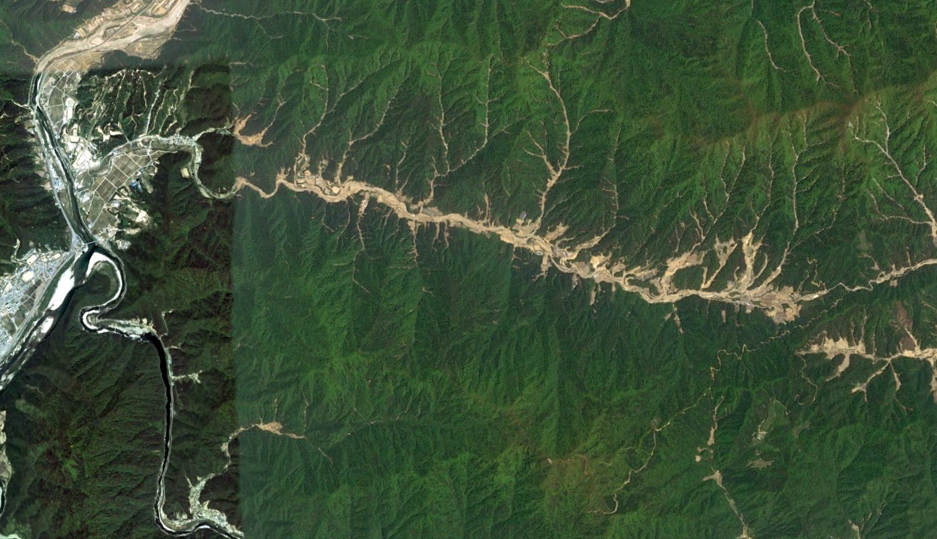
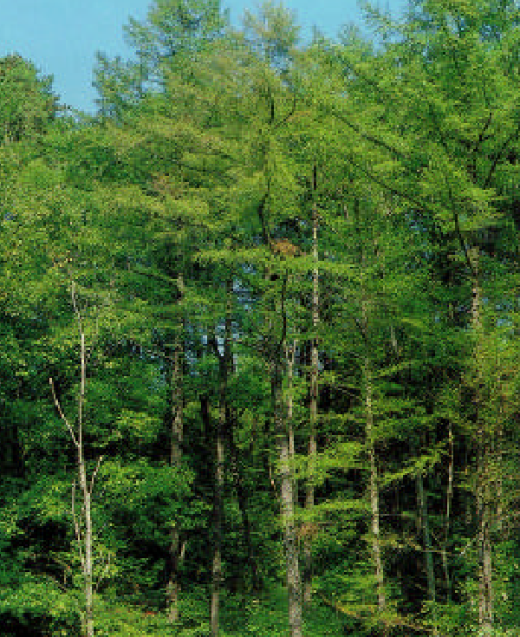
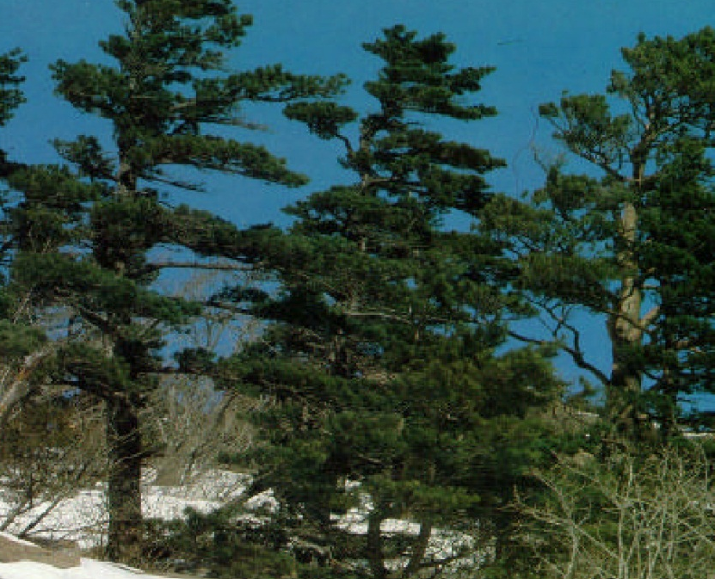
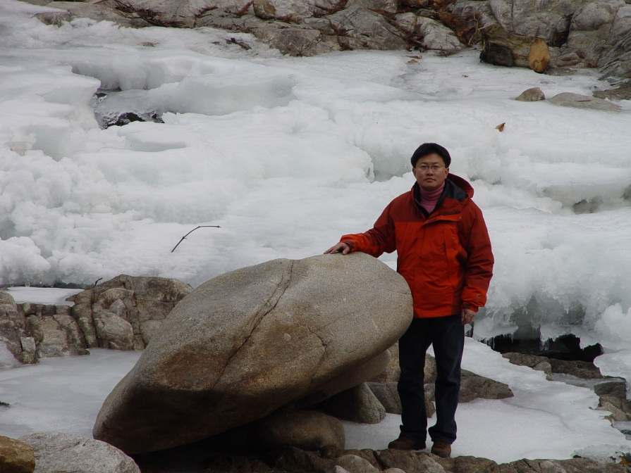
Site Comparison
Q
Duksan Creek
Larix Leptolepis
Pinus Koraiensis

Slide 13
Landslides
Steep hillslopes
High rainfall precipitation
High Infiltration
Saturated yield strength ~ 1kPa

Slide 14
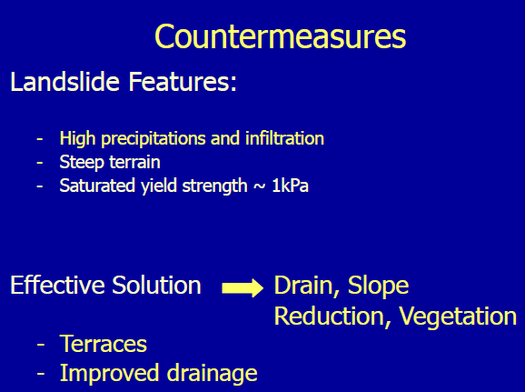

Slide 15
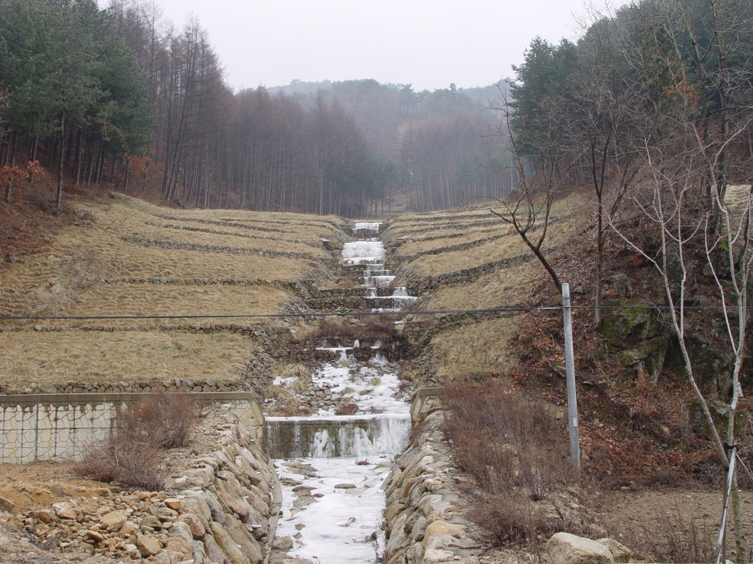
Landslide Countermeasures
Effective Solution
Slope reduction, drain, vegetation
Terraces
Drainage

Slide 16
2. Mudflows

Slide 17
Classification and Rheology
Total shear stress :
τ = τ y+ τ _{v}+ τ _{t}+ τ _{d}
Landslides Yield stress
Mudflows Viscous stress
Mudfloods Turbulent stress
Debris flows Dispersive stress

Slide 18
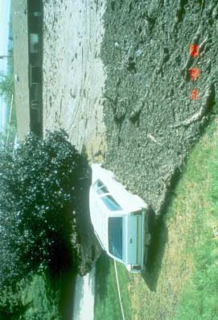
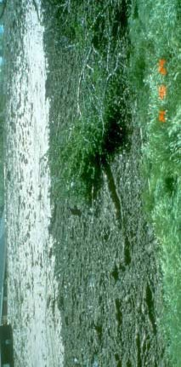

Slide 19
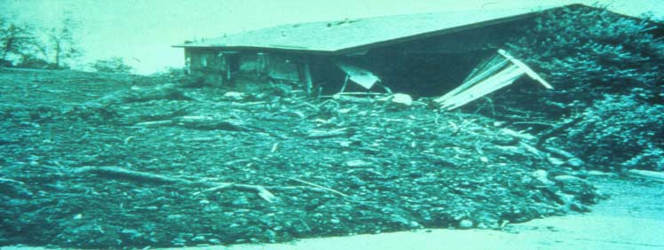
Mudflow
High viscosity and yield stress
High concentration of silts and clays
• 45% < Cv < 55%
Low velocity
Low Froude Number
No abrasion
Large flow depths
High pressure

Slide 20
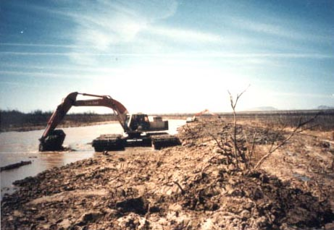

Slide 21
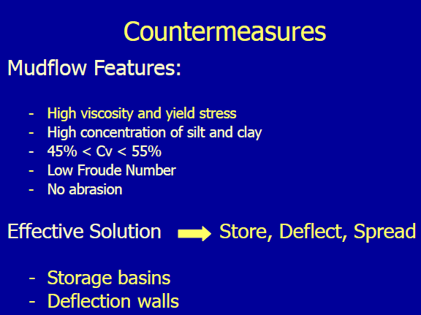

Slide 22
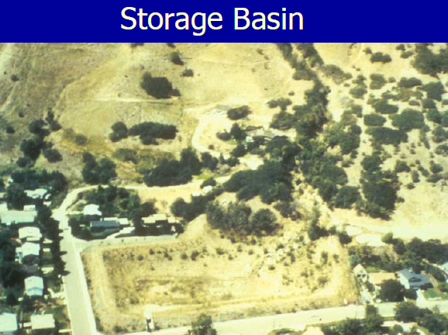

Slide 23
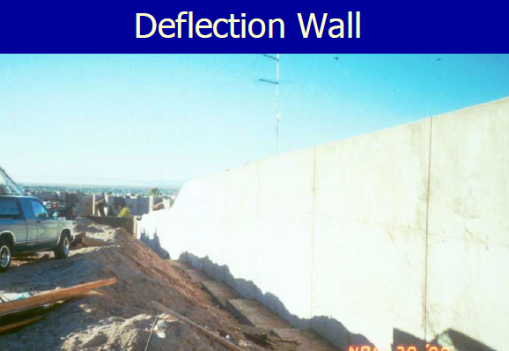

Slide 24
Mudflow Countermeasures
Effective Solution
Store, Deflect, Spread
Storage basins
Deflection walls

Slide 25
3. Mudfloods

Slide 26
Classification and Rheology
Total shear stress :
τ = τ y+ τ _{v}+ τ _{t}+ τ _{d}
Landslides Yield stress
Mudflows Viscous stress
Mudfloods Turbulent stress
Debris flows Dispersive stress

Slide 27
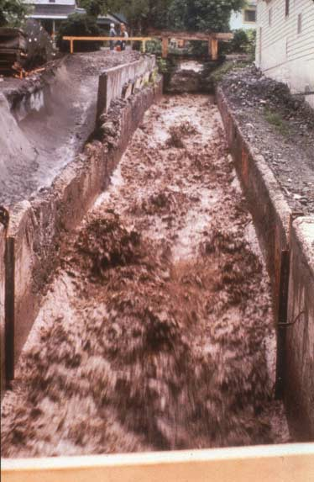
Mud Flood
Turbulent
Non-cohesive particles
Small particles
Cv as high as 40%
High velocity
High Froude Number
Abrasive

Slide 28
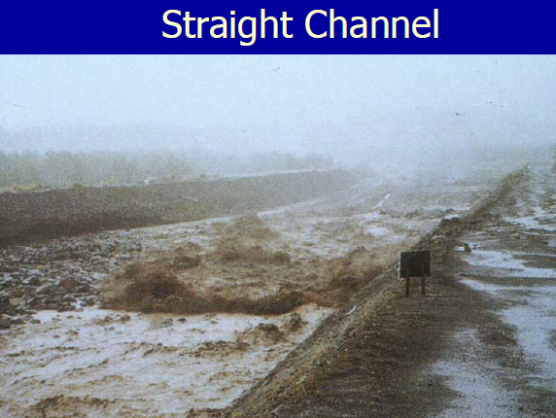

Slide 29
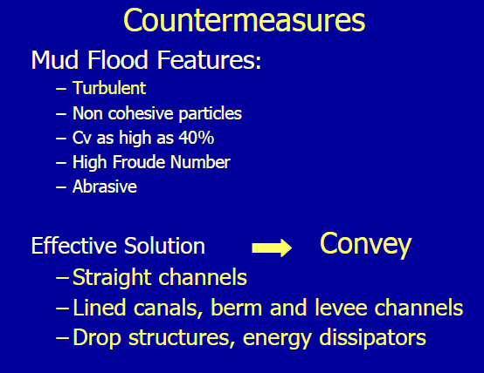

Slide 30
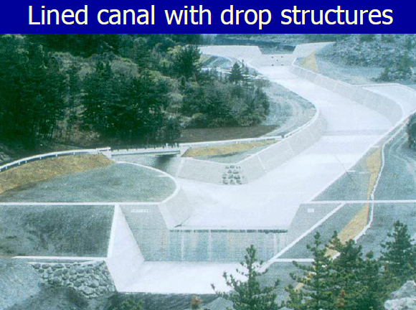

Slide 31
Mudflood Countermeasures
Increased conveyance
Effective Solution
Straight channel
Lined canal
Berm and levee
Drop structure

Slide 32
4. Debris Flows

Slide 33
Classification and Rheology
Total shear stress :
τ = τ y+ τ _{v}+ τ _{t}+ τ _{d}
Landslides Yield stress
Mudflows Viscous stress
Mudfloods Turbulent stress
Debris flows Dispersive stress

Slide 34
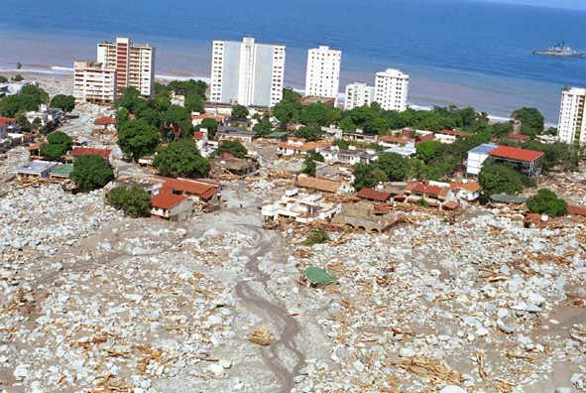

Slide 35
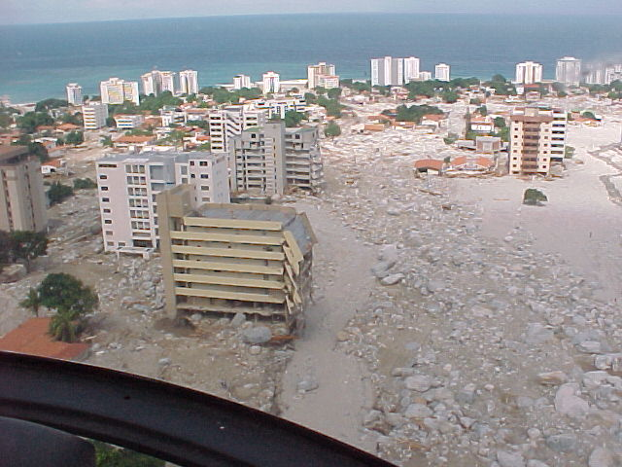
LOS CORALES

Slide 36
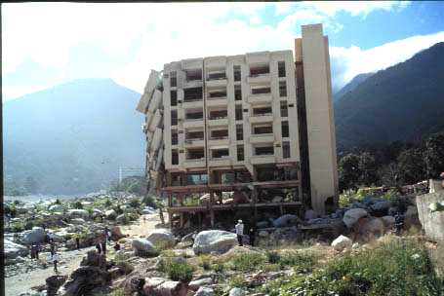
Los Corales

Slide 37
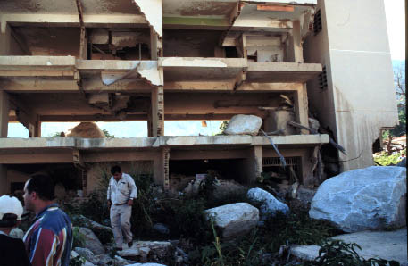
Los Corales

Slide 38
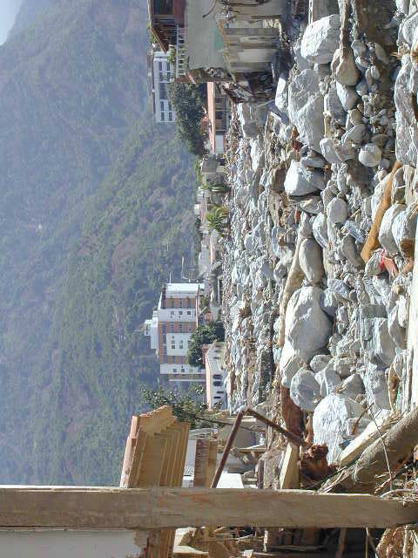
Debris Flow
Dispersive
Large clastic particles
Non cohesive
Low viscosity
High velocity
Destructive impact force

Slide 39
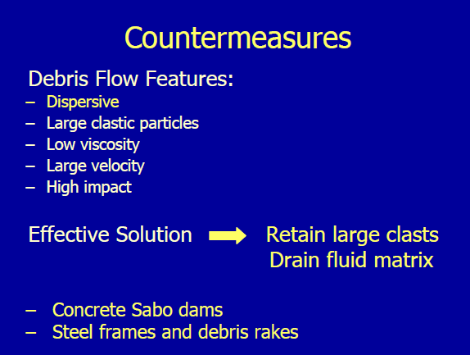

Slide 40
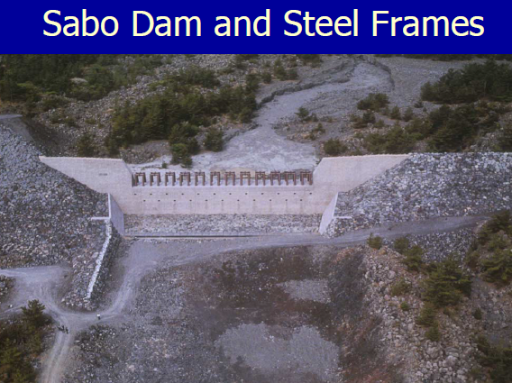
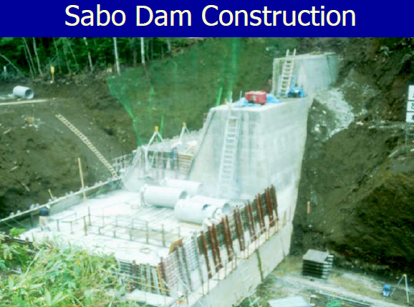
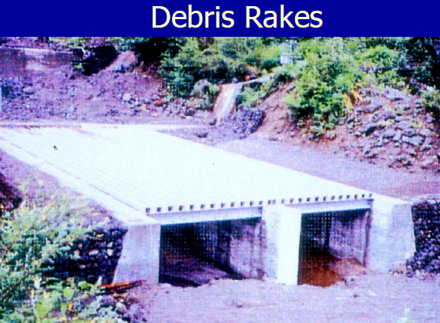
Debris flow Countermeasures
Retain large rocks
Drain water
Effective Solution
Concrete sabo dams
Steel Frames
Debris Racks

Slide 42
Buttress Check Dam
Shell Check Dam
Slit Check Dam

Slide 43
Classification and Rheology
Total shear stress :
τ = τ y+ τ _{v}+ τ _{t}+ τ _{d}
Landslides Yield stress
Mudflows Viscous stress
Mudfloods Turbulent stress
Debris flows Dispersive stress

Slide 44
Example Mt Umyeon

Slide 45
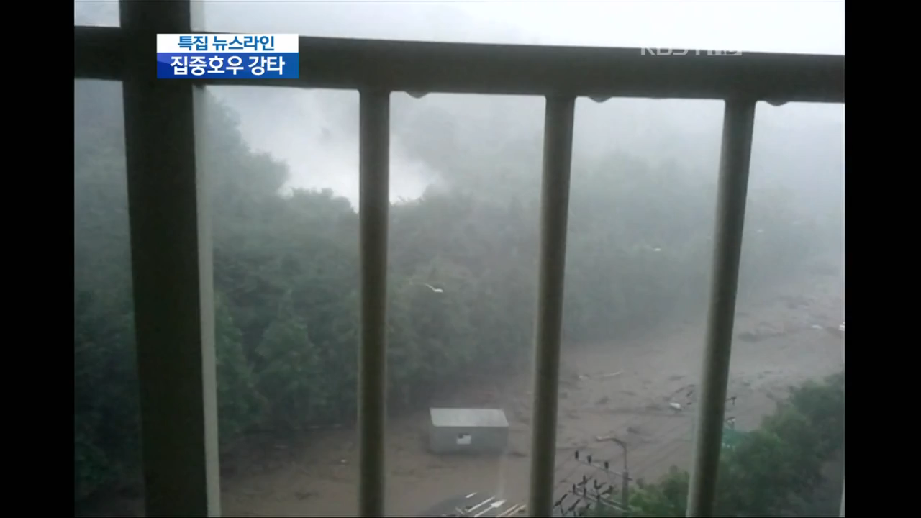

Slide 46
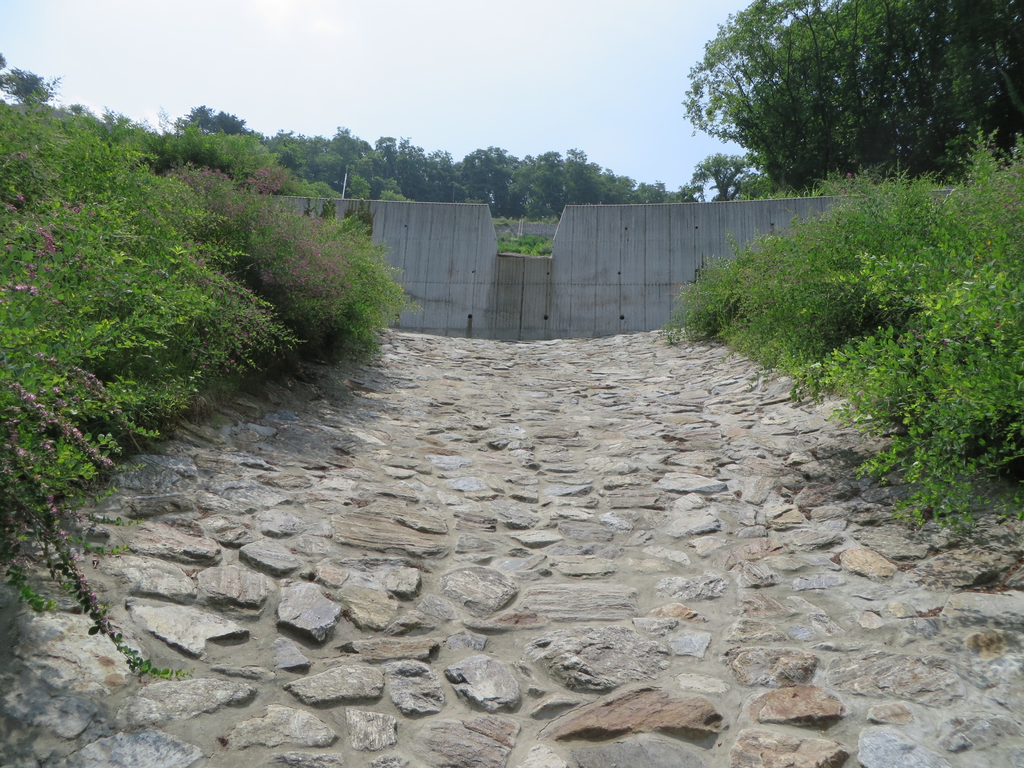

Slide 47
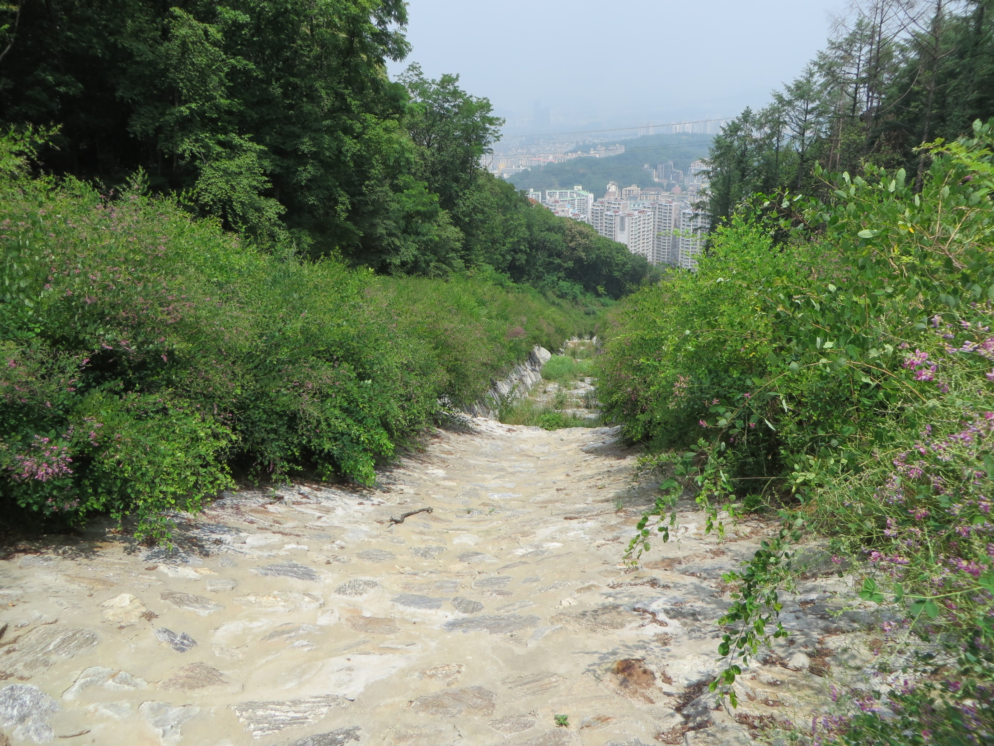

Slide 48
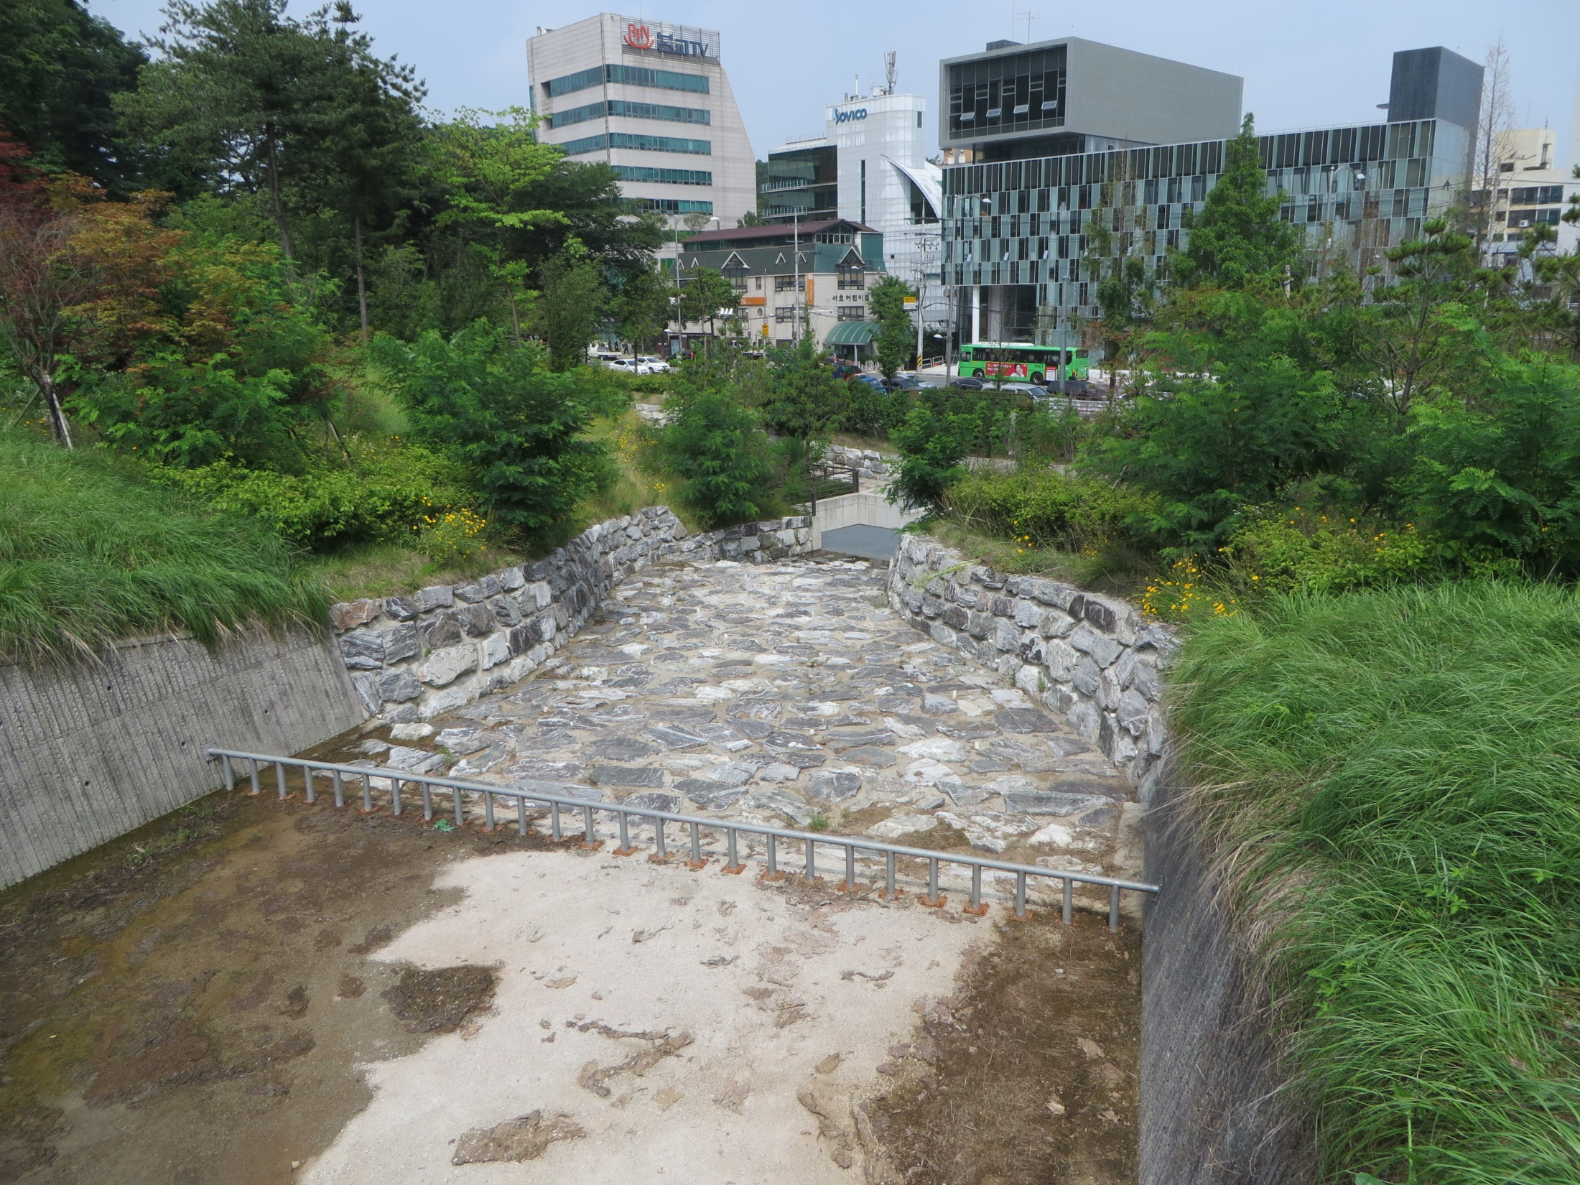

Slide 50
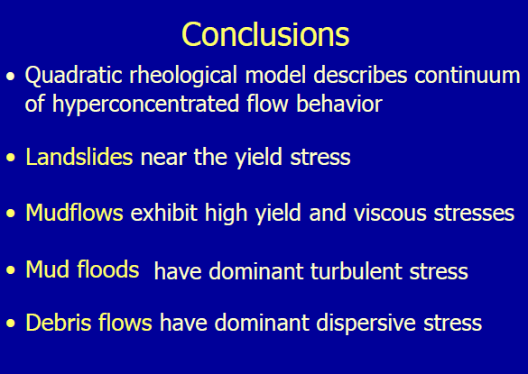

Slide 51
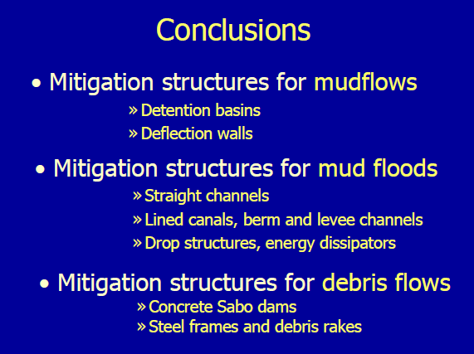

Slide 52
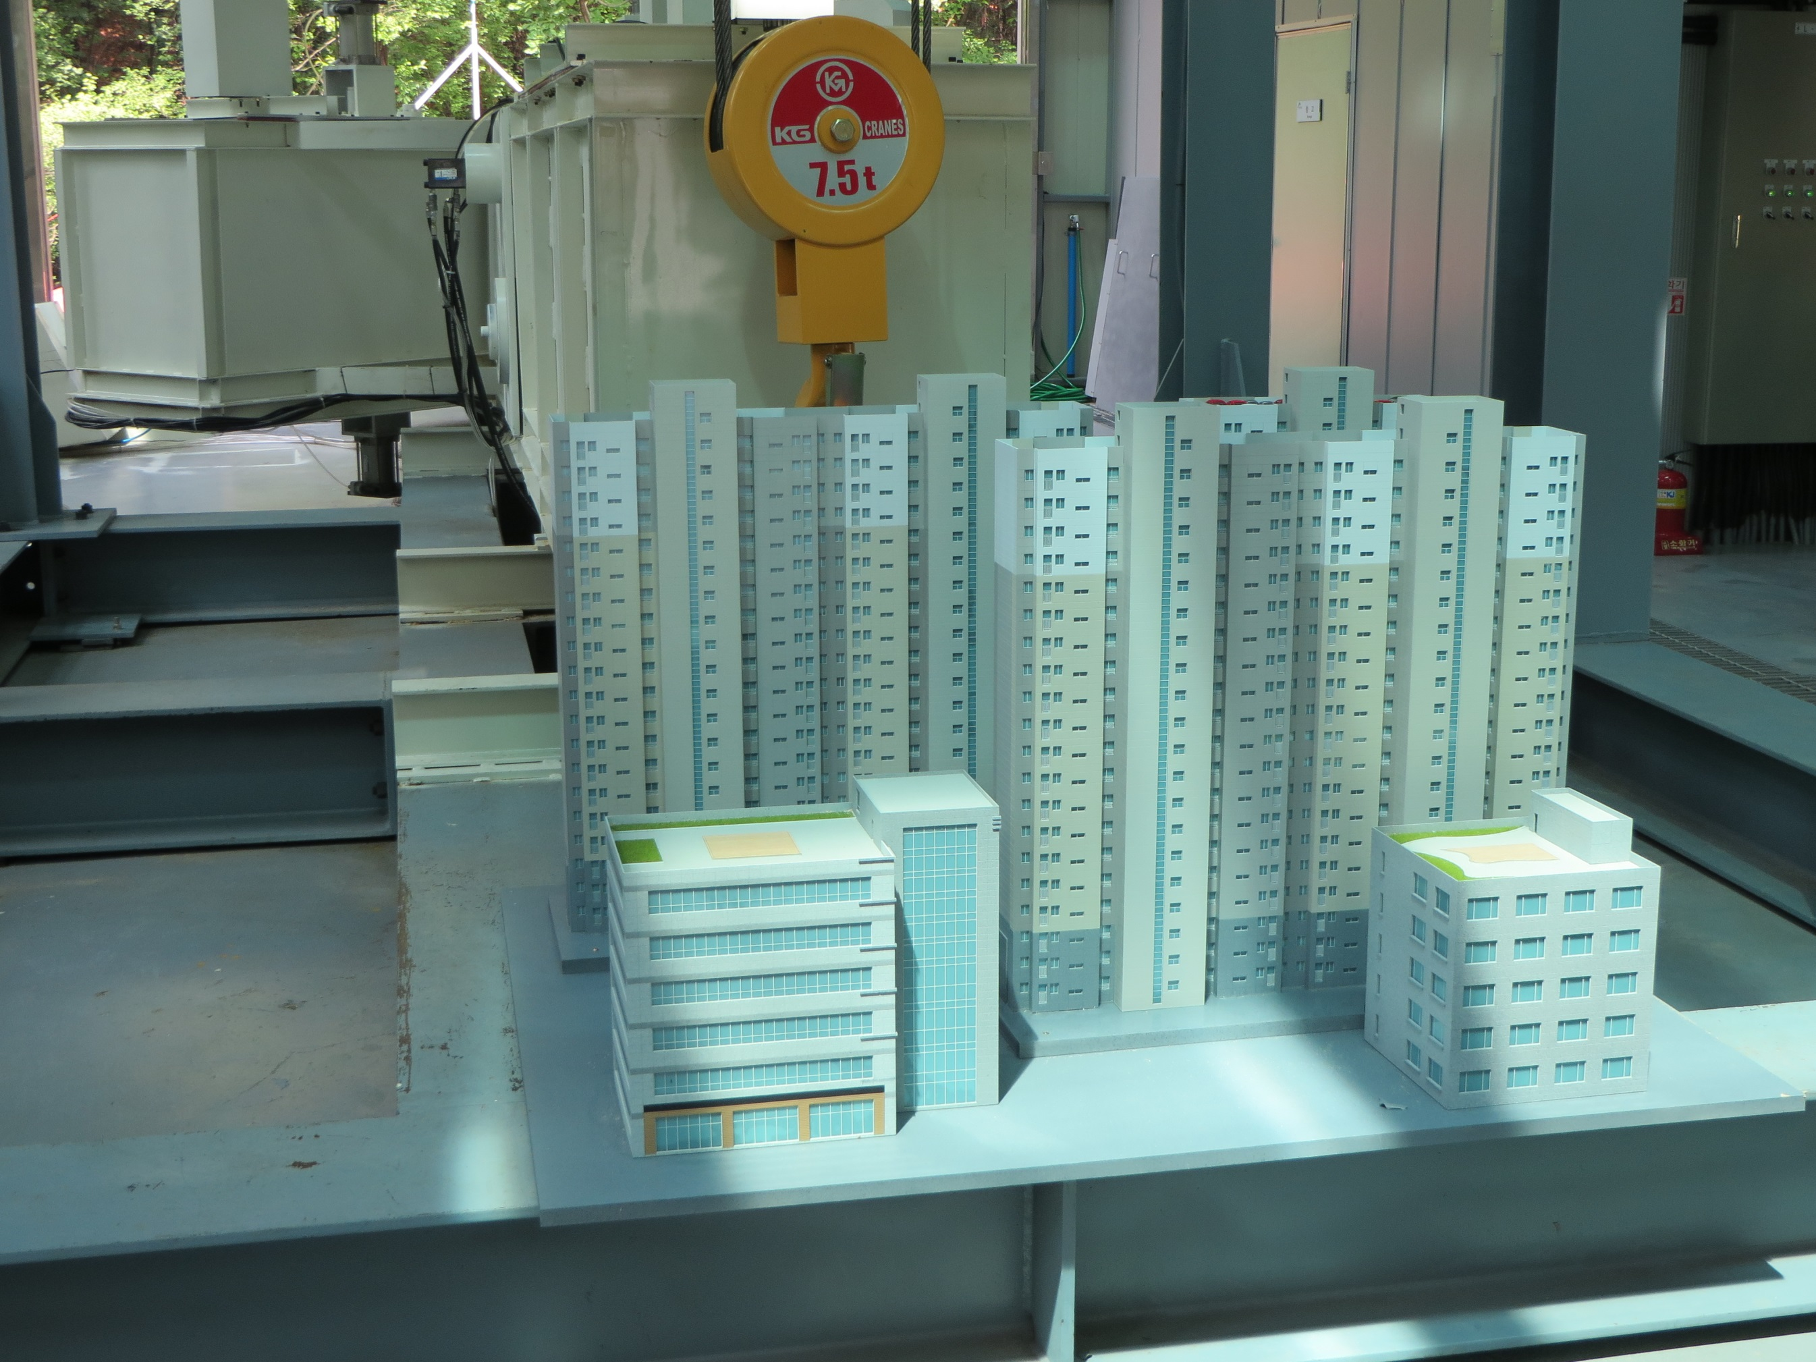
ACKNOWLEDGMENTS
Dr. Jaehoon Kim, KFRI, South Korea
Dr. Jai Hong Lee, CSU, USA
Dr. Claudia Leon, RTI, USA
Dr. Kate White, USACE, USA
Dr. Jose Salas, CSU, USA
Dr. Jose Batista Anderson, UNICAMP, Brasil
Hwayoung Kim, K-water, South Korea
감사합니다
Thank You!

