Slide 1
Runoff and TSS Visualization at Naesung Stream, South Korea (TREX Simulation from Dr. Mark Velleux, HDR HydroQual, NJ)
Jaehoon Kim and Pierre Y. Julien
Department of Civil and Environmental Engineering
Colorado State University

Slide 2
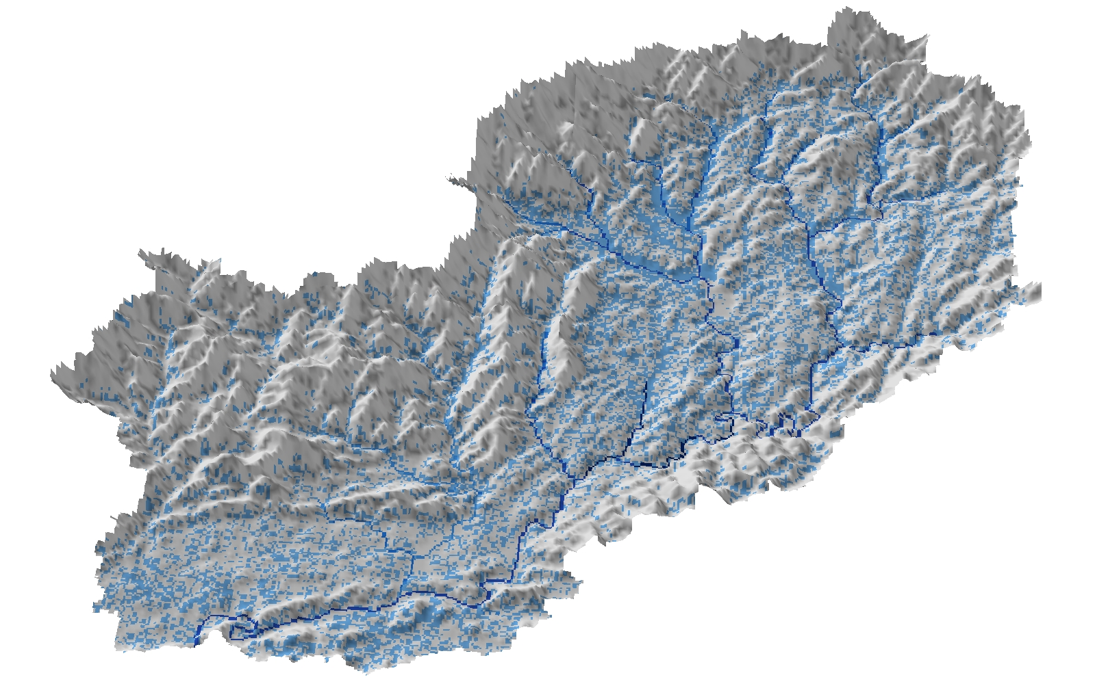
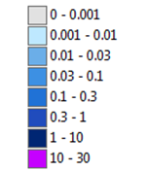
Water Depth
[0 hr]
Water Depth (m)

Slide 3
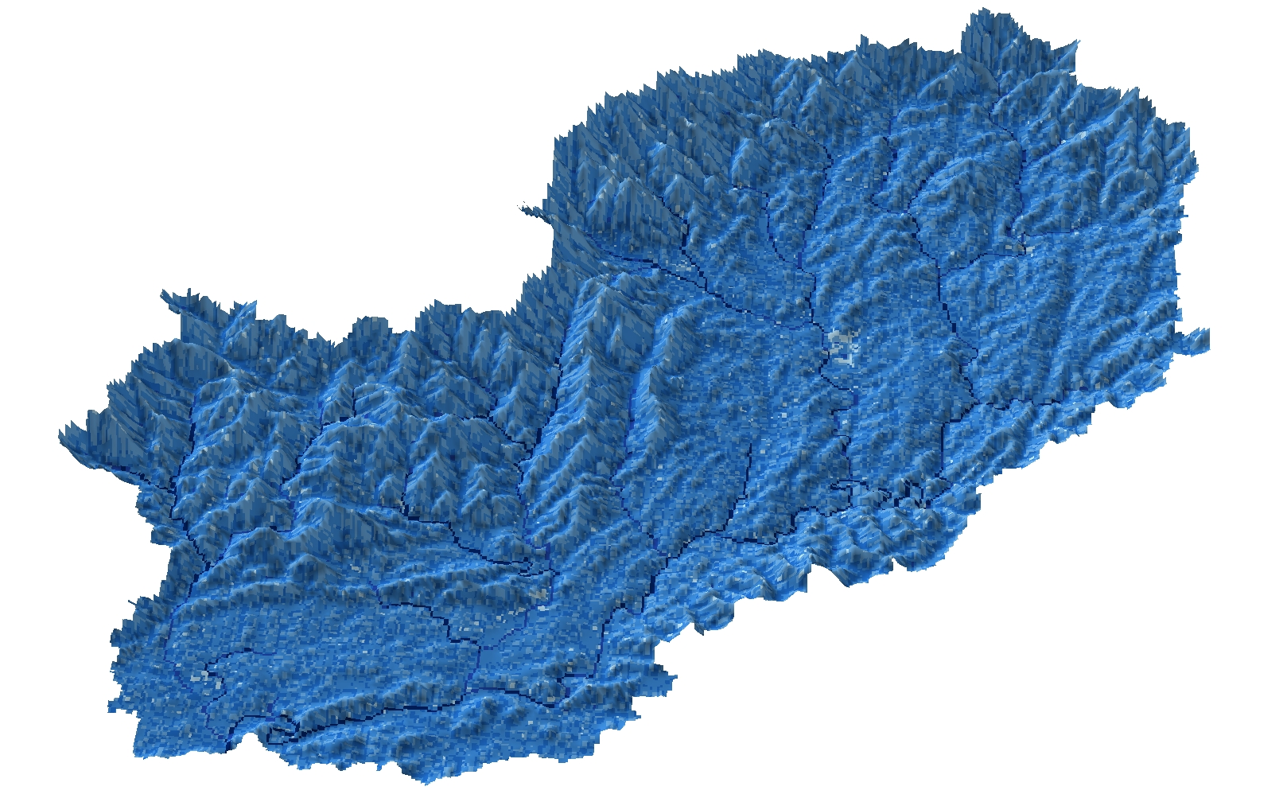
Water Depth
[2 hr]
Water Depth (m)

Slide 4
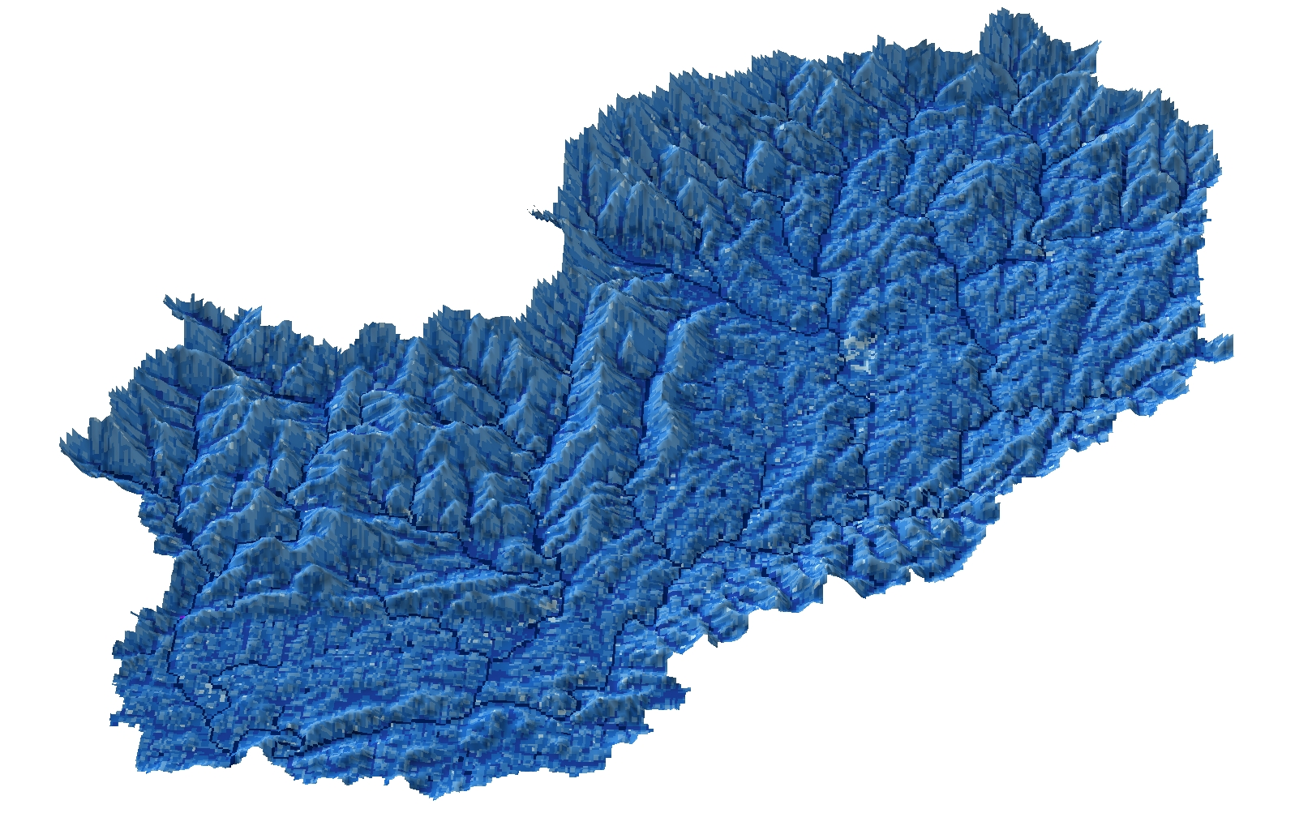
Water Depth
[4 hr]
Water Depth (m)

Slide 5
Water Depth
[6 hr]
Water Depth (m)

Slide 6
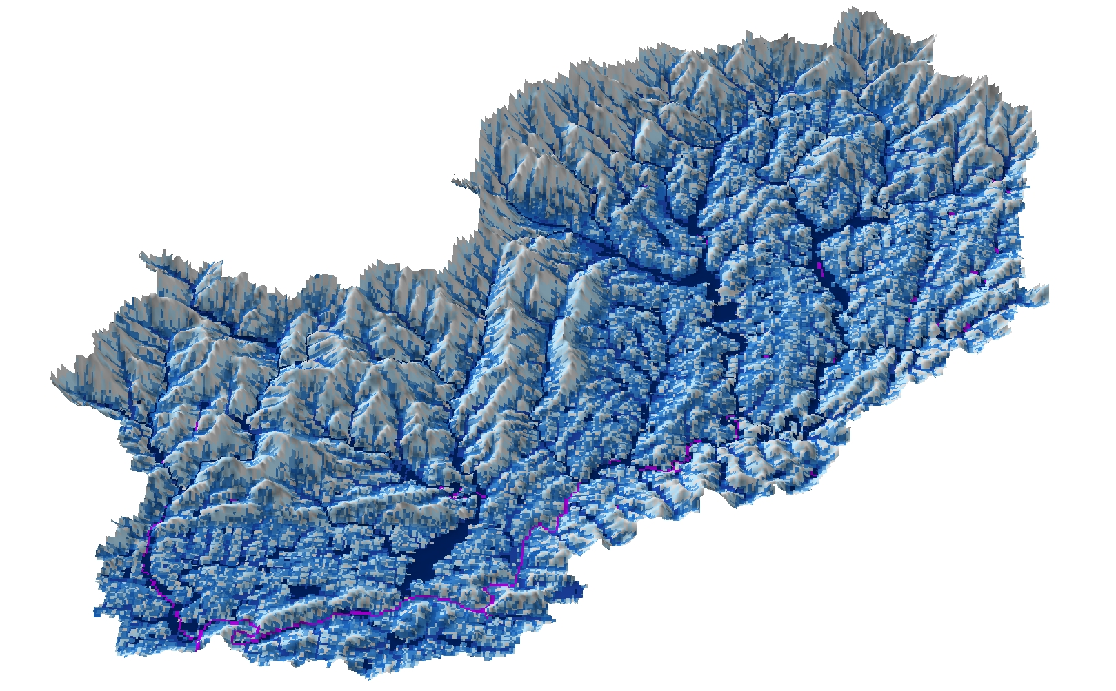
Water Depth
[8 hr]
Water Depth (m)

Slide 7
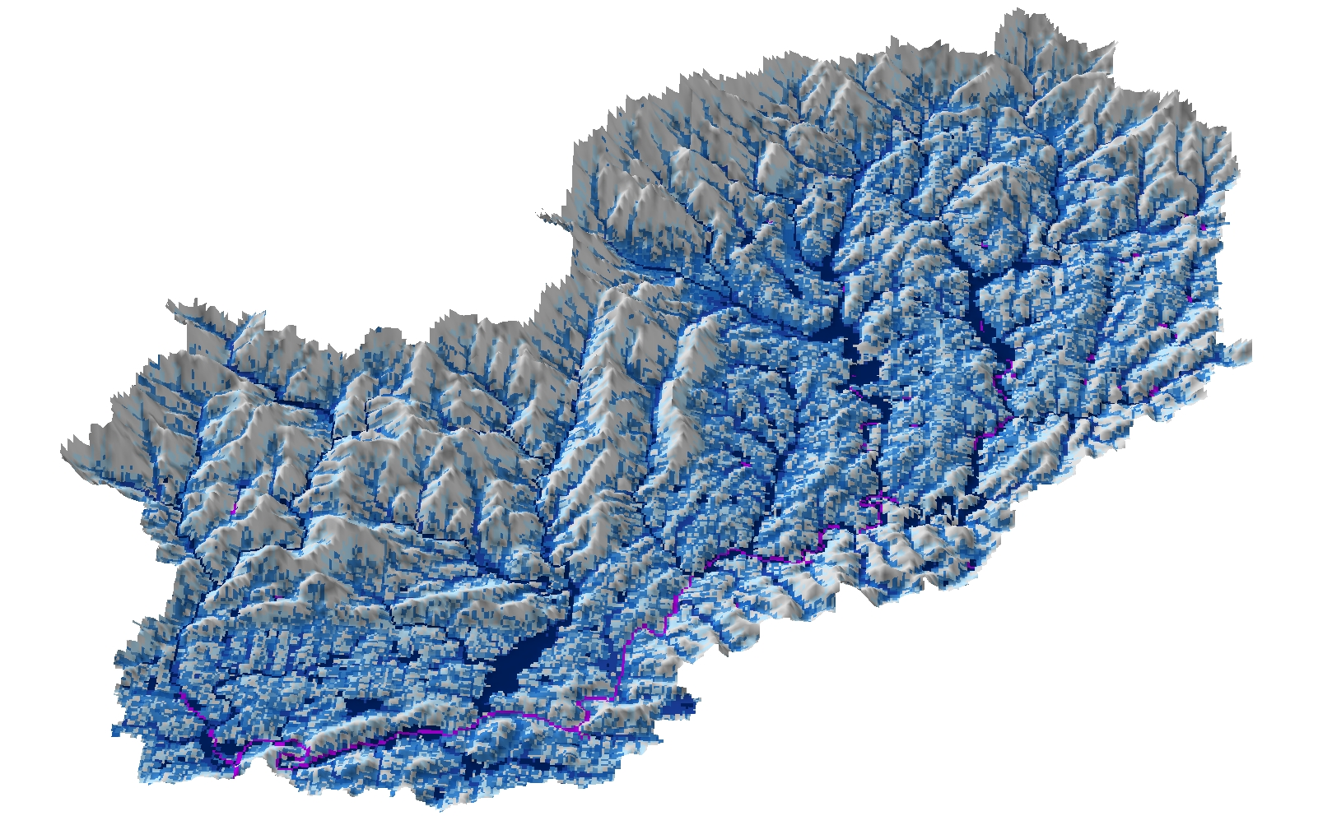
Water Depth
[10 hr]
Water Depth (m)

Slide 8
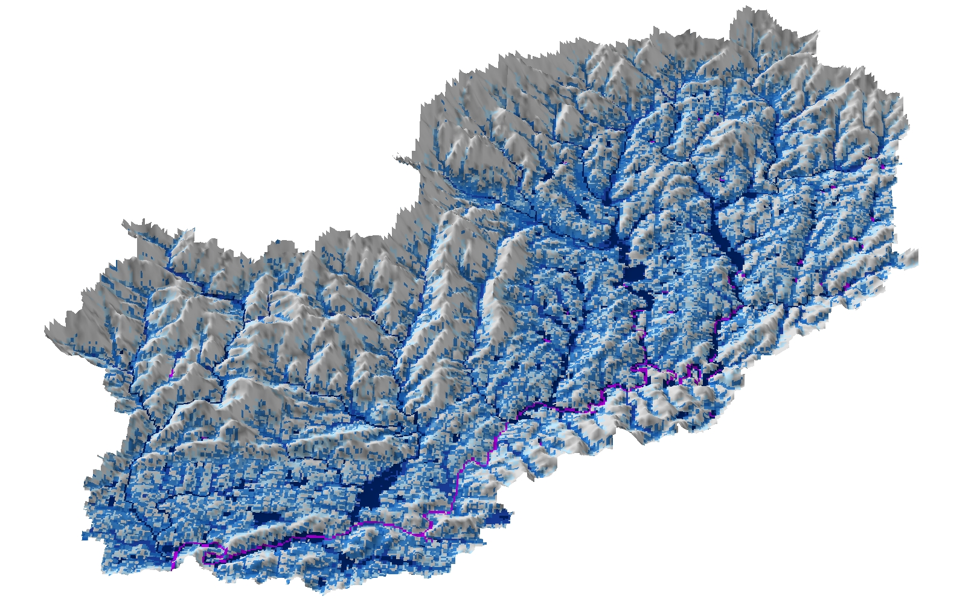
Water Depth
[12 hr]
Water Depth (m)

Slide 9
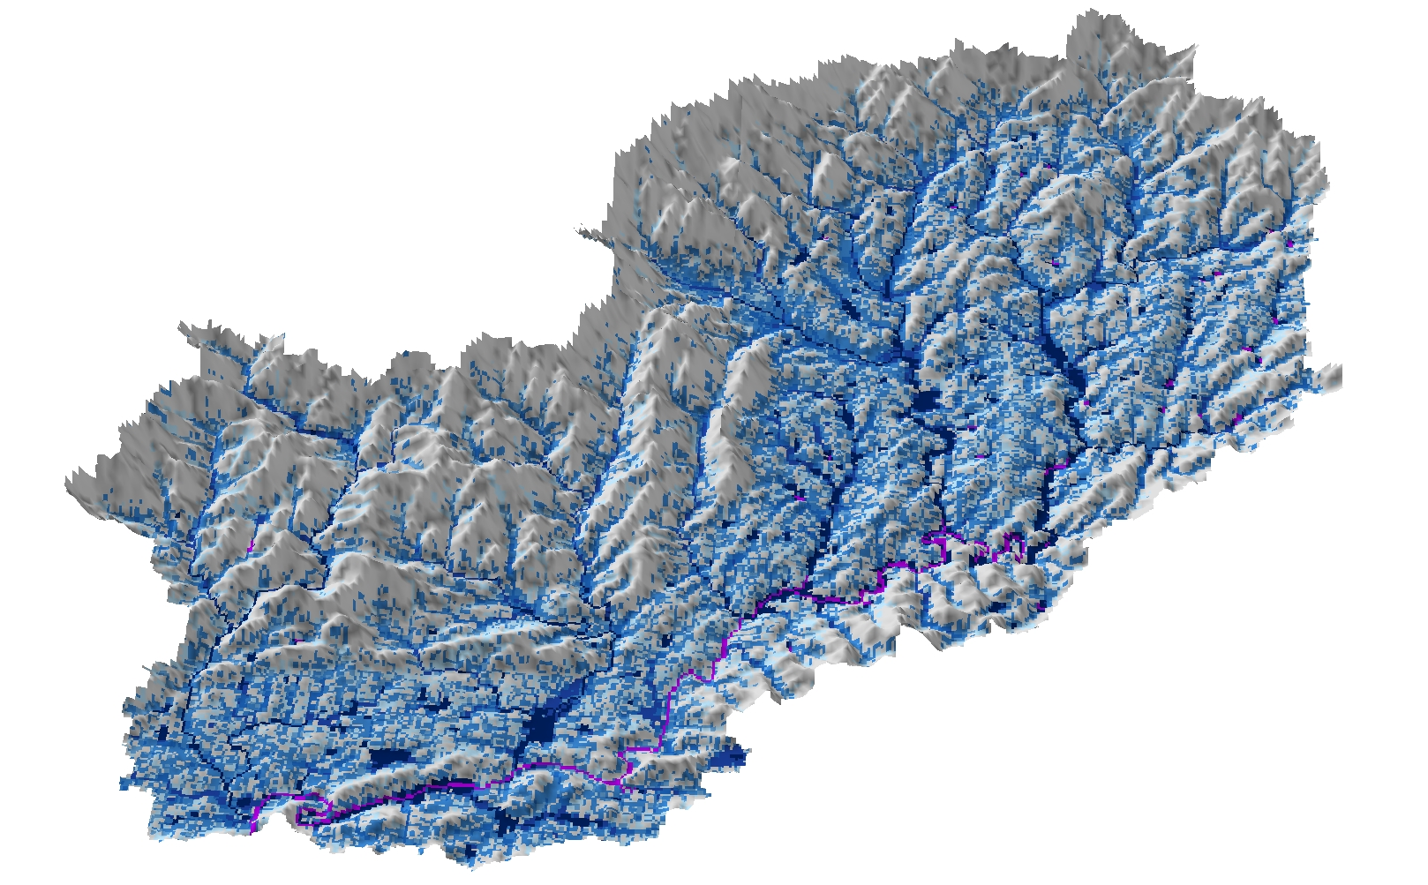
Water Depth
[14 hr]
Water Depth (m)

Slide 10
Water Depth
[16 hr]
Water Depth (m)

Slide 11
Water Depth
[18 hr]
Water Depth (m)

Slide 12
Water Depth
[20 hr]
Water Depth (m)

Slide 13
Water Depth
[22 hr]
Water Depth (m)

Slide 14
Water Depth
[24 hr]
Water Depth (m)

Slide 15
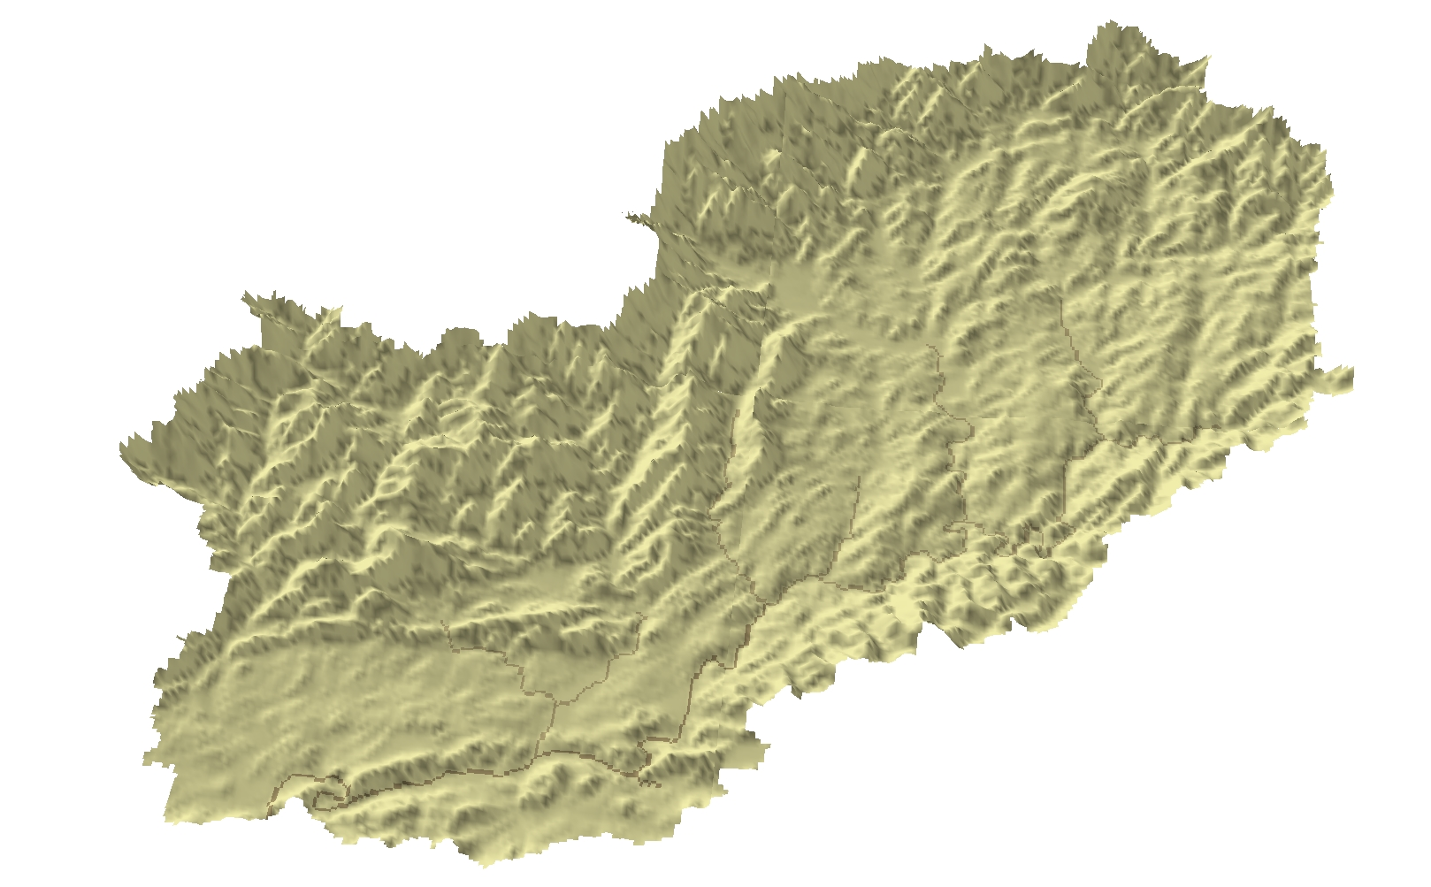
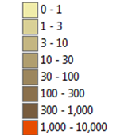
Total Suspended Solids
[0 hr]
TSS (g/m³)

Slide 16
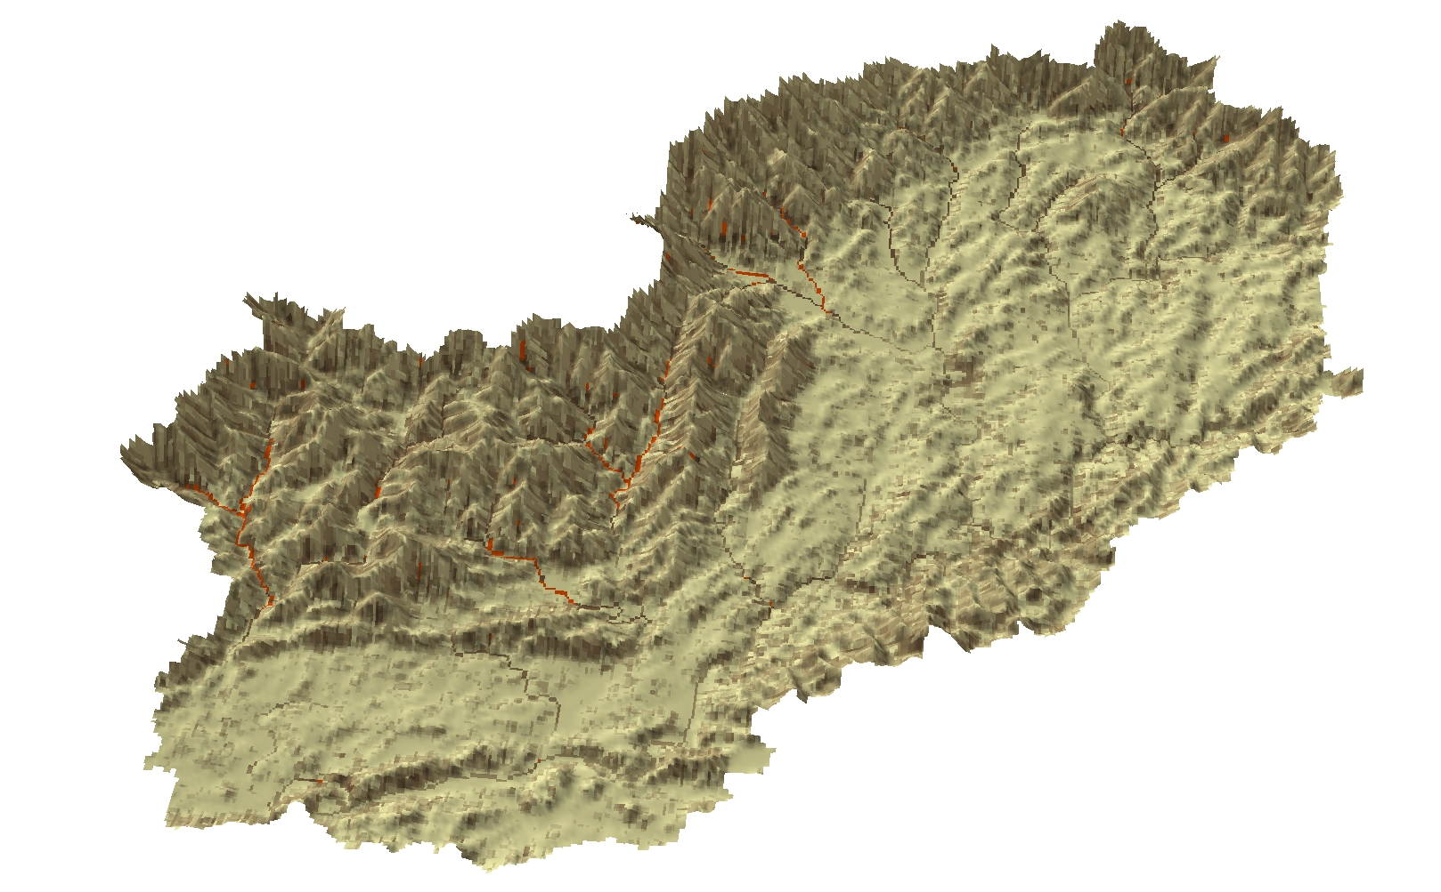
Total Suspended Solids
[2 hr]
TSS (g/m³)

Slide 17
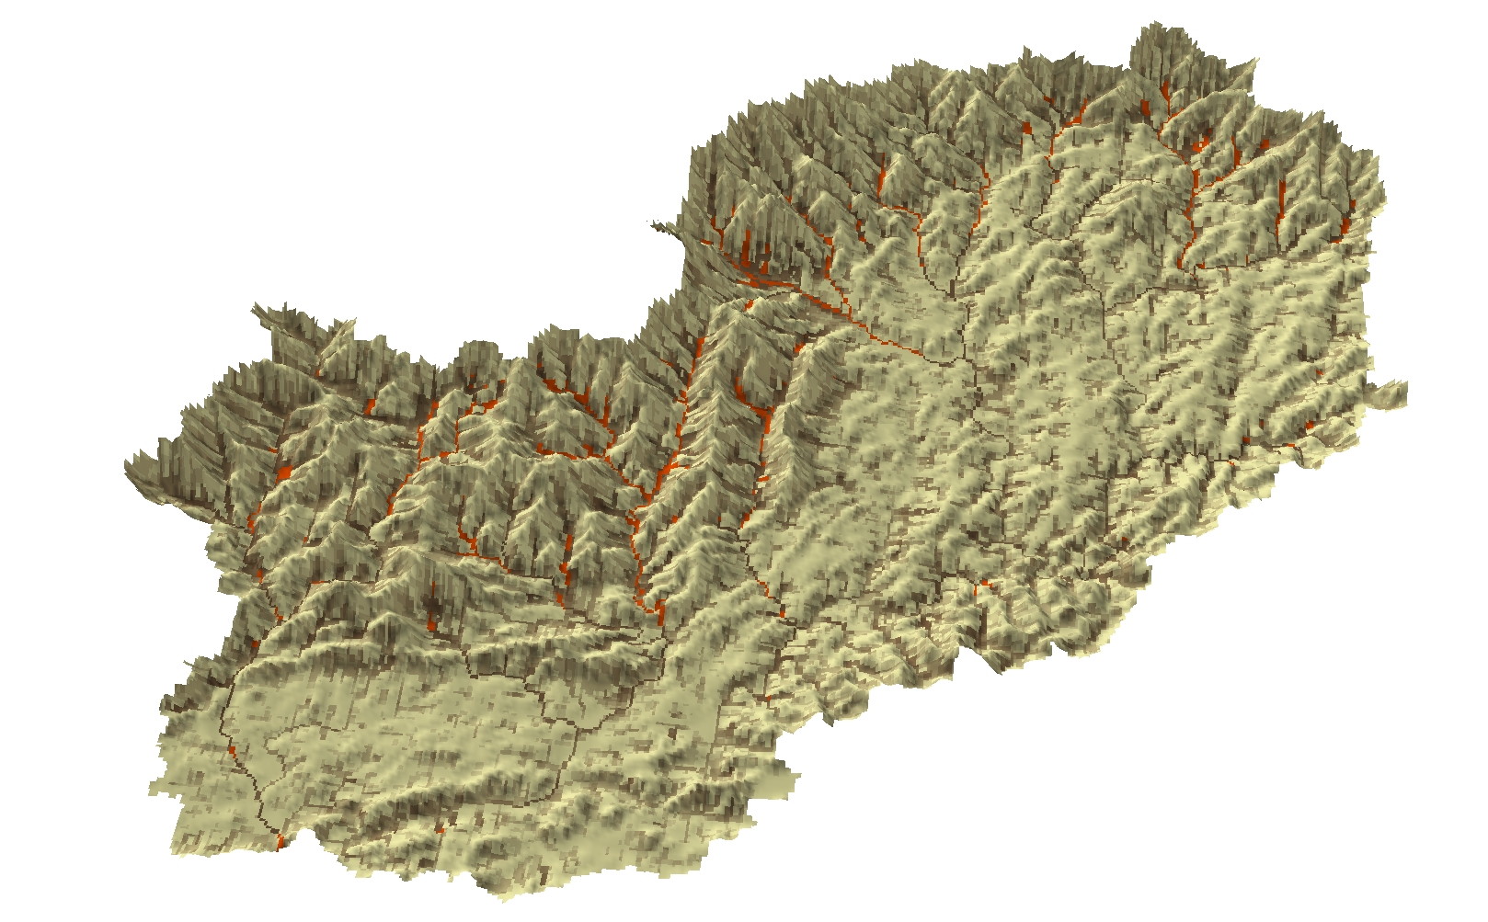
Total Suspended Solids
[4 hr]
TSS (g/m³)

Slide 18
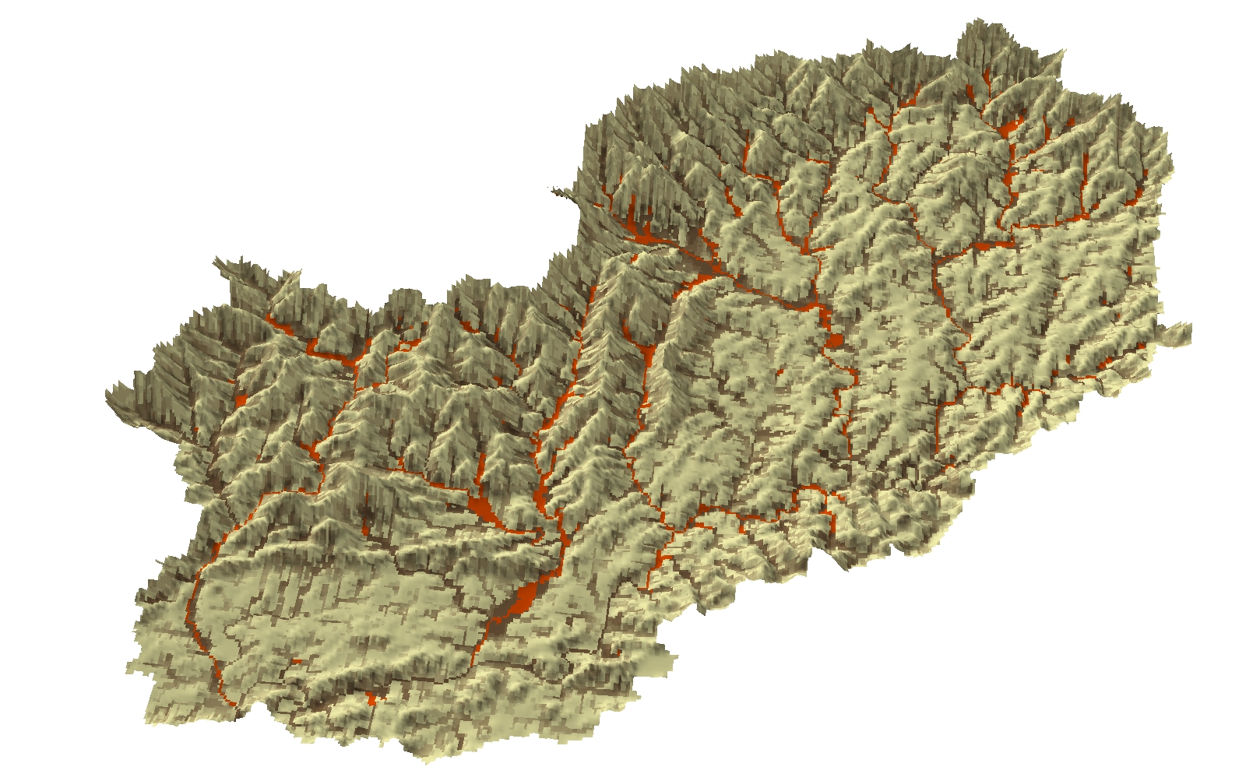
Total Suspended Solids
[6 hr]
TSS (g/m³)

Slide 19
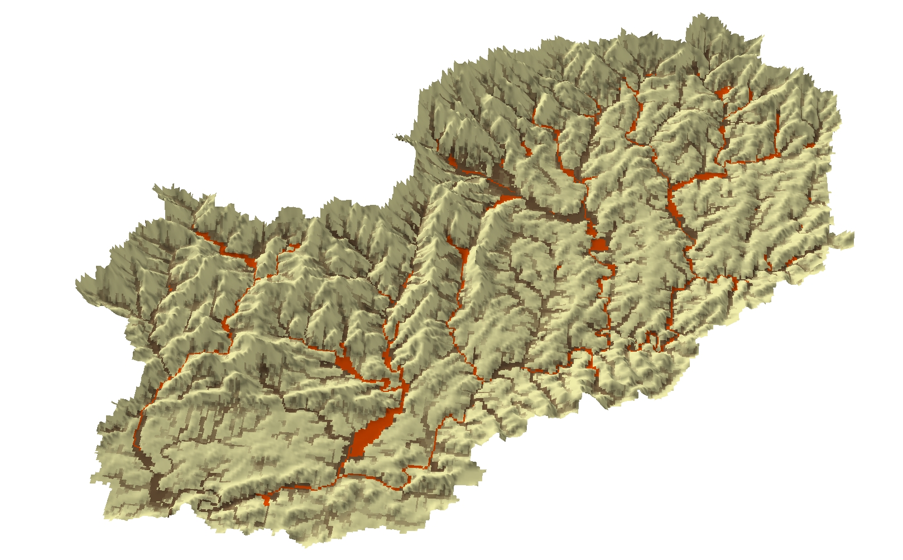
Total Suspended Solids
[8 hr]
TSS (g/m³)

Slide 20
Total Suspended Solids
[10 hr]
TSS (g/m³)

Slide 21
Total Suspended Solids
[12 hr]
TSS (g/m³)

Slide 22
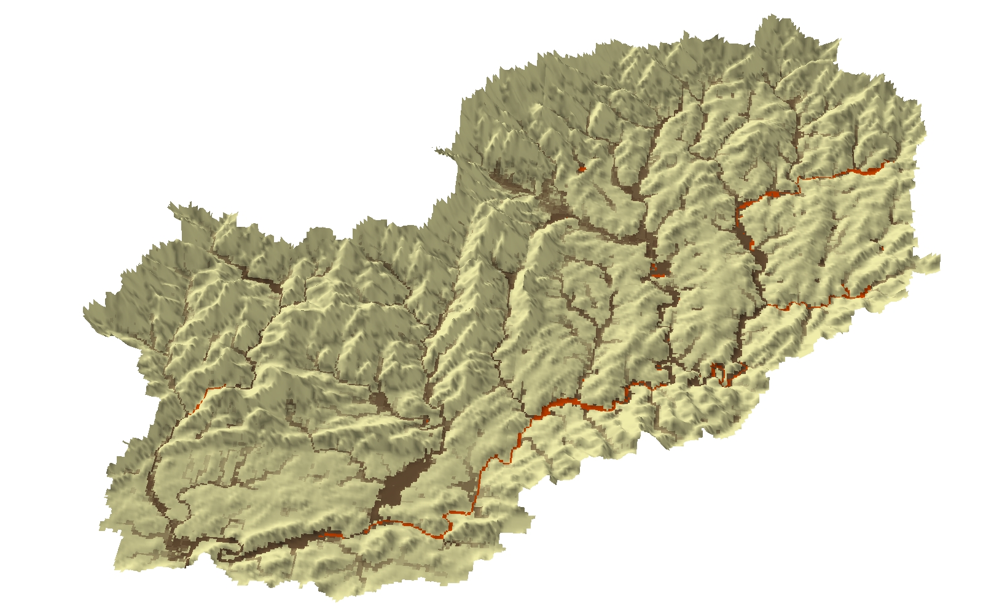
Total Suspended Solids
[14 hr]
TSS (g/m³)

Slide 23
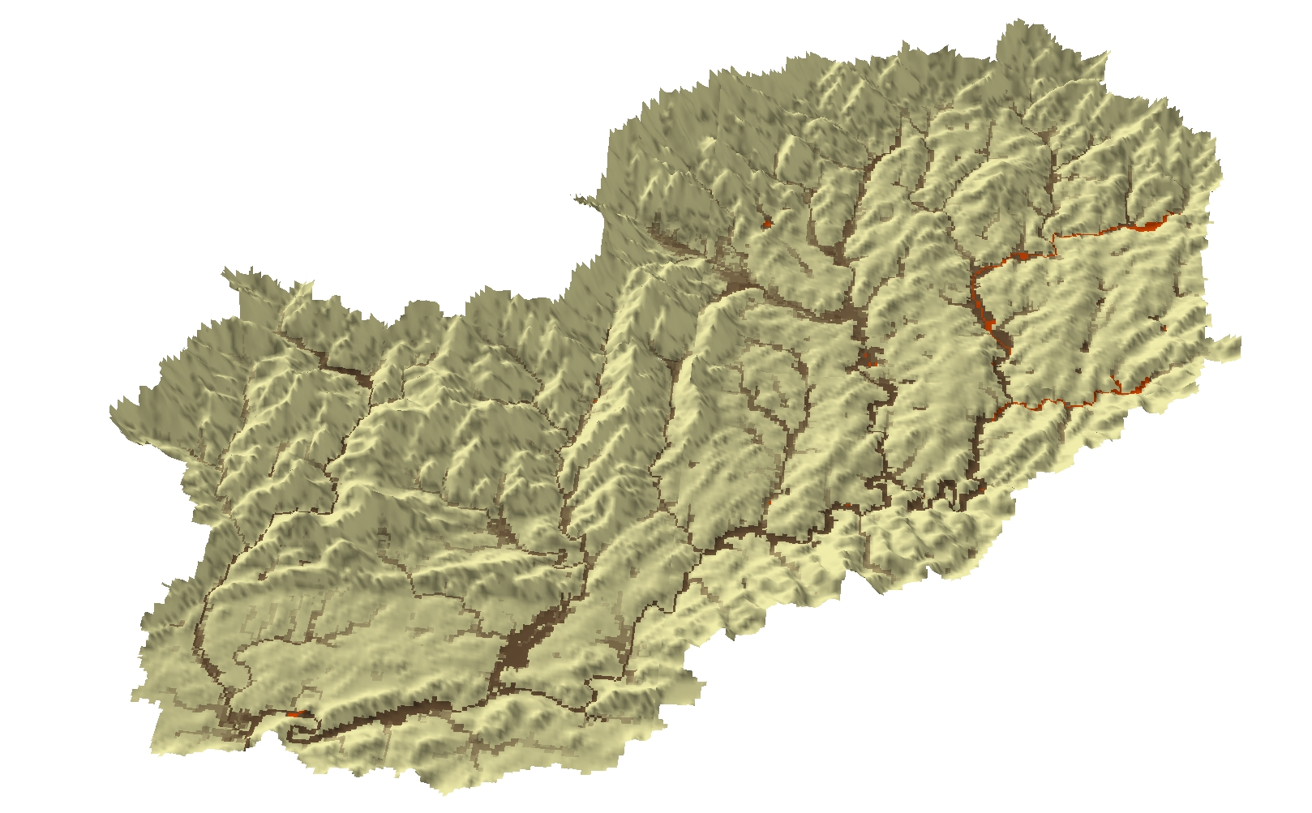
Total Suspended Solids
[16 hr]
TSS (g/m³)

Slide 24
Total Suspended Solids
[18 hr]
TSS (g/m³)

Slide 25
Total Suspended Solids
[20 hr]
TSS (g/m³)

Slide 26
Total Suspended Solids
[22 hr]
TSS (g/m³)

Slide 27
Total Suspended Solids
[24 hr]
TSS (g/m³)

