Slide 1
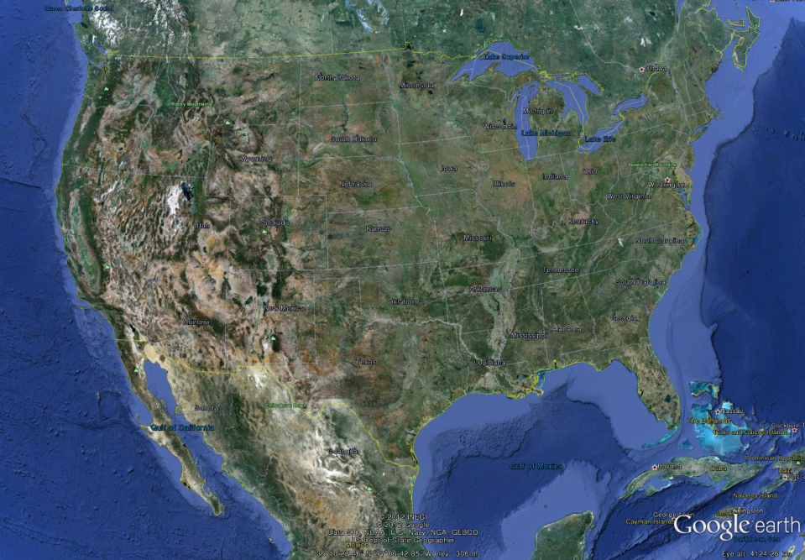

U.S.A
River Management and Restoration
World River Forum
Daegu, South Korea
Sept. 21, 2012
1

Slide 2
River Management and Restoration
River Management
Too much sediment
Notes:
2
In my presentation, I will be reviewing the CASC2D-SED model, then, I will apply it to a case study and finally i will present some of the results as a time-series of raster maps.

Slide 3
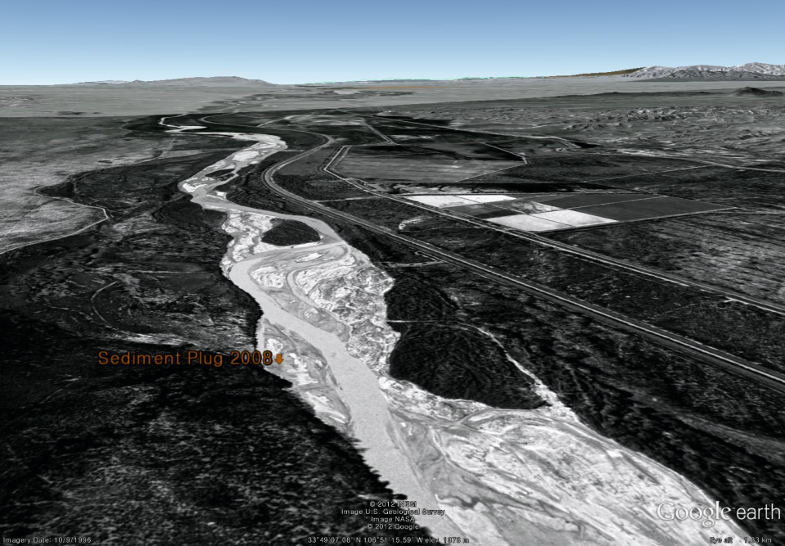
Middle Rio Grande, 1996
1996
Rivers with excess sediment tend to braid
3

Slide 4
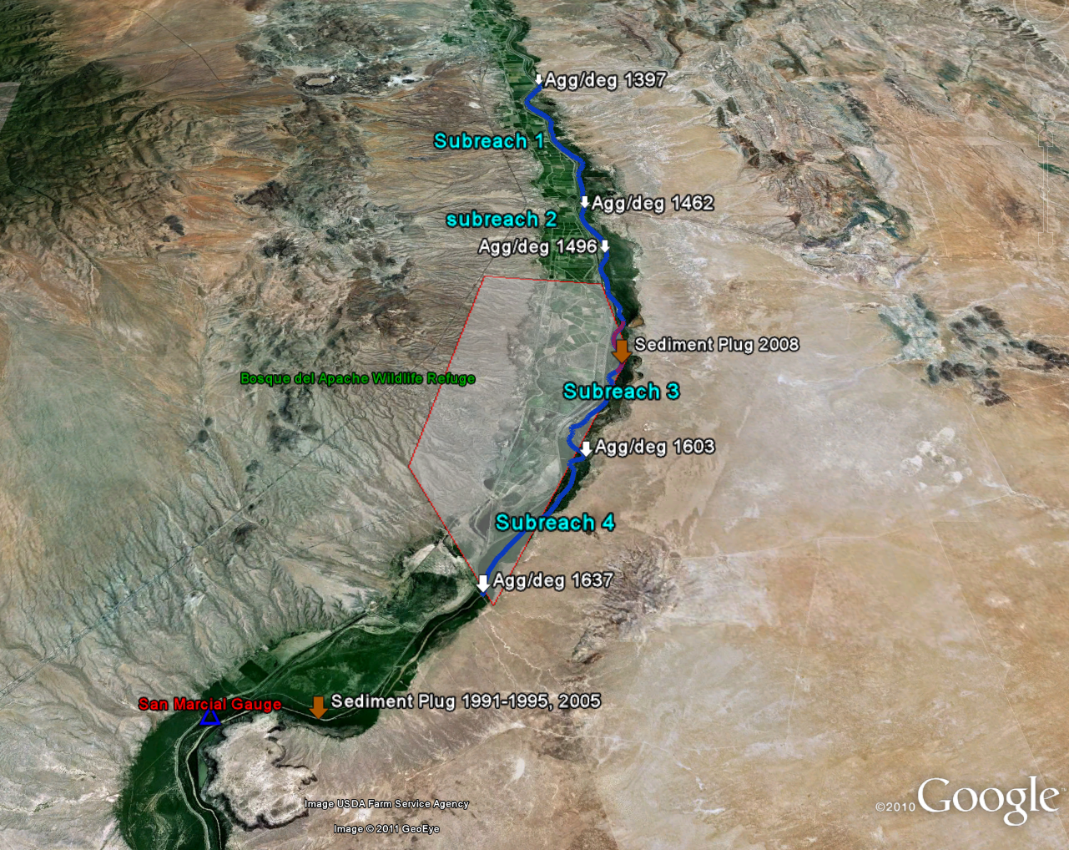
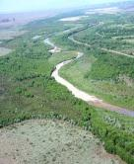
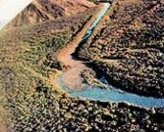

San Acacia Gauge
Sediment plug 2008
Sediment plug 1991-1995, 2005
4

Slide 5
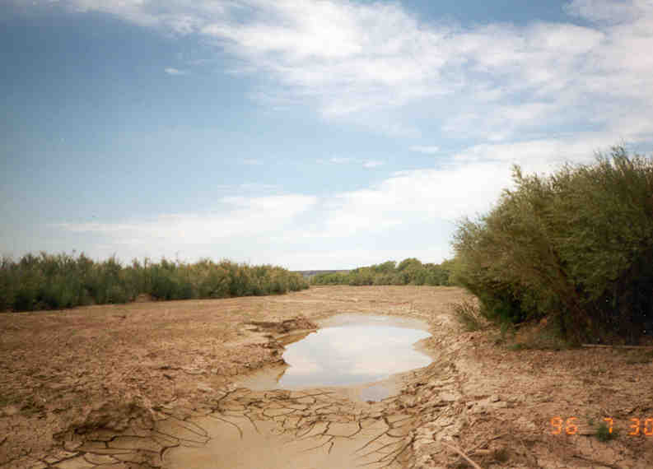
Sediment Plug
Rio Grande near the Bosque del Apache, NM
From D. Baird, USBR

Slide 6
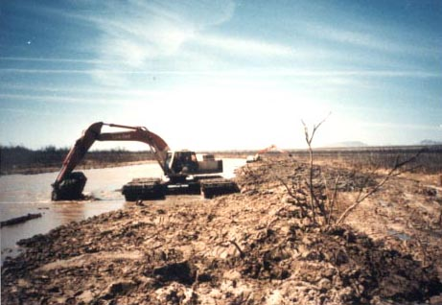
From D. Baird, USBR

Slide 7
River Management and Restoration
River Management
Too much sediment
Not enough sediment
Notes:
7
In my presentation, I will be reviewing the CASC2D-SED model, then, I will apply it to a case study and finally i will present some of the results as a time-series of raster maps.

Slide 8
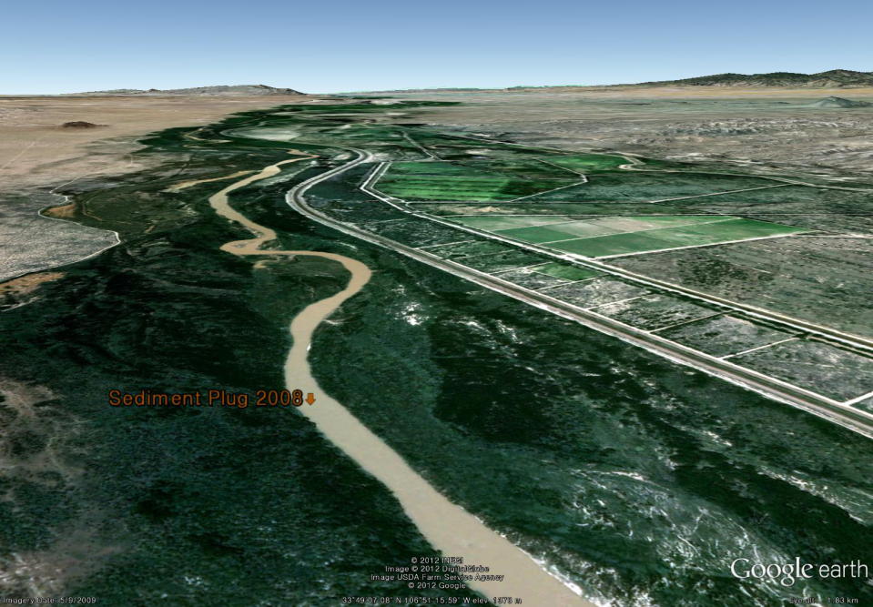
Middle Rio Grande , 2009
2009
Rivers with less
sediment tend to meander
8

Slide 9
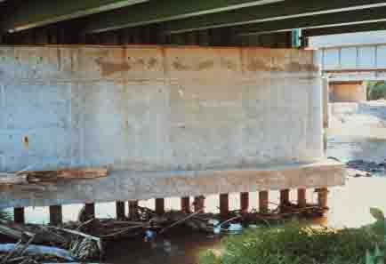
Riverbed degradation causes structural stability problems

Slide 10
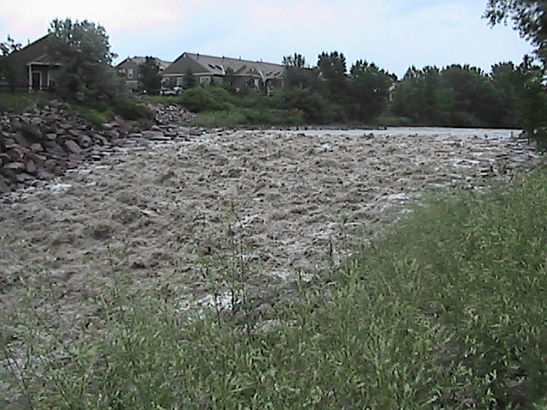
Grade-control Structures Reduce Incision Problems

Slide 11
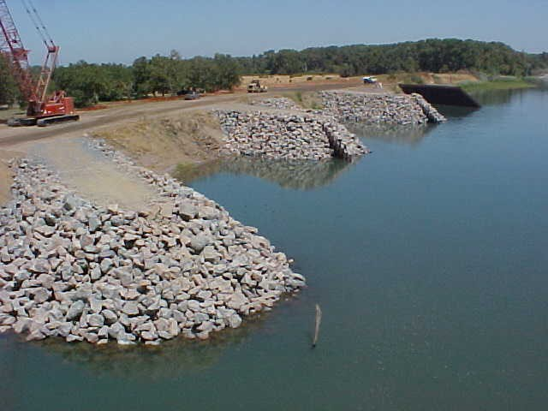
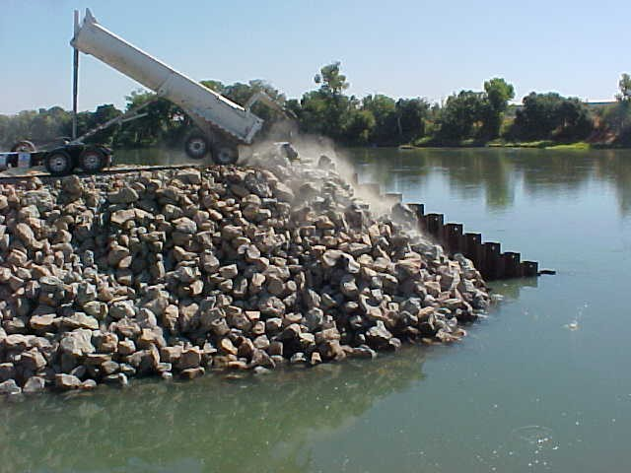
Bank Stabilization near Bridges
Sacramento River, CA
Notes:
11

Slide 12
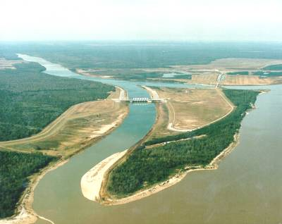
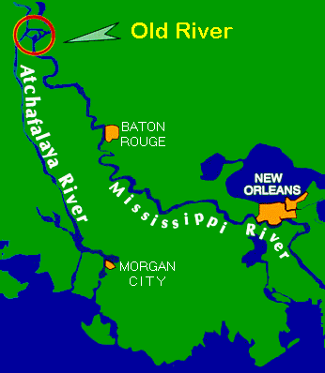
Lower Mississippi River
Outflow Channel to Atchafalaya
Hydroelectric Power Plant
Lowsill Structure
Auxiliary Structure
MISSISSPPI RIVER
Complex Flow and Sediment Control,
Mississippi River, LA
Notes:
12
THIS IS A GOOD PICTURE SHOWING THE LOCATIONS OF THE
HYDRAULIC STRUCTURES AND THE FLOW DIRECTIONS. IT ALSO
CLEARLY SHOWS THE EXISTANCE OF SEDIMENT IN THE LOWER
MISSISSIPPI RIVER.

Slide 13





River Management
Problems and Issues
Flood Control and Dam Safety
Navigation and Transportation
Water Supply
Irrigation and Drainage
Water Quality
Aquatic Habitat
Major Stakeholders
Federal Agencies
State Agencies
Counties and Districts
Cities and Towns
Private Sector/Companies
Public
Laws and Regulations
International Treaties
Water Delivery Compacts
Water Rights
Clean Water Act
Endangered Species Act
National
Technical

Slide 14
River Management and Restoration
River Management
Too much sediment
Not enough sediment
River Restoration
Notes:
14

Slide 15
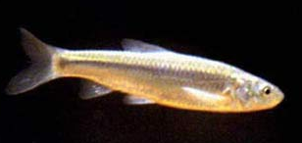
Rio Grande Restoration (Endangered Species)
  Bimodal sand/gravel bed
  Deep water h ~ 1.20 m
  Water velocities 1.4 m/s
Restoration
  Create wider channels
  Sandy/silty substrate
  Shallow water h < 0.4 m
  Water velocities
  0.1 m/s < V < 0.5 m/s

Slide 16
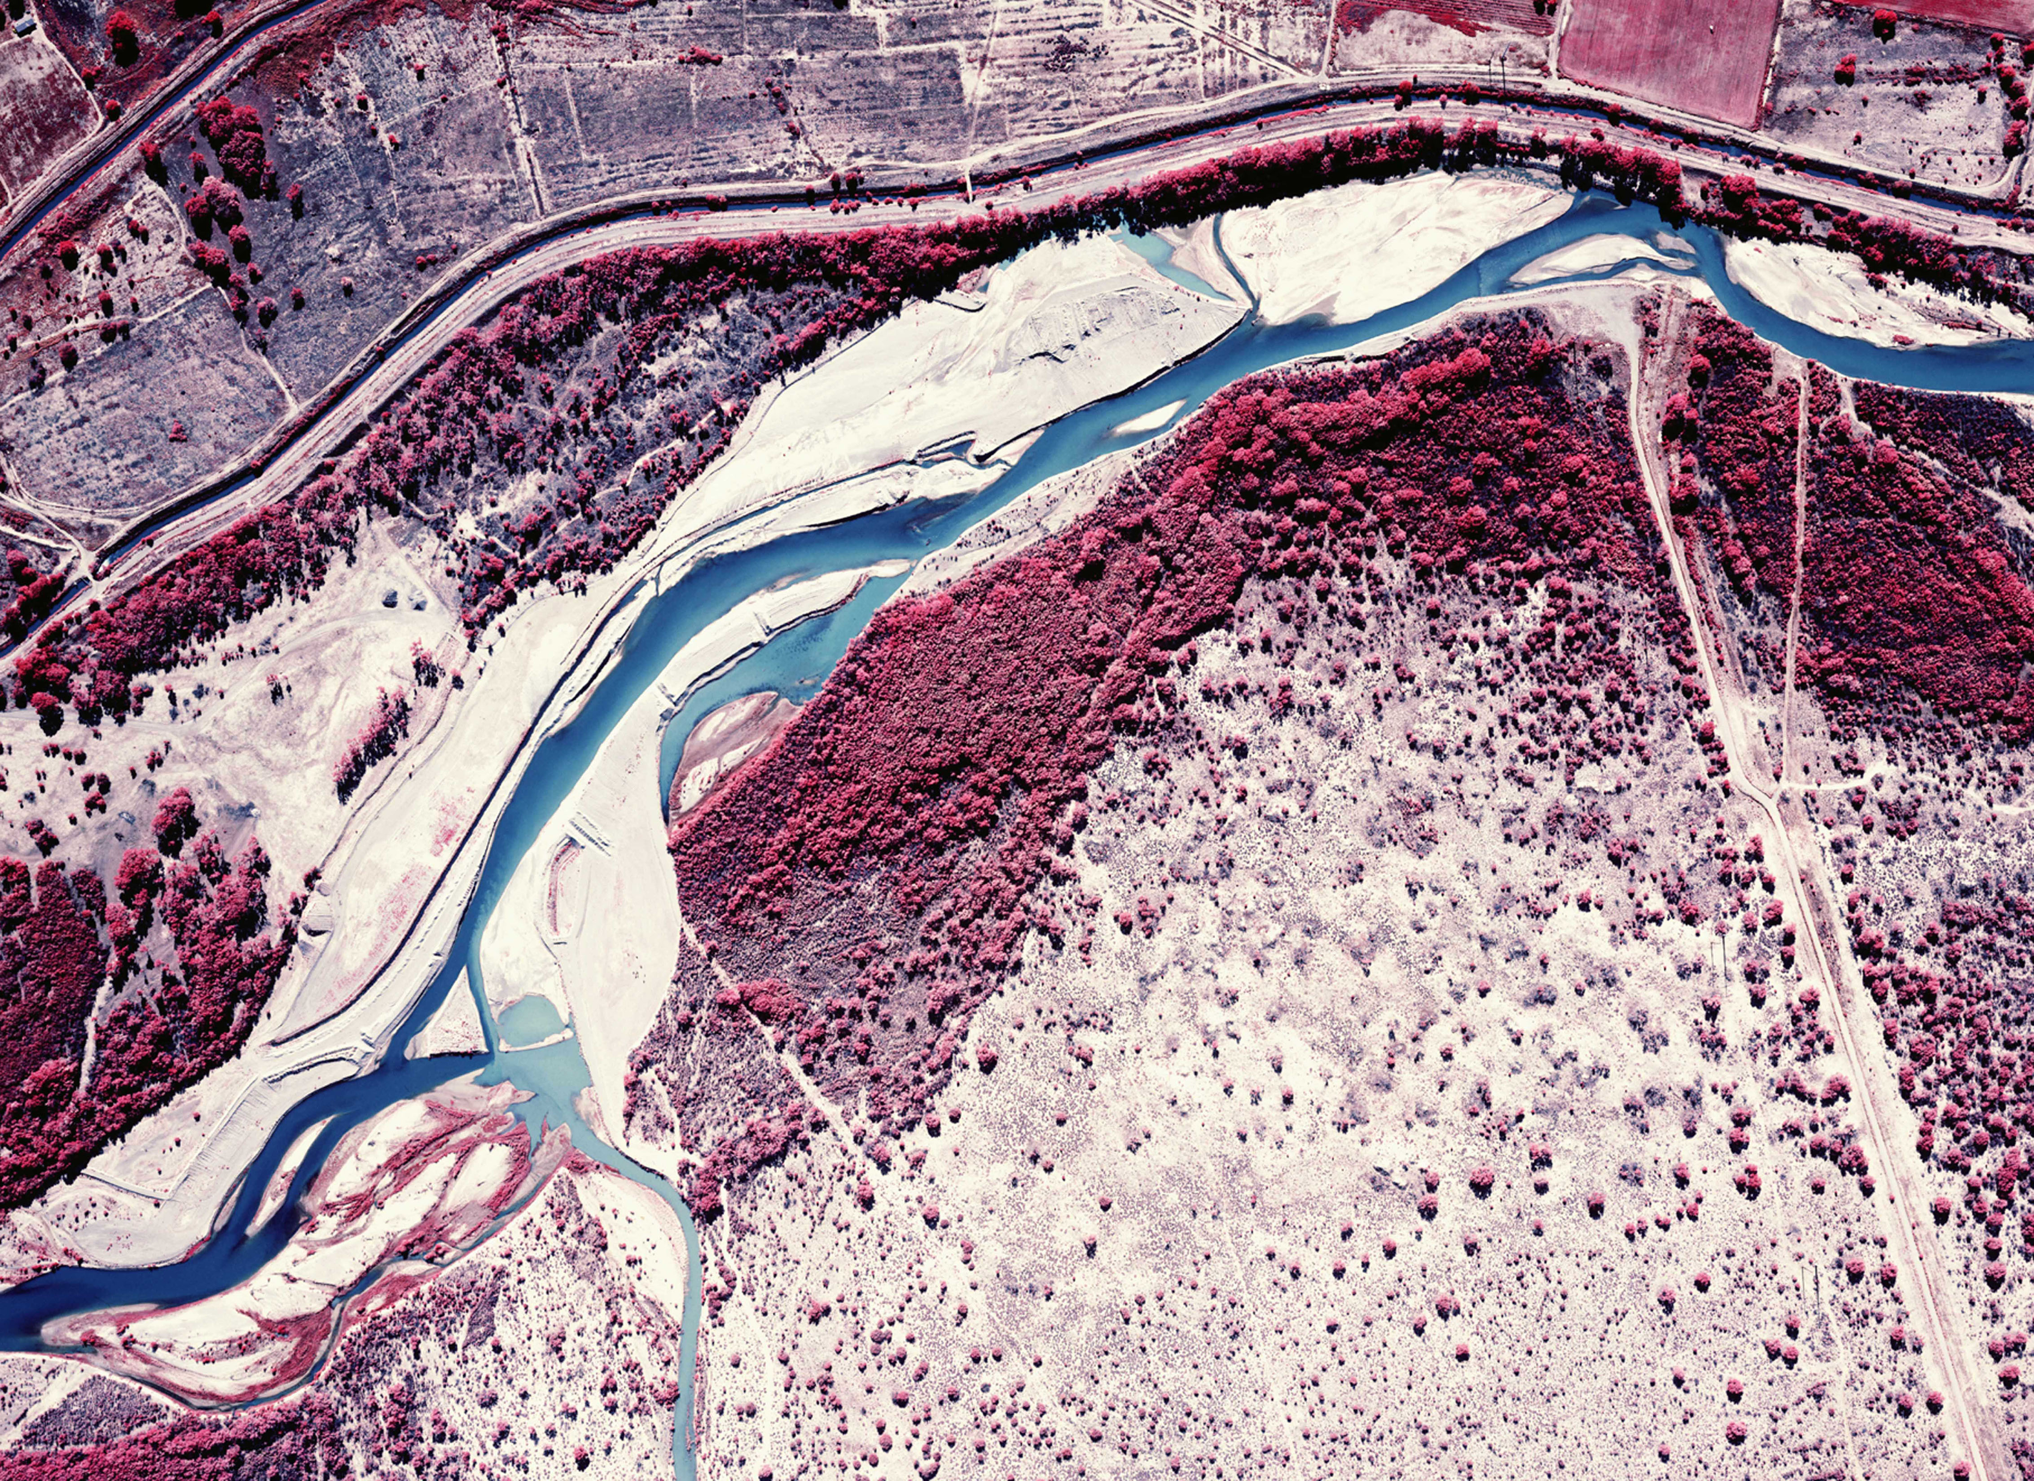
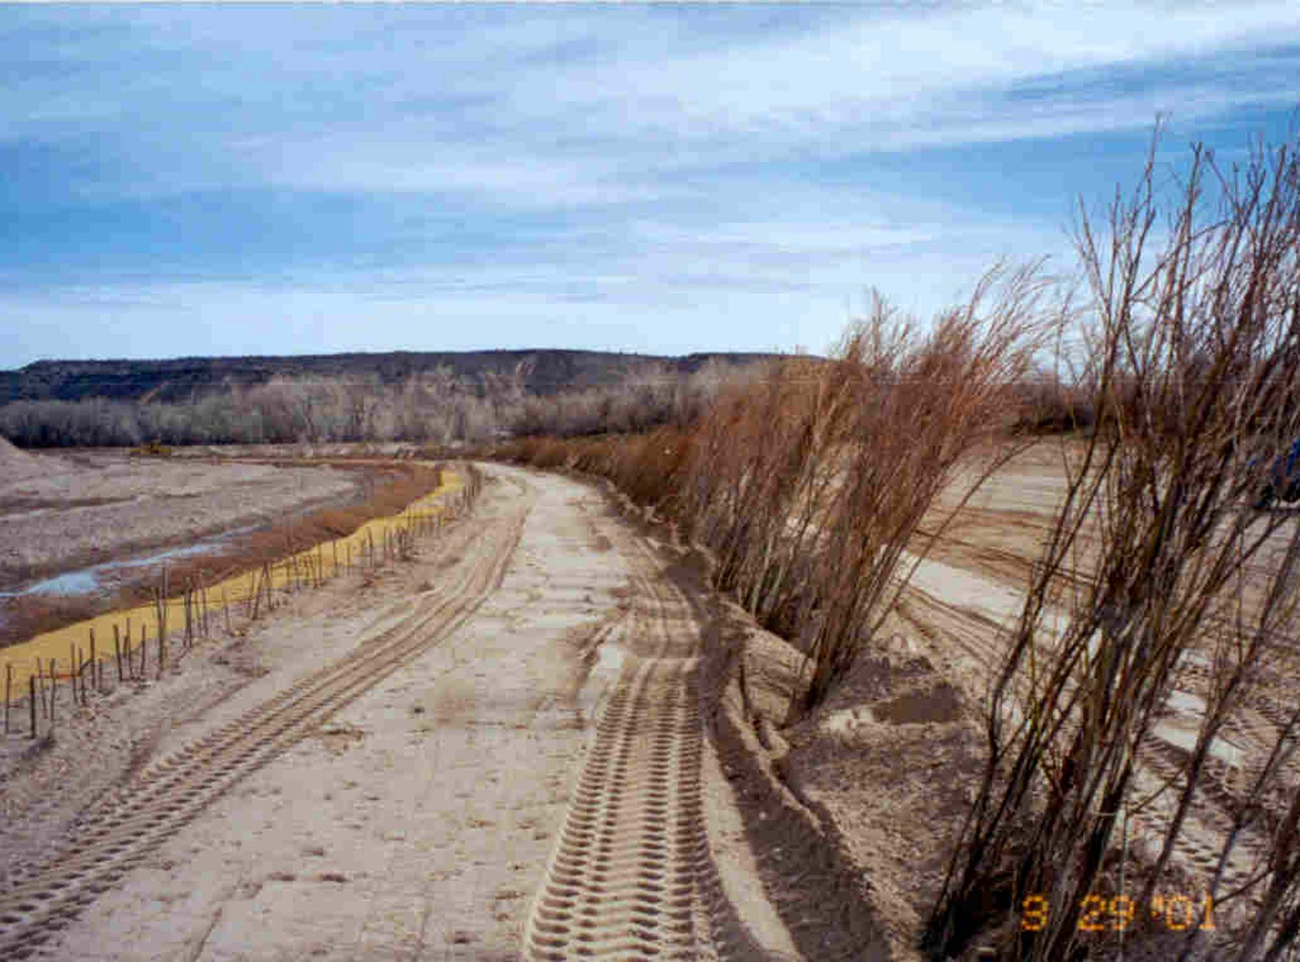
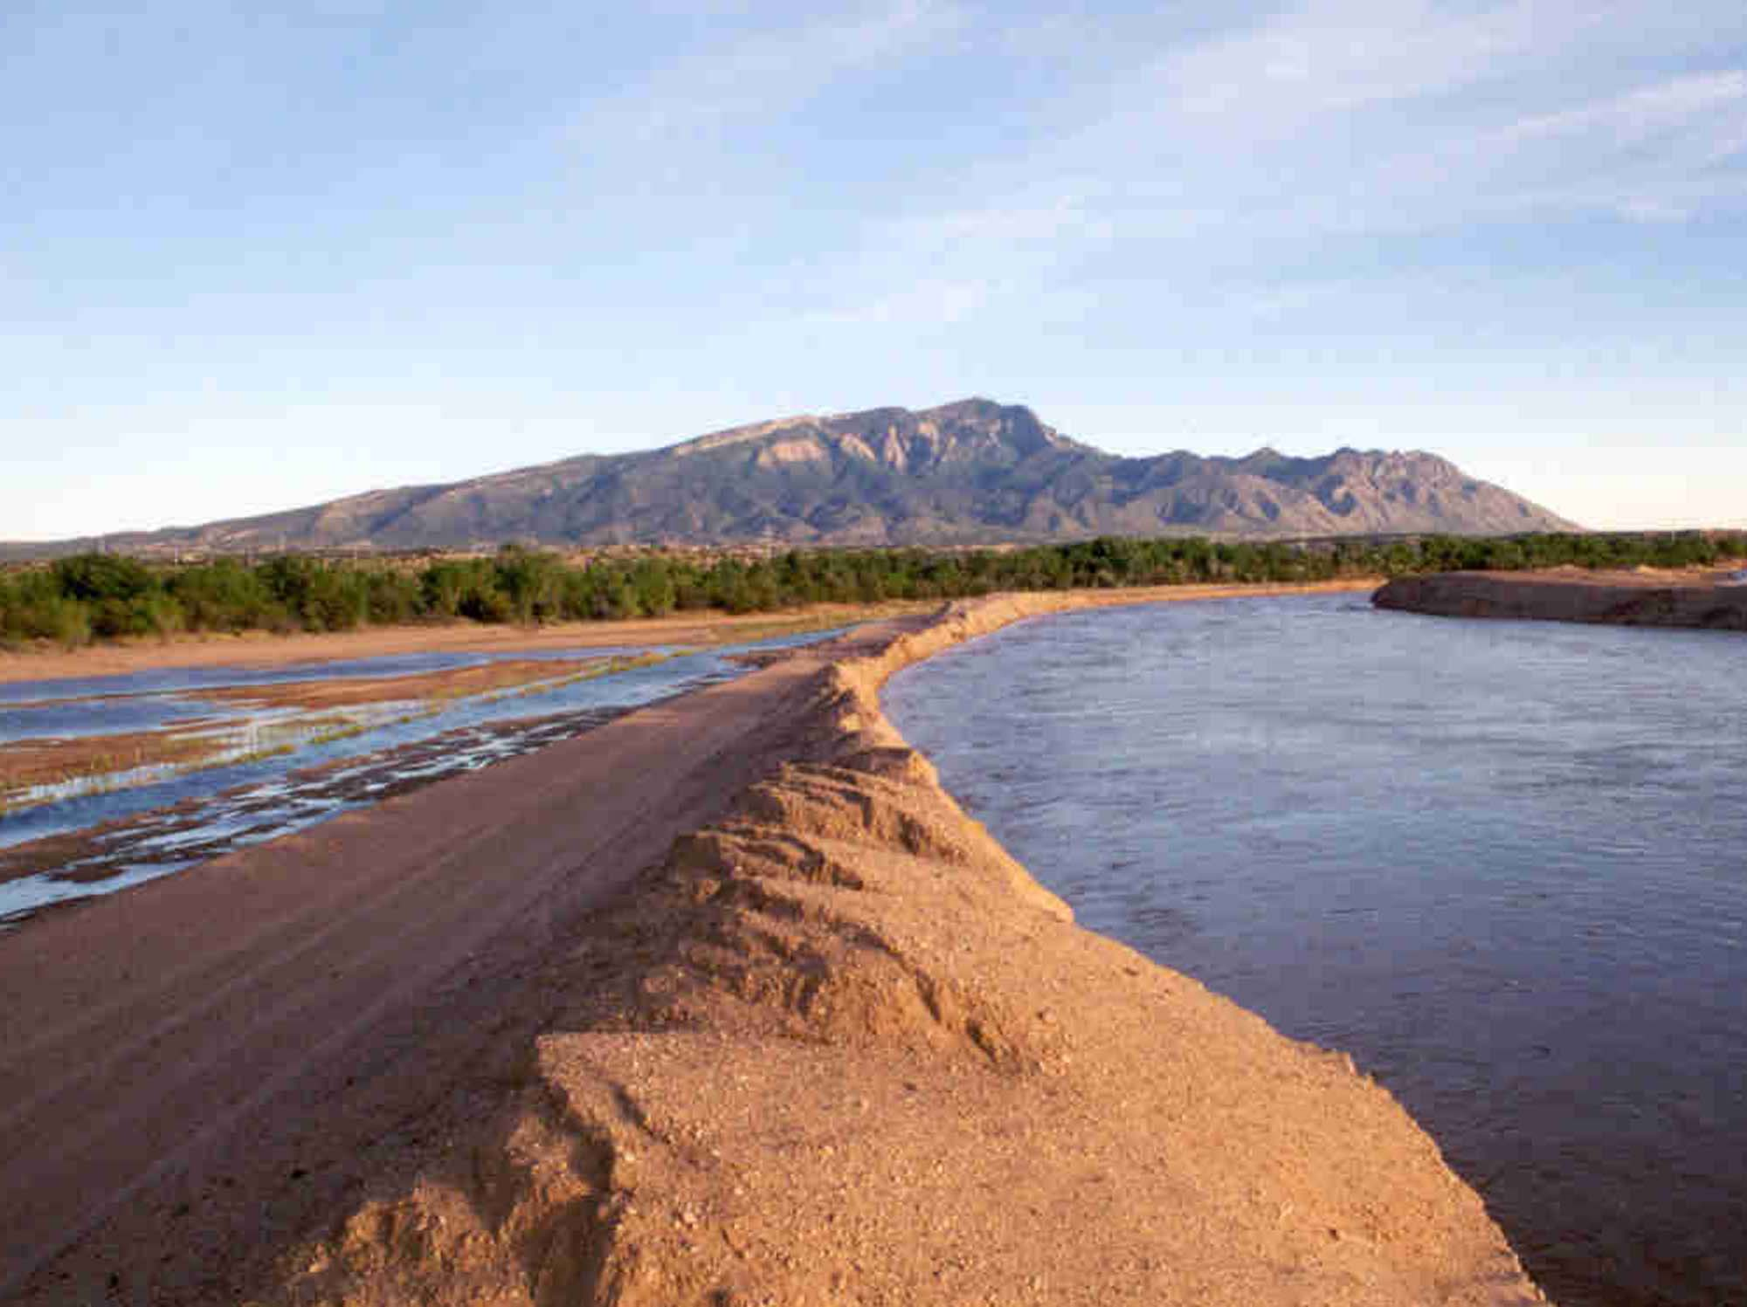
Rio Grande, NM
Restoration Goals
Protect Levee
Create a Functioning Floodplain
Improve Wildlife Habitat
From USBR

Slide 17
River Management and Restoration
River Management
Too much sediment
Not enough sediment
River Restoration
Climate Change and Watersheds
Notes:
17

Slide 18
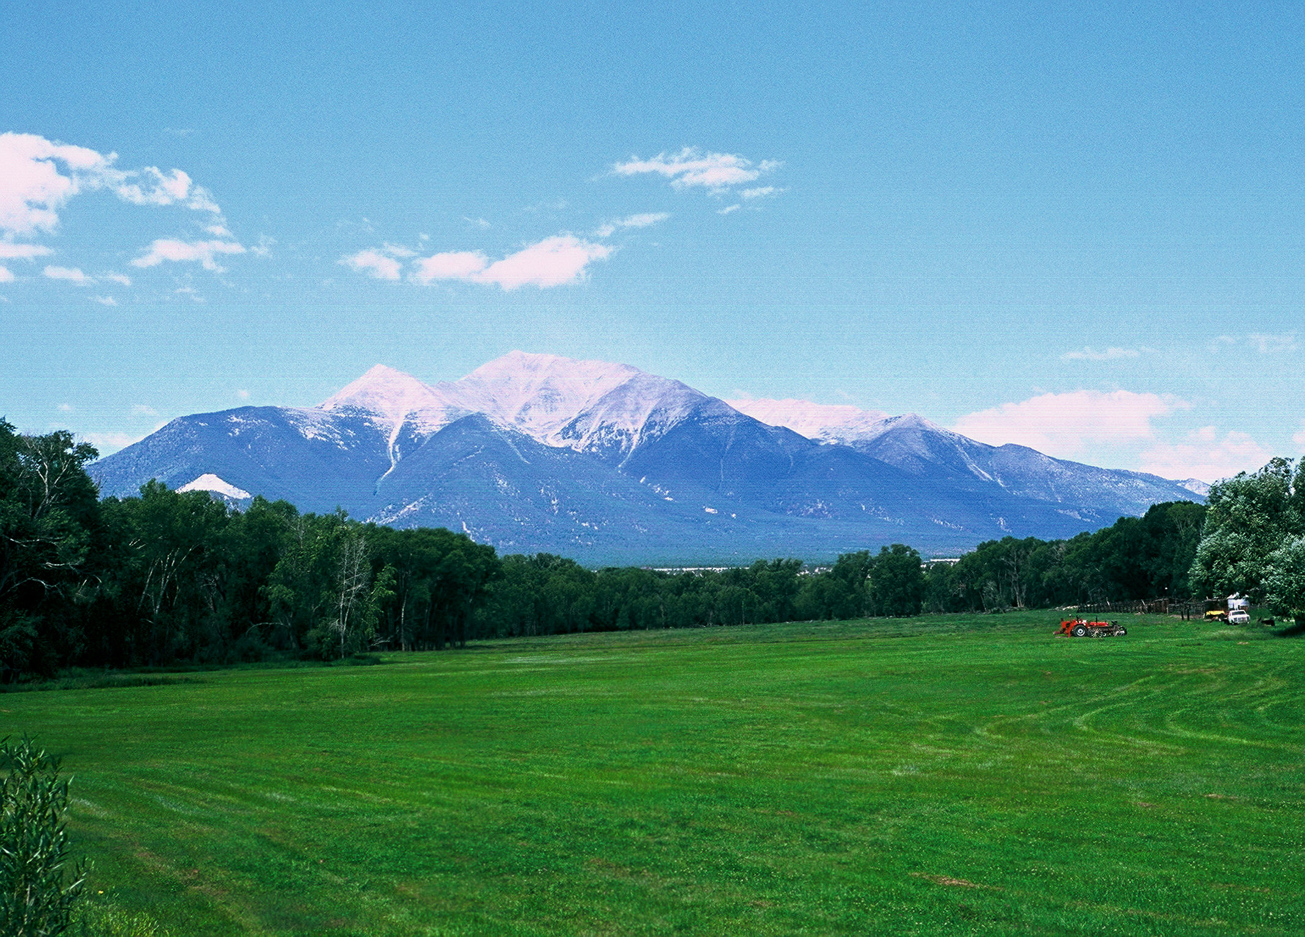
Climate Change Impact on Watersheds
Upper Elevation: Flooding from snowmelt
-----------------------------
Lower Elevation: Flooding from rainstorms
Global Warming

Slide 19
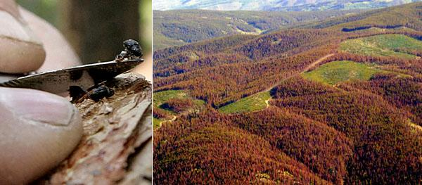
Upper Basin: high-elevation snowpack; snowmelt runoff
Diverse Topography: highest mountains in Colorado – Elbert, Massive, Harvard, etc.
Colorado Forest Infested
by Pine Beetle during Droughts

Slide 20
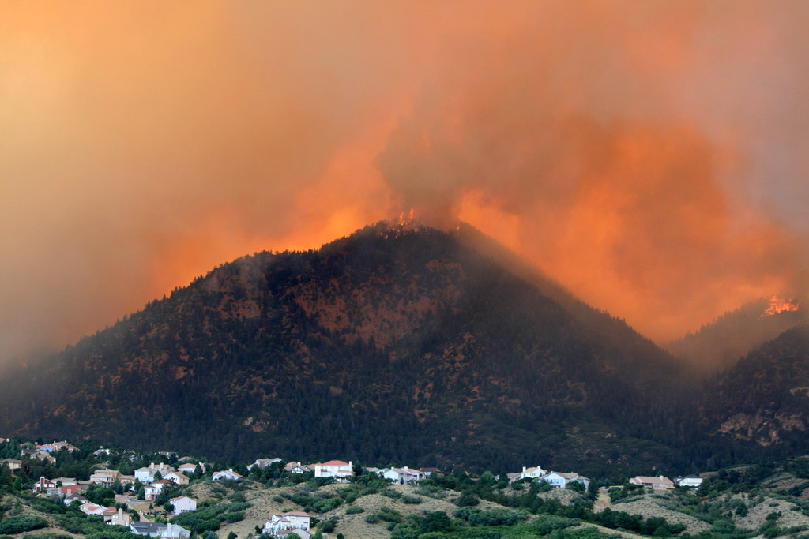
Upper Basin: high-elevation snowpack; snowmelt runoff
Diverse Topography: highest mountains in Colorado – Elbert, Massive, Harvard, etc.
Waldo Fire
Colorado June 2012

Slide 21
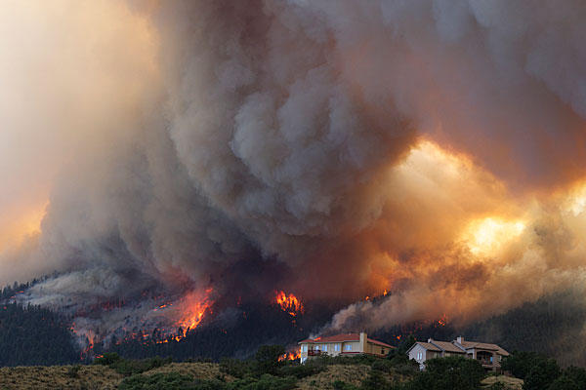
Upper Basin: high-elevation snowpack; snowmelt runoff
Diverse Topography: highest mountains in Colorado – Elbert, Massive, Harvard, etc.
Waldo Fire
Colorado June 2012

Slide 22
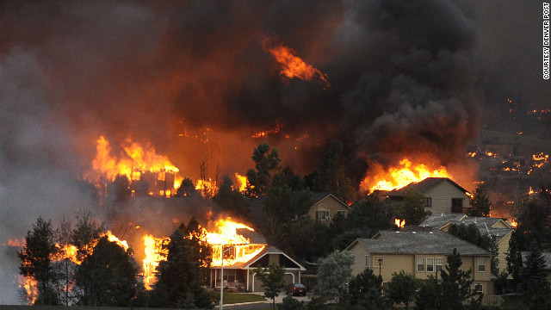
Waldo Fire
Colorado June 2012

Slide 23
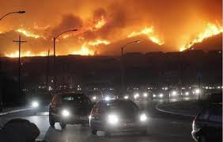
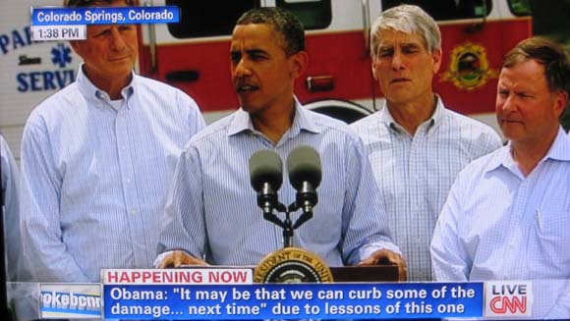
Waldo Fire
Colorado June 2012

Slide 24
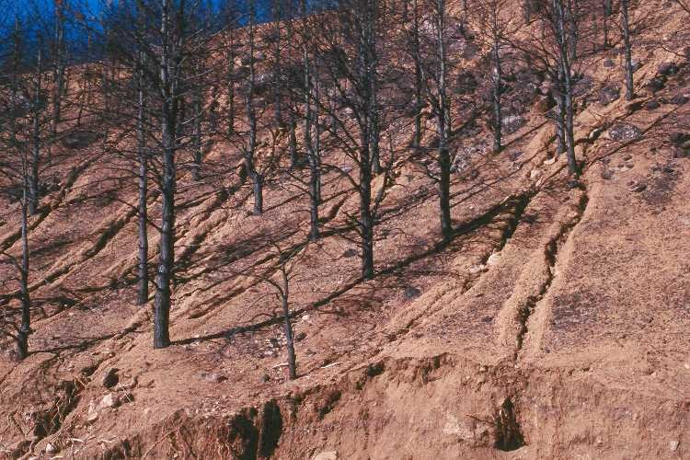
Post- fire erosion
Buffalo Creek, CO
Photo from US Geological Survey
Notes:
24

Slide 25
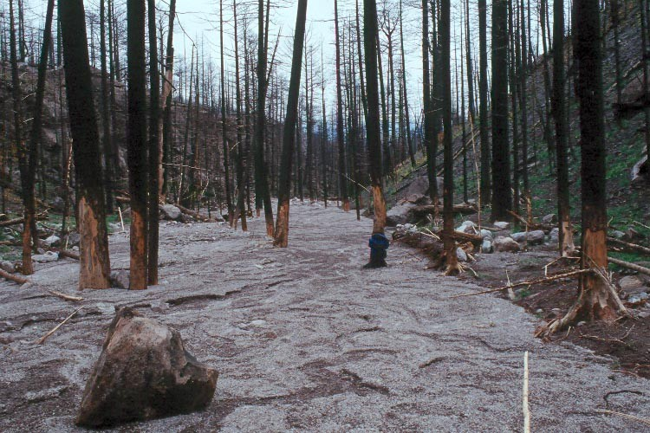
Post-fire erosion
Buffalo Creek, CO
Photo from US Geological Survey
Notes:
25

Slide 26
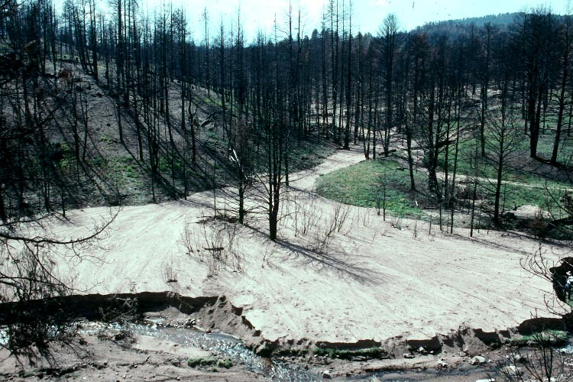
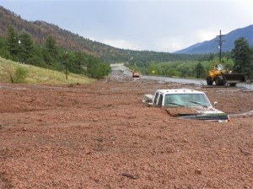
Post-fire mudslides
Colorado 2012

Slide 27
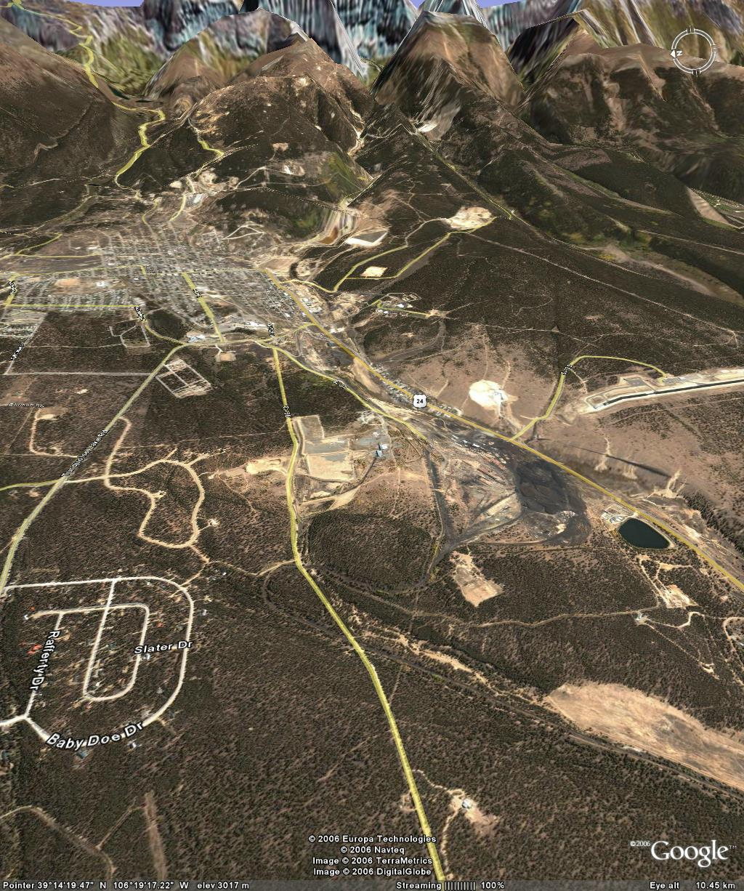
EPA Superfund Site Restoration
California Gulch near Leadville, Colorado
Notes:
27
The revised version of the CASC2D-SED model has been applied in the extensively monitored Goodwin Creek, which….

Slide 28
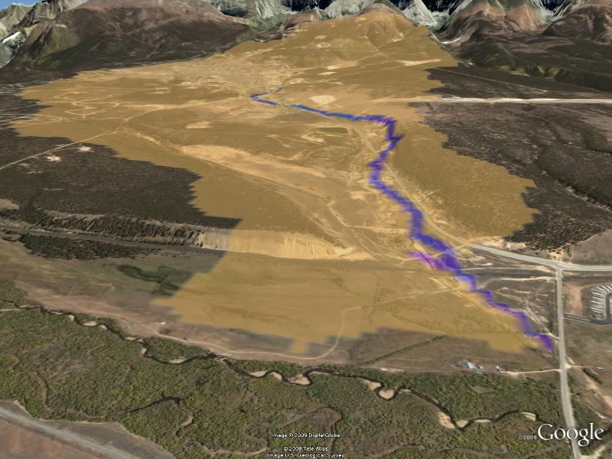
TREX Model California Gulch near Leadville, Colorado
28
Notes:
28
28

Slide 29
River Management and Restoration
River Management balance
Too much sediment between
Not enough sediment water-sediment
River Restoration - aquatic species
Climate Change and Watersheds
    Complex ecosystems
Notes:
29

Slide 30
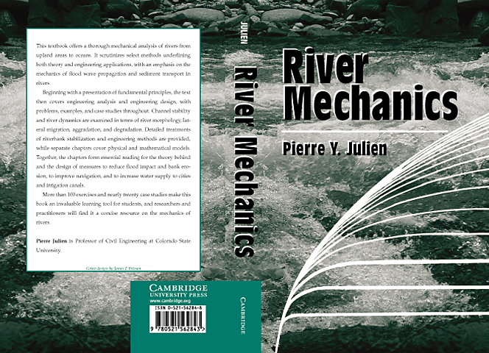
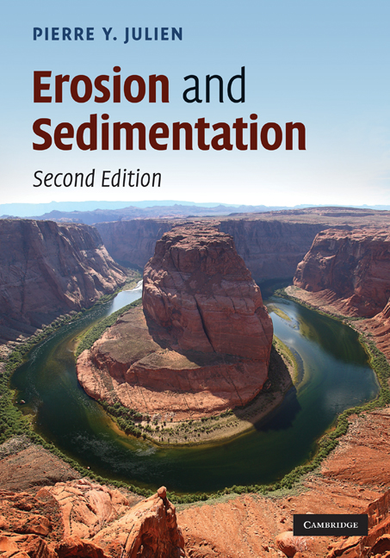
Notes:
30

Slide 31
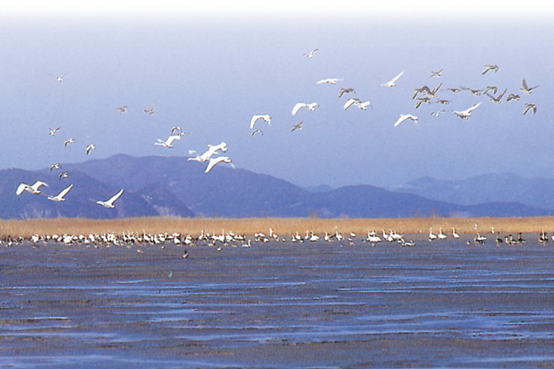
감사합니다
Honorable Shim M.P., 4-Rivers, South Korea
Woo Hyoseop, KICT, S. Korea
Choi Gyewoon, IU, S. Korea
Park Sangkil, PNU, S. Korea
Ji Un, MJU, S. Korea
An Sangdo, K-Water S. Korea
Shin Yongho., K-Water, S. Korea
Kim Hyeonsik, K-Water S. Korea
M. Velleux, CSU, now HDR-HydroQual
J. Halgren, CSU now RTI-NOAA
G. Richard, Mesa State
C. Leon, CSU and RTI
D.C. Baird, USBR
P. O’Brien, USACE
and apologies to all forgotten…
Thank You!
pierre@engr.colostate.edu

