Slide 1
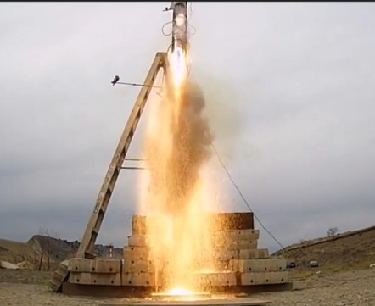
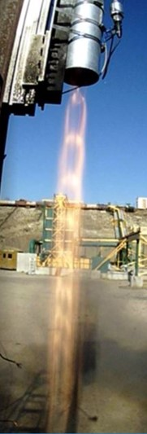
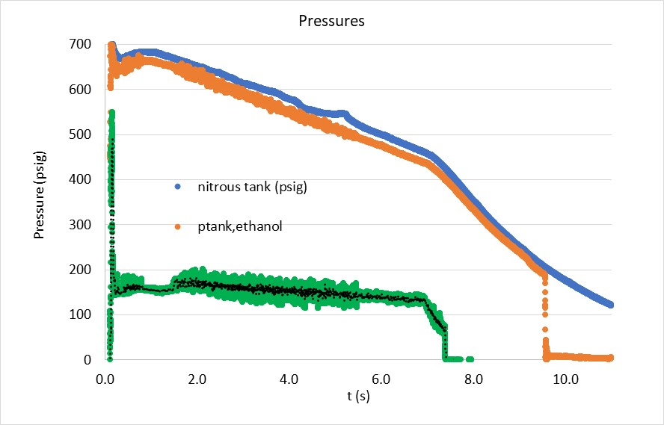
June 19, 2018
DESIGN OF THE ARIES IV TRIBRID LIQUID PROPELLANT ROCKET ENGINE
Colum Ashlin and Eric Lufkin
Colorado State University

Slide 2
Introduction | Design Summary | Details of Design and Supporting Analysis | Testing and Evaluation | Conclusions and Recommendations
CSU History in IREC Competition
ARIES I (2015) – The team designed and built a nitrous oxide/HTPB hybrid powered rocket and were awarded the Gil Moore Technology Innovation Award.
ARIES II (2016) – The team improved the hybrid rocket engine with the use of aluminum/HTPB/nitrous oxide and improved the airframe construction.
ARIES III (2017) – The team designed and built a LIQUID ethanol/nitrous oxide engine, added grid fins to the design and greatly improved the airframe.
ARIES IV (2018) – The team has refined the liquid rocket engine and included an active control system to control the apogee.

Slide 3
ARIES I (2015) and ARIES II (2016)
Introduction | Design Summary | Details of Design and Supporting Analysis | Testing and Evaluation | Conclusions and Recommendations
Injector Plate
Oxidizer Tank Fitting
Electronics/ Payload Bays
Solid Fuel Grain
Vent Tube
Preheater Grain
Oxidizer Tank
Drogue Parachute
Main Parachute
Graphite Nozzle
CSU ARIES I and II teams successfully designed, built, launched and recovered hybrid rocket in their first two years in the competition

Slide 4
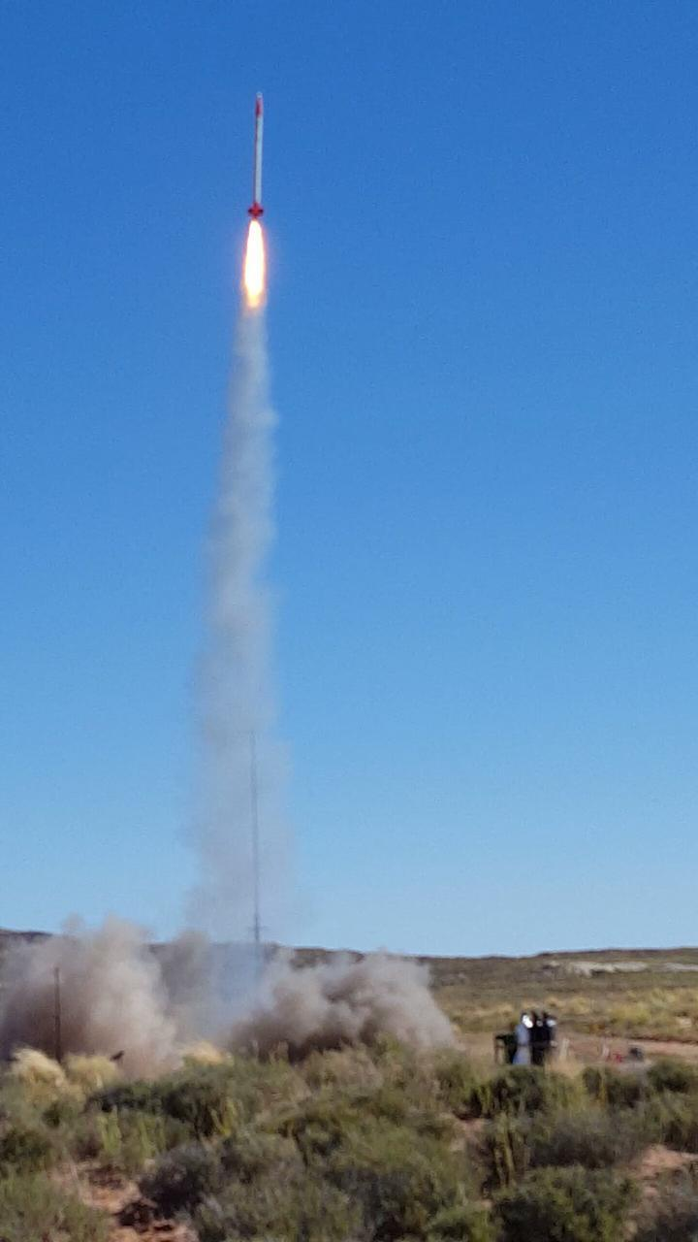
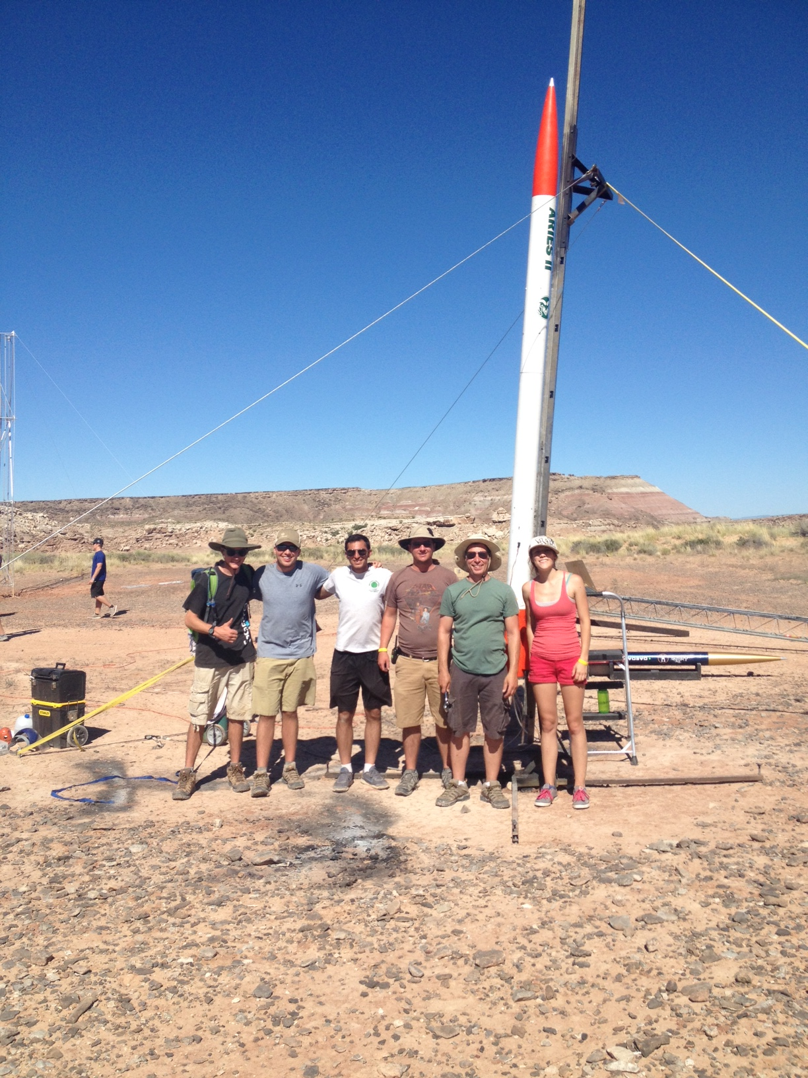
ARIES II - 2016
Introduction | Design Summary | Details of Design and Supporting Analysis | Testing and Evaluation | Conclusions and Recommendations

Slide 5
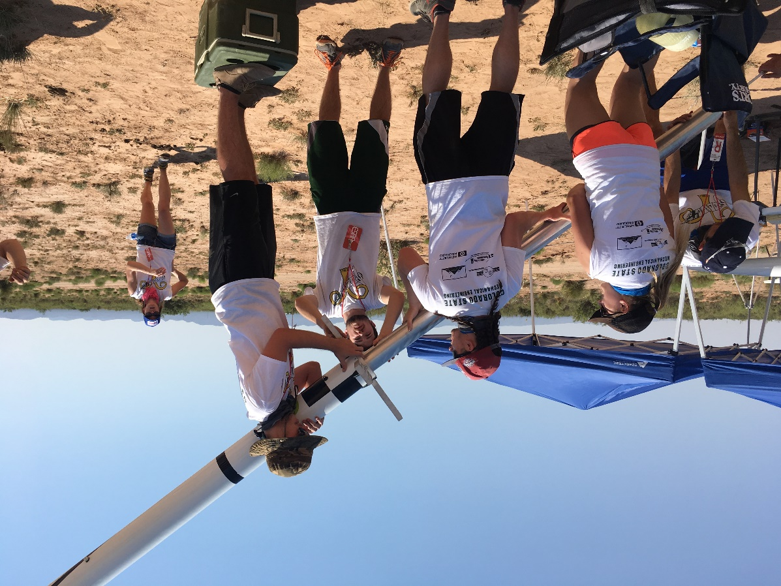
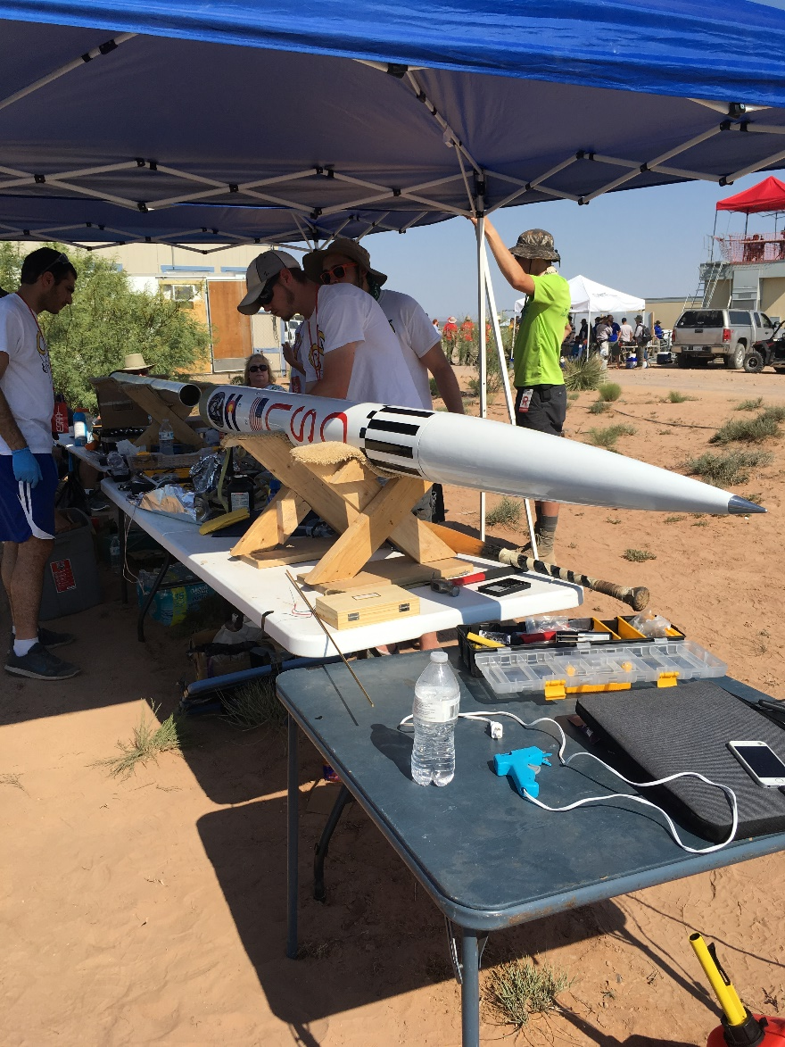
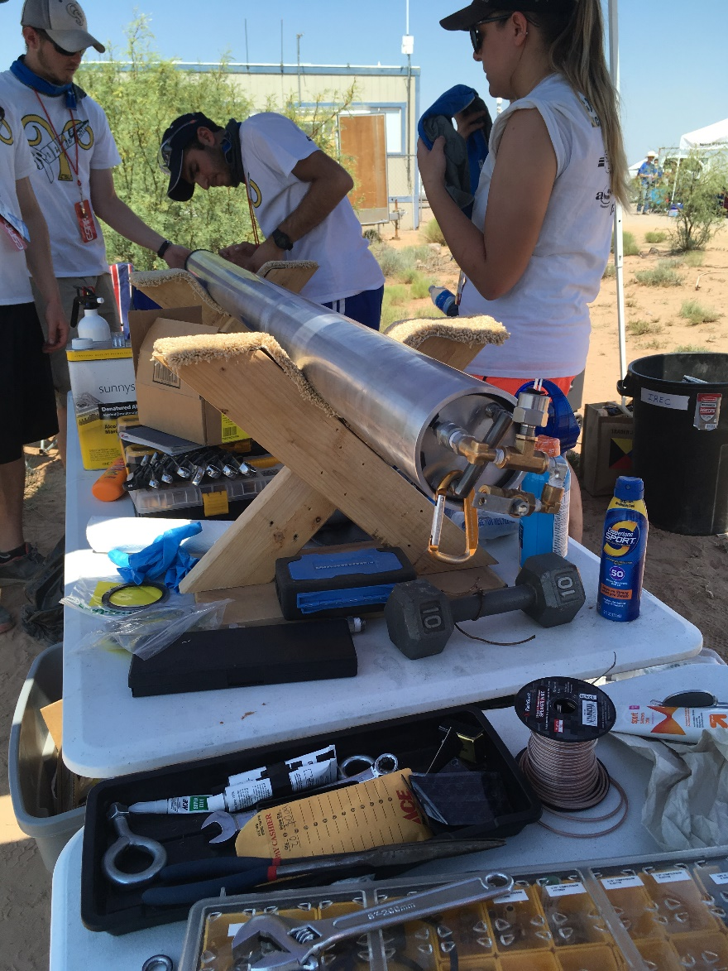
ARIES III (2017)
Introduction | Design Summary | Details of Design and Supporting Analysis | Testing and Evaluation | Conclusions and Recommendations
CSU ARIES III team successfully designed, built and launched liquid propellant N₂O/C₂H₅OH rocket.

Slide 6
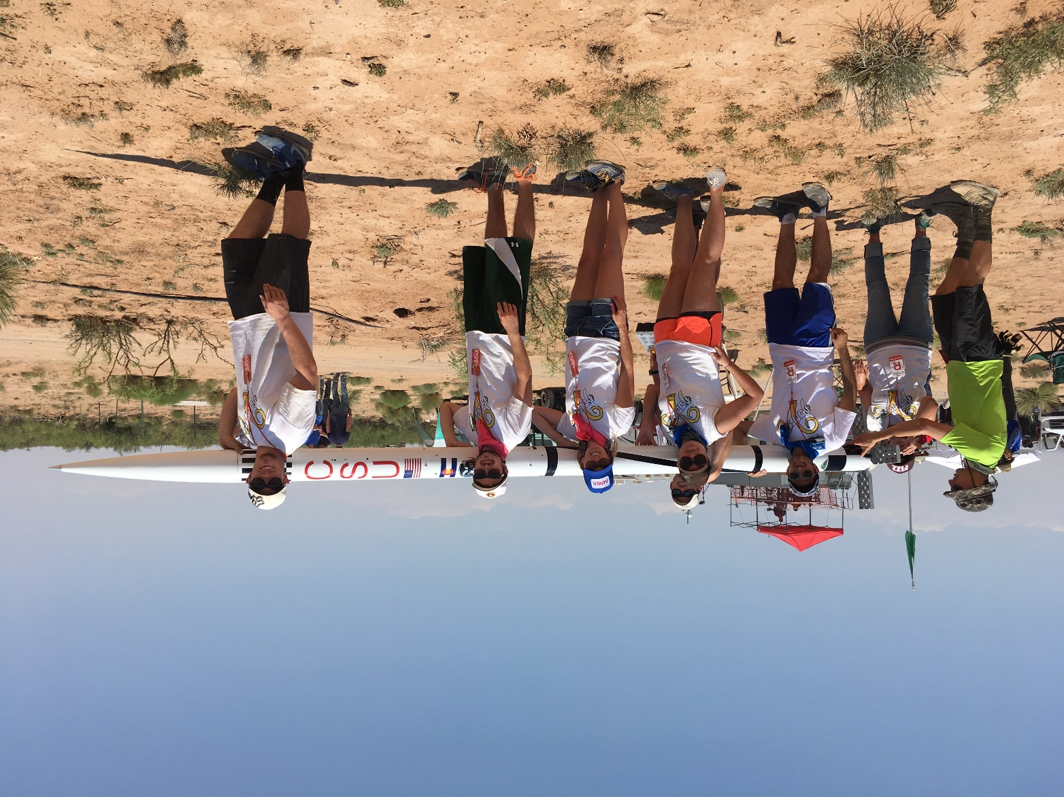
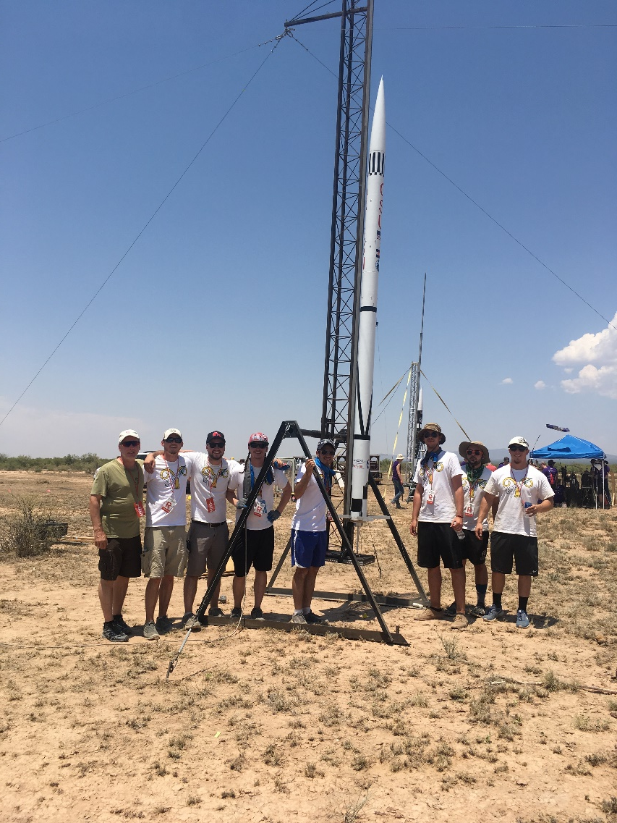
ARIES III (2017)
Introduction | Design Summary | Details of Design and Supporting Analysis | Testing and Evaluation | Conclusions and Recommendations

Slide 7
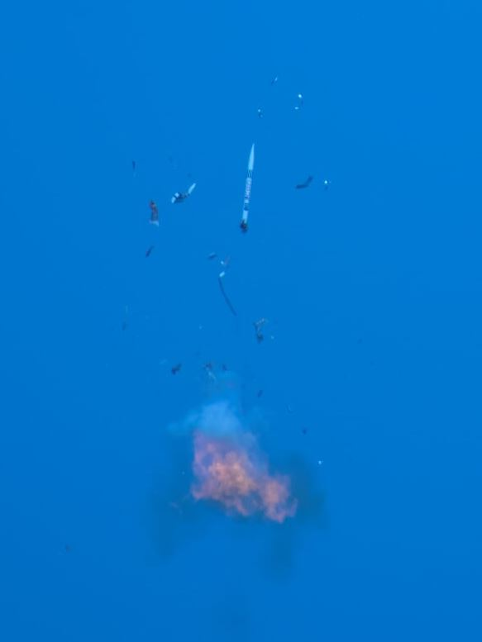
ARIES III (2017)
Introduction | Design Summary | Details of Design and Supporting Analysis | Testing and Evaluation | Conclusions and Recommendations
CSU ARIES III N₂O/C₂H₅OH rocket catastrophically failed 1 second into flight.

Slide 8
ARIES IV – 2018
Introduction | Design Summary | Details of Design and Supporting Analysis | Testing and Evaluation | Conclusions and Recommendations
Mission: Improve upon the Aries III design by separating tanks, developing a new injector with better mixing, and developing mathematical models to better predict performance
Successfully developed small scale engine. Allowed for full systems testing at a fraction of the cost of full scale testing.
Successfully developed robust mathematical model of rocket trajectory, as well as a model that accurately predicts discharge time of propellants.
Unsuccessfully, then successfully developed a liquid engine capable of taking the Aries IV to 10000 ft.

Slide 9
Introduction | Design Summary | Details of Design and Supporting Analysis | Testing and Evaluation | Conclusions and Recommendations
Design Summary Overview
Major Design Innovations:
Separation of propellant tanks and combustion chamber
Custom slide check valves
Pintle Injector

Slide 10
Introduction | Design Summary | Details of Design and Supporting Analysis | Testing and Evaluation | Conclusions and Recommendations
Design Summary
Tribrid Liquid Propellant Engine

Slide 11
Introduction | Design Summary | Details of Design and Supporting Analysis | Testing and Evaluation | Conclusions and Recommendations
Design Summary
Tank/Chamber Separation

Slide 12
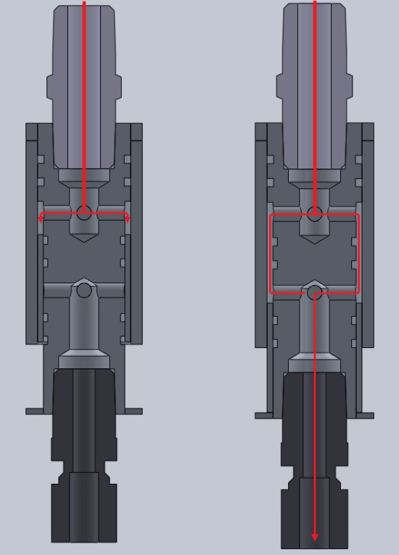
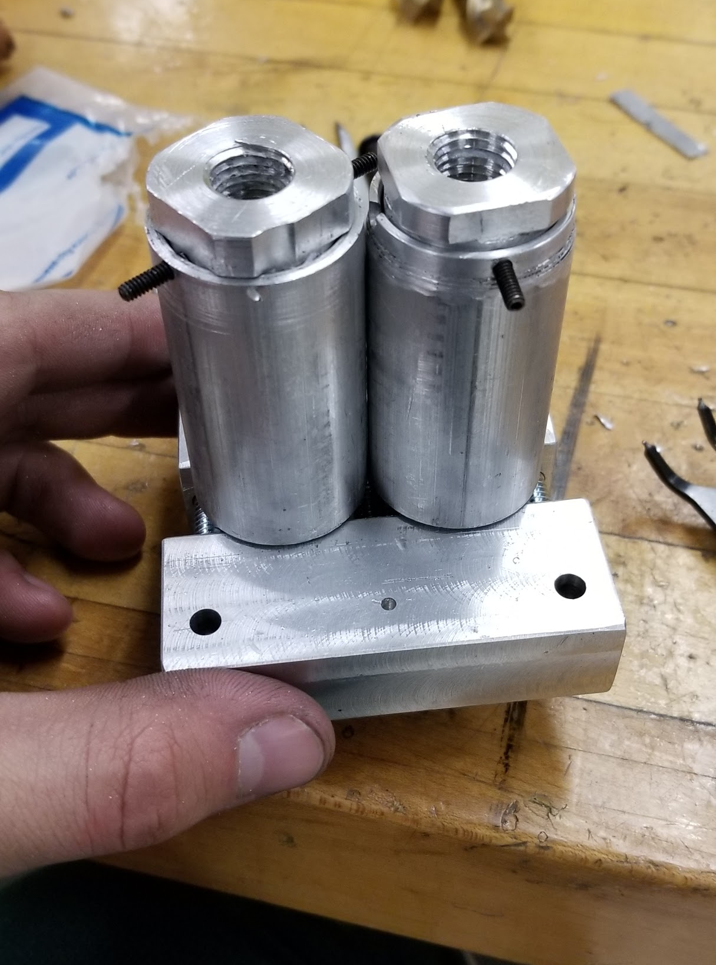
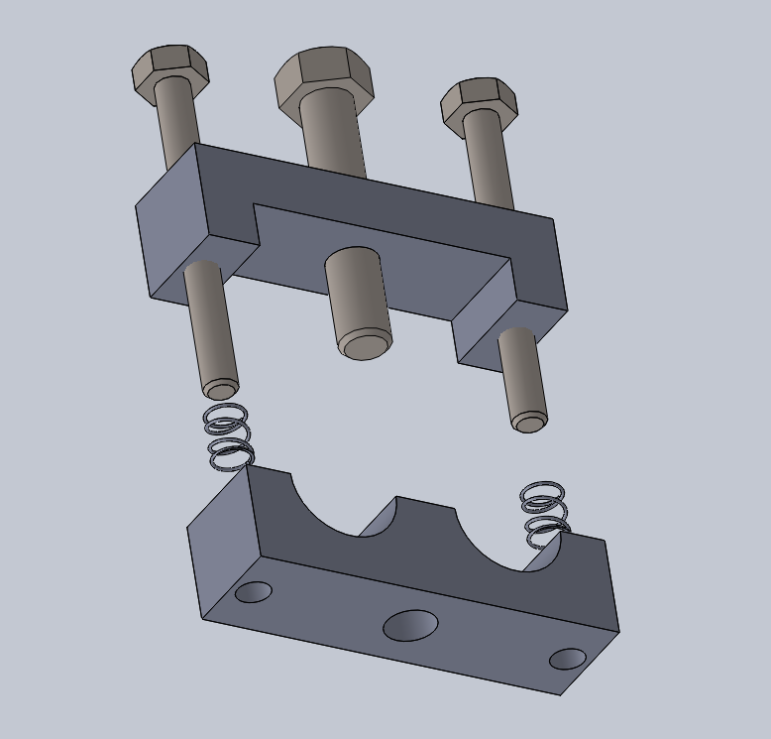
Introduction | Design Summary | Details of Design and Supporting Analysis | Testing and Evaluation | Conclusions and Recommendations
Design Summary
Slide Check Valves

Slide 13
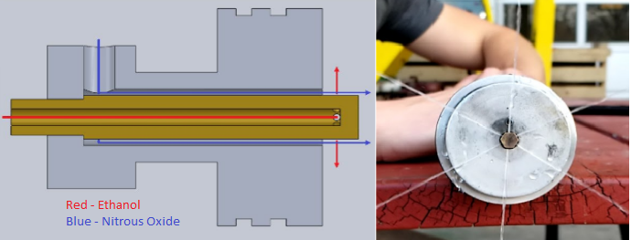
Introduction | Design Summary | Details of Design and Supporting Analysis | Testing and Evaluation | Conclusions and Recommendations
Design Summary
Pintle Injector

Slide 14
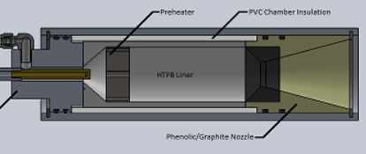
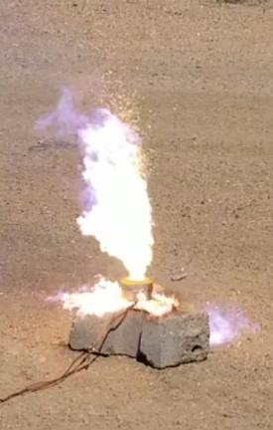
Introduction | Design Summary | Details of Design and Supporting Analysis | Testing and Evaluation | Conclusions and Recommendations
Design Summary
Ignition Process

Slide 15
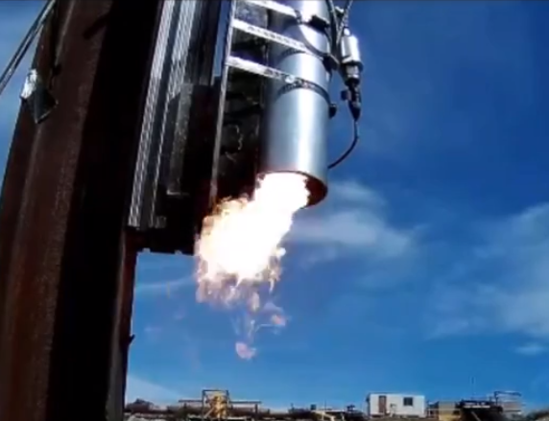
Testing and Evaluation
Introduction | Design Summary | Details of Design and Supporting Analysis | Testing and Evaluation | Conclusions and Recommendations
Hybrid mode (depleted ethanol)
Full ethanol combustion

Slide 16
Failure Analysis
The propellant built up in the combustion chamber and a hard start was achieved.
The nozzle was also designed to allow for a high combustion chamber pressure, which prevented the exhaust from leaving easily.
The entire team worked together to cut weight from the rocket so the mass flow could be reduced and the combustion chamber could operate at a lower pressure.
The propellant tanks were shortened to the minimum size necessary to take an optimized rocket to 10,000 ft.
The combustion chamber was shortened to prevent propellant build up and reduce rocket mass.
The mass flow was significantly reduced and the throat area of the nozzle was increased.

Slide 17
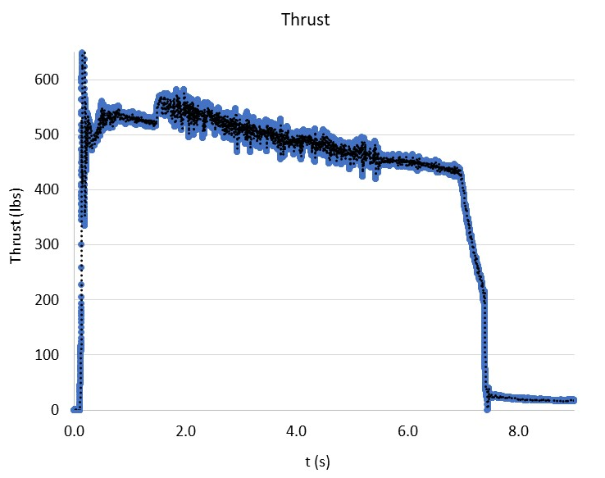
Introduction | Design Summary | Details of Design and Supporting Analysis | Testing and Evaluation | Conclusions and Recommendations
Experimental Results from Static Test Fires
Chamber Pressure, Thrust, Nitrous Tank Pressure, Ethanol Tank Pressure, Average Propellant Mass Flow Rate

Slide 18
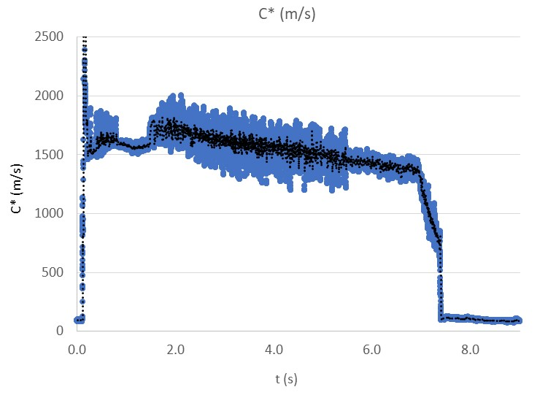
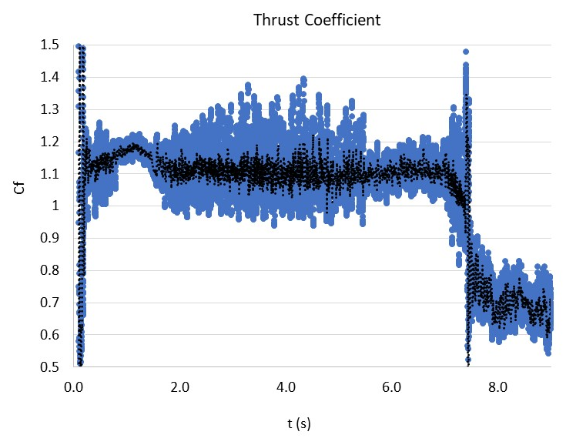
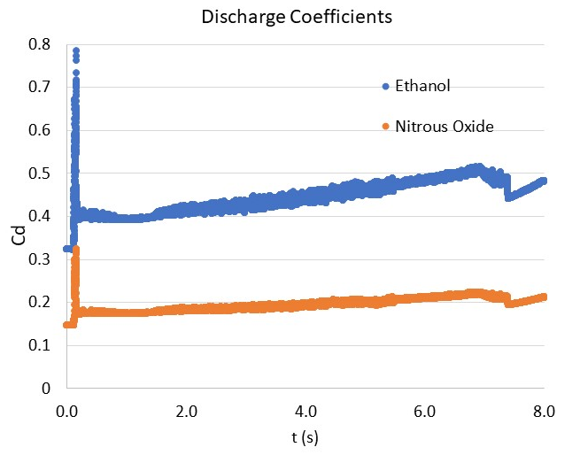
Introduction | Design Summary | Details of Design and Supporting Analysis | Testing and Evaluation | Conclusions and Recommendations
Experimental Results from Static Test Fires Used to Refine Rocket Engine Model
C*, Thrust Coefficient, Injector Discharge Coefficients

Slide 19
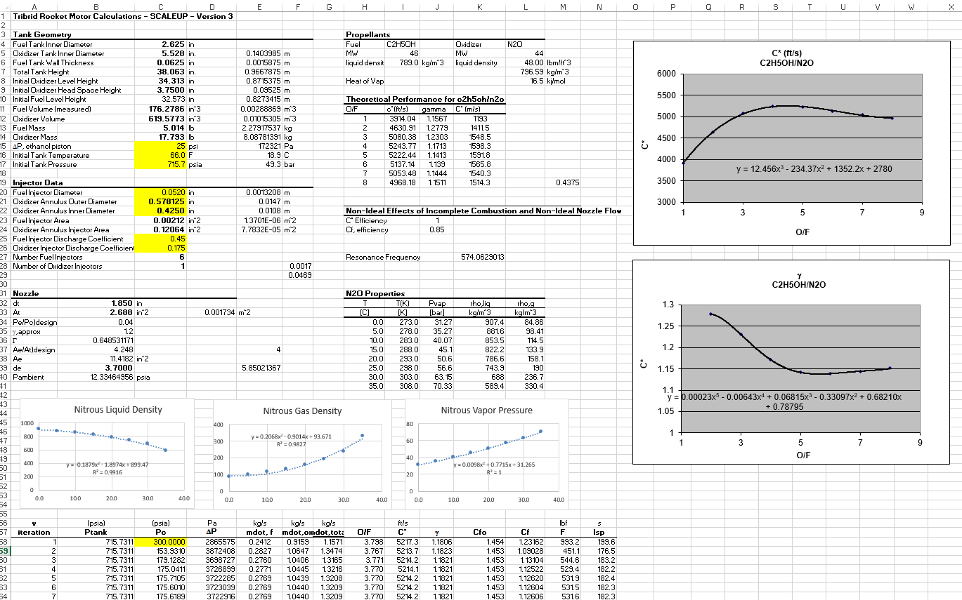
Thermodynamic Liquid Rocket Engine Model Static
Introduction | Design Summary | Details of Design and Supporting Analysis | Testing and Evaluation | Conclusions and Recommendations

Slide 20
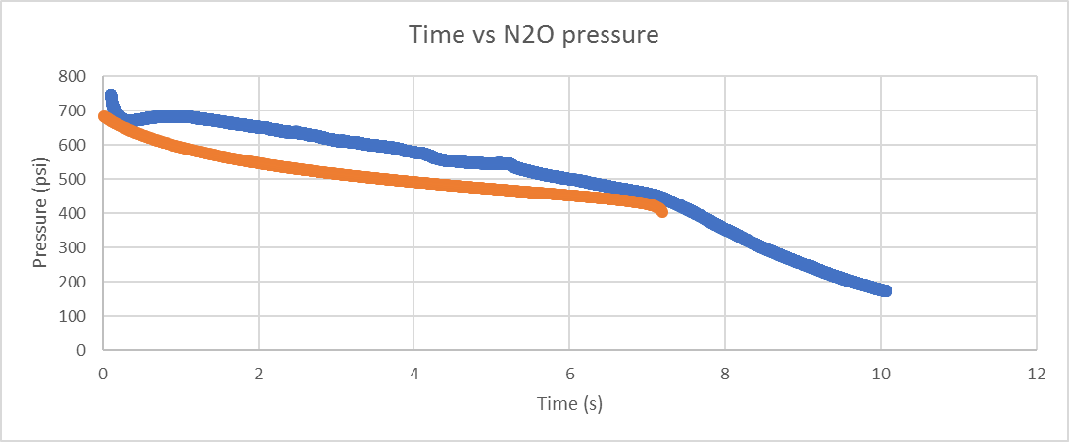
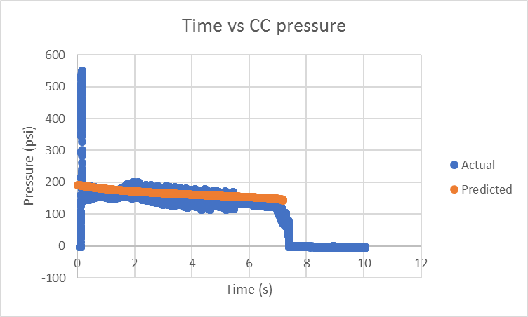
Thermodynamic Liquid Rocket Engine Model Dynamic
Introduction | Design Summary | Details of Design and Supporting Analysis | Testing and Evaluation | Conclusions and Recommendations

Slide 21
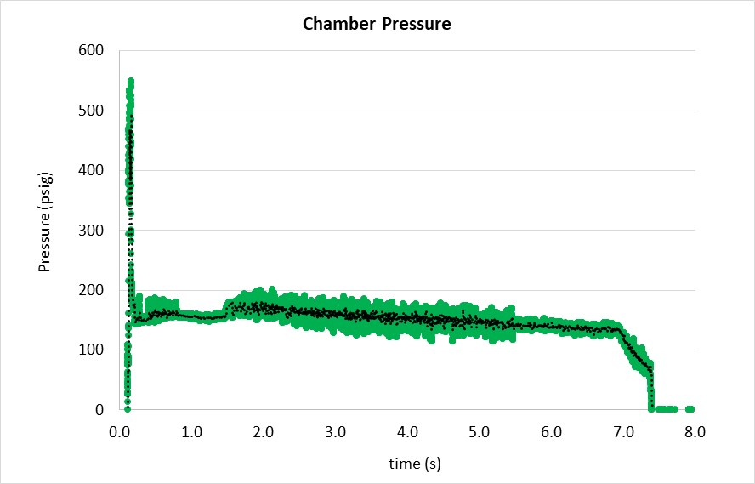
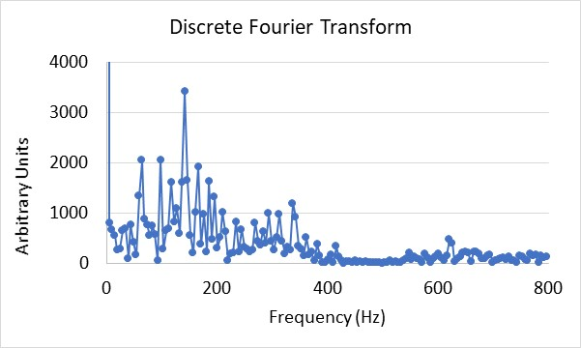
Introduction | Design Summary | Details of Design and Supporting Analysis | Testing and Evaluation | Conclusions and Recommendations
Ignition Transient and Combustion Stability
Quasi-steady engine/tank models accurately predict steady chamber pressure and thrust vs. time, but we currently lack the ability to predict transient chamber pressure at ignition and pressure pulsations due to “chugging”.
Ignition Transient
140 Hz
Pressure Pulsations (50 psi peak-peak; 140 Hz)

Slide 22
Testing and Evaluation
Introduction | Design Summary | Details of Design and Supporting Analysis | Testing and Evaluation | Conclusions and Recommendations
 | Impulse (lb*s) | C* efficiency (s) | Thrust (lbs)
Range | 3500-4000* | 90-93% | 480-520
*Hybrid mode included
Total impulse needs to be met to reach apogee
C* efficiency is measured to see how well the system is performing

Slide 23
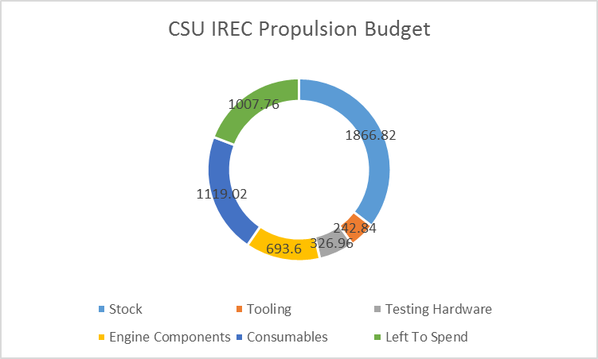
Conclusions and Recommendations
Introduction | Design Summary | Details of Design and Supporting Analysis | Testing and Evaluation | Conclusions and Recommendations
Manufactured well within budget constraints
Stock | 1866.82
Tooling | 242.84
Testing Hardware | 326.96
Engine Components | 693.6
Consumables | 1119.02
Left To Spend | 1007.76

Slide 24
Conclusions and Recommendations
Introduction | Design Summary | Details of Design and Supporting Analysis | Testing and Evaluation | Conclusions and Recommendations
Understand every subsystem necessary for the engine to perform, as well as all identified failure modes
Get started manufacturing and doing subsystem tests early. It takes longer than you think
Have more members on the propulsion team
Take the system that’s been designed and built this year, and scale it up to take Aries V to 30,000 feet (or beyond)
Begin experimenting with kerosene and maybe LOX
Try for a full scale launch prior to the competition

Slide 25
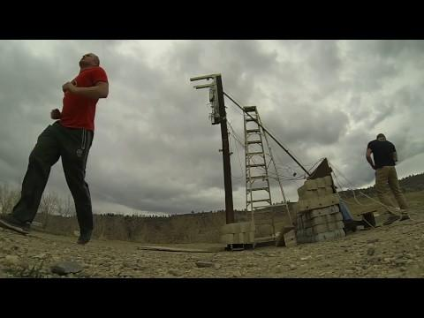
Questions?

