Slide 1

October 2, 2017
KEY 192A
Biofuels from Microalgae
Alyssa Aligata
Mechanical Engineering Graduate Student

Slide 2
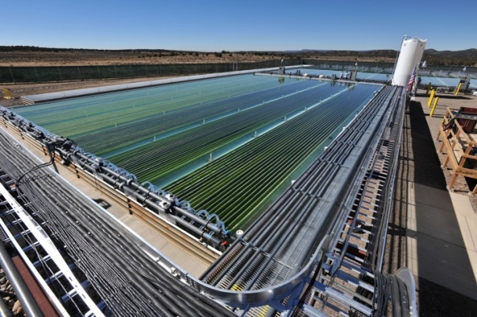
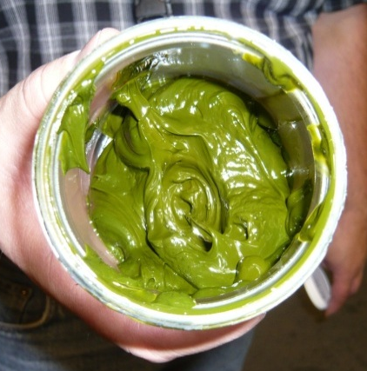
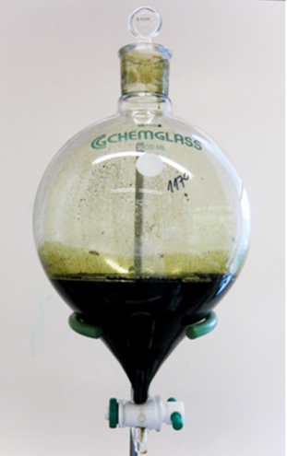
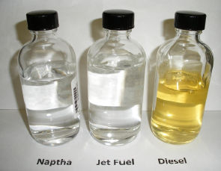
Algal Biofuels: Progress and Research Challenges
Overview
  Motivation for Renewable Liquid Fuels
  The Case for Algae
  Current Research Challenges: Biology to Combustion
  Cultivation, Harvesting and Extraction Research
  Conversion of Algal Lipids and Biomass into Liquid Fuels
  Conclusions

Slide 3
Algal Biofuels: Progress and Research Challenges
Overview
  Motivation for Renewable Liquid Fuels
  The Case for Algae
  Current Research Challenges: Biology to Combustion
  Cultivation, Harvesting and Extraction Research
  Conversion of Algal Lipids and Biomass into Liquid Fuels
  Conclusions

Slide 4

Biofuels Introduction
Biofuel = liquid fuel that has been developed from renewable plant or animal materials
Why are biofuels important?
  Finite fossil fuels
  Carbon footprint
  Energy security

Slide 5
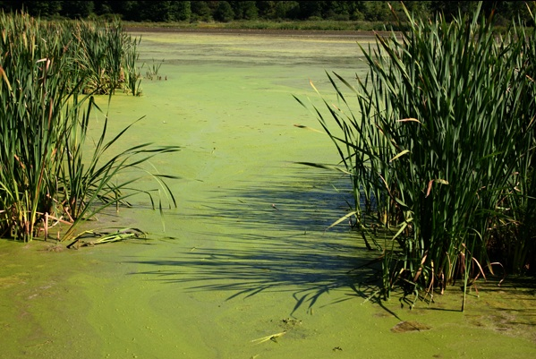
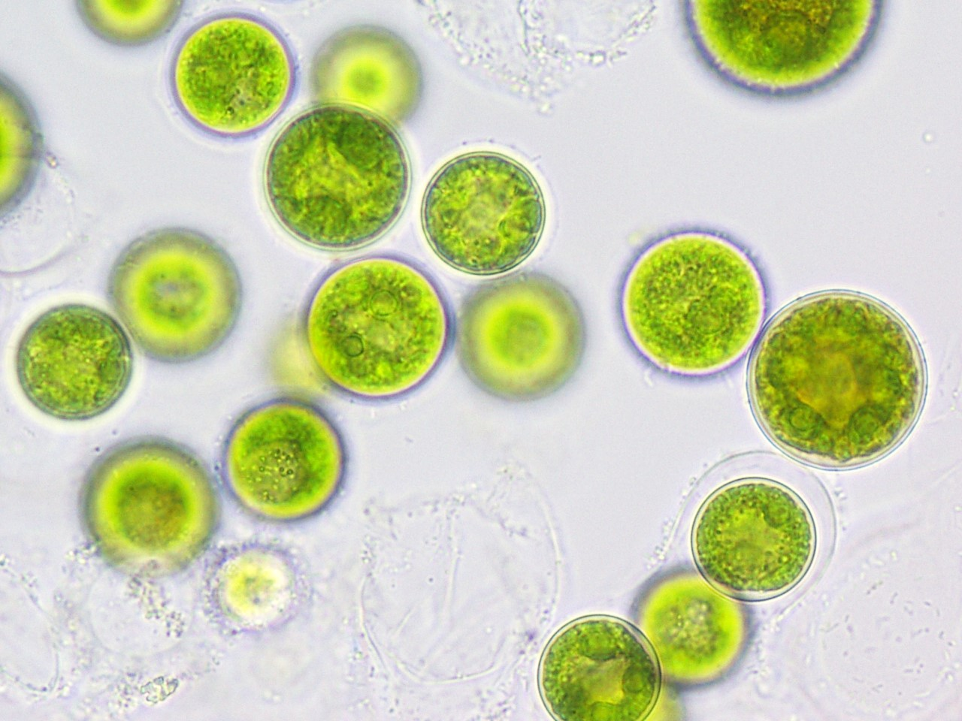
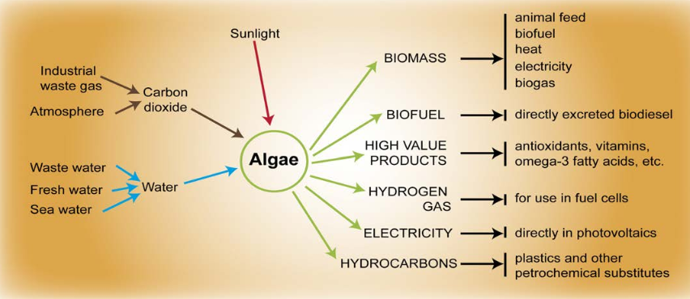
Algal Biofuels

Slide 6
Algal Biofuels: Progress and Research Challenges
Overview
  Motivation for Renewable Liquid Fuels
  The Case for Algae
  Current Research Challenges: Biology to Combustion
  Cultivation, Harvesting and Extraction Research
  Conversion of Algal Lipids and Biomass into Liquid Fuels
  Conclusions

Slide 7
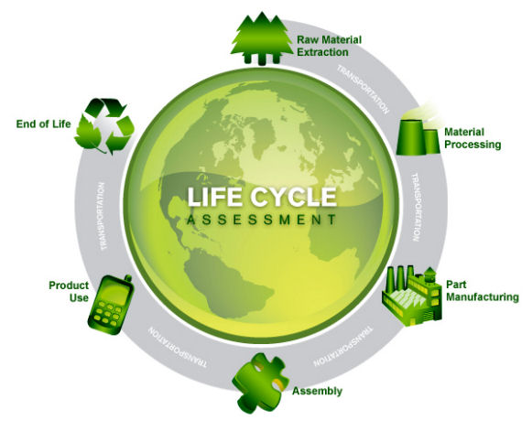
Life Cycle Assessment
Technique to assess environmental impacts associated with all the stages of a product's life from raw material extraction through materials processing, manufacture, distribution, use, repair and maintenance, and disposal or recycling

Slide 8
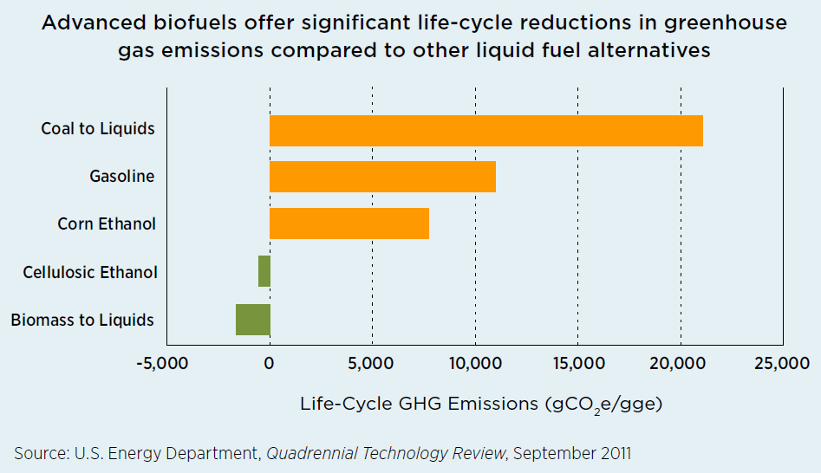
Advanced Biofuels
Offer Significant Reduction in Greenhouse Gas Emissions

Slide 9
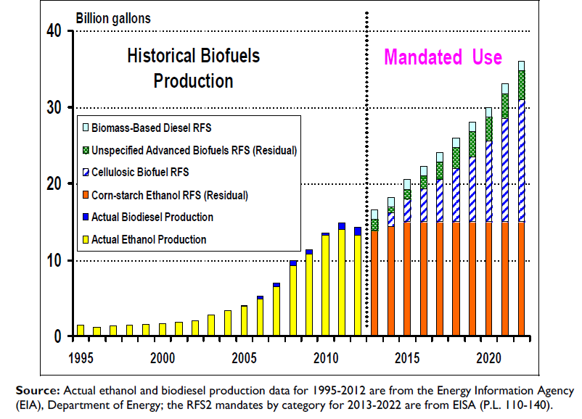
U.S. Advanced Biofuels Mandate
21 billion gal/year by 2022
  The 2007 Energy Independence and Security Act (EISA) mandates the production of 36 billion gallons per year of biofuels by 2022
    21 billion gallons per year must qualify as advanced biofuels.
  Note: the U.S. consumes 300 Billion gallons per year of liquid fuels

Slide 10
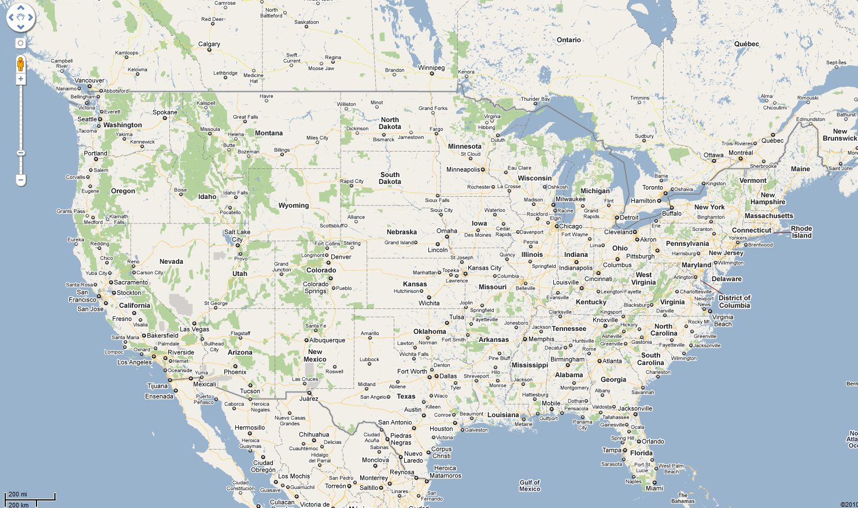
The Case for Algae
Phototrophic Microalgae is Potentially Scalable
  21 billion gallons per year of “advanced biofuels” ≈ 10% of U.S. liquid on-road fuel usage ≈ how much cultivation area?
21 billion gallons per year of soy biodiesel (≈ Alaska)
21 billion gallons per year of algae biodiesel (≈ Connecticut)

Slide 11
Algal Biofuels: Progress and Research Challenges
Overview
  Motivation for Renewable Liquid Fuels
  The Case for Algae
  Current Research Challenges: Biology to Combustion
  Cultivation, Harvesting and Extraction Research
  Conversion of Algal Lipids and Biomass into Liquid Fuels
  Conclusions

Slide 12
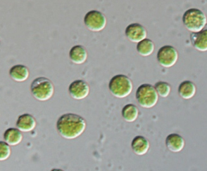
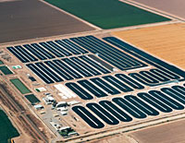
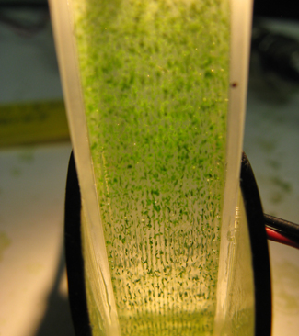
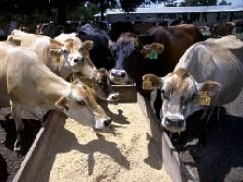
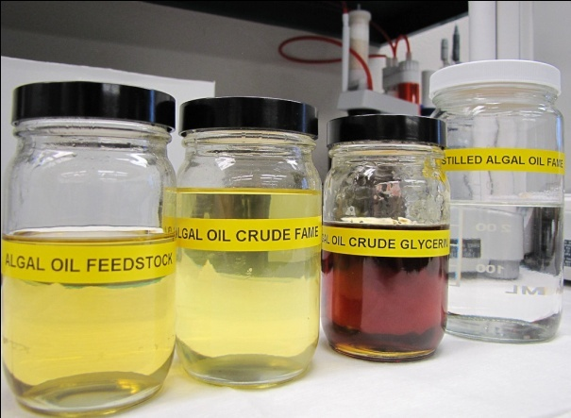
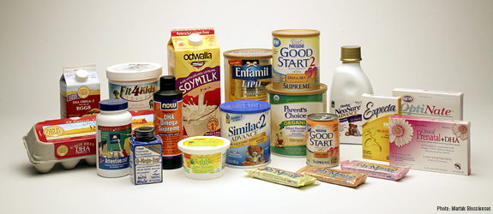
Current Research Challenges
Biology, Cultivation, Harvesting, Extraction, Conversion, Co-Products
Biology
Cultivation
Harvesting
Conversion
Co-products
Extraction

Slide 13
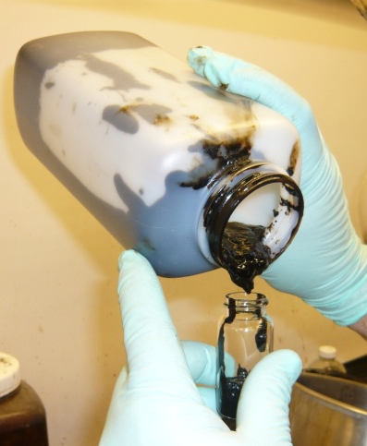
Current Research Challenges
Direct Conversion of Wet Algae Biomass into Bio-Crude Oil
Biology
Cultivation
Harvesting
Nutrient Recycle
Upgrading to
Drop-In Fuels
Conversion to Biocrude
Whole Algal Biomass

Slide 14
Algal Biofuels: Progress and Research Challenges
Overview
  Motivation for Renewable Liquid Fuels
  The Case for Algae
  Current Research Challenges: Biology to Combustion
  Cultivation, Harvesting and Extraction Research
  Conversion of Algal Lipids and Biomass into Liquid Fuels
  Algal Biofuel Combustion and Engines Research
  Conclusions

Slide 15
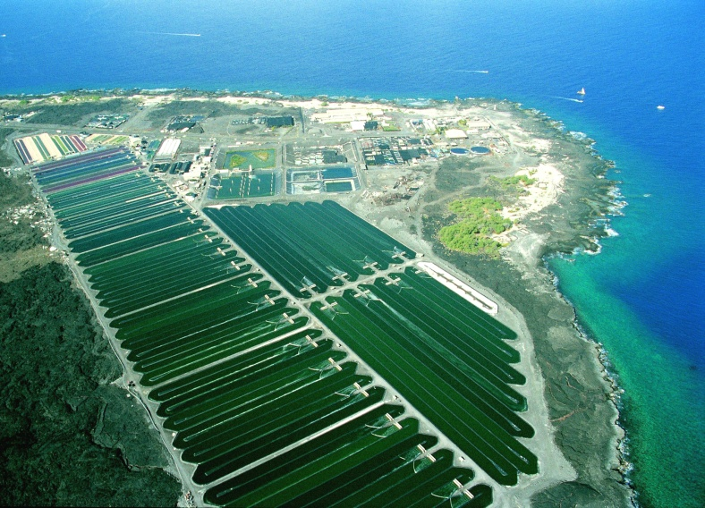
Cultivation Research: Open Ponds
Numerous profitable enterprises use open pond cultivation techniques for high value products (e.g. pharmaceutical)
Advantages
Lowest capital cost
Only technology demonstrated to date at large scale
Research Issues
Contamination of specific culture with local species
Susceptible to weather , dust, sand
Water loss from evaporation
Unconfined genetically modified organisms is a concern for many!
Nutrex, Hawaii
Earthrise, California

Slide 16
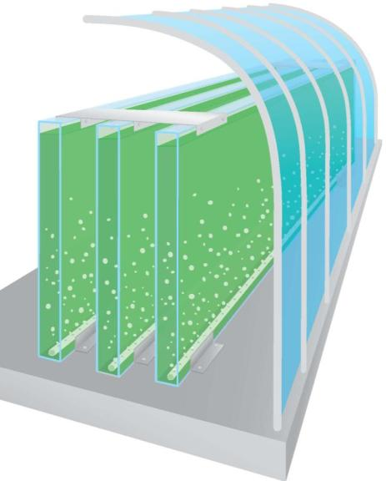
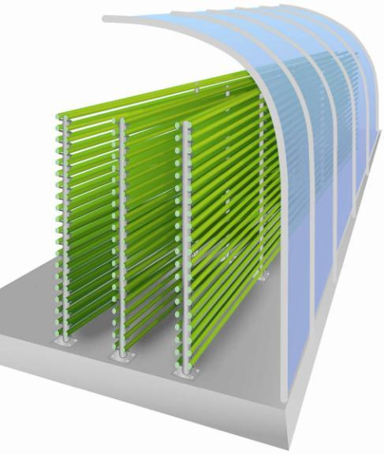
Cultivation Research: Closed PhotoBioreactors
Glass Plate Photobioreactor
(Pulz, Richmond, others)
Advantages
Allow growth of specific cultures
No contamination from invasive species
Allows environmental control
Potential for much higher growth rates
Ability to confine GMO’s
Disadvantages
Higher capital cost
Higher energy costs
Low-cost production has not been demonstrated
Glass Tube Photobioreactor
(Pulz, IGV, Ketura, Torzillo, others)

Slide 17
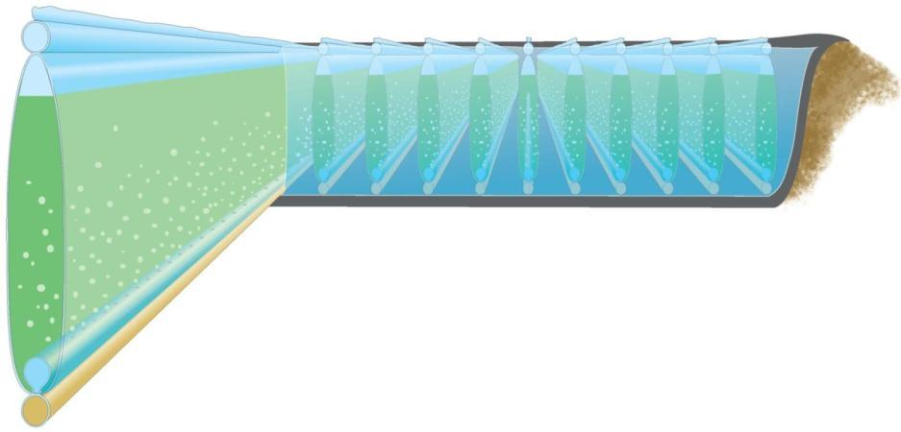
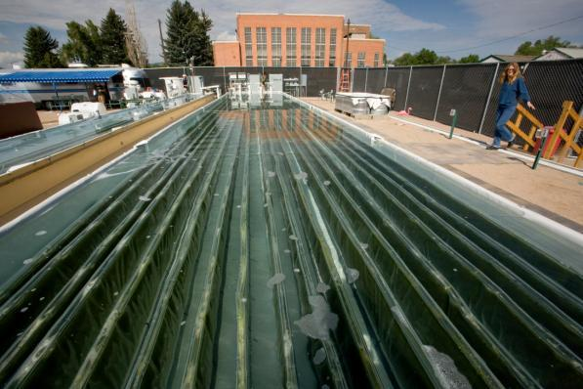

Solix BioSystems
Development of Low Cost Scalable PhotoBioreactors
Solix G3 Technology:
Extended surface area
Water supported
Integrated CO₂ / air sparging

Slide 18
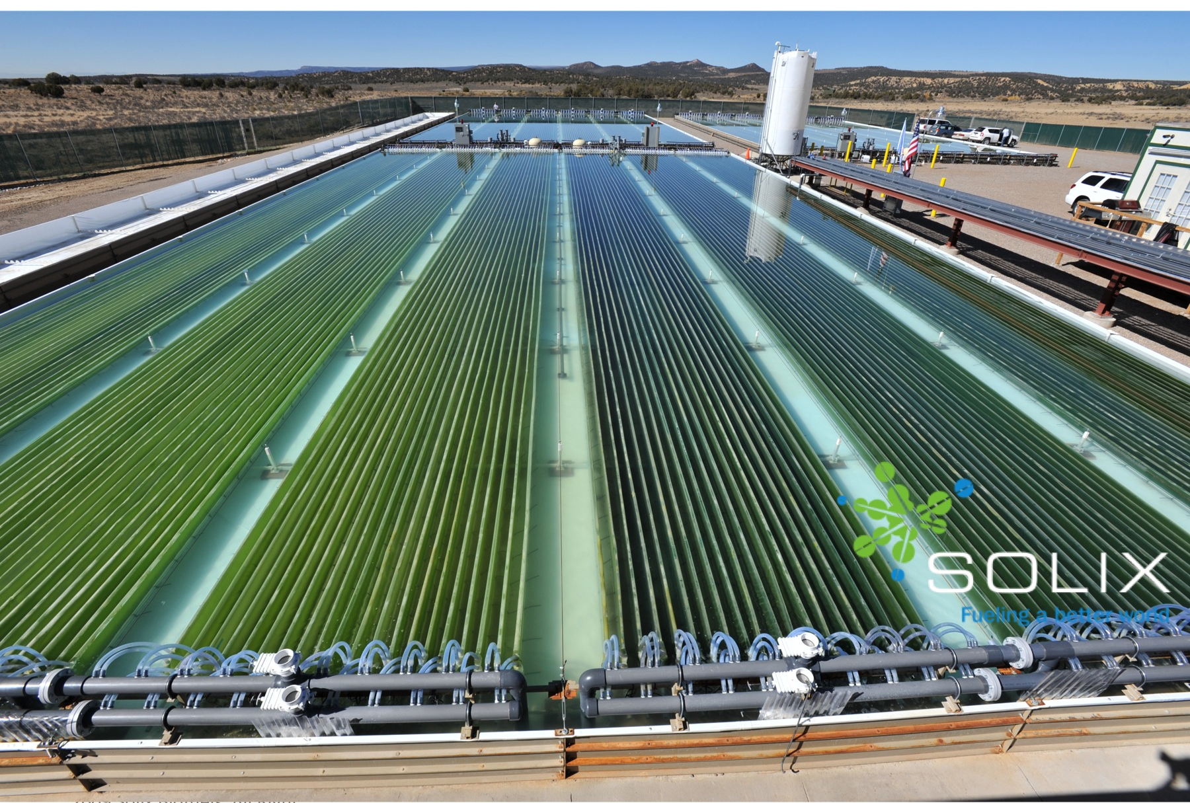
Full Scale Demonstration Site
Approximately 1 acre surface area.
18

Slide 19
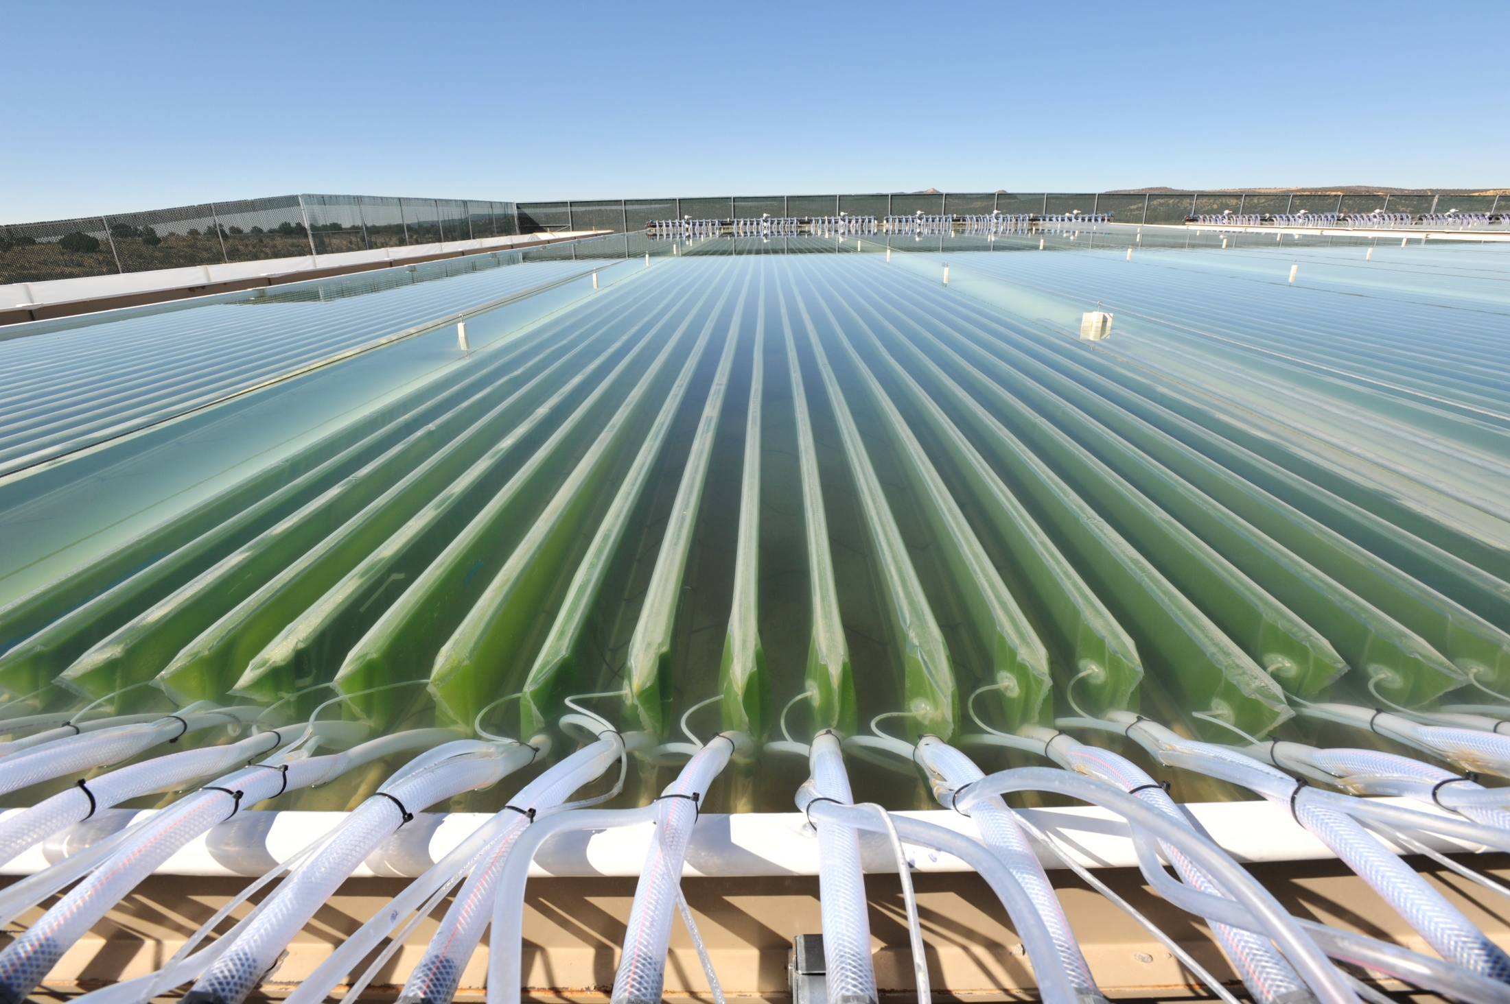
Solix Full Scale Demonstration Site
Approximately 1 acre surface area

Slide 20
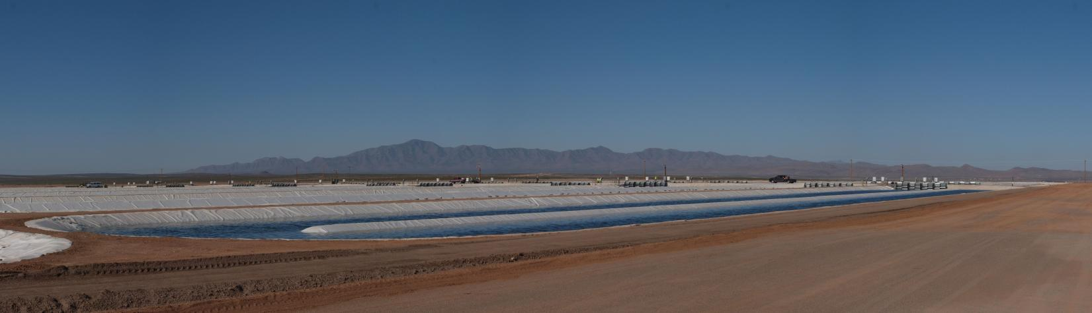

Open Pond Cultivation at Scale
Earthrise, California
Location: Columbus, NM
Feedstock(s): CO₂/Algae/Sunlight/Non-Potable Water
Size: 300 acres of open raceway ponds
Primary Products: Jet fuel and diesel
Capacity: 1 million gallons per year of finished product
Operations: Phase 1 - 100 acres of ponds; Phase 2 - scale up and expand farming operations.

Slide 21
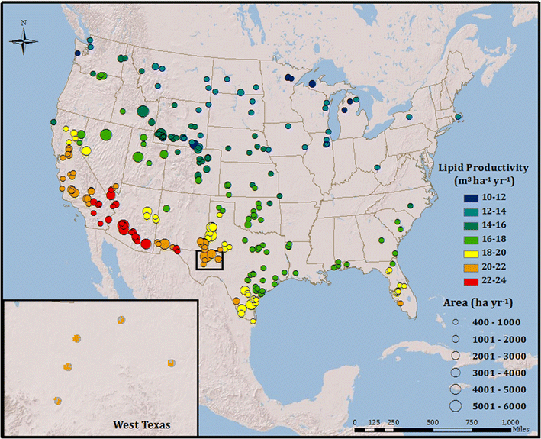
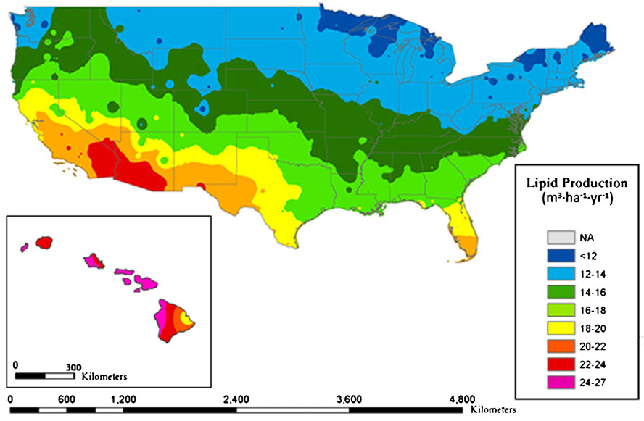
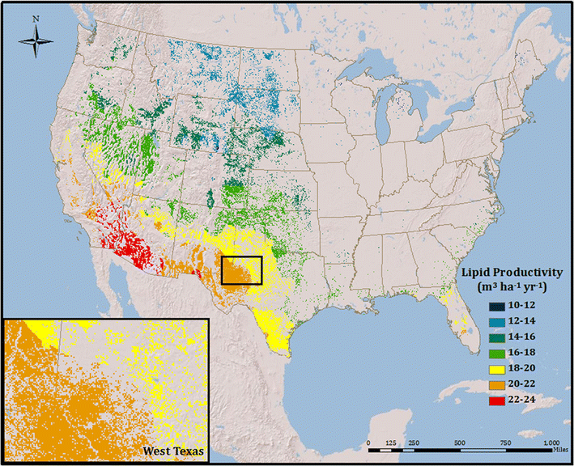
Constraints for Scale Up to 21 Billion gal/year in U.S.
Technoeconomic study completed by CSU to evaluate U.S. resources available to achieve EISA 21 billion gal/year from algae alone
Model: N. salina, PBR growth, centrifugal dewater, ethanol/ hexane lipid extraction, validated microalgae growth models, GIS data
What resources will limit
microalgae productivity?
  1. Climate, sunlight, temp
  2. Land availability, slope
  3. CO₂ availability (within
  a constraint of 5km)
Results:
Suitable land for algae
production would yield
only 1 billion gal/year with
these constraints.
Quinn, J. and Bradley, T. (2013).

Slide 22
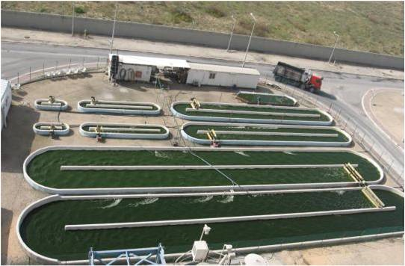
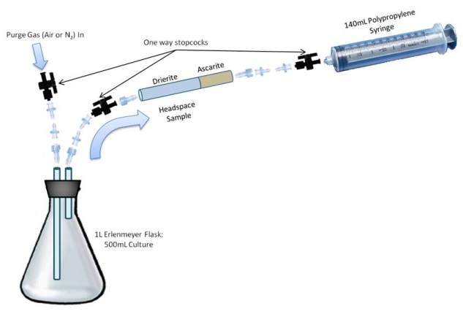
Microalgae Cultivation Research
Environmental Impacts of Microalgae Cultivation
Nitrous oxide (N₂O) has 300 times the global warming potential of CO₂.
The goal of this study was to measure N₂O emissions during cultivation.
Direct measurement showed that emissions were minimal, except for under conditions of low light and low dissolved oxygen.
Fagerstone, K., Quinn, J. C., De Long, S, Bradley, T. and Marchese, A. J. (2011). Quantitative Measurements of Direct N₂O Emissions from Microalgae Cultivation. Environmental Science & Technology 45 (21), pp. 9449-9456.

Slide 23
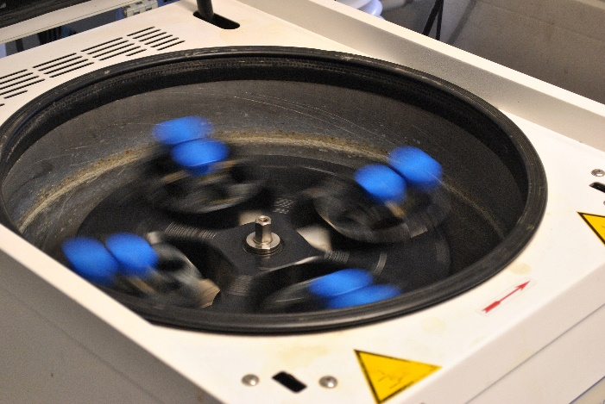
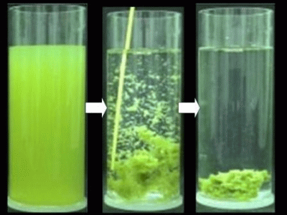
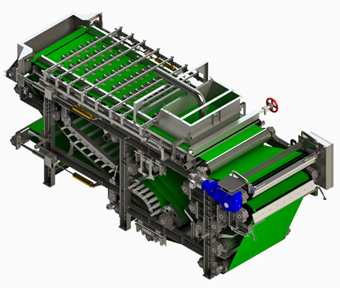
Harvesting Microalgae
Need to collect the algae and remove water
Common methods:
These methods are energy intensive and expensive!
Centrifugation
Flocculation
Filtration

Slide 24

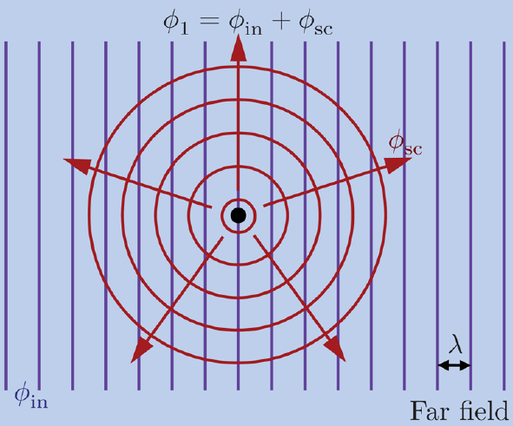
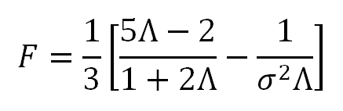


Microalgae Harvesting Research
Ultrasonic Harvesting of Microalgae
Ultrasonic techniques represent a low-energy, scalable solution.
Acoustic Radiation Force, F_{ac}, acting on particles of radius, R, in a liquid media subjected to a ultrasonic standing wave:
c_{p} / c_{m}
Hincapie and Marchese (2014). An Ultrasonically Enhanced Inclined Settler for Microalgae Harvesting. Biotechnol. Prog. DO 10.1002/btpr.2031

Slide 25
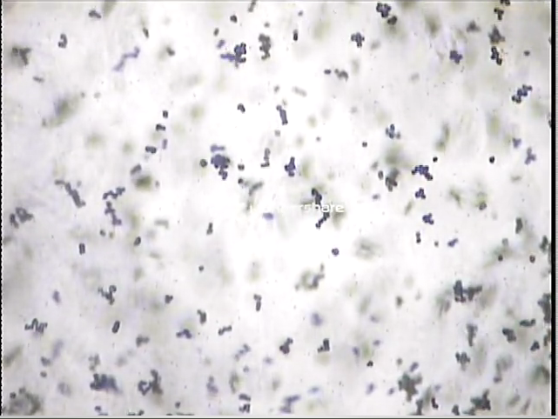
Microalgae Harvesting Research
Ultrasonic Harvesting of Microalgae
Ultrasonic techniques represent a low-energy, scalable solution.
Acoustic Radiation Force, F_{ac}, acting on particles of radius, R, in a liquid media subjected to a ultrasonic standing wave:
c_{p} / c_{m}
Hincapie and Marchese (2014). An Ultrasonically Enhanced Inclined Settler for Microalgae Harvesting. Biotechnol. Prog. DO 10.1002/btpr.2031

Slide 26
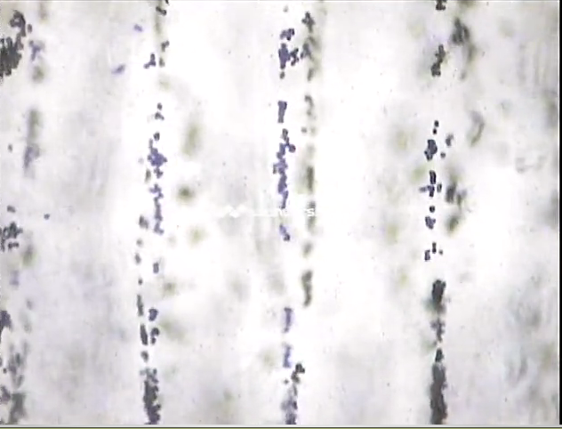
Microalgae Harvesting Research
Ultrasonic Harvesting of Microalgae
Ultrasonic techniques represent a low-energy, scalable solution.
Acoustic Radiation Force, F_{ac}, acting on particles of radius, R, in a liquid media subjected to a ultrasonic standing wave:
c_{p} / c_{m}
Hincapie and Marchese (2014). An Ultrasonically Enhanced Inclined Settler for Microalgae Harvesting. Biotechnol. Prog. DO 10.1002/btpr.2031

Slide 27
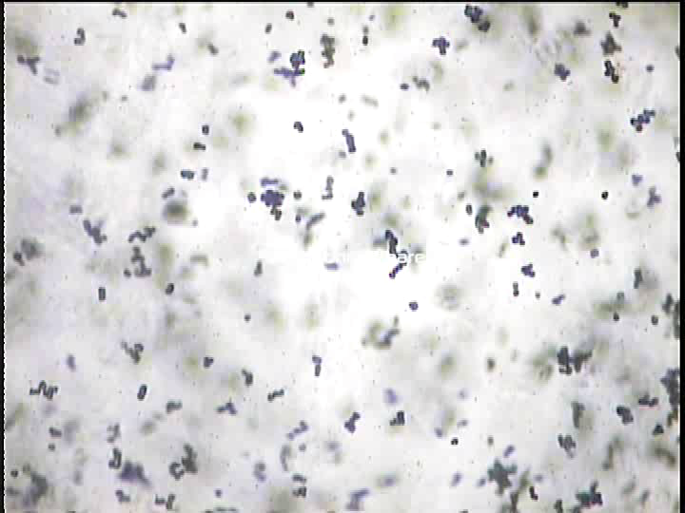
Microalgae Harvesting Research

Slide 28
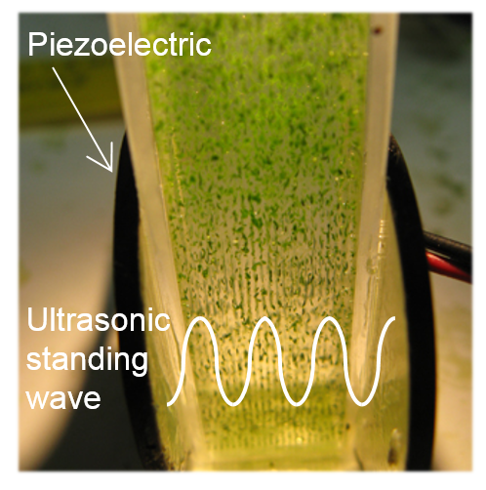
Microalgae Harvesting Research
Uses standing waves to separate out particles in suspension with a liquid
Piezoelectric disc creates standing wave
Standing wave exerts a force on the particles and pushes them into lines

Slide 29
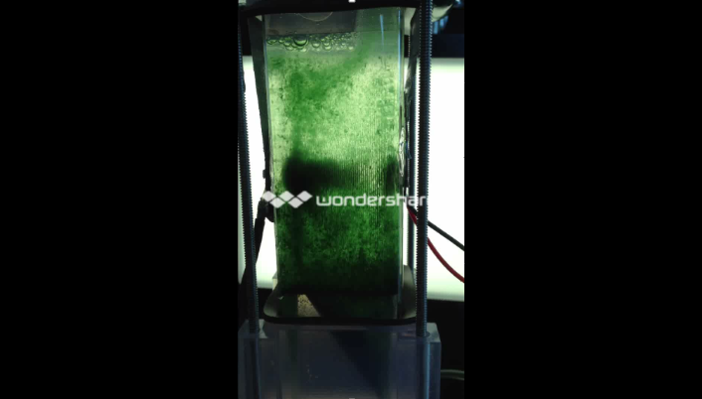
Ultrasonic Microalgae Harvesting
Development of a Continuous Flow System
Hincapie and Marchese (2014). An Ultrasonically Enhanced Inclined Settler for Microalgae Harvesting. Biotechnol. Prog. DO 10.1002/btpr.2031

Slide 30
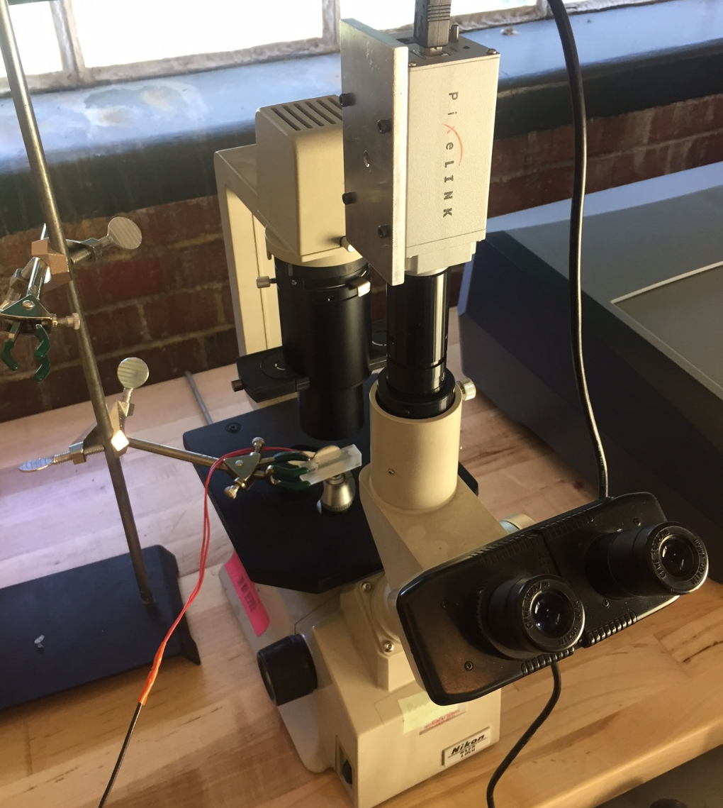
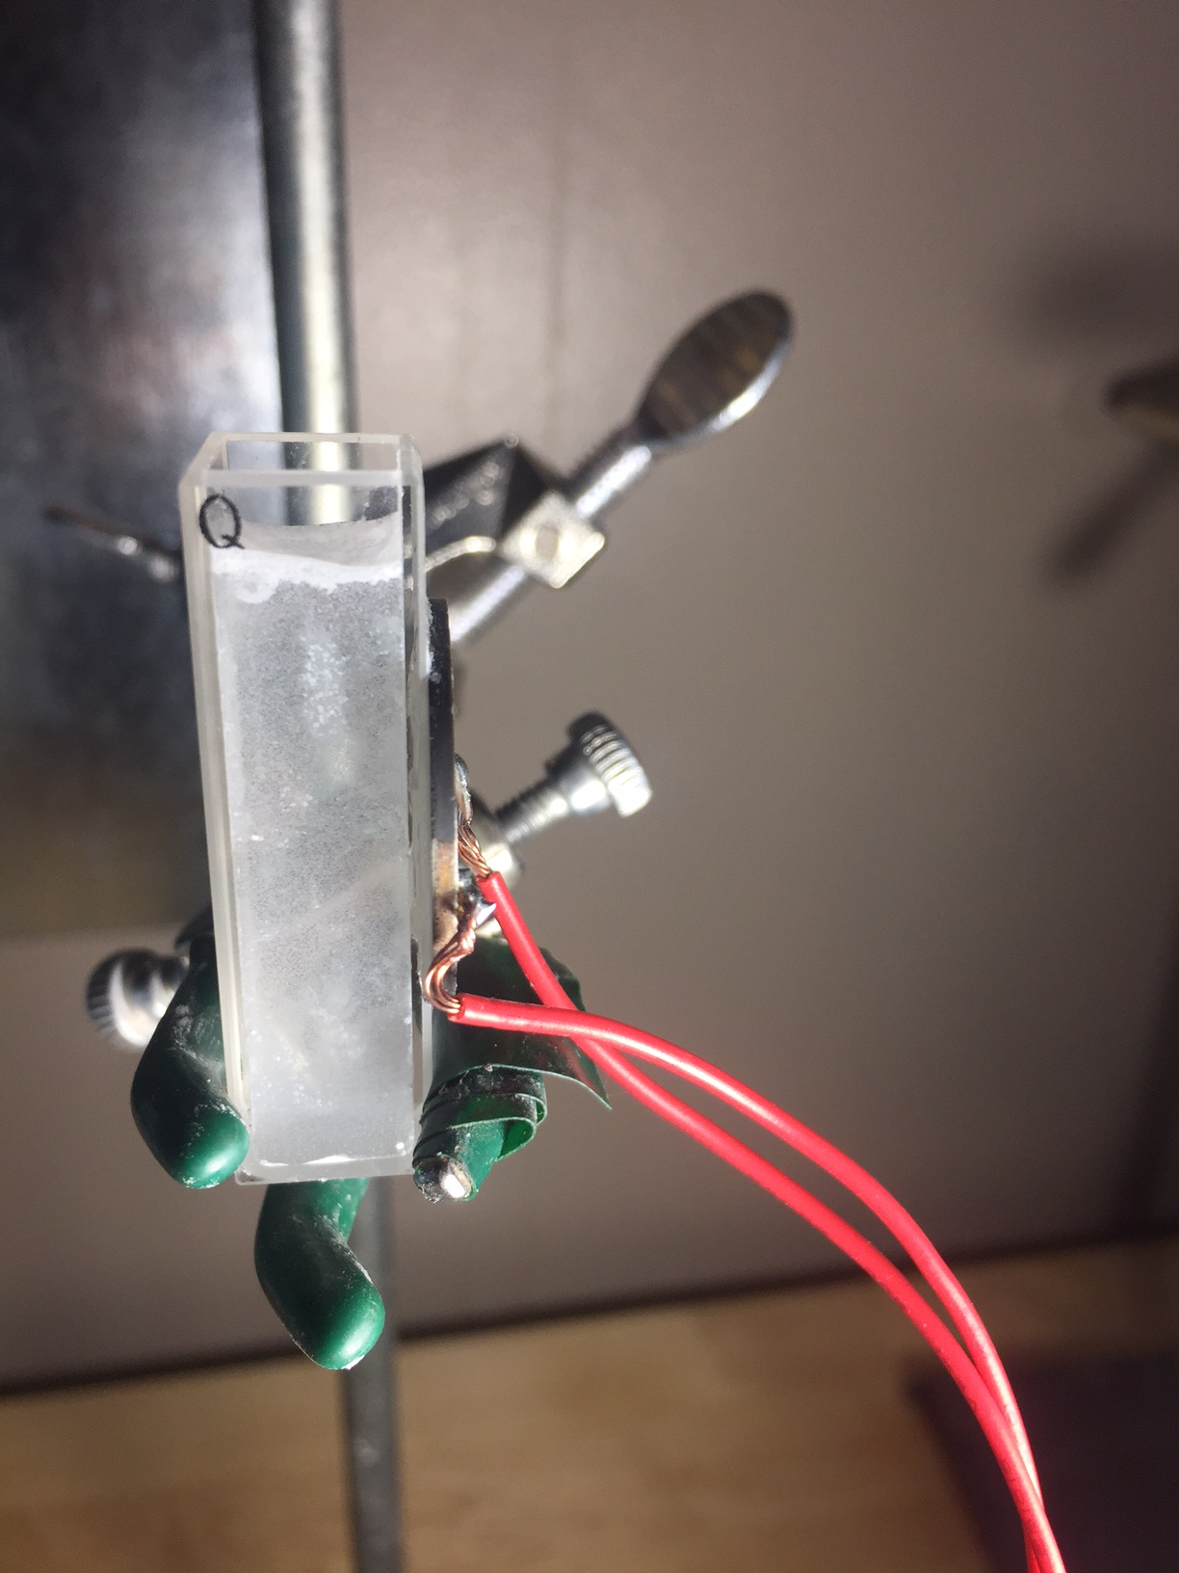
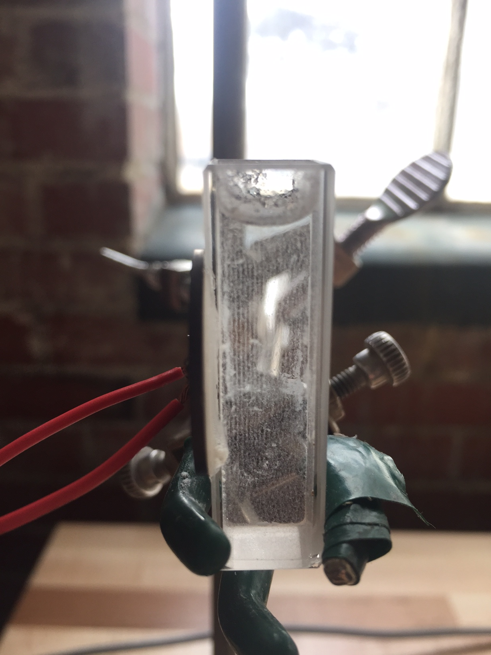
Microalgae Harvesting Research
Record particle / cell movement
Camera
Before
After
Cuvette with Piezo
Microscope

Slide 31
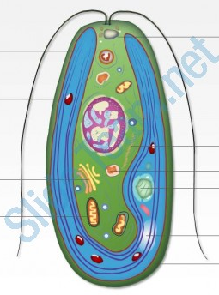
Microalgae Harvesting Research
Cells are made of lipids, carbohydrates, and proteins
  Each component has different acoustic properties
Cell composition affects the ability to harvest with acoustics
c_{p} / c_{m}

Slide 32
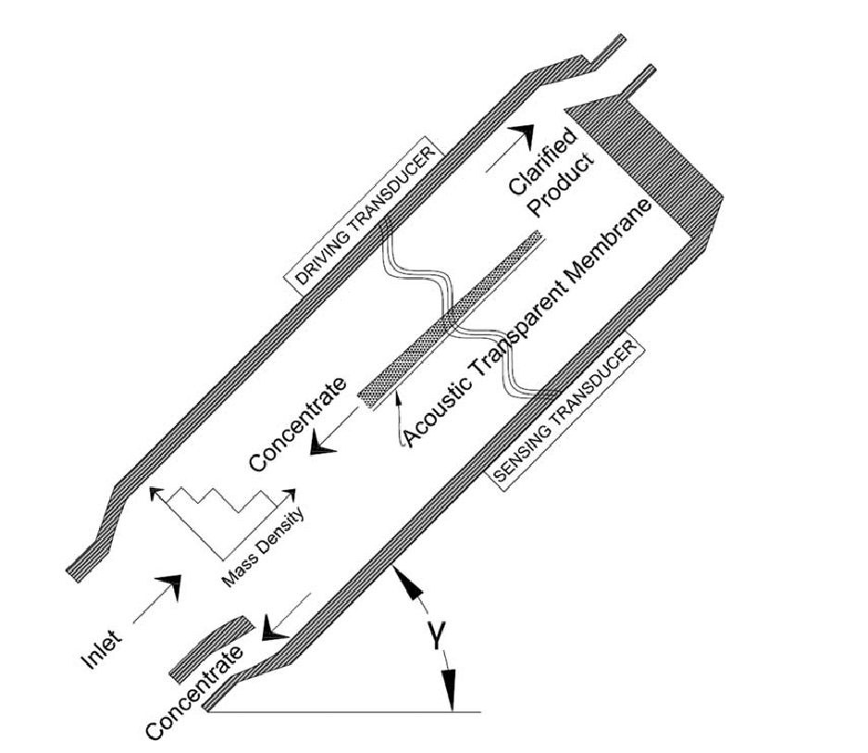
Acoustic Harvesting Device

Slide 33
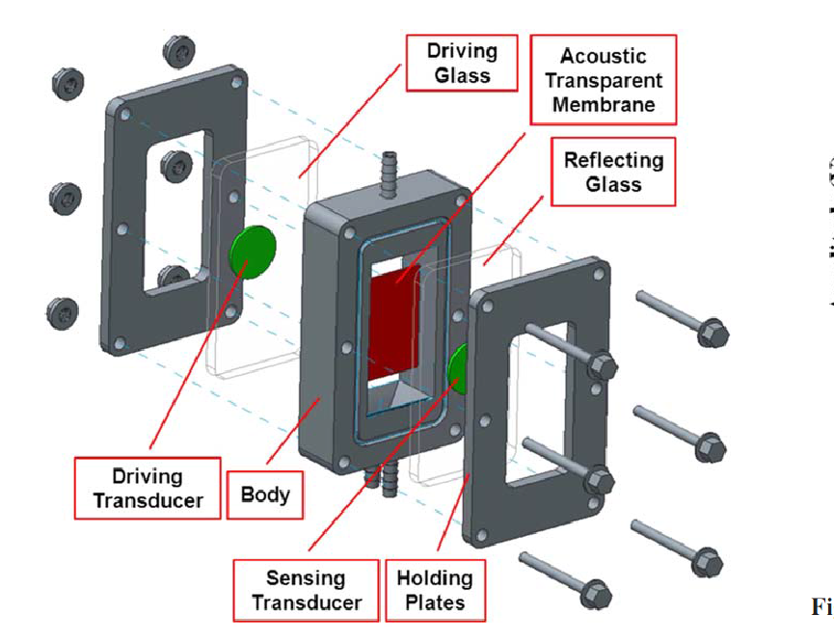
Acoustic Harvesting Device

Slide 34
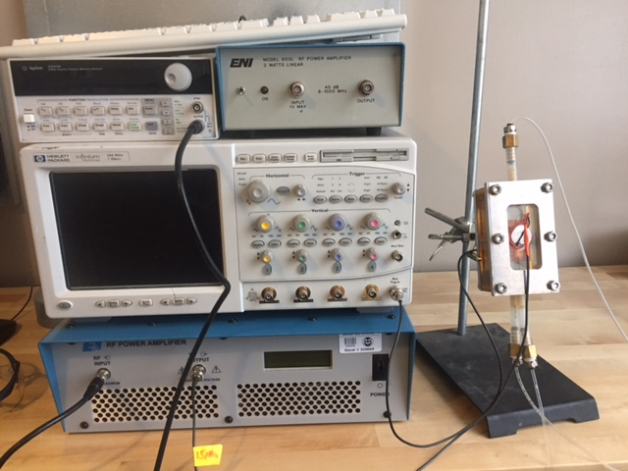
Acoustic Harvesting Setup
Function Generator
Small Amplifier
Oscilloscope
Acoustic Harvester
Large Amplifier

Slide 35
Algal Biofuels: Progress and Research Challenges
Overview
  Motivation for Renewable Liquid Fuels
  The Case for Algae
  Current Research Challenges: Biology to Combustion
  Cultivation, Harvesting and Extraction Research
  Conversion of Algal Lipids and Biomass into Liquid Fuels
  Conclusions

Slide 36
The Algae Biofuels Value Chain
The “Conventional” Route: Extracted Lipids to Fuel
Biology
Cultivation
Harvesting, Drying?
Nutrient Recycle
Co-products
Lipid to Fuel Conversion
Lipid Extraction

Slide 37
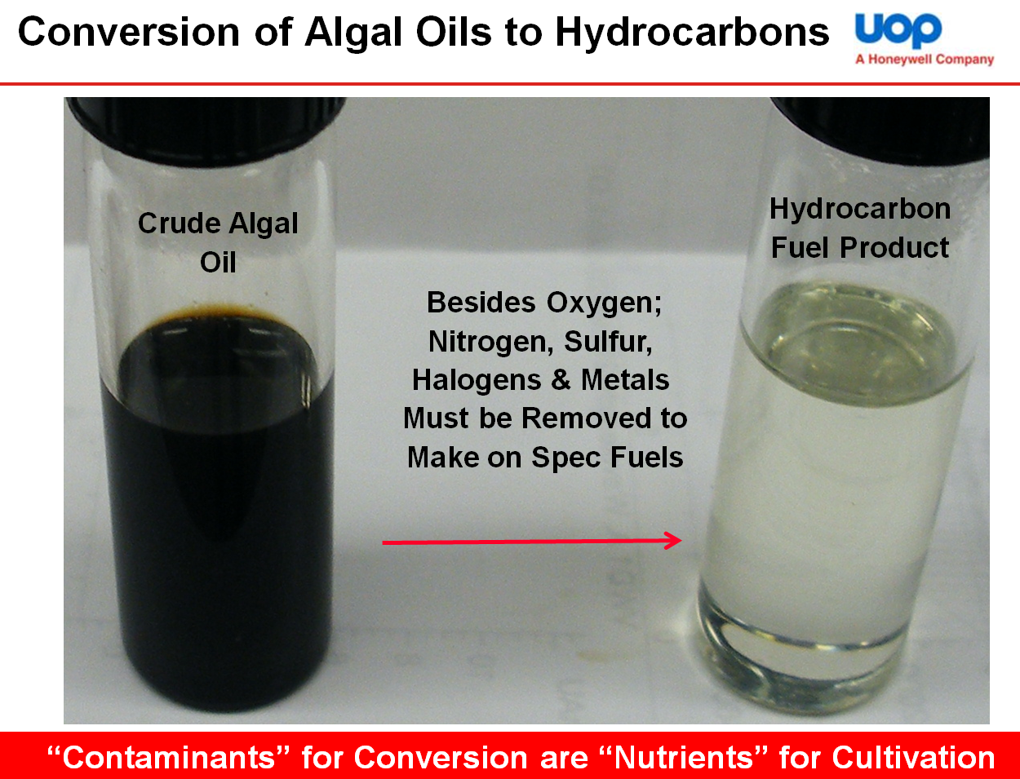
Conversion of Algal Lipids into Liquid Fuels
Algal Renewable Diesel/Jet Fuel

Slide 38
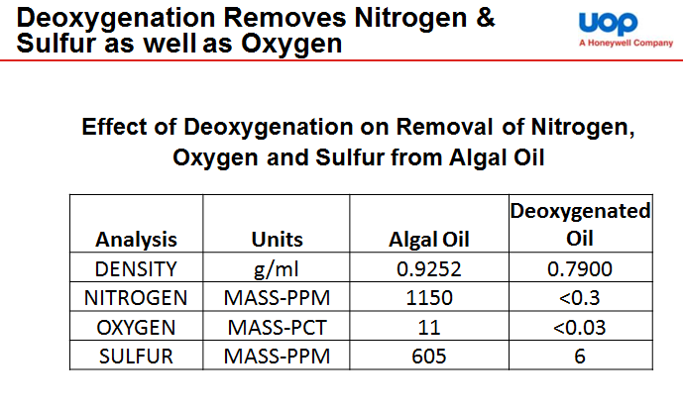
Conversion of Algal Lipids into Liquid Fuels
Algal Renewable Diesel/Jet Fuel

Slide 39
The Algae Biofuels Value Chain (Revisited)
Conversion of Whole (Wet) Algal Biomass To Biofuels
Biology
Cultivation
Harvesting
Nutrient Recycle
Upgrading to
Drop-In Fuels
Conversion to Biocrude
Whole Wet Algal Biomass

Slide 40




Conversion of Whole Algal Biomass into Fuels
Hydrothermal Liquefaction (HTL)
Hydrothermal liquefaction uses water at sufficient temperature and pressure to convert a wet biomass feedstock directly into a liquid bio-crude oil.
By processing the feedstock wet, the need for drying is eliminated.
Process temperatures are lower compared to dry pyrolysis.
  Current process conditions for the continuous flow system at PNNL are just below the supercritical point of water (350⁰C, 3000 psi).
Feedstock: Wet Nannochloropsis salina Paste
Fractionated cuts: naphtha, diesel, bottoms
HTL Bio-Oil
Hydrotreated HTL Bio-Oil
Elliott, D. and Oyler, J. (2012). Hydrothermal processing: Efficient production of high-quality fuels from algae. 2nd International Conference on Algal Biomass, Biofuels and Bioproducts, San Diego, CA, June 2012.

Slide 41
Algal Biofuels: Progress and Research Challenges
Overview
  Motivation for Renewable Liquid Fuels
  The Case for Algae
  Current Research Challenges: Biology to Combustion
  Cultivation, Harvesting and Extraction Research
  Conversion of Algal Lipids and Biomass into Liquid Fuels
  Conclusions

Slide 42
Conclusions
Microalgae is a potentially scalable liquid biofuel
  The “ambitious” goal is 36 billion gal/year by 2022
  300 billion gal/year will be needed in future generations
Many challenges remain to realize commercial viability at scale
  biological challenges, engineering challenges, economic challenges
Acoustic harvesting could lower the overall energy requirements and cost of algal fuel

Slide 43

Questions?

