Slide 1
MECH 558 – Lecture #1/Motivation
August 24, 2015
Motivation for Studying Combustion (MECH 558): Fossil Fuel Depletion, Climate Change, Human Health Concerns from Combustion Generated Pollutants, Fire Safety, Energy Density
Anthony J. Marchese
Professor, Mechanical Engineering
Director, Engines and Energy Conversion Laboratory
Colorado State University
Fort Collins, CO 80523
http://www.engr.colostate.edu/~marchese

Slide 2
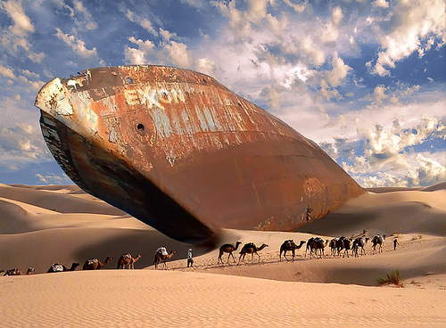
Peak Oil
Are we there yet?
The Anomalous Age of Easy Oil

Slide 3
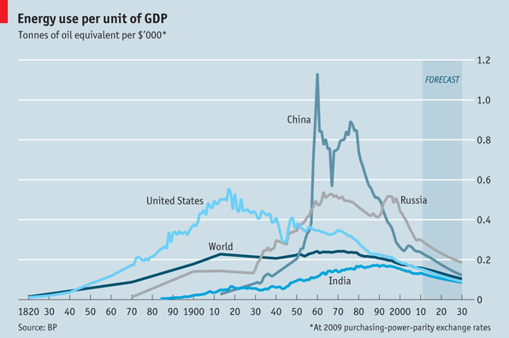
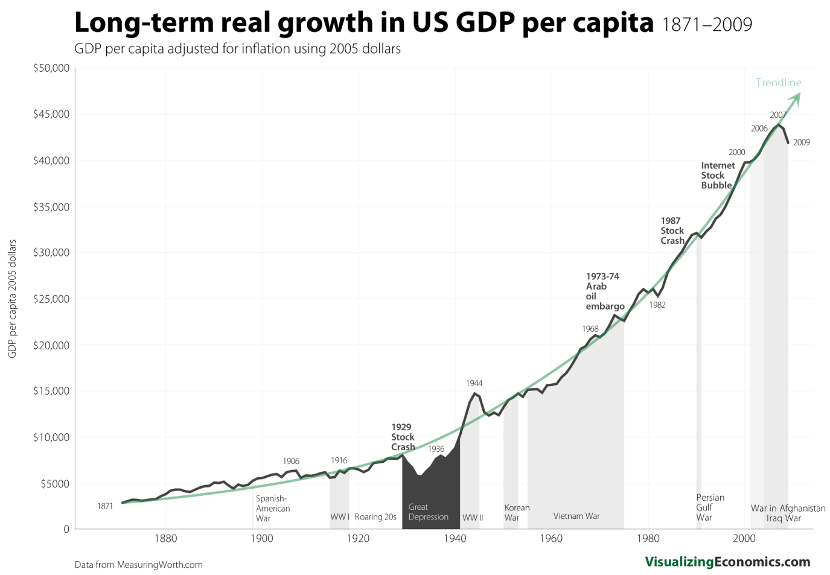
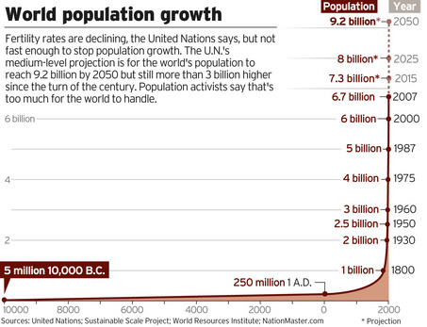
The Master Equation
Fossil Fuel Depletion (A Matter of WHEN…not IF)
FFC/GDP is fundamentally constrained by the 2nd Law of Thermodynamics!

Slide 4
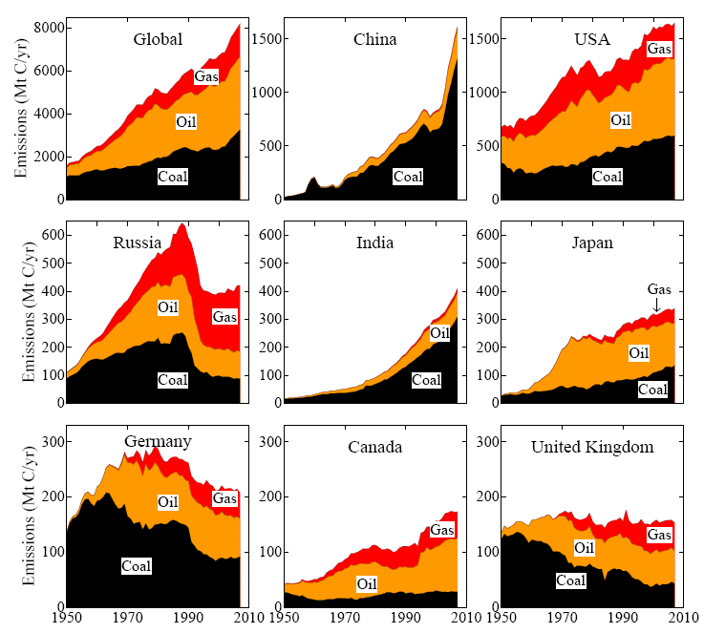
Fossil Fuel Consumption

Slide 5
Peak Oil
Are we there yet?

Slide 6
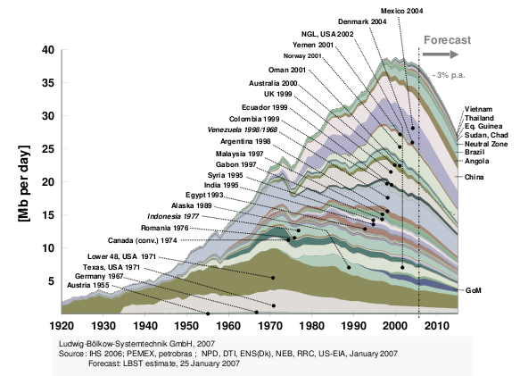
Peak Oil
“Anomalous Age of Easy Oil” is Nearing its End

Slide 7
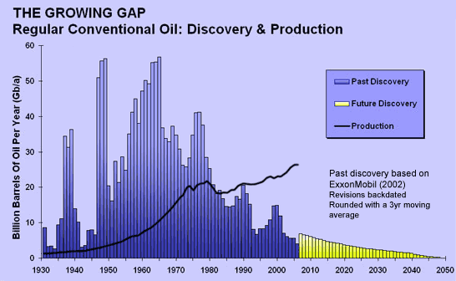
Peak Oil
“Anomalous Age of Easy Oil” is Nearing its End
Campbell, C. J. (2012). The Anomalous Age of Easy Energy. Energy, Transport and the Environment, Springer.

Slide 8
Peak Oil
“Anomalous Age of Easy Oil” is Nearing its End
Campbell, C. J. (2012). The Anomalous Age of Easy Energy. Energy, Transport and the Environment, Springer.

Slide 9
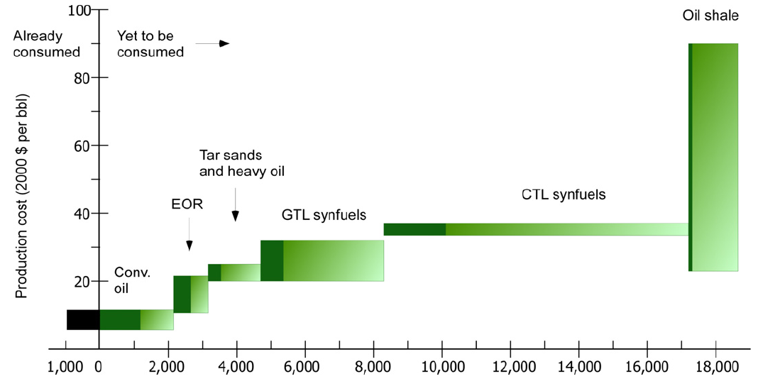
Non-Conventional Liquid Fossil Fuels
Substantial Resources Still Exist for GTL or CTL
Enhanced oil recovery
Potential Liquid Hydrocarbon Production (Gbbl)
Brandt, A. R and Farrell, A. E. (2007). Scraping the bottom of the barrel: greenhouse gas emission consequences of a transition to low-quality and synthetic petroleum resources. Climate Change, 84, pp. 241-263.

Slide 10
Proven Fossil Fuel Reserves
Oil, Gas and Other

Slide 11
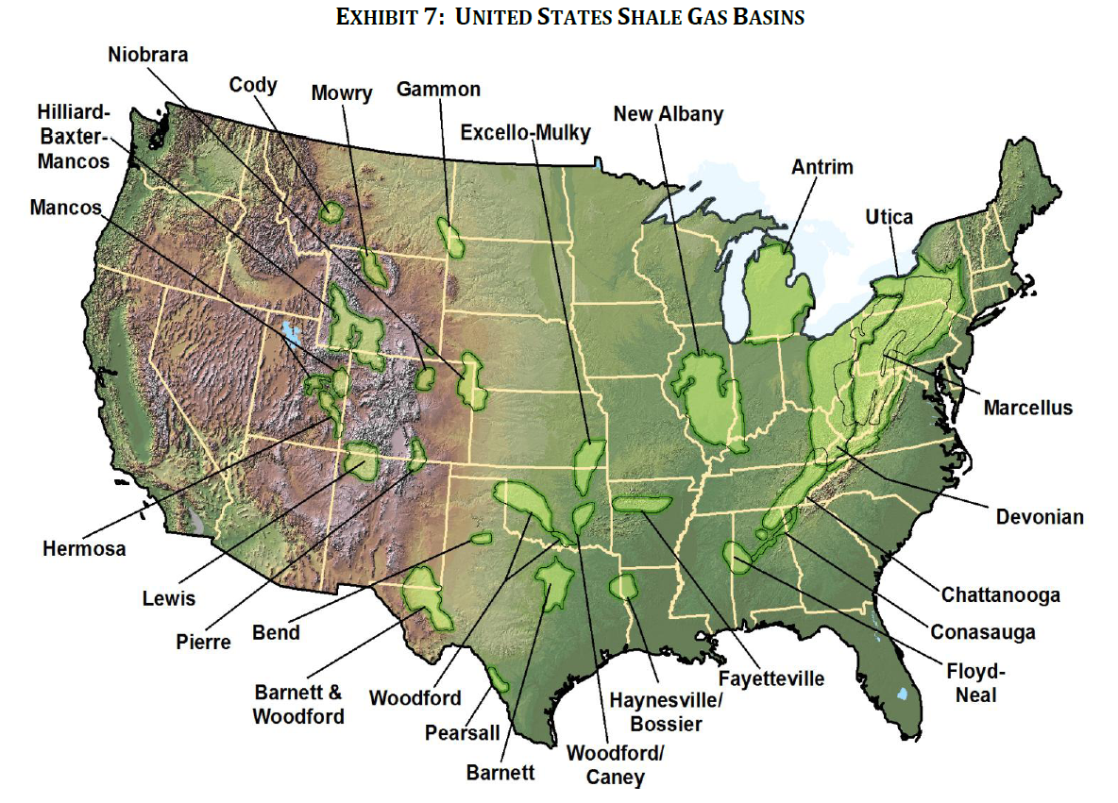
Shale Gas: Vast U.S. Resource

Slide 12
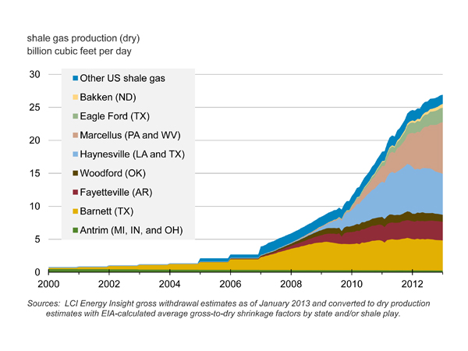
Shale Gas: Vast U.S. Resource

Slide 13
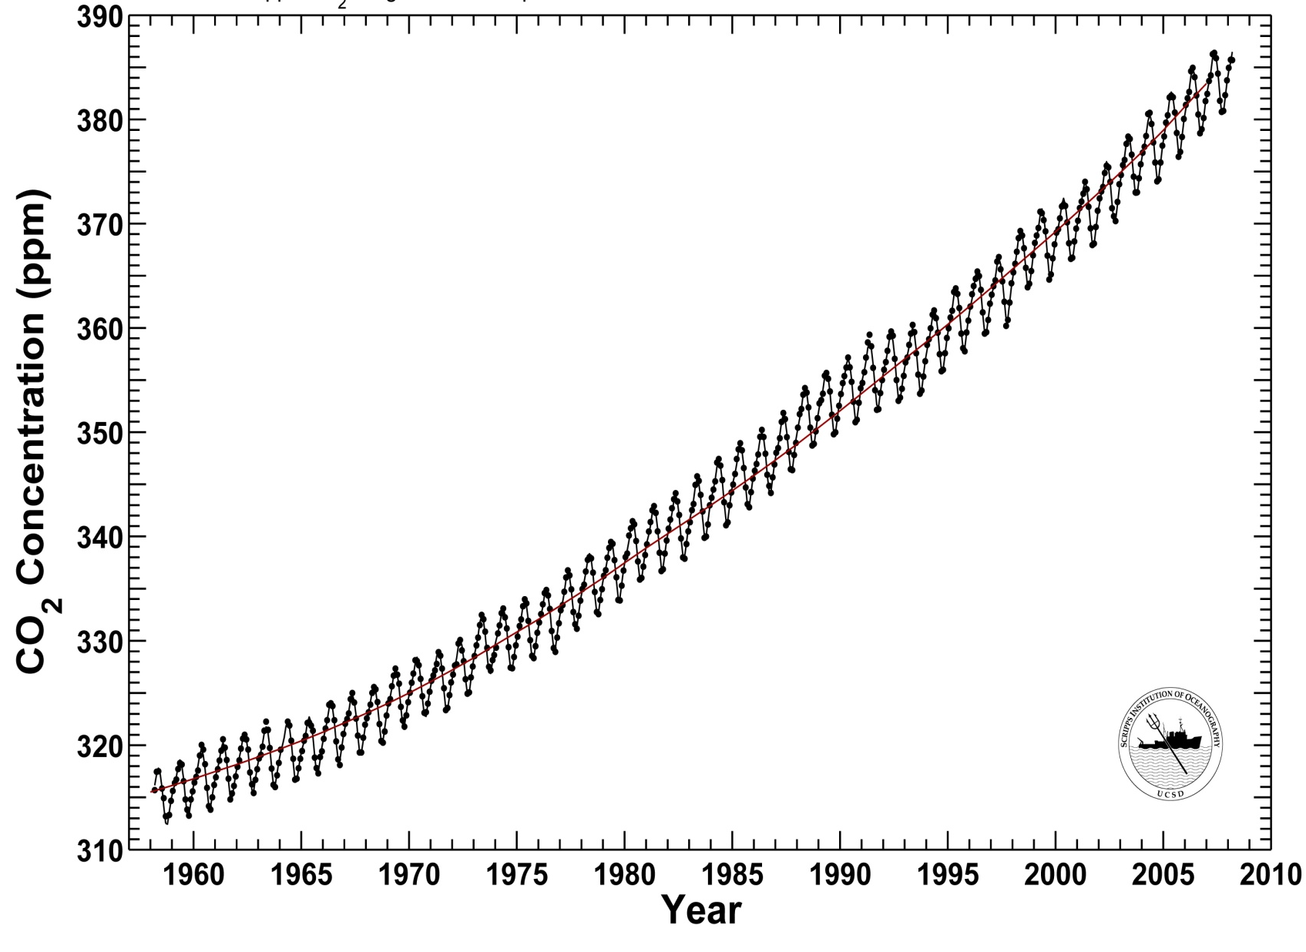
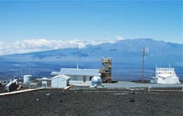
Keeling Curve, CO₂ at Mauna Loa
Red line is 57% of fossil fuel CO₂ emissions
Climate Change
Role of Anthropogenic Greenhouse CO₂ Emissions

Slide 14
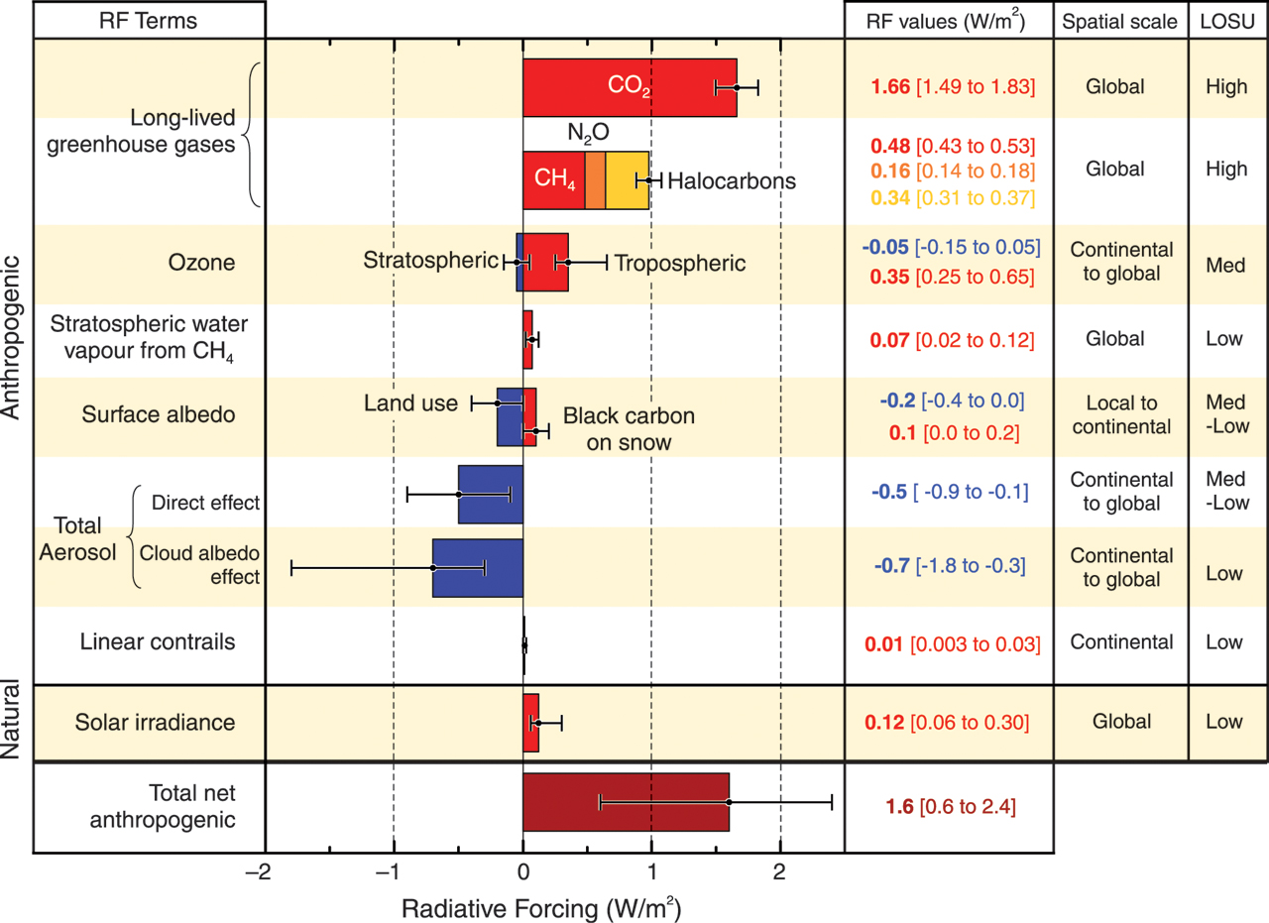
Climate Change
Role of Anthropogenic Greenhouse CO₂ Emissions

Slide 15
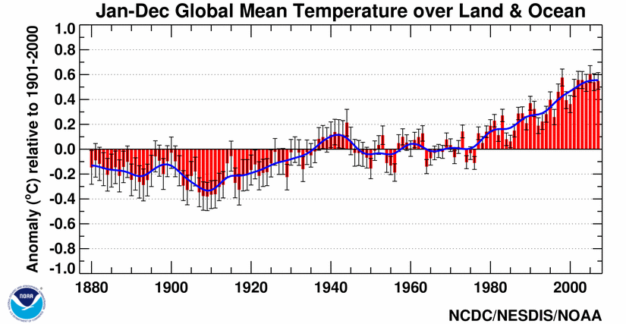
Climate Change
Role of Anthropogenic Greenhouse CO₂ Emissions

Slide 16
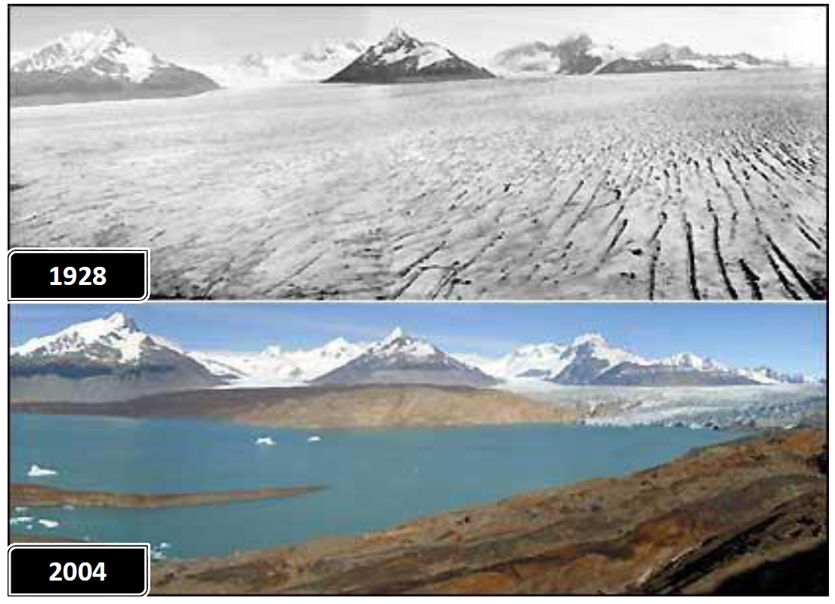
Climate Change
Disappearing Glaciers: Patagonia Glacier

Slide 17
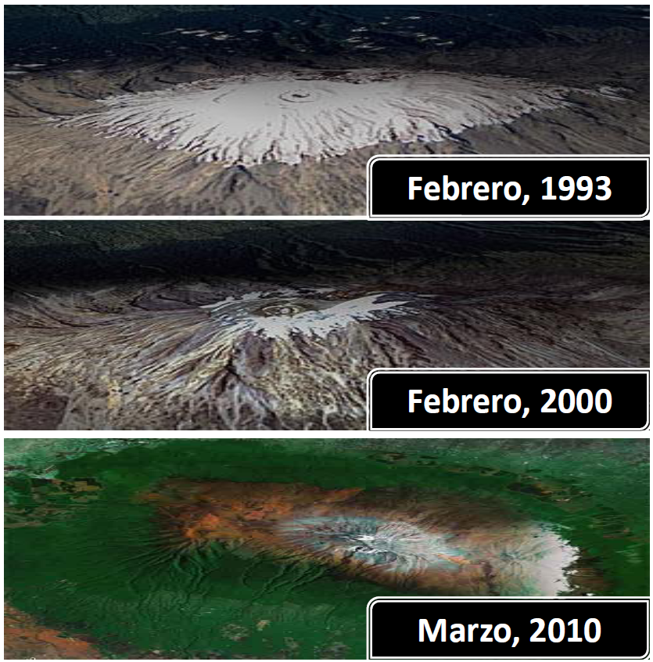
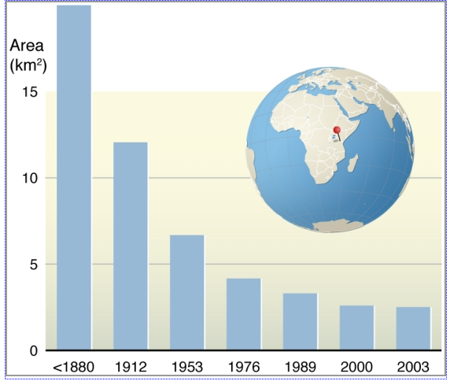
Climate Change
Disappearing Glaciers: Mt. Kilimanjaro
February
February
March

Slide 18
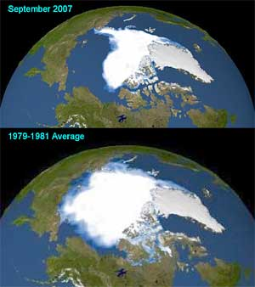
Climate Change
Melting of the Polar Ice Sheet

Slide 19
Climate Change
Predicted Rise in Sea Level

Slide 20
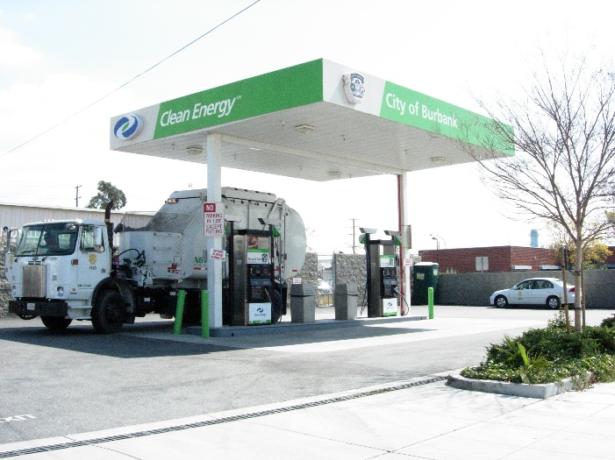
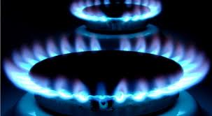
Climate Change
Natural Gas Combustion is Better than Coal…Right?
  It generally believed that burning natural gas for energy is better than coal (or oil) in terms of greenhouse gas emissions:
    Why is it the case that CH₄ combustion should be better than coal?
    Is CH₄ substitution advisable for stationary power plants, natural gas vehicles, all of the above?
    What about emissions of unburned methane (CH₄) into the atmosphere?
    The global warming potential of CH₄ is a factor of 34x (or 86x) higher than CO₂.

Slide 21
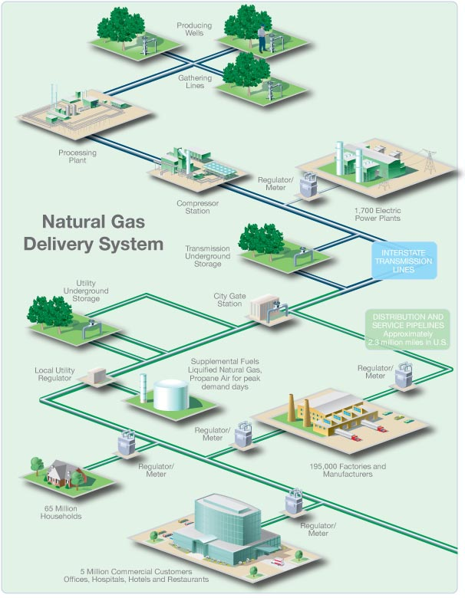
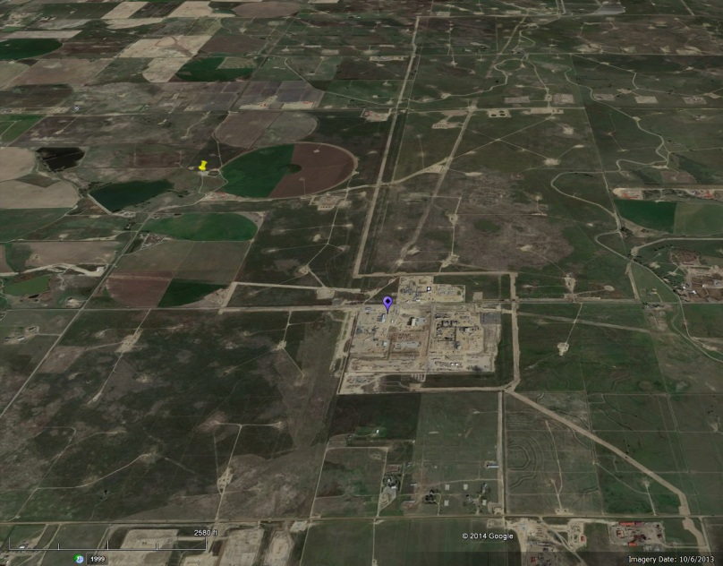
Climate Change
Natural Gas Combustion is Better than Coal…Right?
  Many opportunities for CH₄ to be emitted into the atmosphere from wells, to gathering pipelines, to gathering compressor stations, to processing plants, to transmission pipelines, to distribution networks, to end use!
  If overall leakage rate is greater than 1.5 %, replacement of diesel trucks with natural gas is a net greenhouse penalty!
  Leakage rate of 3.0% is tolerable for replacement of coal power plants with natural gas.

Slide 22
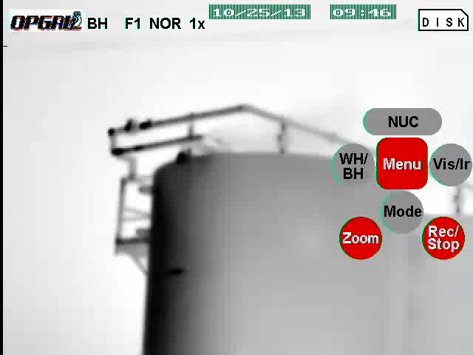

Slide 23
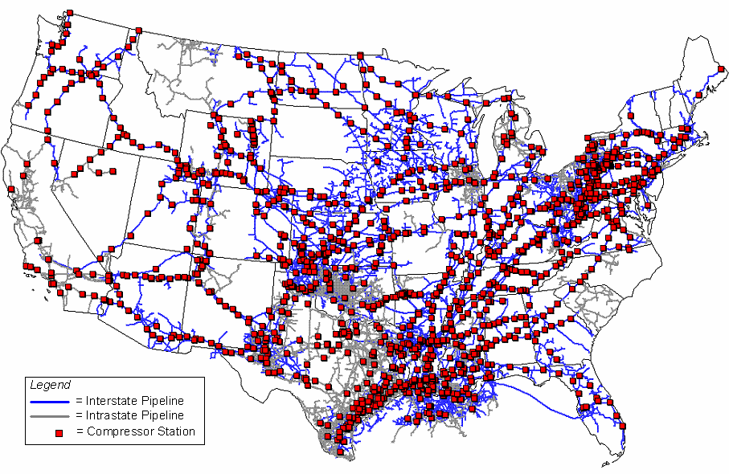
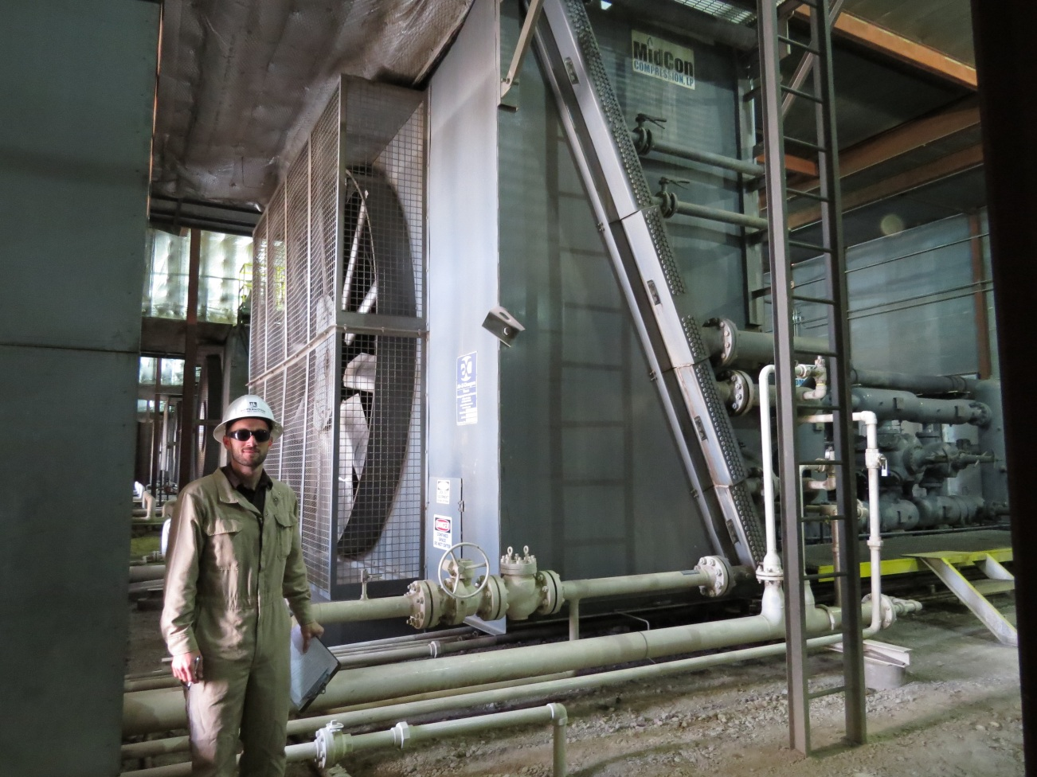
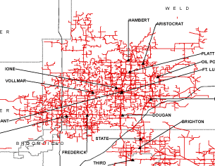
Climate Change
Natural Gas Combustion is Better than Coal…Right?
    Combustion research is important here as well: methane exhaust emissions from natural gas compression engines, on-road natural gas engines, overall engine efficiency, etc.

Slide 24
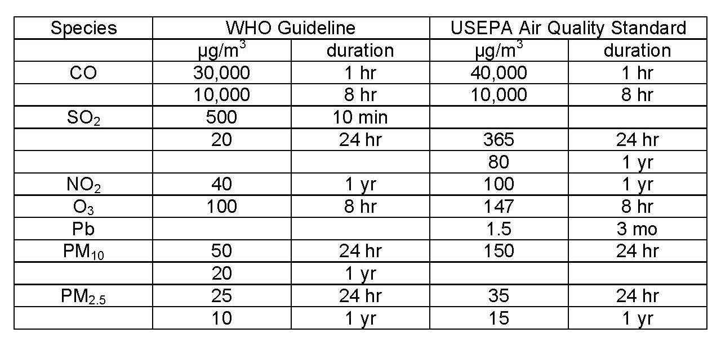
Motivation
Human Health Concerns from Combustion Generated Pollutants
CO
SO₂
NO₂
O₃
Pb
Particulates
Air contaminants/air toxics

Slide 25
Motivation
Human Health Concerns from Combustion Generated Pollutants
Mortality Relative Risks from 10-µg/m³ Increase in PM_{2.5} (Jarrett, et al.)

Slide 26
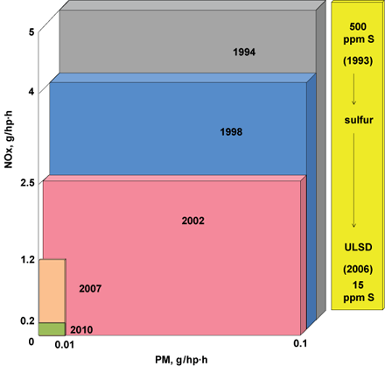
Motivation
Human Health Concerns from Combustion Generated Pollutants
U.S. EPA Diesel Emissions and Fuel Regulations

Slide 27
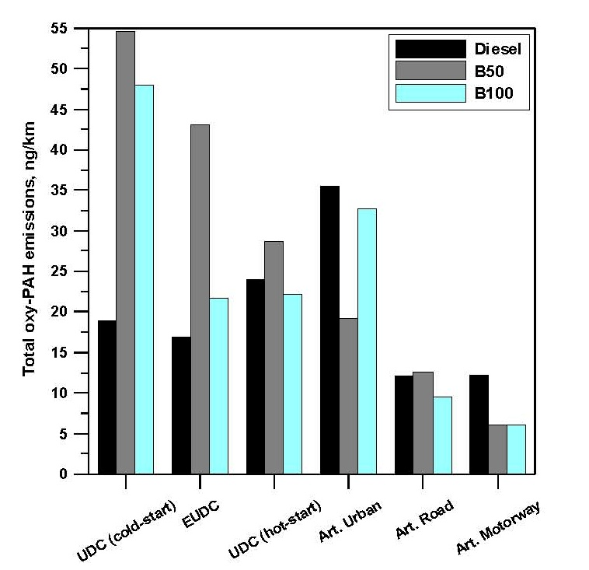
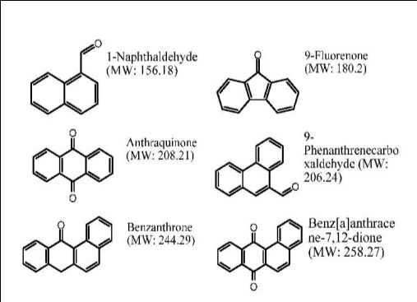
Motivation
Combustion Generated Particulate Matter (PM)
Size (and Chemical Composition) Matters…but are not regulated
oxy-PAH’s

Slide 28
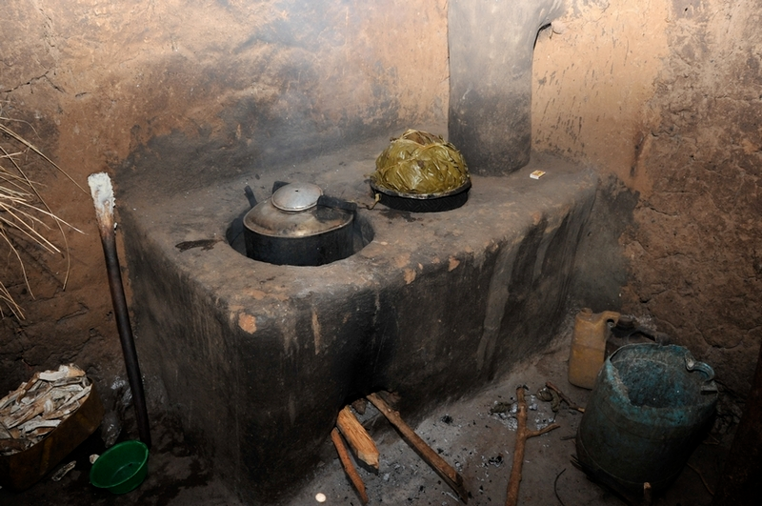

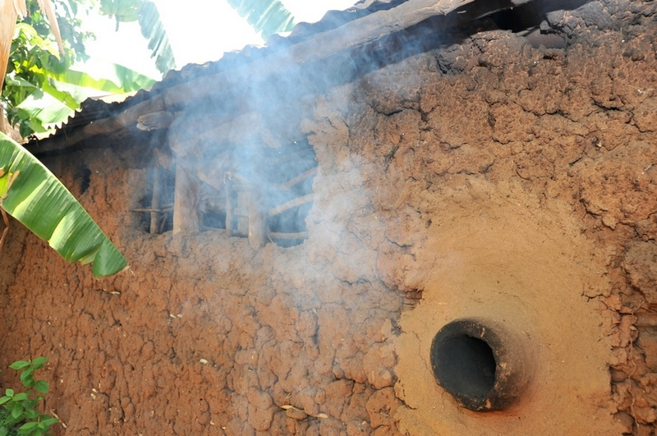
Motivation
Global Human Health Concerns from Indoor Air Pollution

Slide 29
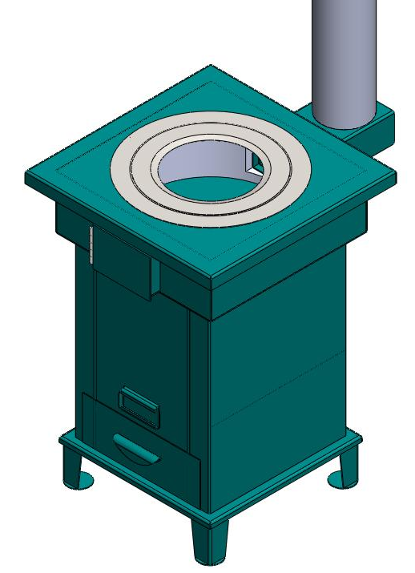
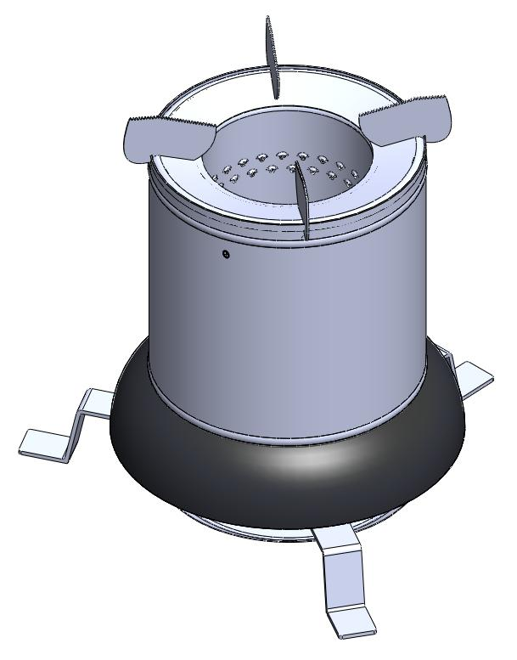
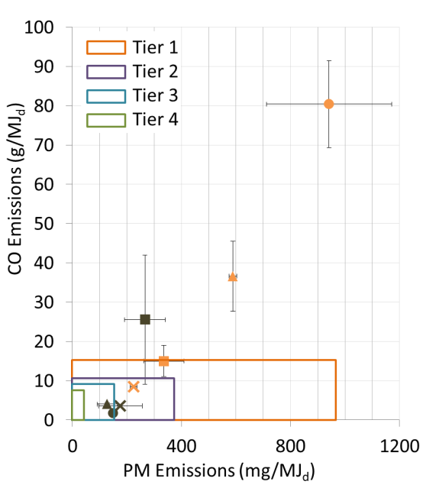

Motivation
Global Human Health Concerns from Indoor Air Pollution
Industrialized countries have reduced combustion generated pollutant emissions [gm/MJ] by about 98% in the past 40 years
Urgent public health need to reduce cooking and heating emissions in agrarian and developing societies

Slide 30
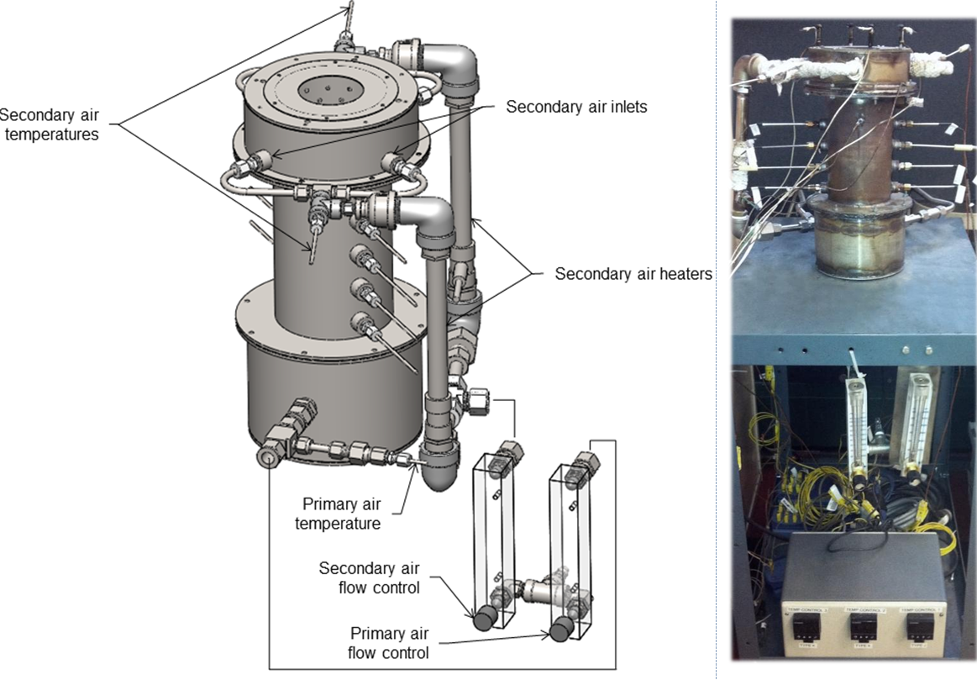
Motivation
Global Human Health Concerns from Indoor Air Pollution
Industrialized countries have reduced combustion generated pollutant emissions [gm/MJ] by about 98% in the past 40 years
Urgent public health need to reduce cooking and heating emissions in agrarian and developing societies

Slide 31
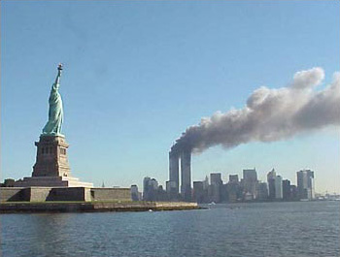
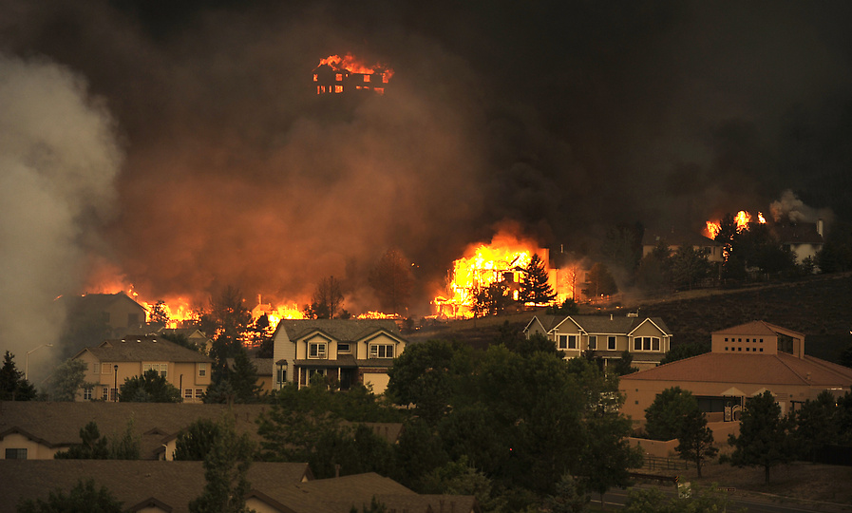
Motivation
Fire Safety and Security
Fire kills more U.S. citizens than all other natural disasters combined.
  Approximately 4,500 deaths/year
  Approximately 25,000 injuries
  2 million reported fires per year
  $10 billion/year in property damage
Why can’t we prevent unwanted fires on this planet?

Slide 32
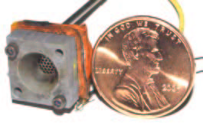
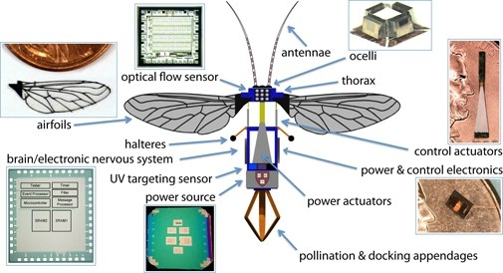
Motivation
Energy Density of Liquid Hydrocarbons
In terms of energy density (MJ/m³), liquid hydrocarbons are difficult to beat, especially when air is available as a “free” oxidizer.
  Batteries (approx. 1 MJ/kg)
  Liquid hydrocarbons (approx. 50 MJ/kg)
Microcombustors are very promising.
  What is the energy (in kW-hr) contained is a C battery compared to the same volume of diesel fuel?
  How long could you power your lap top on diesel fuel?
For some applications, batteries will NEVER be feasible in comparison to liquid hydrocarbons.
  Aviation, for example
http://robobees.seas.harvard.edu/

